Slide 1
BTC Algorithmic Trading Bot
Project 2 - Group 3
Arkie Ariyana, Jordan Dass, Tracey Martin, Vincent Jadraque, Colletta Baker

Slide 2


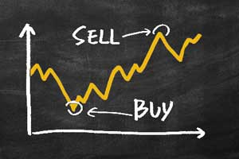
Motivation & Summary
Notes:
Algorithmic trading bots are programs that automatically generates buy or sell signals for various assets according to various technical indicators.
In order to be profitable a bot needs to identify certain market patterns.
Machine learning can identify these patterns using multiple factors more efficiently than human beings potentially resulting in better trading outcomes.
Our project aims to form an algorithmic trading bot using a selection of technical indicators including Simple moving average (SMA), Bollinger Bands (BB), Exponential moving average (EMA), Relative strength index (RSI), Directional Movement Index (DMI), Volume Weighted Moving Averages (vWAP), Fibonacci Pivot Points
Using different combinations of these indicators as a set feature (X) we will use machine learning to predict a target variable of buy/sell (y)
Buy low sell high
Battery storage buyers guide - WATTever
Machine Learning
An Introduction to Machine Learning | by Anmol Behl | Becoming Human: Artificial Intelligence Magazine
Candlestick image
Technical Analysis 101: The Best Technical Indicators for Crypto and Stocks | Alexandria (coinmarketcap.com)

Slide 3
Predictive Model Selection
Small → Medium Datasets
Highly flexible
XGBoost
Cross-validates
Uses parallel processing
Handles missing data
Faster than Gradient Boosting
Supports regularization
Notes:
[1] https://www.nvidia.com/en-us/glossary/data-science/xgboost/
[2] https://datascience.foundation/datatalk/xgboost-an-efficient-implementation-of-gradient-boosting
Extreme Gradient Boosting of XGBoost was selected in this study, it is a scalable, distributed gradient boosted decision tree (GBDT) machine learning library. It provides parallel tree boosting and is the leading machine learning library for regression, classification and ranking problems. [1]
Advantages of XGBoost [2]
It is Highly Flexible
It uses the power of parallel processing
It is faster than Gradient Boosting
It supports regularization
It is designed to handle missing data with its in-build features.
The user can run a cross-validation after each iteration.
It Works well in small to medium dataset

Slide 4
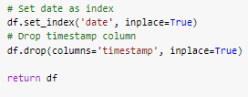
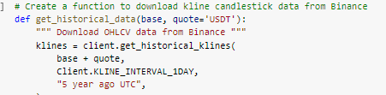

Data Preparation
Step 1
Step 2
Step 3
Step 4
Step 5
Create a function to download kline candlestick data from Binance using its API
Select relevant columns only. Only include open, high, low, close and volume.
Convert data into Dataframe.
Convert timestamp into date format
Set date as index
Drop ‘timestamp’ column.

Slide 5

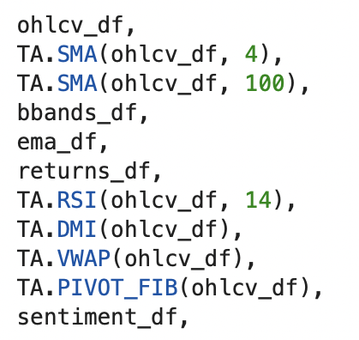
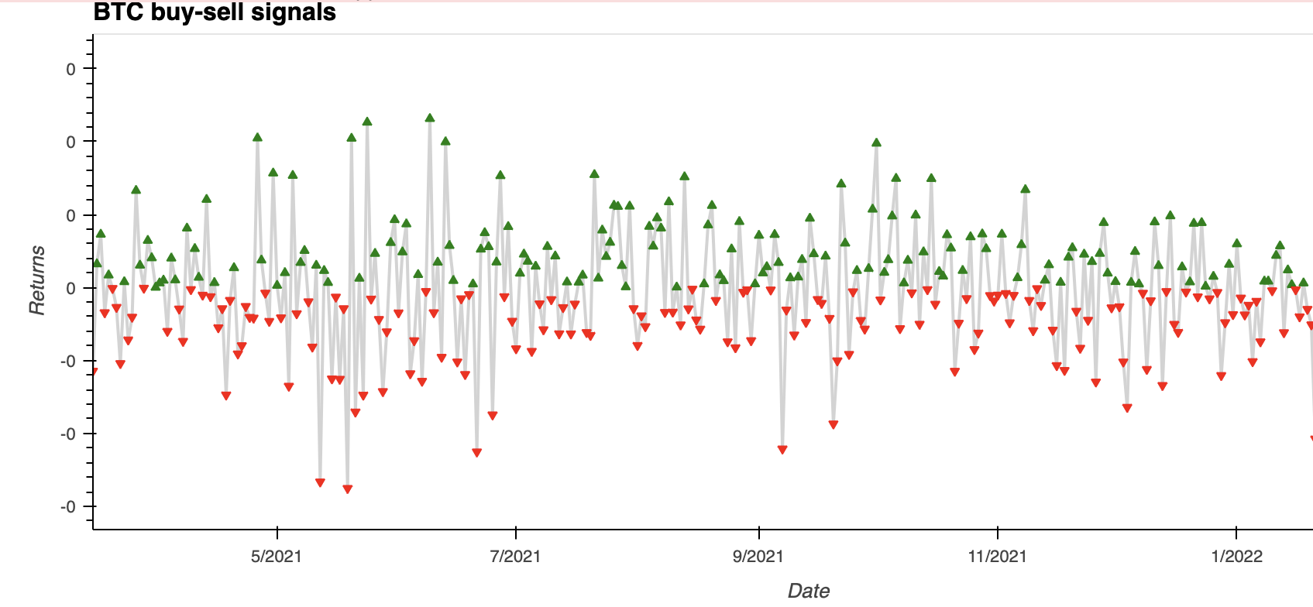
Procedure - Data Preparation
Step 1
Step 2
Step 3
Step 4
Pull Bitcoin daily OHLCV candlestick data from Binance API
Add technical indicators using `finta` and sentiment analysis
Set up entry/exit signals according to daily returns
Split the data into training and testing datasets
Notes:
Data Preparation

Slide 6
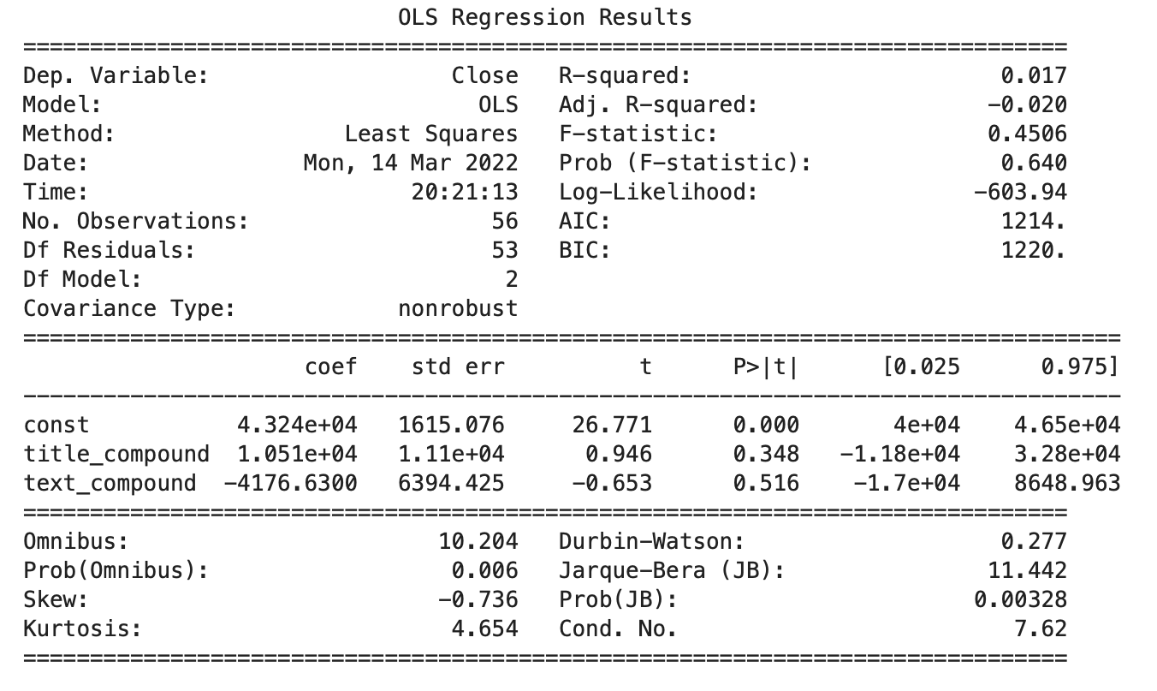


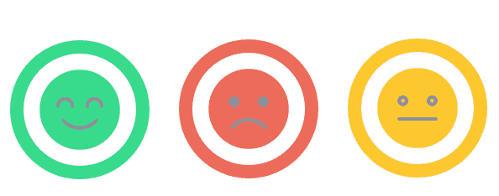

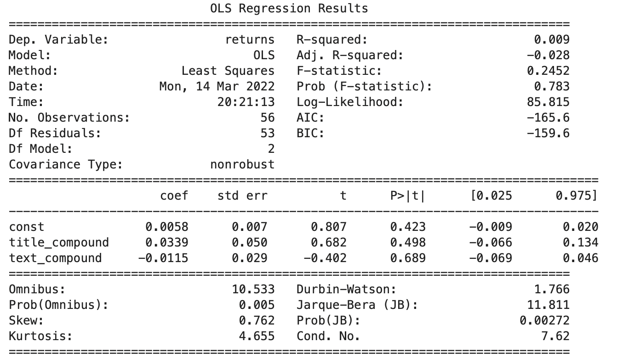

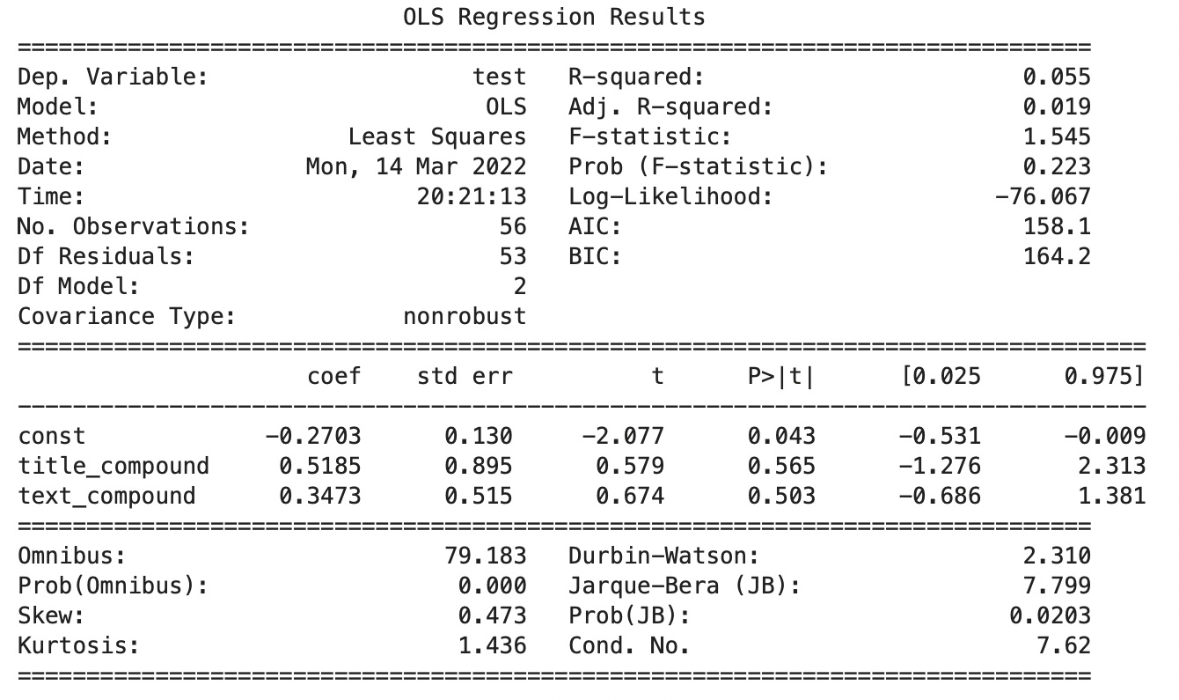
Sentiment Analysis as an Indicator
Step 1
Step 2
Step 3
Step 4
Selection of sentiment sources
Scraping using packages and APIs
Sentiment Analysis Algorithm
Running regression analysis on results

Slide 7



Model Training Challenges
Data processing took multiple hours
Initial results required multiple GBs of storage
Some Finta indicators required additional research

Slide 8
Procedure - Model Training
Step 5
Step 6
Step 7
Step 8
Train machine learning models using “xgboost” on various combinations of technical indicators
Save the model into the “model” folder
Make predictions using the testing data
Review the classification report associated with the model predictions
Notes:
We only used TA in groups of 3 but we could use more but it would take longer to train all possible combinations
SMA
EMA
BB
Fibonacci
VWAP
Save it so that we don’t have to retrain the same models repeatedly
Predictions were made using testing data from 3 months ago

Slide 9
Procedure - Saving the Results
Step 9
Step 10
Step 11
Step 12
Save the results into the “result” folder
Search for the best model after all the results are generated
Calculate and plot the cumulative returns of the most profitable models and save them as “.png” files
Display results using Streamlit
Notes:
2 files:
*.csv for actual TA, predictions and returns
*.json file for classification report i.e. accuracy, precision, recall etc
Save the generated results
Hvplot and streamlit

Slide 10
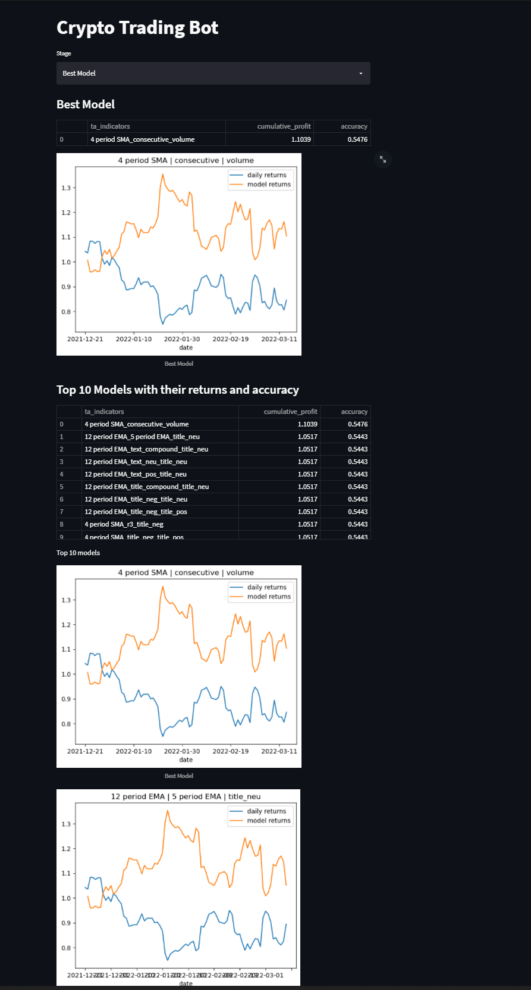
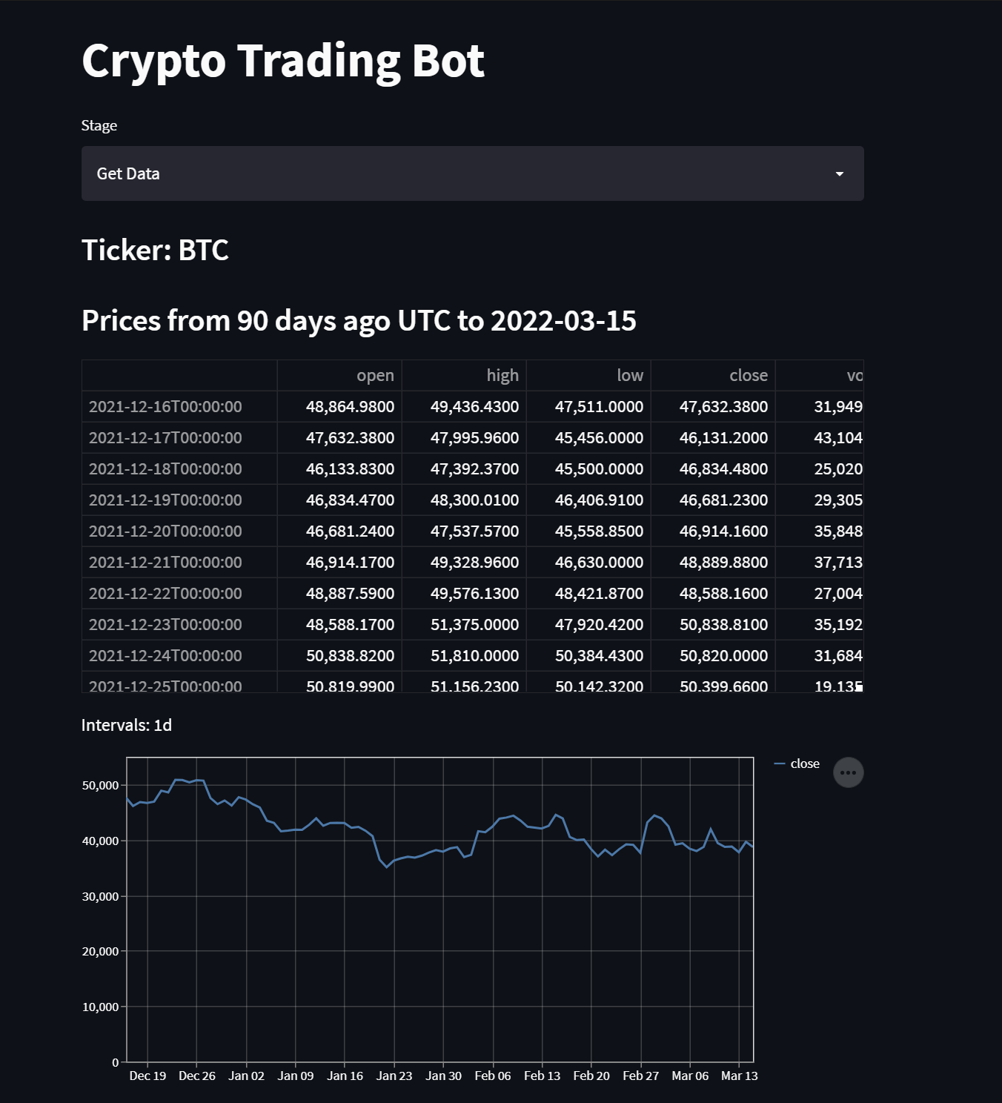
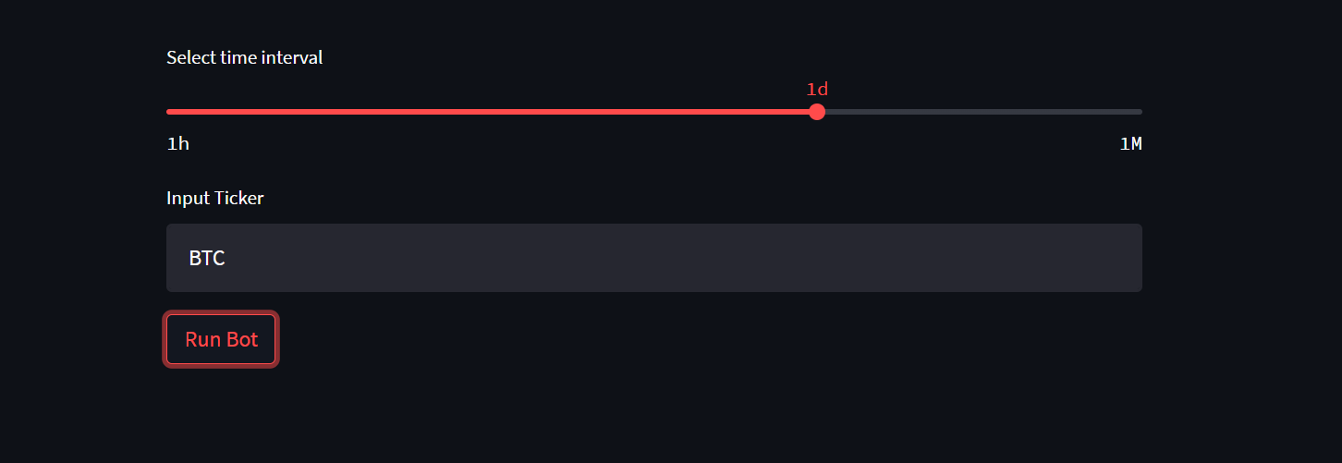
Streamlit
Notes:
-run by streamlit
- has title, slider

Slide 11
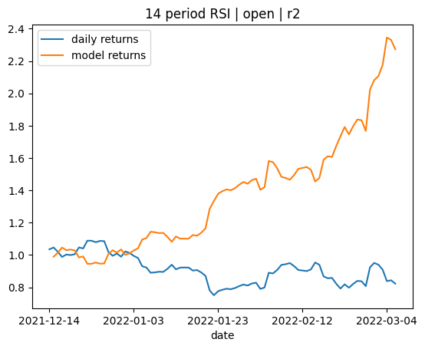
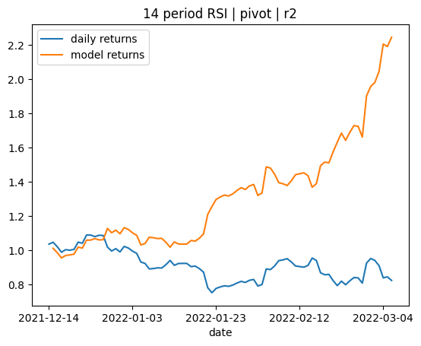
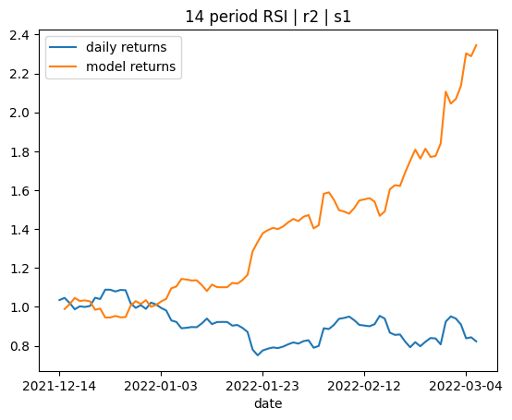
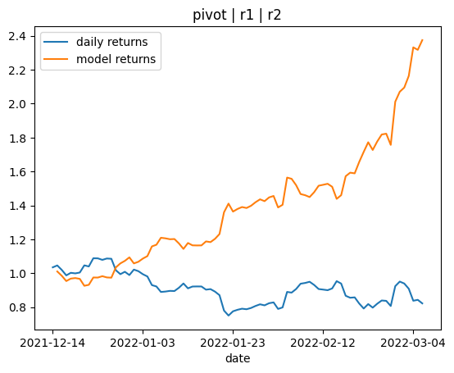
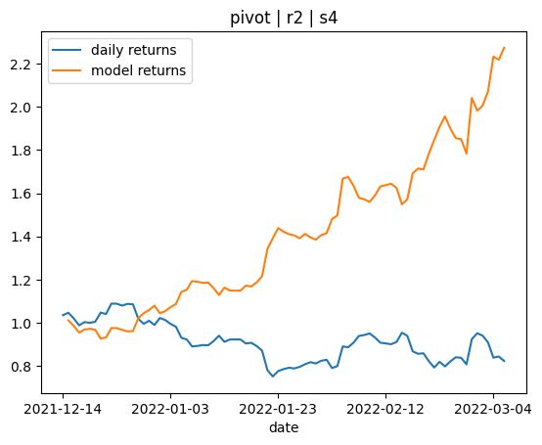
Results
Using the streamlit module, the process runs the “find_best_model” python file to show the top model and top 10 from the results csv.
The models can be viewed while being processed and while all combinations are tested, where the page can be refreshed to view the updated files and hierachy.
ta_indicators | cumulative_profit | accuracy
pivot_r1_r2 | 2.37447277 | 0.626506
14 period RSI_r2_s1 | 2.345642563 | 0.650602
pivot_r2_s4 | 2.273622888 | 0.578313
14 period RSI_open_r2 | 2.272767197 | 0.614458
14 period RSI_pivot_r2 | 2.24609442 | 0.60241

Slide 12
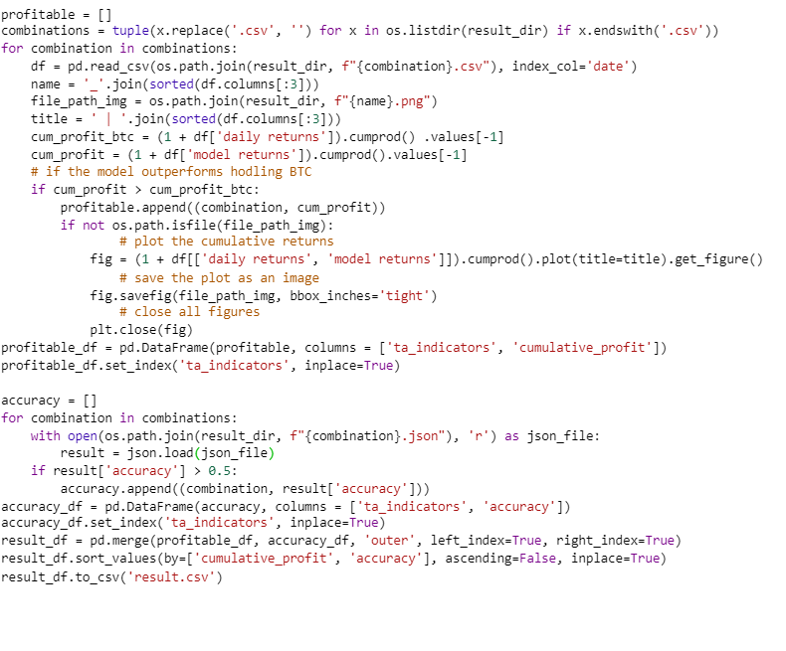
Model Evaluation
Brief explanation on ‘find best model’ script
Grabs daily returns with pct.change() and model returns
Puts in dataframe and plots model, then stored in ‘profitable’ dataframe
All models indicators and their accuracy are read, sorted and stored in a ‘results.csv’ file. Index[0] has the “best” model.
Can compare daily and model returns - with stored visualisations
Cumulative profits & accuracy
Popular indicators include r2, RSI and EMAs
Can be quite profitable, found some ideal outcomes (20%) $$$
Could include sharpe ratio to measure performance
Accuracy was not ideal - alot of lowballers such as 0.6 :(
With more time, include precision and recall

Slide 13
Discussion
Using XGBoost machine learning model our trading bot has identified some profitable models using a combination of 3 different indicators to identify buy and sell orders. Only approximately 20% (650 out of 3040) of the models were profitable. About 33% of the models outperform buying and holding BTC.
We believe that our model is sufficient enough for further investigation and validation using paper trading. However, our models can be improved by incorporating other factors such as trading fees and stop losses.
Notes:
640 / 3040 were profitable

Slide 14
Different classifier models, such as AdaBoost, DecisionTreeClassifier, or LogisticRegression
Incorporating stop losses, trading fees and sharpe ratio into profit and loss calculations
Different timeframes - 4 hour, 1 hour, 15 min, 5 min etc.
Areas of Improvement
Different trading signals e.g. big sell, small sell, hold, small buy, big buy
Combine multiple models' signals into one and have majority wins
Different indicators and number of indicators
Notes:
Incorporating stop losses into profit and loss calculations
Different classifier models, such as AdaBoost, DecisionTreeClassifier, or LogisticRegression.
Different timeframes - 4 hour, 1 hour, 15 min, 5 min etc.
Different trading signals e.g. big sell, small sell, hold, small buy, big buy
Different indicators and number of indicators
Combine multiple models' signals into one and have majority wins

Slide 15
Questions

