Slide 1
Operating Systems
Chapter 1 Computer System Overview
四川大学软件学院 梁刚
问题交流：lianggang @scu.edu.cn
作业提交、Website for 课件：
Swjx.scu.edu.cn
Tel：18980897656

Slide 2
Agenda
1.1 Basic Elements
1.2 Processor Registers
1.3 Instruction Execution
1.4 Interrupts
1.5 The Memory Hierarchy
1.6 I/O Communication Techniques

Slide 3
1.1 Basic Elements (1/2)
Processor(处理器)
Main Memory(内存)
  Volatile （易失性）
  referred to as real memory or primary memory
I/O modules(输入/输出模块)
  secondary memory devices
  communications equipment
  terminals
System bus(系统总线)
  communication among processors, memory, and I/O modules

Slide 4
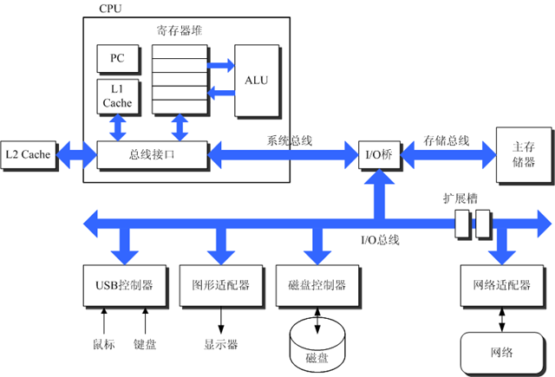
1.1 Basic Elements (2/2)

Slide 5
Agenda
1.0 Intro
1.1 Basic Elements
1.2 Processor Registers
1.3 Instruction Execution
1.4 Interrupts
1.5 The Memory Hierarchy
1.6 I/O Communication Techniques

Slide 6
1.2 Processor Registers
Introduction
  What is R
    Memory inside CPU
  Why R
    Enable programmer to minimize main-memory references
  Can be classified into:
    User-visible registers(用户可见 R)
    Control and status registers(控制和状态 R)
  说明：
    界限模糊性
    具体CPU相关性

Slide 7
1.2 Processor Registers
1.2.1 User-Visible Registers
1.2.2 Control and Status Registers

Slide 8
1.2.1 User-Visible Registers (1/2)
How用之：May be referenced by machine/assemble language
Who用之：Available to all programs
  application programs
  system programs
具体CPU相关
Types of this kind of registers (和书上不同)
  Data R
  Address R [more detail next]

Slide 9
1.2.1 User-Visible Registers (2/2)
List of Address Registers
  Segment pointer
    When memory is divided into segments, memory is referenced by a segment and an offset
  Index register
    Involves adding an index to a base value to get an address
  Stack pointer
    Points to top of stack

Slide 10
1.2 Processor Registers
1.2.1 User-Visible Registers
1.2.2 Control and Status Registers

Slide 11
1.2.2 Control and Status Registers (1/2)
功能：are used to control the operation of the processor
How用之：
  Are not visible to the user.
  May be accessibly by machine instruction
Who用之：Used by privileged operating-system routines (usually in system mode ) to control the execution of programs
具体CPU相关

Slide 12
1.2.2 Control and Status Registers (2/2)
Program Counter (PC)
  Contains the address of an instruction to be fetched
Instruction Register (IR)
  Contains the instruction most recently fetched
Program Status Word (PSW)
  Condition codes
  Other state-related bits, such as:
    Interrupt enable/disable
    Supervisor/user mode
    … …

Slide 13
Agenda
1.0 Intro
1.1 Basic Elements
1.2 Processor Registers
1.3 Instruction Execution
1.4 Interrupts
1.5 The Memory Hierarchy
1.6 I/O Communication Techniques

Slide 14
1.3 Instruction Execution (1/12)
Program in memory
Instruction 1
Instruction n
Program 1
PC
data 1
IR
data n
R
CPU
M

Slide 15
1.3 Instruction Execution (2/12)
Program run/executed by CPU
  Instructions of the program are executed by CPU one by one
  That is : Program Execution = Instruction Execution

Slide 16
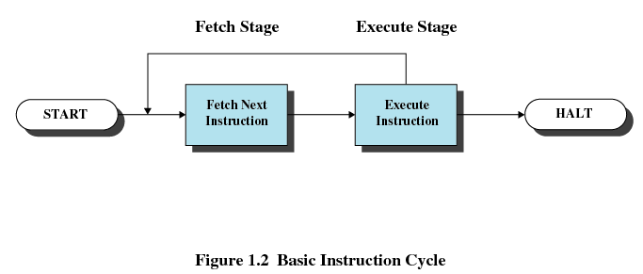
1.3 Instruction Execution (3/12)
Two stages of each Instruction Execution
  Processor reads/loads/Fetches instructions from memory
  Processor Executes each instruction

Slide 17
1.3 Instruction Execution (4/12)
Then, the question is: How the processor executes each instruction?
The next question is: What is the instruction looks like?
  Opcode：操作码
  Opdata：操作数/操作数的地址
Opcode Opdata

Slide 18
1.3 Instruction Execution (5/12)
Program in memory
Opcode1 Opdata1
Opcode2 Opdata2
Program 1
PC
data 1
IR
data 2
R
CPU
M

Slide 19
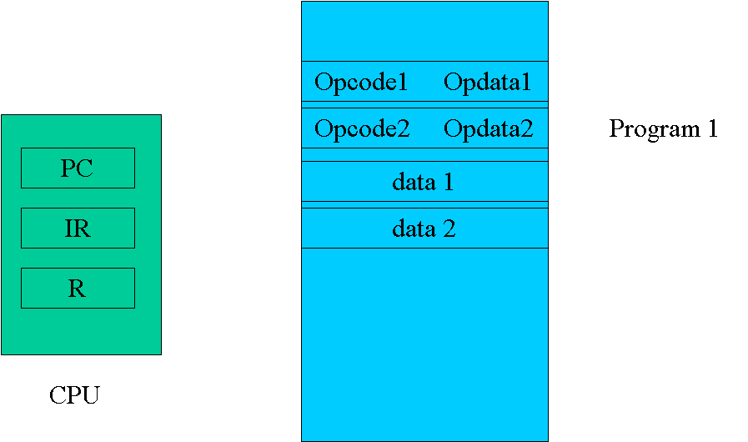
1.3 Instruction Execution (6/12)
Summary:
  Program Execution
    Instruction Fetch + Instruction Execution
      CPU do the Opcode to the Opdata

Slide 20
1.3 Instruction Execution (7/12)
Another key point:
  Program counter (PC) of CPU holds address of the instruction to be fetched next
  Fetched instruction is placed in the instruction register (IR)
  Program counter (PC) of CPU is incremented after each fetch

Slide 21
1.3 Instruction Execution (8/12)
Instruction categories
  Processor-memory
    Transfer data between processor and memory
  Processor-I/O
    Data transferred to or from a peripheral device
  Data processing
    Arithmetic or logic operation on data
  Control
    Alter sequence of execution

Slide 22
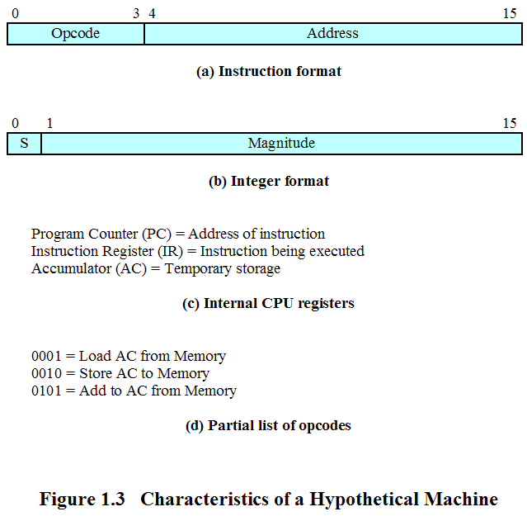
1.3 Instruction Execution (9/12)
An Example: the Instruction

Slide 23
1.3 Instruction Execution (10/12)
An Example (cont.): the CPU
PC
IR
AC
CPU

Slide 24
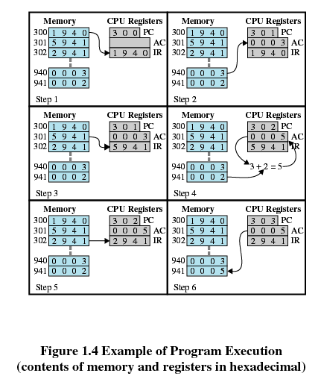
1.3 Instruction Execution (11/12)
An Example (cont.): the process of a program execution
指令1
指令2
指令3

Slide 25
1.3 Instruction Execution (12/12)
Taking home Question
  If I/O is added, how to expend it?
M
CPU
I/O

Slide 26
Agenda
1.0 Intro
1.1 Basic Elements
1.2 Processor Registers
1.3 Instruction Execution
1.4 Interrupts
1.5 The Memory Hierarchy
1.6 I/O Communication Techniques

Slide 27
1.4 Interrupts
1.4.0 Interrupt Introduction
1.4.1 Interrupts and the Instruction Cycle
1.4.2 Interrupt Processing
1.4.3 Multiple Interrupts
1.4.4 Multiprogramming

Slide 28
1.4 Interrupts
1.4.0 Interrupt Introduction
1.4.1 Examples of Interrupts
1.4.2 Interrupt Processing
1.4.3 Multiple Interrupts

Slide 29
1.4.0 Interrupt Introduction (1/2)
What the word of “interrupt” means?
  E.g.: 你打断两个的对话，因为要问路
  E.g.: 老师正在上课，手机突然叫了
  E.g.: …

Slide 30
1.4.0.1 Interrupt Definition (1/3)
Interrupt
  A mechanism by which other modules (I/O, memory) may interrupt the normal sequencing of the processor.
    An I/O device can stop what the CPU is operating to provide some necessary service.
  Interrupt and Restore/Resume
    Both S/W and H/W are used to support it

Slide 31
1.4.0.2 Interrupt Definition (2/3)
Features of Interrupt
  Unpredictable (不可预测性/随机性)
  can be disable (可屏蔽性)
  Can be nested (可嵌套性)

Slide 32
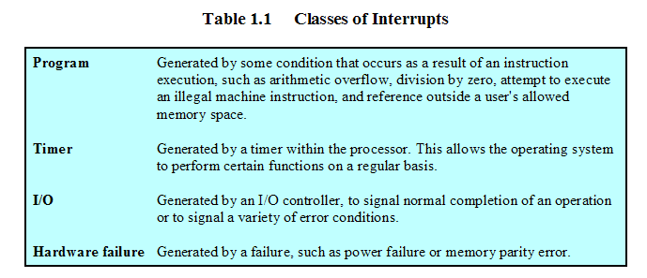
1.4.0.3 Interrupt Definition (3/3)
具体分类和实现是CPU相关的

Slide 33
1.4.0 Interrupt Introduction (2/2)
Why Interrupt in CS?
  Most I/O devices are slower than the processor
    Processor must pause to wait for device
    E.g.: printer

Slide 34
1.4 Interrupts
1.4.0 Interrupt Introduction
1.4.1 Examples of Interrupts
1.4.2 Interrupt Processing
1.4.3 Multiple Interrupts

Slide 35
1.4.1 Examples of Interrupt (1/7)
Instruction 1
WRITE1
PC
Program 1
Instruction n
IR
data 1
R
data n
CPU
M
WRITE1子程序
  初始化I/O controler
  完成要打印数据的Output
  等待打印机完成打印
  其他收尾工作
I/O controler
printer

Slide 36
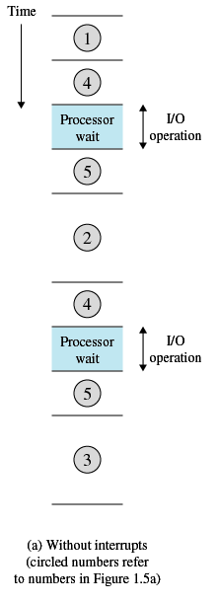
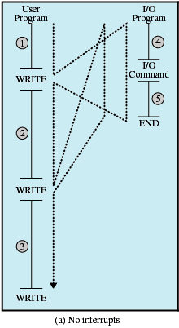
1.4.1 Examples of Interrupt (2/7)

Slide 37
1.4.1 Examples of Interrupt (3/7)
Now, let add Interrupt into this example. So that
  CPU can process other instructions, while printer can do its printing jobs
    Concurrent: 并发
  When the printer finished, it interrupts CPU

Slide 38
1.4.1 Examples of Interrupt (4/7)
？
Instruction 1
WRITE2
PC
Program 1
Instruction n
IR
data 1
R
data n
CPU
M
WRITE2子程序
  初始化I/O controler
  完成要打印数据的Output
I/O controler
printer

Slide 39
1.4.1 Examples of Interrupt (5/7)
Instruction 1
WRITE2
Program 1
PC
Instruction n
data 1
Printer的中断服务程序
= Interrupt Handler
= Interrupt Service Routine
IR
R
data n
CPU
Instructions
M
WRITE2子程序
  初始化I/O controler
  完成要打印数据的Output
I/O controler
printer

Slide 40
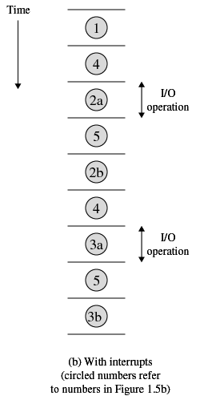
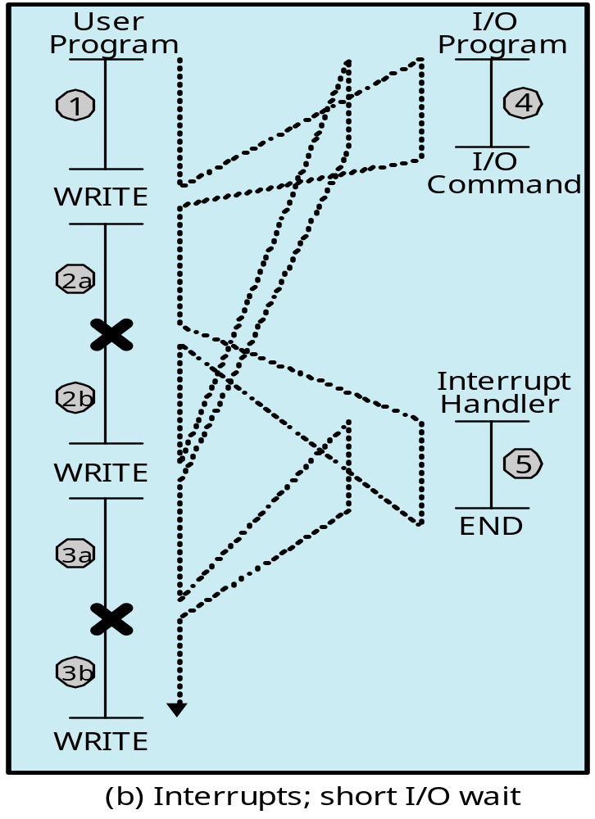
1.4.1 Examples of Interrupt (6/7)
中断点
中断点

Slide 41
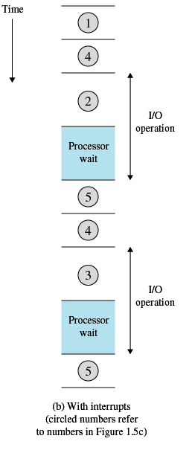
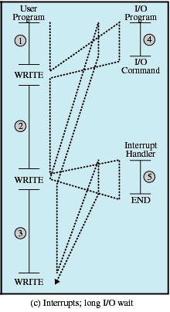
1.4.1 Examples of Interrupt (7/7)
Timing Diagram Based on Long I/O Wait
  1.4.5 Multiprogramming

Slide 42
1.4 Interrupts
1.4.0 Interrupt Introduction
1.4.1 Examples of Interrupts
1.4.2 Interrupt Processing
1.4.4 Multiple Interrupts

Slide 43
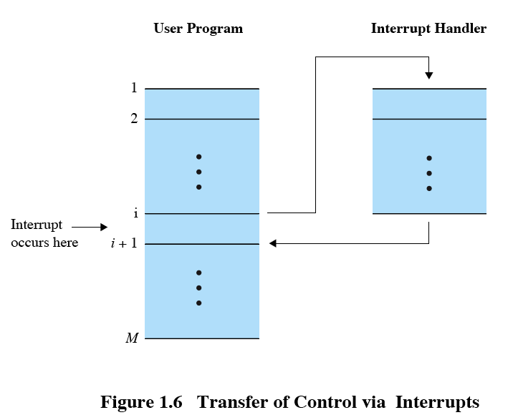
1.4.2 Interrupt Processing (1/5)
Suspends the normal sequence of execution

Slide 44
1.4.2 Interrupt Processing (2/5)
Interrupt Cycle
  Processor checks for interrupts
    If no interrupts fetch the next instruction for the current program
    If an interrupt is pending, suspend execution of the current program, and execute the interrupt-handler routine

Slide 45
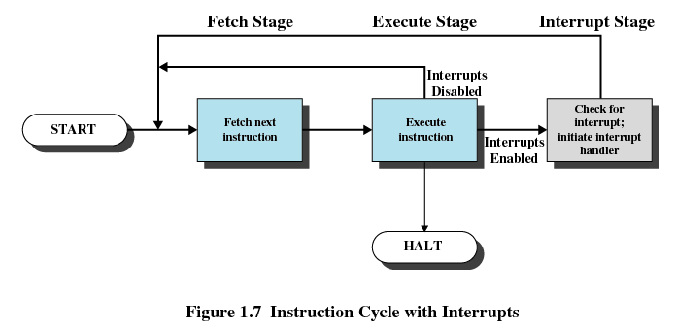
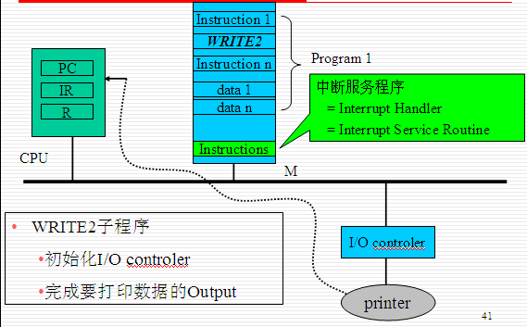
1.4.2 Interrupt Processing (3/5)
修改PC的值成中断服务程序首指令的地址

Slide 46
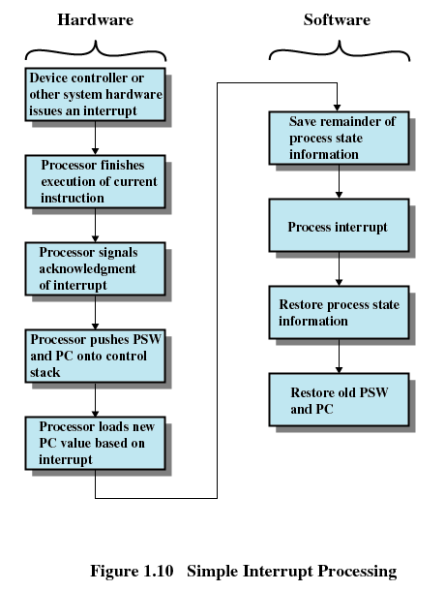
1.4.2 Interrupt Processing (4/5)

Slide 47
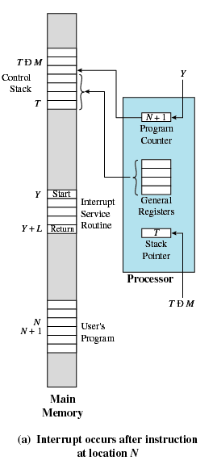
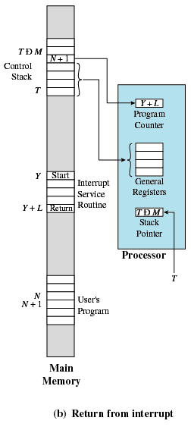
1.4.2 Interrupt Processing (5/5)

Slide 48
1.4 Interrupts
1.4.0 Interrupt Introduction
1.4.1 Examples of Interrupts
1.4.2 Interrupt Processing
1.4.3 Multiple Interrupts

Slide 49
1.4.3 Multiple Interrupts (1/4)
Q: What will happen if an I/O modules rouse a Interrupt, while the CPU is processing instruction of an ISR
  That is interrupt an ISR

Slide 50
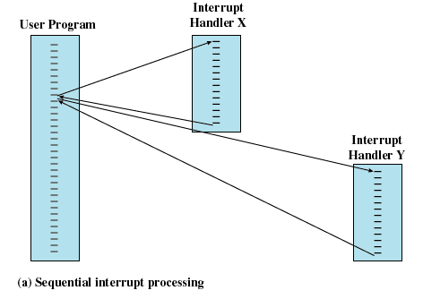
1.4.3 Multiple Interrupts (2/4)
Method 1：Disable interrupts while an interrupt is being processed

Slide 51
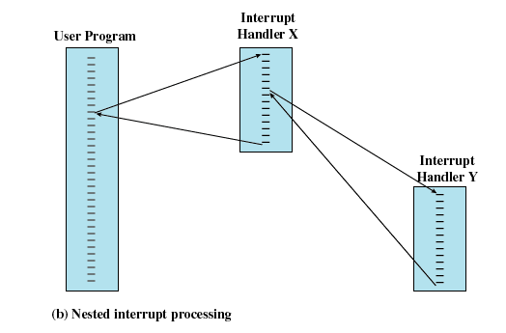
1.4.3 Multiple Interrupts (3/4)
Method 2： Define priorities for interrupts

Slide 52
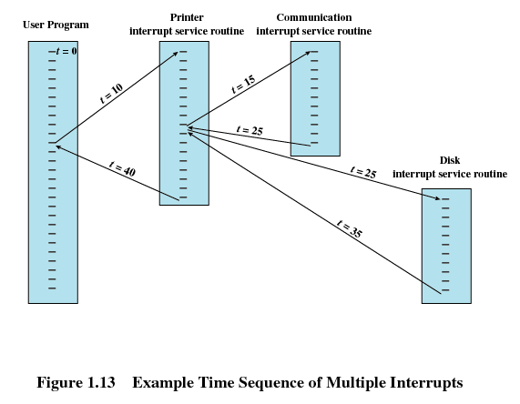
1.4.3 Multiple Interrupts (4/4)
An Example of Method 2

Slide 53
1.4.4 Multiprogramming
Multiprogramming(多道程序)
  Processor has more than one program to execute
  The sequence the programs are executed depend on their relative priority and whether they are waiting for I/O
  After an interrupt handler completes, control may not return to the program that was executing at the time of the interrupt
  More detail later

Slide 54
Agenda
1.0 Intro
1.1 Basic Elements
1.2 Processor Registers
1.3 Instruction Execution
1.4 Interrupts
1.5 The Memory Hierarchy
1.6 I/O Communication Techniques

Slide 55
1.5 The Memory Hierarchy (1/9)
The design constraints of a computer’s memory
  How much : Capacity : larger
  How fast : Speed : faster/ as fast as CPU
  How expensive : Price : cheaper
CPU
M
Disk

Slide 56
1.5 The Memory Hierarchy (2/9)
(Speed , Price, Capacity)的不可兼得性/矛盾:
  Faster access time, greater cost per bit
  Greater capacity, smaller cost per bit
  Greater capacity, slower access speed
What can we do?
  中庸？
    To use them all in the right way: Memory Hierarchy

Slide 57
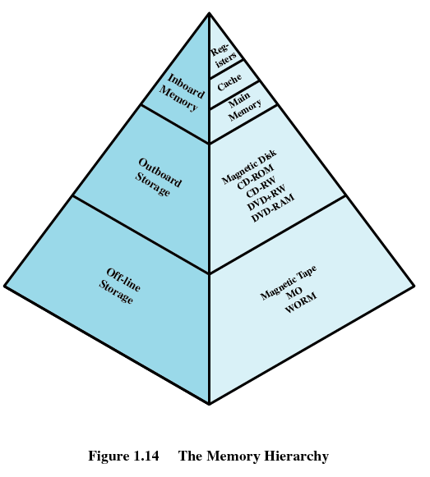
1.5 The Memory Hierarchy (3/9)
Memory Hierarchy： Three Levels

Slide 58
1.5 The Memory Hierarchy (4/9)
Level 1：R ＋ Cache ＋ Main Memory
  semiconductor
  volatile (易失)
  Bytes/words

Slide 59
1.5 The Memory Hierarchy (5/9)
Level 2：
  Auxiliary memory(辅助存储)
  Nonvolatile(非易失)
  files

Slide 60
1.5 The Memory Hierarchy (6/9)
Level 3：many types
  Tapes
  SAN, NAS…..

Slide 61
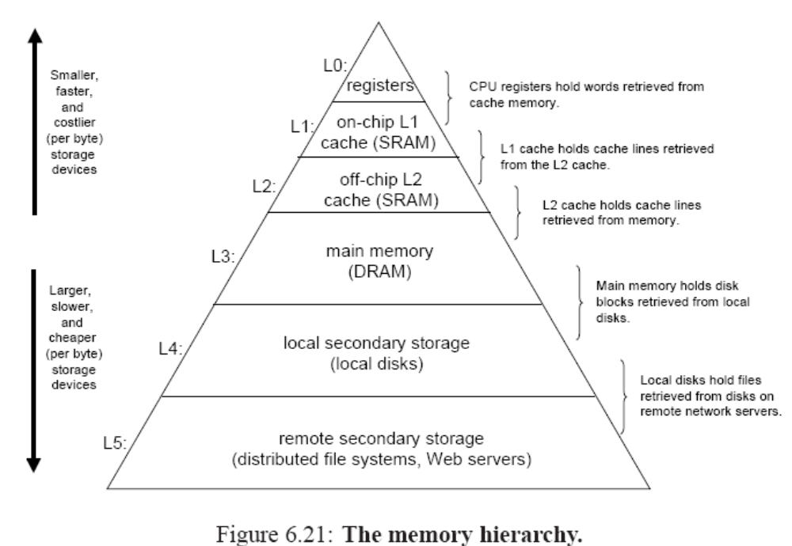
1.5 The Memory Hierarchy (7/9)

Slide 62
1.5 The Memory Hierarchy (8/9)
Going Down the Hierarchy
  Increasing capacity
  Increasing access time ( that is slow speed )
  Decreasing cost per bit
  Decreasing frequency of access of the memory by the processor

Slide 63
1.5 The Memory Hierarchy (9/9)
Decreasing frequency of access
  Smaller, more expensive, faster memories are supplemented (补充) by larger, cheaper, slower memories
  Smaller, more expensive, faster memories cache larger, cheaper, slower memories
Locality of reference(访问局部性/局部性原理/principle of locality)
  What is it
  Why it exists

Slide 64
Agenda
1.0 Intro
1.1 Basic Elements
1.2 Processor Registers
1.3 Instruction Execution
1.4 Interrupts
1.5 The Memory Hierarchy
1.6 I/O Communication Techniques

Slide 65
1.6 I/O Communication Techniques (1/4)
Three methods
  Programmed I/O
  Interrupt-Driven I/O
  Direct Memory Access / DMA
CPU
M
I/O
I/O

Slide 66
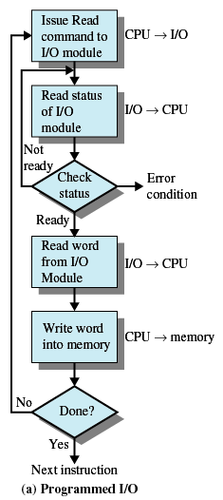
1.7 I/O Communication Techniques (2/4)
Method1/3: Programmed I/O
  I/O module performs the action, not the processor
  Sets appropriate bits in the I/O status register
  No interrupts occur
  Processor checks status until operation is complete

Slide 67
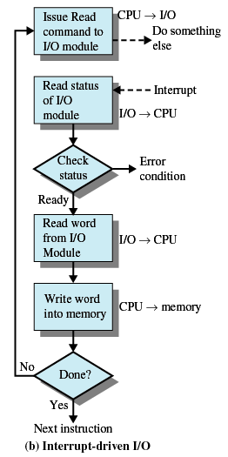
1.6 I/O Communication Techniques (3/4)
Method2/3: Interrupt-Driven I/O
  Processor is interrupted when I/O module ready to exchange data
  Processor saves context of program executing and begins executing interrupt-handler
  No needless waiting
  缺点：Consumes a lot of processor time because every word read or written passes through the processor

Slide 68
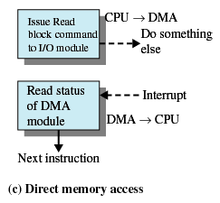
1.6 I/O Communication Techniques (4/4)
Method3/3: Direct Memory Access
  I/O exchanges occur directly with memory
    Relieves the processor responsibility for the exchange
    Transfers a block of data directly to or from memory
  流程
    Processor grants I/O module authority to read from or write to memory
    An interrupt is sent when the transfer is complete
    Processor continues with other work

Slide 69
Homework
Review Questions:
  1.4
  1.9
Problems:
  1.1
  1.13

