Slide 1
Concurrency(并发):
Mutual Exclusion(互斥) and
Synchronization(同步)
Chapter 5

Slide 2
Agenda
5.1 Principles of Concurrency
5.2 Mutual Exclusion: Hardware Support
5.3 Semaphores
5.4 Monitors
5.5 Message Passing
5.6 Readers/Writers Problem
5.7 Summary

Slide 3
Concurrency
Multiple applications(多应用程序)
  Multiprogramming
Structured application(结构化应用程序)
  Application can be a set of concurrent processes
Operating-system structure(操作系统结构)
  Operating system is a set of processes or threads

Slide 4
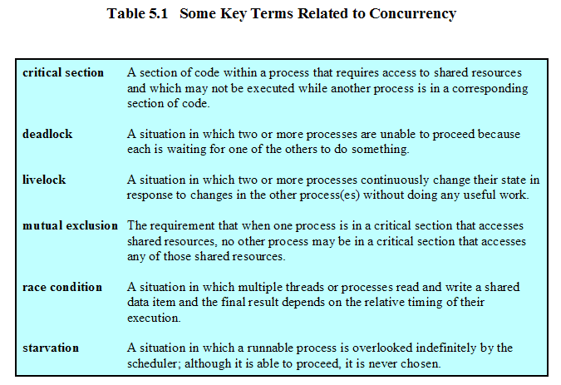
Concurrency

Slide 5
Agenda
5.1 Principles of Concurrency
5.2 Mutual Exclusion: Hardware Support
5.3 Semaphores
5.4 Monitors
5.5 Message Passing
5.6 Readers/Writers Problem
5.7 Summary

Slide 6
5.1 Principles of Concurrency
5.1.1 A Simple Example
5.1.2 Race Condition
5.1.3 Operating System Concerns
5.1.4 Process Interaction
5.1.5 Requirements for Mutual Exclusion

Slide 7
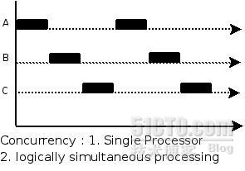
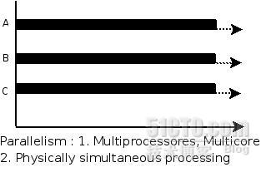
Concurrency & Parallelism

Slide 8
Difficulties of Concurrency
Sharing of global resources(全局共享)
Operating system managing the allocation of resources optimally(资源分配最优化)
Difficult to locate programming errors(定位程序错误)

Slide 9
A Simple Example
void echo()
{
chin = getchar();
chout = chin;
putchar(chout);
}

Slide 10
A Simple Example(Uniprocessor)
Process P1 Process P2
. .
chin = getchar(); .
chout = chin; . chin = getchar();
chout = chin;
putchar(chout);
putchar(chout); .
. .

Slide 11
A Simple Example(Multiprocessor)
Process P1 Process P2
. .
chin = getchar(); .
. chin = getchar();
chout = chin; chout = chin;
putchar(chout); .
. putchar(chout);
. .

Slide 12
5.1 Principles of Concurrency
5.1.1 A Simple Example
5.1.2 Race Condition
5.1.3 Operating System Concerns
5.1.4 Process Interaction
5.1.5 Requirements for Mutual Exclusion

Slide 13
Race Condition(竞争条件)
A race condition occurs when multiple processes or threads read and write data items so that the final result depends on the order of execution of instructions(指令执行顺序) in the multiple processes.

Slide 14
5.1 Principles of Concurrency
5.1.1 A Simple Example
5.1.2 Race Condition
5.1.3 Operating System Concerns
5.1.4 Process Interaction
5.1.5 Requirements for Mutual Exclusion

Slide 15
Operating System Concerns
Keep track of various processes(through PCB)
Allocate and deallocate resources(分配和回收资源)
  Processor time
  Memory
  Files
  I/O devices
Protect data and resources(保护数据和资源)
Output of process must be independent of the speed of execution of other concurrent processes(与执行速度无关)

Slide 16
Concurrency
Communication among processes(进程间通信)
Sharing resources(共享资源)
Synchronization of multiple processes(多进程同步)
Allocation of processor time(分配处理器时间)

Slide 17
5.1 Principles of Concurrency
5.1.1 A Simple Example
5.1.2 Race Condition
5.1.3 Operating System Concerns
5.1.4 Process Interaction
5.1.5 Requirements for Mutual Exclusion

Slide 18
Process Interaction(进程交互)
Processes unaware of each other(互不知道)
Processes indirectly aware of each other(间接知道)
Process directly aware of each other(直接知道)

Slide 19
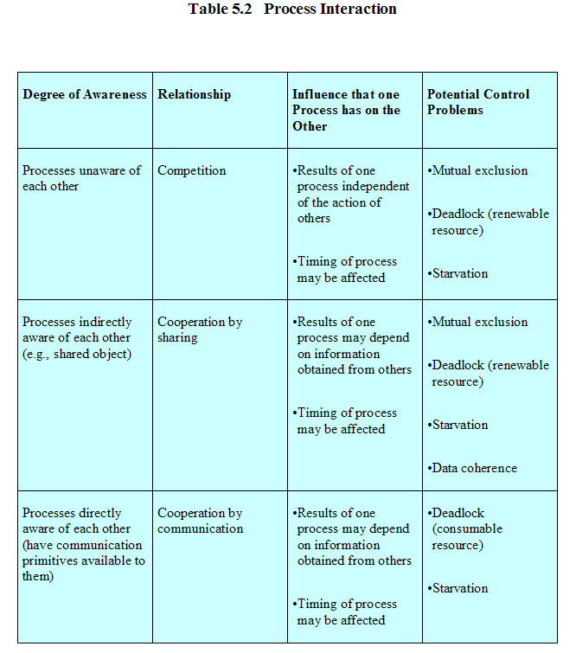

Slide 20
Competition Among Processes for Resources(进程间的资源争用)
Mutual Exclusion(互斥)
  Critical sections
    Only one program at a time is allowed in its critical section
    Example only one process at a time is allowed to send command to the printer
Deadlock(死锁)
Starvation(饥饿)

Slide 21
5.1 Principles of Concurrency
5.1.1 A Simple Example
5.1.2 Race Condition
5.1.3 Operating System Concerns
5.1.4 Process Interaction
5.1.5 Requirements for Mutual Exclusion

Slide 22
Requirements for Mutual Exclusion
Only one process at a time is allowed in the critical section for a resource(一时，一个进程一个临界区资源)
A process that halts in its noncritical section must do so without interfering with other processes(非临界区部分不干涉其他进程)
No deadlock or starvation

Slide 23
Requirements for Mutual Exclusion
A process must not be delayed access to a critical section when there is no other process using it(空闲时立即进入)
No assumptions are made about relative process speeds or number of processes(与进程相对速度和个数无关)
A process remains inside its critical section for a finite time only(临界区时间有限)

Slide 24
Agenda
5.1 Principles of Concurrency
5.2 Mutual Exclusion: Hardware Support
5.3 Semaphores
5.4 Monitors
5.5 Message Passing
5.6 Readers/Writers Problem
5.7 Summary

Slide 25
5.2 Mutual Exclusion: Hardware Support
5.2.1 Interrupt Disabling
5.2.2 Special Machine Instructions

Slide 26
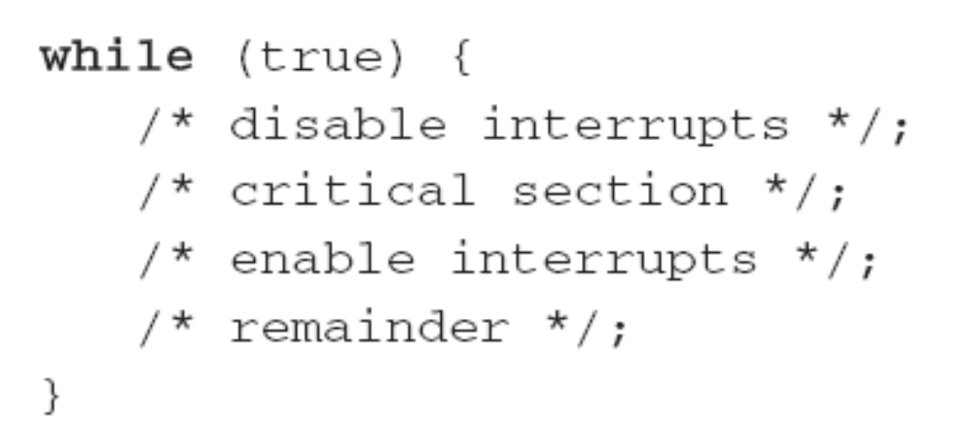
Hardware Support: Interrupt Disabling
A process runs until it invokes an operating system service or until it is interrupted(打断)
Disabling interrupts guarantees mutual exclusion

Slide 27
Hardware Support: Interrupt Disabling
Disadvantage:
  Processor is limited in its ability to interleave programs(交替执行)
  disabling interrupts on one processor will not guarantee mutual exclusion in multi-processors environment.(多处理机环境)

Slide 28
5.2 Mutual Exclusion: Hardware Support
5.2.1 Interrupt Disabling
5.2.2 Special Machine Instructions

Slide 29
Hardware Support: Special Machine Instructions
Performed in a single instruction cycle(单指令周期内完成)
  Access to the memory location is blocked for any other instructions(阻塞其他指令)

Slide 30
Hardware Support: Special Machine Instructions
Test and Set Instruction
boolean testset (int i) {
if (i == 0) {
i = 1;
return true;
}
else {
return false;
}
}

Slide 31
Hardware Support: Special Machine Instructions
Exchange Instruction
void exchange(int register, int memory) {
int temp;
temp = memory;
memory = register;
register = temp;
}

Slide 32
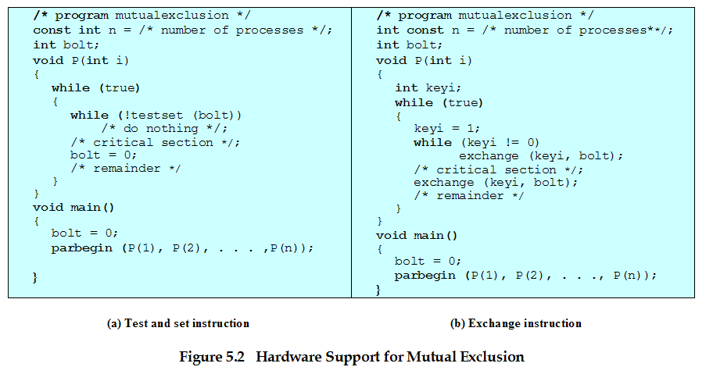
Hardware Support for Mutual Exclusion

Slide 33
Hardware Support: Special Machine Instructions
Advantages
  Applicable to any number of processes on either a single processor or multiple processors sharing main memory(进程数目不限)
  It is simple and therefore easy to verify(简单易证)
  It can be used to support multiple critical sections(支持多临界区)

Slide 34
Hardware Support: Special Machine Instructions
Disadvantages
  Busy-waiting consumes processor time(忙时等待)
  Starvation is possible when a process leaves a critical section and more than one process is waiting. (可能饥饿)
  Deadlock(可能死锁)
    If a low priority process has the critical region and a higher priority process needs, the higher priority process will obtain the processor to wait for the critical region

Slide 35
Agenda
5.1 Principles of Concurrency
5.2 Mutual Exclusion: Hardware Support
5.3 Semaphores
5.4 Monitors
5.5 Message Passing
5.6 Readers/Writers Problem
5.7 Summary

Slide 36
5.3 Semaphores
5.3.1 Overview
5.3.2 Mutual Exclusion
5.3.3 The Producer/Consumer Problem
5.3.4 Implement of Semaphores

Slide 37
Semaphores
Special variable called a semaphore is used for signaling
If a process is waiting for a signal, it is suspended until that signal is sent

Slide 38
Semaphores
Semaphore is a variable that has an integer value
  May be initialized to a nonnegative number
  Wait operation decrements the semaphore value
  Signal operation increments semaphore value

Slide 39
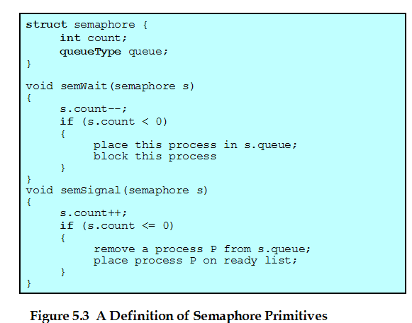
Semaphore Primitives(原语)

Slide 40
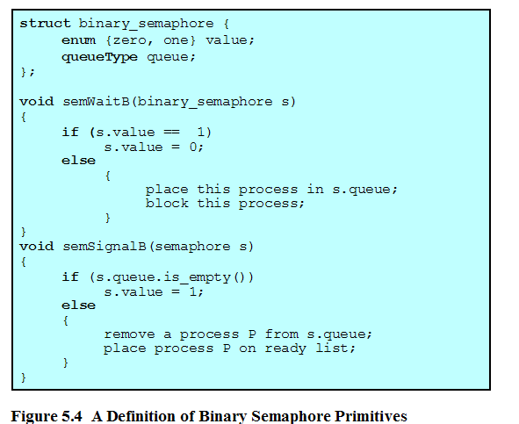
Binary Semaphore Primitives

Slide 41
5.3 Semaphores
5.3.1 Overview
5.3.2 Mutual Exclusion
5.3.3 The Producer/Consumer Problem
5.3.4 Implement of Semaphores

Slide 42
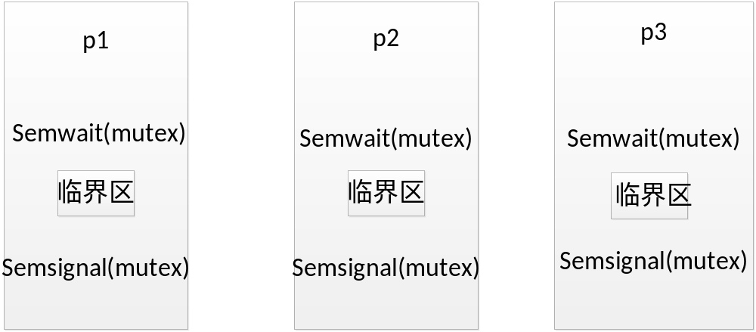
The Use of Semaphore
mutex

Slide 43
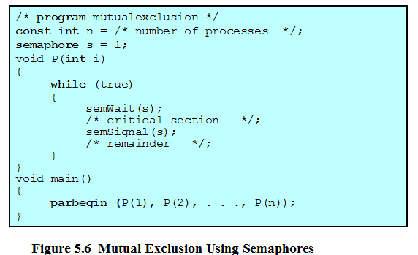
Mutual Exclusion Using Semaphores

Slide 44
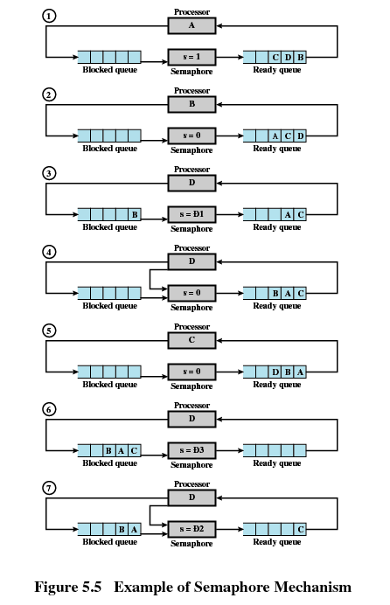

Slide 45
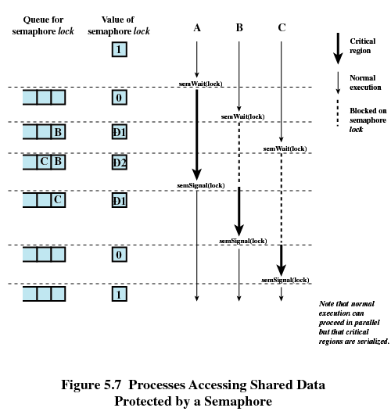
-1
-2
-1

Slide 46
The Use of Semaphore
Synchronization:
For example: process p1 must run before process p2
How can do it by using semaphore?
Semphore mutual=0;
Process p1: Process P2:
While(1) while(1)
{ {
critical area; semwait(mutula);
semsignal(mutual); critical area;
} }

Slide 47
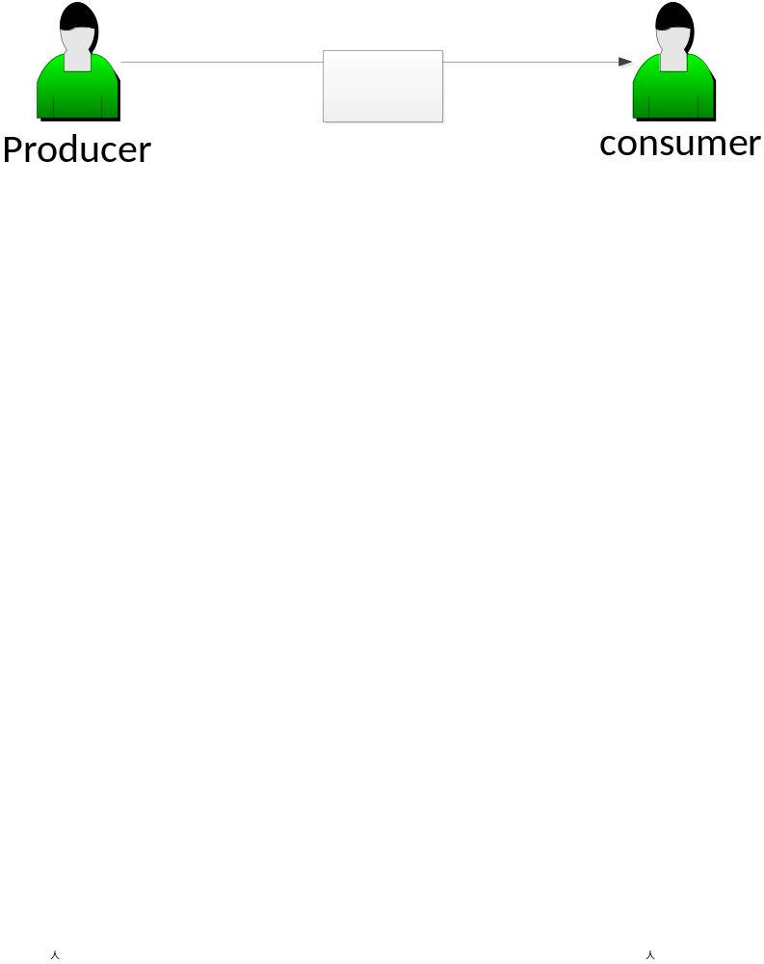
The Simple Problem of Producer-Consumer
One producer and one consumer:
1、if the buffer is empty ,the consumer must wait;
2、if the buffer is full, the producer must wait;
How can I implement this situation by using semaphore?

Slide 48
The Use of Semaphore
Semaphore s1=n,s2=0;
Procduer: consumer:
While(1) while(1)
{ {
semwait(s1); semaphore(s2)
produce(); take();
append(); semsignal(s1);
semsignal(s2); consumer();
} }
There exists one problem we don’t take it into consideration.

Slide 49
The Conclusions of the Semaphore
一、信号量的物理含义：
1、 信号量的整数是可用资源的数目；
2、当信号量中的整数为0表示没有资源可用；
3、当信号量中的整数小于0，这个负数的绝对值表示在这个
信号量上阻塞的进程数目；
二、 semwait(mutex)和semsignal(mutex)的意义
1、semwait(mutex)表示申请一个资源；
2、semsignal(mutex)表示释放一个资源；
3、semwait(mutex)和semsignal(mutex)必须成对出现，如果在
一个进程内出现，表示互斥，如果不在一个进程内出现，
表示同步；
4、如果在一个进程内既有互斥又有同步操作的semwait操作时，
首先执行同步操作的semwait操作，对于semsignal没有要求；

Slide 50
5.3 Semaphores
5.3.1 Overview
5.3.2 Mutual Exclusion
5.3.3 The Producer/Consumer Problem
5.3.4 Implement of Semaphores

Slide 51
Producer/Consumer Problem
One or more producers are generating data and placing these in a buffer
A single consumer is taking items out of the buffer one at time
Only one producer or consumer may access the buffer at any one time

Slide 52
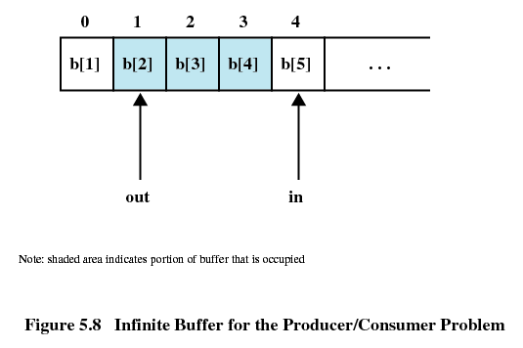
Producer/Consumer Problem

Slide 53
Producer
producer:
while (true) {
/* produce item v */
b[in] = v;
in++;
}

Slide 54
Consumer
consumer:
while (true) {
while (in <= out)
/*do nothing */;
w = b[out];
out++;
/* consume item w */
}

Slide 55
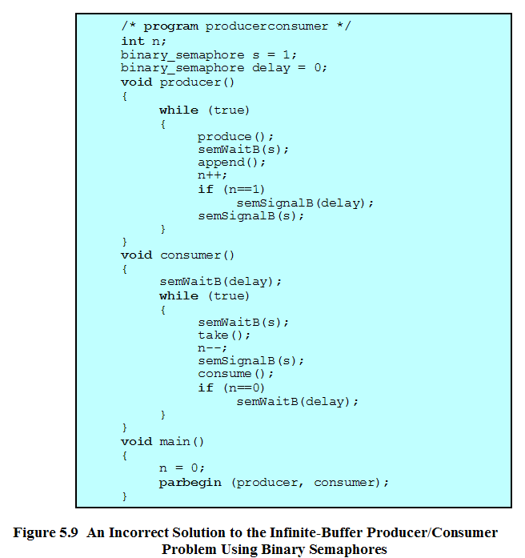

Slide 56
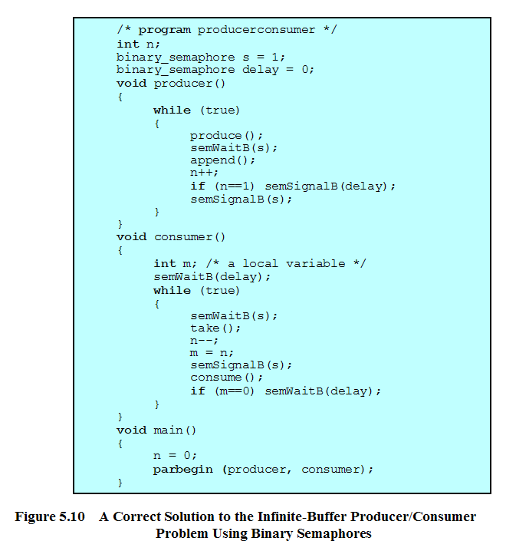

Slide 57
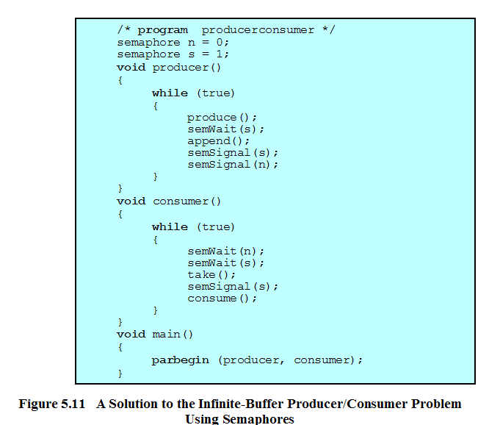

Slide 58
Producer with Circular Buffer
producer:
while (true) {
/* produce item v */
while ((in + 1) % n == out) /* do nothing */;
b[in] = v;
in = (in + 1) % n
}

Slide 59
Consumer with Circular Buffer
consumer:
while (true) {
while (in == out)
/* do nothing */;
w = b[out];
out = (out + 1) % n;
/* consume item w */
}

Slide 60
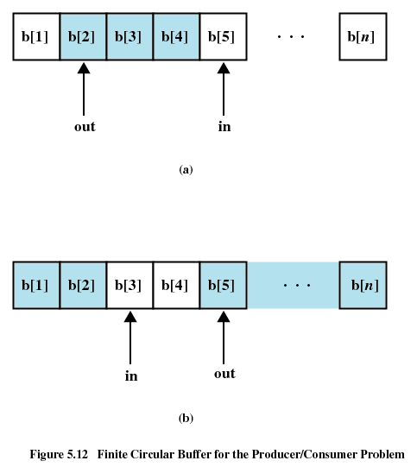

Slide 61
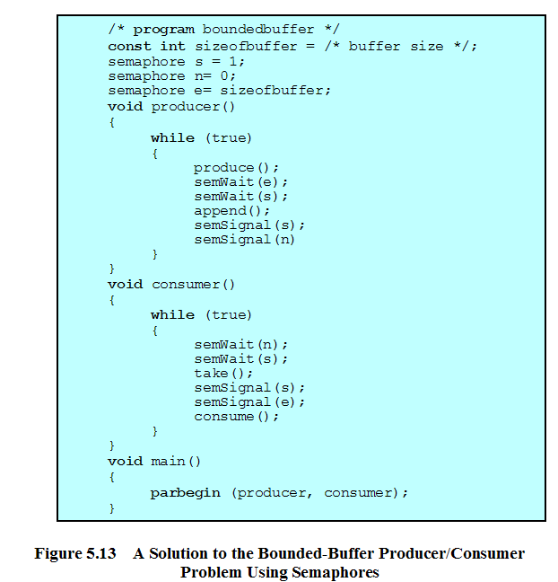
控制进入临界区
控制消费者
控制生产者

Slide 62
生产者-消费者问题
一组生产者进程和一组消费者进程共享一个初始为空、大小为n的缓冲区，只有缓冲区没满时，生产者才能把消息放入到缓冲区，否则必须等待；只有缓冲区不空时，消费者才能从中取出消息，否则必须等待。由于缓冲区是临界资源，它只允许一个生产者放入消息，或者一个消费者从中取出消息。

Slide 63
关系分析
进程间的关系：
1、互斥关系：生产者进程之间、消费者进程之间、生产者与消费者之间；
2、同步关系：生产者生产一个产品通知消费者可以消费；
消费者消耗一个产品通知生产者有一个空的仓位。

Slide 64
信号量的初始化
# for both producer and consumer processes
semphore mutex=1; #仓库是一个临界区，需要互斥访问
#only for producer processes
semphore empty=n; #刚刚开始仓库是空的；
#only for consumer processes
Semphore product=0; #刚刚开没有商品

Slide 65
并发的生产者-消费者
void producer()
{
while 1
{
produce()
semwait(empty);
semwait(mutex);
put item in store;
semsignal(mutex);
semsignal(product);
}
}
Void consumer()
{
while 1
{
semwait(product)
semwait(mutex)
take the item;
semsignal(mutex);
semsignal(empty);
consume the item;
}
}

Slide 66
读者-写者问题
有一个文件，有多个进程读文件，同时也有多个进程写文件：
（1）允许多个读者同时执行读操作；
（2）不允许读者、写者同时操作；
（3）不允许多个写者同时操作。

Slide 67
分析
进程之间的关系：
1、互斥关系：读进程与写进程之间存在互斥关系；
2、互斥关系：读进程之间存在互斥关系；

Slide 68
初始化
Semphore mutex1 =1 ; # 针对临界资源文件设置的互斥量
Semphore mutex2=1 ; #针对读进程数目设置的互斥量

Slide 69
并发运行的进程(读者优先)
int counter=0;
Void reader()
{
int m;
semwait(mutex2);
counter+=1;
m= counter;
semsignal(mutex2);
if (m==1) semwait(mutex1);
read file;
semwait(mutex2)
counter-=1;
m=counter;
semsignal(mutex2)
if (m==0) semsignal(mutex1)
}
void writer()
{
semwait(mutex1);
write file;
semsignal(mutex1);
}

Slide 70
读进程和写进程公平竞争
进程间之间的关系：
1、互斥：读进程与写进程对文件互斥访问；
2、互斥：读进程对readcount互斥访问；
3、互斥：为了公平，让读者与写者进程按照到来的先后顺序在一个信号量上排队，读进程和写进程对这个变量互斥访问。

Slide 71
信号量初始化
Semphore mutex =1 ;#文件互斥量
Semphore readmutex=1; #读进程计数互斥量
Semphore writemutex=1; #写进程计数互斥量
Semphore queue=1; #读进程与写进程排队互斥量

Slide 72
并发的读者与写者进程
int readcount=0;
Void reader()
{
int m=0;
semwait(queue);
semwait(readmutex);
readcount+=1;
m= readcount;
semsignal(readmutex);
if (m==1) semwait(mutex)
semsignal(queue)
read file;
semwait(readmutex)
readcount-=1;
m = readcount;
semsigal(readmutex)
if (m==0) semsignal(mutex)
}
Void reader()
{
semwait(queue);
semwait(mutex);
write file;
semsignal(mutex);
semsignal(queue);
}

Slide 73
5.3 Semaphores
5.3.1 Overview
5.3.2 Mutual Exclusion
5.3.3 The Producer/Consumer Problem
5.3.4 Implement of Semaphores

Slide 74
5.3.4 Implement of Semaphores
Implement in hardware or firmware
Implement in software
Implement by inhibit interrupts for a single-processor system

Slide 75
Agenda
5.1 Principles of Concurrency
5.2 Mutual Exclusion: Hardware Support
5.3 Semaphores
5.4 Monitors
5.5 Message Passing
5.6 Readers/Writers Problem
5.7 Summary

Slide 76
Monitors
Monitor is a software module
Chief characteristics
  Local data variables are accessible only by the monitor
  Process enters monitor by invoking one of its procedures
  Only one process may be executing in the monitor at a time

Slide 77
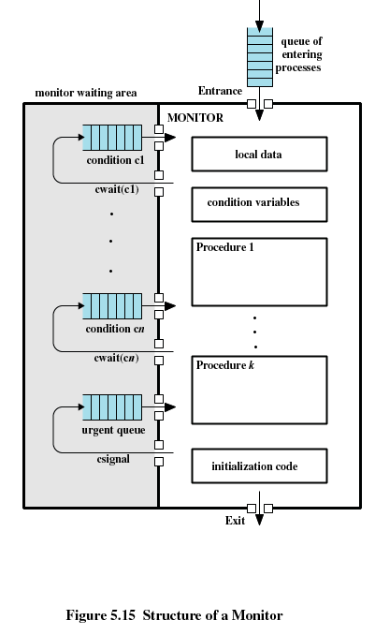

Slide 78
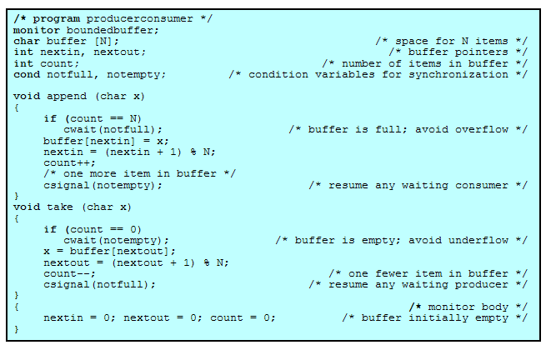

Slide 79
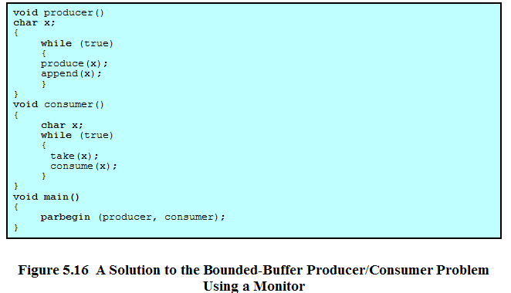

Slide 80
Agenda
5.1 Principles of Concurrency
5.2 Mutual Exclusion: Hardware Support
5.3 Semaphores
5.4 Monitors
5.5 Message Passing
5.6 Readers/Writers Problem
5.7 Summary

Slide 81
Message Passing
Enforce mutual exclusion
Exchange information
send (destination, message)
receive (source, message)

Slide 82
Synchronization
Sender and receiver may or may not be blocking (waiting for message)
Blocking send, blocking receive
  Both sender and receiver are blocked until message is delivered

Slide 83
Synchronization
Nonblocking send, blocking receive
  Sender continues on
  Receiver is blocked until the requested message arrives
Nonblocking send, nonblocking receive
  Neither party is required to wait

Slide 84
Addressing
Direct addressing
  Send primitive includes a specific identifier of the destination process
  Receive primitive could know ahead of time which process a message is expected
  Receive primitive could use source parameter to return a value when the receive operation has been performed

Slide 85
Addressing
Indirect addressing
  Messages are sent to a shared data structure consisting of queues
  Queues are called mailboxes
  One process sends a message to the mailbox and the other process picks up the message from the mailbox

Slide 86
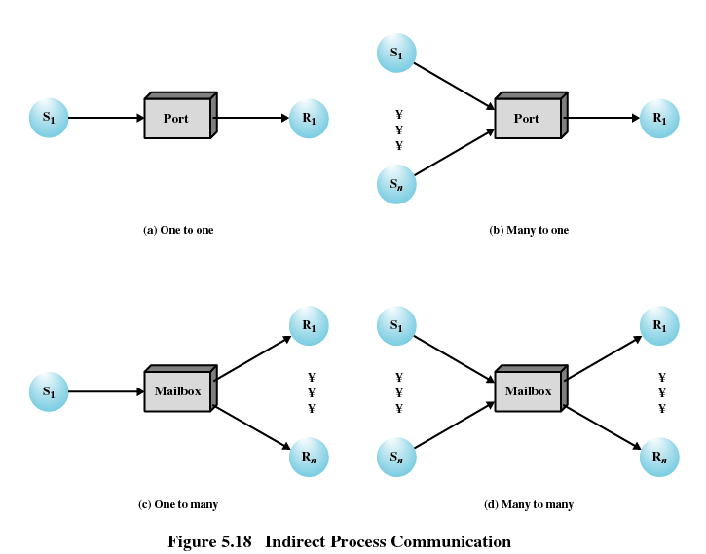

Slide 87
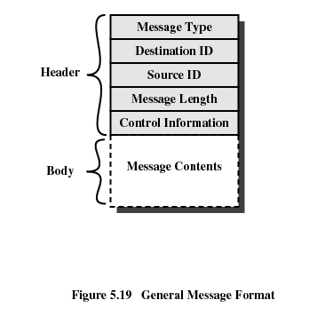
Message Format

Slide 88
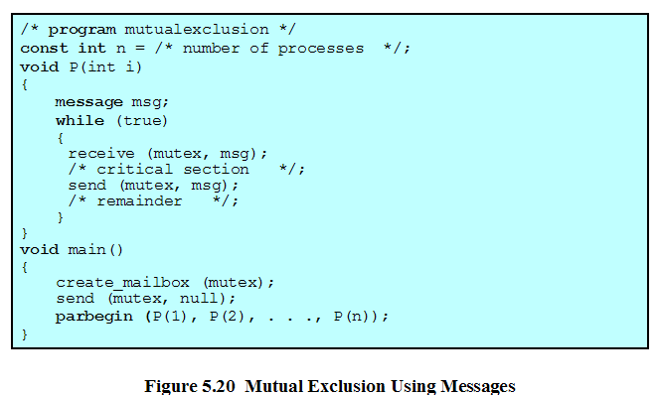

Slide 89
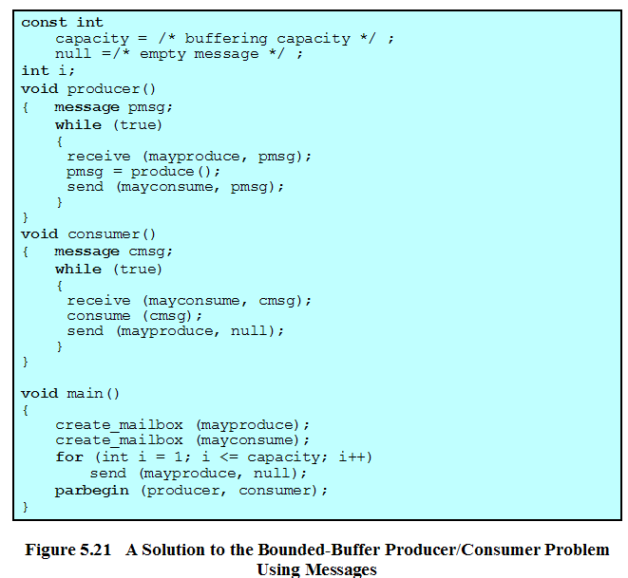

Slide 90
Agenda
5.1 Principles of Concurrency
5.2 Mutual Exclusion: Hardware Support
5.3 Semaphores
5.4 Monitors
5.5 Message Passing
5.6 Readers/Writers Problem
5.7 Summary

Slide 91
Readers/Writers Problem
Any number of readers may simultaneously read the file
Only one writer at a time may write to the file
If a writer is writing to the file, no reader may read it

Slide 92
Agenda
5.1 Principles of Concurrency
5.2 Mutual Exclusion: Hardware Support
5.3 Semaphores
5.4 Monitors
5.5 Message Passing
5.6 Readers/Writers Problem
5.7 Summary

Slide 93
Homework
Review Questions:
  5.1
  5.9
Problems:
  5.2
  5.5

