Slide 1
Concurrency(并发):
Mutual Exclusion(互斥) and
Synchronization(同步)
Chapter 5

Slide 2
Agenda
5.1 Principles of Concurrency
5.2 Mutual Exclusion: Hardware Support
5.3 Semaphores
5.4 Monitors
5.5 Message Passing
5.6 Readers/Writers Problem
5.7 Summary

Slide 3
Concurrency
Multiple applications(多应用程序)
  Multiprogramming
Structured application(结构化应用程序)
  Application can be a set of concurrent processes
Operating-system structure(操作系统结构)
  Operating system is a set of processes or threads

Slide 4
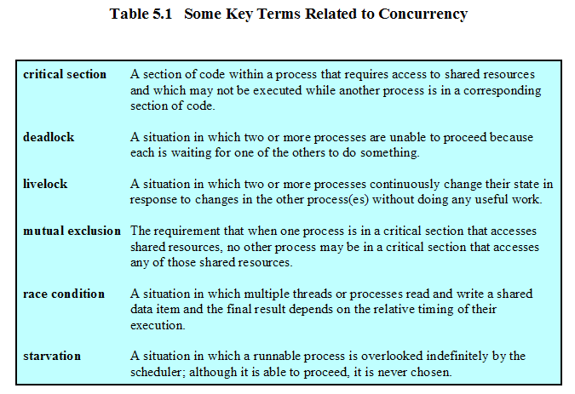
Concurrency

Slide 5
Agenda
5.1 Principles of Concurrency
5.2 Mutual Exclusion: Hardware Support
5.3 Semaphores
5.4 Monitors
5.5 Message Passing
5.6 Readers/Writers Problem
5.7 Summary

Slide 6
5.1 Principles of Concurrency
5.1.1 A Simple Example
5.1.2 Race Condition
5.1.3 Operating System Concerns
5.1.4 Process Interaction
5.1.5 Requirements for Mutual Exclusion

Slide 7
A Simple Example
void echo()
{
chin = getchar();
chout = chin;
putchar(chout);
}

Slide 8
A Simple Example(Uniprocessor)
Process P1 Process P2
. .
chin = getchar(); .
chout = chin; . chin = getchar();
chout = chin;
putchar(chout);
putchar(chout); .
. .

Slide 9
A Simple Example(Multiprocessor)
Process P1 Process P2
. .
chin = getchar(); .
. chin = getchar();
chout = chin; chout = chin;
putchar(chout); .
. putchar(chout);
. .

Slide 10
Difficulties of Concurrency
Sharing of global resources(全局共享)
Operating system managing the allocation of resources optimally(资源分配最优化)
Difficult to locate programming errors(定位程序错误)

Slide 11
Concurrency
Communication among processes(进程间通信)
Sharing resources(共享资源)
Synchronization of multiple processes(多进程同步)
Allocation of processor time(分配处理器时间)

Slide 12
5.1 Principles of Concurrency
5.1.1 A Simple Example
5.1.2 Race Condition
5.1.3 Operating System Concerns
5.1.4 Process Interaction
5.1.5 Requirements for Mutual Exclusion

Slide 13
Race Condition(竞争条件)
A race condition occurs when multiple processes or threads read and write data items so that the final result depends on the order of execution of instructions(指令执行顺序) in the multiple processes.

Slide 14
5.1 Principles of Concurrency
5.1.1 A Simple Example
5.1.2 Race Condition
5.1.3 Operating System Concerns
5.1.4 Process Interaction
5.1.5 Requirements for Mutual Exclusion

Slide 15
Operating System Concerns
Keep track of various processes(through PCB)
Allocate and deallocate resources(分配和回收资源)
  Processor time
  Memory
  Files
  I/O devices
Protect data and resources(保护数据和资源)
Output of process must be independent of the speed of execution of other concurrent processes(与执行速度无关)

Slide 16
5.1 Principles of Concurrency
5.1.1 A Simple Example
5.1.2 Race Condition
5.1.3 Operating System Concerns
5.1.4 Process Interaction
5.1.5 Requirements for Mutual Exclusion

Slide 17
Process Interaction(进程交互)
Processes unaware of each other(互不知道)
Processes indirectly aware of each other(间接知道)
Process directly aware of each other(直接知道)

Slide 18
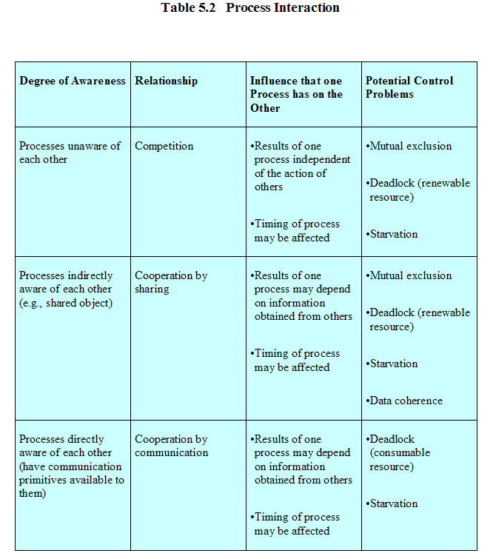

Slide 19
Competition Among Processes for Resources(进程间的资源争用)
Mutual Exclusion(互斥)
  Critical sections
    Only one program at a time is allowed in its critical section
    Example only one process at a time is allowed to send command to the printer
Deadlock(死锁)
Starvation(饥饿)

Slide 20
5.1 Principles of Concurrency
5.1.1 A Simple Example
5.1.2 Race Condition
5.1.3 Operating System Concerns
5.1.4 Process Interaction
5.1.5 Requirements for Mutual Exclusion

Slide 21
Requirements for Mutual Exclusion
Only one process at a time is allowed in the critical section for a resource(一时，一个进程一个临界区资源)
A process that halts in its noncritical section must do so without interfering with other processes(非临界区部分不干涉其他进程)
No deadlock or starvation

Slide 22
Requirements for Mutual Exclusion
A process must not be delayed access to a critical section when there is no other process using it(空闲时立即进入)
No assumptions are made about relative process speeds or number of processes(与进程相对速度和个数无关)
A process remains inside its critical section for a finite time only(临界区时间有限)

Slide 23
Agenda
5.1 Principles of Concurrency
5.2 Mutual Exclusion: Hardware Support
5.3 Semaphores
5.4 Monitors
5.5 Message Passing
5.6 Readers/Writers Problem
5.7 Summary

Slide 24
5.2 Mutual Exclusion: Hardware Support
5.2.1 Interrupt Disabling
5.2.2 Special Machine Instructions

Slide 25
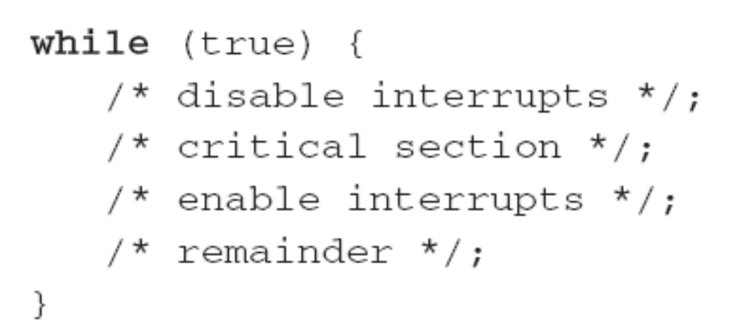
Hardware Support: Interrupt Disabling
A process runs until it invokes an operating system service or until it is interrupted(打断)
Disabling interrupts guarantees mutual exclusion

Slide 26
Hardware Support: Interrupt Disabling
Disadvantage:
  Processor is limited in its ability to interleave programs(交替执行)
  disabling interrupts on one processor will not guarantee mutual exclusion in multi-processors environment.(多处理机环境)

Slide 27
5.2 Mutual Exclusion: Hardware Support
5.2.1 Interrupt Disabling
5.2.2 Special Machine Instructions

Slide 28
Hardware Support: Special Machine Instructions
Performed in a single instruction cycle(单指令周期内完成)
  Access to the memory location is blocked for any other instructions(阻塞其他指令)

Slide 29
Hardware Support: Special Machine Instructions
Test and Set Instruction
boolean testset (int i) {
if (i == 0) {
i = 1;
return true;
}
else {
return false;
}
}

Slide 30
Hardware Support: Special Machine Instructions
Exchange Instruction
void exchange(int register, int memory) {
int temp;
temp = memory;
memory = register;
register = temp;
}

Slide 31
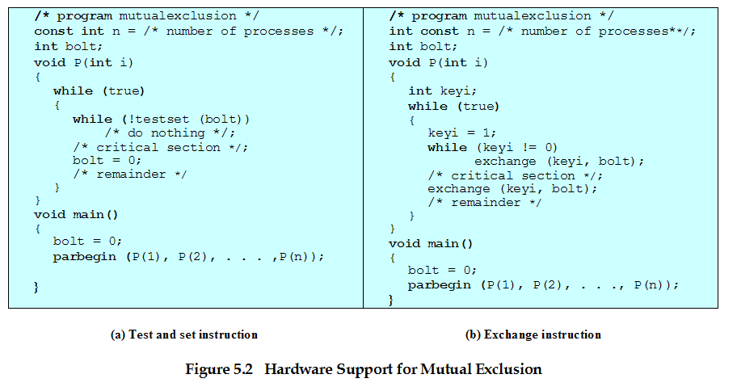
Hardware Support for Mutual Exclusion

Slide 32
Hardware Support: Special Machine Instructions
Advantages
  Applicable to any number of processes on either a single processor or multiple processors sharing main memory(进程数目不限)
  It is simple and therefore easy to verify(简单易证)
  It can be used to support multiple critical sections(支持多临界区)

Slide 33
Hardware Support: Special Machine Instructions
Disadvantages
  Busy-waiting consumes processor time(忙时等待)
  Starvation is possible when a process leaves a critical section and more than one process is waiting. (可能饥饿)
  Deadlock(可能死锁)
    If a low priority process has the critical region and a higher priority process needs, the higher priority process will obtain the processor to wait for the critical region

Slide 34
Agenda
5.1 Principles of Concurrency
5.2 Mutual Exclusion: Hardware Support
5.3 Semaphores
5.4 Monitors
5.5 Message Passing
5.6 Readers/Writers Problem
5.7 Summary

Slide 35
5.3 Semaphores
5.3.1 Overview
5.3.2 Mutual Exclusion
5.3.3 The Producer/Consumer Problem
5.3.4 Implement of Semaphores

Slide 36
Semaphores
Special variable called a semaphore is used for signaling
If a process is waiting for a signal, it is suspended until that signal is sent

Slide 37
Semaphores
Semaphore is a variable that has an integer value
  May be initialized to a nonnegative number
  Wait operation decrements the semaphore value
  Signal operation increments semaphore value

Slide 38
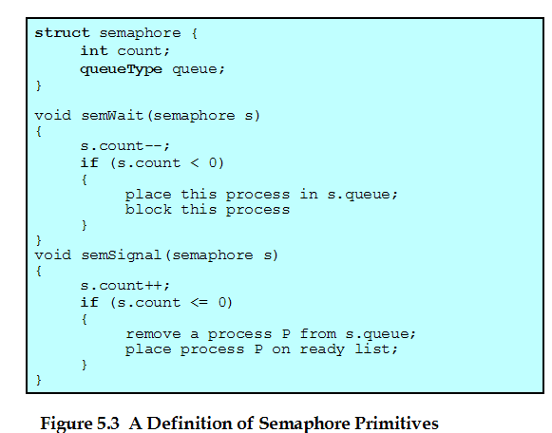
Semaphore Primitives(原语)

Slide 39
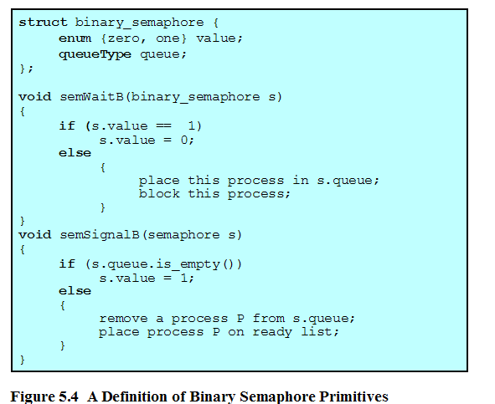
Binary Semaphore Primitives

Slide 40
5.3 Semaphores
5.3.1 Overview
5.3.2 Mutual Exclusion
5.3.3 The Producer/Consumer Problem
5.3.4 Implement of Semaphores

Slide 41
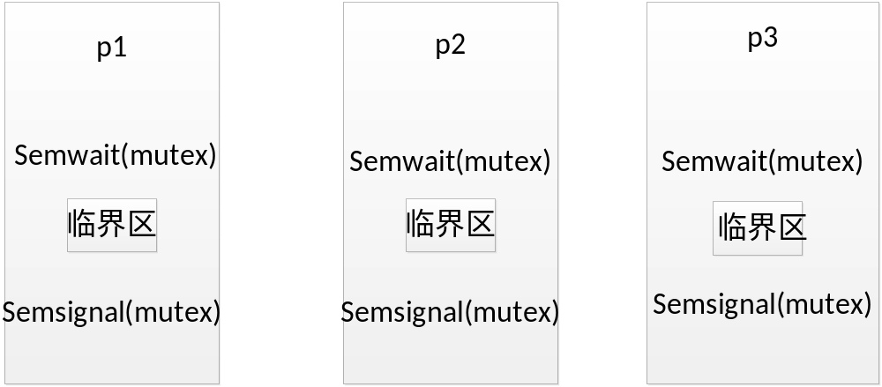
The Use of Semaphore
mutex

Slide 42
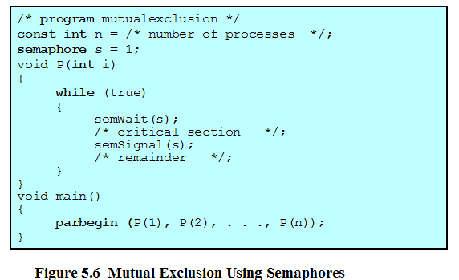
Mutual Exclusion Using Semaphores

Slide 43
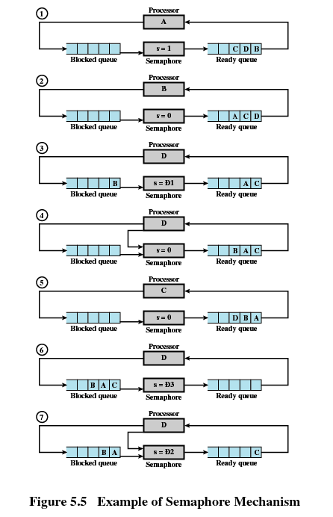

Slide 44
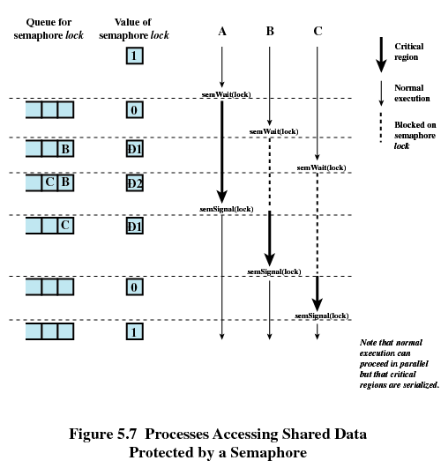
-1
-2
-1

Slide 45
The Use of Semaphore
Synchronization:
For example: process p1 must run before process p2
How can do it by using semaphore?
Semphore mutual=0;
Process p1: Process P2:
While(1) while(1)
{ {
critical area; semwait(mutula);
semsignal(mutual); critical area;
} }

Slide 46
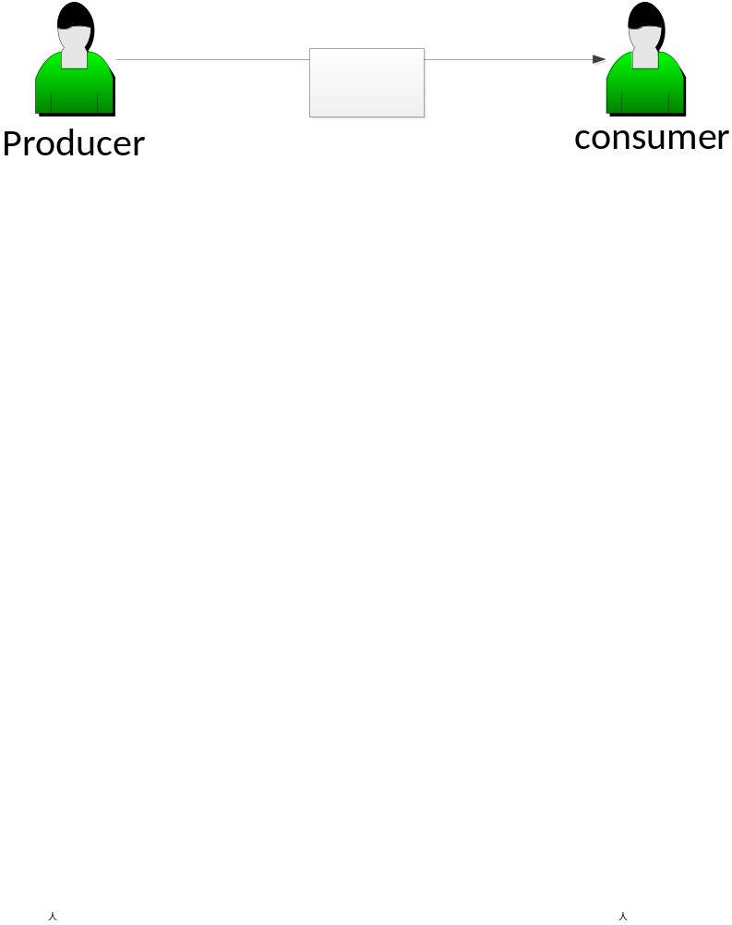
The Simple Problem of Producer-Consumer
One producer and one consumer:
1、if the buffer is empty ,the consumer must wait;
2、if the buffer is full, the producer must wait;
How can I implement this situation by using semaphore?

Slide 47
The Use of Semaphore
Semaphore s1=n,s2=0;
Procduer: consumer:
While(1) while(1)
{ {i
semwait(s1); semaphore(s2)
produce(); take();
append(); semsignal(s1);
semsignal(s2); consumer();
} }
There exists one problem we don’t take it into consideration.

Slide 48
The Conclusions of the Semaphore
一、信号量的物理含义：
1、 信号量的整数是可用资源的数目；
2、当信号量中的整数为0表示没有资源可用；
3、当信号量中的整数小于0，这个负数的绝对值表示在这个
信号量上阻塞的进程数目；
二、 semwait(mutex)和semsignal(mutex)的意义
1、semwait(mutex)表示申请一个资源；
2、semsignal(mutex)表示释放一个资源；
3、semwait(mutex)和semsignal(mutex)必须成对出现，如果在
一个进程内出现，表示互斥，如果不在一个进程内出现，
表示同步；
4、如果在一个进程内既有互斥又有同步操作的semwait操作时，
首先执行同步操作的semwait操作，对于semsignal没有要求；

Slide 49
5.3 Semaphores
5.3.1 Overview
5.3.2 Mutual Exclusion
5.3.3 The Producer/Consumer Problem
5.3.4 Implement of Semaphores

Slide 50
Producer/Consumer Problem
One or more producers are generating data and placing these in a buffer
A single consumer is taking items out of the buffer one at time
Only one producer or consumer may access the buffer at any one time

Slide 51
Producer
producer:
while (true) {
/* produce item v */
b[in] = v;
in++;
}

Slide 52
Consumer
consumer:
while (true) {
while (in <= out)
/*do nothing */;
w = b[out];
out++;
/* consume item w */
}

Slide 53
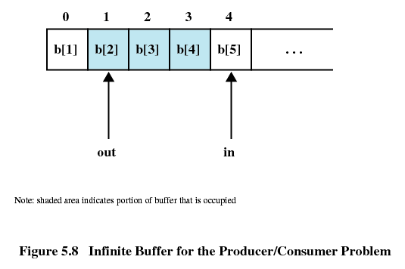
Producer/Consumer Problem

Slide 54
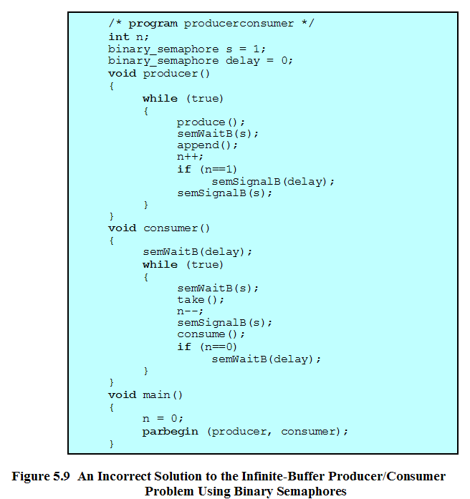

Slide 55
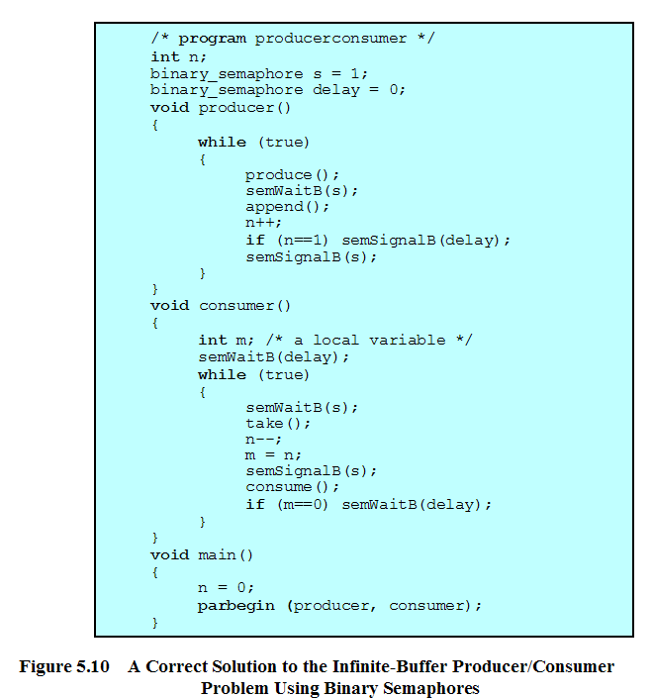

Slide 56
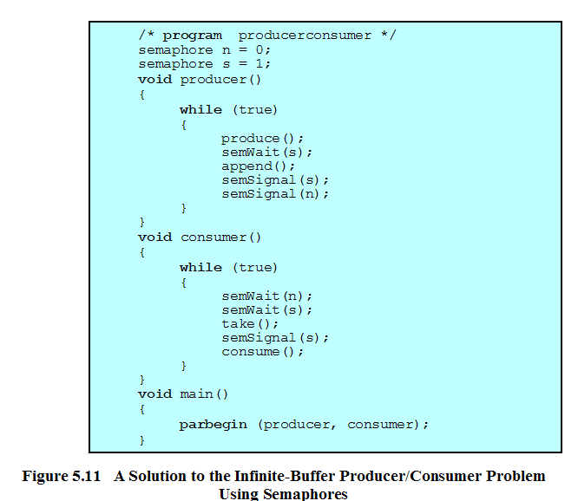

Slide 57
Producer with Circular Buffer
producer:
while (true) {
/* produce item v */
while ((in + 1) % n == out) /* do nothing */;
b[in] = v;
in = (in + 1) % n
}

Slide 58
Consumer with Circular Buffer
consumer:
while (true) {
while (in == out)
/* do nothing */;
w = b[out];
out = (out + 1) % n;
/* consume item w */
}

Slide 59
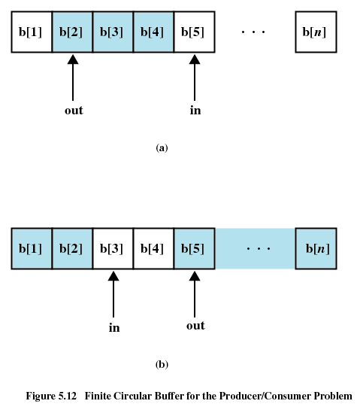

Slide 60
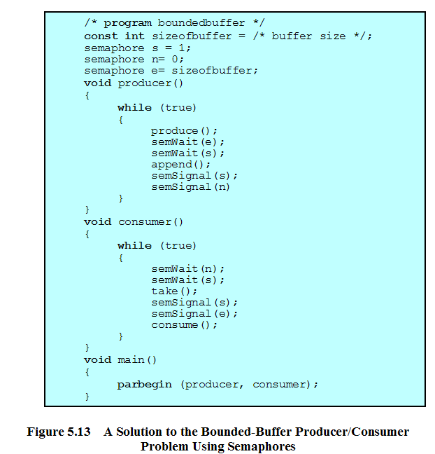
控制进入临界区
控制消费者
控制生产者

Slide 61
5.3 Semaphores
5.3.1 Overview
5.3.2 Mutual Exclusion
5.3.3 The Producer/Consumer Problem
5.3.4 Implement of Semaphores

Slide 62
5.3.4 Implement of Semaphores
Implement in hardware or firmware
Implement in software
Implement by inhibit interrupts for a single-processor system

Slide 63
Agenda
5.1 Principles of Concurrency
5.2 Mutual Exclusion: Hardware Support
5.3 Semaphores
5.4 Monitors
5.5 Message Passing
5.6 Readers/Writers Problem
5.7 Summary

Slide 64
Monitors
Monitor is a software module
Chief characteristics
  Local data variables are accessible only by the monitor
  Process enters monitor by invoking one of its procedures
  Only one process may be executing in the monitor at a time

Slide 65
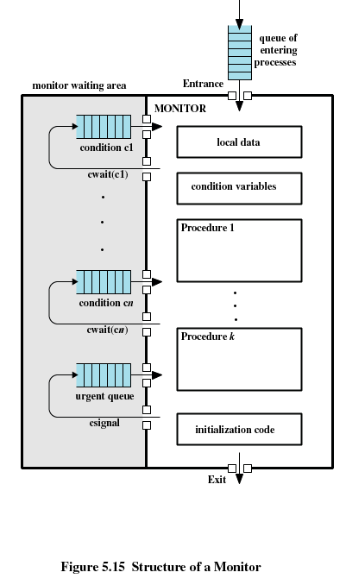

Slide 66
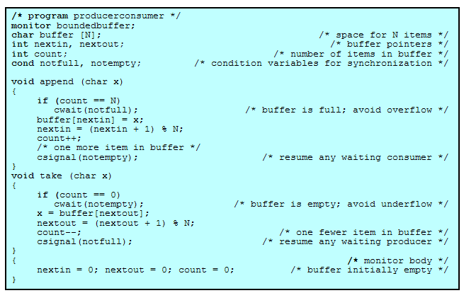

Slide 67
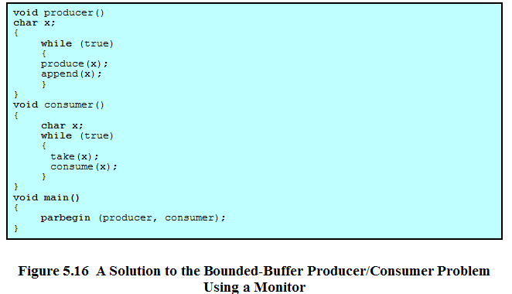

Slide 68
Agenda
5.1 Principles of Concurrency
5.2 Mutual Exclusion: Hardware Support
5.3 Semaphores
5.4 Monitors
5.5 Message Passing
5.6 Readers/Writers Problem
5.7 Summary

Slide 69
Message Passing
Enforce mutual exclusion
Exchange information
send (destination, message)
receive (source, message)

Slide 70
Synchronization
Sender and receiver may or may not be blocking (waiting for message)
Blocking send, blocking receive
  Both sender and receiver are blocked until message is delivered

Slide 71
Synchronization
Nonblocking send, blocking receive
  Sender continues on
  Receiver is blocked until the requested message arrives
Nonblocking send, nonblocking receive
  Neither party is required to wait

Slide 72
Addressing
Direct addressing
  Send primitive includes a specific identifier of the destination process
  Receive primitive could know ahead of time which process a message is expected
  Receive primitive could use source parameter to return a value when the receive operation has been performed

Slide 73
Addressing
Indirect addressing
  Messages are sent to a shared data structure consisting of queues
  Queues are called mailboxes
  One process sends a message to the mailbox and the other process picks up the message from the mailbox

Slide 74
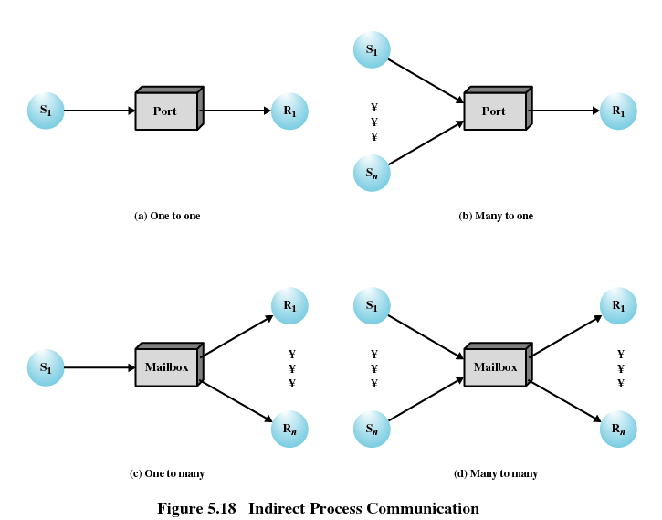

Slide 75
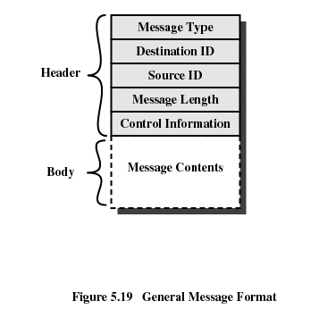
Message Format

Slide 76
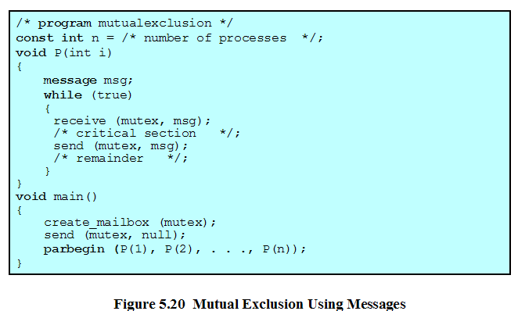

Slide 77
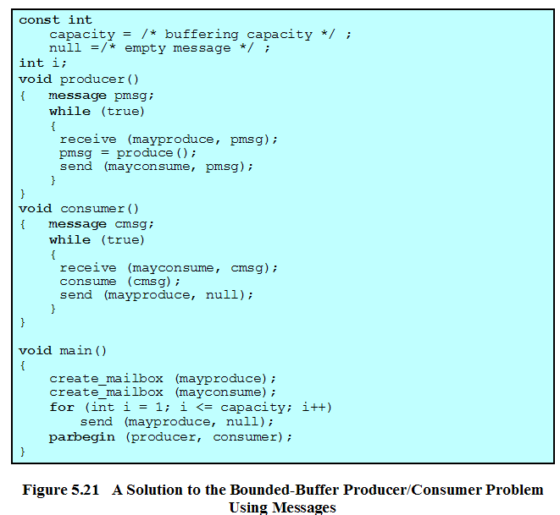

Slide 78
Agenda
5.1 Principles of Concurrency
5.2 Mutual Exclusion: Hardware Support
5.3 Semaphores
5.4 Monitors
5.5 Message Passing
5.6 Readers/Writers Problem
5.7 Summary

Slide 79
Readers/Writers Problem
Any number of readers may simultaneously read the file
Only one writer at a time may write to the file
If a writer is writing to the file, no reader may read it

Slide 80
Agenda
5.1 Principles of Concurrency
5.2 Mutual Exclusion: Hardware Support
5.3 Semaphores
5.4 Monitors
5.5 Message Passing
5.6 Readers/Writers Problem
5.7 Summary

Slide 81
Homework
Review Questions:
  5.1
  5.9
Problems:
  5.2
  5.5

