Slide 1
Virtual Memory(虚拟内存)
Chapter 8

Slide 2
Agenda
8.1 Hardware and Control Structure
8.2 Operating System Software
8.3 Summary

Slide 3
8.1 Hardware and Control Structure
8.1.0 Overview
8.1.1 Locality and Virtual Memory
8.1.2 Paging
8.1.3 Segmentation
8.1.4 Combined Paging and Segmentation
8.1.5 Protection and Sharing

Slide 4
Hardware and Control Structures
Memory references are dynamically translated into physical addresses at run time(运行时访问地址动态转换)
  A process may be swapped in and out (换入和换出) of main memory such that it occupies different regions
A process may be broken up into pieces that do not need to located contiguously in main memory(进程分块)
All pieces of a process do not need to be loaded in main memory during execution(部分载入)

Slide 5
Execution of a Program(程序运行)
Operating system brings into main memory a few pieces of the program(载入部分程序)
Resident set(常驻集) - portion of process that is in main memory
When an address is needed that is not in main memory(所需地址不在内存):
  1. An interrupt is generated, which is known as page fault interrupt(缺页中断)
  2. Operating system places the process in a blocking state(阻塞)

Slide 6
Execution of a Program
  3. Piece of process that contains the logical address is brought into main memory(进程片段载入主存)
    Operating system issues a disk I/O Read request(发出磁盘读请求)
    Another process is dispatched to run while the disk I/O takes place(调度另外一个进程)
    An interrupt is issued when disk I/O complete which causes the operating system to place the affected process in the Ready state(从磁盘中载入后，重置为就绪态)

Slide 7
Advantages of Breaking up a Process(进程分块的优点)
More processes may be maintained in main memory(主存中保留更多进程)
  Only load in some of the pieces of each process(只载入每个进程的部分)
  With so many processes in main memory, it is very likely a process will be in the Ready state at any particular time(某时刻存在就绪进程可能性大)
A process may be larger than all of main memory (支持大于主存的进程)

Slide 8
Types of Memory(存储器类型)
Real memory(实存)
  Main memory
Virtual memory(虚存)
  Memory on disk
  Allows for effective multiprogramming(有效多道程序设计)
  Relieves the user of tight constraints of main memory(解除用户和主存之间的紧密联系)

Slide 9
Thrashing(系统抖动/系统颠簸)
Swapping out a piece of a process just before that piece is needed(马上需要的进程块被换出)
The processor spends most of its time swapping pieces rather than executing user instructions(处理机交换块所需时间大于执行用户指令)

Slide 10
8.1 Hardware and Control Structure
8.1.0 Overview
8.1.1 Locality and Virtual Memory
8.1.2 Paging
8.1.3 Segmentation
8.1.4 Combined Paging and Segmentation
8.1.5 Protection and Sharing

Slide 11
Principle of Locality(局部性原理)
Program and data references within a process tend to cluster(程序和数据访问的集簇倾向)
Only a few pieces of a process will be needed over a short period of time(在一个短时间片内，只需要一部分进程片段)
Possible to make intelligent guesses about which pieces will be needed in the future(可猜测最近需要哪个片段)
This suggests that virtual memory may work efficiently(虚拟内存可有效工作)

Slide 12
Support Needed for Virtual Memory
Hardware must support paging(分页) and segmentation(分段)
Operating system must be able to management the movement of pages and/or segments between secondary memory and main memory(管理主存和辅存之间的移动)

Slide 13
8.1 Hardware and Control Structure
8.1.0 Overview
8.1.1 Locality and Virtual Memory
8.1.2 Paging
8.1.3 Segmentation
8.1.4 Combined Paging and Segmentation
8.1.5 Protection and Sharing

Slide 14
Paging(分页)
Each process has its own page table(页表)
Each page table entry(页表项) contains the frame number of the corresponding page in main memory(帧和页对应)
A bit is needed to indicate whether the page is in main memory or not(P位，存在位)
A bit may be needed to indicate whether the page has been modified or not since it was loaded in main memory (M位，修改位)

Slide 15
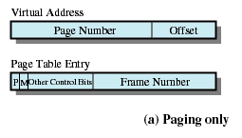
Page Table Structure

Slide 16
Modify Bit in Page Table
Modify bit is needed to indicate if the page has been altered since it was last loaded into main memory(M位，修改位)
If no change has been made, the page does not have to be written to the disk when it needs to be swapped out(换出)

Slide 17
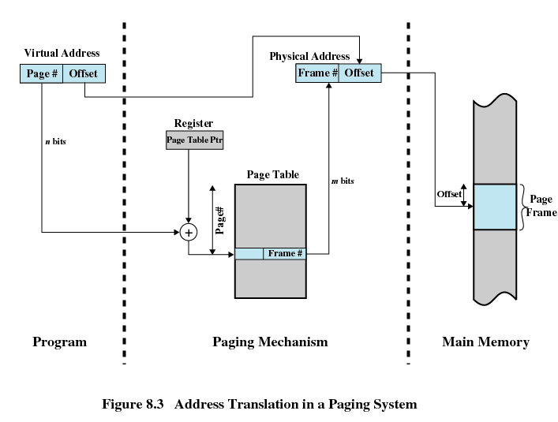
Address Translation in a Paging System(地址转换系统)

Slide 18
Page Tables(页表)
The entire page table size is proportional to that of the virtual address space, and may take up too much main memory(页表太大,占用太多主存)
Page tables are also stored in virtual memory(页表存储于虚拟内存)
When a process is running, part of its page table is in main memory(部分页表在主存中)

Slide 19
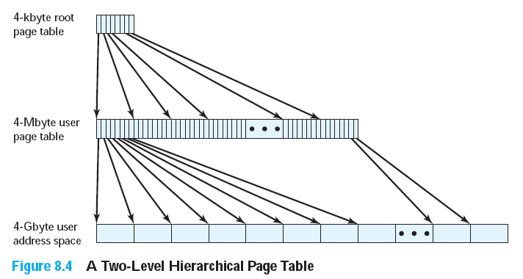
Two-Level Scheme for 32-bit Address(32位地址的两级页表方案)

Slide 20
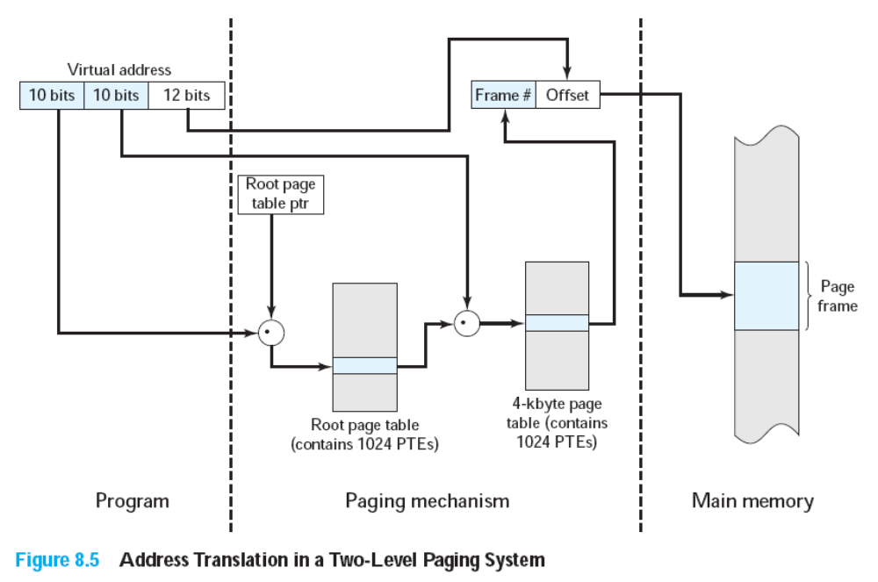

Two-Level Scheme for 32-bit Address(32位地址的两级页表方案)

Slide 21
Inverted Page Table(反向页表)
Used on PowerPC, UltraSPARC, and IA-64 architecture
Page number portion of a virtual address is mapped into a hash value (页号映射为hash值)
Hash value points to inverted page table(hash值指向反向页表)
Fixed proportion of real memory is required for the tables regardless of the number of processes or virtual pages supported (页表大小只和实存相关)

Slide 22
Inverted Page Table
Page number(页号)
Process identifier(进程标志符)
Control bits(控制位)
Chain pointer(链指针)

Slide 23
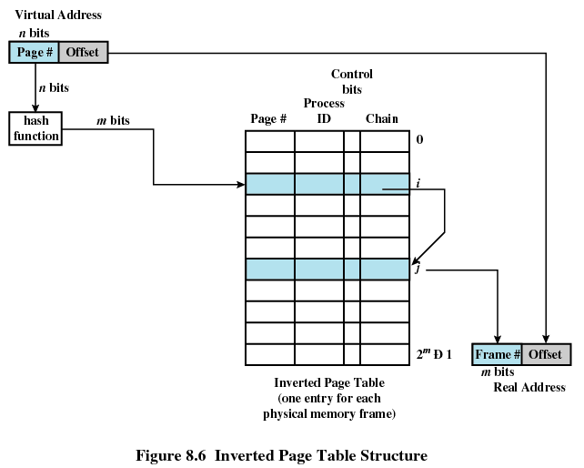
Inverted Page Table Structure

Slide 24
Translation Lookaside Buffer(转移后备缓冲器/旁视缓冲器)
Each virtual memory reference can cause two physical memory accesses
  One to fetch the page table(访问页表)
  One to fetch the data(访问数据)
To overcome this problem a high-speed cache is set up for page table entries(高速缓存)
  Called a Translation Lookaside Buffer (转换后备缓冲器TLB)
  Contains page table entries that have been most recently used(包含最近用过的页表项)

Slide 25
Work Flow of Translation Lookaside Buffer
Given a virtual address, processor examines the TLB(检查TLB表)
If page table entry is present (TLB hit命中), the frame number is retrieved and the real address is formed(得到帧号和实地址)
If page table entry is not found in the TLB (TLB miss未命中), the page number is used to index the process page table(检索进程页表)

Slide 26
Work Flow of Translation Lookaside Buffer
First checks if page is already in main memory (是否存在于主存)
  If not in main memory a page fault is issued(产生页错误)
The TLB is updated to include the new page entry(更新TLB)

Slide 27
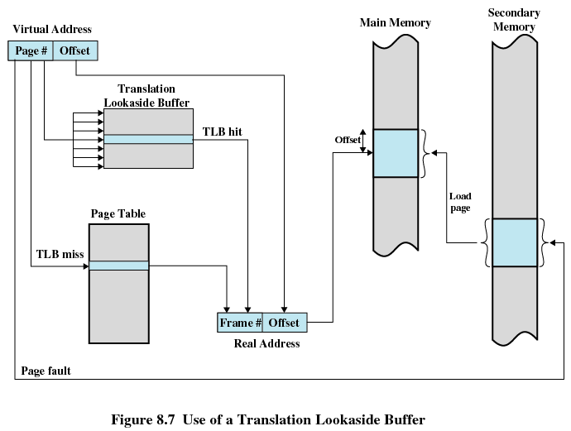
Use of a Translation Lookaside Buffer

Slide 28
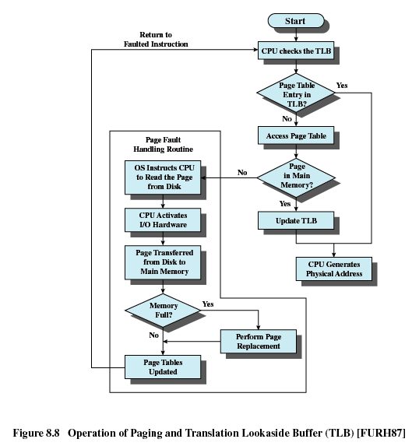

Slide 29
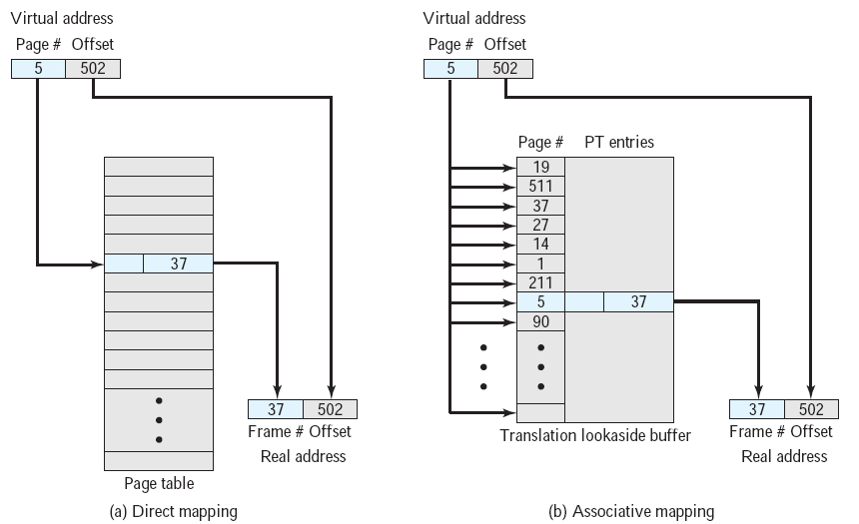
直接映射
关联映射

Slide 30
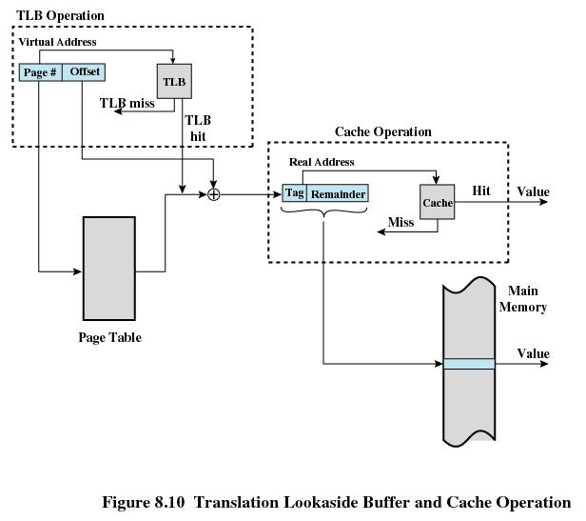

Slide 31
Page Size(页尺寸/页大小)
Smaller page size, less amount of internal fragmentation(更小内部碎片)
Smaller page size, more pages required per process(更多页请求)
More pages per process means larger page tables (更大的页表)
Larger page tables means large portion of page tables in virtual memory(更多的页表项存在于虚存中)
Secondary memory is designed to efficiently transfer large blocks of data so a large page size is better(虚存针对较大页大小优化)

Slide 32
Page Size
Small page size, large number of pages will be found in main memory(大量的页存在于主存)
As time goes on during execution, the pages in memory will all contain portions of the process near recent references. Page faults low.(执行页面大多在主存中，页错误低)
Increased page size causes pages to contain locations further from any recent reference. Page faults rise.(增加页面大小导致局部性下降)
However the page fault rate will begin to fall as the size of page approaches a point.(页错误在页大小某点下降

Slide 33
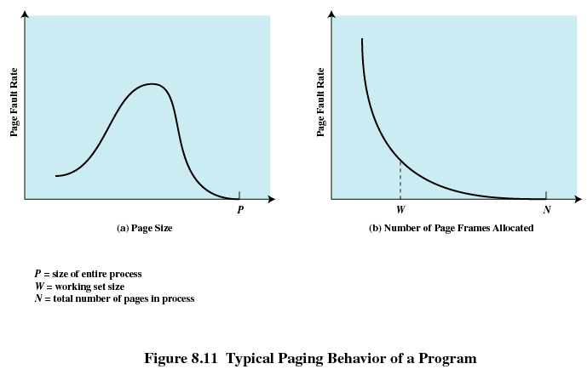

Slide 34
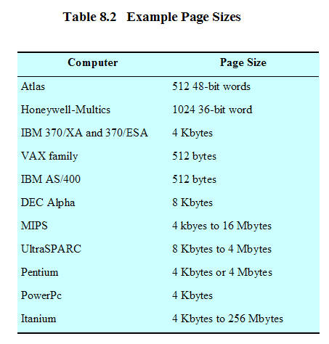
Example Page Sizes

Slide 35
8.1 Hardware and Control Structure
8.1.0 Overview
8.1.1 Locality and Virtual Memory
8.1.2 Paging
8.1.3 Segmentation
8.1.4 Combined Paging and Segmentation
8.1.5 Protection and Sharing

Slide 36
Segmentation(分段)
May be unequal, dynamic size
Simplifies handling of growing data structures
Allows programs to be altered and recompiled independently
Lends itself to sharing data among processes
Lends itself to protection

Slide 37
Segment Tables(段表)
Corresponding segment in main memory(内存段)
Each entry contains the length of the segment(段长)
A bit is needed to determine if segment is already in main memory(存在位)
Another bit is needed to determine if the segment has been modified since it was loaded in main memory(修改位)

Slide 38
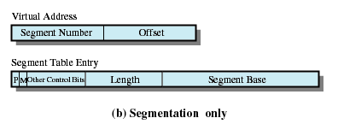
Segment Table Entries
段长
段基址

Slide 39
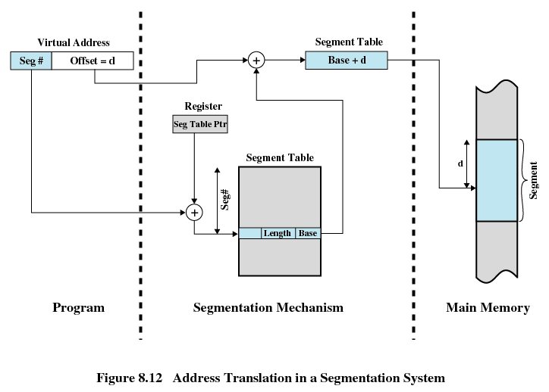

Slide 40
8.1 Hardware and Control Structure
8.1.0 Overview
8.1.1 Locality and Virtual Memory
8.1.2 Paging
8.1.3 Segmentation
8.1.4 Combined Paging and Segmentation
8.1.5 Protection and Sharing

Slide 41
Combined Paging and Segmentation
Paging is transparent to the programmer
Segmentation is visible to the programmer
Each segment is broken into fixed-size pages
Each Process has a segment table and several page tables
Each segment has a page table

Slide 42
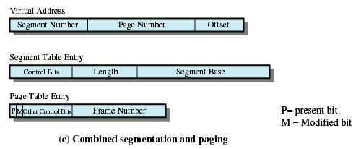
Combined Segmentation and Paging

Slide 43
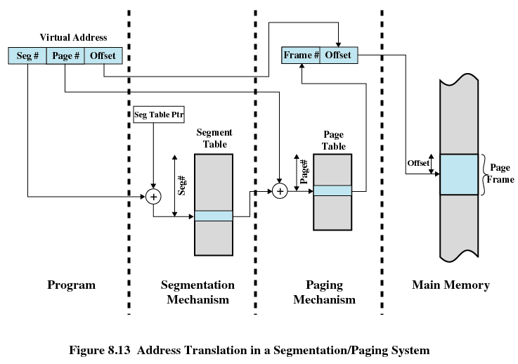

Slide 44
8.1 Hardware and Control Structure
8.1.0 Overview
8.1.1 Locality and Virtual Memory
8.1.2 Paging
8.1.3 Segmentation
8.1.4 Combined Paging and Segmentation
8.1.5 Protection and Sharing

Slide 45
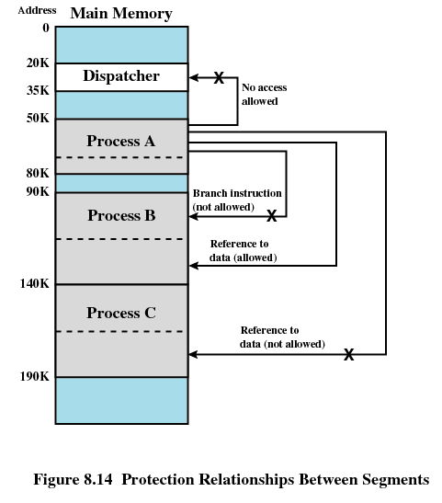

Slide 46
Agenda
8.1 Hardware and Control Structure
8.2 Operating System Software
8.3 Summary

Slide 47
8.2 Operating System Software
8.2.1 Fetch Policy
8.2.2 Placement Policy
8.2.3 Replacement Policy
8.2.4 Resident Set Management
8.2.5 Clearing Policy
8.2.6 Load Control

Slide 48
Fetch Policy(读取策略)
Fetch Policy
  Determines when a page should be brought into memory
  Demand paging(请求分页式) only brings pages into main memory when a reference is made to a location on the page
    Many page faults when process first started
  Prepaging(预约分页式) brings in more pages than needed
    More efficient to bring in pages that reside contiguously on the disk

Slide 49
8.2 Operating System Software
8.2.1 Fetch Policy
8.2.2 Placement Policy
8.2.3 Replacement Policy
8.2.4 Resident Set Management
8.2.5 Clearing Policy
8.2.6 Load Control

Slide 50
Placement Policy(放置策略)
Determines where in real memory a process piece is to reside
Important in a segmentation system and nonuniform memory access(NUMA) system
Paging or combined paging with segmentation hardware performs address translation and placement is usually irrelevant

Slide 51
8.2 Operating System Software
8.2.1 Fetch Policy
8.2.2 Placement Policy
8.2.3 Replacement Policy
8.2.4 Resident Set Management
8.2.5 Clearing Policy
8.2.6 Load Control

Slide 52
Replacement Policy(置换策略)
Placement Policy
  Which page is replaced?
  Page removed should be the page least likely to be referenced in the near future
  Most policies predict the future behavior on the basis of past behavior

Slide 53
Frame Locking(帧锁定)
Frame Locking
  If frame is locked, it may not be replaced, some examples:
    Kernel of the operating system
    Control structures
    I/O buffers
  Associate a lock bit with each frame

Slide 54
Basic Replacement Algorithms
Optimal policy( OPT, 最佳 )
  Selects for replacement that page for which the time to the next reference is the longest
  Impossible to have perfect knowledge of future events

Slide 55
Basic Replacement Algorithms
Least Recently Used (LRU, 最近最少使用)
  Replaces the page that has not been referenced for the longest time
  By the principle of locality, this should be the page least likely to be referenced in the near future
  Each page could be tagged with the time of last reference. This would require a great deal of overhead.

Slide 56
Basic Replacement Algorithms
First-in, first-out (FIFO, 先进先出)
  Treats page frames allocated to a process as a circular buffer
  Pages are removed in round-robin(循环) style
  Simplest replacement policy to implement
  Page that has been in memory the longest is replaced
  These pages may be needed again very soon

Slide 57
Basic Replacement Algorithms
Clock Policy(时钟策略)
  Additional bit called a use bit(使用位)
  When a page is first loaded in memory, the use bit is set to 1
  When the page is referenced, the use bit is set to 1
  When it is time to replace a page, the first frame encountered with the use bit set to 0 is replaced
  During the search for replacement, each use bit set to 1 is changed to 0

Slide 58
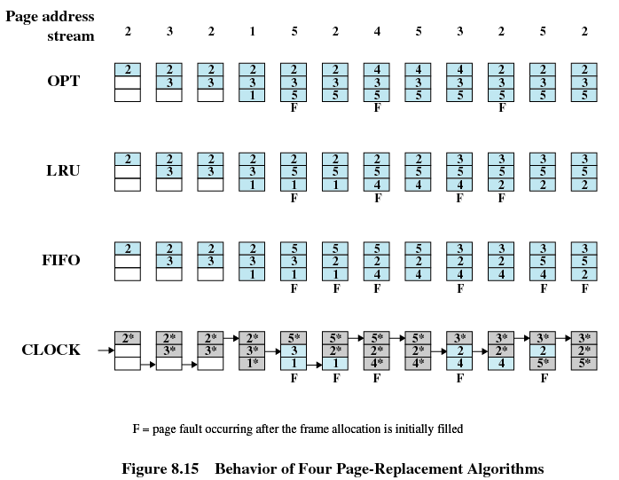

Slide 59
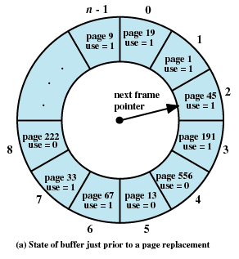
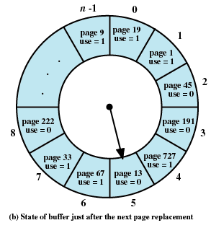

Slide 60
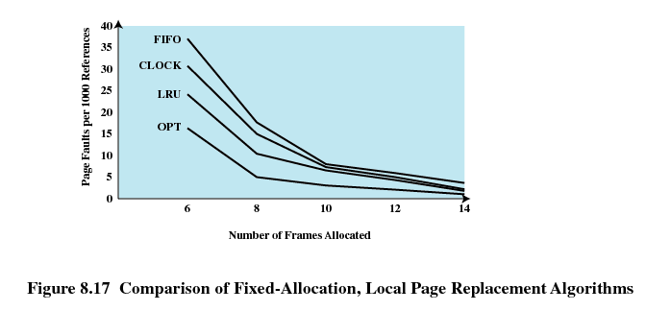
Comparison of Placement Algorithms

Slide 61
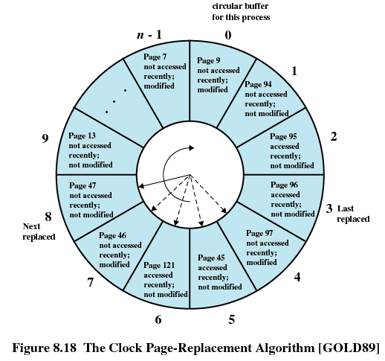
Not accessed recently, not modified (u=0;m=0)
Accessed recently, not modified (u=1;m=0)
Not accessed recently, modified (u=0;m=1)
Accessed recently, modified (u=1;m=1)

Slide 62
Basic Replacement Algorithms
Page Buffering(页缓冲)
  Replaced page is added to one of two lists
    Free page list(空闲页表) if page has not been modified
    Modified page list(修改页表)

Slide 63
8.2 Operating System Software
8.2.1 Fetch Policy
8.2.2 Placement Policy
8.2.3 Replacement Policy
8.2.4 Resident Set Management
8.2.5 Clearing Policy
8.2.6 Load Control

Slide 64
Resident Set Size(驻留集大小)
Fixed-allocation(固定分配)
  Gives a process a fixed number of pages within which to execute
  When a page fault occurs, one of the pages of that process must be replaced
Variable-allocation(可变分配)
  Number of pages allocated to a process varies over the lifetime of the process

Slide 65
Resident Set Size
Local Replace Policy(局部置换)
  Chooses only among the resident pages of the process that generated the page fault in selecting a page to replace
Global Replace Policy(全局置换)
  Considers all unlocked pages in main memory as candidates for replacement, regardless of which process owns a particular page

Slide 66
Fixed Allocation, Local Scope(固定分配，局部置换)
Decide ahead of time the amount of allocation to give a process
If allocation is too small, there will be a high page fault rate
If allocation is too large there will be too few programs in main memory

Slide 67
Variable Allocation, Global Scope(可变分配，全局置换)
Easiest to implement
Adopted by many operating systems
Operating system keeps list of free frames
Free frame is added to resident set of process when a page fault occurs
If no free frame, replaces one from any of the resident processes

Slide 68
Variable Allocation, Local Scope(可变分配，局部置换)
When new process added, allocate number of page frames based on application type, program request, or other criteria
When page fault occurs, select page from among the resident set of the process that suffers the fault
Reevaluate allocation of processes from time to time and increase or decrease allocation to improve overall performance

Slide 69
8.2 Operating System Software
8.2.1 Fetch Policy
8.2.2 Placement Policy
8.2.3 Replacement Policy
8.2.4 Resident Set Management
8.2.5 Clearing Policy
8.2.6 Load Control

Slide 70
Cleaning Policy(清除策略)
Demand cleaning(请求式清除)
  A page is written out only when it has been selected for replacement
Precleaning(预约式清除)
  Pages are written out in batches before they are needed

Slide 71
Cleaning Policy
Best approach uses page buffering
  Replaced pages are placed in two lists
    Modified and unmodified
  Pages in the modified list are periodically written out in batches
  Pages in the unmodified list are either reclaimed if referenced again or lost when its frame is assigned to another page

Slide 72
8.2 Operating System Software
8.2.1 Fetch Policy
8.2.2 Placement Policy
8.2.3 Replacement Policy
8.2.4 Resident Set Management
8.2.5 Clearing Policy
8.2.6 Load Control

Slide 73
Load Control(加载控制)
Determines the number of processes that will be resident in main memory
Too few processes, many occasions when all processes will be blocked and much time will be spent in swapping
Too many processes will lead to thrashing

Slide 74
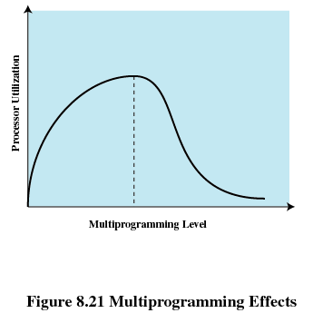
Multiprogramming Level(多道程序设计级)

Slide 75
Process Suspension(进程挂起)
Lowest priority process(最低优先级进程)
Faulting process(页错误进程)
  This process does not have its working set in main memory so it will be blocked anyway
Last process activated(最后被激活的进程)
  This process is least likely to have its working set resident

Slide 76
Process Suspension
Process with smallest resident set(驻留集最小的进程)
  This process requires the least future effort to reload
Largest process(占用空间最大的进程)
  Obtains the most free frames
Process with the largest remaining execution window(具有最大剩余执行窗口的进程)

Slide 77
Agenda
8.1 Hardware and Control Structure
8.2 Operating System Software
8.3 Summary

Slide 78
Homework
Review Questions:
  8.1
  8.2
Problems:
  8.1
  8.4

