Slide 1
Uniprocessor Scheduling
Chapter 9

Slide 2
Agenda
9.1 Type of Processor Scheduling
9.2 Scheduling Algorithms
9.3 Summary

Slide 3
9.1 Type of Processor Scheduling
9.1.0 Overview
9.1.1 Long-term Scheduling
9.1.2 Medium-term Scheduling
9.1.3 Short-term Scheduling

Slide 4
Aim of Scheduling(调度目标)
Assign processes to be executed by the processor(s)(处理器分配)
Response time (响应时间)
Throughput (吞吐率)
Processor efficiency (处理器效率)

Slide 5
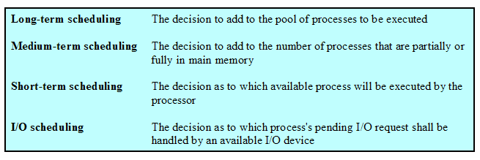
Types of Scheduling
长程调度
中程调度
短程调度
I/O调度

Slide 6
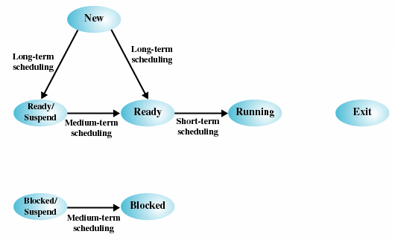
Scheduling and Process State Transitions(调度与进程状态转换)

Slide 7
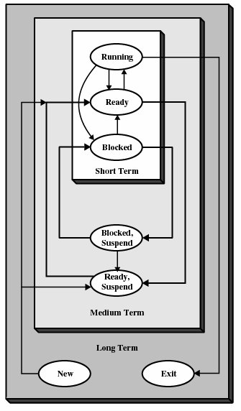
Levels of Scheduling(调度层次)

Slide 8
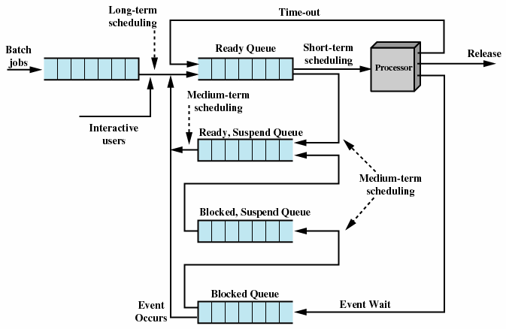
Queuing Diagram for Scheduling调度队列图

Slide 9
9.1 Type of Processor Scheduling
9.1.0 Overview
9.1.1 Long-term Scheduling
9.1.2 Medium-term Scheduling
9.1.3 Short-term Scheduling

Slide 10
Long-Term Scheduling (长程调度)
Determines which programs are admitted to the system for processing(决定哪个程序被处理)
Controls the degree of multiprogramming(控制并发度)

Slide 11
Long-Term Scheduling (长程调度)
When to create a new process is generally driven by the desire degree of multiprogramming(创建线程时机受到程序并发度的制约)
  More processes, smaller percentage of time each process is executed(进程越多，每个进程执行比例越少)
  Each time a job terminates, the scheduler may decide to add one or more new jobs(任务结束，可加新任务)
  If idle time of processor exceeds a certain threshold, the long-term scheduler may be invoked(处理机空闲时间超过某个阈值，启动长程调度)

Slide 12
Long-Term Scheduling (长程调度)
Which job to admit next(下一步执行哪个任务)
  First-come-first-service(先来先服务)
  A tool to manage system performance(系统性能管理工具)
    Include priorty(优先级), expected execution time(期望执行时间) and I/O requirements(I/O请求)
  Time-sharing system will accept all authorized comers until the system is saturated(分时系统接收所有授权用户，直到系统饱和)

Slide 13
9.1 Type of Processor Scheduling
9.1.0 Overview
9.1.1 Long-term Scheduling
9.1.2 Medium-term Scheduling
9.1.3 Short-term Scheduling

Slide 14
Medium-Term Scheduling (中程调度)
Part of the swapping function(交换功能的一部分)
Based on the need to manage the degree of multiprogramming(基于管理并发程度的需求)

Slide 15
9.1 Type of Processor Scheduling
9.1.0 Overview
9.1.1 Long-term Scheduling
9.1.2 Medium-term Scheduling
9.1.3 Short-term Scheduling

Slide 16
Short-Term Scheduling (短程调度)
Known as the dispatcher(分派器)
Executes most frequently(执行最频繁)
Invoked when an event occurs
  Clock interrupts(时钟中断)
  I/O interrupts(I/O中断)
  Operating system calls(操作系统调用)
  Signals(信号)

Slide 17
Agenda
9.1 Type of Processor Scheduling
9.2 Scheduling Algorithms
9.3 Summary

Slide 18
9.2 Scheduling Algorithms
9.2.1 Short-term Criteria
9.2.2 The Use of Priorities
9.2.3 Alternative of Scheduling Policies
9.2.4 Fair-Share Scheduling

Slide 19
Short-Tem Scheduling Criteria(短程调度准则)
User-oriented(面向用户)
  Response Time(响应时间)
    Elapsed time between the submission of a request until there is output.(提交请求到输出之间的时间间隔)
System-oriented(面向系统)
  Effective and efficient utilization of the processor(处理器的使用效率)
  Throughput is a worthwhile measure of system performance and may like to be maximized(吞吐量是性能量度，试图最大化)

Slide 20
Short-Term Scheduling Criteria
Performance-related(性能相关)
  Quantitative 定量的
    Measurable such as
      response time(响应时间)
      throughput(吞吐率)
  Qualitative 定性的
    Unmeasurable such as predictability(可预测性)
  The design of a scheduling policy involves compromising among competing requirements(设计调度策略需要在各种竞争条件之间折衷)

Slide 21
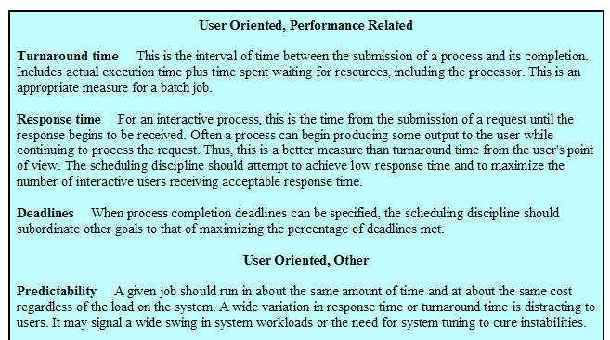
Scheduling Criteria
周转时间
响应时间
最后时间
可预测性

Slide 22
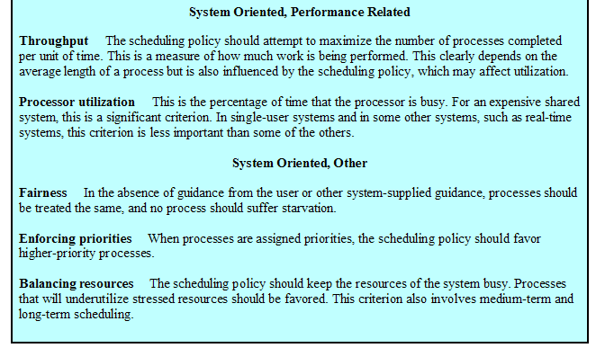
Scheduling Criteria (Cont.)
吞吐量
处理器使用率
公平性
强制优先级
平衡资源

Slide 23
9.2 Scheduling Algorithms
9.2.1 Short-term Criteria
9.2.2 The Use of Priorities
9.2.3 Alternative of Scheduling Policies
9.2.4 Fair-Share Scheduling

Slide 24
Priorities(优先级)
Scheduler will always choose a process of higher priority over one of lower priority(选择高优先级进程运行)
Have multiple ready queues to represent each level of priority(每个优先级一个队列)
Lower-priority may suffer starvation(可能饥饿)
  Allow a process to change its priority based on its age or execution history(基于时间或执行历史改变优先级)

Slide 25
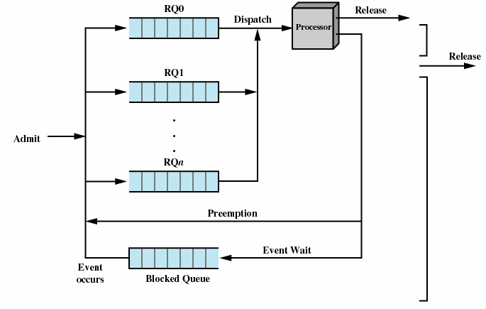
Priorities Queuing

Slide 26
9.2 Scheduling Algorithms
9.2.1 Short-term Criteria
9.2.2 The Use of Priorities
9.2.3 Alternative of Scheduling Policies
9.2.4 Fair-Share Scheduling

Slide 27
Decision Mode (决策模式)
Nonpreemptive (非抢占)
  Once a process is in the running state, it will continue until it terminates(结束) or blocks itself for I/O(阻塞)
Preemptive (抢占)
  Currently running process may be interrupted and moved to the Ready state by the operating system(运行时可中断)
  Allows for better service since any one process cannot monopolize the processor for very long(较好服务，避免进程独占处理机太长时间)

Slide 28
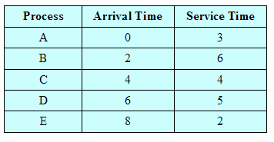
Process Scheduling Example

Slide 29
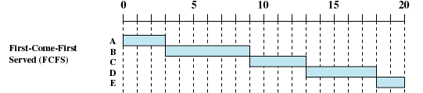
First-Come-First-Served (FCFS，先来先服务)
Nonpreempitive policy(非抢占)
Each process joins the Ready queue(每个进程加入就绪队列)
When the current process ceases to execute, the oldest process in the Ready queue is selected(选择就绪时间最长的进程)

Slide 30
First-Come-First-Served (FCFS)
A short process may have to wait a very long time before it can execute(短进程必须等待)
Favors CPU-bound processes(偏向CPU限制进程)
  I/O processes have to wait until CPU-bound process completes(I/O进程必须等待CPU限制进程完成)

Slide 31


Round-Robin (RR，轮转)
RR，q＝1
Uses preemption based on a clock(基于时钟的抢占)
An amount of time is determined that allows each process to use the processor for that length of time(每个进程占用处理机一段时间)

Slide 32
Round-Robin
Clock interrupt is generated at periodic intervals (周期性产生时钟中断)
When an interrupt occurs, the currently running process is placed in the ready queue (中断发生时，当前运行进程放入就绪队列)
  Next ready job is selected
Known as time slicing (时间片)

Slide 33
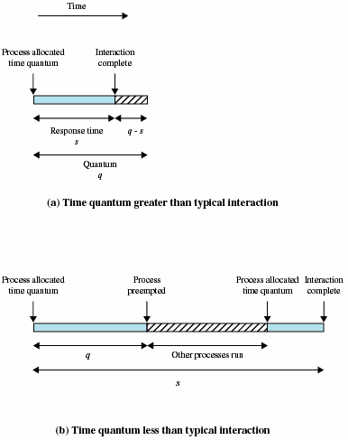
Effect of Size of Preemption Time Quantum (时间段大小的影响)

Slide 34
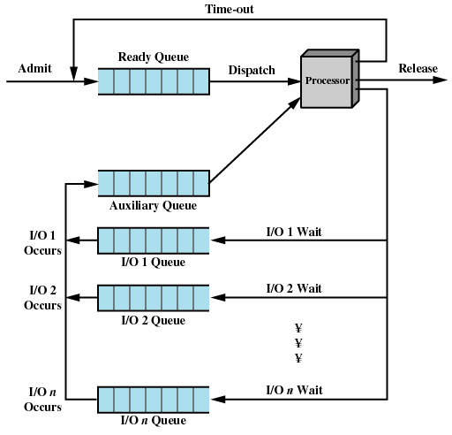
Queuing Diagram for virtual Round-Robin Scheduler (VRR，虚拟轮转法)

Slide 35

Shortest Process Next (SPN，最短进程优先)
Nonpreemptive policy(非抢占)
Process with shortest expected processing time is selected next(所需处理时间最短进程优先)
Short process jumps ahead of longer processes (短进程跳到长进程的前面)

Slide 36
Shortest Process Next
Predictability of longer processes is reduced (长进程预测可能性降低)
If estimated time for process not correct, the operating system may abort it(如果估计时间错误，系统可能退出)
  Exponential averaging(指数平均法)
Possibility of starvation for longer processes(长进程可能饥饿)

Slide 37

Shortest Remaining Time (SRT，最短剩余时间)
Preemptive version of shortest process next policy (最短进程优先的抢占版本)
Must estimate processing time (必须估计处理时间)
Risk of starvation of longer processes (长进程饥饿风险)

Slide 38

Highest Response Ratio Next (HRRN，最高响应比优先)
Nonpreemptive policy(非抢占)
Choose next process with the greatest response ratio
time spent waiting + expected service time
expected service time
R =

Slide 39
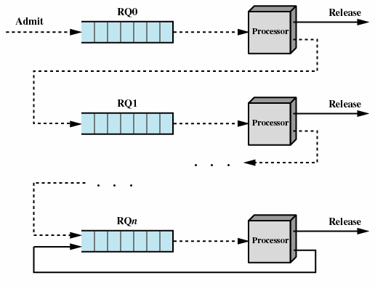
Feedback (反馈)
Penalize(惩罚) jobs that have been running longer
Don’t know remaining time process needs to execute(无须知道进程剩余时间)

Slide 40
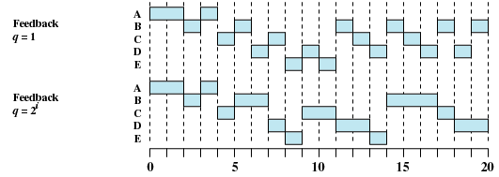
Feedback

Slide 41
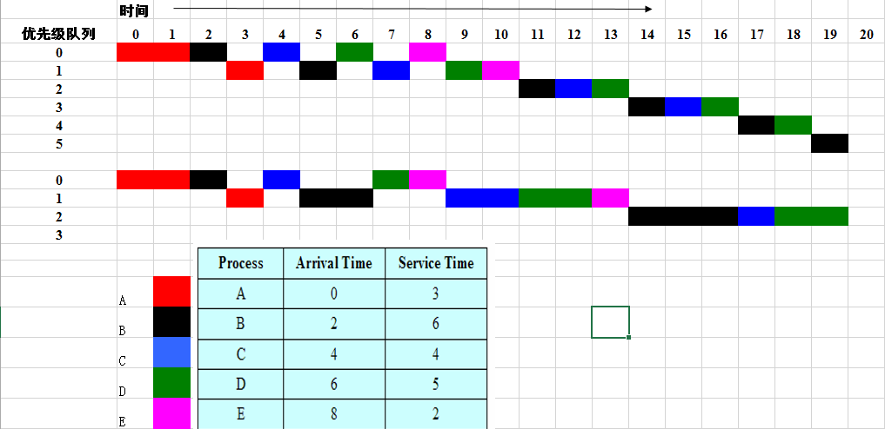


Feedback

Slide 42
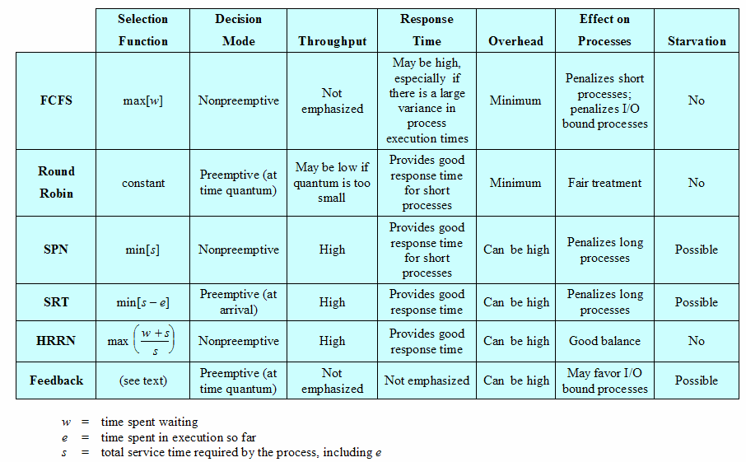
Characteristics of Various Scheduling Policies

Slide 43
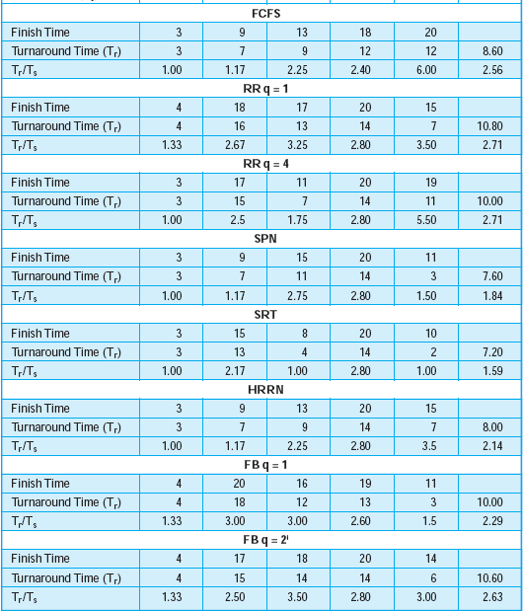
A Comparison of Scheduling policies

Slide 44
Homework
Review Questions:
  9.1
  9.3
Problems:
  9.1
  9.16

