Slide 1
I/O Management and Disk Scheduling
Chapter 11

Slide 2
Agenda
11.1 I/O Devices
11.2 Organization of the I/O Function
11.3 Operating System Design Issues
11.4 I/O Buffering
11.5 Disk Scheduling
11.6 RAID
11.7 Disk Cache
11.8 Summary

Slide 3
Categories of I/O Devices(I/O设备分类)
Human readable(人可读)
  Used to communicate with the user(和人交互)
  Printers
  Video display terminals
    Display(显示)
    Keyboard(键盘)
    Mouse(鼠标)

Slide 4
Categories of I/O Devices
Machine readable(机器可读)
  Used to communicate with electronic equipment(同电子设备交互)
  Disk and tape drives(磁盘、磁带驱动器)
  Sensors(传感器)
  Controllers(控制器)

Slide 5
Categories of I/O Devices
Communication(通信)
  Used to communicate with remote devices(和远程设备通信)
  Digital line drivers(数字线路驱动器)
  Modems(调制解调器)

Slide 6
Differences in I/O Devices
Data rate(数据率)
  May be differences of several orders of magnitude(数量级) between the data transfer rates

Slide 7
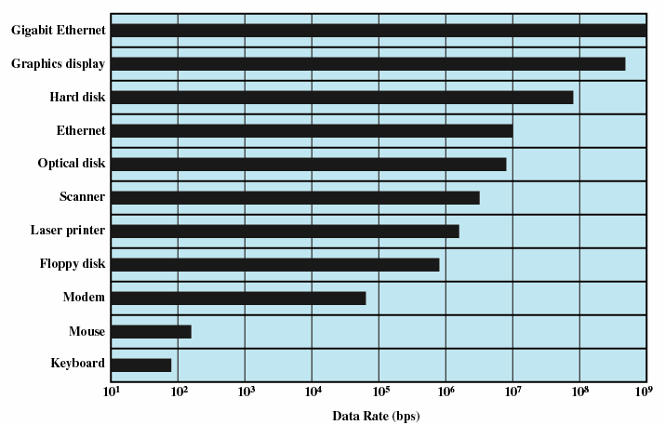
Typical I/O Device Data Rates

Slide 8
Differences in I/O Devices
Application(用途)
  Disk used to store files requires file management software(存储文件需要文件系统)
  Disk used to store virtual memory pages needs special hardware and software to support it(虚拟内存需要特殊硬件软件支持)
  Terminal used by system administrator may have a higher priority(系统管理员使用终端时拥有更高权限)

Slide 9
Differences in I/O Devices
Complexity of control(控制复杂性)
Unit of transfer(传送单位)
  Data may be transferred as a stream of bytes for a terminal or in larger blocks for a disk(位、字节、块)
Data representation(数据表示)
  Encoding schemes(编码方式、奇偶校验)
Error conditions(错误条件)
  Devices respond to errors differently(各种方法报错)

Slide 10
Agenda
11.1 I/O Devices
11.2 Organization of the I/O Function
11.3 Operating System Design Issues
11.4 I/O Buffering
11.5 Disk Scheduling
11.6 RAID
11.7 Disk Cache
11.8 Summary

Slide 11
Performing I/O
Programmed I/O(可编程I/O)
  Process is busy-waiting for the operation to complete(忙等待)
Interrupt-driven I/O(中断驱动I/O)
  I/O command is issued(发出命令)
  Processor continues executing instructions(处理机执行其他指令)
  I/O module sends an interrupt when done(完成后产生中断)
Direct Memory Access (DMA,直接存储器访问)
  DMA module controls exchange of data between main memory and the I/O device(主存和设备之间)
  Processor interrupted only after entire block has been transferred(处理完后产生中断)

Slide 12
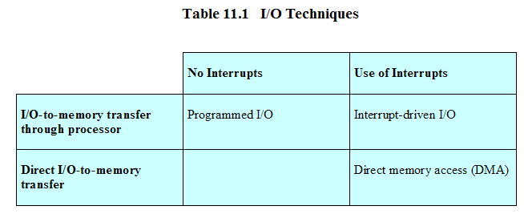
Relationship Among Techniques

Slide 13
Evolution of the I/O Function(I/O功能的发展)
Processor directly controls a peripheral device (处理器直接控制)
Controller or I/O module is added (控制器和I/O模块加入)
  Processor uses programmed I/O without interrupts (可编程I/O)
  Processor does not need to handle details of external devices (无须处理外部设备细节)

Slide 14
Evolution of the I/O Function
Controller or I/O module with interrupts(中断)
  Processor does not spend time waiting for an I/O operation to be performed
Direct Memory Access(直接内存访问)
  Blocks of data are moved into memory without involving the processor (数据块移动)
  Processor involved at beginning and end only (处理器只在开始和结束时参与)

Slide 15
Evolution of the I/O Function
I/O module is a separate processor(独立处理器)
  I/O channel (I/O通道)
I/O processor (I/O处理器)
  I/O module has its own local memory(本地存储)
  Its a computer in its own right

Slide 16
Direct Memory Access(直接存储器访问)
Processor delegates I/O operation to the DMA module (分派I/O任务)
DMA module transfers data directly to or form memory (从内存中直接传送数据)
When complete DMA module sends an interrupt signal to the processor (完成后向处理机发中断信号)

Slide 17
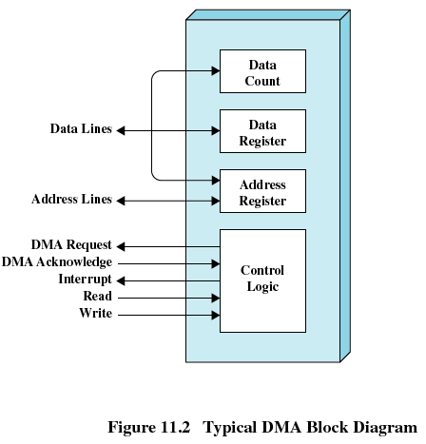
DMA Block diagram

Slide 18
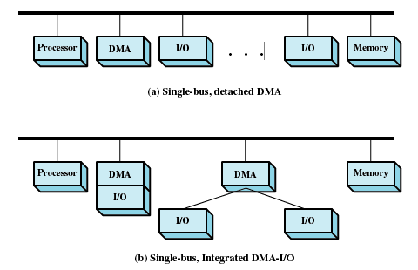
DMA Configurations

Slide 19
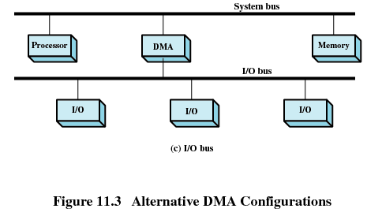
DMA Configurations

Slide 20
Agenda
11.1 I/O Devices
11.2 Organization of the I/O Function
11.3 Operating System Design Issues
11.4 I/O Buffering
11.5 Disk Scheduling
11.6 RAID
11.7 Disk Cache
11.8 Summary

Slide 21
Operating System Design Issues(操作系统设计问题)
Efficiency (效率)
  Most I/O devices extremely slow(相当慢) compared to main memory，I/O cannot keep up with processor speed
  Use of multiprogramming(多道程序) allows for some processes to be waiting on I/O while another process executes
  Swapping(交换) is used to bring in additional Ready processes which is an I/O operation

Slide 22
Operating System Design Issues
Generality (通用性)
  Desirable to handle all I/O devices in a uniform manner(统一模式)
  Hide most of the details of device I/O in lower-level routines(隐藏底层细节) so that processes and upper levels see devices in general terms (通用模式操作) such as read, write, open, close, lock, unlock

Slide 23
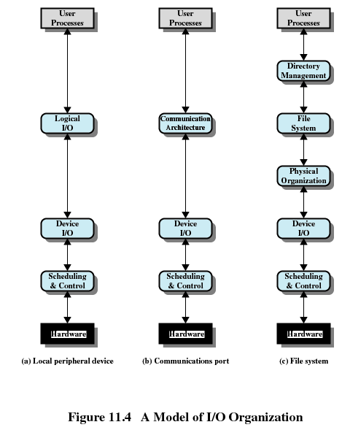

Slide 24
Agenda
11.1 I/O Devices
11.2 Organization of the I/O Function
11.3 Operating System Design Issues
11.4 I/O Buffering
11.5 Disk Scheduling
11.6 RAID
11.7 Disk Cache
11.8 Summary

Slide 25
I/O Buffering(I/O缓冲)
Reasons for buffering(缓存原因)
  Processes must wait for I/O to complete before proceeding (I/O完成之前必须等待)
  Certain pages must remain in main memory during I/O (某些页必须驻留主存)
Define
  Performs input transfers in advance of requests being made and performs output transfers some time after the request is made(预输入，缓输出)

Slide 26
I/O Buffering
Block-oriented(面向块)
  Information is stored in fixed sized blocks (固定大小)
  Transfers are made a block at a time (一次一块)
  Used for disks and tapes (磁盘、磁带)
Stream-oriented(面向流)
  Transfer information as a stream of bytes (字节流)
  Used for terminals, printers, communication ports, mouse and other pointing devices, and most other devices that are not secondary storage (非辅存设备)

Slide 27
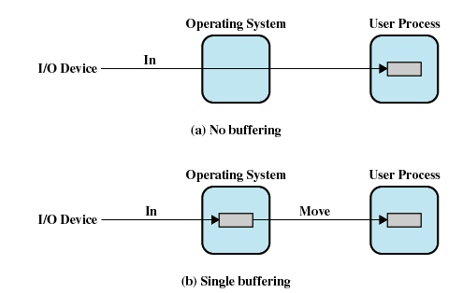
I/O Buffering

Slide 28
Single Buffer(单缓冲)
Operating system assigns a buffer in main memory for an I/O request (指定一内存缓冲区)
Block-oriented single buffering
  Input transfers are made to buffer (输入传输到缓冲区)
  Block is moved to user space when needed (块移动到用户空间)
  Another block is moved into the buffer immediately (下一块立即移动到缓冲区)
    Read ahead(预读), or anticipated input(预输入)

Slide 29
Single Buffer
Advantages of block-oriented single buffer
  User process can process one block of data while next block is read in (处理当前块，读入下一块)
  Swapping can occur since input is taking place in system memory, not user memory (系统内存输入)
Disadvantages of block-oriented single buffer
  Operating system keeps track of assignment of system buffers to user processes (操作系统维护用户进程系统缓冲区)
  The swapping logic is affected (交换逻辑受影响)

Slide 30
Single Buffer
Stream-oriented single buffer (面向流)
  Used a line at time (每次一行)
  User input from a terminal is one line at a time with carriage return signaling the end of the line (一行末尾回车)
  Output to the terminal is one line at a time (输出也为一次一行)

Slide 31
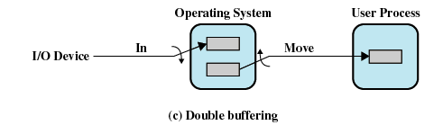
Double Buffer(双缓冲)
Use two system buffers instead of one (使用两个系统缓冲区)
A process can transfer data to or from one buffer while the operating system empties or fills the other buffer (输入输出交替使用)

Slide 32
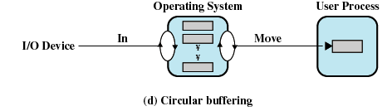
Circular Buffer(循环缓冲)
More than two buffers are used (超过两个缓冲区)
Each individual buffer is one unit in a circular buffer (每个单缓冲区是循环缓冲器的一个单元)
Used when I/O operation must keep up with process (平滑I/O操作和进程之间的数据流)

Slide 33
Agenda
11.1 I/O Devices
11.2 Organization of the I/O Function
11.3 Operating System Design Issues
11.4 I/O Buffering
11.5 Disk Scheduling
11.6 RAID
11.7 Disk Cache
11.8 Summary

Slide 34
Disk Performance Parameters
To read or write, the disk head must be positioned at the desired track(磁道) and at the beginning of the desired sector(扇区)
Seek time (寻道时间)
  Time it takes to position the head(磁头) at the desired track
Rotational delay (旋转延迟)
  Time its takes for the beginning of the sector to reach the head

Slide 35
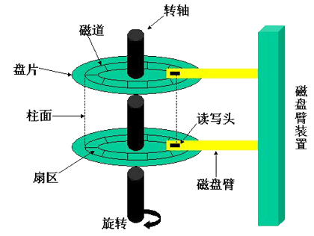

Slide 36
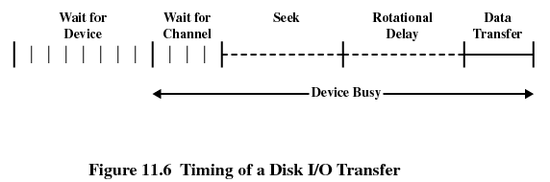
Timing of a Disk I/O Transfer

Slide 37
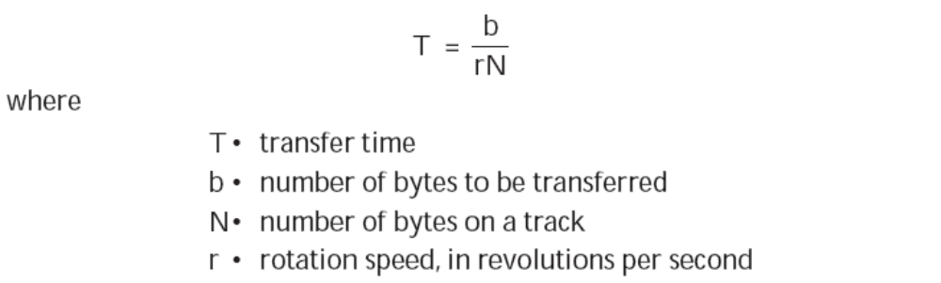
Disk Performance Parameters(磁盘性能参数)
Access time(存取时间)
  The time it takes to get in position to read or write
  Sum of seek time(寻道) and rotational delay(旋转延迟)
Transfer time(传输时间)
  Data transfer occurs as the sector moves under the head (扇区在磁头下数据传输时间)

Slide 38
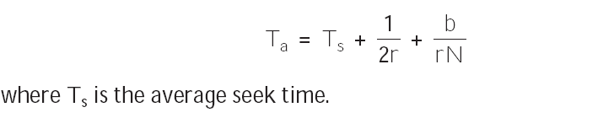
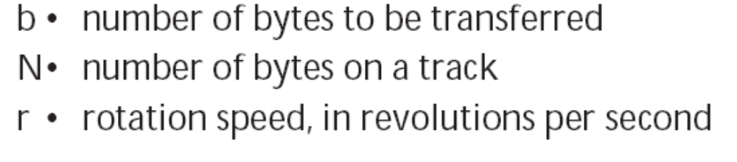
Total average access time(总平均存取时间)

Slide 39
Disk Scheduling Policies
(磁盘调度策略)
Seek time is the reason for differences in performance (性能差异来自寻道时间)
For a single disk there will be a number of I/O requests (一系列I/O请求)
If requests are selected randomly(随机选择), we will poor performance
  used to evaluate other techniques (评估其他技术)

Slide 40
Disk Scheduling Policies
Priority(优先级)
  Goal is not to optimize disk use but to meet other objectives (不优化磁盘使用)
  Short batch jobs may have higher priority (较短批处理作业)
  Provide good interactive response time (交互作业)

Slide 41
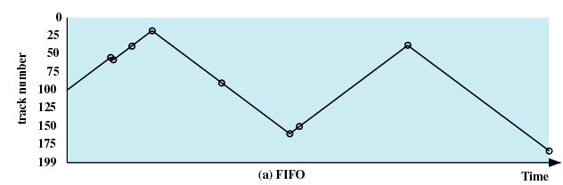
Disk Scheduling Policies
First-in, first-out (FIFO)
  Process request sequentially (顺序请求)
  Fair to all processes (公平对待)
  Approaches random scheduling in performance if there are many processes (多进程环境，性能接近随机调度)
55、58、39、18、90、160、150、38、184

Slide 42
Disk Scheduling Policies
Last-in, first-out (LIFO)
  Good for transaction processing systems (事务处理系统)
    The device is given to the most recent user so there should be little arm movement (设备给最近用户使用，较少磁头臂移动)
  Possibility of starvation since a job may never regain the head of the line (可能饿死)

Slide 43
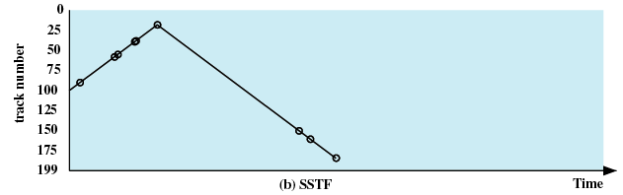
Disk Scheduling Policies
Shortest Service Time First (SSTF,最短服务时间优先)
  Select the disk I/O request that requires the least movement of the disk arm from its current position (磁头臂从当前位置移动最短时间)
  Always choose the minimum Seek time (最短寻道时间)
55、58、39、18、90、160、150、38、184

Slide 44
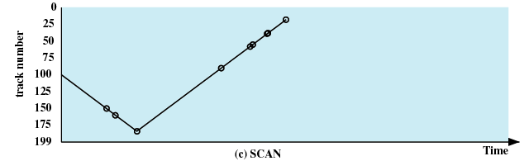
Disk Scheduling Policies
SCAN
  Arm moves in one direction only, satisfying all outstanding requests until it reaches the last track in that direction (磁头臂向一个方向运动)
  Direction is reversed (转向)
55、58、39、18、90、160、150、38、184

Slide 45
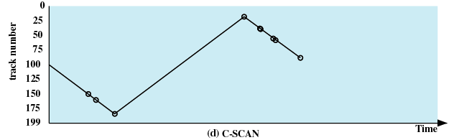
Disk Scheduling Policies
C-SCAN (circular SCAN, 循环SCAN)
  Restricts scanning to one direction only (只从一个方向扫描)
  When the last track has been visited in one direction, the arm is returned to the opposite end of the disk and the scan begins again (到达终点后，返回起点重新扫描)
55、58、39、18、90、160、150、38、184

Slide 46
Disk Scheduling Policies
N-step-SCAN
  Segments the disk request queue into subqueues of length N (磁盘请求队列被分为长度为N的子队列)
  Subqueues are processed one at a time, using SCAN
  New requests added to other queue when queue is processed (每次用SCAN扫描一个子队列)
FSCAN
  Two queues (两个队列)
  One queue is empty for new requests (新请求进入空队列)

Slide 47
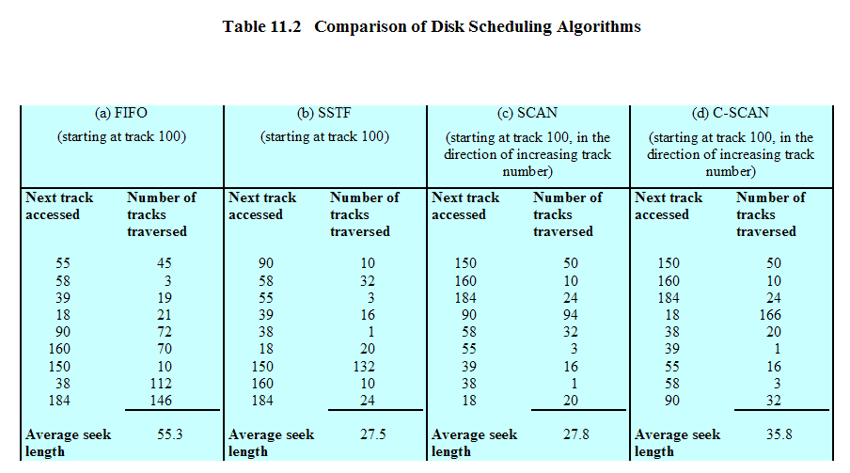
Disk Scheduling Algorithms

Slide 48
Homework
Review Questions:
  11.1
  11.5
Problems:
  11.1
  11.3

