Slide 1
File Management(文件管理)
Chapter 12

Slide 2
Agenda
12.1 Overview
12.2 File Organization and Access
12.3 File Directories
12.4 File Sharing
12.5 Secondary Storage Management
12.6 Summary

Slide 3
File Management
File management system consists of system utility programs that run as privileged applications(特权程序)
Input to applications is by means of a file (文件作为输入)
Output is saved in a file for long-term storage (文件作为输出)

Slide 4
File System Properties
Long-term existence (长期存在)
Sharable between processes (进程共享)
Structure (结构化存储)

Slide 5
File Operations(文件操作)
Create(创建)
Delete(删除)
Open(打开)
Close(关闭)
Read(读)
Write(写)

Slide 6
Terms Used with Files (文件术语)
Field (域)
  Basic element of data
  Contains a single value
  Characterized by its length and data type
Record (记录)
  Collection of related fields
  Treated as a unit
    Example: employee record

Slide 7
Terms Used with Files
File (文件)
  Collection of similar records
  Treated as a single entity
  Have file names
  May restrict access
Database (数据库)
  Collection of related data
  Relationships exist among elements

Slide 8
File Management Systems (文件管理系统)
The way a user or application may access files(用户和程序访问文件的唯一方式)
Programmer does not need to develop file management software (程序员无须开发文件管理软件)

Slide 9
Objectives for a File Management System
Meet the data management needs and requirements of the user (文件管理和用户需求)
Guarantee that the data in the file are valid (保护文件中的数据有效性)
Optimize performance (优化性能)
Provide I/O support for a variety of storage device types (支持各类存储设备)

Slide 10
Objectives for a
File Management System
Minimize or eliminate the potential for lost or destroyed data (减少或消除丢失或者破坏数据的可能性)
Provide a standardized set of I/O interface routines (标准的I/O接口)
Provide I/O support for multiple users (提供多用户I/O支持)

Slide 11
Minimal Set of Requirements (用户需求最小集合)
Each user should be able to create, delete, read, write and modify files (基本操作)
Each user may have controlled access to other users’ files (受控访问其他用户文件)
Each user may control what type of accesses are allowed to the users’ files (控制该用户的文件能够允许何种访问)
Each user should be able to restructure the user’s files in a form appropriate to the problem (可按自己需要，重构文件)

Slide 12
Minimal Set of Requirements
Each user should be able to move data between files (文件之间移动数据)
Each user should be able to back up and recover the user’s files in case of damage (备份和恢复文件)
Each user should be able to access the user’s files by using symbolic names (使用符号名字访问文件)

Slide 13
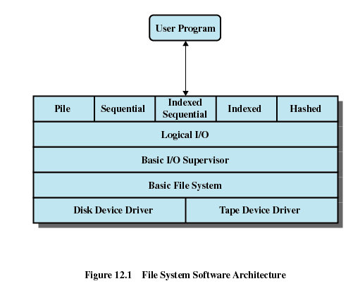

Slide 14
Device Drivers (设备驱动)
Lowest level (最底层)
Communicates directly with peripheral devices (直接和设备通信)
Responsible for starting I/O operations on a device (启动I/O)
Processes the completion of an I/O request (完成I/O)

Slide 15
Basic File System (基本文件系统)
Physical I/O (物理I/O)
Deals with exchanging blocks of data (数据块交换)
Concerned with the placement of blocks (块放置)
Concerned with buffering blocks in main memory (块缓冲)

Slide 16
Basic I/O Supervisor (基本I/O管理)
Responsible for file I/O initiation and termination (文件I/O的发起与结束)
Control structures are maintained (维护控制结构)
Concerned with selection of the device (设备选择) on which file I/O is to be performed
Concerned with scheduling access (存取调度) to optimize performance (性能优化)
Part of the operating system

Slide 17
Logical I/O (逻辑I/O)
Enables users and applications to access records (访问记录)
Provides general-purpose (一致的) record I/O capability
Maintains basic data about file (维护基本数据)

Slide 18
File Management Functions
Identify (标识) and locate (定位) a selected file
Use a directory (目录) to describe the location of all files plus their attributes (属性)
On a shared system describe user access control (存取访问控制)
Blocking (块化) for access to files
Allocate files to free blocks (空闲块)
Manage free storage (空闲存储) for available blocks

Slide 19
Agenda
12.1 Overview
12.2 File Organization and Access
12.3 File Directories
12.4 File Sharing
12.5 Secondary Storage Management
12.6 Summary

Slide 20
12.2 File Organization and Access
12.2.1 Criteria for File Organization
12.2.2 The Pile
12.2.3 The Sequential File
12.2.4 The Indexed Sequential File
12.2.5 The Indexed File
12.2.6 The Direct or Hashed File

Slide 21
Criteria for File Organization (文件管理的评价标准)
Short access time (短的存取时间)
  Needed when accessing a single record (随机访问)
  Not needed for batch mode (批处理模式)
Ease of update (易于修改)
  File on CD-ROM will not be updated, so this is not a concern

Slide 22
Criteria for File Organization
Economy of storage (存储经济性)
  Should be minimum redundancy in the data (最小冗余)
  Redundancy can be used to speed access such as an index (冗余加快访问)
Simple maintenance (维护简单)
Reliability (可靠性)

Slide 23
12.2 File Organization and Access
12.2.1 Criteria for File Organization
12.2.2 The Pile
12.2.3 The Sequential File
12.2.4 The Indexed Sequential File
12.2.5 The Indexed File
12.2.6 The Direct or Hashed File

Slide 24
The Pile (堆文件)
The Pile
  Data are collected in the order they arrive (以数据到达的顺序组织)
  Purpose is to accumulate a mass of data and save it (积累大量的数据并保存)
  Records may have different fields (记录有不同的域)
  No structure (非结构化)
  Record access is by exhaustive search (穷举搜索)

Slide 25
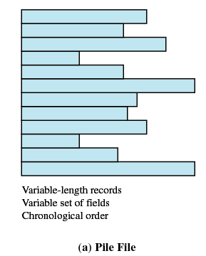
The Pile

Slide 26
12.2 File Organization and Access
12.2.1 Criteria for File Organization
12.2.2 The Pile
12.2.3 The Sequential File
12.2.4 The Indexed Sequential File
12.2.5 The Indexed File
12.2.6 The Direct or Hashed File

Slide 27
The Sequential File (顺序文件)
Fixed format used for records (记录格式固定)
Records are the same length (记录长度固定)
All fields the same (order and length)，Field names and lengths are attributes of the file
One field is the key filed (关键域)
  Uniquely identifies the record (唯一识别记录)
  Records are stored in key sequence (按照关键域存储)

Slide 28
The Sequential File
New records are placed in a log file(日志文件) or transaction file(事务文件)
Batch update (成批更新) is performed to merge(合并) the log file with the master file

Slide 29
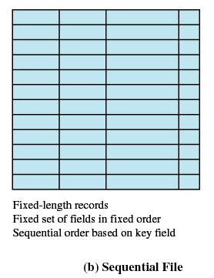
The Sequential File

Slide 30
12.2 File Organization and Access
12.2.1 Criteria for File Organization
12.2.2 The Pile
12.2.3 The Sequential File
12.2.4 The Indexed Sequential File
12.2.5 The Indexed File
12.2.6 The Direct or Hashed File

Slide 31
The Indexed Sequential File (索引顺序文件)
Index(索引) provides a lookup capability to quickly reach the vicinity(邻近、接近) of the desired record
  Contains key field and a pointer to the main file(指针)
  Indexed is searched to find highest key value that is equal (相等) to or precedes (小于) the desired key value (关键字小于或者等于目标关键字的最大记录)

Slide 32
The Indexed Sequential File
Comparison of sequential and indexed sequential
  Example: a file contains 1 million records
  On average 50,000 accesses are required to find a record in a sequential file (平均50万次访问)
  If an index contains 1000 entries, it will take on average 500 accesses to find the key, followed by 500 accesses in the main file. Now on average it is 1000 accesses (500次访问键，500次访问记录)

Slide 33
The Indexed Sequential File
New records are added to an overflow file(溢出文件)
Record in main file that precedes it is updated to contain a pointer to the new record
The overflow is merged (合并) with the main file during a batch update
Multiple level indexes (多级索引) for the same key field can be set up to increase efficiency

Slide 34
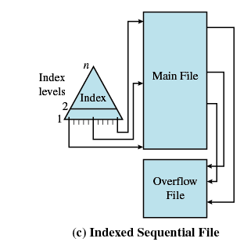
Indexed Sequential File

Slide 35
12.2 File Organization and Access
12.2.1 Criteria for File Organization
12.2.2 The Pile
12.2.3 The Sequential File
12.2.4 The Indexed Sequential File
12.2.5 The Indexed File
12.2.6 The Direct or Hashed File

Slide 36
The Indexed File (索引文件)
Uses multiple indexes for different key fields (不同的关键域，不同的索引)
May contain an exhaustive index(完全索引) that contains one entry for every record in the main file (每个记录的某个域)
May contain a partial index(部分索引)

Slide 37
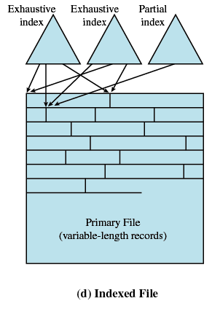
The Indexed File

Slide 38
12.2 File Organization and Access
12.2.1 Criteria for File Organization
12.2.2 The Pile
12.2.3 The Sequential File
12.2.4 The Indexed Sequential File
12.2.5 The Indexed File
12.2.6 The Direct or Hashed File

Slide 39
The Direct or Hashed File(直接或散列文件)
Directly access a block at a known address (直接访问数据块)
Key field required for each record (每个记录需要关键域)

Slide 40
Agenda
12.1 Overview
12.2 File Organization and Access
12.3 File Directories
12.4 File Sharing
12.5 Secondary Storage Management
12.6 Summary

Slide 41
12.3 File Directories
12.3.1 Contents
12.3.2 Structure
12.3.3 Naming

Slide 42
File Directories (文件目录)
Contains information about files
  Attributes (属性)
  Location (位置)
  Ownership (所有者)
Directory itself is a file owned by the operating system (操作系统所有的文件)
Provides mapping between file names and the files themselves (提供文件名和文件之间映射)

Slide 43
12.3 File Directories
12.3.1 Contents
12.3.2 Structure
12.3.3 Naming

Slide 44
Simple Structure for a Directory (简单目录结构)
List of entries(目录项列表), one for each file
Sequential file with the name of the file serving as the key (文件名为关键域)
Provides no help in organizing the files
Forces user to be careful not to use the same name for two different files (用户自行处理相同文件名)

Slide 45
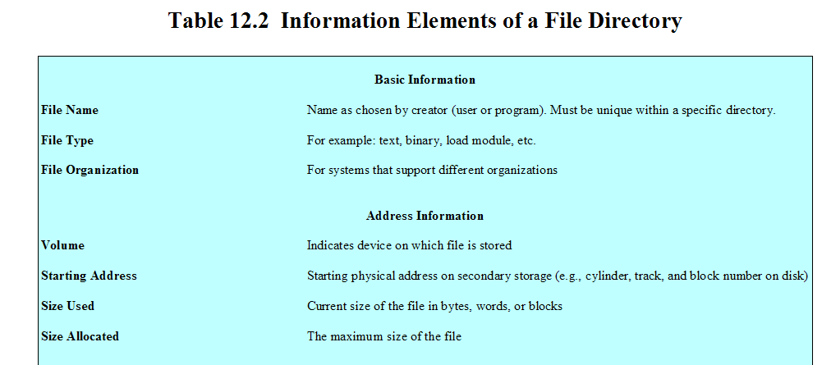

Slide 46
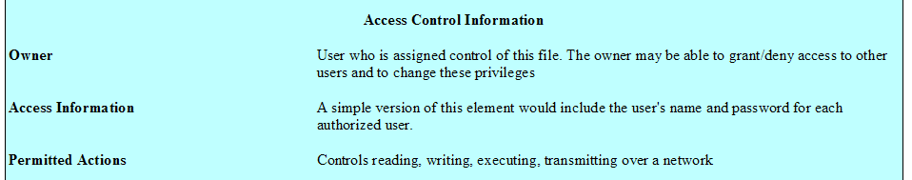

Slide 47
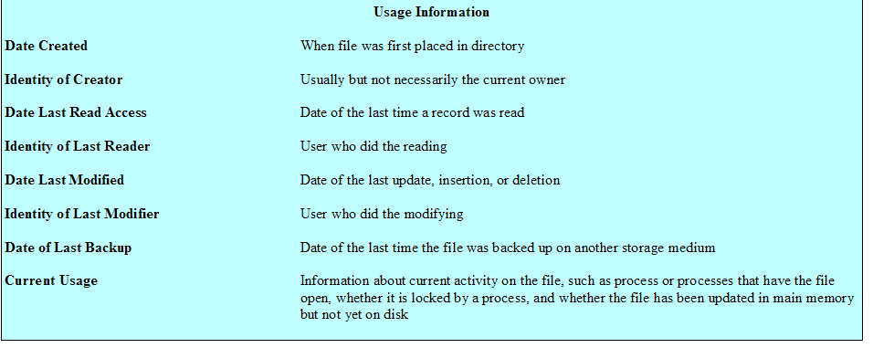

Slide 48
Two-level Scheme for a Directory(两级目录方案)
A master directory (主目录)
One directory for each user (用户目录)
Master directory contains entry for each user (主目录中的每一项为用户目录)
  Provides address and access control information
Each user directory is a simple list of files for that user (用户目录为简单列表文件)
Still provides no help in structuring collections of files (对构造结构化文件集合没有任何帮助)

Slide 49
Hierarchical, or Tree-Structured Directory (层次/树状结构目录)
Master directory with user directories underneath it (主目录和其下的用户目录)
Each user directory may have subdirectories and files as entries (每个用户目录可有子目录、文件项)

Slide 50
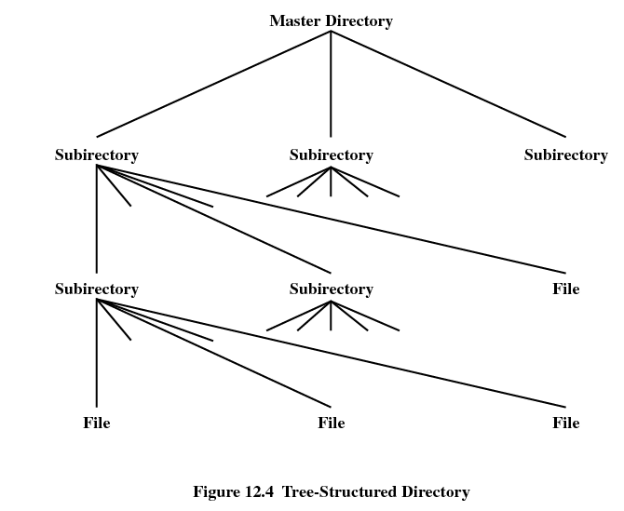

Slide 51
12.3 File Directories
12.3.1 Contents
12.3.2 Structure
12.3.3 Naming

Slide 52
Hierarchical, or Tree-Structured Directory (层次/树状结构目录)
Files can be located (文件定位) by following a path from the root, or master, directory down various branches (从根目录开始的分支)
  This is the pathname for the file (路径名)
Can have several files with the same file name (文件同名) as long as they have unique path names (只要路径名不同就行)

Slide 53
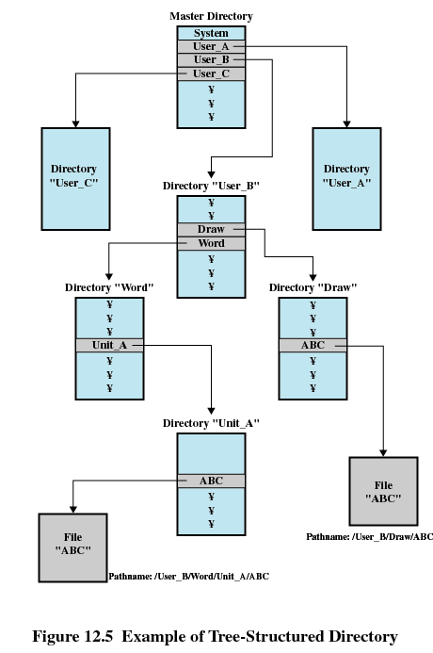

Slide 54
Hierarchical, or Tree-Structured Directory
Current directory is the working directory (工作目录，交互程序)
Files are referenced relative to the working directory (相对路径)

Slide 55
Agenda
12.1 Overview
12.2 File Organization and Access
12.3 File Directories
12.4 File Sharing
12.5 Secondary Storage Management
12.6 Summary

Slide 56
File Sharing (文件共享)
In multiuser system, allow files to be shared among users (多用户系统，允许用户间共享)
Two issues
  Access rights (存取权限)
  Management of simultaneous access (同时存取管理)

Slide 57
Access Rights (访问权限)
None (无)
  User may not know of the existence of the file (用户不知道文件是否存在)
  User is not allowed to read the user directory that includes the file (用户不允许读包含该文件的目录)
Knowledge (知道)
  User can only determine that the file exists and who its owner is (只是知道文件存在和拥有者)

Slide 58
Access Rights (访问权限)
Execution (执行)
  The user can load and execute a program but cannot copy it (用户可执行，但不能复制)
Reading (读)
  The user can read the file for any purpose, including copying and execution(复制、执行)
Appending (追加)
  The user can add data to the file but cannot modify or delete any of the file’s contents (能够添加，但是不能删除和修改)

Slide 59
Access Rights (访问权限)
Updating (更新)
  The user can modify, deleted, and add to the file’s data. This includes creating the file, rewriting it, and removing all or part of the data (用户可修改、删除、增加，包括创建、重写、删除部分或全部数据)
Changing protection (改变保护)
  User can change access rights granted to other users (授予其他用户访问权限)
Deletion (删除)
  User can delete the file

Slide 60
Access Rights (访问权限)
Owners (拥有者)
  Has all rights previously listed (拥有所有权限)
  May grant rights to others using the following classes of users (可授予其他用户权限)
    Specific user (特定用户)
    User groups (用户组)
    All for public files (公共文件)

Slide 61
Simultaneous Access(同时访问)
User may lock entire file when it is to be updated (锁定整个文件)
User may lock the individual records during the update (锁定记录)
Mutual exclusion and deadlock are issues for shared access (互斥、死锁问题)

Slide 62
Agenda
12.1 Overview
12.2 File Organization and Access
12.3 File Directories
12.4 File Sharing
12.5 Secondary Storage Management
12.6 Summary

Slide 63
12.6 Secondary Storage Management(二级存储管理)
12.6.1 File Allocation
12.6.2 Free Space Management
12.6.3 Reliability

Slide 64
Secondary Storage Management
Space must be allocated to files (空间分配给文件)
Must keep track of the space available for allocation (空闲空间管理)

Slide 65
Preallocation (预分配)
Need the maximum size for the file at the time of creation (需要知道文件的最大长度)
Difficult to reliably estimate the maximum potential size of the file (实际估计最大长度的困难性)
Tend to overestimated file size so as not to run out of space (造成浪费)

Slide 66
Contiguous allocation (连续分配)
Single set of blocks is allocated to a file at the time of creation (创建时分配一组块)
Only a single entry in the file allocation table (文件分配表中只有一个表项)
  Starting block and length of the file (起始块和长度)
External fragmentation will occur (外部碎片)
  Need to perform compaction (执行压缩算法，获得足够的块)

Slide 67

Contiguous allocation

Slide 68
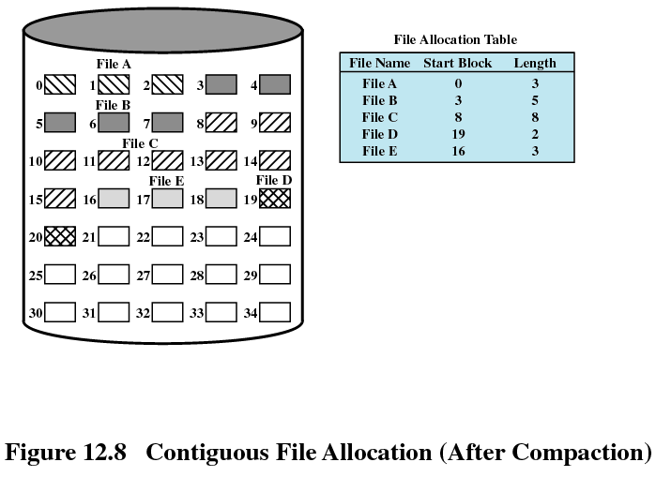
Contiguous allocation

Slide 69
Chained allocation (链式分配)
Allocation on basis of individual block(单个块)
Each block contains a pointer to the next block in the chain (每个块包括下一块指针)
Only single entry in the file allocation table (单表项)
  Starting block and length of file (起始块和文件长度)
No external fragmentation (无外部碎片)
Best for sequential files (适合顺序文件)
No accommodation of the principle of locality (局部性原理不再适用)

Slide 70
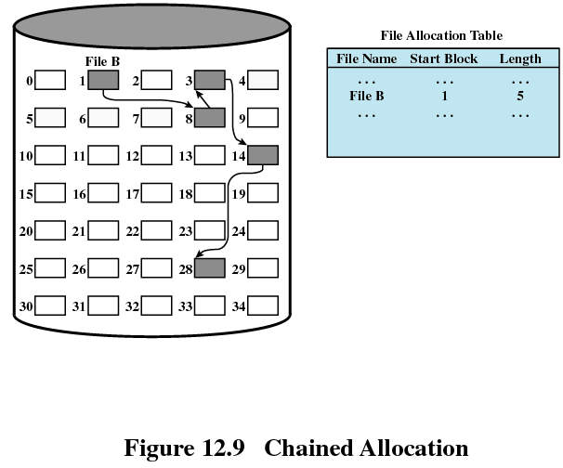
Chained allocation

Slide 71
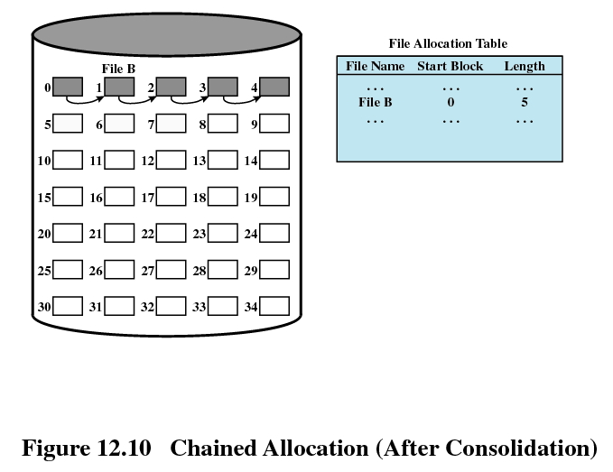
Chained allocation

Slide 72
Indexed allocation (索引分配)
File allocation table contains a separate one-level index (一级索引) for each file
The index has one entry for each portion allocated to the file (每个已分配的部分都用索引表示)
The file allocation table contains block number for the index (文件分配表包括块号作为索引)

Slide 73
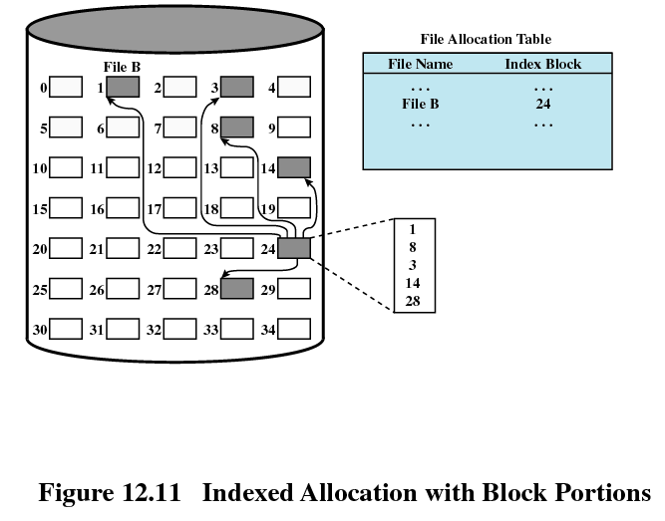
Indexed allocation

Slide 74
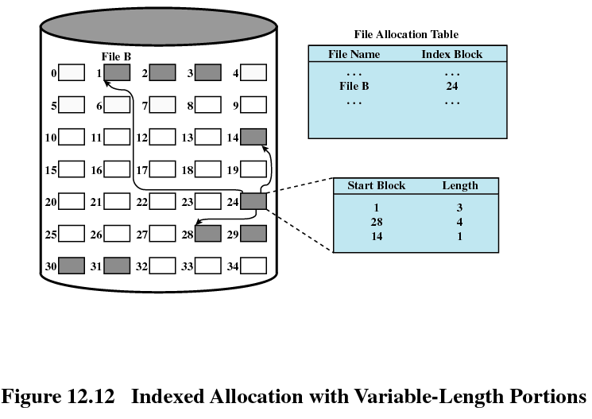
Indexed allocation

Slide 75
12.6 Secondary Storage Management
12.6.1 File Allocation
12.6.2 Free Space Management
12.6.3 Reliability

Slide 76
Free Space Management
Bit tables (位表)
  Use a vector containing one bit for each block on the disk. Each entry of a 0 corresponds to a free block, and each 1 corresponds to a block in use. (0表示空闲，1表示占用)
Chained free portions (链式空闲区)
  The free portions may be chained together by using a pointer and length value in each free portion (用链组织，使用头指针和长度描述空闲块)

Slide 77
12.6 Secondary Storage Management
12.6.1 File Allocation
12.6.2 Free Space Management
12.6.3 Reliability

Slide 78
12.6.3 Reliability(可靠性)
Use a lock to prevent interfere among processes and make sure of consistent of space allocation (使用锁来防止进程间干扰和空间分配一致性)

Slide 79
Homework
Review Questions:
  12.1
  12.5
Problems:
  12.1
  12.3

