Slide 1
Agenda
4.1 Processes and Threads
4.2 Symmetric Multiprocessing
4.3 Microkernel
4.4 Summary

Slide 2
4.1 Processes and Threads
4.1.1 Introduction
4.1.2 Multithreading
4.1.3 Thread Functionality
4.1.4 User-Level and Kernel-Level Thread
4.1.5 Other Arrangements

Slide 3
Introduction
Resource ownership(资源所有权) - process includes a virtual address space to hold the process image
Scheduling/execution(调度/执行)- follows an execution path that may be interleaved with other processes
These two characteristics are treated independently(独立的) by the operating system

Slide 4
Introduction
Dispatching is referred to as a thread or lightweight process(线程或轻量进程)
Resource of ownership is referred to as a process or task(进程或者任务)

Slide 5
4.1 Processes and Threads
4.1.1 Introduction
4.1.2 Multithreading
4.1.3 Thread Functionality
4.1.4 User-Level and Kernel-Level Thread

Slide 6
Multithreading(多线程)
Multithreading refers to the ability of an OS to support multiple threads of execution within a single process
  Windows, Solaris, Linux, Mach, and OS/2 support multiple threads

Slide 7
Single-Thread(单线程)
Single-threaded approach refers to the traditional approach of a single thread of execution per process, in which the concept of a thread is not recognized
  MS-DOS supports a single thread
  Some UNIX supports multiple user processes but only supports one thread per process

Slide 8
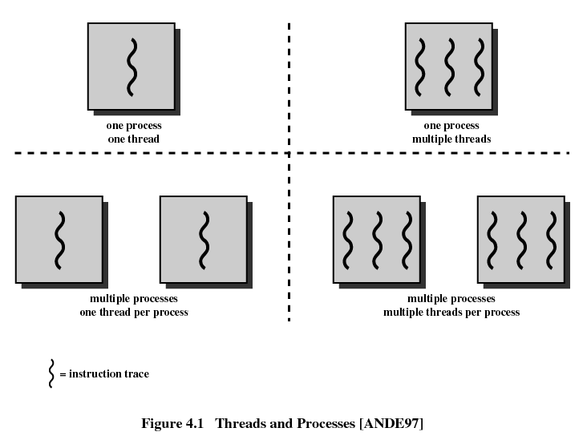

Slide 9
Unit of Resource allocation and Unit of Protection(资源分配和保护的单位)——Process
Have a virtual address space(虚拟地址空间) which holds the process image( code, data, stack and PCB)
Protected access to processors, other processes, files, and I/O resources
Contains one or more threads

Slide 10
Unit of Scheduling/Execution(执行调度的单位) ——Thread
Each thread has:
  An execution state (running, ready, etc.)(执行状态)
  A saved thread context when not running(上下文)
  Has an execution stack(执行栈)
  Some per-thread static storage for local variables(局部变量)
  Access to the memory and resources of its process (资源共享)
    all threads of a process share this

Slide 11
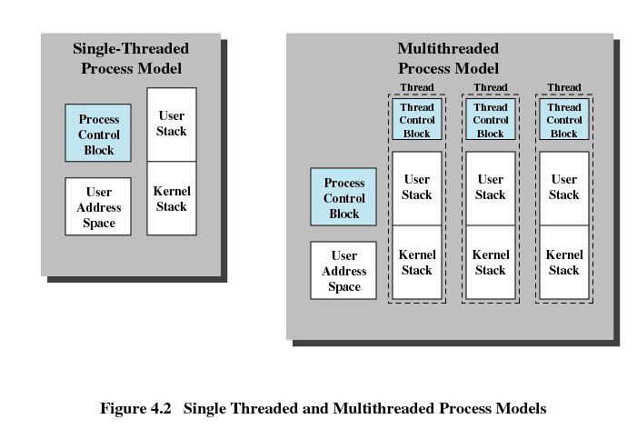
Distinction Between Threads and Processes From the
Point of View of Process Management

Slide 12
Benefits(优点) of Threads
Takes less time to create a new thread than a process (创建快)
Less time to terminate a thread than a process (结束快)
Less time to switch between two threads within the same process (切换快)
Since threads within the same process share memory and files, they can communicate with each other without invoking the kernel (通信快)

Slide 13
Uses of Threads in a Single-User Multiprocessing System
Foreground to background work(前/后台工作)
Asynchronous processing(异步处理)
Speed of execution(加速执行)
Modular program structure(模块化程序结构)
Notes:
Foreground to background work，比如电子表格
Asynchronous processing，word程序的周期保存
Speed of execution，比如迅雷
Modular program structure，网络服务程序

Slide 14
Threads are Affected by Many Process Action
Suspending a process involves suspending all threads of the process since all threads share the same address space
Termination of a process, terminates all threads within the process

Slide 15
4.1 Processes and Threads
4.1.1 Introduction
4.1.2 Multithreading
4.1.3 Thread Functionality(功能特性)
4.1.4 User-Level and Kernel-Level Thread

Slide 16
Thread States
Operations associated with a change in thread state
  Spawn(派生)
    Spawn another thread
  Block(阻塞)
  Unblock(解除阻塞)
  Finish
    Deallocate register context and stacks

Slide 17
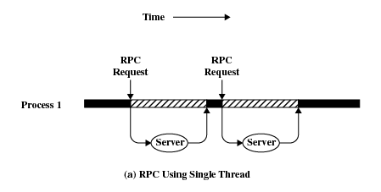
Remote Procedure Call Using Single Thread

Slide 18
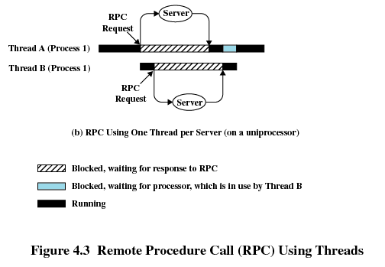
Remote Procedure Call Using Threads

Slide 19
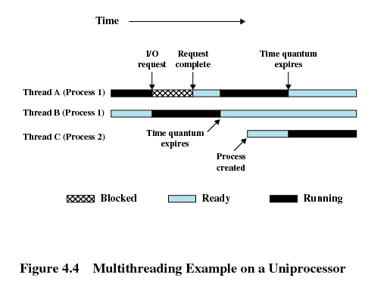
Multithreading

Slide 20
4.1 Processes and Threads
4.1.1 Introduction
4.1.2 Multithreading
4.1.3 Thread Functionality
4.1.4 User-Level and Kernel-Level Thread

Slide 21
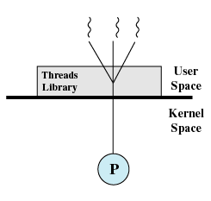
User-Level Threads (ULT，用户级线程)
All thread management is done by the application
The kernel is not aware of the existence of threads
Multithread implemented by a threads library

Slide 22
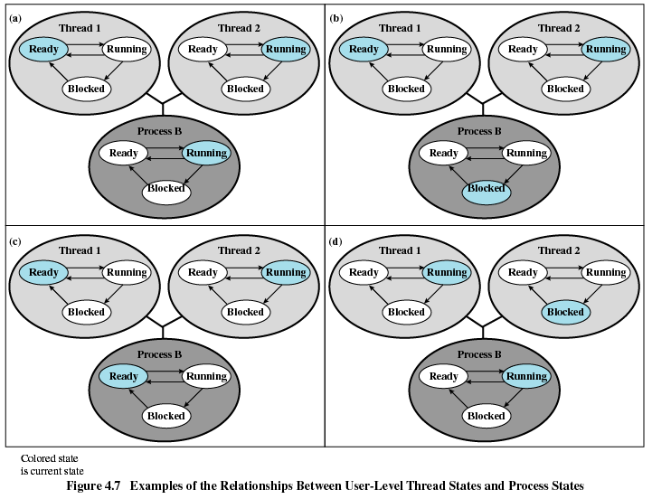

Slide 23
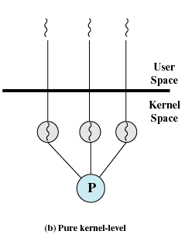
Kernel-Level Threads(内核级线程)
Kernel maintains context information for the process and the threads
Scheduling is done on a thread basis

Slide 24
Advantages of ULT to KLT
Less overhead of two mode switches(user mode and kernel mode) (减少模式切换)
Scheduling can be application specific(应用程序专用)
ULTs can run on any operating system(在作何系统上运行)

Slide 25
Disadvantages of ULT to KLT
One thread is blocked, all other threads of the process are blocked
A multithreaded application cannot take advantage of multiprocessing
Ways to work around these drawbacks:
  Multiple processes
  Jacketing(无阻塞系统调用)

Slide 26
Advantages of KLT to ULT
Overcomes the two principal drawbacks of the ULT
  Multiple threads in on process can simultaneously run on multiple processors
  One threads blocked cannot make the other threads within the same process blocked
  Kernel routines themselves can be multithreaded

Slide 27
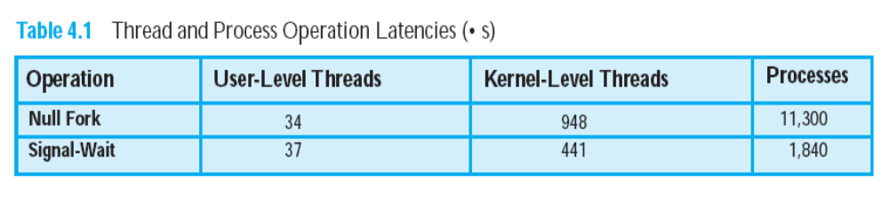
Disadvantages of KLT to ULT
The principal disadvantage is that transfer of control from one thread to another within the same process requires a mode switch(模式切换) to the kernel

Slide 28
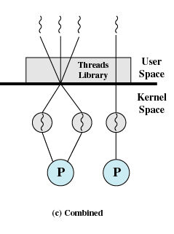
Combined Approaches
Example is Solaris
Thread creation done in the user space
Bulk of scheduling and synchronization of threads within application

Slide 29
Agenda
4.1 Processes and Threads
4.2 Symmetric Multiprocessing
4.3 Microkernel
4.4 Summary

Slide 30
4.2 Symmetric Multiprocessing
4.2.1 SMP Architecture
4.2.2 SMP Organization
4.2.3 Multiprocessor Operating System Design
Considerations

Slide 31
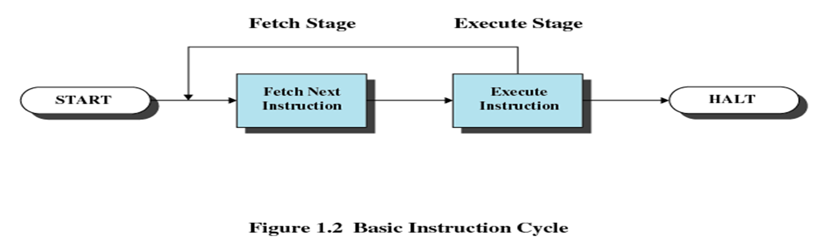
The Traditional Computer

Slide 32
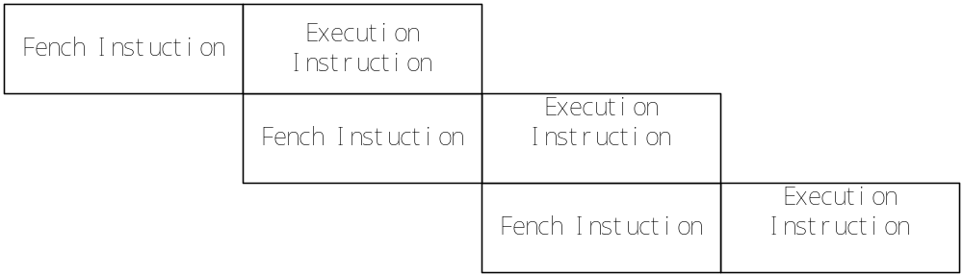
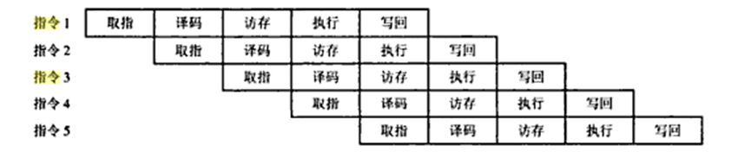
The Improver Method

Slide 33
Categories of Computer Systems
Single Instruction Single Data (SISD) stream(单指令单数据流)
  Single processor executes a single instruction stream to operate on data stored in a single memory
Single Instruction Multiple Data (SIMD) stream(单指令多数据流)
  Each instruction is executed on a different set of data by the different processors
  E.g. vector and array processors

Slide 34
Categories of Computer Systems
Multiple Instruction Single Data (MISD) stream(多指令单数据流)
  A sequence of data is transmitted to a set of processors, each of which executes a different instruction sequence. Never implemented
Multiple Instruction Multiple Data (MIMD) stream (多指令多数据流)
  A set of processors simultaneously execute different instruction sequences on different data sets

Slide 35
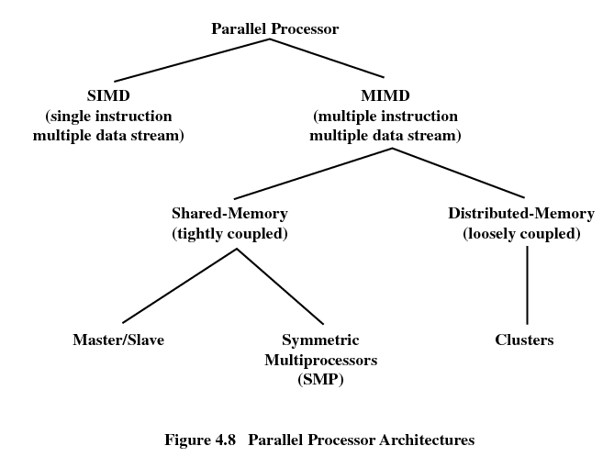

Slide 36
Symmetric Multiprocessing
Kernel can execute on any processor
Typically each processor does self-scheduling(自行调度) from the pool of available process or threads

Slide 37
4.2 Symmetric Multiprocessing
4.2.1 SMP Architecture
4.2.2 SMP Organization
4.2.3 Multiprocessor Operating System Design
Considerations

Slide 38
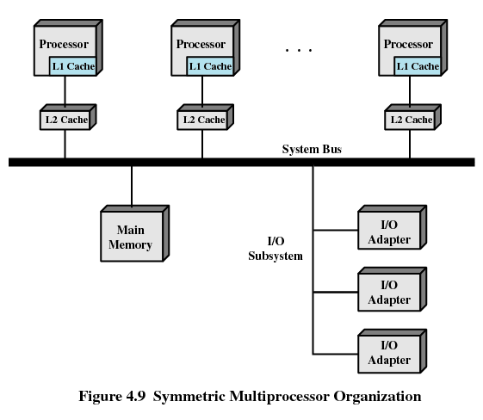

Slide 39
4.2 Symmetric Multiprocessing
4.2.1 SMP Architecture
4.2.2 SMP Organization
4.2.3 Multiprocessor Operating System Design
Considerations

Slide 40
Multiprocessor Operating System Design Considerations
Simultaneous(同时) concurrent(并发) processes or threads
Scheduling
Synchronization(同步)
Memory management
Reliability(可靠性) and fault tolerance(容错)

Slide 41
Agenda
4.1 Processes and Threads
4.2 Symmetric Multiprocessing
4.3 Microkernel
4.4 Summary

Slide 42
4.3 Microkernel(微内核)
4.3.1 Microkernel Architecture
4.3.2 Benefits of a Microkernel Organization
4.3.3 Microkernel Performance
4.3.4 Microkernel Design

Slide 43
Microkernel
Small operating system core
Contains only essential core(必要的核心) operating systems functions
Many services traditionally included in the operating system are now external subsystems
  Device drivers(设备驱动)
  File systems (文件系统)
  Virtual memory manager (虚拟存储管理)
  Windowing system (窗口系统)
  Security services (安全服务)
相对的内核称为单体内核—monolithic kernel

Slide 44
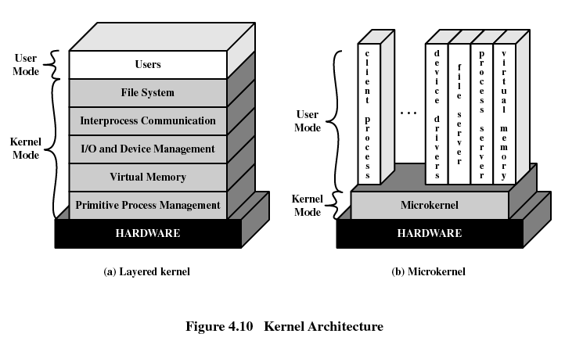

Slide 45
4.3 Microkernel
4.3.1 Microkernel Architecture
4.3.2 Benefits of a Microkernel Organization
4.3.3 Microkernel Performance
4.3.4 Microkernel Design

Slide 46
Benefits of a Microkernel Organization
Uniform interface(一致接口) on request made by a process
  Don’t distinguish between kernel-level and user-level services
  All services are provided by means of message passing
Extensibility(可扩展性)
  Allows the addition of new services
Flexibility(灵活性)
  New features added
  Existing features can be subtracted(删减)

Slide 47
Benefits of a Microkernel Organization
Portability(可移植性)
  Changes needed to port the system to a new processor is changed in the microkernel - not in the other services
Reliability(可靠性)
  Modular design
  Small microkernel can be rigorously tested

Slide 48
Benefits of a Microkernel Organization
Distributed system support (分布式系统支持)
  Message are sent without knowing what the target machine is
Object-oriented operating system (面向对象)
  Components are objects with clearly defined interfaces that can be interconnected to form software

Slide 49
4.3 Microkernel
4.3.1 Microkernel Architecture
4.3.2 Benefits of a Microkernel Organization
4.3.3 Microkernel Performance
4.3.4 Microkernel Design

Slide 50
4.3.3 Microkernel Performance
A potential disadvantage of microkernels that is often cited is that of performance
One response to this problem was to enlarge the microkernel by reintegrating critical servers and drivers back into the OS
Another approach is to make the microkernel not larger but samller

Slide 51
4.3 Microkernel
4.3.1 Microkernel Architecture
4.3.2 Benefits of a Microkernel Organization
4.3.3 Microkernel Performance
4.3.4 Microkernel Design

Slide 52
Microkernel Design
Low-level memory management(低级存储管理)
Interprocess communication (进程间通信)
I/O and interrupt management (I/O和中断管理)

Slide 53
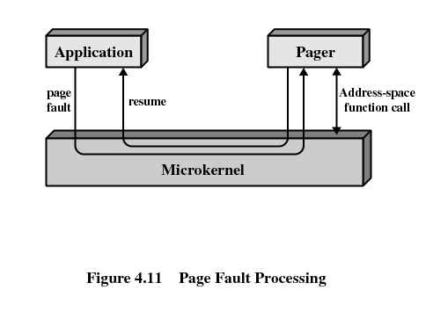
Microkernel Design
Low-level memory management
  Mapping each virtual page to a physical page frame

Slide 54
Microkernel Design
Interprocess communication
  Message
  Port
  Thread-based IPC
  Memory-sharing

Slide 55
Microkernel Design
I/O and interrupt management
  Driver thread:
  do
  waitFor (msg, sender);
  if (sender == my_hardware_interrupt)
  {
  read/write I/O ports;
  reset hardware interrupt
  }

Slide 56
Agenda
4.1 Processes and Threads
4.2 Symmetric Multiprocessing
4.3 Microkernel
4.4 Summary

Slide 57
Homework
Review Questions:
  4.2
  4.3
  4.6
  4.7
Problems:
  4.2

