Slide 1
Process Description and Control
Chapter 3

Slide 2
Agenda
3.1 What is a Process
3.2 Process States
3.3 Process Description
3.4 Process Control

Slide 3
3.1 What is a Process
3.1.1 Background
3.1.2 Processes and Process Control Blocks

Slide 4
Concepts Introduced In Chapter 1&2
Computer platform consists of a collection of hardware resources(硬件资源)
Computer applications(应用程序) are developed to perform some task
Inefficient for applications to be written directly(直接编写应用) for a given hardware platform
Operating system provides a convenient to use, feature rich, secure, and consistent interface(接口) for applications to use
OS provides a uniform, abstract representation of resources(统一和抽象的资源描述) that can be requested and accessed by application

Slide 5
Manage Execution of Applications (管理应用程序执行的目的)
Resources made available(可用) to multiple applications
Processor is switched among multiple applications (多应用间切换)
The processor and I/O devices can be used efficiently (有效利用处理器和I/O设备)

Slide 6
3.1 What is a Process
3.1.1 Background
3.1.2 Processes and Process Control Blocks

Slide 7
Process
A program in execution(执行中的程序)
An instance of a program running on a computer(执行的程序实例)
The entity that can be assigned to and executed on a processor(能分配处理器及执行的实体)
A unit of activity characterized by：
  the execution of a sequence of instructions
  a current state(状态)
  an associated set of system resources(资源)

Slide 8
Process Control Block
Process Identification(标识信息)
Processor State Information(状态信息)
  User-Visible Registers
  Control and Status Registers
  Stack Pointers
Process Control information(控制信息)
  Scheduling and State Information
  Data Structuring
  Interprocess Communication
  Process Privileges
  Memory Management
  Resource Ownership and Utilization

Slide 9
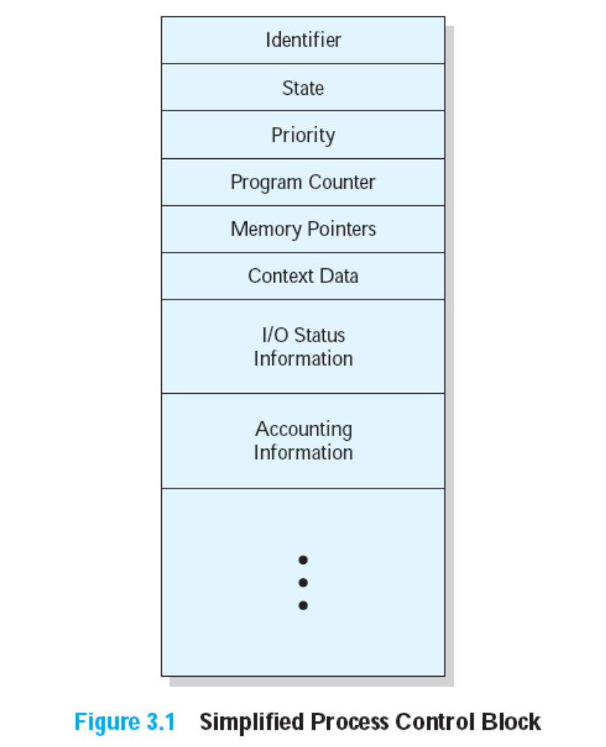
Process Control Block(进程控制块)
Contains the process elements
Created and managed by the operating system
Allows support for multiple processes

Slide 10
Agenda
3.1 What is a Process
3.2 Process States
3.3 Process Description
3.4 Process Control

Slide 11
3.2 Process States
3.2.1 Trace of the Process
3.2.2 A Two-State Process Model
3.2.3 The Creation and Termination of Processes
3.2.4 A Five-State Model
3.2.5 Suspended Process

Slide 12
Trace of Process(进程轨迹)
Sequence of instruction (指令顺序) that execute for a process
Dispatcher(调度器) switches the processor from one process to another

Slide 13
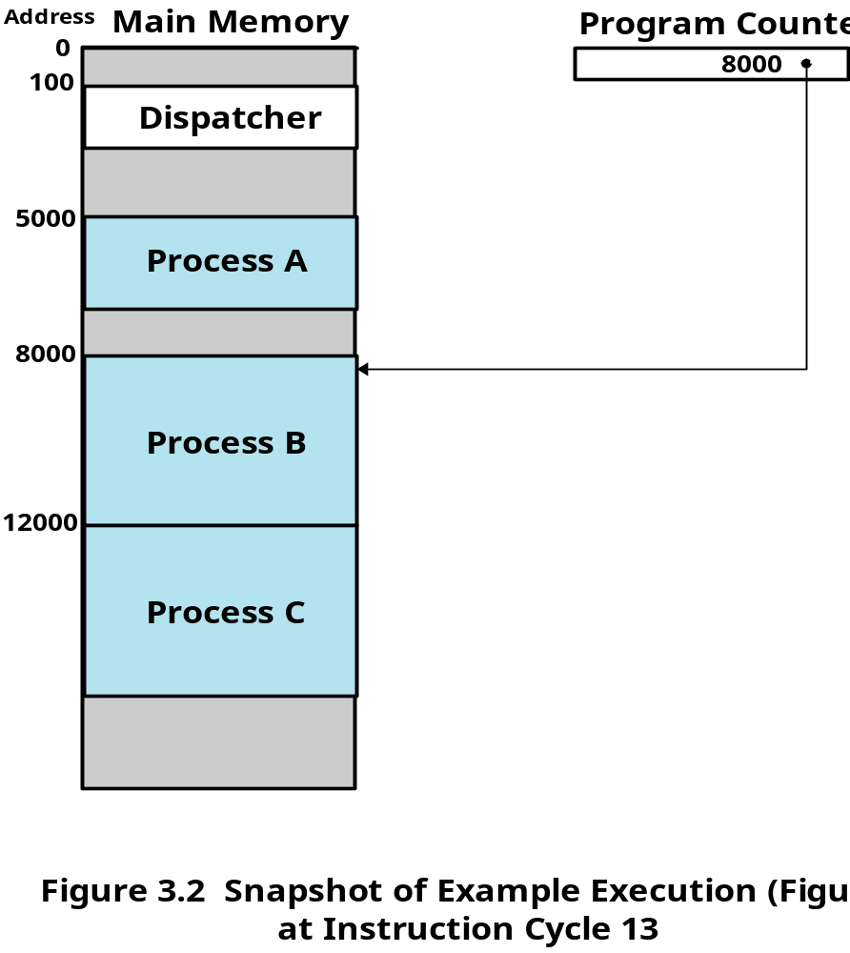
Example Execution

Slide 14
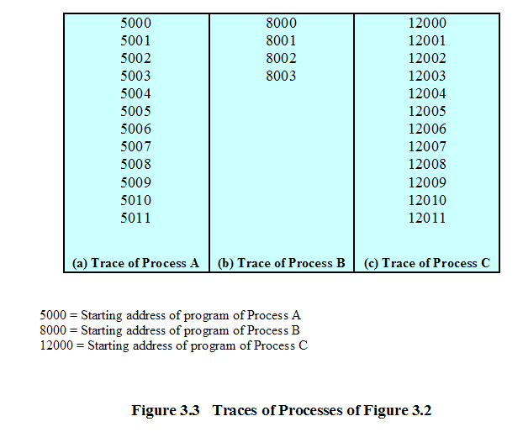
Trace of Processes

Slide 15
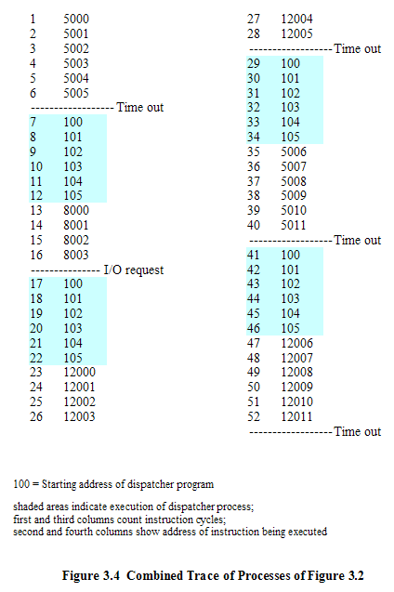
Trace of Processes

Slide 16
3.2 Process States
3.2.1 Trace of the Process
3.2.2 A Two-State Process Model
3.2.3 The Creation and Termination of Processes
3.2.4 A Five-State Model
3.2.5 Suspended Process

Slide 17
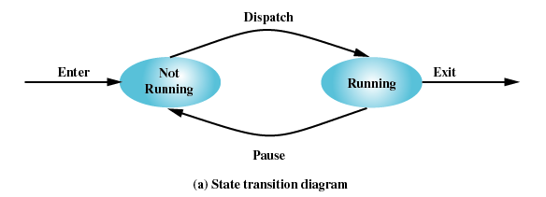
Two-State Process Model
Process may be in one of two states
  Running
  Not-running

Slide 18
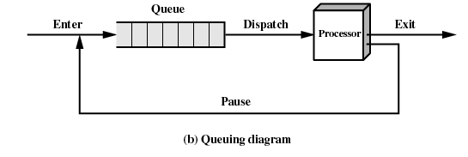
Not-Running Process in a Queue

Slide 19
3.2 Process States
3.2.1 Trace of the Process
3.2.2 A Two-State Process Model
3.2.3 The Creation and Termination of Processes
3.2.4 A Five-State Model
3.2.5 Suspended Process

Slide 20
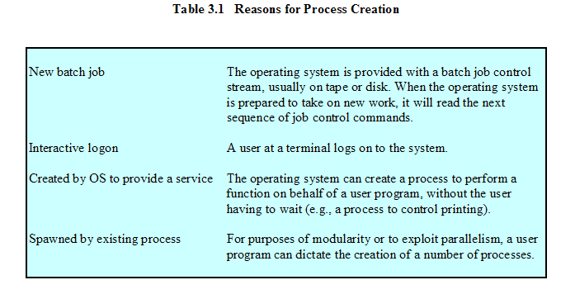
Process Creation

Slide 21
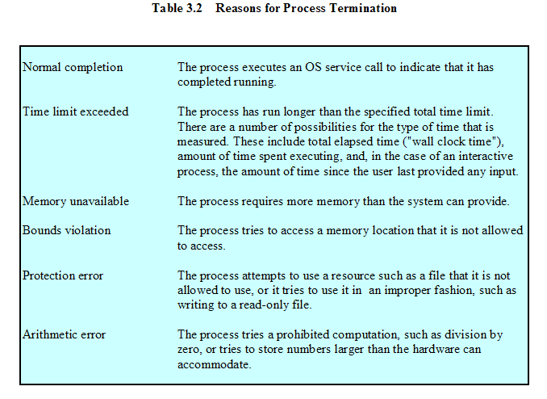
Process Termination

Slide 22
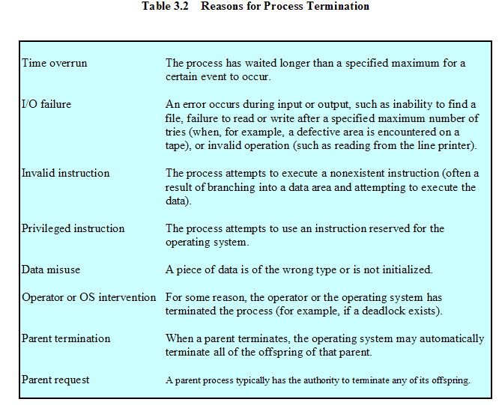
Process Termination

Slide 23
3.2 Process States
3.2.1 Trace of the Process
3.2.2 A Two-State Process Model
3.2.3 The Creation and Termination of Processes
3.2.4 A Five-State Model
3.2.5 Suspended Process

Slide 24
Limit of Two-State Process Model
Not-running
  ready to execute
  waiting for I/O (blocked)
Dispatcher cannot just select the process that has been in the queue the longest because it may be blocked (阻塞)

Slide 25
A Five-State Model
Running(运行态)
Ready(就绪态)
Blocked(阻塞态)
New(新建态)
Exit(退出态)

Slide 26
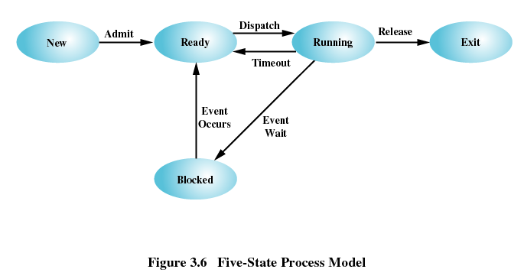
Five-State Process Model

Slide 27
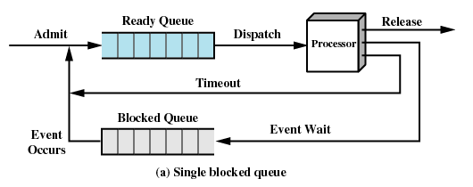
Using Two Queues

Slide 28
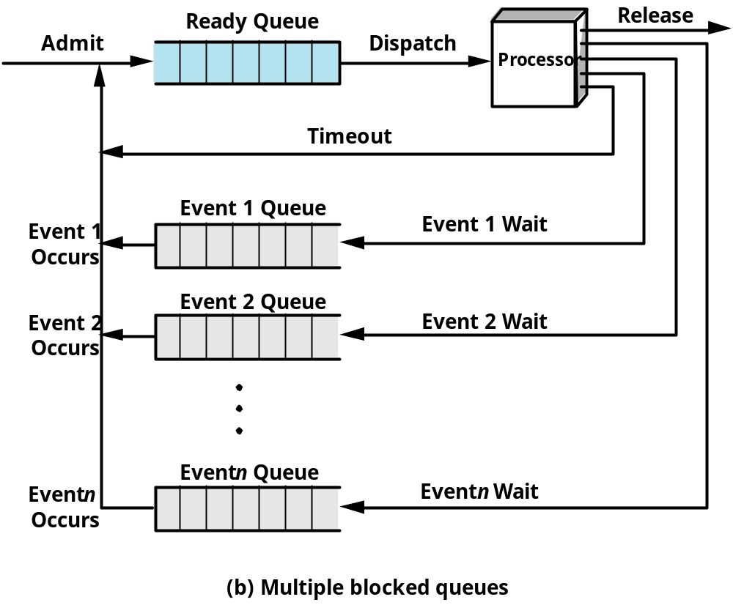
Multiple Blocked Queues

Slide 29
3.2 Process States
3.2.1 Trace of the Process
3.2.2 A Two-State Process Model
3.2.3 The Creation and Termination of Processes
3.2.4 A Five-State Model
3.2.5 Suspended Process

Slide 30
Suspended Processes(被挂起的进程)
Processor is faster than I/O so all processes could be waiting for I/O
Swap these processes to disk to free up more memory
Blocked state becomes suspend state when swapped to disk

Slide 31
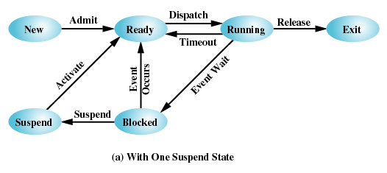
One Suspend State

Slide 32
Suspended Processes(被挂起的进程)
Whether a process is waiting on an event(是否被阻塞)
Whether a process has been swapped(是否被挂起)
Two new states
  Blocked/Suspend
  Ready/Suspend

Slide 33
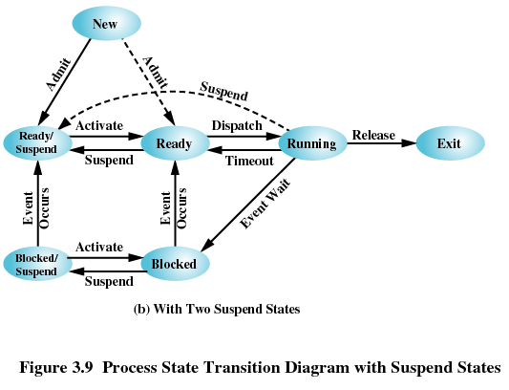
Two Suspend States

Slide 34
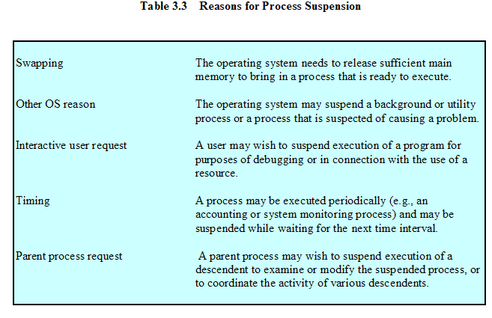
Reasons for Process Suspension

Slide 35
Agenda
3.1 What is a Process
3.2 Process States
3.3 Process Description
3.4 Process Control

Slide 36
3.3 Process Description
3.3.1 Processes and Resources
3.3.2 Operating System Control Structures
3.3.3 Process Control Structures

Slide 37
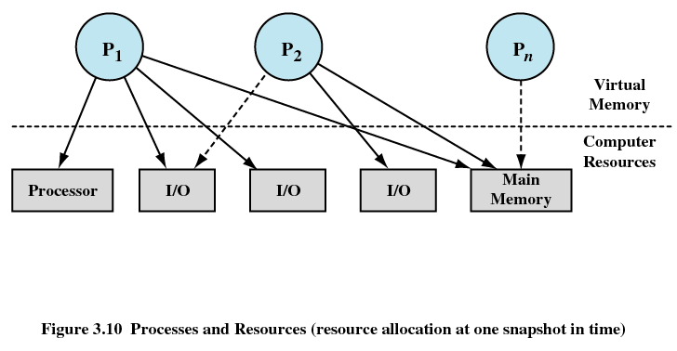
Processes and Resources

Slide 38
3.3 Process Description
3.3.1 Processes and Resources
3.3.2 Operating System Control Structures
3.3.3 Process Control Structures

Slide 39
Operating System Control Structures
Information about the current status of each process and resource(进程和资源状态)
Tables(表) are constructed for each entity the operating system manages

Slide 40
Memory Tables
Allocation of main memory to processes (分配给进程的主存)
Allocation of secondary memory to processes (分配给进程的辅存)
Protection attributes for access to shared memory regions(共享内存区域)
Information needed to manage virtual memory (虚拟内存)

Slide 41
I/O Tables
I/O device is available(可用) or assigned(已分配)
Status of I/O operation
Location in main memory being used as the source or destination of the I/O transfer

Slide 42
File Tables
Existence of files (文件是否存在)
Location on secondary memory (文件位置)
Current Status (当前状态)
Attributes (属性)

Slide 43
Process Table
Every entry is a description of a process image
(每个条目描述一个进程映像)

Slide 44
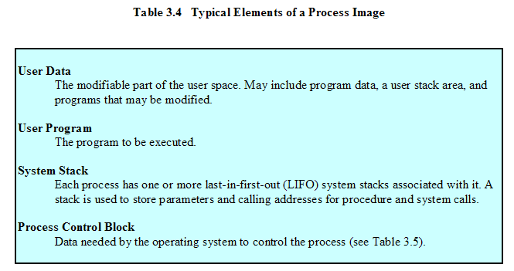
Process Image

Slide 45
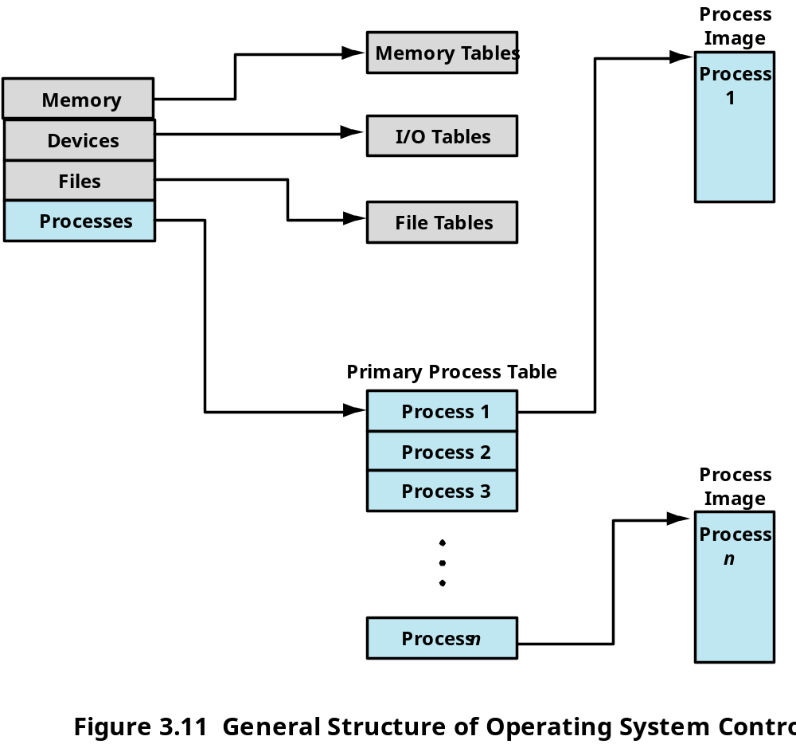
Structure of OS Control Tables

Slide 46
Agenda
3.1 What is a Process
3.2 Process States
3.3 Process Description
3.4 Process Control

Slide 47
3.4 Process Control
3.4.1 Modes of Execution
3.4.2 Process Creation
3.4.3 Process Switching
3.4.4 Execution of the Operating System

Slide 48
Modes of Execution
User mode(用户模式)
  Less-privileged mode
  User programs typically execute in this mode
System mode, control mode, or kernel mode(内核模式)
  More-privileged mode
  Kernel of the operating system
Translation(切换) between the two model
  Processor status register (psr) and current privileged level (cpl)
  User mode->System mode
  System mode->User mode

Slide 49
3.4 Process Control
3.4.1 Modes of Execution
3.4.2 Process Creation
3.4.3 Process Switching
3.4.4 Execution of the Operating System

Slide 50
Process Creation
Assign a unique process identifier
Allocate space for the process
Initialize process control block
Set up appropriate linkages(连接)
  Ex: add new process to linked list used for scheduling queue
Create of expand other data structures
  Ex: maintain an accounting file

Slide 51
3.4 Process Control
3.4.1 Modes of Execution
3.4.2 Process Creation
3.4.3 Process Switching
3.4.4 Execution of the Operating System

Slide 52
When to Switch a Process
Clock interrupt
  process has executed for the maximum allowable time slice
I/O interrupt
Memory fault(失效)
  memory address is in virtual memory so it must be brought into main memory

Slide 53
When to Switch a Process
Trap
  error or exception occurred
  may cause process to be moved to Exit state
Supervisor call (System Call)
  such as file open

Slide 54
Change of Process State
Save context(上下文) of processor including program counter and other registers
Update the process control block of the process that is currently in the Running state
Move process control block to appropriate queue – ready; blocked; ready/suspend
Select another process for execution

Slide 55
Change of Process State
Update the process control block of the process selected
Update memory-management data structures
Restore context of the selected process

Slide 56
3.4 Process Control
3.4.1 Modes of Execution
3.4.2 Process Creation
3.4.3 Process Switching
3.4.4 Execution of the Operating System

Slide 57
Execution of the Operating System
Non-process Kernel（无进程内核）
  Execute kernel outside of any process
  Operating system code is executed as a separate entity that operates in privileged mode
Execution Within User Processes(在用户进程中执行)
  Operating system software within context of a user process
  Process executes in privileged mode when executing operating system code
Process-Based Operating System（基于进程的OS）
  Implement operating system as a collection of system processes
  Useful in multi-processor or multi-computer environment

Slide 58
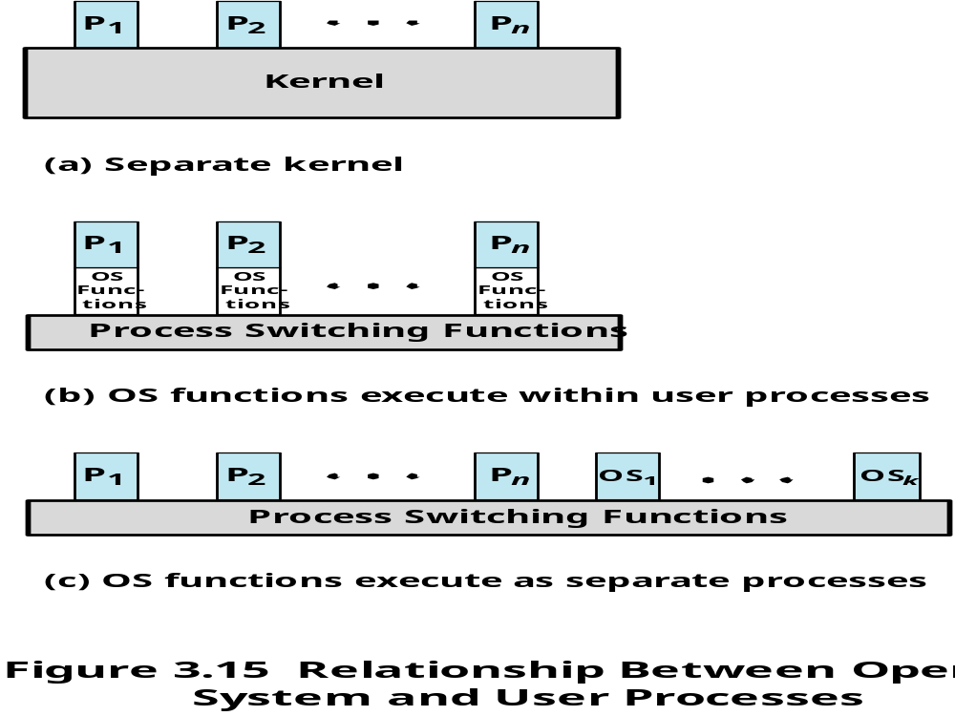

Slide 59
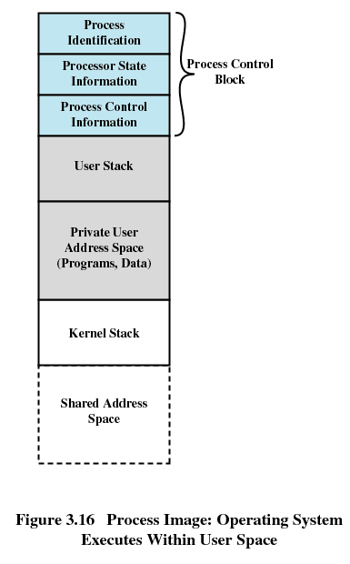

Slide 60
Homework
Review Questions:
  3.5
  3.10
Problems:
  3.1
  3.3

