Slide 1
Operating Systems
Chapter 2 Operating System Overview
四川大学软件学院 梁刚
问题交流：lianggang@scu.edu.cn
作业提交、Website for 课件：
Swjx.scu.edu.cn
Tel：15881060466

Slide 2
Agenda
2.1 Operating System Objectives and Functions
2.2 The Evolution of Operating Systems
2.3 Major Achievements
2.4 Developments Leading to Modern Operating Systems

Slide 3
Agenda
2.1 Operating System Objectives and Functions
2.2 The Evolution of Operating Systems
2.3 Major Achievements
2.4 Developments Leading to Modern Operating Systems

Slide 4
2.1 Operating System Objectives and Functions
2.1.0 Introduction
2.1.1 The Operating System as a User/Computer Interface
2.1.2 The Operating System as Resource Manager
2.1.3 Ease of Evolution of an Operating System

Slide 5
2.1 Operating System Objectives and Functions
2.1.0 Introduction
2.1.1 The Operating System as a User/Computer Interface
2.1.2 The Operating System as Resource Manager
2.1.3 Ease of Evolution of an Operating System

Slide 6
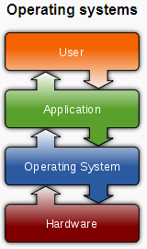
2.1.0 Introduction (1/3)
operating System definition: A program that
  controls the execution of application programs
  Acts as an interface between applications and hardware

Slide 7
2.1.0 Introduction (2/3)
Other definition: [Ref: Wiki]
  An operating system (OS) is an interface between hardware and user, which is responsible for the management and coordination of activities and the sharing of the resources of a computer, that acts as a host for computing applications run on the machine.
  One of the purposes of an operating system is to handle the resource allocation and access protection of the hardware. This relieves the application programmers from having to manage these details.

Slide 8
2.1.0 Introduction (3/3)
Operating System Objectives
  Convenience/方便
    Makes the computer more convenient to use
  Efficiency /有效
    Allows computer system resources to be used in an efficient manner
  Ability to evolve /扩展
    Permit effective development, testing, and introduction of new system functions without interfering with service

Slide 9
2.1 Operating System Objectives and Functions
2.1.0 Introduction
2.1.1 The Operating System as a User/Computer Interface
2.1.2 The Operating System as Resource Manager
2.1.3 Ease of Evolution of an Operating System

Slide 10
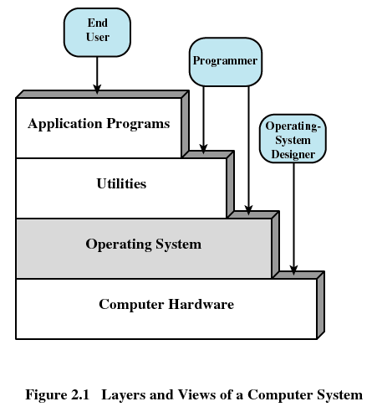
2.1.1 The Operating System as a User/Computer Interface (1/3)
Layers of Computer System

Slide 11
2.1.1 The Operating System as a User/Computer Interface (2/3)
Services Provided by the Operating System
  Program development
    Editors and debuggers
  Program execution
    loader
  Access to I/O devices
  Controlled access to files
  System access

Slide 12
2.1.1 The Operating System as a User/Computer Interface (3/3)
Services Provided by the Operating System(cont)
  Error detection and response
    Internal and external hardware errors
    Software errors
    ……
  Accounting(审计)

Slide 13
2.1 Operating System Objectives and Functions
2.1.0 Introduction
2.1.1 The Operating System as a User/Computer Interface
2.1.2 The Operating System as Resource Manager
2.1.3 Ease of Evolution of an Operating System

Slide 14
2.1.2 The Operating System as Resource Manager (1/3)
The Operating System as Resource Manager
  Responsible for managing resources/Hardware
  Work in the same way as ordinary computer software
    It is program that is executed
  Operating system frequently relinquishes(放弃) and regains control of the processor

Slide 15
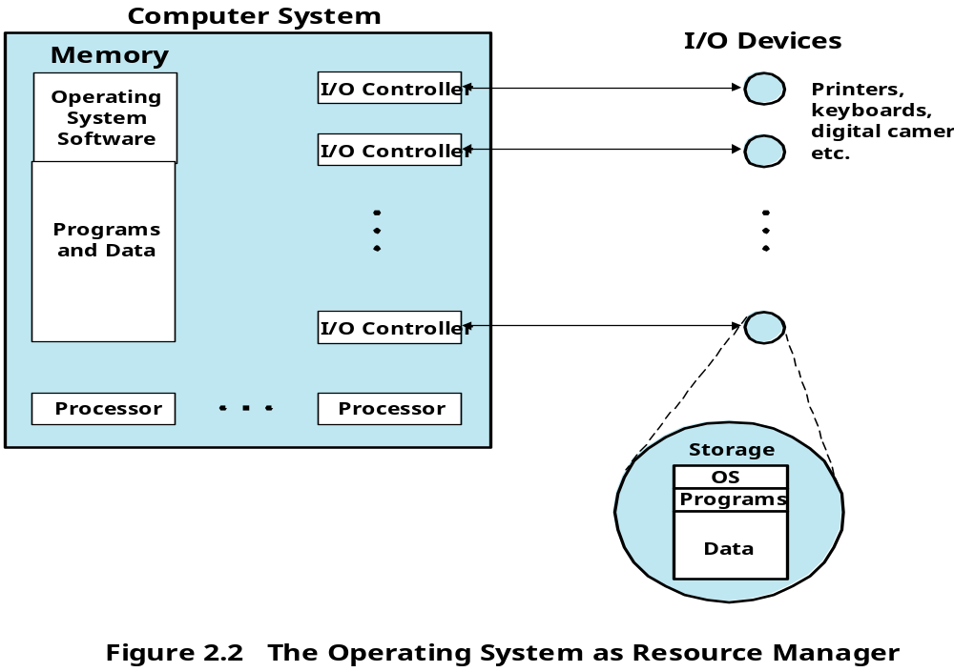
2.1.2 The Operating System as Resource Manager (2/3)

Slide 16
2.1.2 The Operating System as Resource Manager (3/3)
Kernel(内核)
  Portion of operating system that is in main memory
  Contains most frequently used functions
  Also called the nucleus（核子）

Slide 17
2.1 Operating System Objectives and Functions
2.1.0 Introduction
2.1.1 The Operating System as a User/Computer Interface
2.1.2 The Operating System as Resource Manager
2.1.3 Ease of Evolution of an Operating System

Slide 18
2.1.3 Ease of Evolution of an Operating System (1/1)
Why ?
  Hardware upgrades plus new types of hardware
  New services
  Fixes Bug
How ?
  OS Architecture [for more detail later on 2.3.5 ]

Slide 19
Agenda
2.1 Operating System Objectives and Functions
2.2 The Evolution of Operating Systems
2.3 Major Achievements
2.4 Developments Leading to Modern Operating Systems

Slide 20
2.2 The Evolution of Operating Systems
2.2.1 Serial Processing: No Operating Systems
2.2.2 Simple Batch Systems
2.2.3 Multiprogrammed Batch Systems
2.2.4 Time-Sharing Systems
Notes:
之后为了方便无人值守的批量任务执行，产生了单任务的批处理操作系统，批处理操作系统的任务很简单，按照实现设定好的顺序把任务装入执行。
为了充分利用大型机等昂贵设备的资源，产生了多任务操作系统（分时操作系统），为了让一般的学生和科学工作者也可以分享大型机的计算能力，出现了大型机+分时操作系统+ 哑终端的模式。
之后，慢慢出现了为普通人服务的微型机，也就是个人电脑。然而最早的个人电脑也是没有操作系统的，最早的个人电脑是阿尔塔（牛郎星电脑）没有键盘，显示器，只有开关和灯泡（像不像微型版的ENIAC）。
微软第一个成功的商业产品其实就是给牛郎星写的BASIC解释器，因为很多人免费使用（也就是盗版）这个BASIC解释器，比尔盖茨写了封“给爱好者们的公开信”，成为商业软件产业诞生的标志。实际上我们知道的著名的Apple I上面也并没有安装操作系统，只有一个ROM BASIC和引导程序。
From: <什么是操作系统？兼谈WebOS >: http://tech.163.com/06/0520/14/2HIT72KQ00091JUR.html

Slide 21
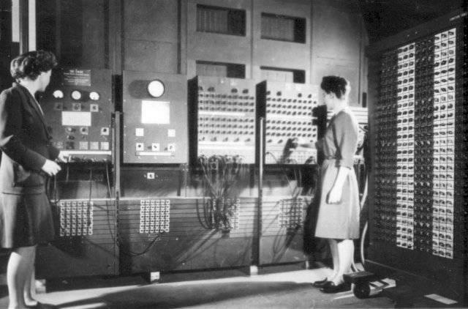
2.2.1 Serial Processing(1/2)
操作ENIAC
Time
  1940s-1950s
Notes:
最早的ENIAC （Electronic Numerical Integrator and Computer）没有键盘显示器等等的，所有的输入操作都是通过对开关的通断来实现的，输出是通过灯泡的亮灭显示的，改变计算公式甚至需要对线路进行重新的布置，那个年代是没有操作系统的
ENIAC里面并没有内存，只有寄存器，而且控制系统是通过硬接线实现的，想改变公式就需要对线路重新布置。这样操作其实非常的不方便。
所以，著名的“计算机之父”冯·诺依曼加入这个计划之后，提出了改进意见EDVAC （Electronic Discrete Variable AutomaticComputer）计划。EDVAC实际上就是最早的冯诺依曼结构的雏形，现在我们使用的通用计算机结构仍旧属于冯诺依曼结构。
From: <什么是操作系统？兼谈WebOS >: http://tech.163.com/06/0520/14/2HIT72KQ00091JUR.html

Slide 22
2.2.1 Serial Processing(2/2)
命名：the user have access to the system in series
特点：the programmer interacted directly with the computer hardware
如何操作：Machines run from a console with display lights, toggle switches, input device, and printer
Problem
  Scheduling: Most installations used a hardcopy sign-up sheet to reserve computer time
  Setup time: included loading the compiler, source program, saving compiled program, and loading and linking

Slide 23
2.2 The Evolution of Operating Systems
2.2.1 Serial Processing : No Operating Systems
2.2.2 Simple Batch Systems
2.2.3 Multiprogrammed Batch Systems
2.2.4 Time-Sharing Systems

Slide 24
2.2.2 Simple Batch Systems (1/10)
The central idea behind the simple batch processing scheme is
  Batch: made up by many jobs from users
    A job may use several program
  the use of a piece of software known as the monitor that controls the sequence of events.

Slide 25
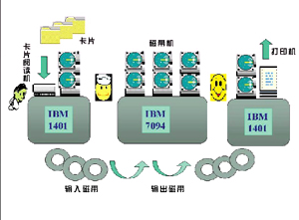
2.2.2 Simple Batch Systems (2/10)
举例：IBM 7904 简单/单任务批处理系统
  Batch / 批: 多个用户作业
Monitor

Slide 26
2.2.2 Simple Batch Systems (3/10)
The Process
  The monitor reads a job from the batch o
  Then control is passed to this job
  When the job is completed, it returns control to the monitor
  The monitor reads in the next job
Look at it from two point of view
  Monitor: resident manager
  CPU: control switch

Slide 27
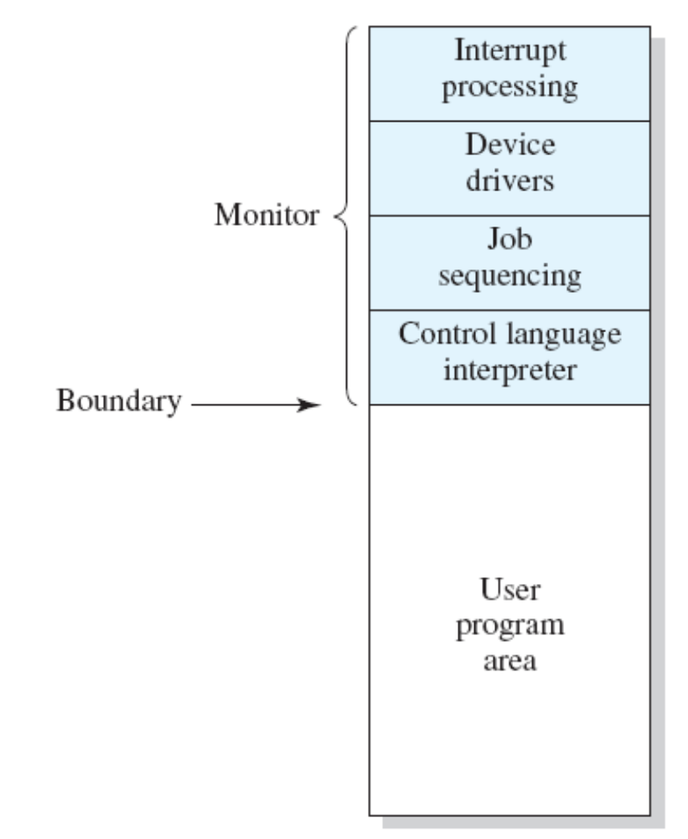
2.2.2 Simple Batch Systems (4/10)
PC
IR
R
CPU

Slide 28
2.2.2 Simple Batch Systems (5/10)
举例：IBM 7904 简单/单任务批处理系统
  Batch / 批: 多个用户作业
如何向Monitor描述操作？

Slide 29
2.2.2 Simple Batch Systems (6/10)
Job Control Language (JCL)
  Special type of programming language
  Provides instruction to the monitor
    What compiler to use
    What data to use
    …….

Slide 30
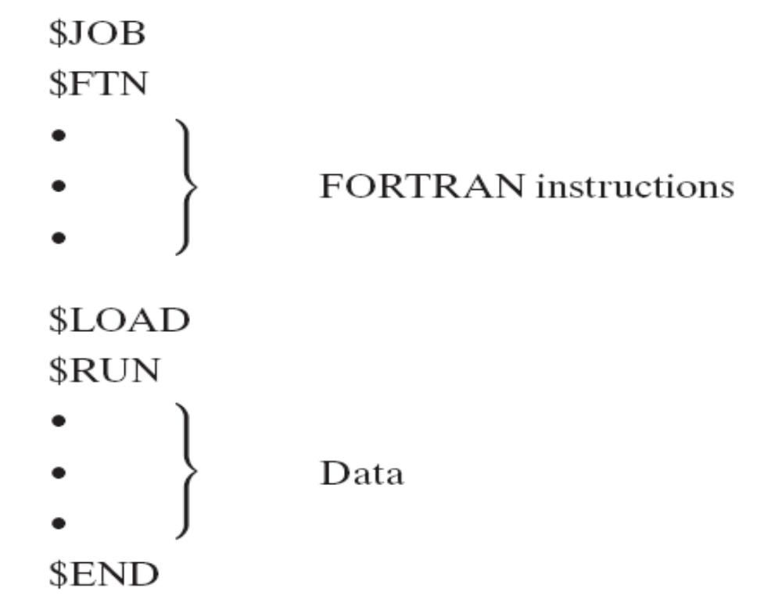
2.2.2 Simple Batch Systems (7/10)
Examples of Job Control Language (JCL)

Slide 31
2.2.2 Simple Batch Systems (8/10)
Hardware Features(cont.)
  Memory protection
    Do not allow the memory area containing the monitor to be altered
  Timer
    Prevents a job from monopolizing the system

Slide 32
2.2.2 Simple Batch Systems (9/10)
Hardware Features(cont.)
  Privileged instructions
    Certain machine level instructions can only be executed by the monitor
  Interrupts
    This feature gives the OS more flexibility in relinquishing control to and regaining control from user programs

Slide 33
2.2.2 Simple Batch Systems (10/10)
CPU mode
  User program executes in user mode(用户模式)
    Certain instructions may not be executed
    Some memory can not be accessed
  Monitor executes in system mode(系统模式)
    Kernel mode(内核模式)
    Privileged instructions are executed
    Protected areas of memory may be accessed

Slide 34
2.2 The Evolution of Operating Systems
2.2.1 Serial Processing : No Operating Systems
2.2.2 Simple Batch Systems
2.2.3 Multiprogrammed Batch Systems
2.2.4 Time-Sharing Systems

Slide 35
2.2.3 Multiprogrammed Batch Systems (1/10)
Simple
  single
PC
IR
R
CPU

Slide 36
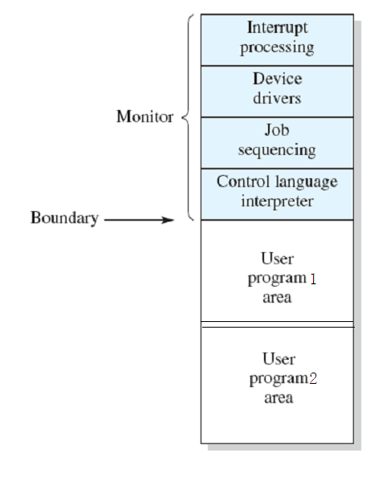
2.2.3 Multiprogrammed Batch Systems (2/10)
Multi
PC
IR
R
CPU

Slide 37
2.2.3 Multiprogrammed Batch Systems (3/10)
Why ?
  I/O Devices Slow
    CPU not Busy

Slide 38
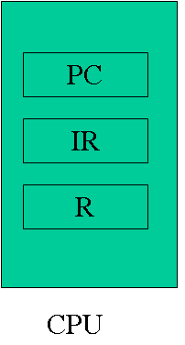
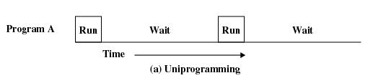
2.2.3 Multiprogrammed Batch Systems (4/10)
If the running user program
use slow I/O
  The CPU has to wait
I/O

Slide 39
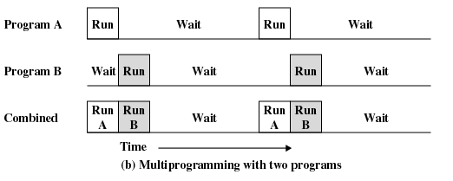
2.2.3 Multiprogrammed Batch Systems (5/10)
If the running user program 1
use slow I/O
  The CPU can run
  user program 2
I/O

Slide 40
2.2.3 Multiprogrammed Batch Systems (6/10)
Uniprogramming(单道程序设计)
  Processor must wait for I/O instruction to complete before preceding
Multiprogramming(多道程序设计)
  When one job needs to wait for I/O, the processor can switch to the other job
  Also known as Multitasking(多任务处理)

Slide 41
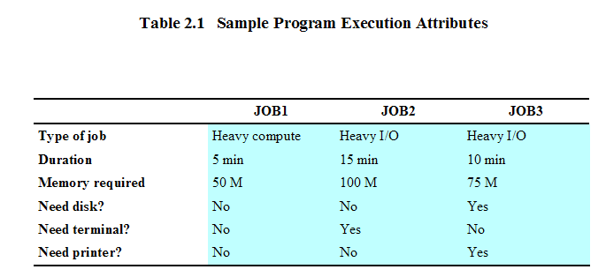
2.2.3 Multiprogrammed Batch Systems (7/10)
Example: 3个作业/程序
  各自情况描述

Slide 42
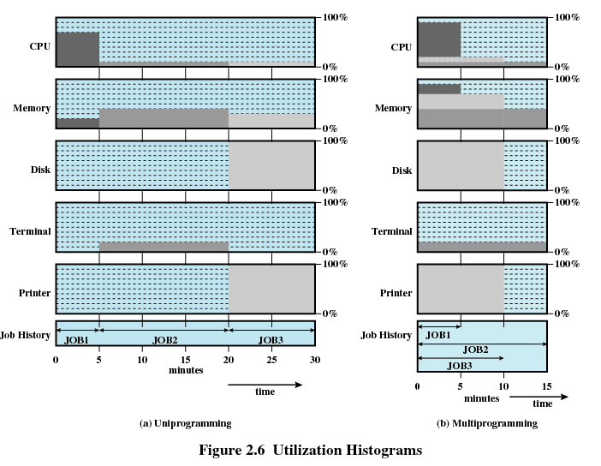
2.2.3 Multiprogrammed Batch Systems (8/10)
Example: 3个作业/程序 (cont.)
  Utilization Histograms(利用率直方图)

Slide 43
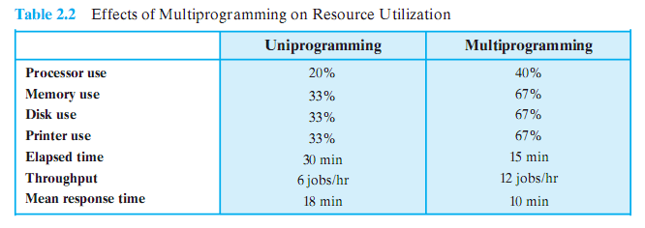
2.2.3 Multiprogrammed Batch Systems (9/10)
Example: 3个作业/程序(cont.)
  Effects of Multiprogramming on Resource Utilization

Slide 44
2.2.3Multiprogrammed Batch Systems(10/10)
所需支持：Multiprogrammed Batch Systems need H/W supports
  Interrupt
  DMA
  … …
带来的新问题：The new problem in Multiprogrammed Batch Systems
  Memory Management
  Scheduling / save and restore
  Contention（竞争）for resources
  ……

Slide 45
2.2 The Evolution of Operating Systems
2.2.1 Serial Processing : No Operating Systems
2.2.2 Simple Batch Systems
2.2.3 Multiprogrammed Batch Systems
2.2.4 Time-Sharing Systems

Slide 46
2.2.4 Time-Sharing Systems (1/4)
Why?
  Background: 1960s
    Mainframe Computer System:
    Multiple users simultaneously access the system through terminals
  Requirement: handle multiple interactive users/jobs
Idea
  Processor’s time is shared among multiple users/jobs

Slide 47
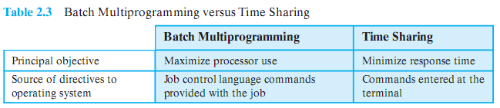
2.2.4 Time-Sharing Systems (2/4)
Batch Multiprogramming VS Time Sharing

Slide 48
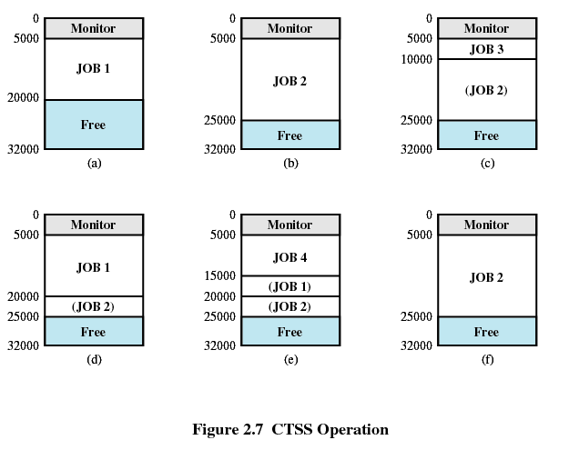
2.2.4 Time-Sharing Systems (3/4)
Example： CTSS ：First time-sharing system developed at MIT

Slide 49
2.2.4 Time-Sharing Systems (4/4)
所需支持：Multiprogrammed Batch Systems need H/W supports
  Interrupt
  … …
带来的新问题：The new problem in Time-Sharing Systems
  Memory Management
  Scheduling / save and restore
  Contention（竞争）for resources
  …

Slide 50
Agenda
2.1 Operating System Objectives and Functions
2.2 The Evolution of Operating Systems
2.3 Major Achievements
2.4 Developments Leading to Modern Operating Systems

Slide 51
2.3 Major Achievements
2.3.0 Introduction
2.3.1 The Process
2.3.2 Memory Management
2.3.3 Information Protection and Security
2.3.4 Scheduling and Resource Management
2.3.5 System Structure

Slide 52
2.3.0 Introduction
Review: OS are trying to meet some competing objectives, including convenience, efficiency, and ability to evolve.
Ref: [DENN80a] proposes that five major achievements
  The Process
  Memory Management
  Information Protection and Security
  Scheduling and Resource Management
  System Structure

Slide 53
2.3 Major Achievements
2.3.0 Introduction
2.3.1 The Process
2.3.2 Memory Management
2.3.3 Information Protection and Security
2.3.4 Scheduling and Resource Management
2.3.5 System Structure

Slide 54
2.3.1 The Processes (1/5)
Origin:
  Multics of 1960s
Some definition
  A program in execution
  An instance(实例) of a program running on a computer
  The entity(实体) that can be assigned to and executed on a processor
  A unit of activity(活动单位) characterized by a single sequential thread of execution(单一的顺序执行轨迹), a current state(当前状态), and an associated set of system resources(系统资源)

Slide 55
2.3.1 The Processes (2/5)
产生背景：Difficulties with Designing OS
  Improper synchronization
  Failed mutual exclusion
  Nondeterminate program operation
  Deadlocks

Slide 56
2.3.1 The Processes (3/5)
构成：Consists of three components
  An executable program /code
  Associated data needed by the program
  Execution context of the program (the core)
    All information the operating system needs to manage the process

Slide 57
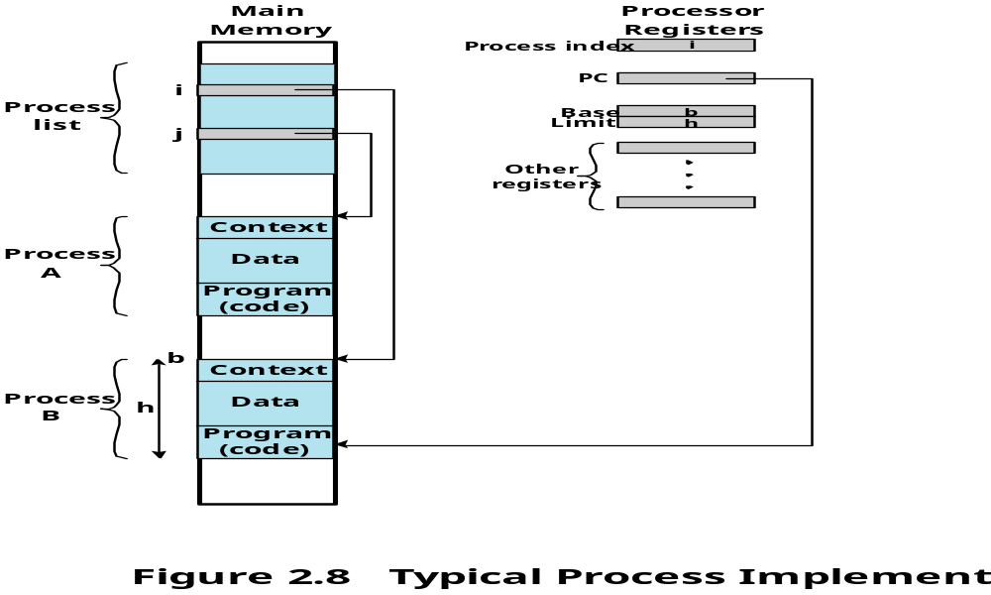
2.3.1 The Processes (4/5)
An example
CPU

Slide 58
2.3.1 The Processes (5/5)
The process is realized/implemented as a data structure
  This structure is employed to solve the problem raised by multiprogramming and resource sharing
  All information the operating system needs to manage the process is stored in the data structure
  More detail on Chapter 3

Slide 59
2.3 Major Achievements
2.3.0 Introduction
2.3.1 The Process
2.3.2 Memory Management
2.3.3 Information Protection and Security
2.3.4 Scheduling and Resource Management
2.3.5 System Structure

Slide 60
2.3.2 Memory Management (1/6)
OS has five storage management responsibilities:
  Process isolation(进程隔离)
  Automatic allocation and management(自动分配和管理)
  Support of modular programming(模块化程序设计)
  Protection and access control
  Long-term storage(长期存储)

Slide 61
2.3.2 Memory Management (2/6)
国内教材的一般观点：
  内存分配和回收
  地址翻译/地址映射
  保护/隔离和共享
  内存扩充
Disk

Slide 62
2.3.2 Memory Management (3/6)
File System
  Implements long-term store
  Information stored in named objects called files
    secondary store

Slide 63
2.3.2 Memory Management (4/6)
Virtual Memory / VM
  Allows programmers to address memory from a logical point of view
  No hiatus(裂缝) between the execution of successive processes while one process was written out to secondary store and the successor process was read in
Page
  Allows process to be comprised of a number of fixed-size blocks, called pages
  Each page may be located any where in main memory

Slide 64
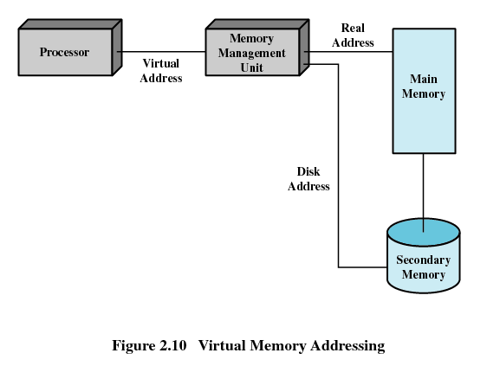
2.3.2 Memory Management (5/6)
Virtual Memory Addressing
  Storage system consists of main memory and auxiliary memory

Slide 65
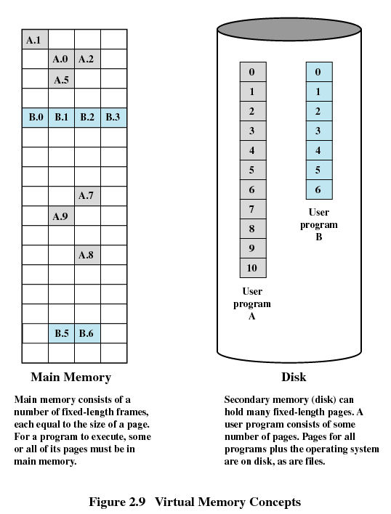
2.3.2 Memory Management (6/6)
Example of Virtual Memory / VM

Slide 66
2.3 Major Achievements
2.3.0 Introduction
2.3.1 The Process
2.3.2 Memory Management
2.3.3 Information Protection and Security
2.3.4 Scheduling and Resource Management
2.3.5 System Structure

Slide 67
2.3.3 Information Protection and Security(1/1)
Availability
Confidentiality
Data integrity
Authenticity

Slide 68
2.3 Major Achievements
2.3.0 Introduction
2.3.1 The Process
2.3.2 Memory Management
2.3.3 Information Protection and Security
2.3.4 Scheduling and Resource Management
2.3.5 System Structure

Slide 69
2.3.4 Scheduling and Resource Management (1/4)
OS:
  manage the resources (such as CPU, Main Memory, I/O devices)
  Schedule/调度 them to various active processes/进程
I/O

Slide 70
2.3.4 Scheduling and Resource Management (2/4)
The factors that should be considered
  Fairness(公平性)
    Give equal and fair access to resources
  Differential responsiveness(有差别的响应性)
    Discriminate among different classes of processes
  Efficiency(高效性)
    Maximize throughput(吞吐量), minimize response time(响应时间), and accommodate as many users as possible

Slide 71
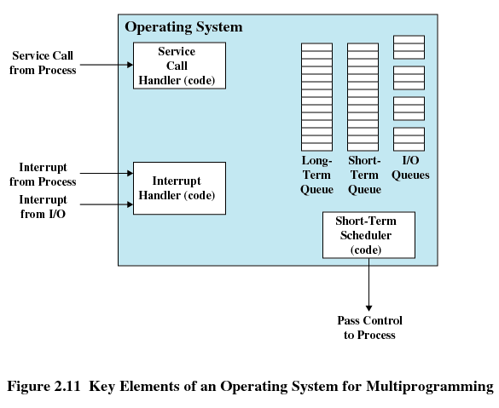
2.3.4 Scheduling and Resource Management (3/4)
Key Elements of Scheduling of Operating System

Slide 72
2.3.4 Scheduling and Resource Management (4/4)
Scheduling and resource management are essentially OS research problems
  Mathematical can be applied
Detail design of this portion of OS differ in various system
  Different application, so different needs and goals

Slide 73
2.3 Major Achievements
2.3.0 Introduction
2.3.1 The Process
2.3.2 Memory Management
2.3.3 Information Protection and Security
2.3.4 Scheduling and Resource Management
2.3.5 System Structure

Slide 74
2.3.5 System Structure (1/8)
the size and complexity of operating systems has grown.
  As more and more features have been added to operating systems,
  As the underlying hardware has become more capable and versatile,

Slide 75
2.3.5 System Structure (2/8)
CTSS: 32,000 36-bit words
OS/360: more than a million machine instructions
Multics: more than 20 million instructions.
Windows
  Windows NT 4.0: 16 million lines of code
  Windows 2000: more than 32 million lines of code
  Windows XP: 35 million lines of code
  Windows Vista: 50 million lines of code
Linux 2.6.27: 10 million lines of code

Slide 76
2.3.5 System Structure (3/8)
led to four unfortunate but all-too-common problems
  chronically late in being delivered
  performance is often not what was expected
  have latent bugs
  it has proved impossible to deploy a complex OS that is not vulnerable to a variety of security attacks, including viruses, worms, and unauthorized access.
Solution：
  The software must be modular.
  The modules must have well-defined interfaces
  Levels

Slide 77
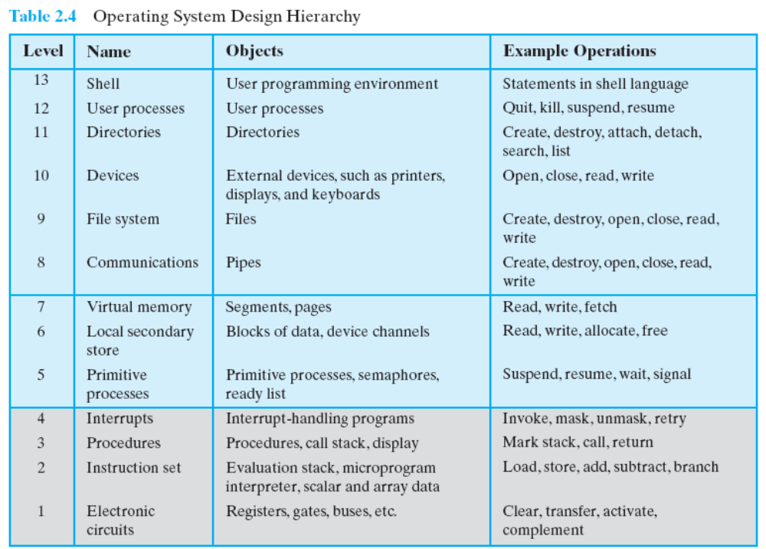
2.3.5 System Structure (4/8)

Slide 78
2.3.5 System Structure (5/8)
View the system as a series of levels
  Each level performs a related subset of functions
  Each level relies on the next lower level to perform more primitive functions
  效果：This decomposes a problem into a number of more manageable subproblems

Slide 79
2.3.5 System Structure (6/8)
Level 1
  Electronic circuits
  Objects are registers, memory cells, and logic gates
  Operations are clearing a register or reading a memory location
Level 2
  Processor’s instruction set
  Operations such as add, subtract, load, and store
Level 3
  Adds the concept of a procedure or subroutine, plus call/return operations
Level 4
  Interrupts

Slide 80
2.3.5 System Structure (7/8)
Level 5
  Process as a program in execution
  Suspend and resume processes
Level 6
  Secondary storage devices
  Transfer of blocks of data
Level 7
  Creates logical address space for processes
  Organizes virtual address space into blocks

Slide 81
2.3.5 System Structure (8/8)
Level 8
  Communication of information and messages between processes
Level 9
  Supports long-term storage of named files
Level 10
  Provides access to external devices using standardized interfaces
Level 11
  Responsible for maintaining the association between the external and internal identifiers
Level 12
  Provides full-featured facility for the support of processes
Level 13
  Provides an interface to the operating system for the user

Slide 82
Agenda
2.1 Operating System Objectives and Functions
2.2 The Evolution of Operating Systems
2.3 Major Achievements
2.4 Developments Leading to Modern Operating Systems

Slide 83
2.4 Modern Operating Systems (1/6)
Background
  new developments in hardware
  new applications
  new security threats
Five features are mentioned in this chapter
  Microkernel architecture : more on chapter 4
  Multithreading : more on chapter 4
  Symmetric multiprocessing (SMP) : more on chapter 4
  Distributed operating systems : chapter 14~15: 不讲解
  Object-oriented design

Slide 84
2.4 Modern Operating Systems (2/6)
Microkernel architecture
  VS monolithic kernel architecture
  Assigns only a few essential functions to the kernel
    Address spaces
    Interprocess communication (IPC)
    Basic scheduling

Slide 85
2.4 Modern Operating Systems (3/6)
Multithreading
  Process is divided into threads that can run concurrently
    Thread
      Dispatchable unit of work
      executes sequentially and is interruptable
    Process is a collection of one or more threads

Slide 86
2.4 Modern Operating Systems (4/6)
Symmetric multiprocessing (SMP)
  There are multiple processors
  These processors share same main memory and I/O facilities
  All processors can perform the same functions

Slide 87
2.4 Modern Operating Systems (5/6)
Distributed operating systems
  Provides the illusion of a single main memory space and single secondary memory space

Slide 88
2.4 Modern Operating Systems (6/6)
Object-oriented design
  Used for adding modular extensions to a small kernel
  Enables programmers to customize an operating system without disrupting system integrity

Slide 89
Homework
Review Questions:
  2.1
  2.5
Problems:
  2.1
  2.4

