Slide 1
Concurrency: Deadlock(死锁) and Starvation(饥饿)
Chapter 6

Slide 2
6.1 Principles of Deadlock
6.1 Principles of Deadlock
6.2 Deadlock Prevention
6.3 Deadlock Avoidance
6.4 Deadlock Detection
6.5 An Integrated Deadlock Strategy
6.6 Dining Philosophers Problem
6.7 Summary

Slide 3
Deadlock(死锁)
Permanent blocking(永久阻塞) of a set of processes(一组进程，闭环) that either compete for system resources or communicate with each other(相互竞争资源、通信)
No efficient solution(无通用有效解决方案)
Involve conflicting(冲突) needs for resources by two or more processes(两个以上)

Slide 4
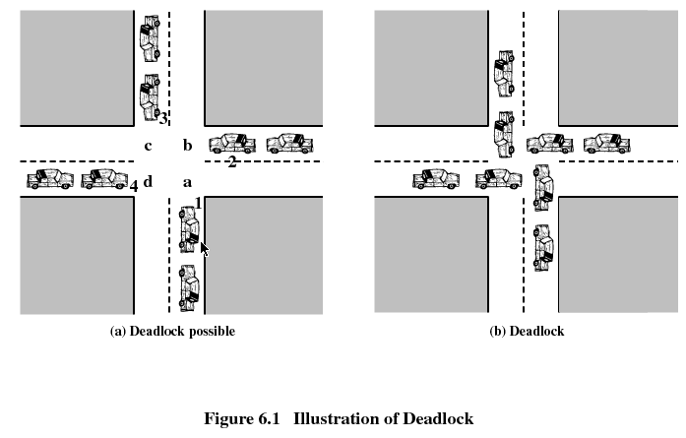

Slide 5
6.1 Principles of Deadlock
6.1.1 Reusable Resources
6.1.2 Consumable Resources
6.1.3 Resource Allocation Graphs
6.1.4 The Conditions for Deadlock

Slide 6
Reusable Resources(可重用资源)
Used by only one process at a time and not depleted(耗尽) by that use
Processes obtain resources that they later release for reuse by other processes(释放后其他进程可用)
Processors(处理器), I/O channels(I/O通道), main and secondary memory, devices, and data structures such as files, databases, and semaphores
Deadlock occurs if each process holds one resource and requests the other(拥有某个资源，再请求其他资源)

Slide 7
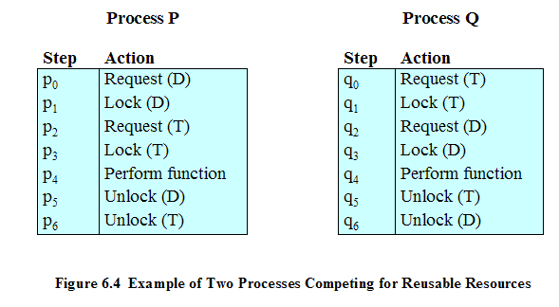
Example of Deadlock
Interleaves the execution: p0 p1 q0 q1 p2 q2

Slide 8
Another Example of Deadlock
Space is available for allocation of 200Kbytes, and the following sequence of events occur
Deadlock occurs if both processes progress to their second request
P1
P2
. . .
. . .
Request 80 Kbytes;
Request 70 Kbytes;
. . .
. . .
Request 60 Kbytes;
Request 80 Kbytes;

Slide 9
6.1 Principles of Deadlock
6.1.1 Reusable Resources
6.1.2 Consumable Resources
6.1.3 Resource Allocation Graphs
6.1.4 The Conditions for Deadlock

Slide 10
Consumable Resources(可消费资源)
Created (produced) and destroyed (consumed)
Interrupts, signals, messages, and information in I/O buffers
Deadlock may occur if a receive message is blocking
May take a rare combination of events to cause deadlock(很少的事件组合也可能导致死锁)

Slide 11
Example of Deadlock
Deadlock occurs if receive is blocking
P1
P2
. . .
. . .
Receive(P2);
Receive(P1);
. . .
. . .
Send(P2, M1);
Send(P1, M2);

Slide 12
6.1 Principles of Deadlock
6.1.1 Reusable Resources
6.1.2 Consumable Resources
6.1.3 Resource Allocation Graphs
6.1.4 The Conditions for Deadlock

Slide 13
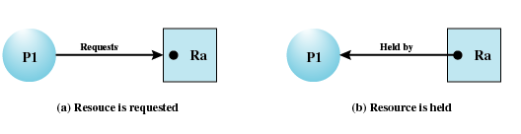
Resource Allocation Graphs(资源分配图)
Directed graph(有向图) that depicts(表述) a state of the system of resources and processes

Slide 14
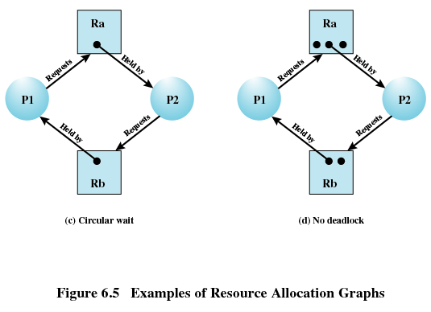
Resource Allocation Graphs

Slide 15
6.1 Principles of Deadlock
6.1.1 Reusable Resources
6.1.2 Consumable Resources
6.1.3 Resource Allocation Graphs
6.1.4 The Conditions for Deadlock

Slide 16
Conditions for Deadlock(死锁的条件)
Mutual exclusion(互斥)
  Only one process may use a resource at a time
Hold-and-wait(占有且等待)
  A process may hold allocated resources while awaiting assignment of others
No preemption(非抢占)
  No resource can be forcibly removed(强行抢占) form a process holding it

Slide 17
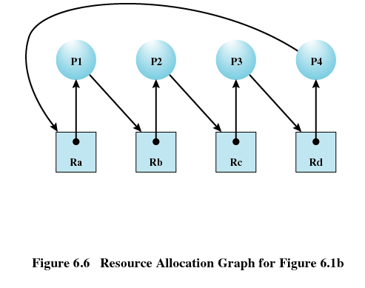
Conditions for Deadlock
Circular wait(循环等待)
  A closed chain of processes exists(封闭进程链), such that each process holds at least one resource needed by the next process in the chain

Slide 18
Dealing with deadlock
Prevent(预防)
  Adopting a policy that eliminates one of the conditions.(适当策略，消除4条件之一)
Avoid(避免)
  Making the appropriate dynamic choices based on the current state of resource allocation.(基于资源分配的当前状态，动态选择)
detect
  Detect the presence of deadlock and take action to recover.(检测死锁并恢复)

Slide 19
Agenda
6.1 Principles of Deadlock
6.2 Deadlock Prevention
6.3 Deadlock Avoidance
6.4 Deadlock Detection
6.5 An Integrated Deadlock Strategy
6.6 Dining Philosophers Problem
6.7 Summary

Slide 20
Deadlock Prevention(死锁预防)
Mutual Exclusion
  Must be supported by the operating system
Hold and Wait
  Require a process request all of its required resources at one time(一次性请求所有资源)

Slide 21
Deadlock Prevention
No Preemption
  Process must release resource and request again(被拒绝后释放占有资源)
  Operating system may preempt a process to require it releases its resources(被高优先级进程抢占)
Circular Wait
  Define a linear ordering of resource types(资源线性顺序)

Slide 22
Agenda
6.1 Principles of Deadlock
6.2 Deadlock Prevention
6.3 Deadlock Avoidance
6.4 Deadlock Detection
6.5 An Integrated Deadlock Strategy
6.6 Dining Philosophers Problem
6.7 Summary

Slide 23
Deadlock Avoidance(死锁避免)
A decision is made dynamically whether the current resource allocation request will, if granted, potentially lead to a deadlock(资源请求的动态决定)
Requires knowledge of future process request(需要知道进程的未来请求)

Slide 24
Two Approaches to
Deadlock Avoidance
Do not start a process if its demands might lead to deadlock(如果一个进程的请求会导致死锁，则不启动此进程，进程启动拒绝)
Do not grant an incremental resource request to a process if this allocation might lead to deadlock(如果一个进程增加资源的请求会导致死锁，则不容许此分配，资源分配拒绝)

Slide 25
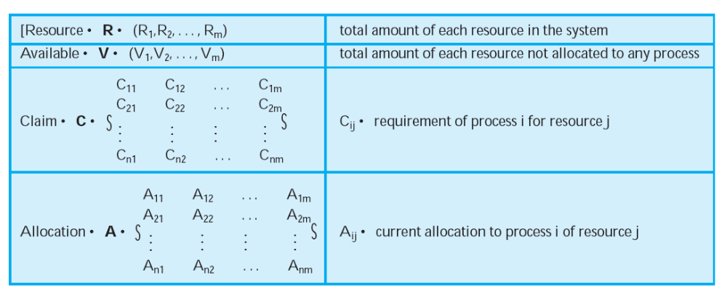
Process Initiation Denial(进程启动拒绝)
=
=
=
=
=
=
=
=
=
=

Slide 26
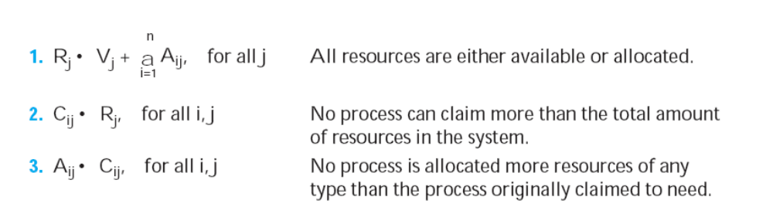
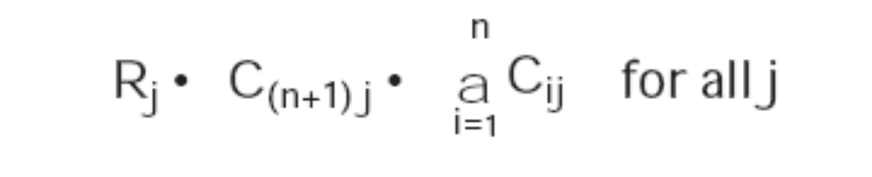
Process Initiation Denial (进程启动拒绝)
=
≦
≦
≧
+

Slide 27
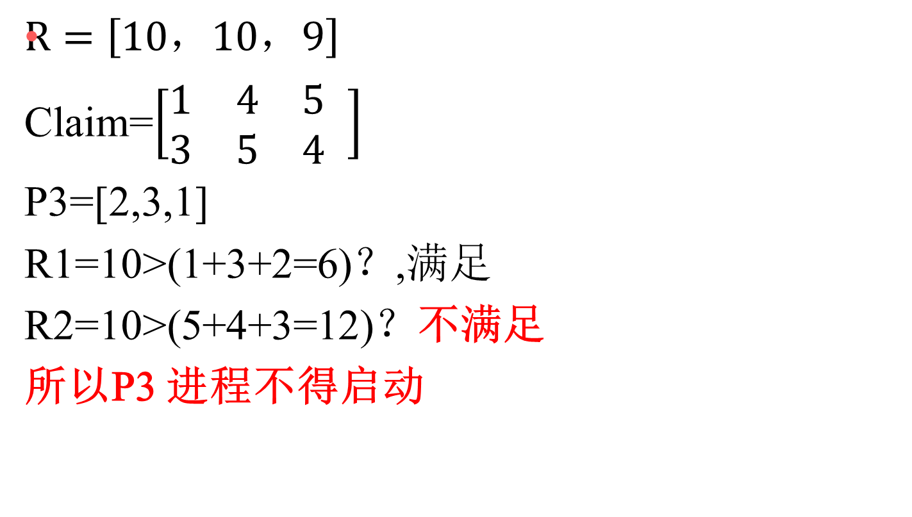
例：进程启动

Slide 28
Resource Allocation Denial
Referred to as the banker’s algorithm(银行家算法)
State of the system(系统状态) is the current allocation of resources to process
Safe state(安全状态) is where there is at least one sequence that does not result in deadlock
Unsafe state(不安全状态) is a state that is not safe

Slide 29
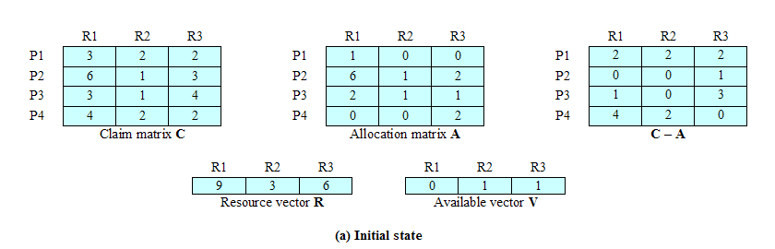
Determination of a Safe State
Initial State

Slide 30
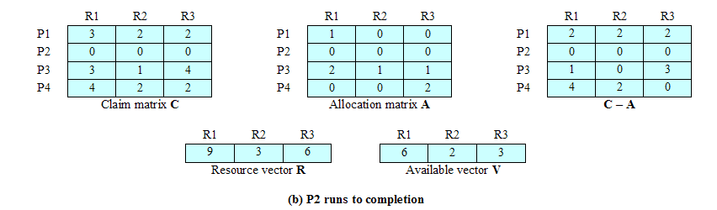
Determination of a Safe State
P2 Runs to Completion

Slide 31
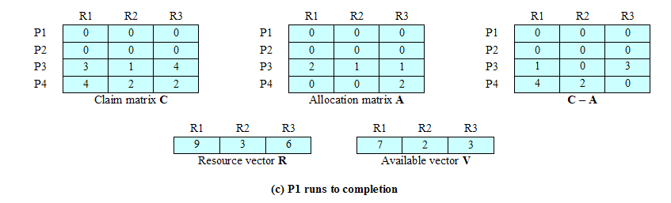
Determination of a Safe State
P1 Runs to Completion

Slide 32
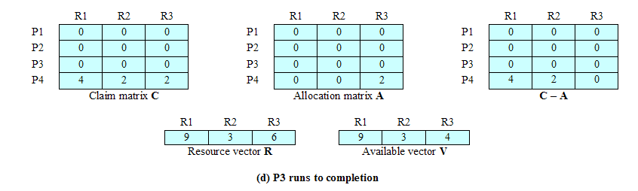
Determination of a Safe State
P3 Runs to Completion

Slide 33
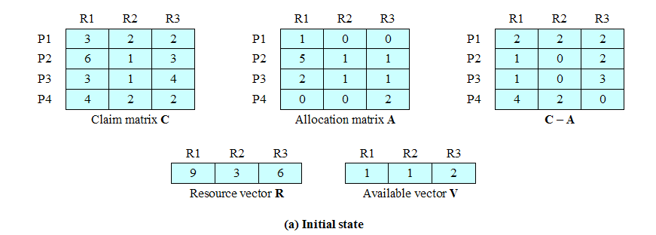
Determination of an
Unsafe State
P1 request for one additional unit each of R1 and R3

Slide 34
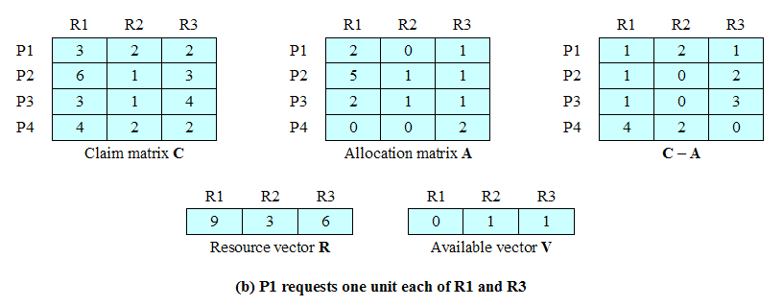
Determination of an
Unsafe State

Slide 35
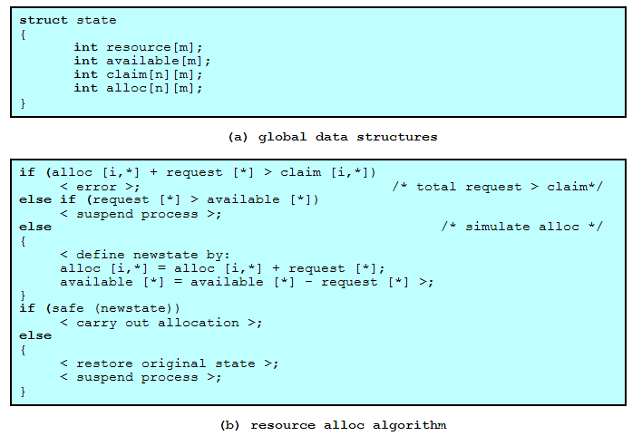
Deadlock Avoidance Logic(死锁避免逻辑)

Slide 36
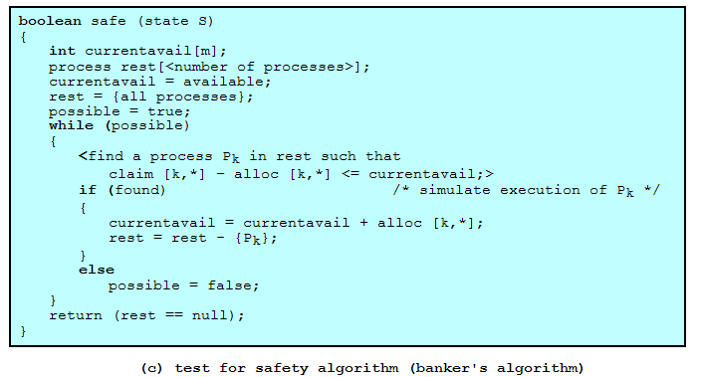
Deadlock Avoidance Logic

Slide 37
Restrictions of Deadlock Avoidance
Maximum resource requirement must be stated in advance(事先声明每个进程请求的最大资源)
Processes under consideration must be independent(独立); no synchronization requirements(无同步要求)
There must be a fixed number of resources to allocate(分配资源数目必须固定)
No process may exit while holding resources(占有资源，不能退出)

Slide 38
Agenda
6.1 Principles of Deadlock
6.2 Deadlock Prevention
6.3 Deadlock Avoidance
6.4 Deadlock Detection
6.5 An Integrated Deadlock Strategy
6.6 Dining Philosophers Problem
6.7 Summary

Slide 39
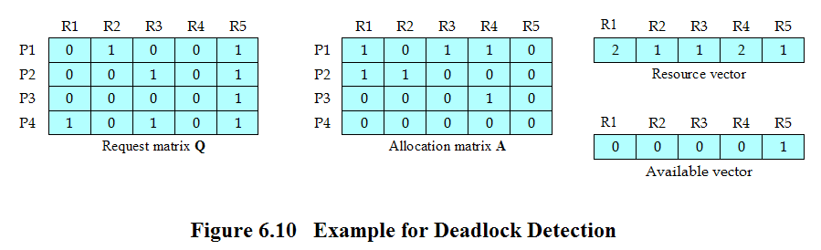
Deadlock Detection
Reference P.273 of the textbook for deadlock detection algorithm

Slide 40
Strategies Once Deadlock Detected
Abort all deadlocked processes(退出死锁进程)
Back up each deadlocked process to some previously defined checkpoint, and restart all process(回滚某个检查点，再重启)
  Original deadlock may occur
Successively abort deadlocked processes until deadlock no longer exists(连续退出进程)
Successively preempt resources until deadlock no longer exists(连续抢占资源)

Slide 41
Selection Criteria Deadlocked Processes(选择死锁进程原则)
Least amount of processor time consumed so far(耗费处理器时间最少)
Least number of lines of output produced so far(输出行数最少)
Most estimated time remaining(估计剩下时间最长)
Least total resources allocated so far(分配的资源最少)
Lowest priority(最低优先级)

Slide 42
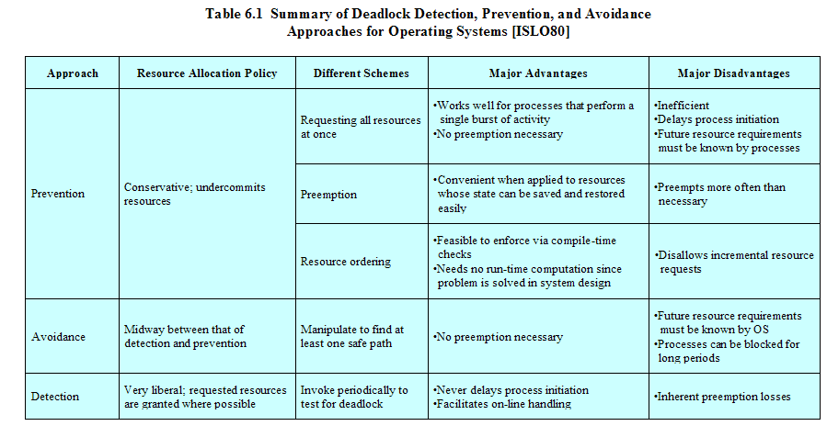
Strengths and Weaknesses of the Strategies

Slide 43
Agenda
6.1 Principles of Deadlock
6.2 Deadlock Prevention
6.3 Deadlock Avoidance
6.4 Deadlock Detection
6.5 An Integrated Deadlock Strategy
6.6 Dining Philosophers Problem
6.7 Summary

Slide 44
An Integrated Deadlock Strategy(一种综合死锁策略)
Group resources into a number of different resource classes(资源分类)
Use the linear ordering strategy defined previously for the prevention of circular wait to prevent deadlocks between resource classes(资源类之间采用线性排序)
Within a resource class, use the algorithm that is most appropriate for that class(资源类中使用最合适的算法)

Slide 45
An Integrated Deadlock Strategy
Swappable Space(可交换空间)
Process resource(进程资源)
Main memory(主存)
Internal resources(内部资源)

Slide 46
An Integrated Deadlock Strategy
Swappable Space: requiring all resources at one time(一次请求所有需要的资源)
Process resource: avoidance(死锁避免),resource ordering(资源排序)
Main memory: preemption(抢占)
Internal resources: resource ordering(资源排序)

Slide 47
Agenda
6.1 Principles of Deadlock
6.2 Deadlock Prevention
6.3 Deadlock Avoidance
6.4 Deadlock Detection
6.5 An Integrated Deadlock Strategy
6.6 Dining Philosophers Problem
6.7 Summary

Slide 48
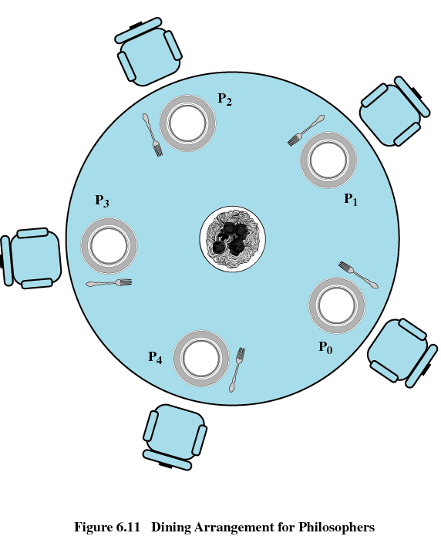
Dining Philosophers Problem(哲学家就餐问题)

Slide 49
Tactics(1)
允许死锁：
与题意不符合，所以鸵鸟算法和死锁检测不适用。
不允许死锁：
  静态方法，死锁预防：
    互斥：6把叉子或吃饭时共享叉子（不符合题意）；
    保持占有：要拿就拿两把（教材的例子）；
    抢占：不符合哲学家的身份；
    设定资源访问顺序：假设第一个哲学家年龄最大，第二个哲学家和第五个哲学家要让第一个哲学家先吃

Slide 50
Tactics(2)
  动态方法（应行家算法）：
  思路：哲学家在每次拿筷子的时候，进行判断，是否会造成死锁，如果可能出现死锁，哲学家就不拿筷子。

Slide 51
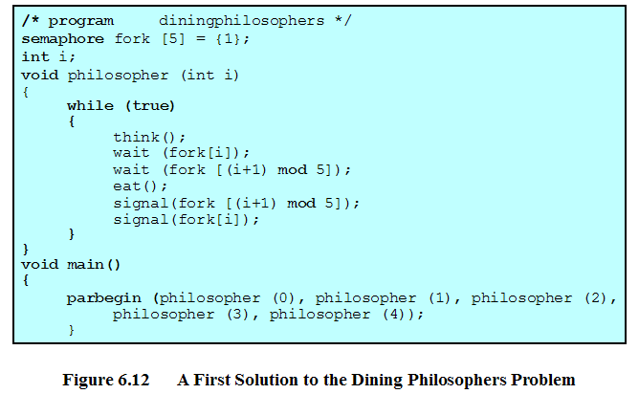
Dining Philosophers Problem (incorrect)

Slide 52
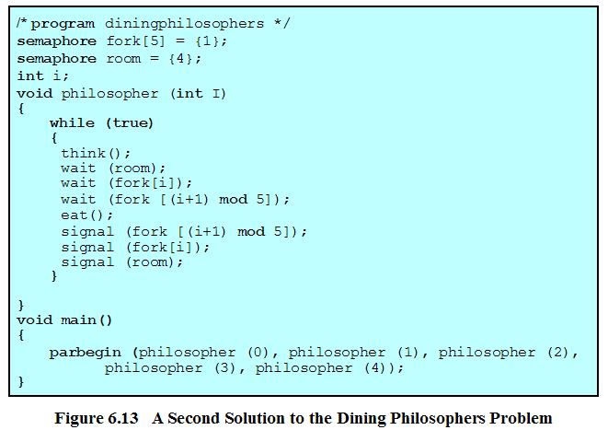
Dining Philosophers Problem

Slide 53
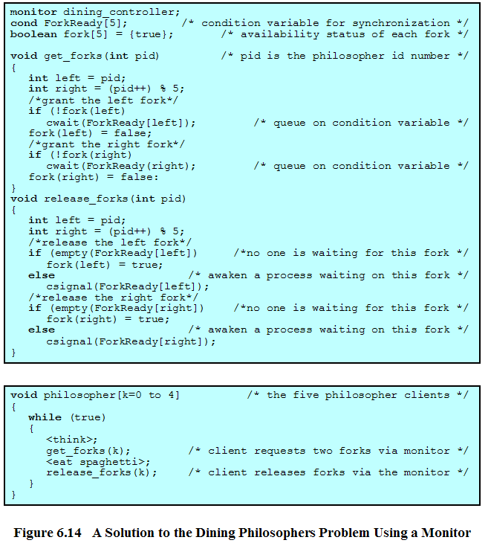
Dining Philosophers Problem

Slide 54
方法二：一次拿起两双筷子
semphore mutex=1
semphore philosopher[5]=1
Void philosopher(int i)
{
think();
semwait(mutex);
semwait(i%5);
semwait((i+1)%);
semsignal(mutex);
eat();
semsignal(i%5);
semsignal((i+1)%5);
}

Slide 55
方法三、设定资源的访问顺序
Semaphore fork[5]=1;
Semamphore s1=0,s2=0;
int i；
Void philosopher(int i)
{
while (true)
{
think();
if ((i mod 5)==1)
semwait(s1);
if ((i mod 5)==4)
semwait(s2);
semwait(fork[i]);
semwait(fork[(i+1)mod5]);}
eat();
semsignal(fork[i]);
semsignal(fokr[(i+1)mod 5]);
if ((i mod 5)==0)
{
semsignal(s1);
semsignal(s2);
}
}

Slide 56
方法三、动态避免
留给你们，家庭作业

Slide 57
Agenda
6.1 Principles of Deadlock
6.2 Deadlock Prevention
6.3 Deadlock Avoidance
6.4 Deadlock Detection
6.5 An Integrated Deadlock Strategy
6.6 Dining Philosophers Problem
6.7 Summary

Slide 58
Homework
Review Questions:
  6.2
  6.3
Problems:
  6.4
  6.5
Solution:
用银行家算法解决哲学家就餐问题

