Slide 1
Memory Management(内存管理)
Chapter 7

Slide 2
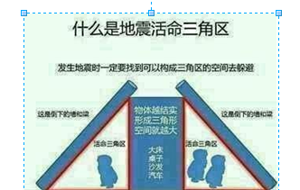
地震常识（1）

Slide 3

地震常识（2）

Slide 4
Agenda
7.1 Memory Management Requirements
7.2 Memory Partitioning
7.3 Paging
7.4 Segmentation
7.5 Summary

Slide 5
Memory Management
Subdividing memory to accommodate multiple processes(细分内存支持多道程序)
Memory needs to be allocated to ensure a reasonable supply of ready processes to consume available processor time(内存需要管理已确保有适当数目的就绪进程使用处理器时间)

Slide 6
7.1 Memory Management Requirements
7.1.1 Relocation
7.1.2 Protection
7.1.3 Sharing
7.1.4 Logical Organization
7.1.5 Physical Organization

Slide 7
Memory Management Requirements
Relocation(重定位)
  Programmer does not know where the program will be placed in memory when it is executed
  While the program is executing, it may be swapped(交换) to disk and returned to main memory at a different location (relocated)
  Memory references(访问) must be translated in the code to actual physical memory address(物理内存地址)

Slide 8
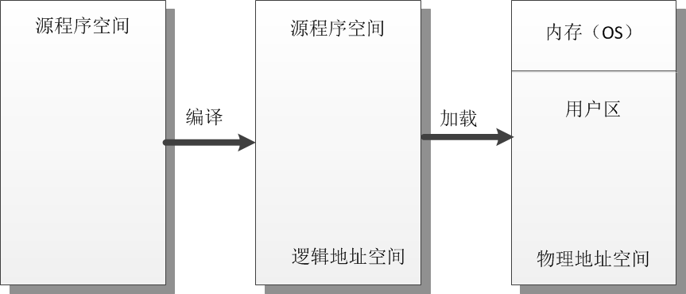
Relocation(重定位)

Slide 9
Addresses
Logical Address(逻辑地址)
  Reference to a memory location independent of the current assignment of data to memory(与当前数据在内存中的分配无关的访问地址)
  Translation must be made to the physical address
Relative Address(相对地址)
  Address expressed as a location relative to some known point
Physical Address(物理地址)
  The absolute address or actual location in main memory

Slide 10
Relocation(重定位)
When program loaded into(载入) memory the actual (absolute) memory locations are determined
A process may occupy different partitions which means different absolute memory locations during execution (from swapping，交换)
Compaction(压缩) will also cause a program to occupy a different partition which means different absolute memory locations

Slide 11
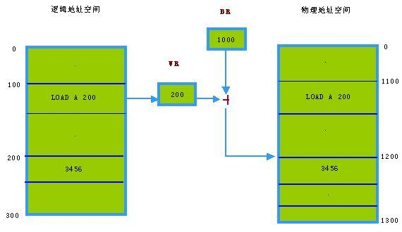
Static Relocation

Slide 12
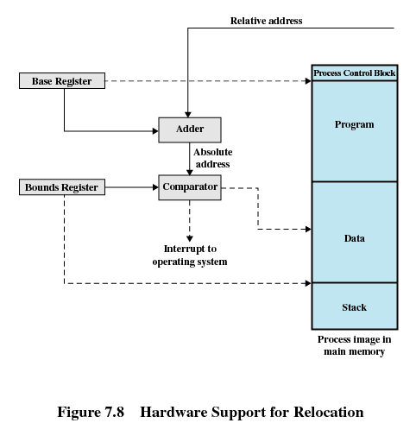
相对地址
基址寄存器
加法器
界限寄存器
绝对地址
比较器
给操作系统的中断
进程映像

Slide 13
Registers Used during Execution
Base register(基址寄存器)
  Starting address for the process
Bounds register(界限寄存器)
  Ending location of the process
These values are set when the process is loaded(加载) or when the process is swapped in(换入)

Slide 14
Registers Used during Execution
The value of the base register is added to a relative address to produce an absolute address
The resulting address is compared with the value in the bounds register
If the address is not within bounds, an interrupt is generated to the operating system

Slide 15
7.1 Memory Management Requirements
7.1.1 Relocation
7.1.2 Protection
7.1.3 Sharing
7.1.4 Logical Organization
7.1.5 Physical Organization

Slide 16
Memory Management Requirements
Protection(保护)
  Processes should not be able to reference memory locations in another process without permission
  Impossible to check absolute addresses at compile time
  Must be checked at rum time
  Memory protection requirement must be satisfied by the processor (hardware) rather than the operating system (software)
    Operating system cannot anticipate all of the memory references a program will make

Slide 17
7.1 Memory Management Requirements
7.1.1 Relocation
7.1.2 Protection
7.1.3 Sharing
7.1.4 Logical Organization
7.1.5 Physical Organization

Slide 18
Memory Management Requirements
Sharing(共享)
  Allow several processes to access the same portion of memory
  Better to allow each process access to the same copy of the program rather than have their own separate copy

Slide 19
7.1 Memory Management Requirements
7.1.1 Relocation
7.1.2 Protection
7.1.3 Sharing
7.1.4 Logical Organization
7.1.5 Physical Organization

Slide 20
Memory Management Requirements
Logical Organization(逻辑组织)
  Programs are written in modules
  Modules can be written and compiled independently
  Different degrees of protection given to modules (read-only, execute-only)
  Share modules among processes

Slide 21
7.1 Memory Management Requirements
7.1.1 Relocation
7.1.2 Protection
7.1.3 Sharing
7.1.4 Logical Organization
7.1.5 Physical Organization

Slide 22
Memory Management Requirements
Physical Organization(物理组织)
  Memory available for a program plus its data may be insufficient
    Overlaying(覆盖) allows various modules to be assigned the same region of memory
  Programmer does not know how much space will be available

Slide 23
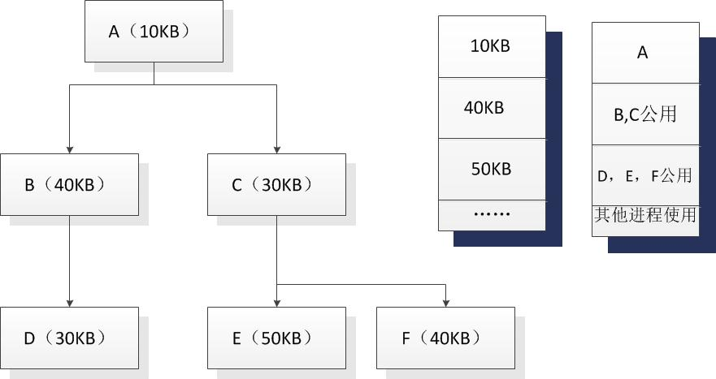
Example of Overlaying

Slide 24
Agenda
7.1 Memory Management Requirements
7.2 Memory Partitioning
7.3 Paging
7.4 Segmentation
7.5 Summary

Slide 25
7.2 Memory Partitioning(内存分区)
7.2.1 Fixed Partitioning
7.2.2 Dynamic Partitioning
7.2.3 Buddy System
7.2.4 Relocation

Slide 26
Fixed Partitioning(固定分区)
Alternatives for Fixed Partitioning
  Equal-size partitions(大小相等的分区)
  Unequal-size partitions(大小不等的分区)

Slide 27
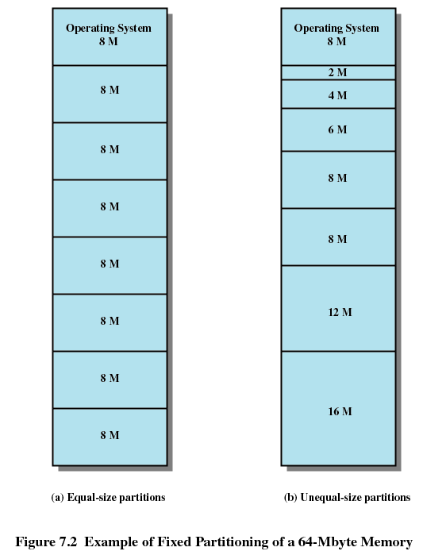

Slide 28
Fixed Partitioning
Equal-size partitions: features
  Any process whose size is less than or equal to the partition size can be loaded into an available partition
  If all partitions are full, the operating system can swap a process out of a partition

Slide 29
Fixed Partitioning
Equal-size partitions: difficulties
  A program may not fit in a partition. The programmer must design the program with overlays
  Main memory use is inefficient. Any program, no matter how small, occupies an entire partition. This is called internal fragmentation(内部碎片/内零头).

Slide 30
Fixed Partitioning
Unequal-size partitions(大小不等的分区)
  Both of these problems of equal-size partitions can be lessened, though not solved, by using unequal-size partitions.

Slide 31
Placement Algorithm(放置算法) with Fixed Partitions
Equal-size partitions
  Because all partitions are of equal size, it does not matter which partition is used
Unequal-size partitions
  Can assign each process to the smallest partition within which it will fit
  Queue for each partition
  Processes are assigned in such a way as to minimize wasted memory within a partition

Slide 32
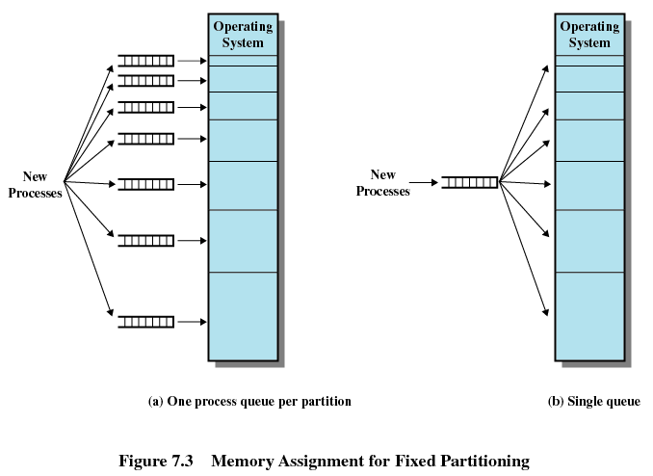

Slide 33
7.2 Memory Partitioning
7.2.1 Fixed Partitioning
7.2.2 Dynamic Partitioning
7.2.3 Buddy System
7.2.4 Relocation

Slide 34
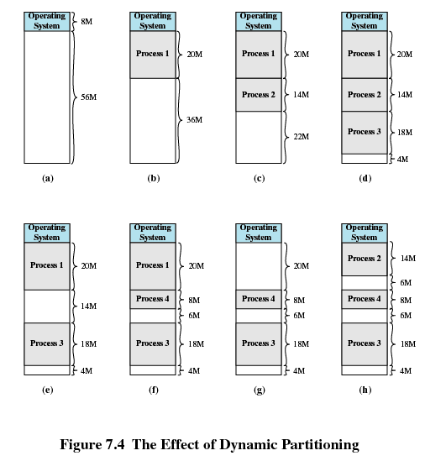

Slide 35
Dynamic Partitioning(动态分区)
Partitions are of variable length and number
Process is allocated exactly as much memory as required
Eventually get holes in the memory. This is called external fragmentation(外部碎片/外零头)
Must use compaction(压缩) to shift(移动) processes so they are contiguous and all free memory is in one block

Slide 36
Dynamic Partitioning Placement Algorithm
Operating system must decide which free block to allocate to a process
Best-fit algorithm(最佳适配)
  Chooses the block that is closest in size to the request
  Worst performer overall
  Since smallest block is found for process, the smallest amount of fragmentation is left
  Memory compaction must be done more often

Slide 37
Dynamic Partitioning Placement Algorithm
First-fit algorithm(首次适配)
  Scans memory form the beginning and chooses the first available block that is large enough
  Fastest
  May have many process loaded in the front end of memory that must be searched over when trying to find a free block

Slide 38
Dynamic Partitioning Placement Algorithm
Next-fit(邻近适配)
  Scans memory from the location of the last placement
  More often allocate a block of memory at the end of memory where the largest block is found
  The largest block of memory is broken up into smaller blocks
  Compaction is required to obtain a large block at the end of memory

Slide 39
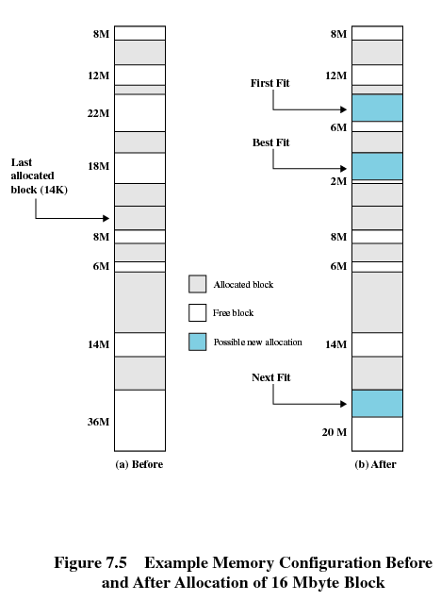

Slide 40
7.2 Memory Partitioning
7.2.1 Fixed Partitioning
7.2.2 Dynamic Partitioning
7.2.3 Buddy(伙伴) System
7.2.4 Relocation

Slide 41
Buddy System
Entire space available is treated as a single block of 2^{U}
If a request of size s such that 2^{U-1} < s <= 2^{U}, entire block is allocated
  Otherwise block is split into two equal buddies
  Process continues until smallest block greater than or equal to s is generated

Slide 42
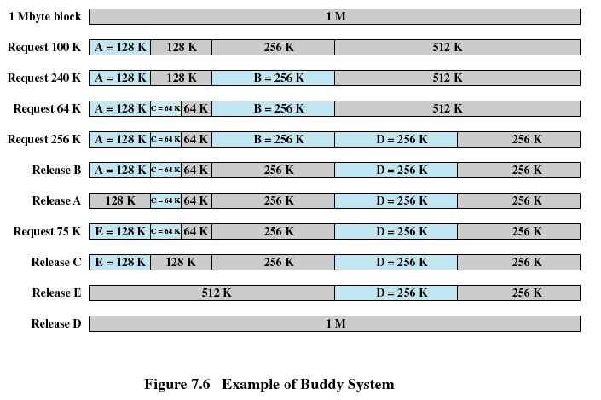

Slide 43
Agenda
7.1 Memory Management Requirements
7.2 Memory Partitioning
7.3 Paging
7.4 Segmentation
7.5 Summary

Slide 44
Paging(分页)
Partition memory into small equal fixed-size chunks(块) and divide each process into the same size chunks
The chunks of a process are called pages(页) and chunks of memory are called frames(帧或者页帧)
Operating system maintains a page table(页表) for each process
  Contains the frame location(帧位置) for each page in the process
  Memory address consist of a page number(页号) and offset(偏移量) within the page

Slide 45
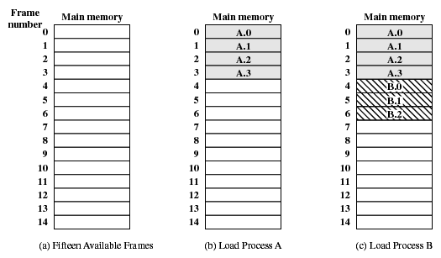
Assignment of Process Pages to Free Frames

Slide 46
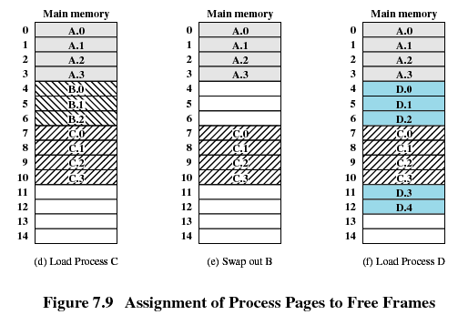
Assignment of Process Pages to Free Frames

Slide 47
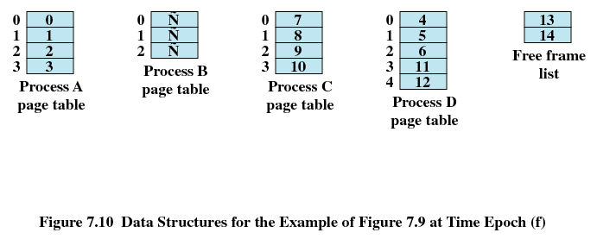

Page Tables for Example

Slide 48
Agenda
7.1 Memory Management Requirements
7.2 Memory Partitioning
7.3 Paging
7.4 Segmentation
7.5 Summary

Slide 49
Segmentation(分段)
All segments of all programs do not have to be of the same length
There is a maximum segment length
Addressing consist of two parts - a segment number(段号) and an offset(偏移量)
Since segments are not equal, segmentation is similar to dynamic partitioning(动态分区)

Slide 50
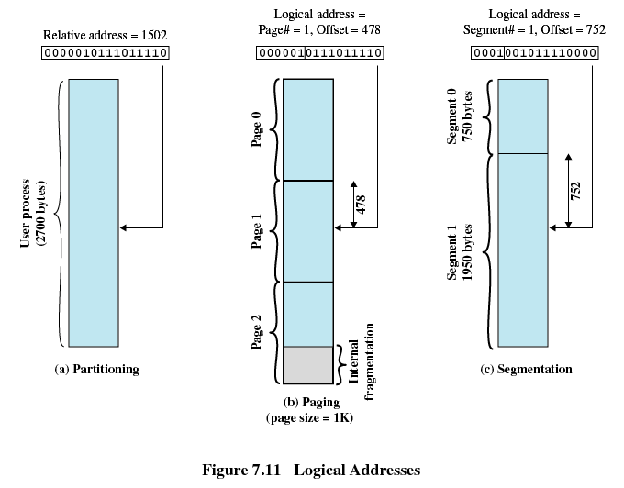

Slide 51
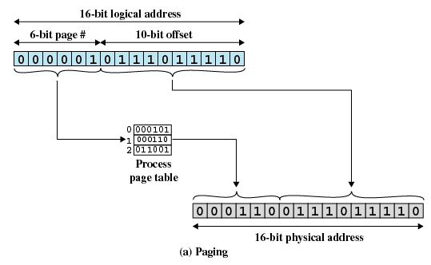

Slide 52
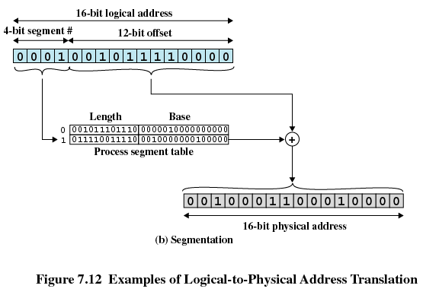

Slide 53
Agenda
7.1 Memory Management Requirements
7.2 Memory Partitioning
7.3 Paging
7.4 Segmentation
7.5 Summary

Slide 54
Homework
Review Questions:
  7.1
  7.7
Problems:
  7.6
  7.12

