Slide 1
Cell Painting tells you about mechanism —
not about toxicity
…and it beats chemical structure, which is free, at doing so.
WS4A · cross-modal integration · HepG2
119 compounds · morphology (636) × gene expression (41,780) × chemical structure (1,024)
SAY THIS FIRST, OR NOTHING ELSE MAKES SENSE:
Every number in this section is an HONEST GAP — how well the model did on the real answers, minus how well the same model did when we scrambled the answers between compounds. Scrambled means there is nothing left to learn, so that second number is what luck alone buys. Across our grid, luck scored between 0.38 and 0.60 — where 0.50 is a coin flip. That is why we never quote a raw score.
Notes:
OPENING LINE — say this before anything else, or no axis on any later slide means anything:
"Every number I show is an HONEST GAP: how well the model did on the real answers, minus how well the identical model did when we scrambled the answers between compounds. Scrambled means there is nothing left to learn, so that second number is what luck alone buys. Across our whole grid, luck scored between 0.38 and 0.60 — where 0.50 is a coin flip. That is why we never quote a raw score."
THE THREE NUMBERS TO MEMORISE
+0.143 what morphology adds to chemistry for mechanism (4/4 models)
-0.273 vs +0.017 cost of dropping to 2,000 HVGs vs what the leakage was worth
0 of 41,780 genes surviving the shared-axis permutation null

Slide 2
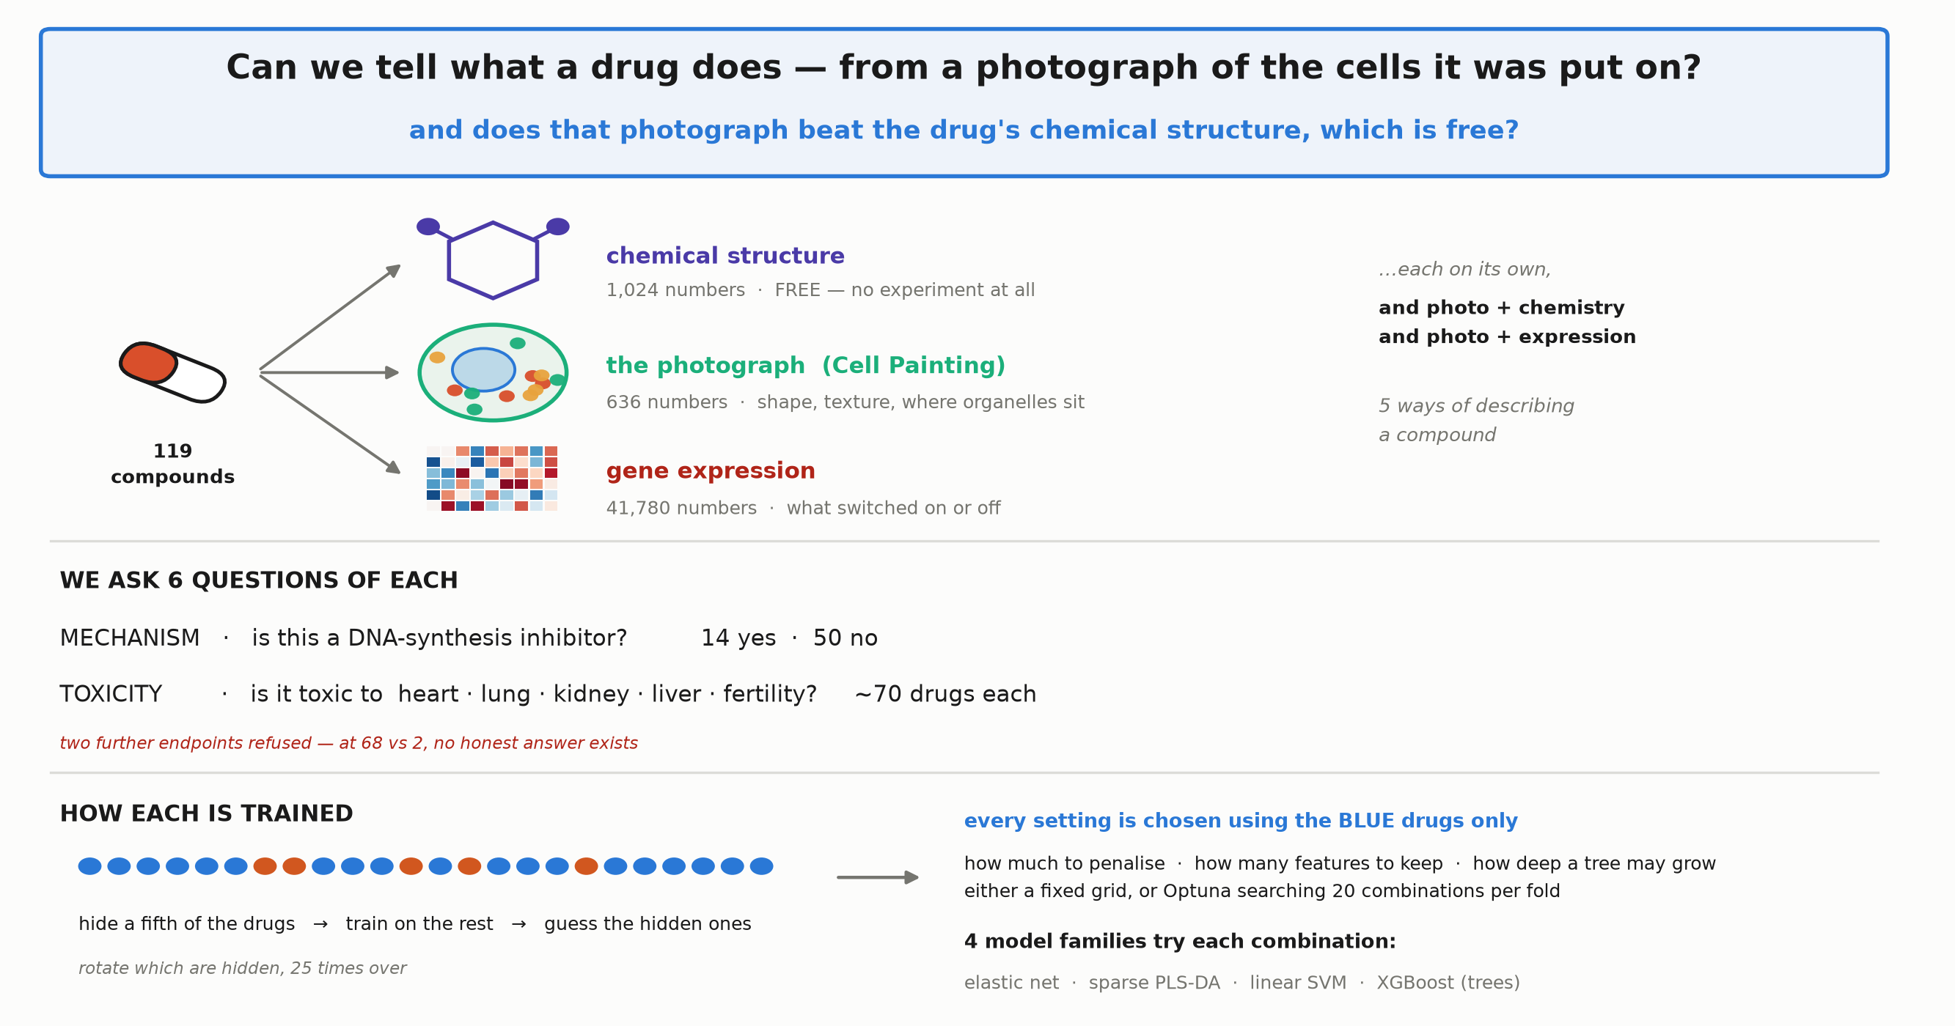
WHAT WAS TRAINED, AND HOW
Only 119 drugs — so every score gets a scrambled-label twin
Six questions · five kinds of data · four model families · every setting chosen on drugs the score never sees.
THE DATA. 119 compounds, each described three ways: its chemical structure (free — computed from the molecule, no experiment); the Cell Painting photograph of treated HepG2 cells (636 measurements of shape, texture and where organelles sit); and gene expression (41,780 genes). The expression comes from 384,533 single cells, but cells given the same drug are replicates — they are averaged into ONE row per drug. So the model sees 119 examples, not 384,000.
WHAT WE PREDICT. Six questions: is this a DNA-synthesis inhibitor (14 yes vs 50 no), and is it toxic to heart, lung, kidney, liver or fertility (~70 drugs each). Two further toxicity endpoints were refused outright — at 68 yes vs 2 no, a model that always says yes is right 97% of the time and has learned nothing.
HOW A MODEL IS TESTED. Hide a fifth of the drugs, learn from the rest, guess the hidden ones, and rotate which are hidden 25 times. Every setting — how much to penalise, how many features to keep, how deep a tree may grow — is chosen using only the training drugs, so the ones being scored never influence anything.
WHY EVERYTHING RUNS TWICE. With 119 rows and up to 41,780 measurements, some measurements line up with the answer by pure chance. So we repeat the whole thing with the answers SCRAMBLED between drugs — nothing left to learn. Luck alone scored 0.38 to 0.60, where 0.50 is a coin flip. Every number on the next slides is real minus scrambled.
Notes:
SAY:
"First, exactly what we did.
Panel 1 — the questions. Mechanism of action: is this a DNA-synthesis inhibitor, 14 yes against 50 no. And five toxicity endpoints, yes/no, about 70 drugs each. Two further endpoints we REFUSED to score at all — at 68 to 2, a model that always says yes is right 97 percent of the time and has learned nothing.
Panel 2 — what the model may look at. Chemistry, the photograph, gene expression, and two combinations. Chemistry is our control because it is free: you compute it from the molecule, no experiment at all.
Panel 3 — four model families. Three are variations on drawing a straight dividing line; XGBoost builds decision trees, a completely different way of looking. That matters: when methods that disagree about HOW to find structure agree about WHERE it is, that means something.
Panel 4 — this is the part people usually get wrong. The orange blocks are the drugs we score on. They never influence anything that gets fitted. Every setting — how much to penalise, how many features to keep, how deep a tree may grow — is chosen by splitting the BLUE part again and looking only in there.
Panel 5 — we did it twice: once with a fixed grid declared in advance, once letting Optuna search 20 combinations per fold. Both kept, both compared. And critically, the scrambled control gets the same 20 trials — if you tune the real answers harder than the control, you invent a result.
Panel 6 — then the whole thing again with the answers scrambled between drugs. Nothing left to learn, so whatever it scores is luck. On our grid luck alone scored 0.38 to 0.60, where 0.5 is a coin flip. So we never quote a score — we quote real minus scrambled."
IF ASKED
Q: Why 119 rows when you have 384,000 cells?
A: Cells given the same drug are replicates, not independent observations. Treating them as 384,000 examples would inflate everything enormously.
Q: How were hyperparameters chosen?
A: Entirely inside the inner loop, on the training part of each outer fold. The scored drugs never influenced them. A pre-flight check asserts this by tagging every row and verifying no search ever saw all of them.
Q: Did tuning just make the numbers look better?
A: We measured that. The shuffled-label scores moved by −0.0003, and zero of 120 comparisons were flagged as bias. It also produced no new findings — 56 results cleared zero before tuning and 56 after.
Q: Isn't this just a permutation test?
A: Yes, but run separately for every model × question × data-type combination and subtracted individually, because each has its own luck level.

Slide 3
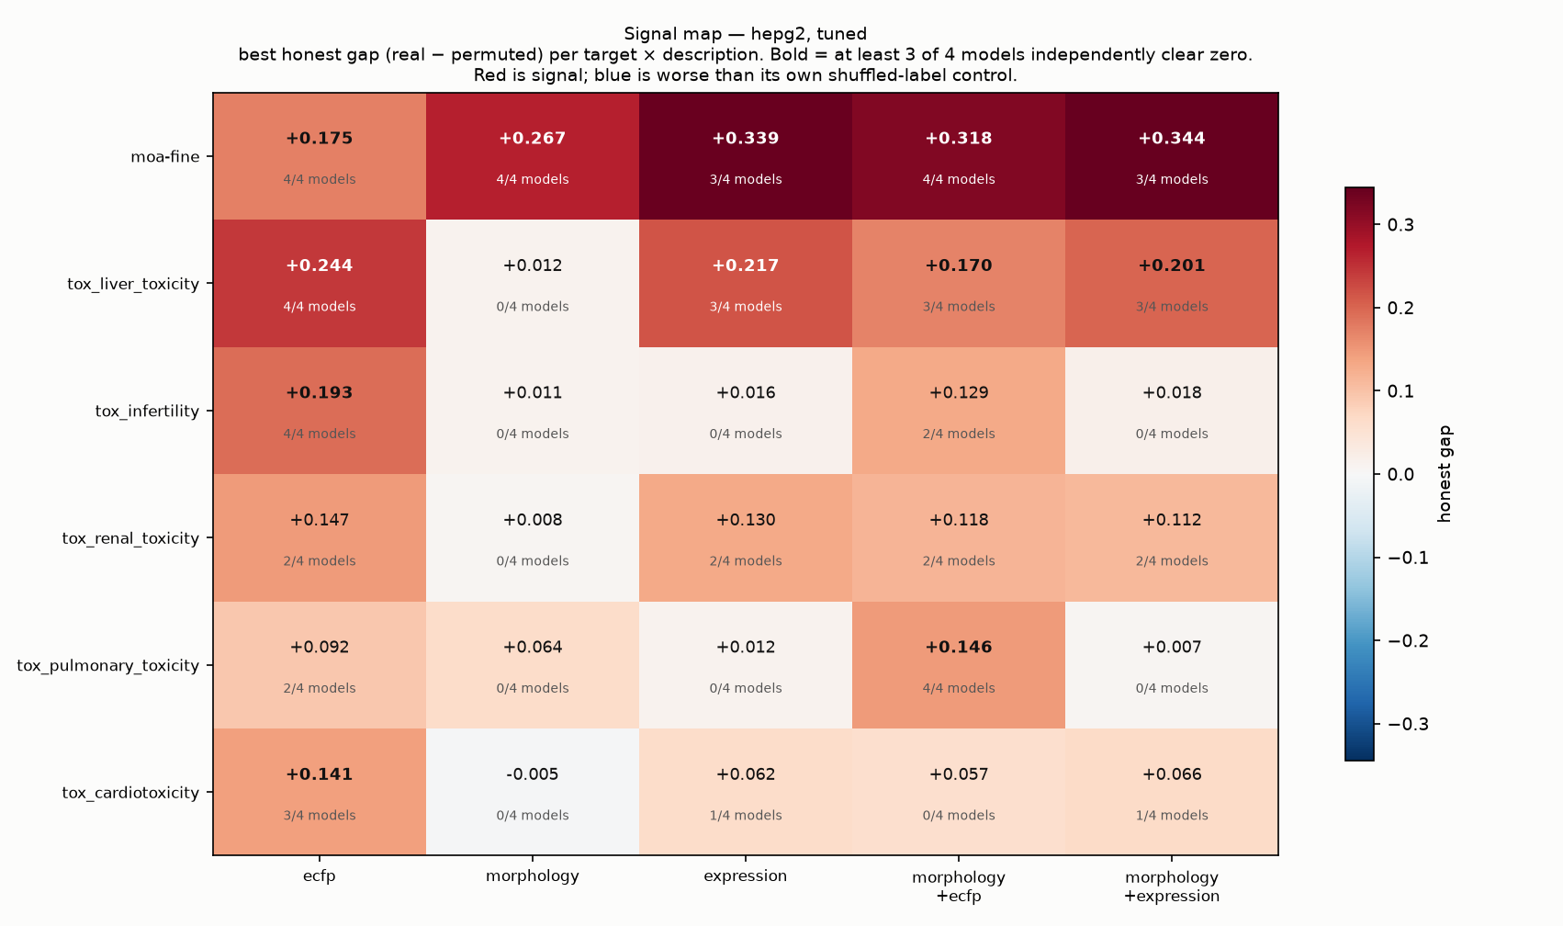
RESULT 1 OF 3
Morphology beats chemistry — for mechanism only
+0.143 over chemical structure for mechanism of action, all four models agreeing. For all five toxicity endpoints it adds nothing.
WHAT A "MODEL" IS. A recipe for guessing. We show it drugs whose answer we already know — here are 636 numbers from the photograph, and yes, this one is a DNA-synthesis inhibitor — and it learns a rule. Then it must guess drugs it has NEVER seen. Four different recipes are used on every box: three that draw a dividing line in different ways (elastic net, sparse PLS-DA, linear SVM) and one that builds a flowchart of yes/no questions instead (XGBoost).
SHUFFLED vs UNSHUFFLED — every box is run TWICE. UNSHUFFLED: each drug keeps its true answer. SHUFFLED: we deal the answers out at random, so drug A is given drug B's answer — the link between measurements and answer is destroyed on purpose, so there is nothing left to learn. The model still scores something, because with 119 drugs and up to 41,780 measurements some line up with random answers by pure chance. THAT is the luck level, and it differs for every box.
WHERE THE NUMBER IN EACH BOX COMES FROM. Worked example — morphology predicting mechanism, the box reading +0.267. The best model got 74.5 % right on the real answers. With the answers shuffled it still got 47.7 %. 0.745 − 0.477 = +0.267, and that difference is what is printed. So the number is NOT accuracy — it is how far the model beat its own shuffled twin. Note the shuffled run was 47.7 %, not 50 %: across the four models in that one box it ranged 47.7–51.7 %, which is why each box is compared against its OWN control rather than against 0.5.
HOW TO READ THE GRID. Rows are the six questions; columns are what the model was allowed to look at. Red = the model beat its shuffled twin. White = it did not. −0.005 means it did slightly WORSE than nonsense, which is what "nothing here" looks like when measured honestly. The small print — 4/4 models — is how many of the four recipes each independently beat its own shuffled run.
WHAT IT SHOWS, AND THE POINT. The top row, mechanism of action, is the only row that works across the board: chemistry +0.175, the photograph +0.267, both together +0.318. Read DOWN the morphology column and every toxicity row is near-white with 0 of 4 models finding anything — while the chemistry column IS predicting them. Chemistry is the control because it is free, so the question is not whether imaging beats chance but whether it beats the free option. For MECHANISM it does, by +0.143. For TOXICITY it does not.
Notes:
SAY:
"Chemistry is our control, and it is the right control because it is FREE — you compute a structural fingerprint from the molecule on a laptop, no cells, no microscope, no sequencing. Chemists have predicted drug properties this way for thirty years. So 'imaging beats random guessing' is not a finding anyone should act on. The question is whether imaging beats the free option.
Top row is mechanism of action. Chemistry alone: 0.175. The photograph alone: 0.267 — better. Both together: 0.318. So the photograph adds 0.143 on top of structure, and the small print says all four of our models found it independently.
Now look down the morphology column at the five toxicity rows: 0.012, 0.011, 0.008, 0.064, minus 0.005. Nothing, and zero of four models in every case. Meanwhile the chemistry column IS predicting toxicity.
So the claim is narrow and defensible: Cell Painting tells you about MECHANISM, over and above chemical structure. It does not tell you about toxicity."
IF ASKED
Q: Isn't 0.143 small?
A: It is an 82% increase over the chemistry-only gap, and four independent model families found it while the scrambled control did not.
Q: Why does ADDING data make toxicity worse?
A: Small-sample dilution. Adding 636 columns to ~70 compounds gives the model 636 more chances to fit a coincidence.
Q: So Cell Painting can't see toxicity?
A: Careful — say 'not from 70 compounds with these labels'. 'Known to be hepatotoxic' is a coarse literature annotation, much noisier than a curated mechanism class.
DO NOT SAY: anything about A549 (its morphology is contaminated), and never quote a raw score without its scrambled twin.

Slide 4
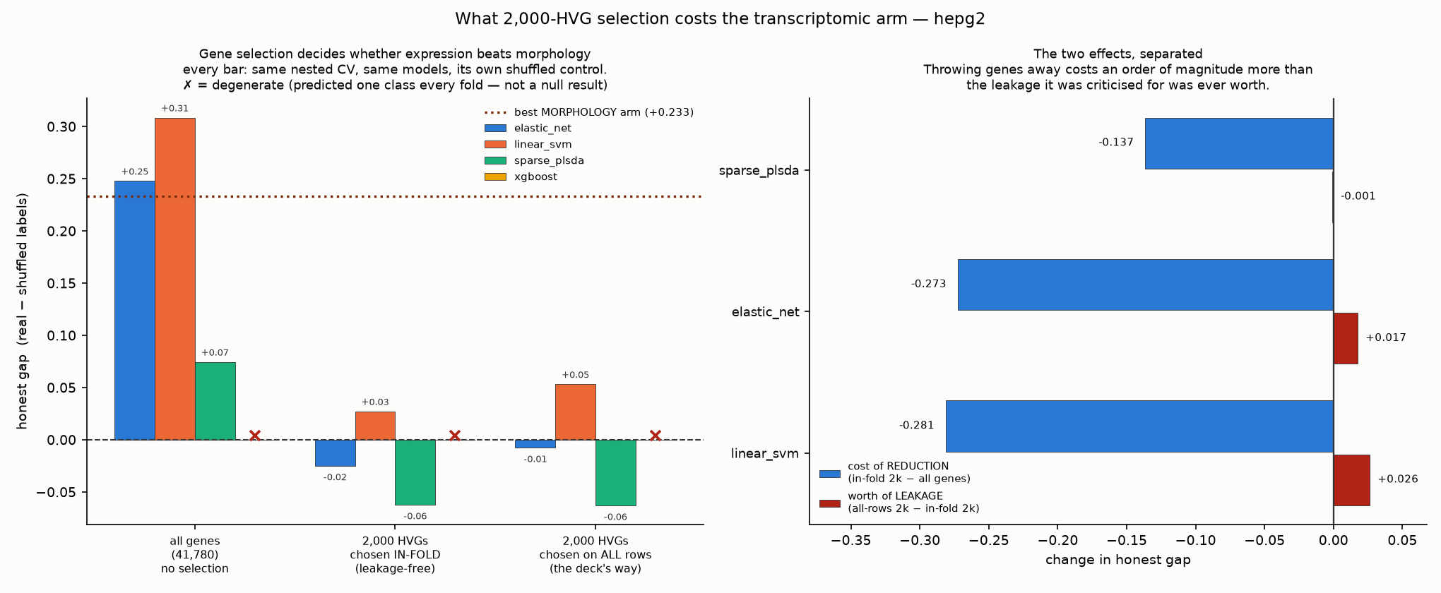
RESULT 2 OF 3 · reconciles with Task 1
Gene selection, not the modality, is why expression lost
Dropping to 2,000 highly variable genes costs 16× what the leakage it is usually criticised for was worth.
THE BACKGROUND. Almost every single-cell workflow keeps only the ~2,000 most variable genes out of 40,000. Task 1 of this workstream does that, and its own caveat slide flags the leakage. But that caveat bundles TWO different problems: REDUCTION (throwing 39,780 genes away) and LEAKAGE (choosing which 2,000 using drugs you later test on). Nobody knew which was actually costing anything.
HOW TO READ IT. Left: three groups of bars, identical cross-validation in each — all 41,780 genes; 2,000 genes chosen separately INSIDE each training fold (leakage-free); and 2,000 chosen once using all drugs (the bundled approach). The brown dotted line is the best morphology result. Right: the two effects separated — blue is what reduction costs, red is what the leakage was worth.
THE POINT. Reduction costs −0.273; the leakage was worth +0.017. About sixteen times more. And with all 41,780 genes the expression arm clears the brown line — with 2,000 it does not come close. So "gene expression does not beat morphology" looks like a property of the gene selection, not of the modality. Both pipelines agree once the same genes are used.
Notes:
LEAD WITH THE AGREEMENT — this reconciles two analyses, it does not overturn one.
SAY:
"First, where we agree with the main analysis. It finds that fusing morphology and gene expression does not improve mechanism prediction. We got the same thing independently — our fusion gain is plus 0.005, theirs is minus 0.096. Different pipeline, different task formulation, same conclusion. That is a replication and it is worth saying out loud.
Second, one thing we can add. Task 1 selects 2,000 highly variable genes before cross-validating, and flags the leakage in its own caveat. But that caveat bundles TWO different problems. One is leakage — choosing which genes using compounds you later test on. The other is reduction — simply throwing 39,780 genes away. Nobody knew which was costing anything, so we separated them.
Blue is reduction. Red is leakage. Reduction costs about sixteen times more.
And the brown dotted line is the best morphology arm. With all 41,780 genes, expression clears it. With 2,000 highly variable genes it does not come close. So the finding that gene expression does not beat morphology looks like a property of the gene selection, not of the modality. Our two pipelines agree once the same genes are used."
CAVEAT TO STATE: this ran on mechanism only, one target, untuned — which is why the morphology reference is 0.233 and not 0.267. Everything in the figure is like-for-like.
BACKGROUND IF PUSHED: Ambroise & McLachlan (PNAS 2002) showed gene selection before cross-validation gives near-zero error rates on data with NO signal. That is exactly the leakage the caveat flags — and we are showing it was the smaller of the two problems.
The x marks XGBoost, which was degenerate in every arm (predicted one class every fold) and is therefore not a measurement.

Slide 5
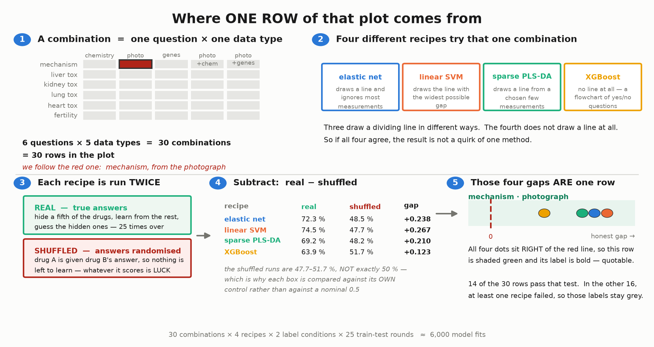
BEFORE THE NEXT SLIDE · where every number comes from
One combination, four recipes, run twice — that is one row
The same chain produces every number in this talk. Worked through with real figures from one box.
READ IT LEFT TO RIGHT, THEN DOWN. A COMBINATION is one question paired with one kind of data — six questions × five data types = 30, and each becomes one row of the next slide. FOUR RECIPES try each combination; three draw a dividing line in different ways and the fourth builds a flowchart instead, so agreement between them is not a quirk of one method. Each recipe is run TWICE — once with the true answers, once with the answers dealt out at random. Subtract, and the four resulting gaps ARE the four dots on one row.
THE NUMBERS ARE REAL ONES, FROM THE HEADLINE BOX. Mechanism predicted from the photograph. The best recipe got 74.5 % right on the true answers and still got 47.7 % when the answers were randomised, so the honest gap is +0.267. Note the four randomised runs came out at 47.7, 48.2, 48.5 and 51.7 % — never exactly 50 %. That is why each box is measured against its OWN randomised control instead of against a nominal coin flip.
Notes:
USE THIS SLIDE IF ANYONE LOOKS LOST. It is the whole method in one picture, and it is worked with real numbers rather than symbols.
SAY:
"Let me show you exactly where one of these numbers comes from.
A combination is one question and one kind of data — mechanism from the photograph, say. There are thirty of those, and each one becomes a row on the next slide.
Four different recipes try that combination. Three of them draw a dividing line through the data in different ways; the fourth doesn't draw a line at all, it builds a flowchart of yes/no questions. That difference matters — if all four agree, it isn't a quirk of one method.
Each recipe runs twice. Once with the true answers. Once with the answers dealt out at random, so drug A gets drug B's answer and there is nothing left to learn. Then we subtract.
Here are the real numbers. The best recipe got 74.5 percent right on the true answers. With the answers randomised it STILL got 47.7 percent — that is what luck alone buys with 119 drugs and 41,780 measurements. 74.5 minus 47.7 is the 0.267 you will see on the next slide.
And notice the randomised runs: 47.7, 48.2, 48.5, 51.7. Never exactly fifty. That is why we compare every box against its own randomised control rather than against a coin flip."
IF ASKED
Q: Why 25 train-test rounds?
A: One split could be lucky. We hide a different fifth of the drugs each time and average, so every drug is hidden several times.
Q: How many models is that in total?
A: 30 combinations x 4 recipes x 2 label conditions x 25 rounds, about 6,000 fits -- and we did the whole thing twice, tuned and untuned.

Slide 6
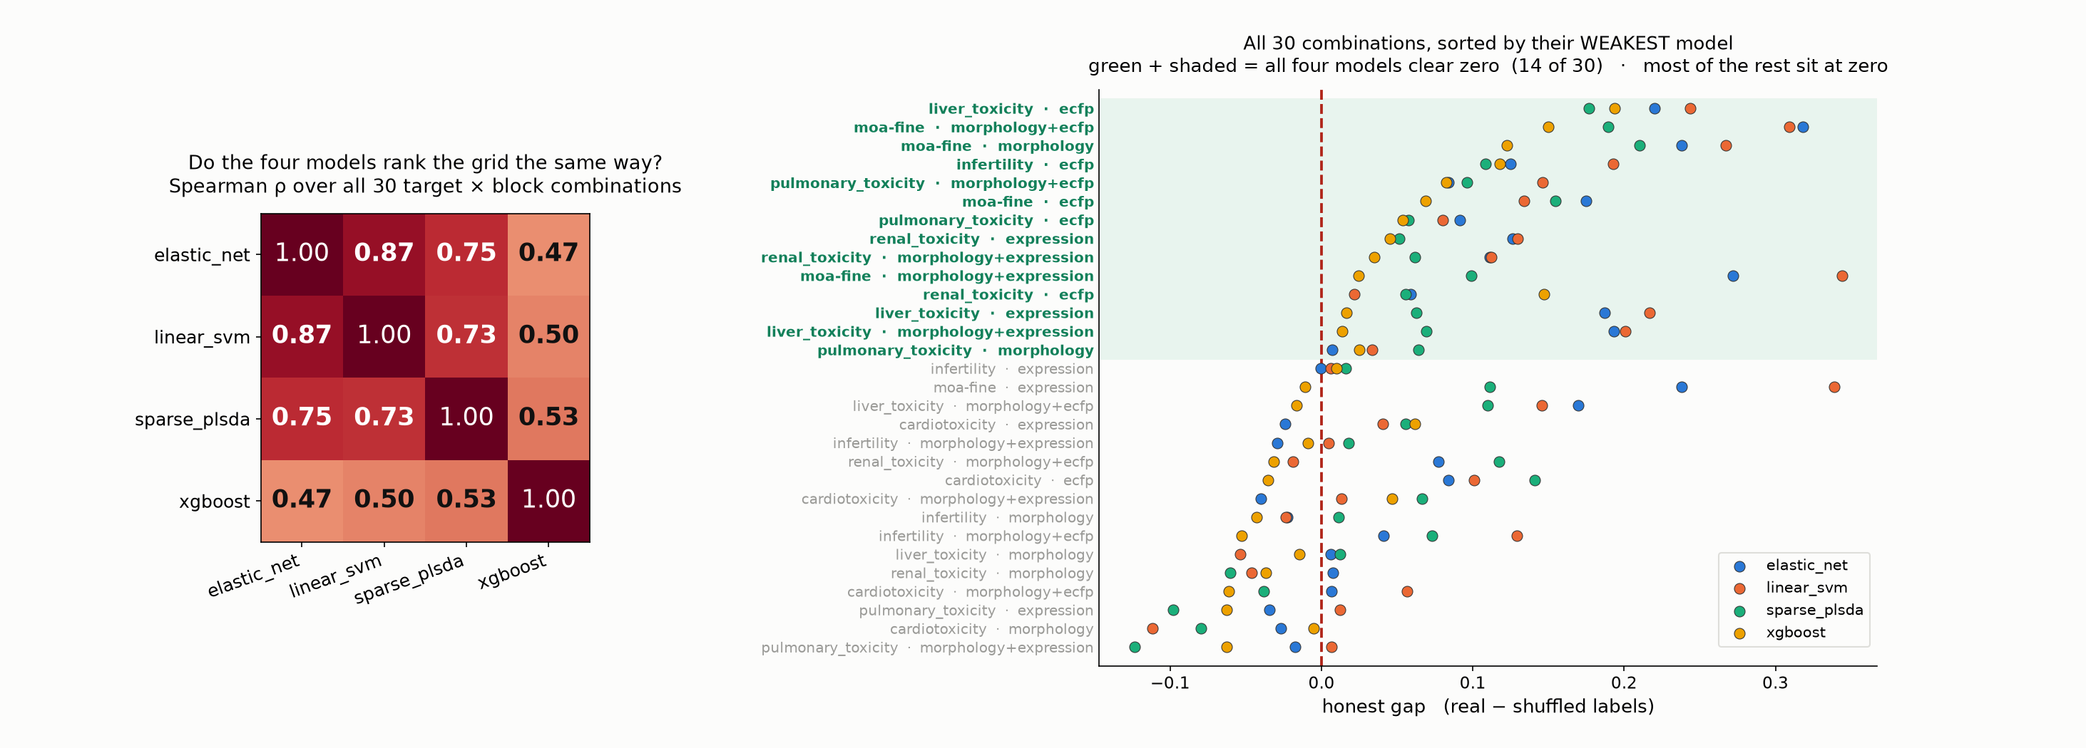
RESULT 3 OF 3 · why this is not one lucky model
Four different models, the same answer
Model families that fail in different ways agree on where the signal is — better evidence here than a p-value cross-validation cannot honestly give.
WHY THIS SLIDE. The obvious objection to any result from 119 compounds is that we got lucky with one model. Our uncertainty intervals are also anti-conservative — cross-validation folds share training data, so there is no honest variance estimate at this sample size. So instead of a fragile p-value we show four model families that fail in different ways, and ask whether they agree.
HOW TO READ IT. Left: how similarly each pair of models ranks all 30 question × data combinations (1.00 = identical ordering, 0 = unrelated). Right: every combination as one row with all four models plotted, sorted by its WEAKEST model. The red line is zero — no better than that model's own scrambled control. Green and shaded = all four models clear zero.
THE POINT. The three linear models agree closely (0.73–0.87). XGBoost, which builds decision trees rather than drawing a line, agrees far less (0.47–0.53) — and that is exactly why its agreement counts: it is looking for a different kind of pattern. In 14 of the 30 combinations all four models clear zero, and that green set includes mechanism from morphology. Most of the other 16 sit at zero: the signal is concentrated, not everywhere.
Notes:
SAY:
"The obvious objection to anything from 119 compounds is that we got lucky with one model. So we ran four families that look for structure in genuinely different ways.
On the left, how similarly each pair ranks all thirty combinations. One point zero would be identical ordering. The three linear models — elastic net, linear SVM, sparse PLS-DA — agree at 0.73 to 0.87. They are all variations on drawing a dividing line, so that much agreement is expected.
XGBoost agrees much less, around 0.5. It builds decision trees. And that low number is the interesting one: if all four sat at 0.95 you would have four views of essentially one model, and 'they all agree' would mean nothing. At 0.5, when it does land on the same combinations as the others, that is independent confirmation.
On the right, all thirty combinations, sorted by their WEAKEST model — a combination is only as good as the worst of the four. Most of them sit at zero: the signal is concentrated at the top, which is what an honest landscape looks like. In the shaded band, 14 of 30, every single model clears zero — and that band includes mechanism of action from morphology, our headline."
WHY THIS SLIDE, AND WHY IT MATTERS MORE THAN A P-VALUE HERE
Our uncertainty intervals are anti-conservative — cross-validation folds share training data, so there is no unbiased variance estimate for k-fold CV (Bengio & Grandvalet 2004). Rather than lean on a shaky interval, we lean on four methods with different failure modes agreeing. At this sample size that is the more honest evidence.
BE HONEST ABOUT THE ALTERNATIVE READING IF PUSHED
A rho of 0.5 for XGBoost can mean two things: it is finding different REAL structure, or it is simply noisier and worse on this data. Both are consistent with 0.5 — XGBoost had 10 degenerate rows in the untuned run and rarely wins a combination. So the safe claim is the narrow one: the three linear models agree strongly, and on the top combinations XGBoost independently clears zero too. Do not oversell the 'different inductive bias' story.
WHY SORTED BY THE WEAKEST MODEL: sorting by the mean would scatter the 'all four clear zero' rows through the panel and the shading would read as stripes. Sorting by the minimum makes that set exactly the top block, and it is the conservative ranking anyway.
IF ASKED WHY ONLY SIX ROWS ARE LABELLED: 30 labels do not read from the back of an auditorium -- the panel is dense, not merely small, so a bigger screen enlarges the rows AND the gaps and never improves the ratio. All 30 rows are still plotted, because you do not need to read a label to see the trend. The fully labelled version is in the pack at 04_methods/08_model_concordance.png.
IF ASKED
Q: Why not just report a p-value?
A: See above — the interval for a k-fold CV mean is not trustworthy at this n. Model consensus is the substitute, and we say so.
Q: What happened to the gene-level analysis?
A: We have it — a permutation null on the shared morphology-expression axis where 0 of 41,780 genes survive. We left it out because this deck already reports 0 of 1.27 million feature-gene pairs at FDR below 0.05, by a different method. Same conclusion, already covered. It is in the backup.

Slide 7
Narrow claims, and the controls that made them narrow
Several of these controls changed our own conclusions — that is the point.
WE CAN SAY
• Morphology adds +0.143 over chemical
structure for mechanism, 4 of 4 models
• It adds nothing for the five toxicity
endpoints — chemistry does that
• Fusion does not help — we independently
replicate the main analysis
• The modalities agree weakly but really
(adjusted RV 0.016, Mantel p = 0.0001)
• Dropping to 2,000 HVGs costs 16× what
its leakage was worth
WE MUST NOT SAY
• Any plain RV number — it scores random
noise as high as our real data
• "r = 0.903" — its own null reaches 0.902.
Quote the p-value (0.017)
• "Four joint components" — the null also
reached four, p = 0.095
• Any gene list — 0 of 41,780 survive
• Anything about A549 — its morphology
is contaminated (max 1.5e19)
Every number is shown next to the same number computed on data where the answer is known to be nothing —
and several of those controls changed our conclusions.
Notes:
CLOSING LINE:
"If you remember one thing: every number we show is printed next to the same number computed on data where the answer is known to be nothing — and several of those controls changed our conclusions. At 119 compounds that is worth more than another decimal place of accuracy."
THE CONTROL THAT KILLED OUR OWN FINDING — say this if you want credibility:
AJIVE reported four shared components between morphology and expression. We then destroyed the compound pairing and it still found four. p = 0.095. So we do not report it. Volunteering that is worth more than any result on the previous slides.

