Slide 1
GAS 2.1 Enhancements
Veeva Professional Services

Slide 2
GAS 2.1 New Features
Criteria based configurable filters
Support for Profile/User specific UI and Messages– Upgrade to Hierarchical Custom setting
Conversion of all GAS Veeva Messages (Message_vod) to GAS Hierarchical Custom Settings
Support for Reps aligned to multiple territories

Slide 3
Criteria Based Filtering

Slide 4
Criteria Based Filtering Overview
Criteria based filtering allows users to apply Home office filters to default GAS results using configuration
GAS 2.1 Custom setting can be used to completely turn this off if required – comes Turned ON as the default value in GAS 2.1
Using configuration, Home office can now set filter criterion at one or more of the following levels – Organization, Profile, User, Public Group
The filter is applicable either directly to the Account object or any object which is the Child of Account (either via Master-detail or Lookup)
A cumulative addition of all applicable filter criterion for that logged in user is performed (see examples later)

Slide 5
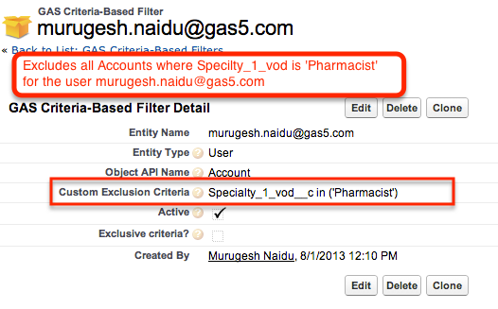
GCF (GAS Criteria-Based Filter) Object
A GCF Object defines the criteria to be applied to the Account and/or any child object of the Account to exclude certain Accounts from GAS Search Results

Slide 6
What is a valid Filter criteria?
Any valid SOQL where-clause (without the word “where”) can be put into a GCF object as the filter criteria
For eg: Specialty_1_vod__c = ‘Pharmacist’ on the GCF object for Account will ensure any GAS Results with ‘Pharmacist’ as specialty 1 are not shown
Support for special Veeva keywords that work in a VMOC. Supported Veeva keywords are: VOD_RECORDTYPE_ID, VOD_MY_TERRITORY, VOD_SF_PROFILEID, VOD_SF_USER_ID, VOD_MY_ORGID, VOD_USER_LANG_CD
For eg: Account_Lang_cd__c = @@VOD_USER_LANG_CD@@
Additional keyword called VOD_SF_USER:<User_Obj_Field_API_Name) allows to pull field values from the User object ( for the Logged in User context):
For eg: Account_country_cd__c = @@VOD_SF_USER:Country_cd__c@@

Slide 7
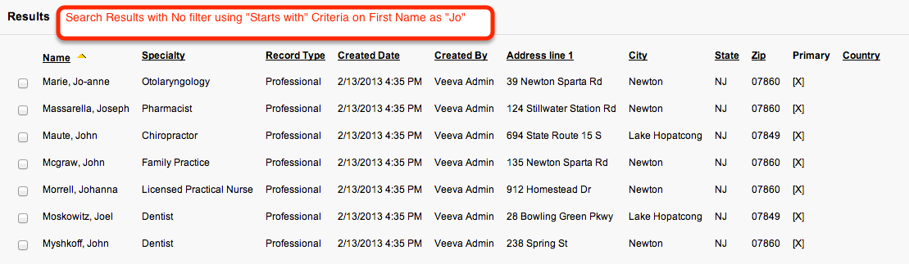
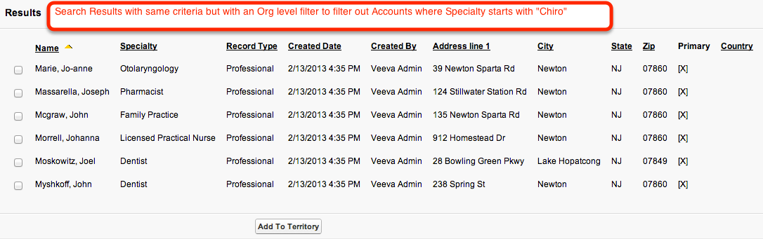
Criteria Based Filtering in Action

Slide 8
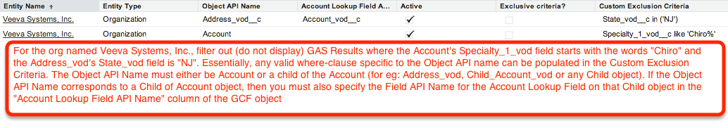
Criteria Based Filtering Sample Use cases
USE CASE: Only Org-wide GCF Objects exists for Account and Address object as shown below

Slide 9
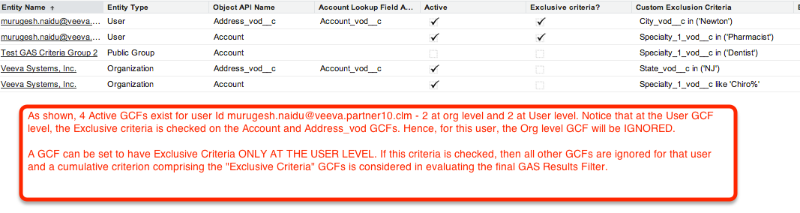
Criteria Based Filtering Sample Use cases
USE CASE: Multiple active GCFs exist for a user at Org and User levels, however the User Level GCFs are “Exclusive”

Slide 10
Criteria Based Filtering – Public Groups/Profiles
Similar to earlier use cases, you may also have GCFs defined at a Public Group level
Public Groups give the flexibility to combine users that may not necessarily be linked in any manner via a Profile or Territory or Role into a common logical grouping
Multi-layered Public Groups are also supported (for eg: Public Group inside a Public Group inside a Public Group…)
Public Group level support needs to be turned ON in the Custom Setting – it is OFF by default as this is resource intensive and involves loading Territory tree, Role Tree and Public Group tree in memory for every search
You may also have GCFs simply defined at a Profile Level

Slide 11
GCF Object Overview
As mentioned earlier, a GCF object can be created at a User, Profile and/or Public Group level
Each User/Profile/Public Group level CVC must be unique for that level – there will be triggers to ensure data integrity to this effect
GCFs support any valid SOQL where-clause and also include support for some special Veeva keywords used in VMOC
GCFs can be manually created in Veeva, or data-loaded using the Salesforce Data Loader tool by an Administrator

Slide 12
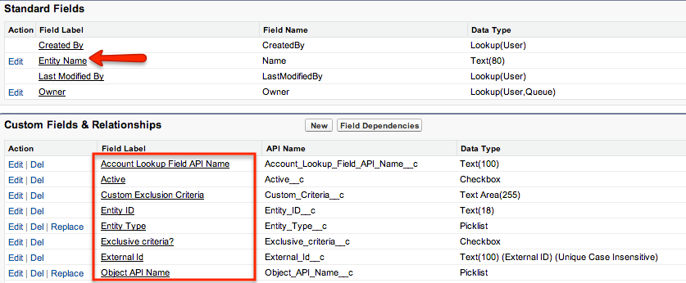
GCF Object Schema

Slide 13
GCF Object Checks and Balances
A Before Insert/Update trigger built by Veeva Technical Services applies the following logical constructs and validations:
Entity Name (Profile Name, User Name, Org Name, Public Group Name) must be valid
Object and Field Names must be valid in the Orgnization
The custom criteria SOQL must be valid
Exclusive Criteria may only be checked if Entity type is User
If Object API Name is Account, then the Account Lookup Field value is automatically cleared if it exists
The Unique External Id is computed by the trigger as SFDC ID of the Entity Name specified + The Object API Name

Slide 14
GAS Hierarchical Custom Settings

Slide 15
GAS Hierarchical Custom Settings Overview
Starting with GAS 2.1, we are now migrating all the List type GAS Custom settings as well as GAS Veeva Messages to Hierarchy type custom setting
Custom setting name is GAS Hierarchical Custom Settings
Most or all of the key Field names are kept consistent with the previous List based custom setting to allow easy transition
This transition allows us to provide a Profile/User specific UI and Messaging for GAS users
Provides a single place to manage all GAS messaging and UI constructs
With GAS 2.1, users must upgrade/migrate to GAS Hierarchical Settings. The installation manual addresses a section on this

Slide 16
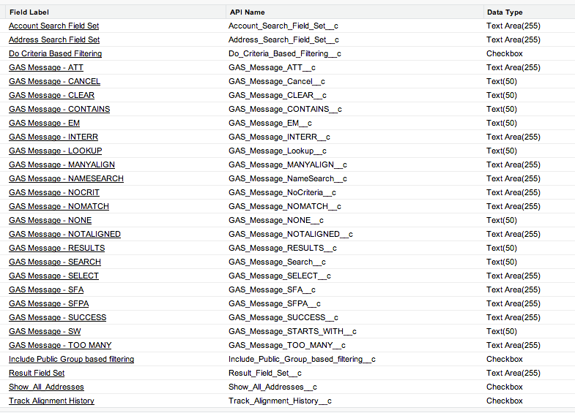
GAS Hierarchical Settings Schema

Slide 17
Multi-territory Rep Support

Slide 18


Multi-territory aligned Rep Support
If a user is aligned to more than one territory, this feature allows an Account to be aligned all of the user’s territories.
By default this feature is turned off. The default functionality is to show an error message if the user is aligned to more than one territory.
To turn on the multi-territory alignment, edit the custom setting “” in “GAS Hierarchical Settings”. If checked, Accounts can be aligned to multiple territories.

Slide 19
Support and Resources
Murugesh Naidu (Product Manager/Developer for Global Account Search)
Jeff Kelso (Developer for Global Account Search)
Wayne Abbott (Tech Services Practice Manager)
Chatter Group to post feature requests, installation issues, concerns or just plain old comments: Global Account Search
Tech Services Website: https://sites.google.com/a/veevasystems.com/technical-services/

