Slide 1

Global Inflation Analysis

Slide 2
Table of contents
01
02
03
Questions Asked
The Data
Dashboard
04
05
Map
Resources

Slide 3
01
Questions we Asked

Slide 4
Questions we Asked
What were the inflation rates by year between 2005-2022 per country?
What are the Top 10 years of inflation for each country?
What are the Bottom 10 years of inflation for each country?
What are the Top and Bottom 10 countries with the highest and lowest inflation rate in 2022?

Slide 5
02
The Data

Slide 6

Data Source
Kaggle.com
https://www.kaggle.com/datasets/belayethossainds/global-inflation-dataset-212-country-19702022
GitHub
https://gist.github.com/ofou/df09a6834a8421b4f376c875194915c9#file-country-capital-lat-long-population-csv

Slide 7
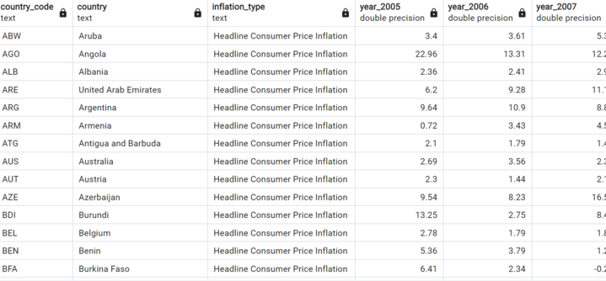

Slide 8
03
Dashboard

Slide 9
04
Map

Slide 10
05
Resources

Slide 11
Resources
GITHUB
https://gist.github.com/ofou/df09a6834a8421b4f376c875194915c9#file-country-capital-lat-long-population-csv
https://github.com/themustafaomar/jsvectormap
KAGGLE
https://www.kaggle.com/datasets/belayethossainds/global-inflation-dataset-212-country-19702022
TOOLS
Visual Studio, D3 Library, jsvectormap library, plotly

Slide 12
Our team
Olivia Kim
Katherine LoPrimo
Romy Montalva
Avani Patel
Amanda Rose
Amber Owens

Slide 13
Thank You

