Slide 1
Project Presentation
DISTML
Presenters: Alireza Karimi

Slide 2
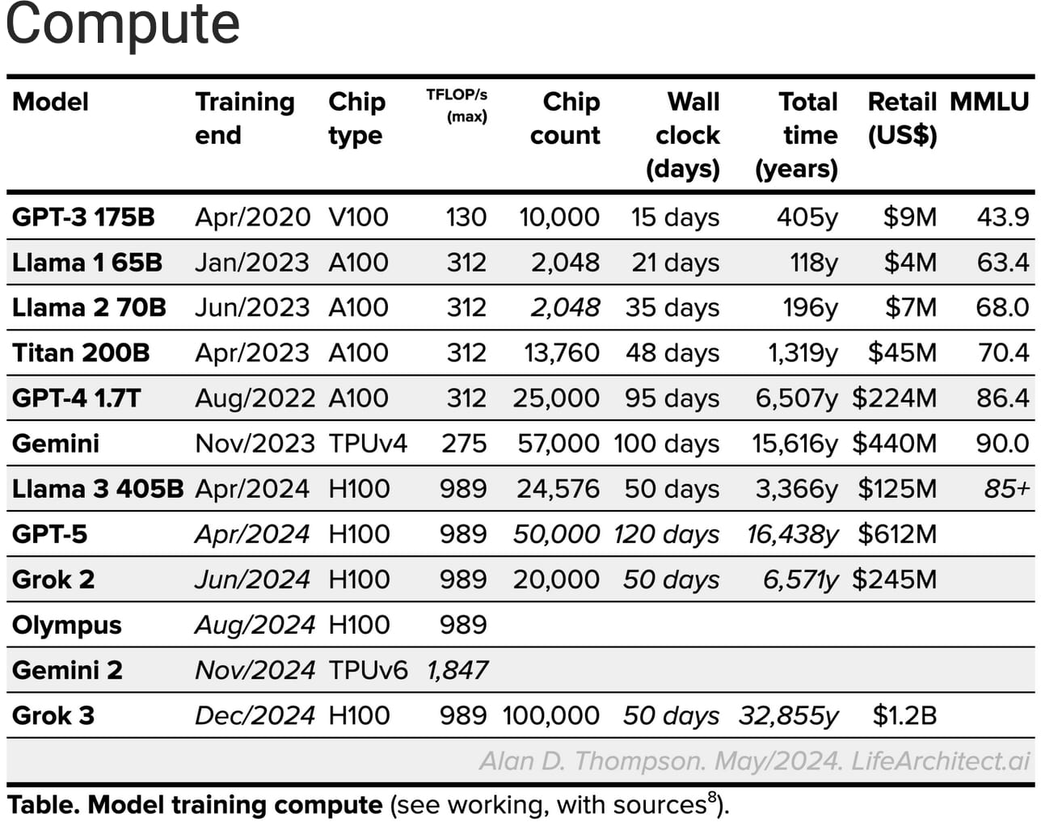
Big large language models
Notes:
Look at the number of parameters, chip counts and wall clock (days) column
Remember:A 1 trillion parameter model stored in FP16 requires 2 TB of memory.
GPU 5090: 32GB vram

Slide 3
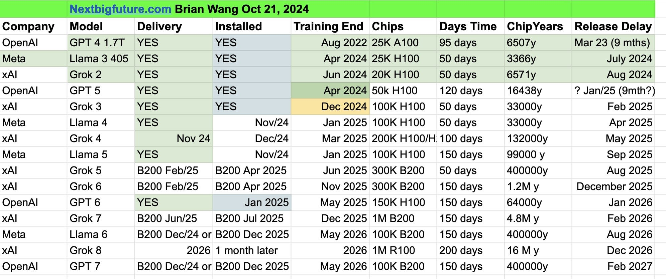
Big large language models
Notes:
Look at the Model, Chips and Days Time column

Slide 4
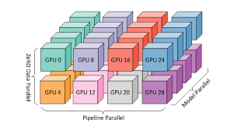
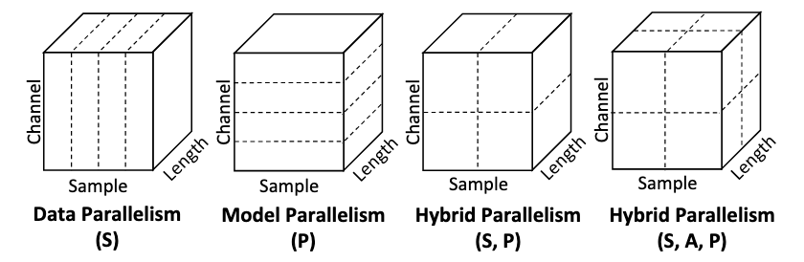
Big large language models
Necessitates utilization of Distributed Deep Learning Systems
How to train these big models? Parallelization

Slide 5
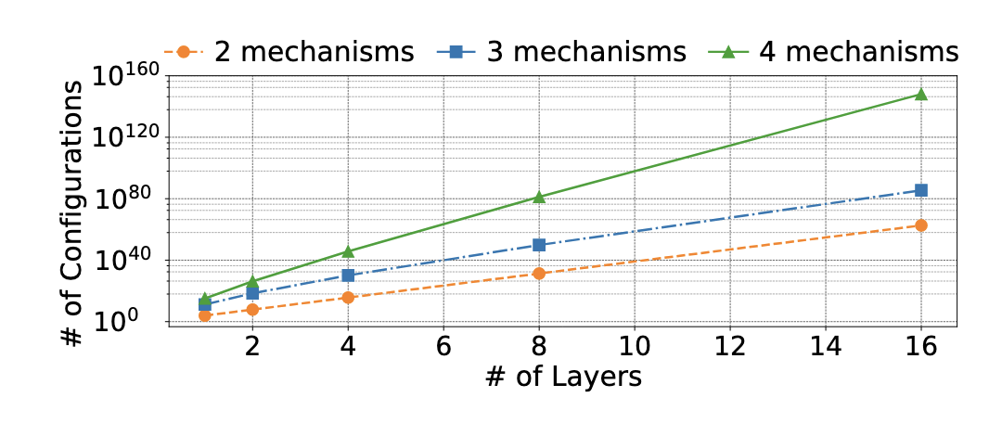
Parallelism
Data
Model
Pipeline
Tensor
Operator
Context
Sequence
Expert
Attribute
One type is not enough
Interdependent
Notes:
Figure 1. Number of possible configurations (in log scale) increases with the number of model layers and mechanisms. (GPT models on 16 devices, 2 mechanisms include data and tensor parallelism, 3 mechanisms further include pipelineparallelism, and 4 mechanisms further include recomputation.)

Slide 6
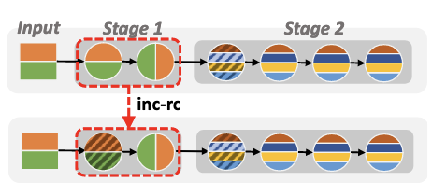
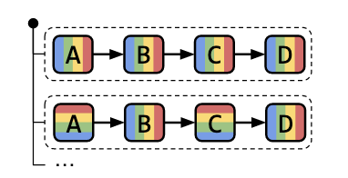
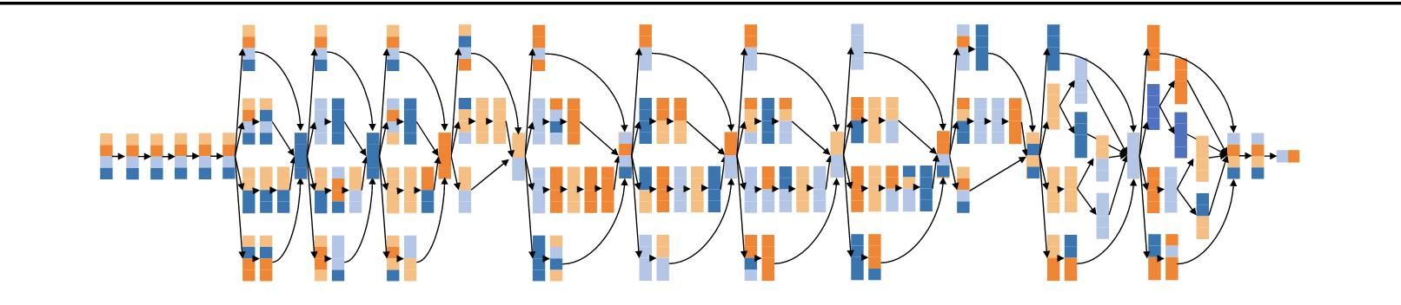
Hybrid Parallelization
Notes:
Not enough space for a whole data to be imported to one replica.
Not enough space for the whole model parameter and gradients and … to be in one gpu
Need parallelization planners to do that for us.

Slide 7
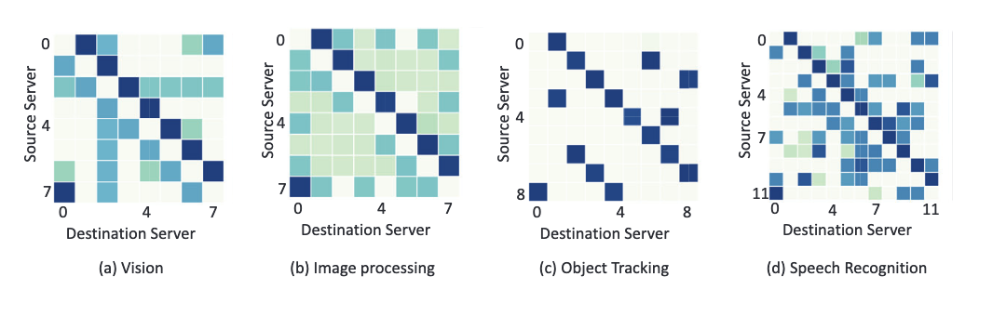
Bottlenecks
Computation 1000x but network ability 12x. Comm. bottleneck
Tensor parallel communication should be chip-to-chip (near) due to high communication volume
Fetching data from remote storage
Different models have different traffic patterns

Slide 8
Solution
Putting TP partitions in a Rack. (placement-aware partitioning)
Using prefetch and caching, gradually importing data for the next mini batch training. Overlapping data-load phase
Models with different traffic patterns can be scheduled to be trained together, in a cluster
Having a planner for hybrid parallelization jointly optimized with placement-awareness, and prefetch and caching which supports co-optimized multi-model cluster scheduling

Slide 9
Referenced paper
TopoopT: Co-optimizing Network Topology and Parallelization Strategy for Distributed Training Jobs
Beyond data and model parallelism for deep neural networks.
Aceso: Efficient Parallel DNN Training through Iterative Bottleneck Alleviation
Alpa: Automating inter-and {Intra-Operator} parallelism for distributed deep learning
Efficient Training of Large Language Models on Distributed Infrastructures: A Survey

Slide 10
Thank You

