Slide 1
On Improving Efficiency of Distributed Deep Learning Training
DISTML
Presenter: Alireza Karimi, Taha Majlesi

Slide 2
hybrid parallelization with
IO awareness
  Overlapping preprocessing
  Prefetching data pipelines
  Caching
Network awareness
  Device placement
  Topology awareness
  Network contention aware
Multi job scheduling
  Inter job contention
  Resource allocation
  Cluster scheduling
Notes:
Communication is the bottleneck. Silod paper

Slide 3
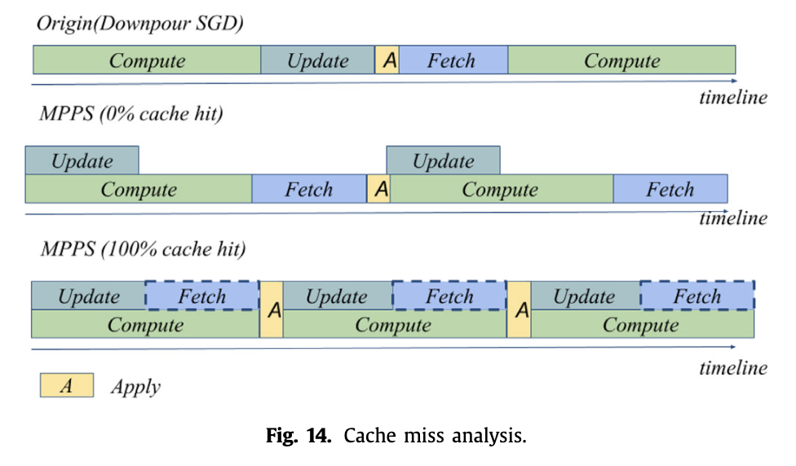
IO-awareness
DNNs spend up to 65% of the epoch time in data pre-processing, primarily on redundant decoding (Analyzing and Mitigating Data Stalls in DNN Training, 2021)

Slide 4
MegaScale-Data: Scaling Dataloader for Multisource Large Foundation Model Training Proceedings of the 21st European Conference on Computer Systems, EuroSys 2026
Previous works does not consider IO-aware hybrid parallelism
Supports 4D parallelism (combines Pipeline, Data, Context, and Tensor Parallelism)
Also supports
  Data Preprocessing & Transformations
  Declarative Data Pipeline & Orchestration
  Background Loading and Prefetch Buffers
  Adaptive Scaling & Resource Management
  Fault Tolerance & Resiliency

Slide 5
MegaScale-Data: Scaling Dataloader for Multisource Large Foundation Model Training Proceedings of the 21st European Conference on Computer Systems, EuroSys 2026
Results compared with:
  Without the Data Constructor (Direct-Transfer Baseline)
  Without Data Orchestration (Vanilla Baseline)
  Without Disaggregated Preprocessing (Standard Dataloaders)
  Data Fetching and Prefetching
Improvements
  Massive Throughput and Speed Improvements
  Drastic Memory Reduction
  Performance Under Complexity (Context & Model Size)
  Extreme Scalability and Fault Tolerance

Slide 6
NEST: Network- and Memory-Aware Device Placement For Distributed Deep Learning
Ninth Annual Conference on Machine Learning and Systems, MLSys 2026
Hierarchical non-uniformities make distributed training highly topology-dependent
Jointly reason about parallelism, memory, and network topology
Level-Wise Network Abstraction
Supports realistic datacenter topologies
Solution: operator graph + dynamic programming (with device placement)

Slide 7
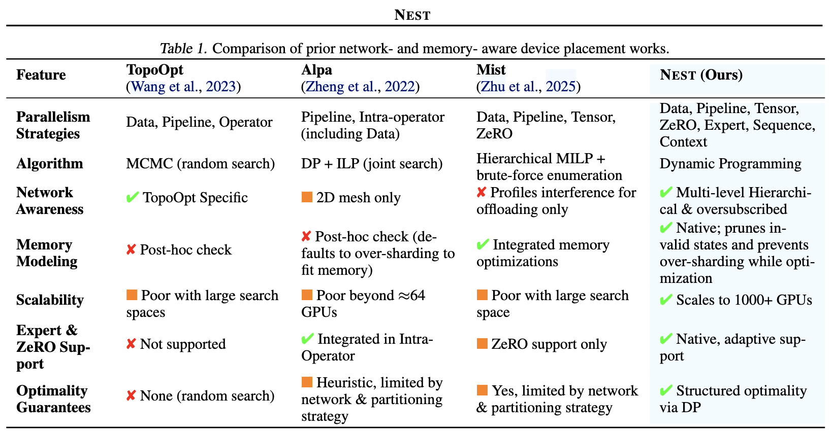
NEST: Network- and Memory-Aware Device Placement For Distributed Deep Learning
Ninth Annual Conference on Machine Learning and Systems, MLSys 2026
Notes:
Does not consider network topology, or variables.
It is iterative, compared with alpha optimiziation.

Slide 8
NEST: Network- and Memory-Aware Device Placement For Distributed Deep Learning
Ninth Annual Conference on Machine Learning and Systems, MLSys 2026
Nest results:
Throughput improvements
Finds optimal placements approximately faster
Successfully identifies feasible placements under strict memory budgets (Avoids OOM)
Nest limitation:
Only single job
Notes:
Does not consider network topology, or variables.
It is iterative, compared with alpha optimiziation.

Slide 9
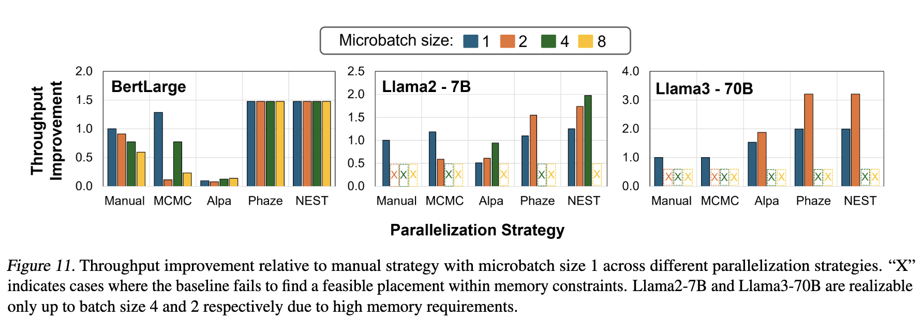
NEST: Network- and Memory-Aware Device Placement For Distributed Deep Learning
Ninth Annual Conference on Machine Learning and Systems, MLSys 2026
Nest results:
Notes:
Does not consider network topology, or variables.
It is iterative, compared with alpha optimiziation.

Slide 10
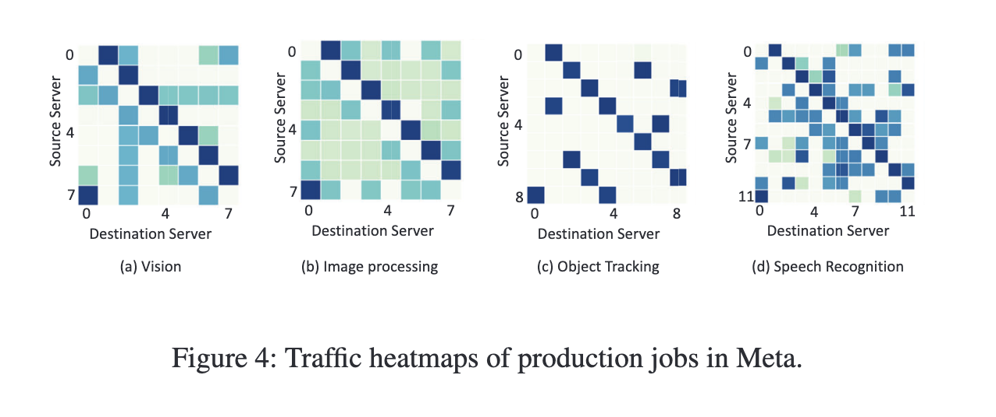
ML jobs (have predictable traffic patterns)

Slide 11
Arena: Efficiently Training Large Models via Dynamic Scheduling and Adaptive Parallelism Co-Design
Proceedings of the 21st European Conference on Computer Systems, EuroSys 2026
Previous works
  Some only supports general ML jobs
  Some support static parallelization profiles
Arena supports
  Adaptive parallelization
  joint scheduling-parallelism optimization

Slide 12
Arena: Efficiently Training Large Models via Dynamic Scheduling and Adaptive Parallelism Co-Design
Proceedings of the 21st European Conference on Computer Systems, EuroSys 2026
Arena workflow for each job
  For different combinations of GPU numbers and pipeline parallelization degrees, guess the best plan (best dp and mp degree that suits)
  Calculate the time using a single GPU computation and communication benchmarks
  Arena now has a menu of exactly how fast every job will run on any given number of GPUs.
  Allocate resources based on these profiled information and jobs deadline
  Can change the number or the version of the GPUs
  Train each job on its allocated resources based on their plan

Slide 13
Arena: Efficiently Training Large Models via Dynamic Scheduling and Adaptive Parallelism Co-Design
Proceedings of the 21st European Conference on Computer Systems, EuroSys 2026
Results
  Compared with SP profiling schedulers
  Real-World Clusters
  Reduced average JCT by 75.2% to 81.3% compared to the baselines and completed up to 1.45× more jobs
  In heavy-load environment, it achieved up to 1.55× higher average throughput
  improves the deadline satisfaction ratio by 1.69× over

Slide 14
Arena: Efficiently Training Large Models via Dynamic Scheduling and Adaptive Parallelism Co-Design
Proceedings of the 21st European Conference on Computer Systems, EuroSys 2026
Arena cons
  Buddy allocation: GPUs assigned to a single job as physically close together as possible
  Periodic Defragmentation As jobs start and finish, ensuring that jobs remain tightly grouped.
  Does not consider network contention, Prevent Cross-Region Traffic

Slide 15
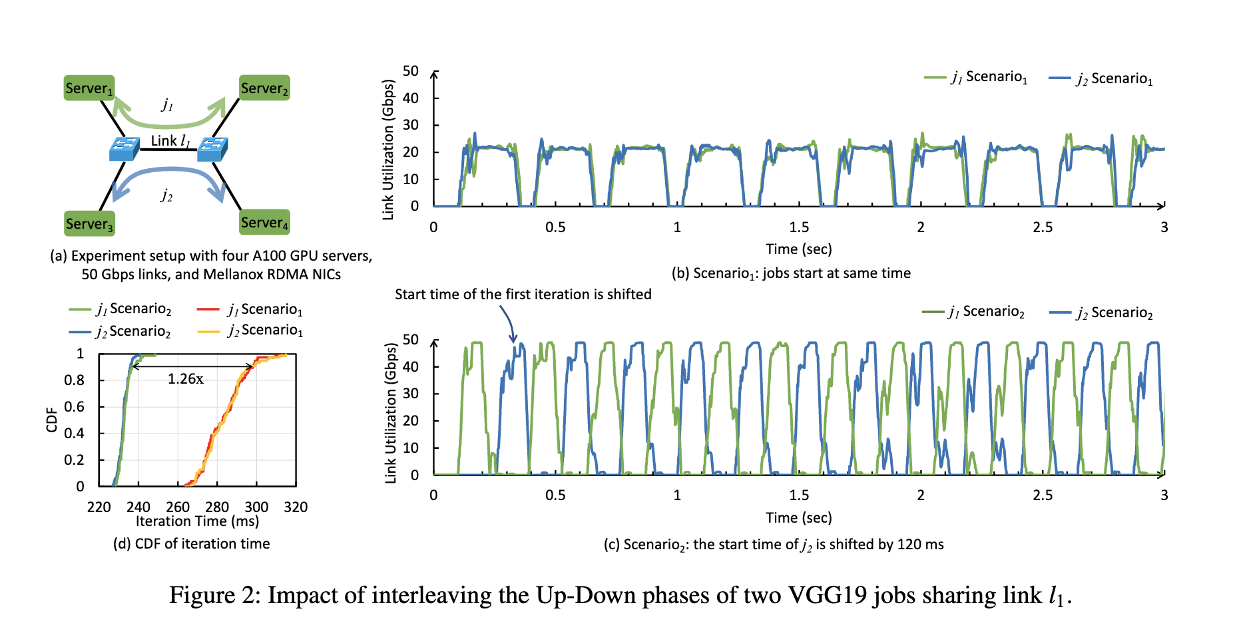
Multi job scheduling + inter job contention

Slide 16
References
NEST: Network- and Memory-Aware Device Placement For Distributed Deep Learning, 2026
Adaptive cache pre-forwarding policy for distributed deep learning, 2020
Analyzing and mitigating data stalls in DNN training, 2021
CASSINI: Network-Aware Job Scheduling in Machine Learning Clusters, 2024
TopoOpt: Co-optimizing Network Topology and Parallelization Strategy for Distributed Training Jobs, 2023
MegaScale-Data: Scaling Dataloader for Multisource Large Foundation Model Training, 2026
Arena: Efficiently Training Large Models via Dynamic Scheduling and Adaptive Parallelism Co-Design, 2026
Notes:
Does not consider network topology, or variables.
It is iterative, compared with alpha optimiziation.

Slide 17
Thank You

