Slide 1

Distributed Deep Learning
Alireza Karimi & Taha Majlesi
Department of Electrical and Computer Engineering,
University of Tehran

Slide 2
Outline
Overview of what we achieved
Formulation
MILP using SCIP solver
Heuristics
Evaluations
  Baselines
  Ablations
Conclusion

Slide 3
Outline
Overview of what we achieved
Formulation
MILP using SCIP solver
Heuristics
Evaluations
  Baselines
  Ablations
Conclusion

Slide 4
Overview
    Distributed deep learning training
    Hybrid parallelization
      Data and model parallel
      Fixed vs adaptive hybrid parallel input
Multi-job and cluster scheduling
    Consider topology-dependency
      Network aware
      Placement aware
      Topology aware
    Prefetching of input training data

Slide 5
Our work’s features
    Multi-objective system
      Lateness
      Overall makespan
      Job completion time
      GPU utilization
      VRAM peak memory usage
    Modeling delays in network
      Transition delay
      Propagation delay (hop by hop)
    Hierarchical topology of datacenters (fat-tree)
    Converged (shared) network

Slide 6
Outline
Overview of what we achieved
Formulation
MILP using SCIP solver
Heuristics
Evaluations
  Baselines
  Ablations
Conclusion

Slide 7
Formulation
Model’s constraints
  VRAMs
  Bandwidth and links
  GPUs
  Micro-batches
Pruning constraints
  Micro-batch ordering
  Time bounding constraints

Slide 8
Outline
Overview of what we achieved
Formulation
MILP using SCIP solver
Heuristics
Evaluations
  Baselines
  Ablations
Conclusion

Slide 9
MILP and SCIP
MILP = mixed integer linear programming
SCIP solver and library
What we defined?
  Indexes
  Decision variables
  Constraints
  Pruning constrains
  Objectives
Input
  General system parameters
  JSON configs

Slide 10
Outline
Overview of what we achieved
Formulation
MILP using SCIP solver
Heuristics
Evaluations
  Baselines
  Ablations
Conclusion

Slide 11
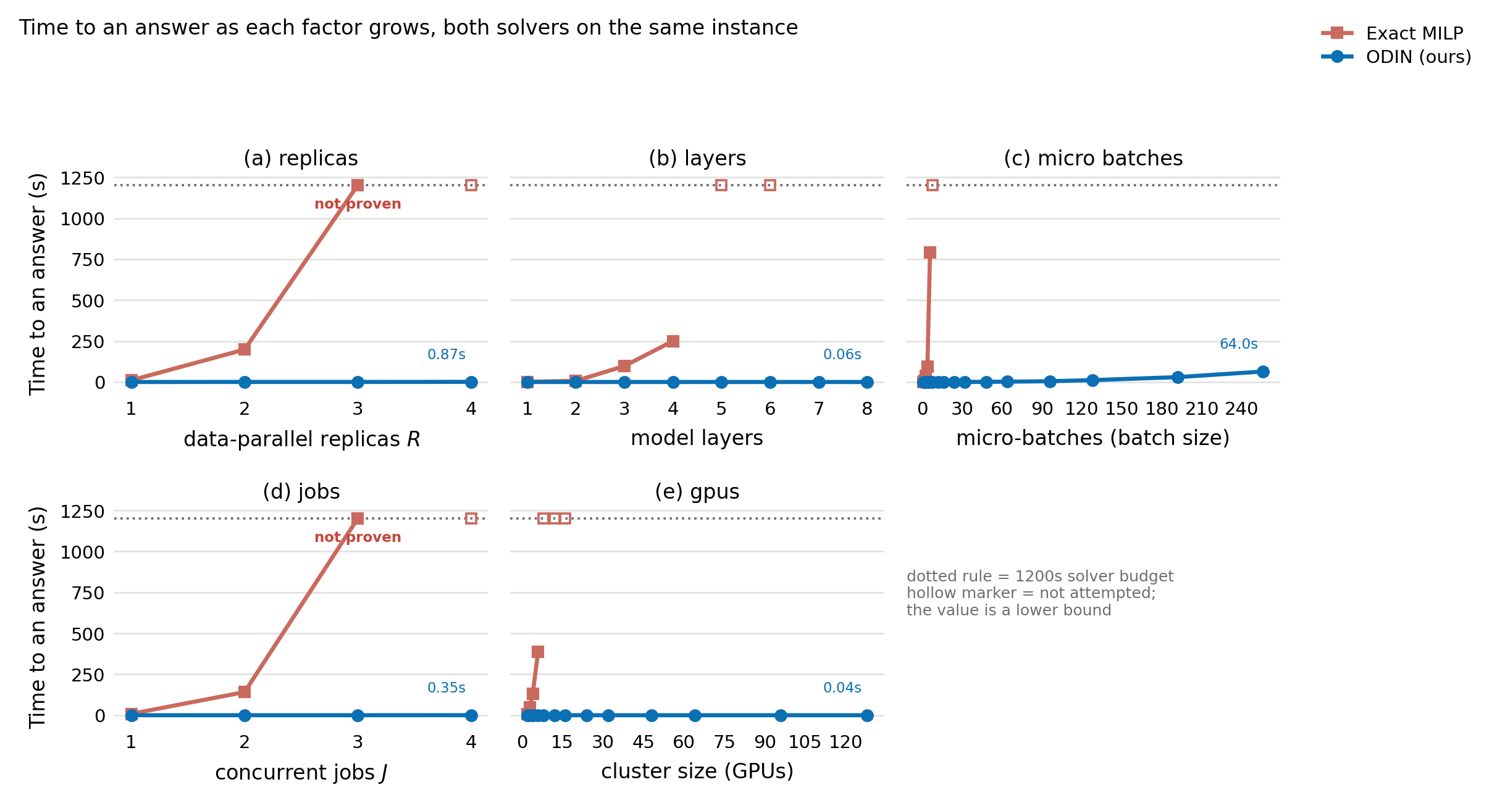
Heuristics
MILP can’t get big enough (takes time)
Heuristic will mimic most MILP answers
Faster

Slide 12
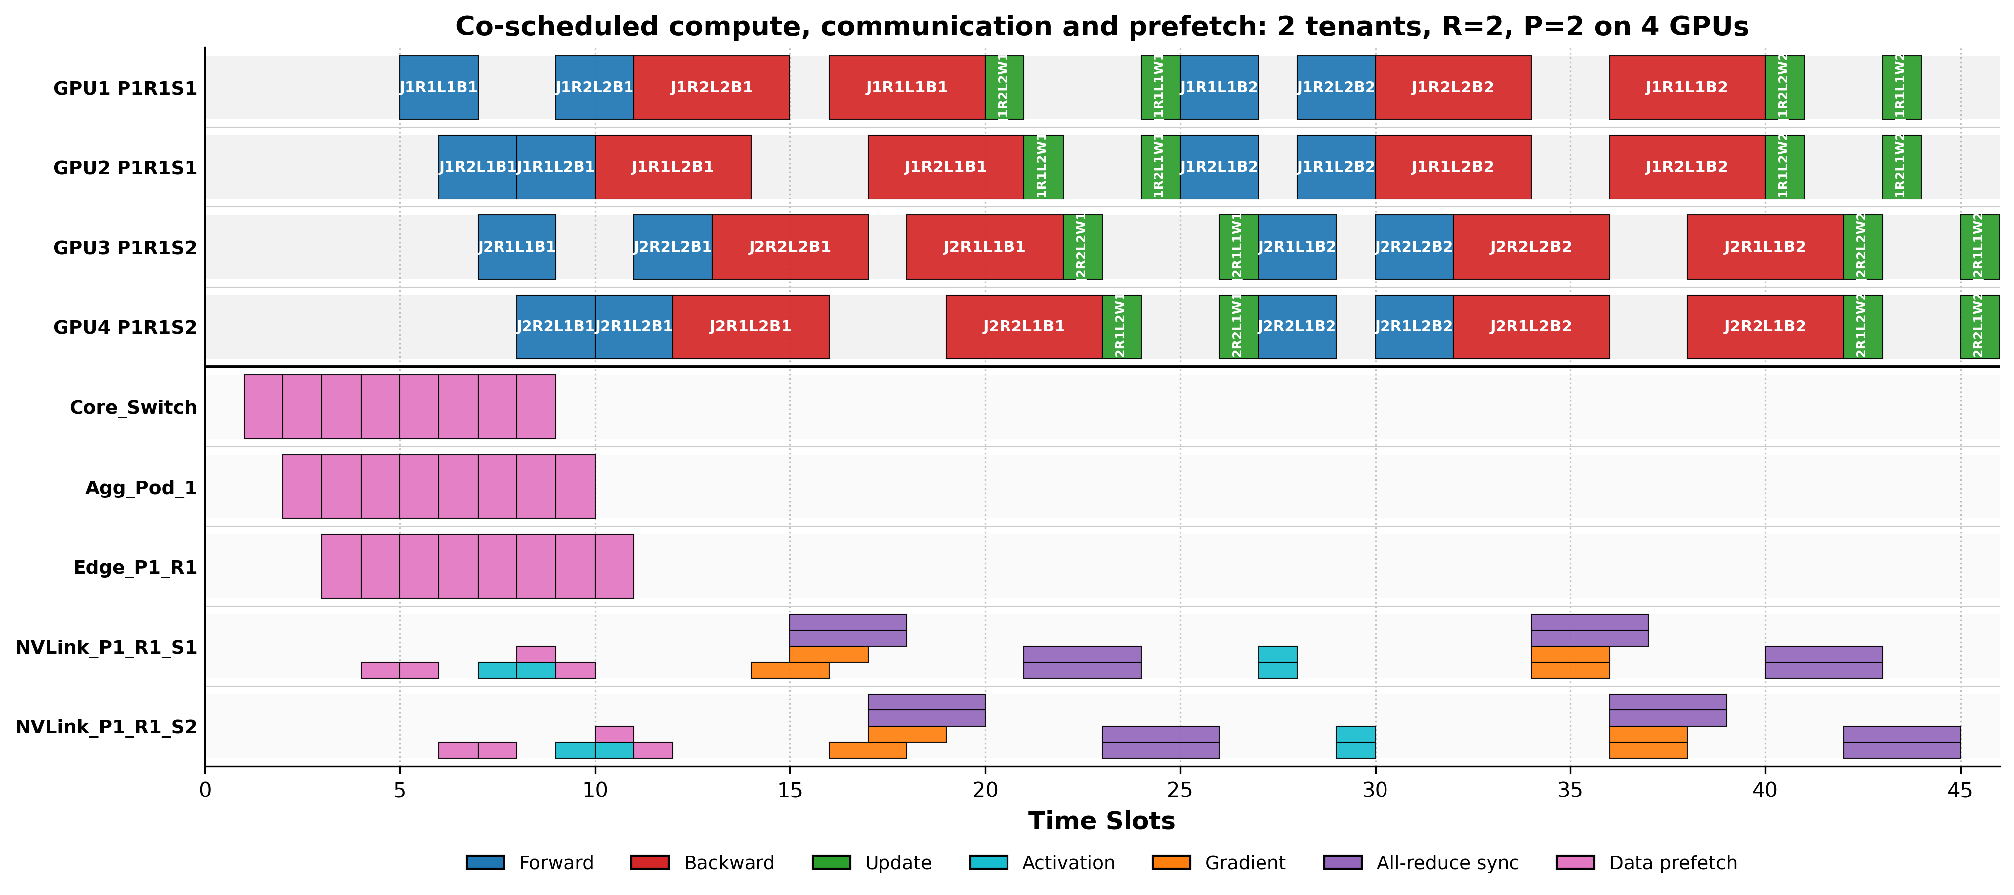
Example

Slide 13
Outline
Overview of what we achieved
Formulation
MILP using SCIP solver
Heuristics
Evaluations
  Baselines
  Ablations
Conclusion

Slide 14
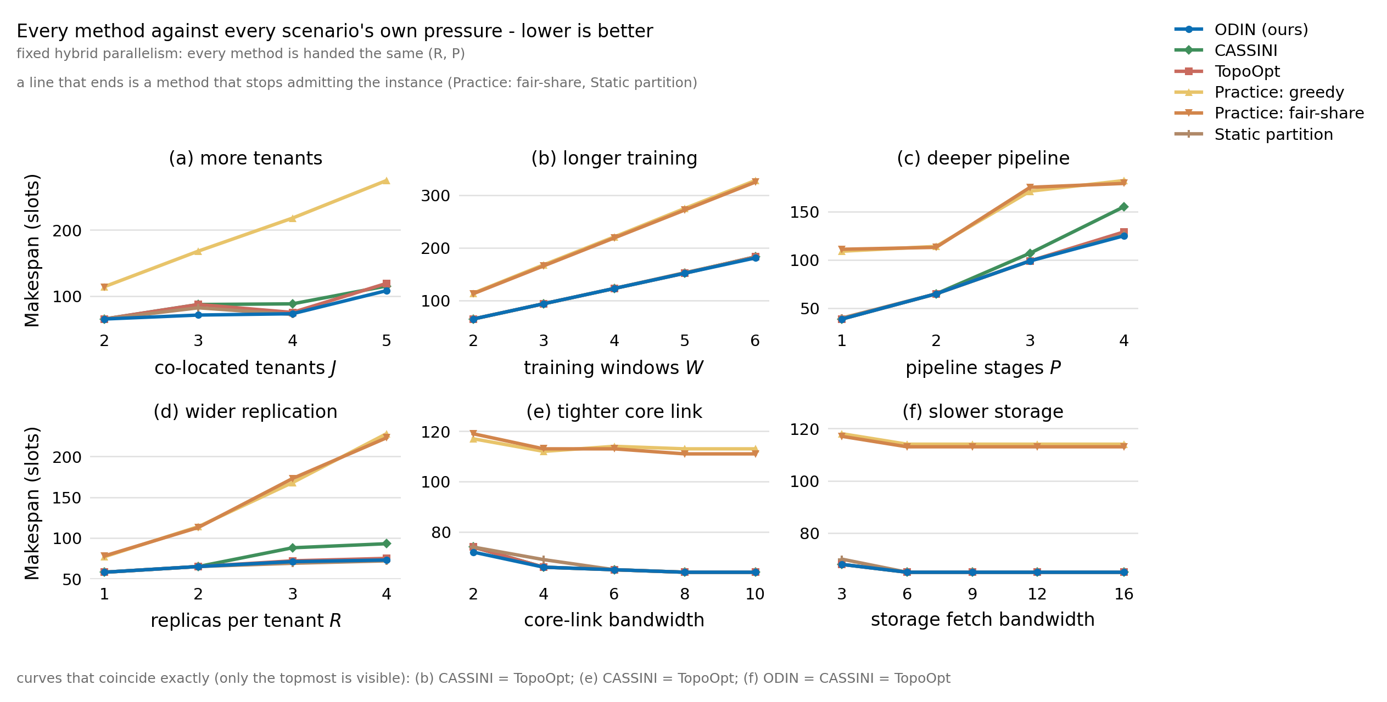
1. Baselines

Slide 15
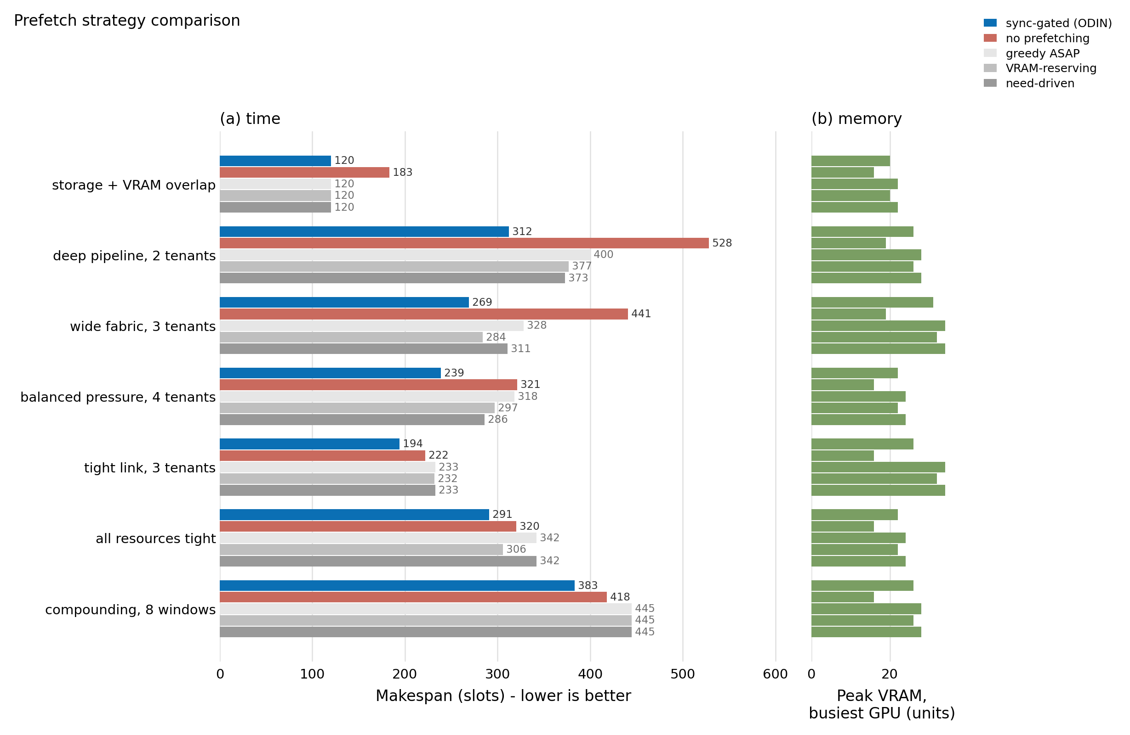
2. Prefetch ablations

Slide 16
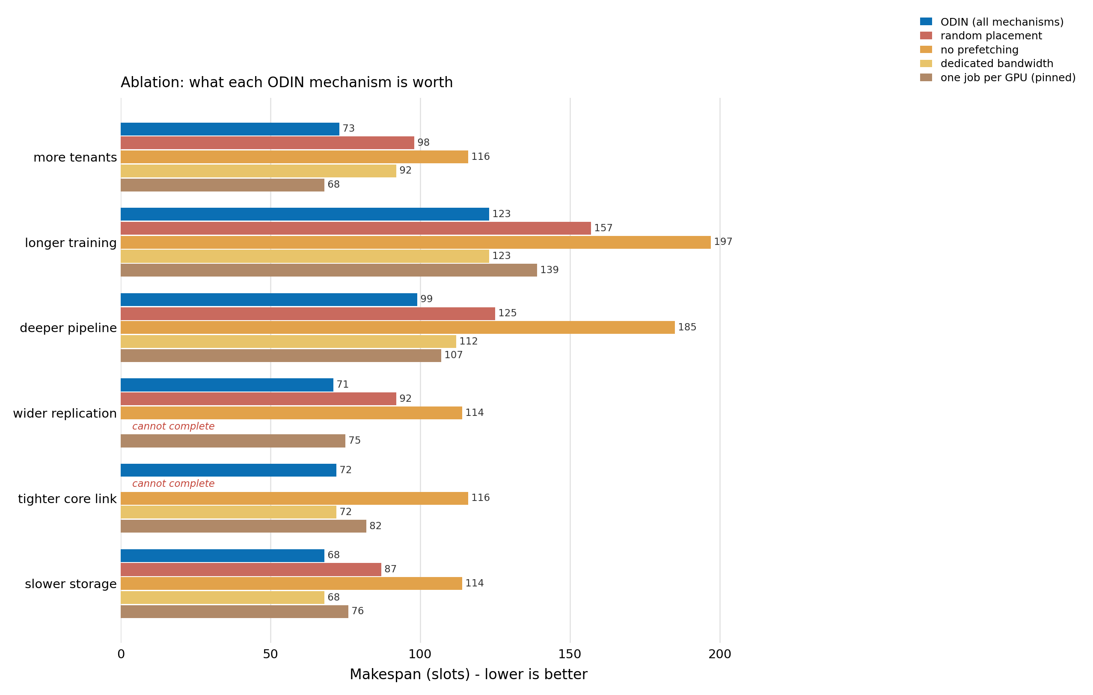
3. Different ablations

Slide 17
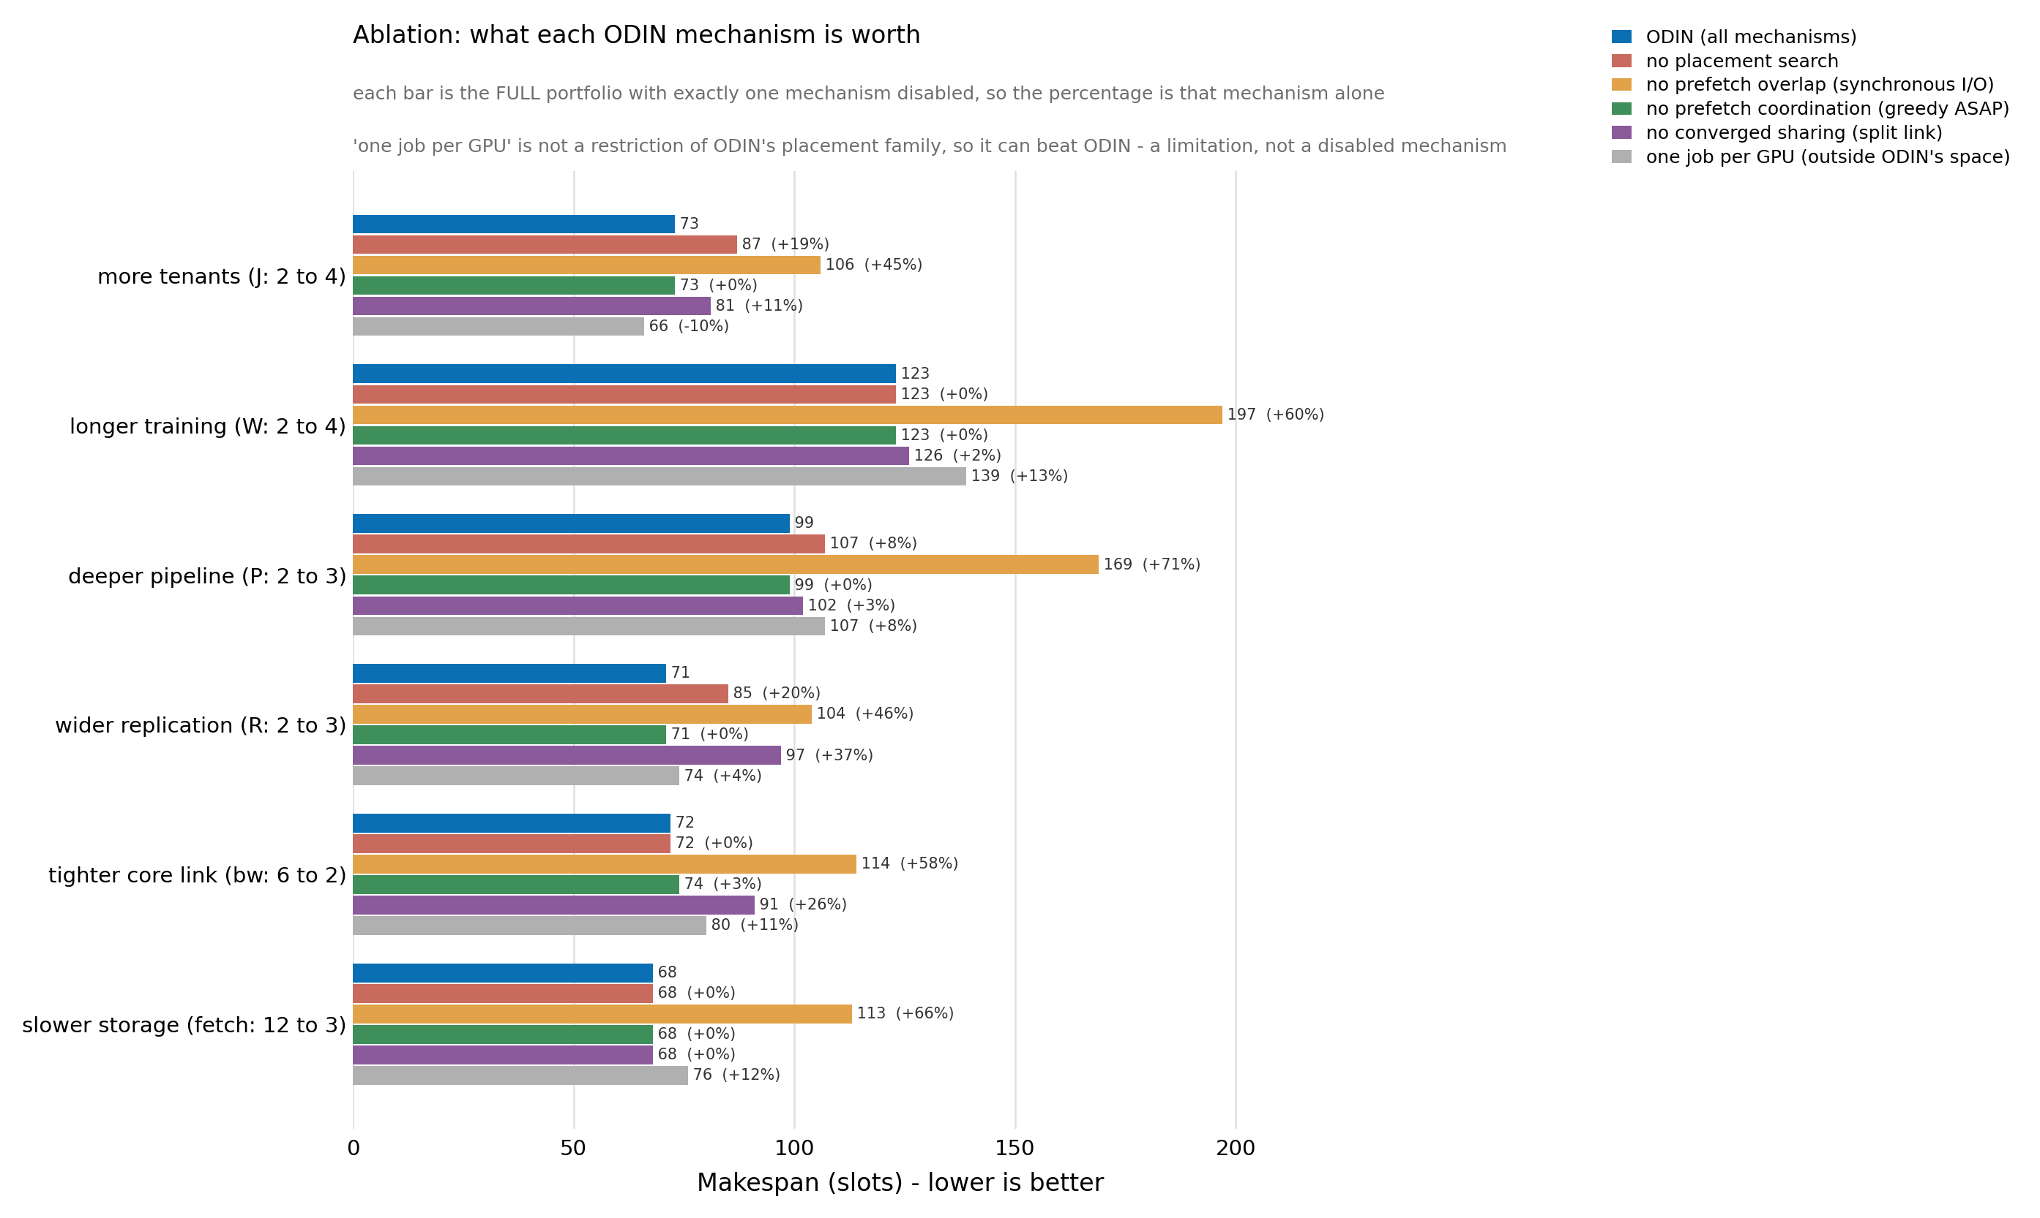
4. Different ablations

Slide 18
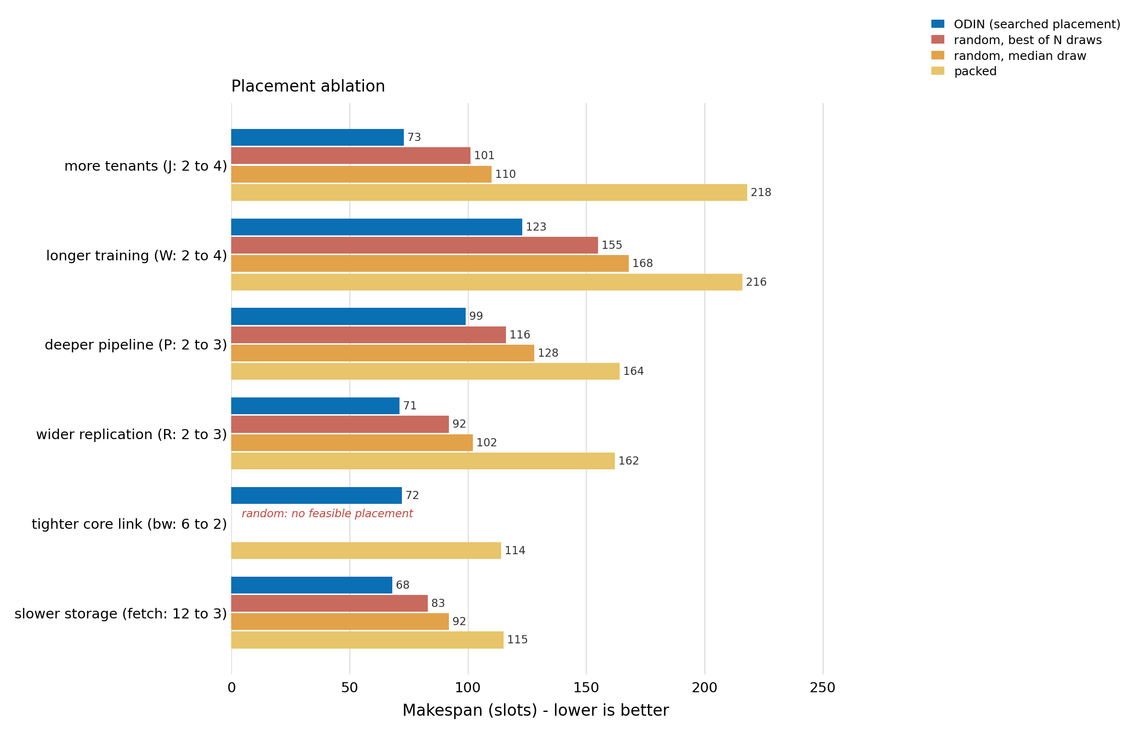
5. Placement ablations

Slide 19
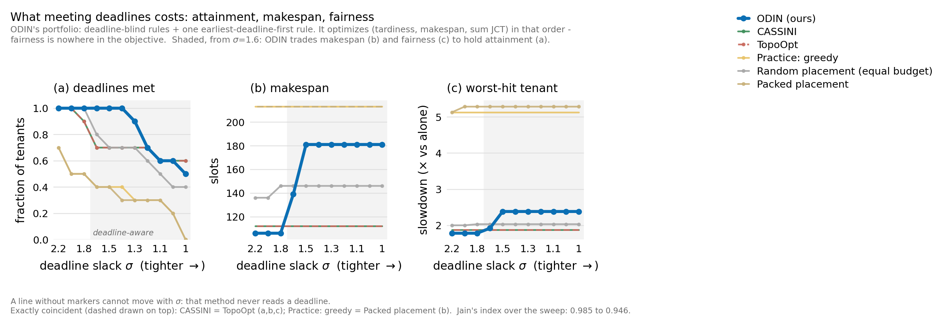
6. Deadline met,makespan and fairness

Slide 20
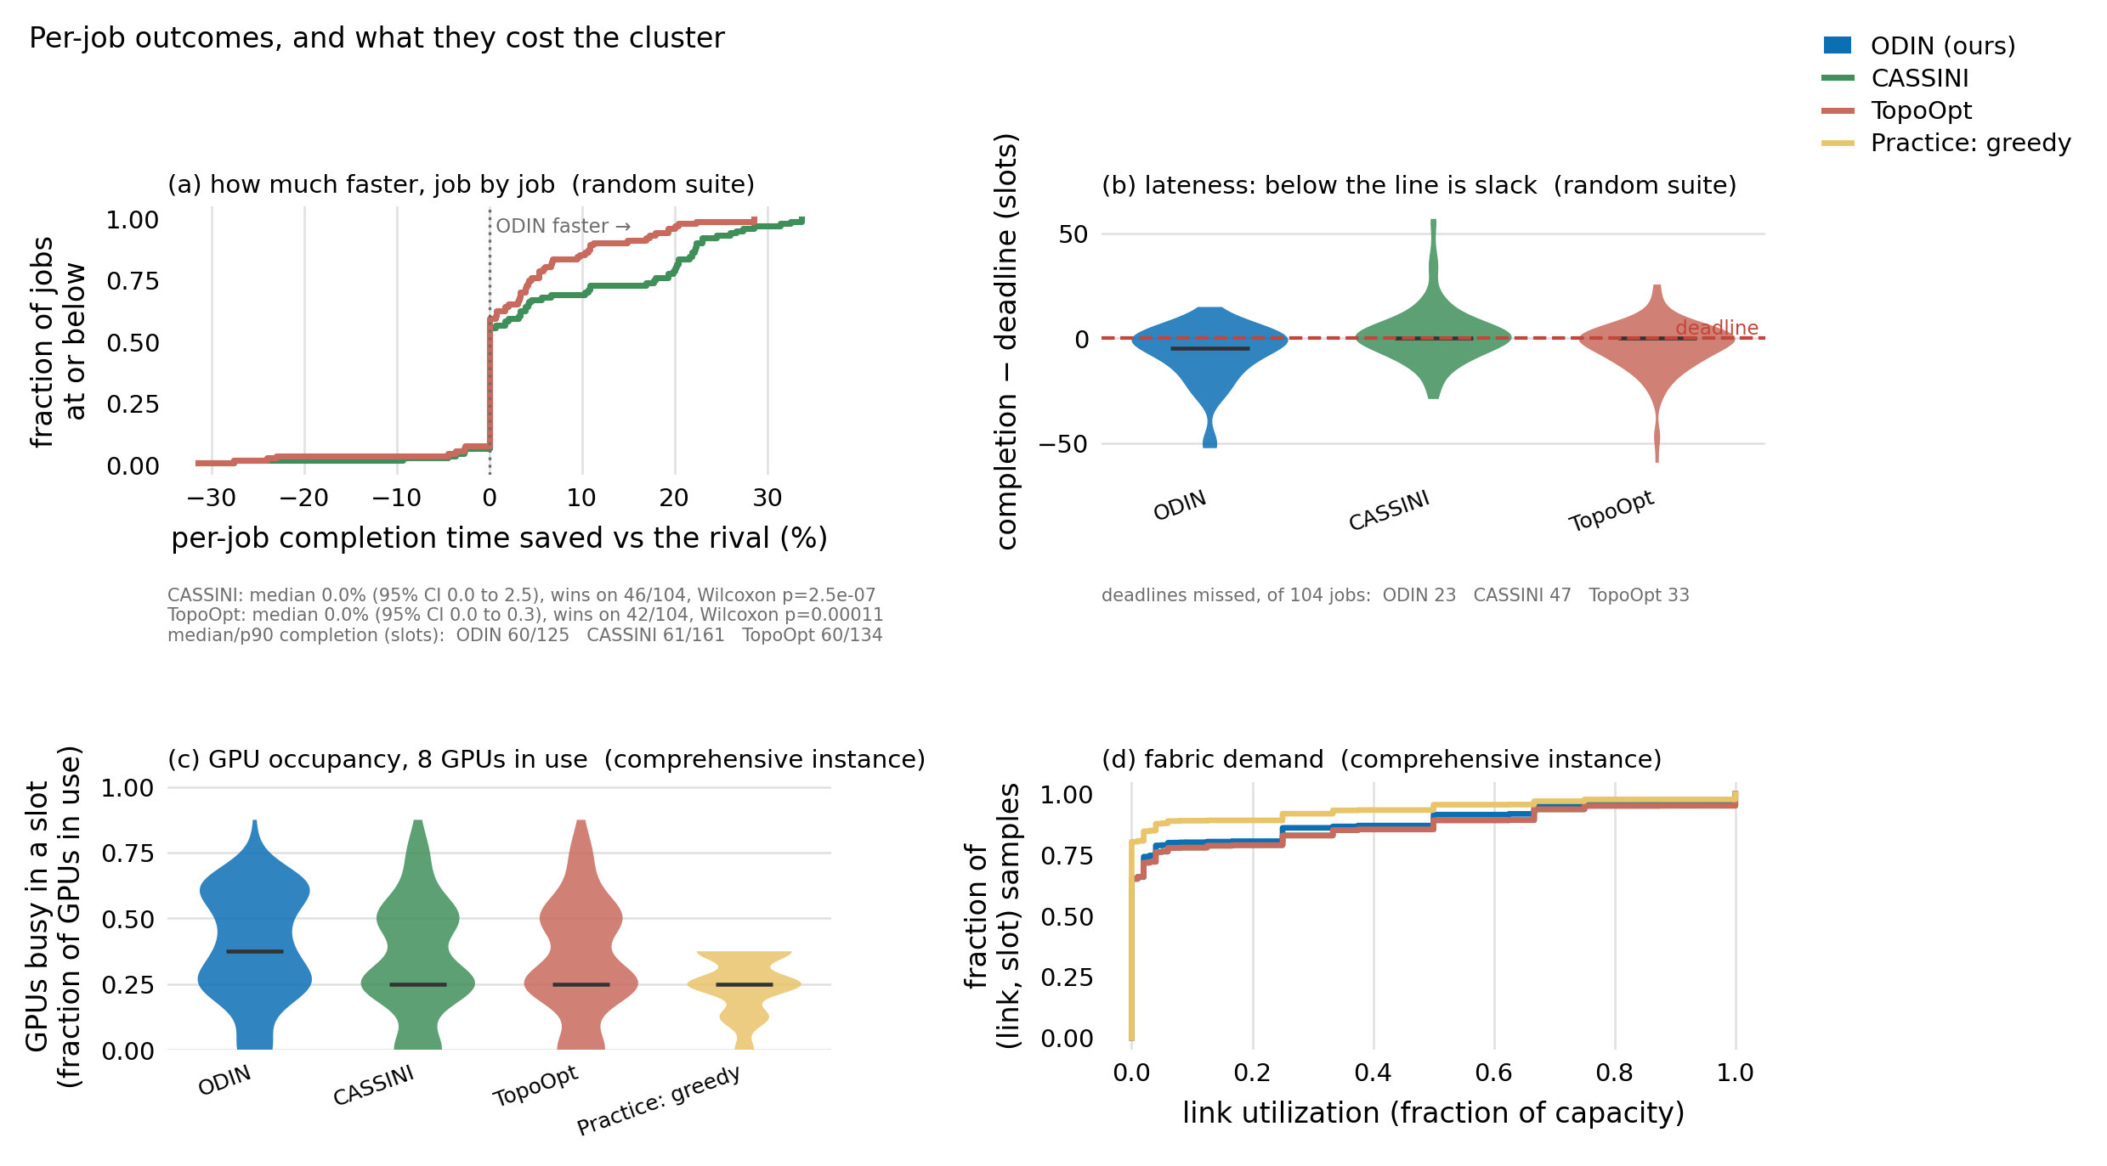
7. JCT & lateness

Slide 21
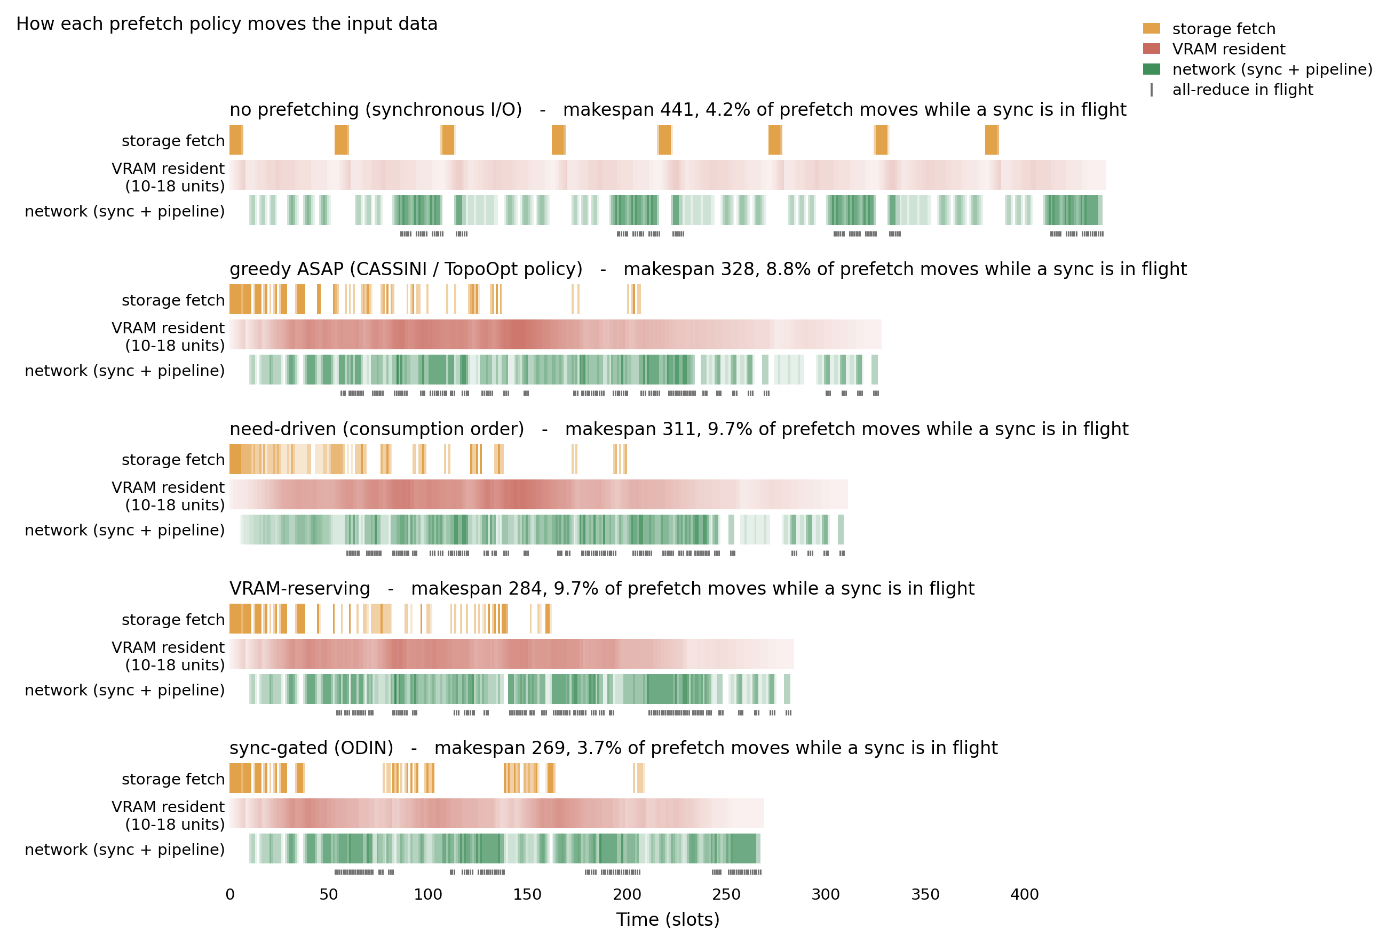
8. Different prefetching approaches

Slide 22
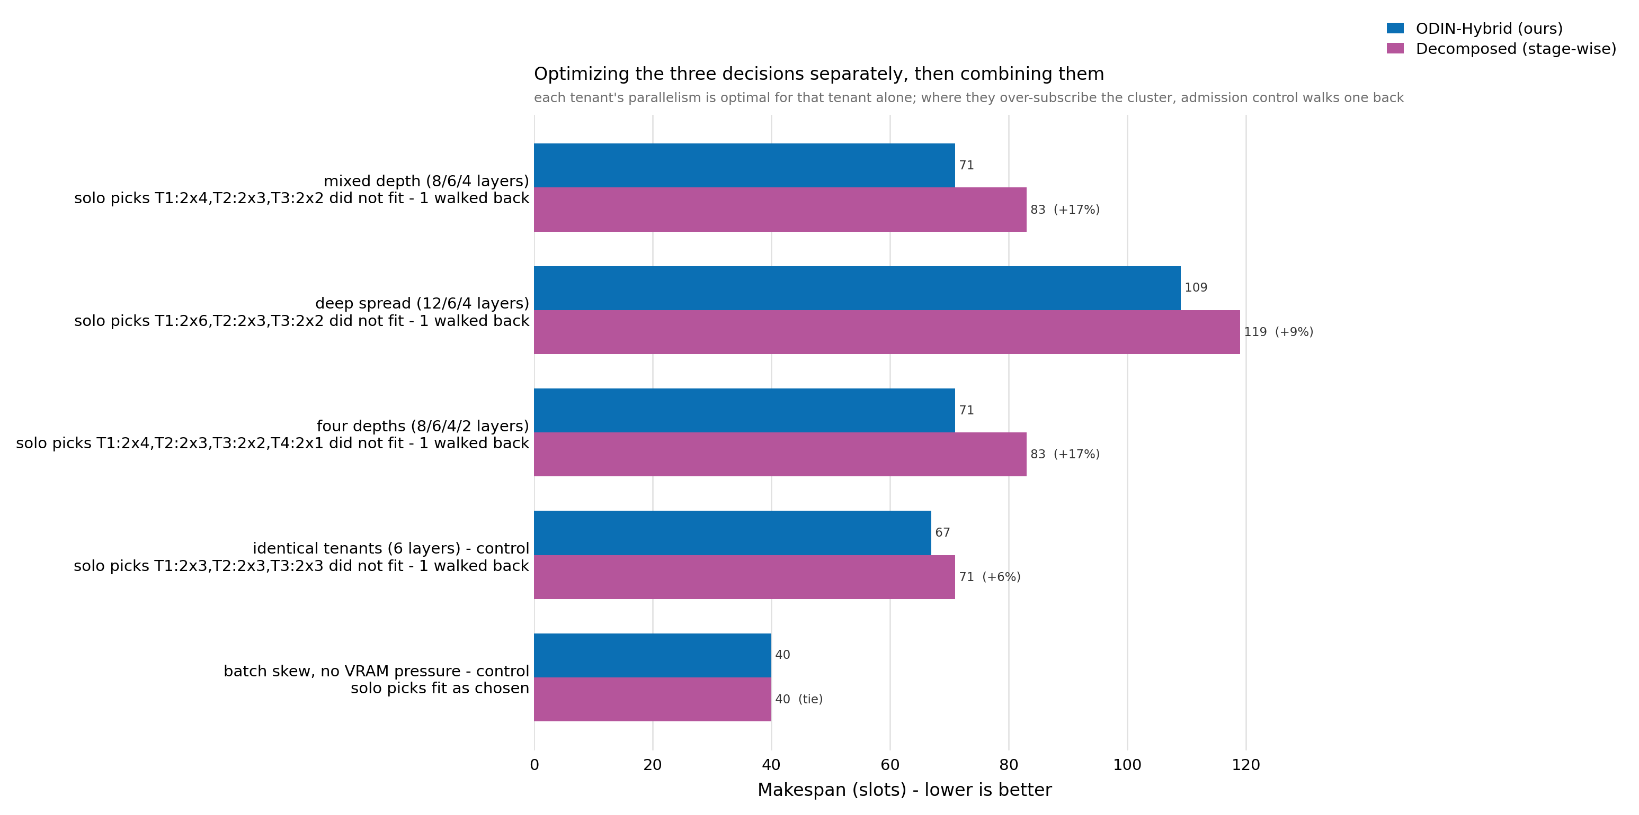
9. Joint vs decomposed optimization

Slide 23
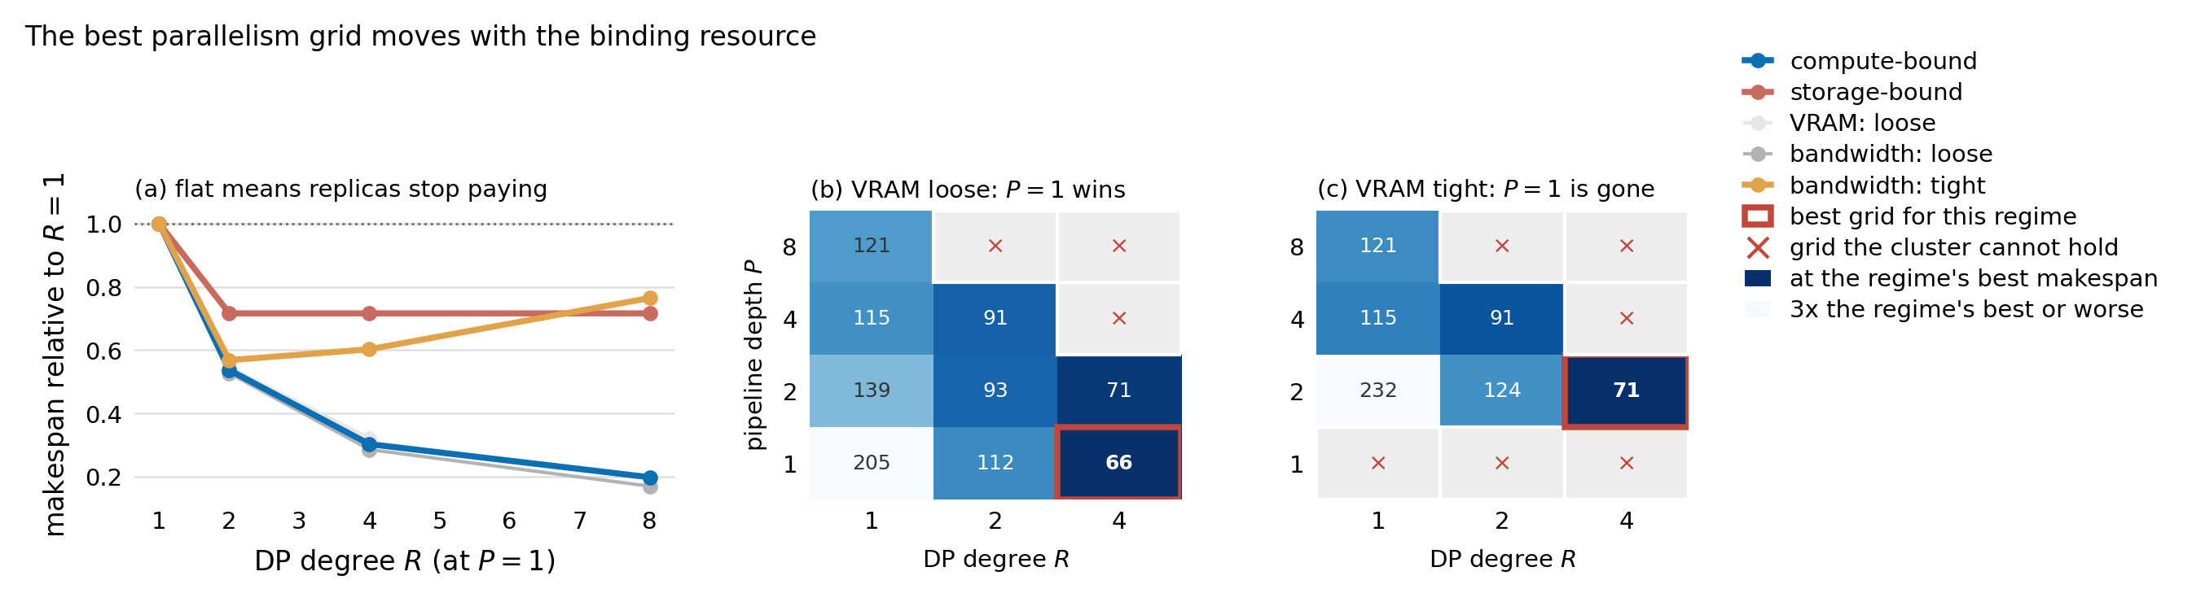
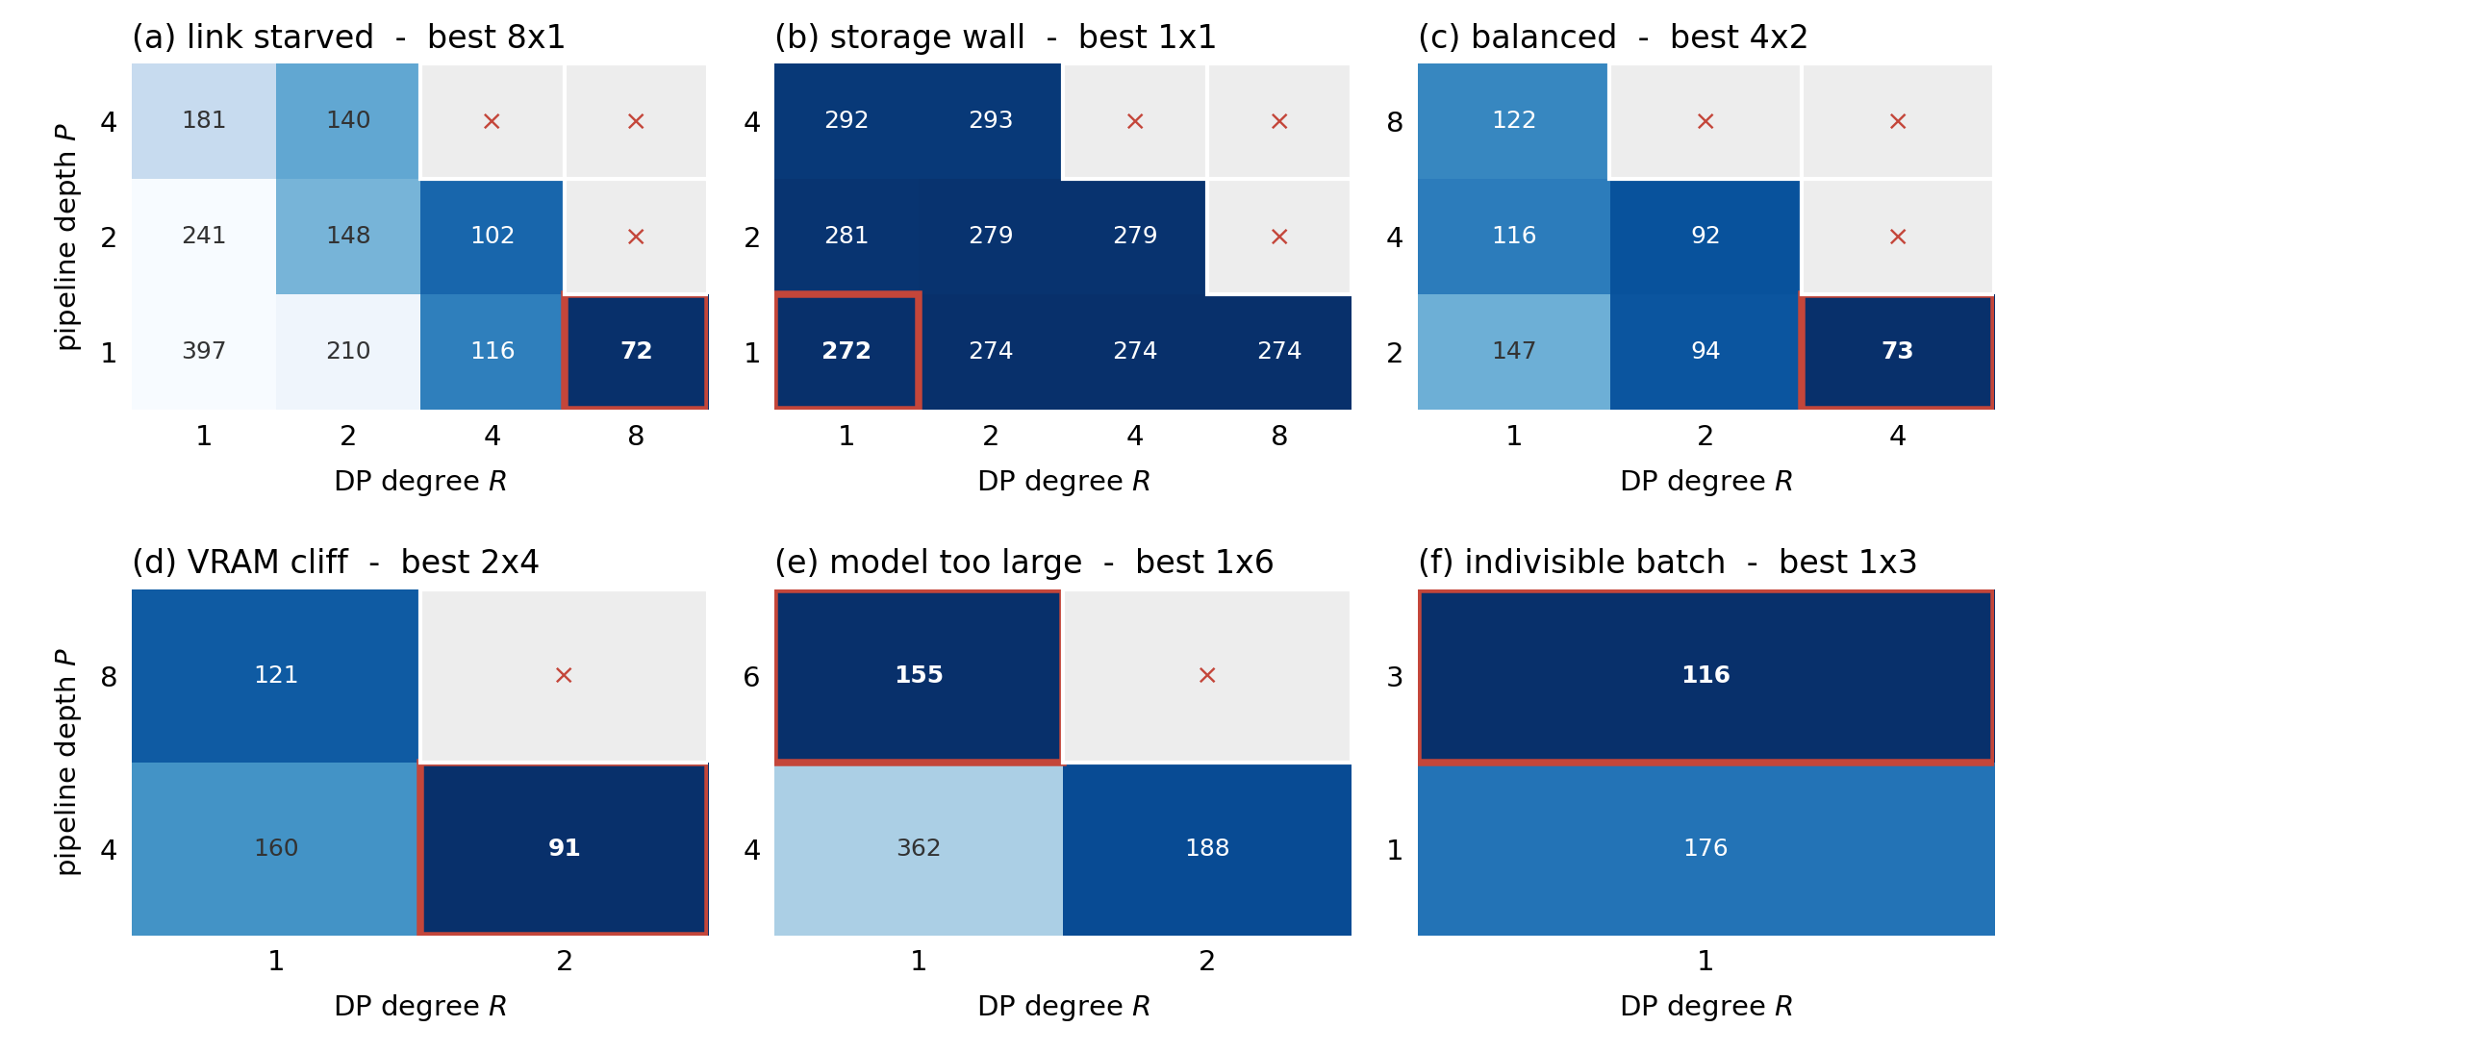
10. DP vs PP

Slide 24
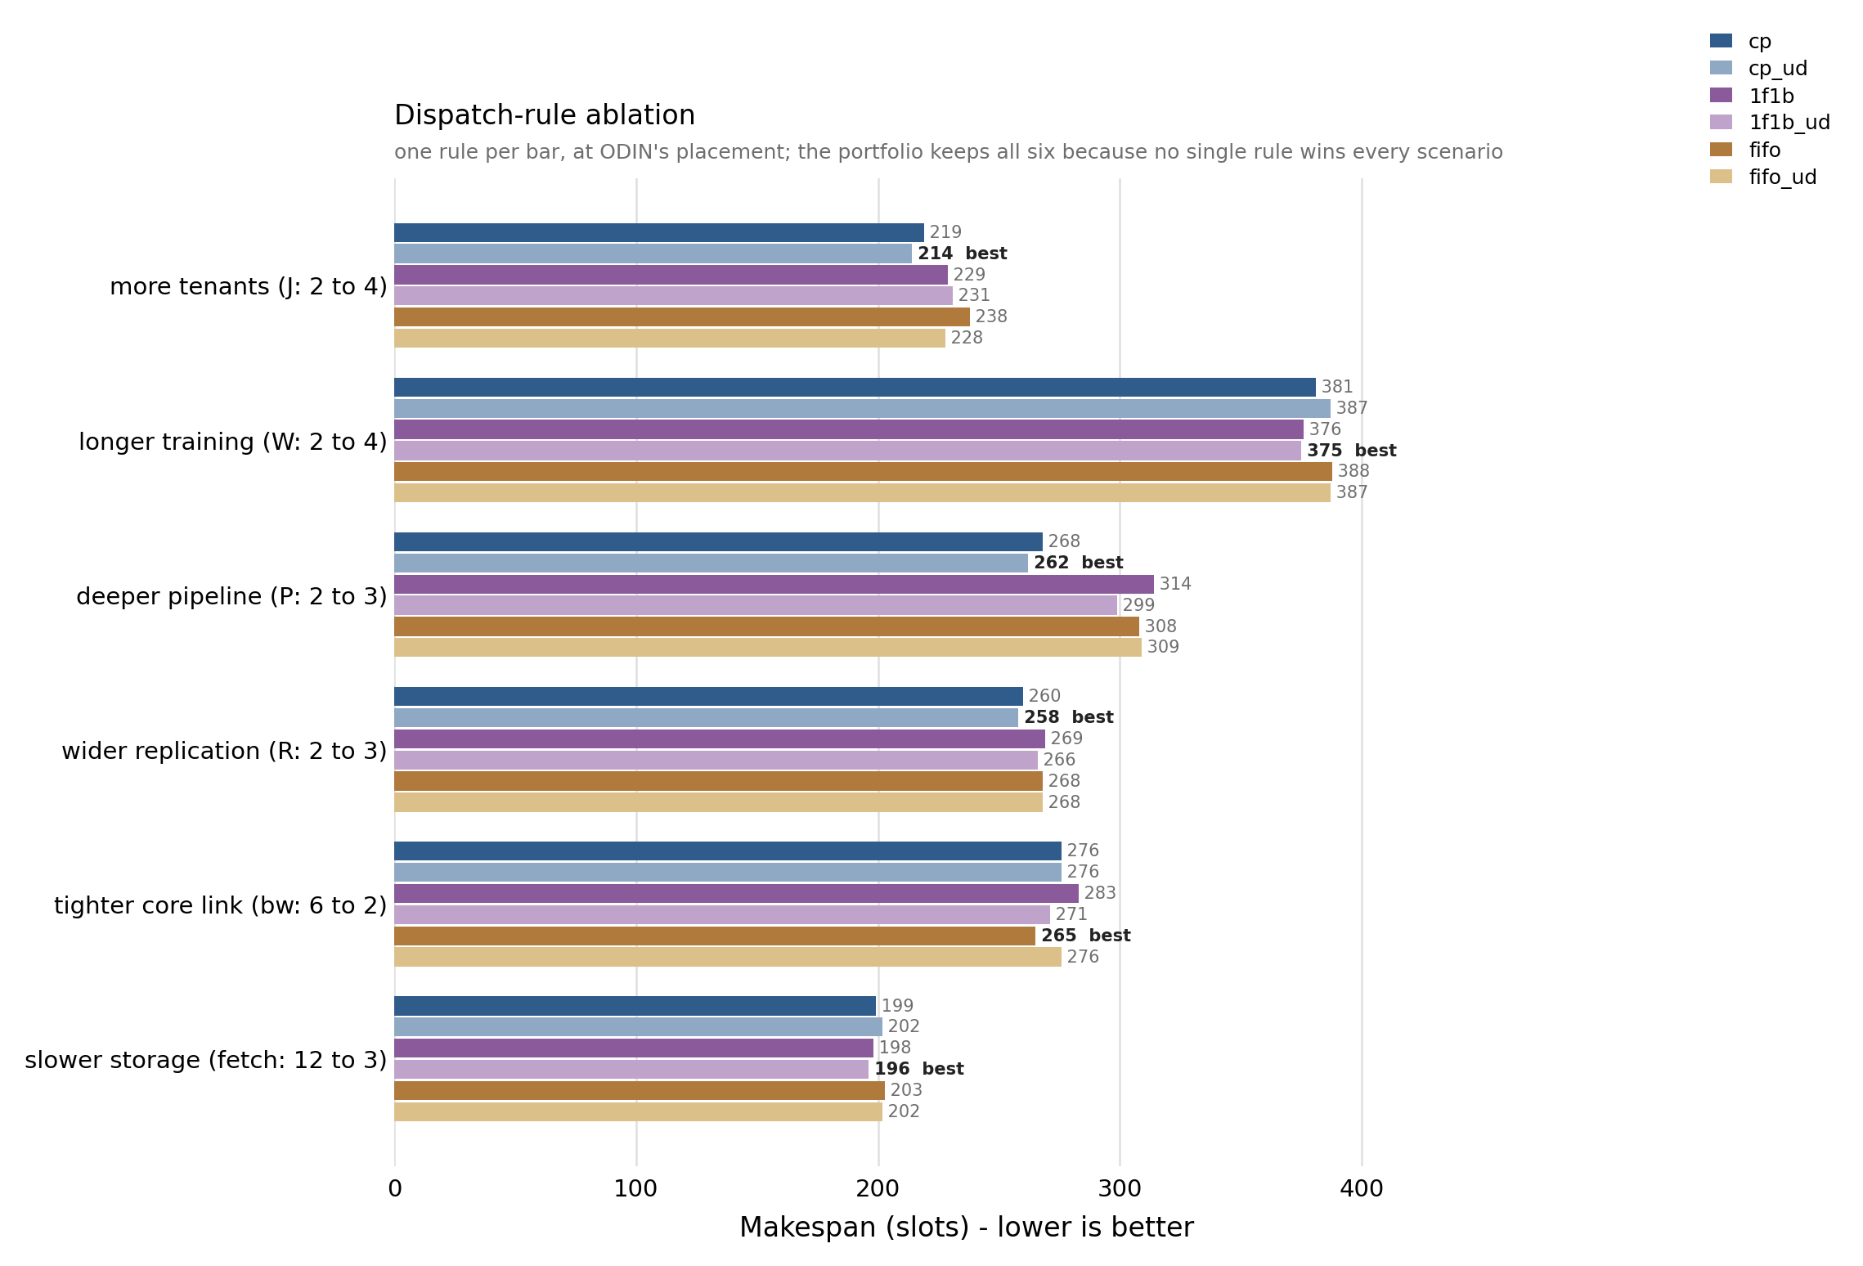
11. Dispatch rule

Slide 25
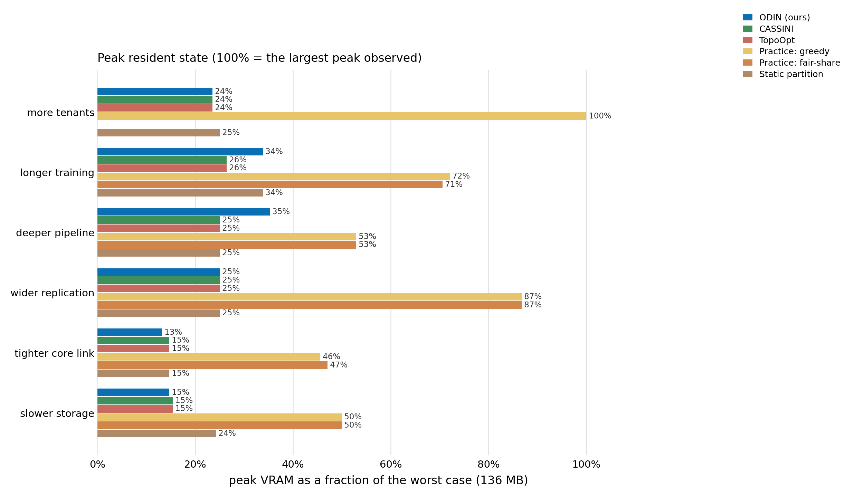
12. VRAM peak

Slide 26
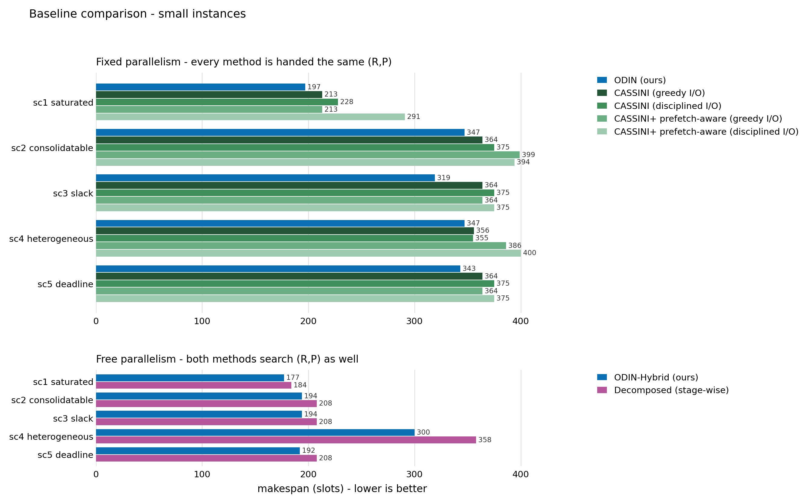
13. Top baselines

Slide 27
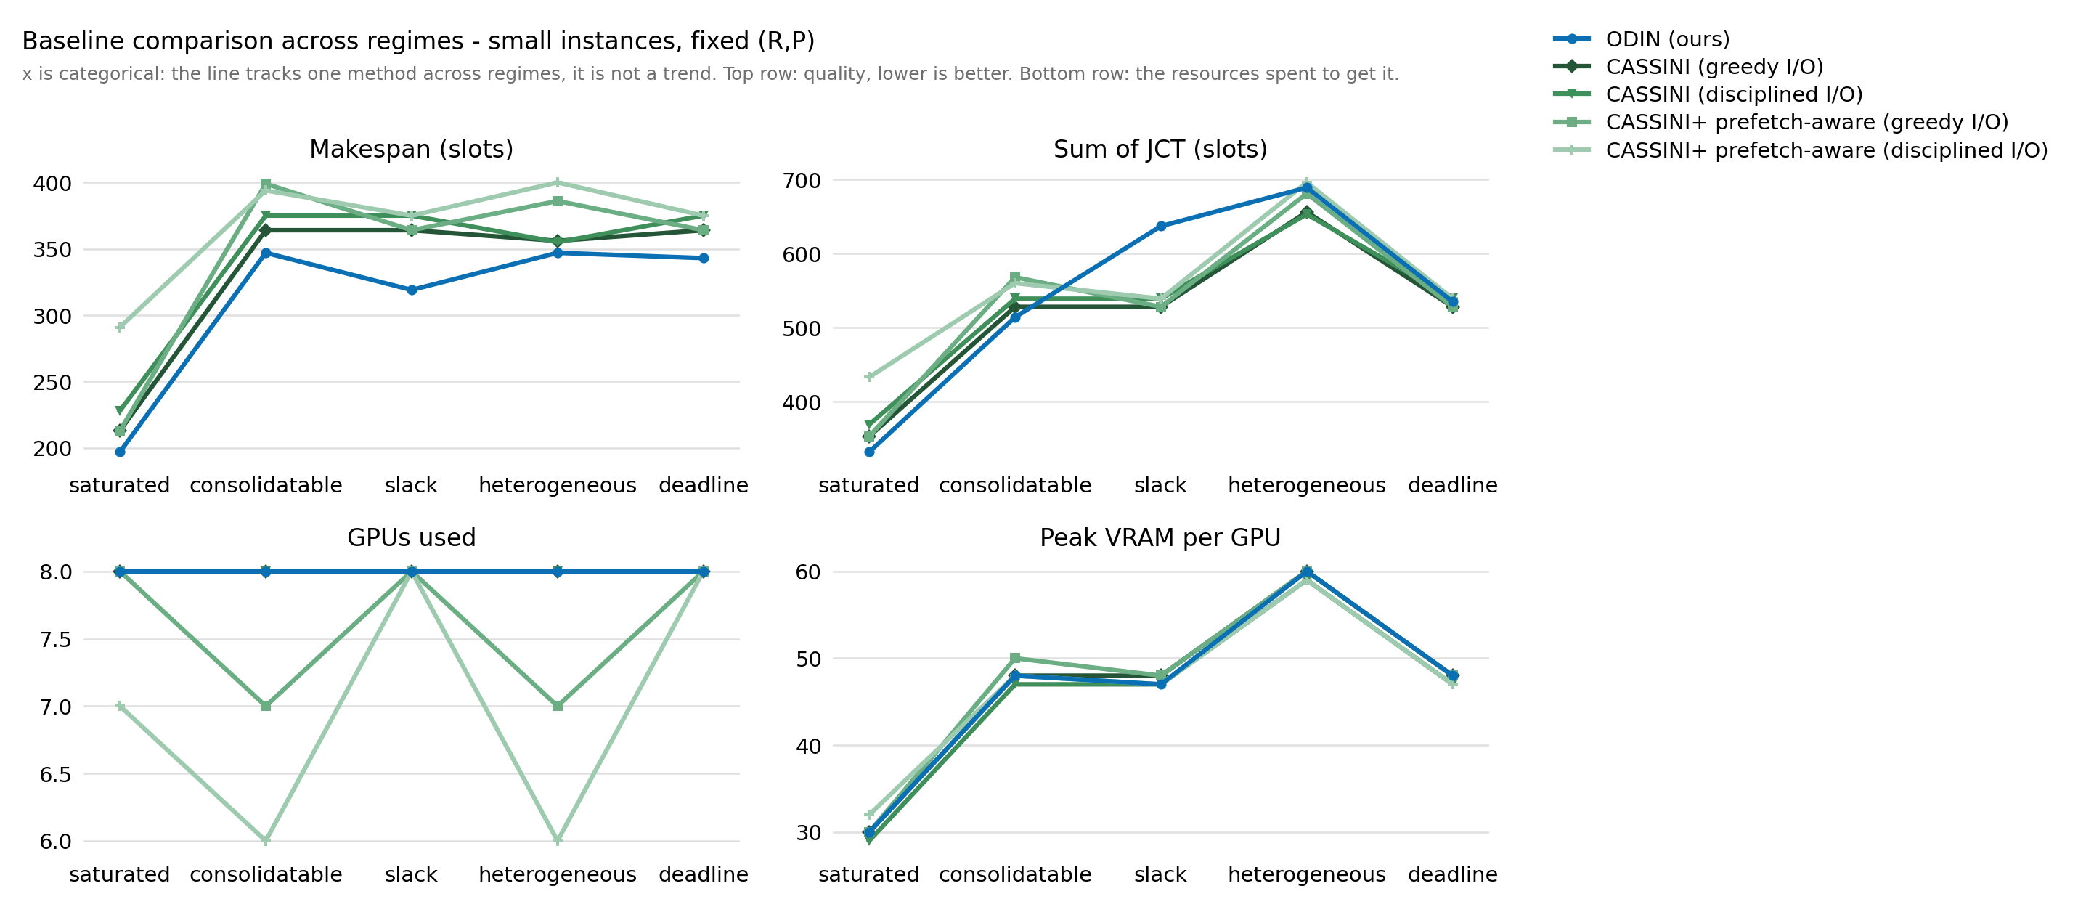
14. Top baselines

Slide 28
Outline
Overview of what we achieved
Formulation
MILP using SCIP solver
Heuristics
Evaluations
  Baselines
  Ablations
Conclusion

Slide 29
Conclusion
Different jobs have different traffic and computation patterns
Heterogeneous jobs can be overlapped
Prefetching should be done at certain times to be effective
Placement awareness is effective in reducing delays
Joint optimization gets better results than decomposed one
DP is always preferred to PP in loose situations

Slide 30
Reference
Duan et al. - 2024 - Efficient Training of Large Language Models on Distributed Infrastructures A Survey
Wang et al. - 2026 - NEST Network- and Memory-Aware Device Placement For Distributed Deep Learning
Rajasekaran et al. - Cassini Network-Aware Job Scheduling in Machine Learning Clusters
Wang et al. - 2023 - TopoOpt Co-optimizing Network Topology and Parallelization Strategy for Distributed Training Jobs

Slide 31
Contact information
Email: karimialireza2004@ut.ac.ir

Slide 32
Thank you for your attention

