Slide 1
RapidChain:
Scaling Blockchain via Full Sharding
Presenter: Alireza Karimi
Tir 1404

Slide 2
Outline
Introduction
  Previous Works
  RapidChain Contribution
Design Components
  Bootstrapping
  Consensus
  Reconﬁguration
Consensus in Committees
  Protocol Details
  Inter-Committee Routing
  Intra-Committee Routing
Evaluation
  Security
  Performance
Challenges and Suggestions

Slide 3
Previous Works
Nakamoto Consensus
  All propose, All verify
  Bitcoin
    Every node maintains a full copy of the entire ledger
    Not Scalable
    Low transaction throughput
    High latency
    poor energy eﬃciency
    Mining-pool centralization
    Initial download of the entire blockchain
Notes:
Ethereum is an open source, globally decentralized computing infrastructure that executes programs called smart contracts

Slide 4
Previous Works
Committee-Based Consensus Protocols
  All propose, Some verify
  Solve Scalability to some degree
  PeerCensus
    Unclear
  Hybrid Consensus
    Corruption by adversary
  ByzCoin
    Incomplete and vulnerable to Byzantine faults
  BA*
    Biased randomness
  Solida
    Trusted genesis block
Notes:
Ethereum is an open source, globally decentralized computing infrastructure that executes programs called smart contracts

Slide 5
Previous Works
Sharding-Based Consensus Protocols
  Some propose, Some verify
  Parallel Work
  RSCoin
    Not Byzantine fault tolerant
  Elastico
    Re-build all committees in “every” epoch.
    Biased randomness
    Trusted setup for initial common randomness
    Gossip-to-all
  OmniLedger
    Runs a global reconﬁguration protocol at every epoch
    Gossip-to-all
    Incomplete and unclear
    Trusted setup
    Vulnerable to (DoS) attacks
Notes:
Ethereum is an open source, globally decentralized computing infrastructure that executes programs called smart contracts

Slide 6
Rapidchain Contribution
Pros
  First Fully Sharding Protocol (parallel)
  Not gossip-to-all (Logarithmic latency and storage)
  Without the assumption of a trusted randomness
  First 1/3 resilient protocol (rather than ¼ like before)
Cons
  ?
  ??
  ???
Notes:
Ethereum is an open source, globally decentralized computing infrastructure that executes programs called smart contracts

Slide 7
Design Components
Bootstrapping
  18.5 hours
Consensus
  One day
  Each contains thousands of about 8.7 seconds consensus instances
Reconfiguration
  6 minutes
Notes:
Ethereum is an open source, globally decentralized computing infrastructure that executes programs called smart contracts

Slide 8
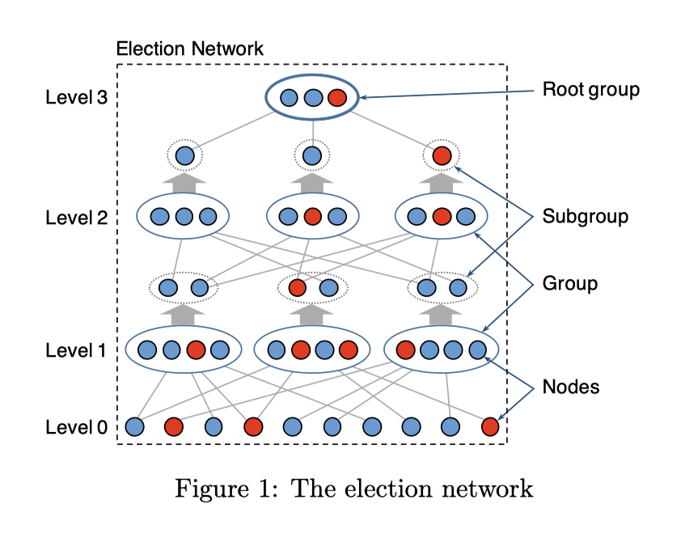
Bootstrapping
  Committee election
    Sampler Graph
  Create root group
  Select Reference Committee
    Epoch Randomness Generation
    Protocol Reconfiguration
  Create sharding Committees
  High Cost (86.5 G storage)
Notes:
Ethereum is an open source, globally decentralized computing infrastructure that executes programs called smart contracts

Slide 9
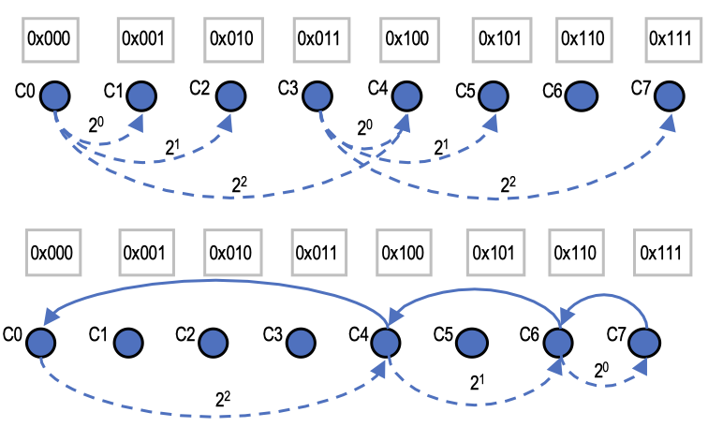
Consensus
  Intra-Committee
    Synchronous
    IDA-Gossip
    Pipeline (1.4x better)
  Inter-Committee
    Partially synchronous
    Cross-Shard transactions
    Cross-Shard batching
    Kademlia technique (O(log n))
Notes:
Ethereum is an open source, globally decentralized computing infrastructure that executes programs called smart contracts

Slide 10
Reconfiguration
  Generate new Randomness
    Distributed Random Generation(DRG)
    Verifiable Secret Sharing (VSS)
    Create new offline PoW puzzles
  Nodes join, leave or corrupt
    Node Initialization and Storage
      State of the new committee
      Only UTXOs (not all transactions)
    Cuckoo rule
    Reshuffle committees
      Adversary can’t take control
Notes:
Ethereum is an open source, globally decentralized computing infrastructure that executes programs called smart contracts

Slide 11
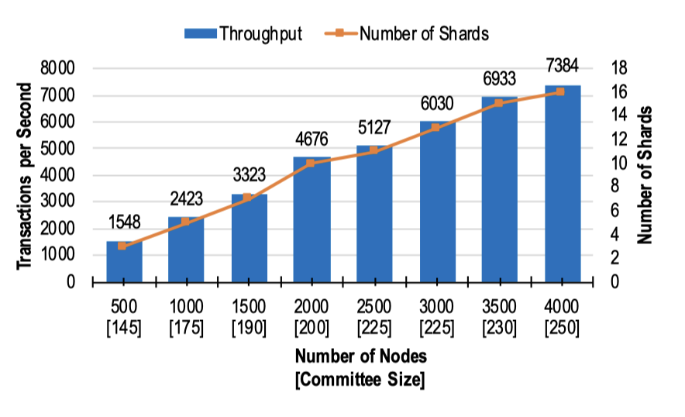
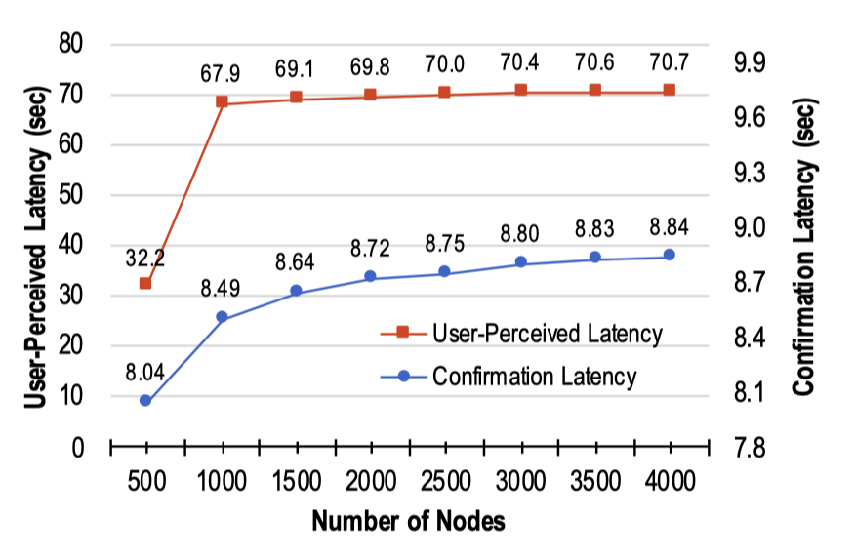
Evaluation
    Throughput scalability of RapidChain
    Transaction latency
Notes:
Ethereum is an open source, globally decentralized computing infrastructure that executes programs called smart contracts

Slide 12
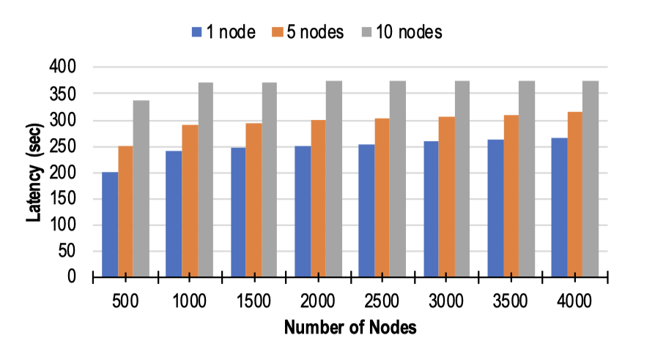
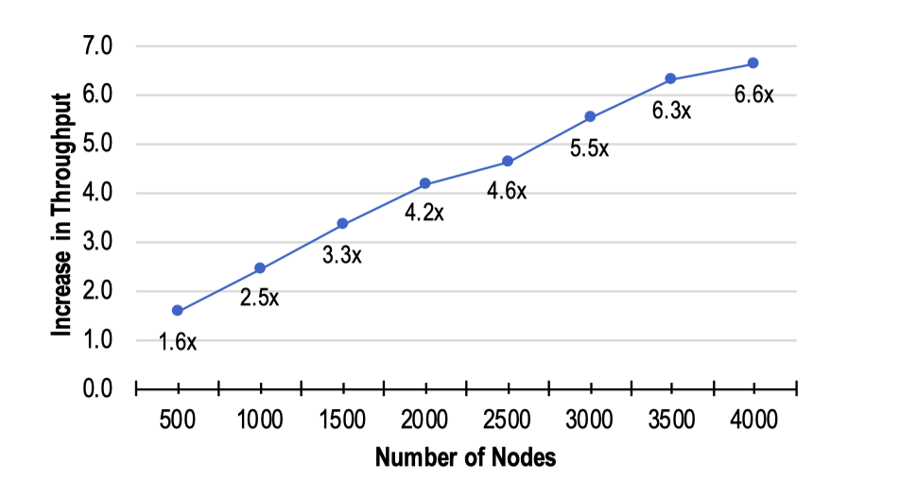
Evaluation
    Reconﬁguration latency when 1, 5, or 10 nodes join each committee
      If a lot of nodes enter, we will have more latency
    Impact of batching cross-shard veriﬁcations
      It is So effective
Notes:
Ethereum is an open source, globally decentralized computing infrastructure that executes programs called smart contracts

Slide 13
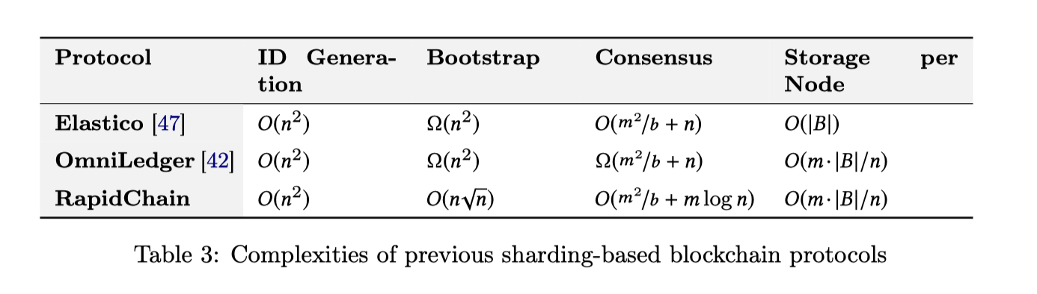
Evaluation
Notes:
Ethereum is an open source, globally decentralized computing infrastructure that executes programs called smart contracts

Slide 14
Challenges
Security Assumptions
  This model assumes the adversary can only choose which nodes to corrupt. Between epochs, but not during an active epoch.
  Small number of nodes join, leave, or are corrupted
  The protocol assumes that all participants have roughly equivalent computational power
Cons
  Complex detail
  Slowly-adaptive
  High Cost of Bootstrapping (86.5 G)
Notes:
Ethereum is an open source, globally decentralized computing infrastructure that executes programs called smart contracts

Slide 15
Suggestions
Avalanche
  highly responsive and lightweight
Algorand
  Secure against fully-adaptive adversaries
HotStuff
Ethereum 2.0 (The Merge)
Notes:
Ethereum is an open source, globally decentralized computing infrastructure that executes programs called smart contracts

Slide 16
Thank You

