Slide 1
Communication-Efficient Distributed Training For SGD
DMLS
Presenter: Alireza Karimi
26 Bahman 1404
Notes:
2 PARTS TO EXPLAIN
first about the varient of SGD that minimize the communicaittons
second comminicaiton overlap in pipeline parallelization.

Slide 2
Introduction
Asynchronous SGD vs. Synchronous SGD
Different Approaches to lessen communication bottleneck
  Quantization: Compress
  Sparsification: Communicate important gradients
  Local Updates: synch once in a while
Unbiased vs. biased compressions
Notes:
asynch: naive : withuot communication. diverge
synchrouns bRRIENE
TOP K SELECTION
basic concept and can be combiined and merged with other concepts like momentum
WITH OR WITHOUT MOMENTUM

Slide 3



QSGD
Unbiased
Guarantee convergence: E[Q(g)]=g
Trade off communication bandwidth and convergence
Increase gradient variance
Encodings:
  Simple
  More compressed Elias coding
Levels of QSGD
  Best: s = $√n$
Notes:
$0.0001$ است یا $1000$؟
+-۱
با احتمال ۷۰٪ آن را ۱ می‌کنیم.
با احتمال ۳۰٪ آن را ۰ می‌کنیم.
noise variance
upperbound
d = $d$ (ابعاد - Dimension): تعداد کل پارامترهای مدل توست.
$s$ (تعداد سطوح - Levels): یعنی از چند بیت استفاده کردی

Slide 4
SignSGD
±1
Biased: E[sign(g)]!=g
Increase gradient variance
Diverge in Non-Convex problems
How to solve this bias issue?
Notes:
even not good at convex

Slide 5
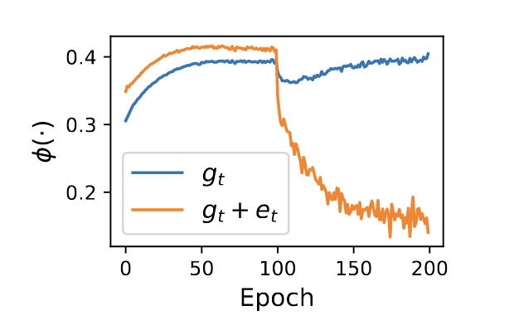
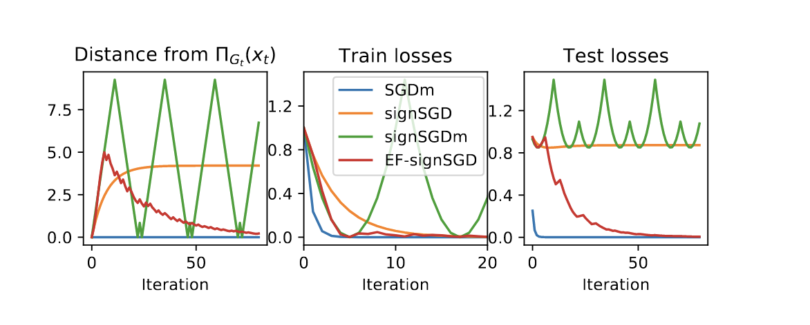
EF-signSGD
Biased: E[sign(g)]!=g
Converge better
Add Accumulated Error from the previous step.
Compress
Update Error Buffer

Slide 6
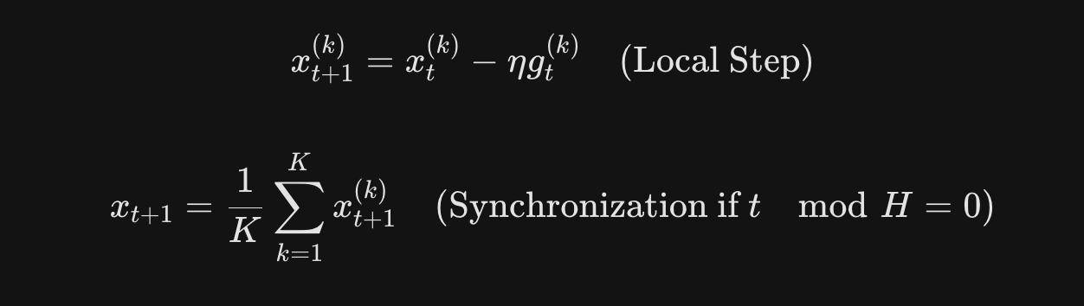

Local SGD
The noise from the data is much larger than the error from not communicating, so the lack of communication doesn't "hurt" the final result.
Stich proves that you can reduce the number of communication rounds by a factor of $√T$without losing accuracy.
Notes:
saves up to a factor of O(T 1/2) in global communication rounds compared to mini-batch SGD, while still converging at the same rate in terms of total stochastic gradient computations..

Slide 7
Comparison based on models
CNNs (e.g., ResNet, AlexNet):
  noise-tolerant
  over-parameterized
  signSGD fail but signSGD+ EF is great
RNNs / LSTMs (Language Models)
  quantization levels must be carefully tuned for LSTMs to ensure convergence.
  Pure SignSGD diverges
Convex (e.g., Logistic Regression)
  Local SGD is best
  Stich proves Local SGD converges at the same rate as SGD.
  Karimireddy shows SignSGD can diverge even on simple convex cases without EF
Notes:
raate is iteration here

Slide 8
Comparison based on network constraints
Low Bandwidth
  Quantization (QSGD / SignSGD + EF) due to Payload Reduction
High Latency
  Local SGD due to Frequency Reduction.
  Initial handshakes problem
HPC
  Local SGD due to Synchronization Barrier problem not the bandwidth
Internet & Federated learning
  QSGD
Which one to use:
  both combined: Quantized Local SGD
Notes:
1 gig or 10 gig

Slide 9
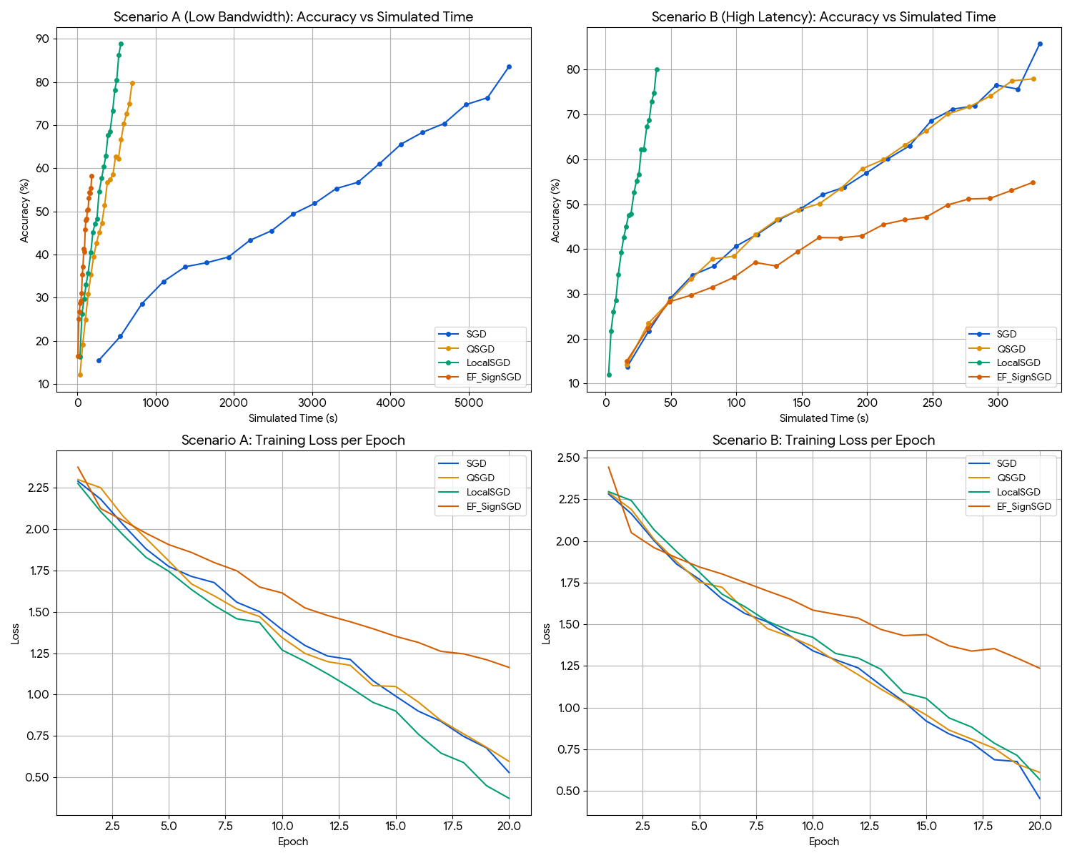
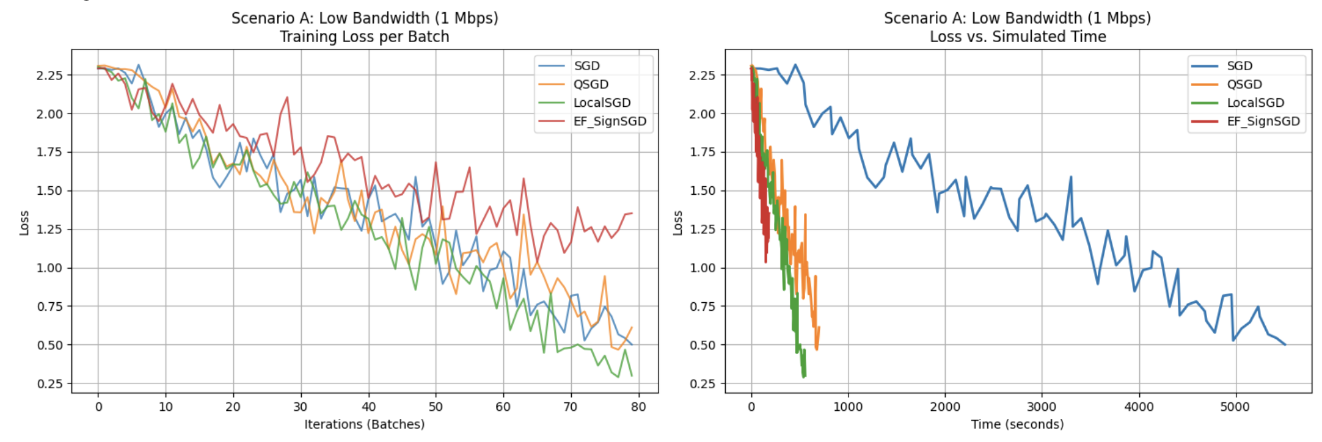
Comparison based on network constraints
Network Model: T = Latency + (Size / Bandwidth)
Dataset = cifar-10
Model = simple CNN
Scenario A = low bandwidth
Notes:
simulate time for network

Slide 10
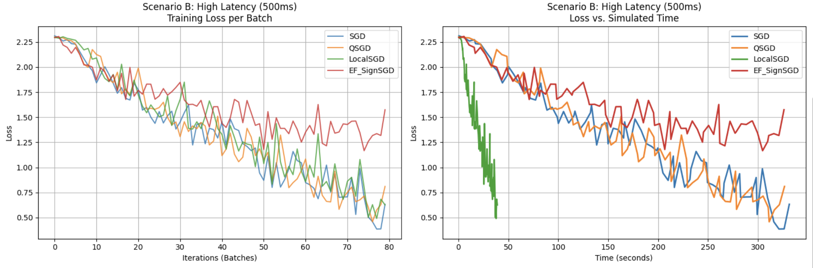
Comparison based on network constraints
Scenario B: high latency
20 epoch
32 iteration
Notes:
Increasing the number of GPUs will increase the throughput.

Slide 11
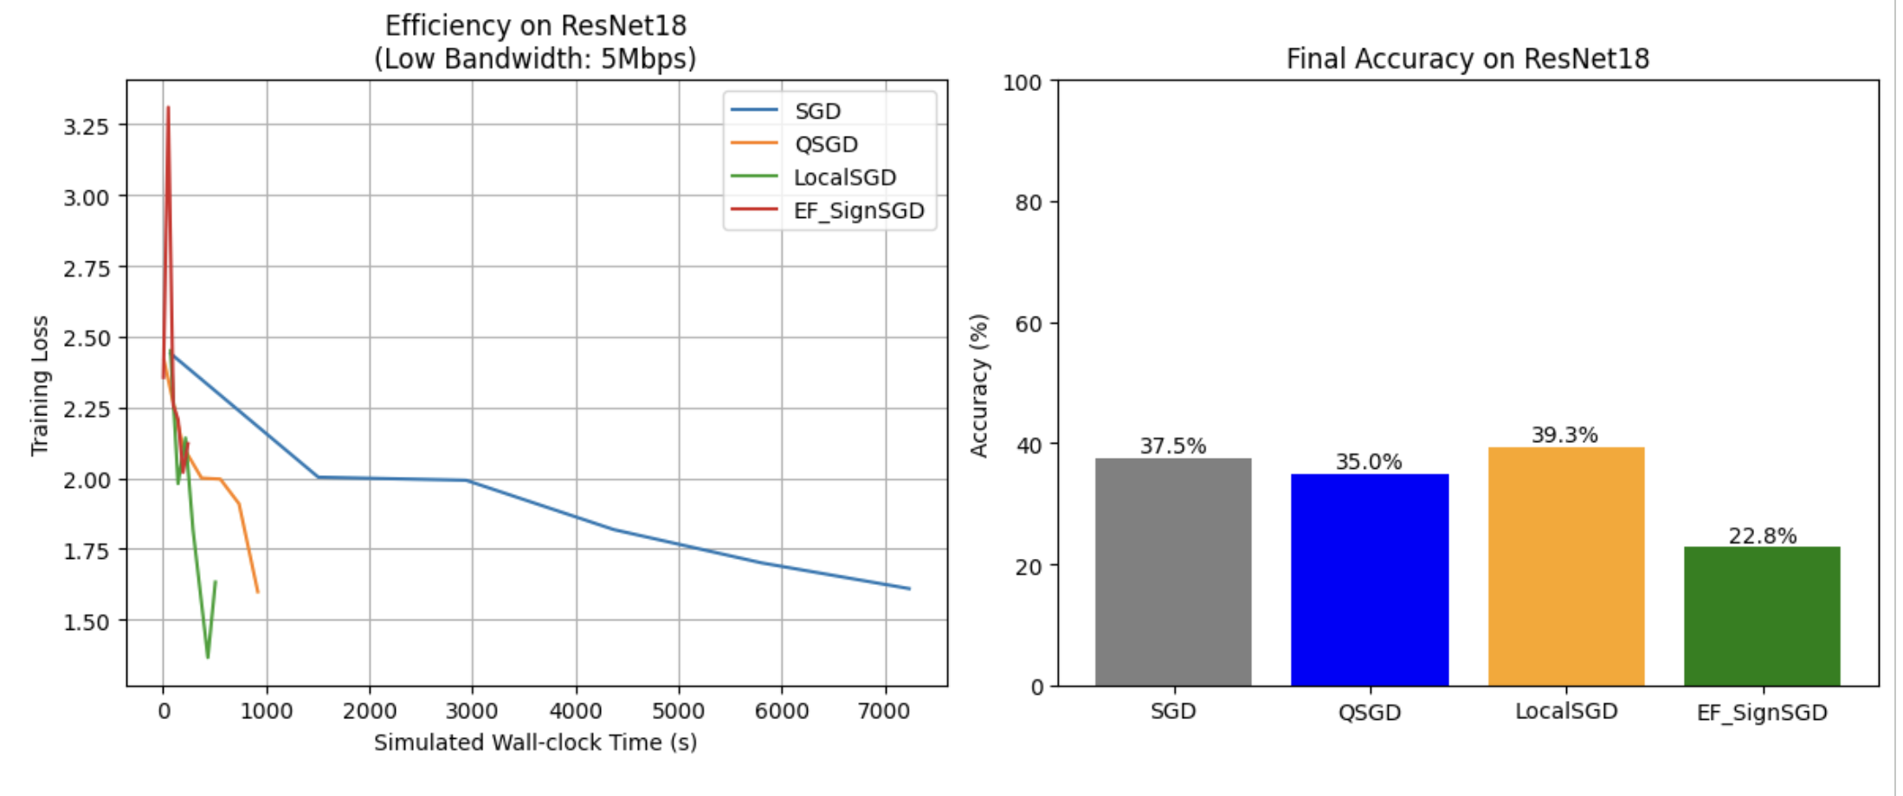
Comparison based on network constraints
ResNet18
2 epoch
Notes:
Increasing the number of GPUs will increase the throughput.

Slide 12
Part2: Computation-communication overlap
DMLS
Presenter: Alireza Karimi
26 Bahman 1404

Slide 13
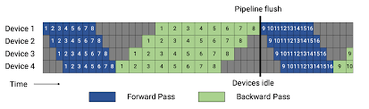
GPIPE
Notes:
Increasing the number of GPUs will increase the throughput.

Slide 14
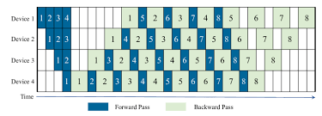
1F1B
Notes:
FIRST MICRO BATCH AS SOON AS POSSIBLE

Slide 15
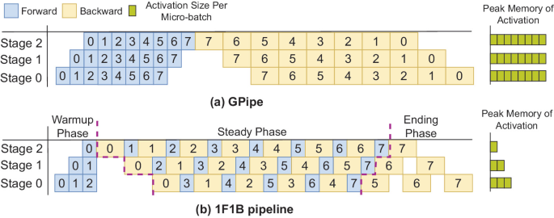
Memory Comparison
Notes:
Increasing the number of GPUs will increase the throughput.
FIRST MICROBATCH INFORMATION REMAIN

Slide 16

1 Forward & 2 Backward?!
Forward Pass F: Calculates the output Y using input X and weights W.
Math: Y = W . X
Cost: 1 Unit of Time
Backward Pass Part 1 $∇X$: Calculates the gradient of the input. This is what the previous layer (Layer n-1) is waiting for so it can start its work.
Math: $∇$X = $W^{T}$ .$∇$Y
Cost: 1 Unit of Time
Backward Pass Part 2 $∇$W: Calculates the gradient of the weights. This is only used by the optimizer to update the model later. No other layer needs this to proceed.
Math: $∇$W = $∇$Y . $X^{T}$
Cost: 1 Unit of Time
Notes:
Increasing the number of GPUs will increase the throughput.

Slide 17

Zero-bubble
Notes:
Increasing the number of GPUs will increase the throughput.

Slide 18
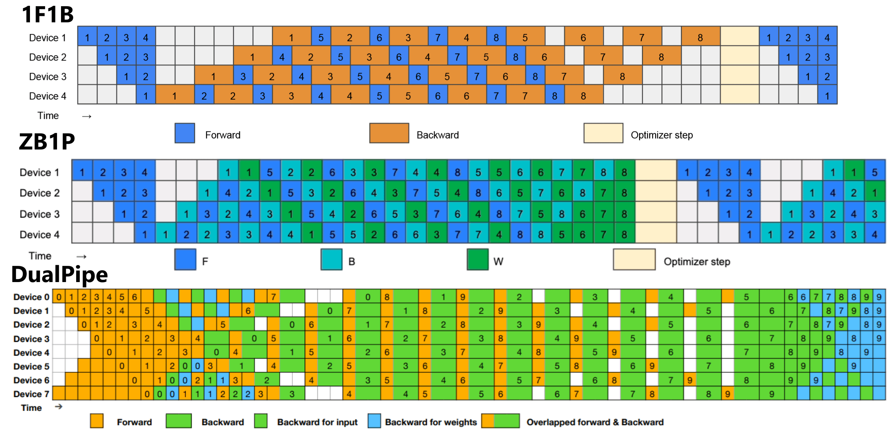
Time Comparison
Notes:
Increasing the number of GPUs will increase the throughput.

Slide 19
References:
Alistarh et al. - 2017 - QSGD Communication-Efficient SGD via Gradient Quantization and Encoding
Karimireddy et al. - 2019 - Error Feedback Fixes SignSGD and other Gradient Compression Schemes
Stich - 2019 - Local SGD Converges Fast and Communicates Little
Qi et al. - 2024 - Zero Bubble (Almost) Pipeline Parallelism
Huang et al. - 2019 - GPipe Efficient Training of Giant Neural Networks using Pipeline Parallelism
Narayanan et al. - 2019 - PipeDream generalized pipeline parallelism for DNN training
Notes:
Increasing the number of GPUs will increase the throughput.

Slide 20
Thank You

