Slide 1
Evidence of mutual effects of DP and MP
DISTML
Presenter: Alireza Karimi
1 Aban 1404

Slide 2
Challenges of pure DP and MP
DP
  As the number of devices (workers) increases, the cost of synchronizing gradients increases.
  store a complete replica of the entire model.
MP
  Requires frequent communication of intermediate results
  Load Imbalance (Heterogeneous Infrastructure)
  Pipeline Bubbles (Specifically for Inter-Operator/Pipeline MP)
  Batch size

Slide 3
Research on Model Parallelism and DataParallelism Optimization Methods inLarge Language Model–Based Recommendation Systems
hybrid scheme increases training throughput by over 30% and resource utilization by about 20% compared to single-mode parallelism.
  highest throughput (3,800 samples/s vs. 3,400 for DP and 2,800 for MP)
  the best speedup (3.8x vs. 3.4x/2.8x)
  highest GPU utilization (90% vs. 85%/80%)
  lowest communication overhead (1.5 ms/iter vs. 1.8ms/2.5ms).
  best speedup (14.6x vs. 12.8x/10.5x) at 4 nodes.

Slide 4
Uni-MoE: Scaling Unified Multimodal LLMs with Mixture of Experts
It shows a form of model parallelism and its effectiveness when combined with data parallelism strategies especially across modalities(aka different data types e.g. text, audio, …) to create efficient and powerful unified MLLMs.

Slide 5
Training Recommender Systems at Scale: Communication-Efficient Model and Data Parallelism
clear example of how tuning one aspect (DP batch size) negatively impacts the other (MP communication).
increasing the batch size to improve DP efficiency simultaneously increases the communication load for MP, potentially creating a bottleneck there.

Slide 6
Optimizing Multi-GPU Parallelization Strategies for Deep Learning Training
Data Parallelism's Limitations:
  As the number of devices in DP increases, so does the communication overhead for synchronizing gradients.
  Larger aggregate batch sizes in DP can lead to "statistical efficiency loss," meaning more training epochs are needed to reach the desired accuracy.
Model Parallelism as a Solution:
  MP speeds up each training step by splitting the model across multiple devices.
  Crucially, when used in a hybrid model, MP improves the performance of each data-parallel worker without increasing the global batch size. This directly counteracts the statistical efficiency problem of large-scale DP.

Slide 7
DAPPLE: A Pipelined Data Parallel Approach for Training Large Models
Proposes a "planner" to automatically find an optimal hybrid strategy combining Pipeline Parallelism (MP) and Data Parallelism (via stage replication) .
It searches for the best combination directly.
outperform the best DP-only approach by an average of 1.71x to 1.79x across different hardware configs.
Pipeline Parallelism for between servers: small communication: slower Ethernet.
Data Parallelism within each server: heavy communication: ultra-fast NVLink connections

Slide 8
Joint Dynamic Data and Model Parallelism for Distributed Training of DNNs Over Heterogeneous Infrastructure
static partitioning (a fixed way of combining DP and MP) is often suboptimal, especially on heterogeneous or dynamically changing infrastructure.
dynamic approach that adjusts the partitioning between DP and MP during training based on runtime conditions.
adjustments are based on monitoring the system's state at runtime (e.g., observing device speeds, communication bottlenecks).

Slide 9

AutoDDL: Automatic Distributed Deep Learning with Near-Optimal Bandwidth Cost
optimal way to combine DP and MP can change even within the same model, reinforcing the need for a joint, adaptive optimization approach.
for the VGG model, AutoDDL uses pure data parallelism for the convolution layers but then applies a complex 2D model parallel strategy for the dense layers, avoiding weight synchronization overhead where it's most costly.
For p compute nodes and matrix size of $n^{2}$, megatron-LM vs. AutoDDL $O(\frac{n^{2}}{p^{1/2}}) VS. O(\frac{n^{2}}{p^{2/3}})$

Slide 10
Malleus: Straggler-Resilient Hybrid Parallel Training of Large-scale Models via Malleable Data and Model Parallelization
integrates non-uniform partitioning of
  GPU devices
  pipeline stages
  model layers
  training data
with heterogeneous device speeds (stragglers)
dynamically detects shifts in straggler (lags) situations and adaptively adjusts the parallelization plan "on the fly" through a re-planning process.

Slide 11
Beyond Data and Model Parallelism for Deep Neural Networks (FlexFlow)
Finds the best combination of parallelization strategies across multiple dimensions (Sample-Operation-Attribute-Parameter) simultaneously, leading to significant performance gains.(up to 3.8 times faster)
split by samples (Data Parallelism), by channels (Parameter/Attribute Model Parallelism), and potentially other dimensions all at once.
Fine-Grained Optimization: Unlike approaches that decide on a high-level structure (e.g., X data parallel replicas, Y pipeline stages)

Slide 12
Beyond Data and Model Parallelism for Deep Neural Networks (FlexFlow)
Sample (S): This dimension refers to how the training data samples (e.g., different images in a batch) referred as Data Parallelism.
Operation (O): how different computational operations (like matrix multiplication, convolution layers) in the DNN's graph are assigned to different devices, related to Pipeline Parallelism or other forms of inter-operator Model Parallelism.
Attribute (A): a 2D image has height, width, and channel attributes; device handles the top half of the image, another handles the bottom half, or splitting by channels
Parameter (P): The weights and biases of the network. technique in Model Parallelism (specifically Tensor/Operator Parallelism).

Slide 13
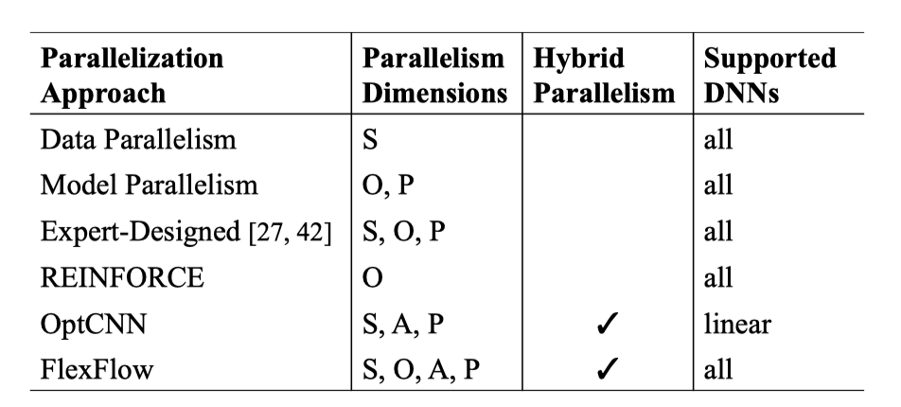
Beyond Data and Model Parallelism for Deep Neural Networks (FlexFlow)

Slide 14
Alpa: Automating Inter- and Intra-Operator Parallelism for Distributed Deep Learning
Inter-operator parallelism
  pipeline parallelism
  assign stages to device meshes
  Done by dynamic programming
intra-operator parallelism
  Data parallelization
  Tensor parallelization
  within a single stage on its assigned device mesh
  Done by Integer linear programming

Slide 15
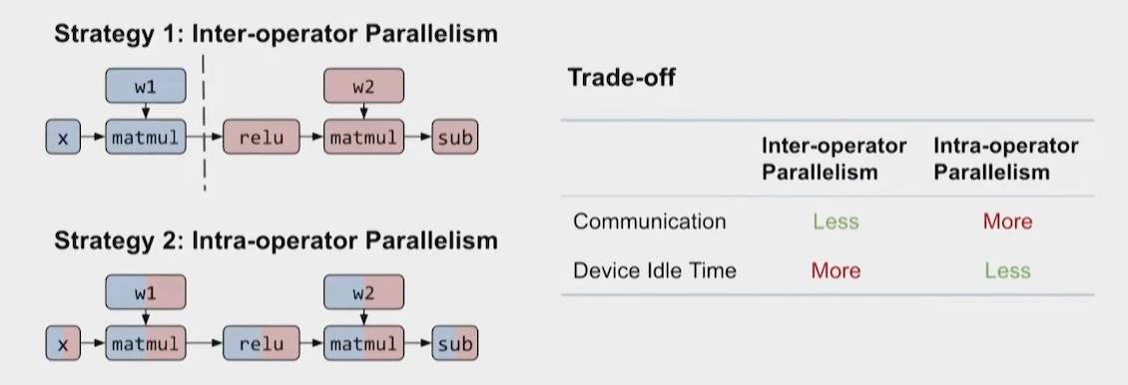
Alpa: Automating Inter- and Intra-Operator Parallelism for Distributed Deep Learning

Slide 16
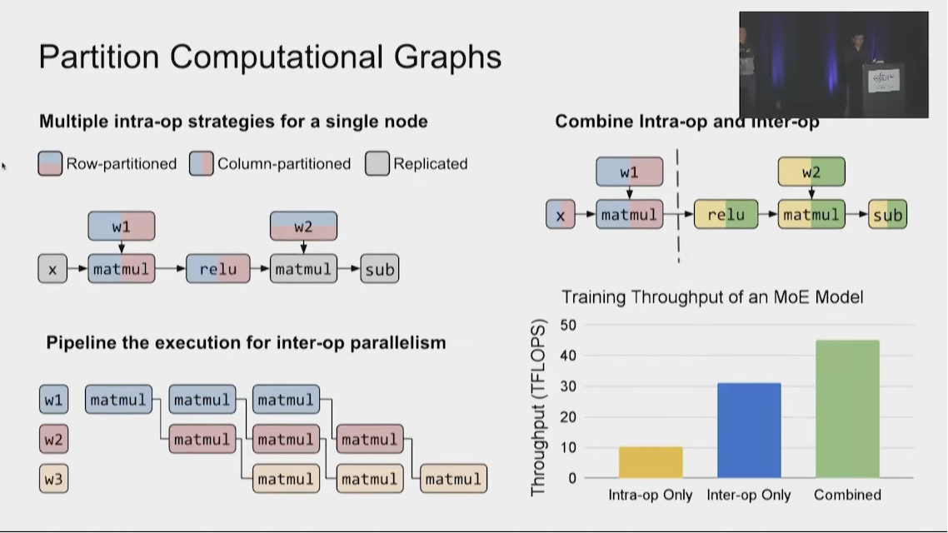
Alpa: Automating Inter- and Intra-Operator Parallelism for Distributed Deep Learning

Slide 17
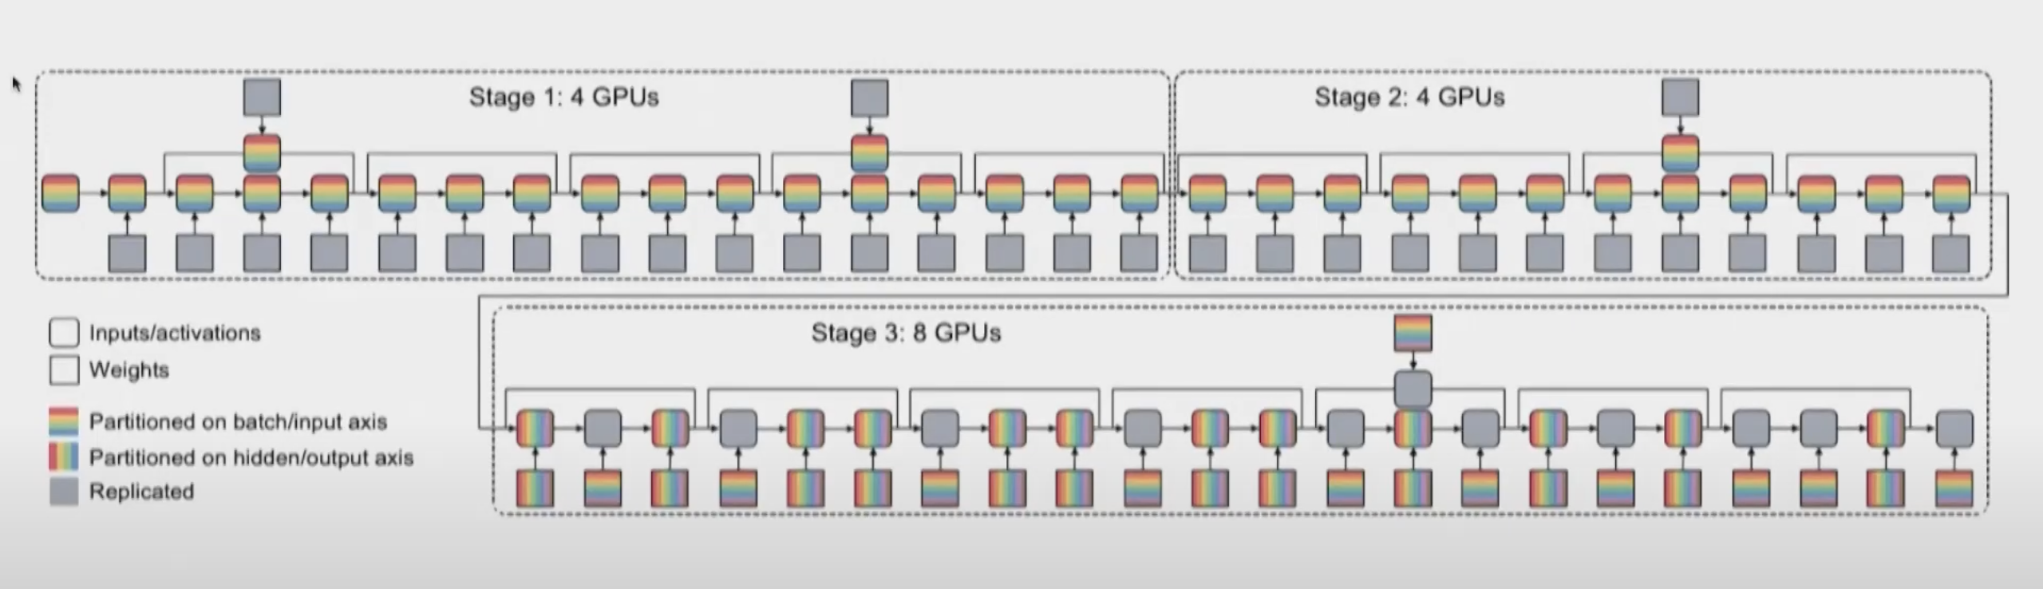
Alpa: Automating Inter- and Intra-Operator Parallelism for Distributed Deep Learning

Slide 18
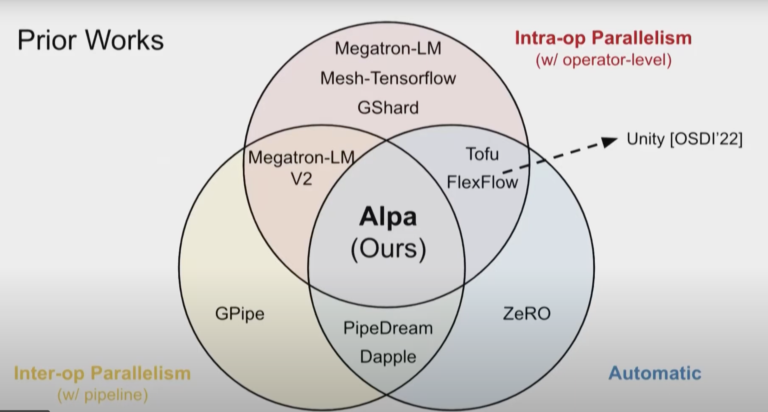
Comparison between some models

Slide 19
Enabling Parallelism Hot Switching for Ecient Training of Large Language Models
not static but depends heavily on the input sequence length.
for long sequences: more memory (often involving higher degrees of Model Parallelism like Tensor Parallelism, Pipeline Parallelism, or Sequence Parallelism) are necessary
short sequences: often relying more on Data Parallelism
dynamically switch between different complex parallelism strategies (e.g., changing DP/TP/PP/SP degrees and configurations)
focuses on efficiently orchestrating and transitioning between multiple potentially optimal hybrid strategies to adapt to varying workloads during training.

Slide 20
Automatic Operator-level Parallelism Planning for Distributed Deep Learning – A Mixed-Integer Programming Approach
Solve the JSSP optimiziation problem (even FDJSSP)
criticizes existing systems (like Megatron-LM, DeepSpeed) and some automated approaches (Alpa, FlexFlow mentioned in Table I/Lit Review) for often relying on manual configuration, heuristics, or simplified assumptions (like chain-like structures) lead to suboptimal performance, especially for complex, non-linear model architectures
considering operation execution times, dependencies, communication times, machine/channel availability, and memory constraints
finds a schedule with 50% fewer pipeline bubbles under the same memory constraints in comparison to DualPipe strategy

Slide 21
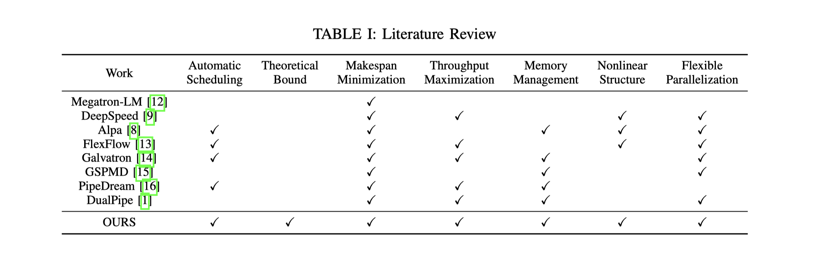
Automatic Operator-level Parallelism Planning for Distributed Deep Learning – A Mixed-Integer Programming Approach

Slide 22
Thorough Characterization and Analysis of Large Transformer Model Training At-Scale
provide insights and guidelines for choosing better hybrid configurations (e.g., recommending TP degree <= GPUs/node, PP degree related to node count in bandwidth-limited settings)
For example, increasing PP reduces the DP degree for a fixed number of GPUs. If the DP degree becomes small enough, DP communication (like AllGather) can switch from slower inter-node to faster intra-node communication, drastically changing performance .

Slide 23
Chimera: Communication Fusion for Hybrid Parallelism in Large Language Models
provides a comprehensive analysis of communication patterns in various LLM parallelisms (DP, TP, PP, SP, EP) and systematically identifies and quantifies the communication redundancy that occurs during transitions between them in hybrid setups .
eliminate redundancy by fusing adjacent communication operators during parallelism transformation. By reordering operations and generating redundancy-free communication operator.
Talk about advantages and disadvantages of each.
Fusion refers to the process of replacing a sequence of two adjacent communication operations with a single, equivalent communication operation

Slide 24
Thank You

