Slide 1
more and more research
DISTML
Presenter: Alireza Karimi
16 Aban 1404

Slide 2
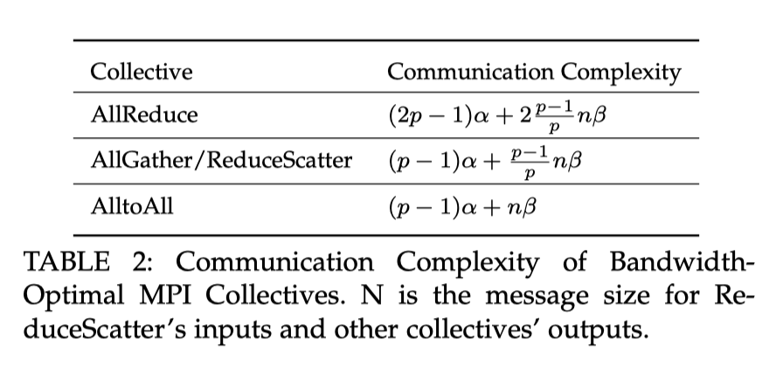
AutoDDL: Automatic distributed deep learning with near-optimal bandwidth cost
IEEE Transactions on Parallel and Distributed Systems, 2024
alpha-beta model to simulate communication time.
Communicating an n-byte message takes α + n β time
α: the network latency
Β: inverse network bandwidth

Slide 3
AutoDDL: Automatic distributed deep learning with near-optimal bandwidth cost
IEEE Transactions on Parallel and Distributed Systems, 2024
We estimate the α and β parameters in a real-world environment.
The purpose: rank various parallel strategies, facilitating the selection of a strategy with low communication costs
Experiment on:
  Multi-node-single-GPU
  Heterogenous Multi-node-multi-GPU
different α and β parameters are used for inter- and intra-node communications.

Slide 4
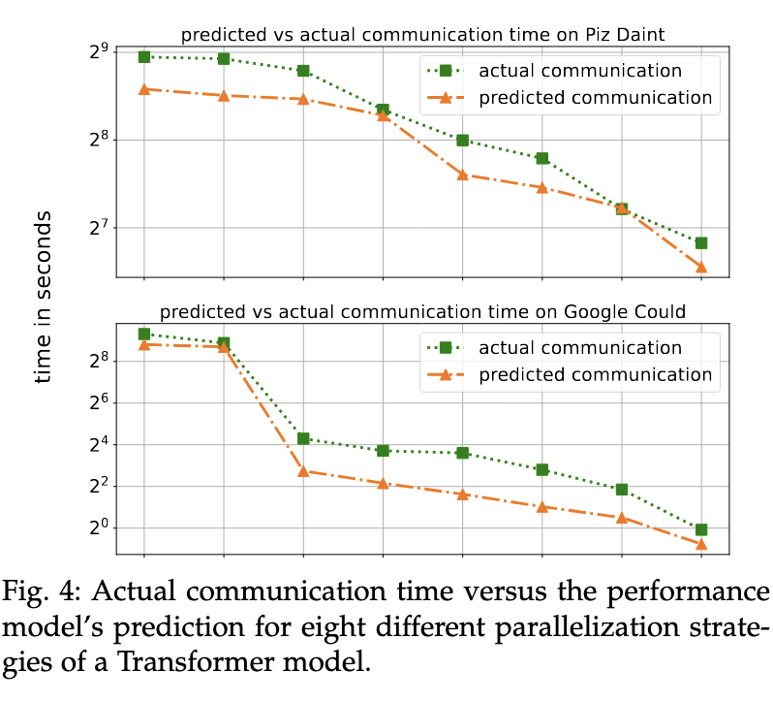
AutoDDL: Automatic distributed deep learning with near-optimal bandwidth cost
IEEE Transactions on Parallel and Distributed Systems, 2024
AutoDDL builds a communication
model and selects the optimal
strategies for different models, as
described in Section 3 and Section 4

Slide 5

AutoDDL: Automatic distributed deep learning with near-optimal bandwidth cost
IEEE Transactions on Parallel and Distributed Systems, 2024
AutoDDL utilizes an analytical performance model combined with a Coordinate Descent-based search algorithm to discover the strategy with minimal communication.
Asymptotically optimal communication cost.
Neglect computation cost compared with communication cost.
For p compute nodes and matrix size of $n^{2}$, megatron-LM vs. AutoDDL $O(\frac{n^{2}}{p^{1/2}}) VS. O(\frac{n^{2}}{p^{2/3}})$

Slide 6
Aceso: Efficient Parallel DNN Training through Iterative Bottleneck Alleviation
European Conference on Computer Systems(EuroSys), 2024 (found & published on ACM)
Aceso, an efficient and effective system that automates the configuration search of parallel DNN training through iterative bottleneck alleviation.
Aceso considers bottlenecks in the context of pipeline parallelism.
For the identified bottleneck, Aceso chooses the most promising Reconfiguration Primitive to alleviate the bottleneck.
If fails, starts from secondary bottleneck.
Data, tensor and pipeline parallelisms and recomputation.
Scalability to 1K layers.
Notes:
Does not consider network topology, or variables.
It is iterative, compared with alpha optimiziation.

Slide 7
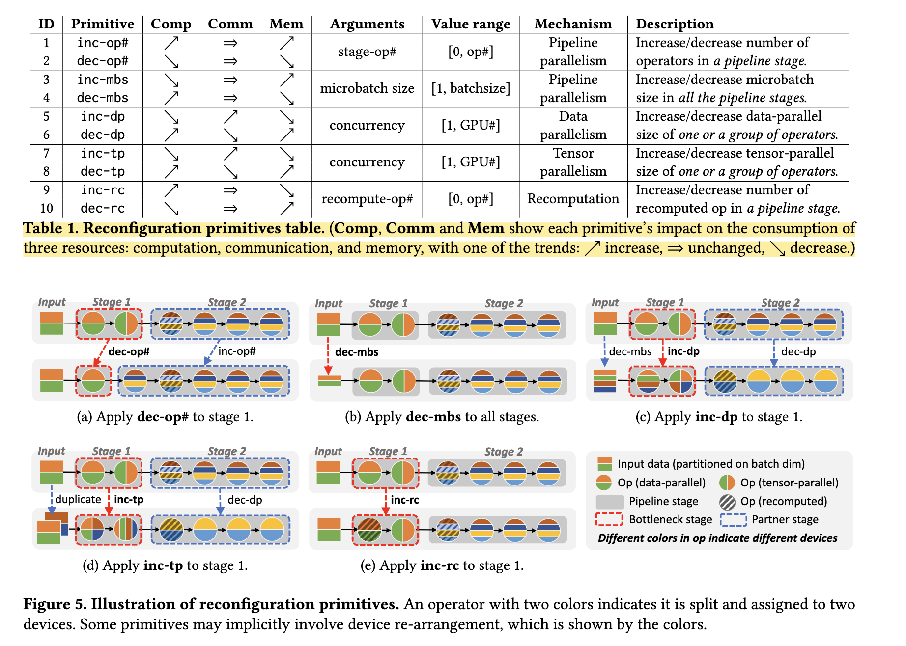

Slide 8
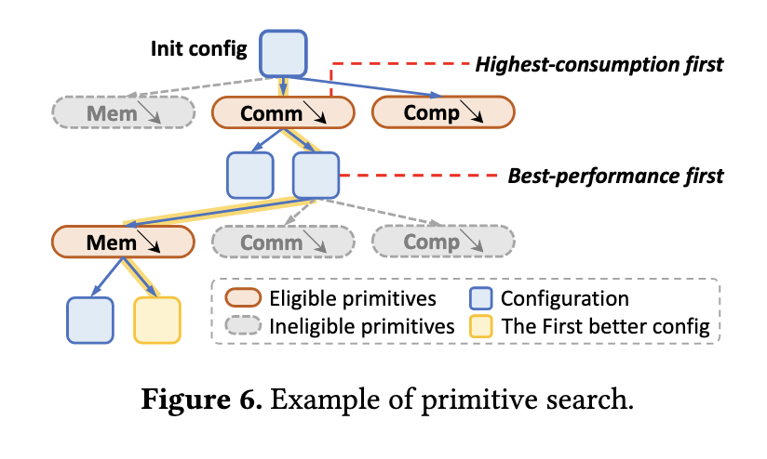
Aceso: Efficient Parallel DNN Training through Iterative Bottleneck Alleviation
European Conference on Computer Systems(EuroSys), 2024 (found & published on ACM)
Primitives
  stage-level
  model-level
  op-level
Partner primitives
Multi-hop search
  MaxHops
Relies on resource utilization
information to identify the bottleneck
and choose reconfiguration primitives
  communication time
  computation time
  memory consumption

Slide 9
Aceso: Efficient Parallel DNN Training through Iterative Bottleneck Alleviation
European Conference on Computer Systems(EuroSys), 2024 (found & published on ACM)
first splits into stages using pipeline parallelism. stage is further parallelized using data/tensor parallelisms.
Heuristic-1 (for finding bottleneck):
  the stage with the largest memory consumption is the bottleneck.
  Otherwise, the stage with the longest execution time is the bottleneck.
Heuristic-2 (explore primitives in the following order):
  first alleviate the one with the highest consumption proportion.
  If multiple primitives can reduce the consumption of the same resource, we first choose the one with the best estimated performance.

Slide 10
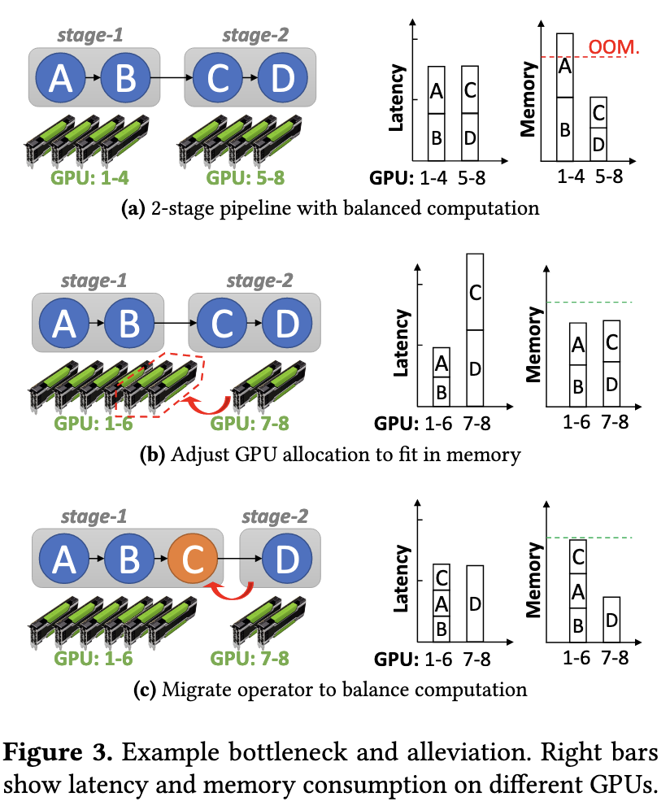
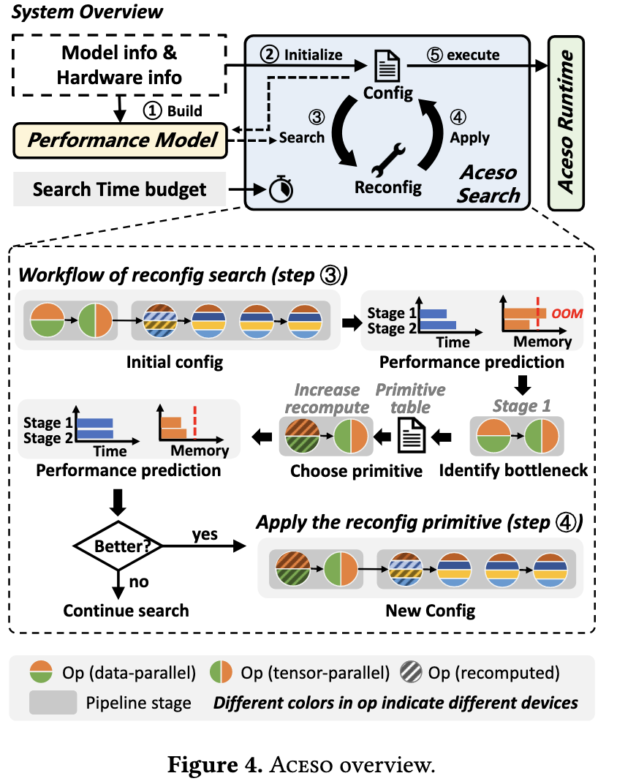

Slide 11
Helix: Serving Large Language Models over Heterogeneous GPUs and Network via Max-Flow
ASPLOS, ACM International Conference, 30 March 2025, Carnegie Mellon University
Automated planner for inference serving.
Over heterogeneous GPUs and network connections
As a max-flow problem on directed, weighted graphs
Uses a mixed integer linear programming (MILP) algorithm to discover highly optimized strategies
For routing inference requests
Requests can only be transmitted through valid connections

Slide 12
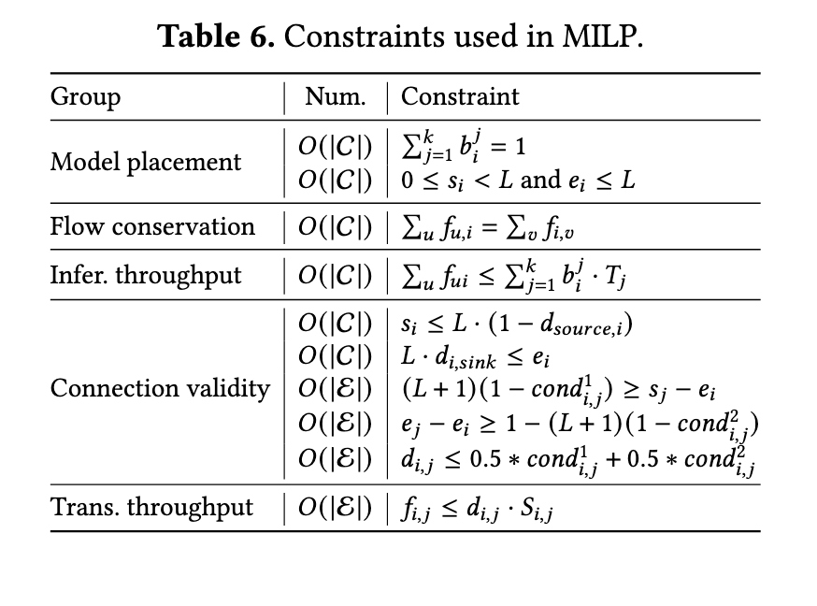
Helix: Serving Large Language Models over Heterogeneous GPUs and Network via Max-Flow
ASPLOS, ACM International Conference, 30 March 2025, Carnegie Mellon University

Slide 13
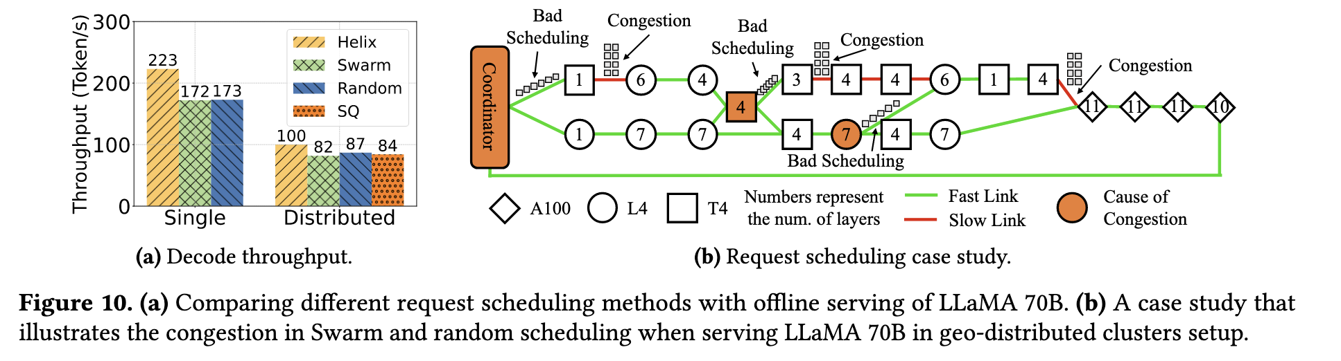
Helix: Serving Large Language Models over Heterogeneous GPUs and Network via Max-Flow
ASPLOS, ACM International Conference, 30 March 2025, Carnegie Mellon University
Helix avoid congestion compared to swarm
SWARM is a decentralized model-parallel algorithm that leverages randomized fault-tolerant pipelines and dynamically rebalances nodes between pipeline stages. designed for poorly connected, heterogeneous and unreliable devices.

Slide 14
Disadvantages of previous papers mentioned in Sailor
Aceso:
  A homogeneous planner.
  do not consider the differences in forward and backward passes of the different GPU types.
  expect the user to select a fixed resource allocation for which the system recommends a job parallelization plan.
Helix:
  Helix uses a time-consuming MILP algorithm for model placement, which is not suitable for environments with high resource availability.
  optimize only for performance, ignoring the monetary communication costs that arise in geo-distributed settings

Slide 15
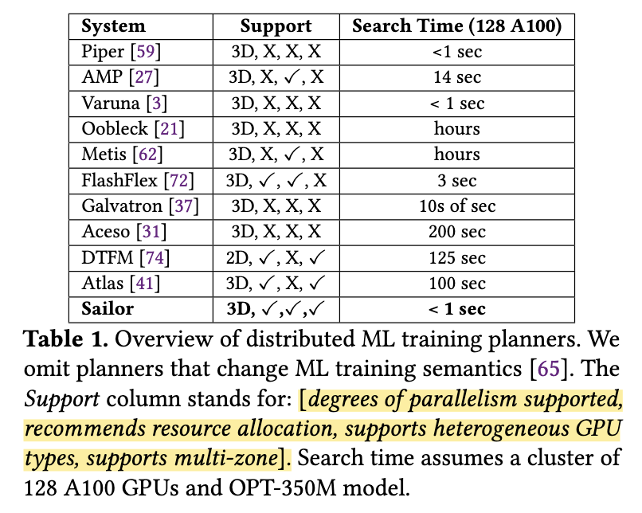
Sailor: Automating Distributed Training over Dynamic, Heterogeneous, and Geo-distributed Clusters SOSP, 12 October 2025, ACM SIGOPS 31st Symposium on Operating Systems Principles, ETH & MIT
Profiler, Planner, Simulator and
Distributed Training Framework.
jointly optimizing the resource
allocation and job parallelization
plan (e.g., data/pipeline/tensor
parallelism degrees).
over heterogeneous resources with
dynamic availability.

Slide 16
Sailor: Automating Distributed Training over Dynamic, Heterogeneous, and Geo-distributed Clusters SOSP, 12 October 2025, ACM SIGOPS 31st Symposium on Operating Systems Principles, ETH & MIT
Some problems:
  resource availability changes dynamically in datacenters, due to variable demand and node failures or preemptions
  inter-node bandwidth typically lead to stragglers
  variability in memory capacity per GPU: out-of-memory (OOM) errors
recommends configurations that optimize a user defined objective (e.g., max throughput or min cost)
under constraints (e.g., max budget or min throughput).

Slide 17
Sailor: Automating Distributed Training over Dynamic, Heterogeneous, and Geo-distributed Clusters SOSP, 12 October 2025, ACM SIGOPS 31st Symposium on Operating Systems Principles, ETH & MIT
Simulator supports different types of heterogeneity:
  hardware heterogeneity (GPU type, num of GPUs per node, and network bandwidth)
  job config. heterogeneity (num of pipelines and different stage configs per pipeline).
Use heterogeneous, geo-distributed GPUs. Hosted in data-centers.
Support fault tolerance and elasticity.
Planners apply techniques to identify configurations that minimize training time
  exhaustive search
  dynamic programming
  integer linear programming
  Search space pruning
Sailor dynamically re-configures the job as resource availability changes.
Notes:
Increasing the number of GPUs will increase the throughput.

Slide 18
Thank You

