Slide 1
NEST
DISTML
Presenter: Alireza Karimi
1405/2/30

Slide 2
Paper Info.
NEST: Network- and Memory-Aware Device Placement For Distributed Deep Learning
Published on March 2026
MLSYS 2026 conference
unifies parallelism, topology modeling, and memory feasibility via structured dynamic programming
NEST defines a principled search space for hybrid strategies while jointly optimizing co-location, network latency, and memory feasibility.
The source code is available at: https://github.com/scai-tech/Nest.

Slide 3
Claims
Real-world datacenters are rarely uniform, typically employing hierarchical topologies such as Fat-Tree, Spine-Leaf, Clos networks, oversubscribed trees and torus networks.
Hierarchical non-uniformities make distributed training highly topology-dependent
The most efficient parallelization strategy depends on both the model and the underlying topology—what works on a uniform mesh may perform poorly on a hierarchical or bandwidth-asymmetric cluster.
They model network hierarchy, asymmetry, and oversubscription.

Slide 4
Critique
Aceso
  its local search can stall in suboptimal configurations
  provides no global optimality guarantees.
TopoOpt
  Monte Carlo-based random search
  explores placements stochastically, lacks optimality guarantees
  sensitive to initialization
  and scales poorly as the number of parallelization dimensions grows.
Alpa
  assumes simplified 2D mesh networks
  cannot capture oversubscription or multi-level hierarchy.

Slide 5
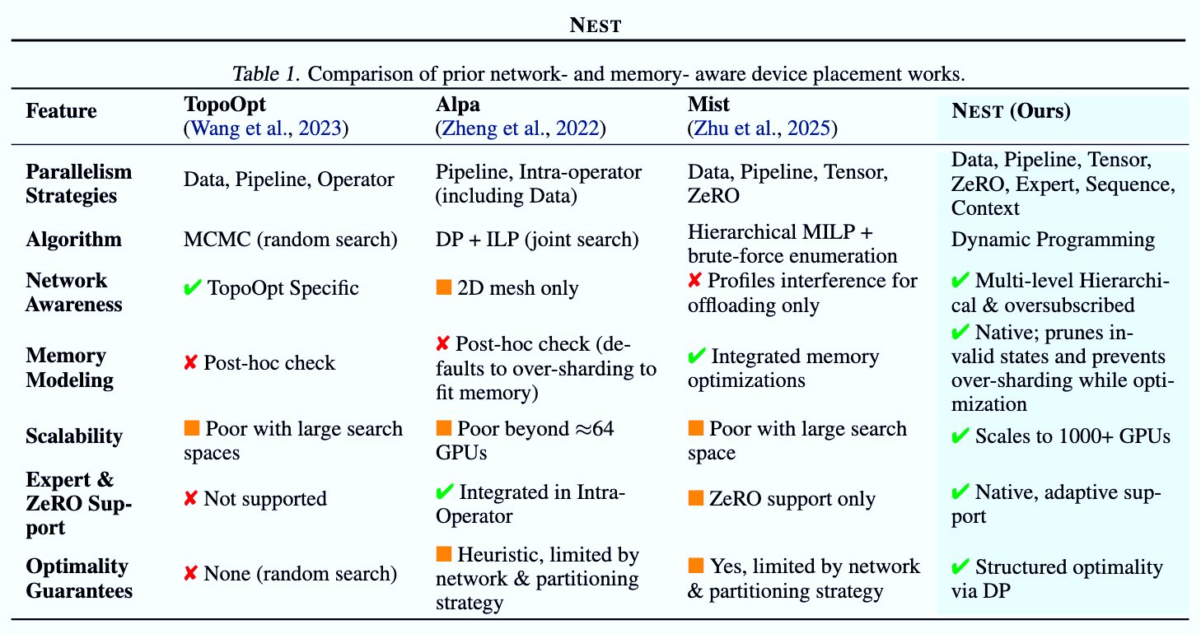

Slide 6
Presumptions
Training parallelization techniques can be organized along orthogonal dimensions
Separates local, intra-operator transformations from global, inter-operator scheduling decisions.
SUB-GRAPH strategies
  within individual operators or small subgraphs. intra-layer parallelization.
  Tensor, expert, sequence and context parallelism
GRAPH-GLOBAL strategies
  Pipeline and data parallelism and ZeRO-style sharding
treating SUB-GRAPH and GRAPH-GLOBAL strategies as orthogonal dimensions

Slide 7
NEST’s workflow
extracts the operator graph from training scripts(matmul, softmax,)
SUB-GRAPH for a group of operators
inserts the corresponding communication operators(all-reduce, ...)
Compute costs are derived from hardware estimators or profilers
communication costs are estimated using network simulators
the DP solver explores GRAPH-GLOBAL configurations
  Optimal(Graph-i​)=min​-j(LocalCost-j​+Optimal(RemainingGraph))
frequently communicating components physically close.
  Level-Wise Network Abstraction.
The final output is a parallelism configuration and placement plan.

Slide 8
NEST’s Dynamic Programming
extracts.

Slide 9
Thank You

