Slide 1
Prefetching
DISTML
Presenters: Alireza Karimi

Slide 2
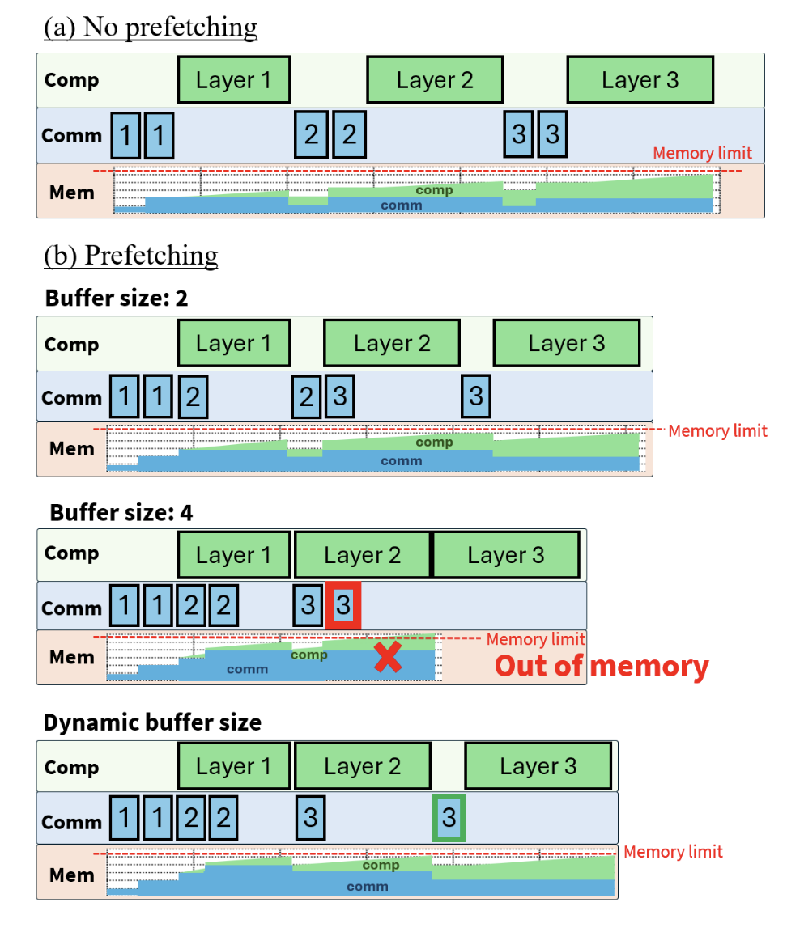
OOM

Slide 3
Prefetching Parameters
In fully sharded training, ZeRO‑3 and FSDP, each GPU holds only a fraction of every layer’s parameters. Before using a layer, it must gather the full parameters from all GPUs (an all‑gather operation). Prefetching launches this all‑gather early, so it runs while the GPU is still computing previous layers, hiding communication latency behind useful computation.
The need for scheduling each all‑gather individually, moving it as early as possible while making sure total memory never exceeds the limit.

Slide 4
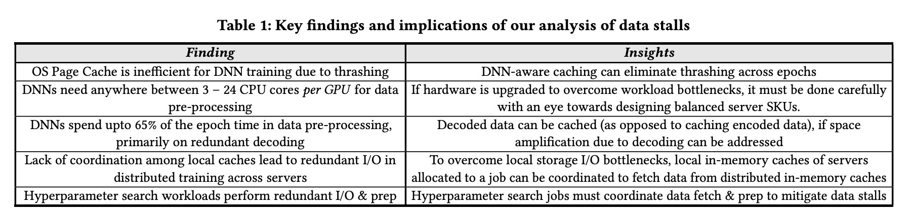
input data pipeline
fetching raw data items from storage and performing data pre-processing in memory

Slide 5
data loading and pre-processing libraries
NVIDIA DALI (Data Loading Library)
PyTorch DataLoader
  uses multiple worker processes and a prefetch_factor parameter to load
  optionally preprocess batches
TensorFlow tf.data with .prefetch()
  asynchronously prepare the next batch while the model is training

Slide 6
Thank You

