Slide 1
Recruitment Recommendations for Teach For America
Wharton - People Analytics Conference 2017
Arkojyoti Hore
Parth Shiras
Pranavanshu Vadrevu

Slide 2
Teach for America wants to improve their recruitment strategy to maximize their limited resources
Complications/Gaps
The factors required to differentiate each university are not known
Framework to determine recruitment tiers for different universities is not in place
Current state
Desired Future state
Teach For America is a non-profit organization with an aims to develop future leaders for education equity and excellence
Teach for America seeks to recruit remarkable leaders from a broad spectrum of universities
The organization wants to create a recruitment strategy for 2018 to maximize use of their limited resources
Teach for America has understood the differentiation between individual campuses based on their competitive dynamics
The organization has successfully differentiated resource allocation at each university to maximize the applications
Questions
What are the optimal number of tiers?
Which schools should be in which tiers?
Notes:
Background on the problem statement for the case study.

Slide 3
How Do Outreach And Impact Affect the Number of Applications Differently?
The proposed solution finds an optimal mix of both outreach and impact to maximize the number of applicants
Outreach is the number of students a recruiter gets in touch with, to make them aware of the TFA and education inequality issue.
However, outreach negatively affects the impact on students. When we try to reach out to more students, the impact on the students reduces and vice versa.

Slide 4
What are the factors that affect Outreach and Impact for each university?
1. University size
2. Teach for America awareness
3. Education inequity awareness
4. # Current CM’s in the university
5. # Alumni working for TFA
6. # TFA staff for university
!

Slide 5
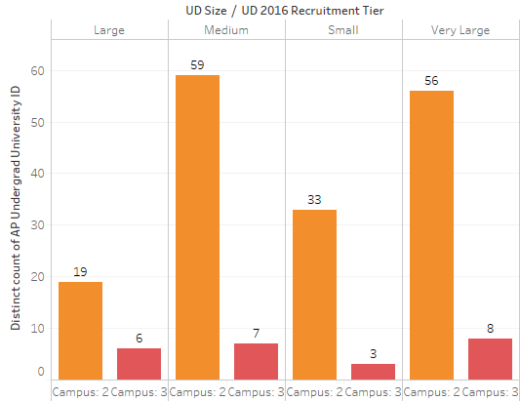
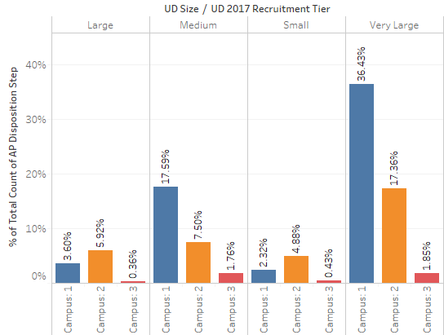
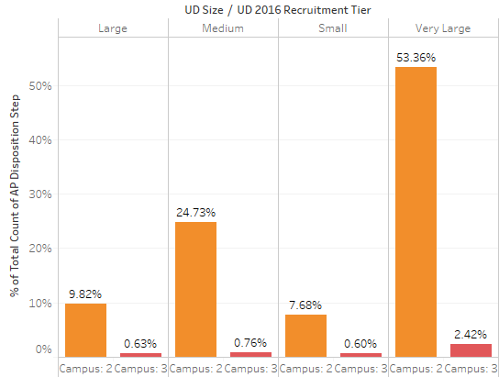
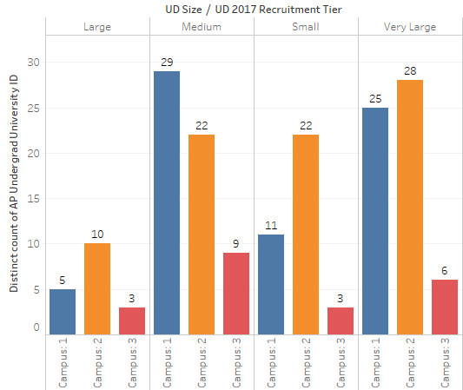
Impact of university size on number of applicants
Insight
25 of Very Large schools when placed in Campus 1 give 36% of applicants vs. 28 very large schools placed in campus 2 give only 17% of applicants
Recommendation
A very large school will have a very big outreach, but to gain the impact that is needed to maximize the number of applicants, such large schools need to be placed in campus 1

Slide 6
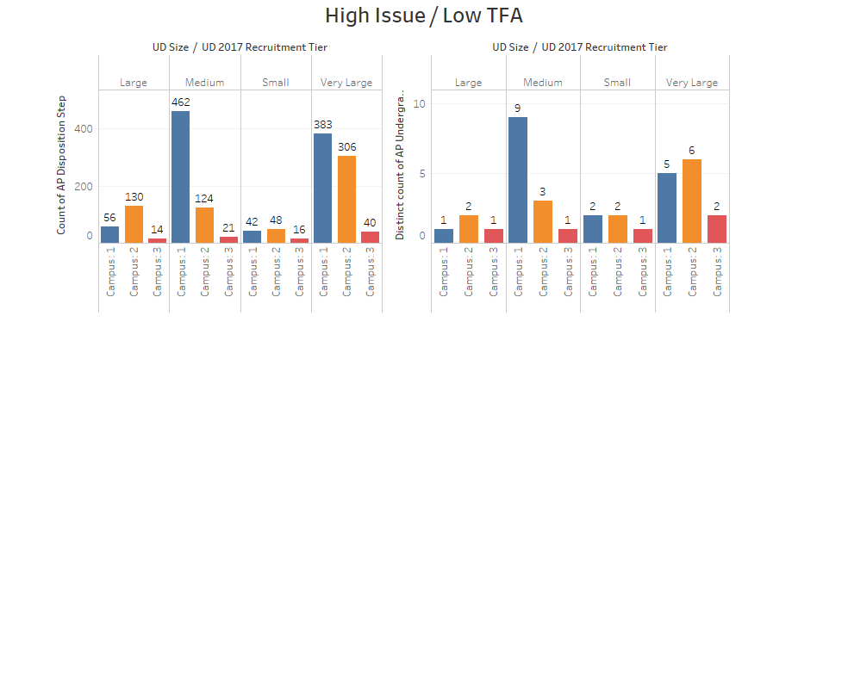
Impact of awareness on number of applicants
Insight
6 schools in campus 2 contribute to 306 applicants, the 5 schools in campus 1 contribute to a higher 383 applicants
Recommendation
High issue and low TFA schools should be placed in higher tiers

Slide 7
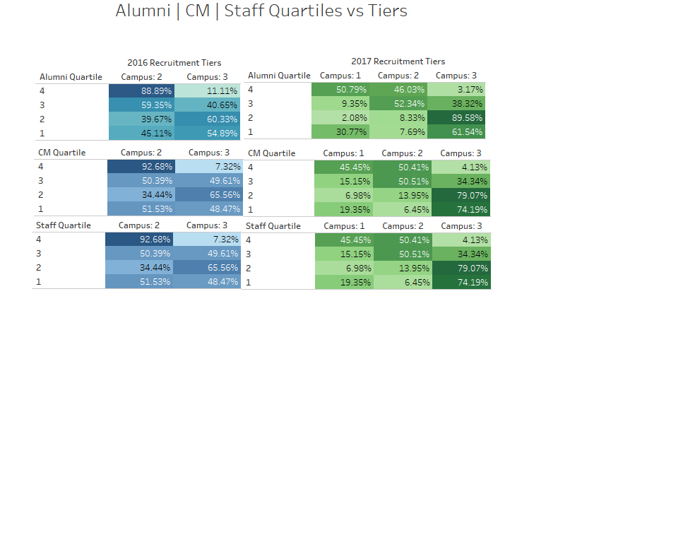
Impact of Alumni, Staff and Current Corps on number of applicants
Insight
The concentration of the percentages for the tables depict a random pattern highlighting an insight that the number of the members for each of these groups were probably not taken into consideration while bucketing the universities into the different tiers
Recommendation
Universities with higher number of members should be logically placed in higher quartiles

Slide 8

Methodology to assign tiers to universities
#CM
#Staff
TFA
Size
Issue
#Alumni
Tier 1
Classification
models
$$γθβα$$
Tier 2
Since we do not know how much value each variable holds or how much it contributes, we run different classification models.
In addition, from our judgement and the insights we come across, we include an business intuition weightage to our set. Finally, we take an average to give us an ensemble weight for each variable.
Being cognizant about the average percentage contribution of each of these significant attributes, we proceed towards developing a mathematical equation which will equip us to procure a score for each university.
Tier 3
Finally, we rank and divide the universities into tiers keeping the 2017 proportions intact.

Slide 9

So is our equation working?
72% Match
$$γθβα$$
We propose to make changes in the remaining 28% universities which will make a difference for Teach For America in the year 2018

Slide 10
Future Scope for improvement
Apply Round Robin methodology
Promote over performing schools in lower tiers
Demote underperforming schools in top tiers

Slide 11
Questions?

