Slide 1
AIRBNB NYC
Case Study
By – Vijaykumar Rangvani
Sonam Gupta

Slide 2
Contents
Introduction
Problem Statement
Objectives
Key Insights
Appendix
About the data
Methodology
Assumptions

Slide 3
Introduction
Airbnb, Inc. is an American company that operates an online marketplace for lodging, primarily homestays for vacation rentals, and tourism activities. Airbnb provides a platform for hosts to accommodate guests with short-term lodging and tourism-related activities.
New York City is the most diverse and populated city in the United States. The city is made up of 5 burrows: Manhattan, Brooklyn, Queens, the Bronx and Staten Island, all of which were “grouped” together into a single city. It is widely recognized as the global centre for the financial services industry. It’s also the heartbeat of the American media, entertainment (along with California), telecommunications, law and advertising industries.

Slide 4
Problem statement
For the past few months, Airbnb has seen a major decline in revenue. Now that the restrictions have started lifting and people have started to travel more, Airbnb wants to make sure that it is fully prepared for this change.
So, analysis has been done on a dataset consisting of various Airbnb listings in
New York.

Slide 5
Objective
The presentation will focus mainly on the following points:
▶ Get a better understanding about Airbnb listings with respect to various parameters
▶ Understand the customer preferences
▶ Understand the customer booking trend

Slide 6
Key Insights
To understand some important insights we have explored the following questions:
▶ How are the Airbnb listings spread out in NYC
▶ What type of rooms do customers prefer
▶ What could be the ideal number of minimum nights to increase customer
bookings
Based on customer review:
▶ Most preferred neighbourhood
▶ Most preferred room type
▶ Who are the Hosts who have the highest listings w.r.t. Neighbourhood

Slide 7


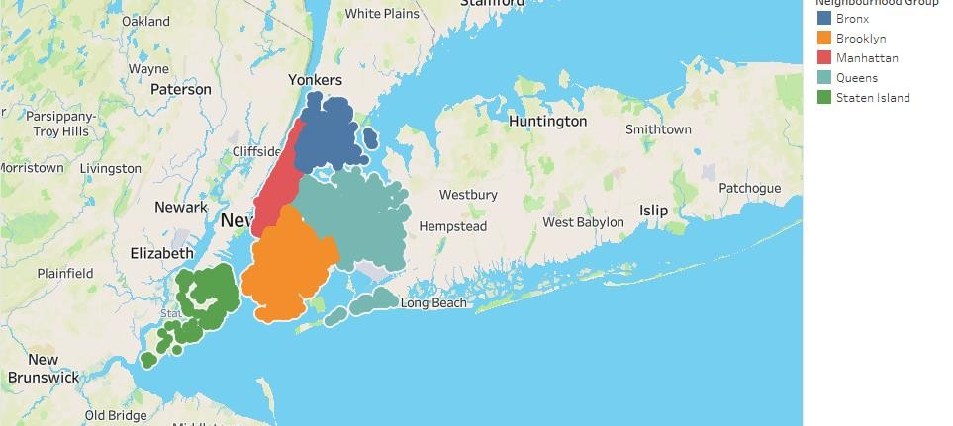
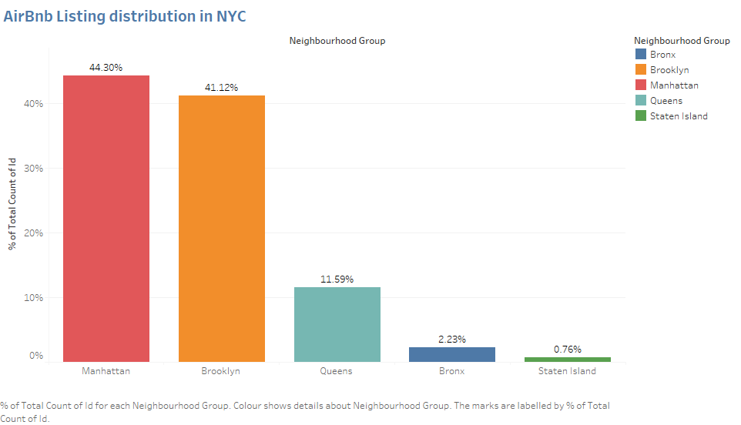
▶ Airbnb has good presence in Manhattan, Brooklyn & Queens.
▶ Listings are maximum in Manhattan (44%) & Brooklyn (41%) owing to the high population density and it being the financial and tourism hub of NYC. Staten Island (~1%) has the least number of listings, due to its low population density and very few tourism destinations.

Slide 8

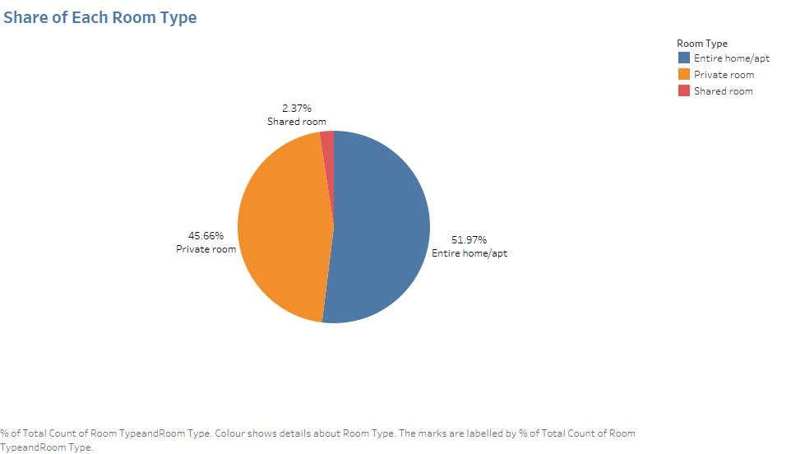
▶ Three types of rooms - Entire home/Apartment, Private room & shared room.
▶ Overall, customers appear to prefer private rooms (45%) or entire homes (52%) in comparison to shared rooms (2.4%).
▶ Airbnb can promote shared room by providing discounts to increase bookings

Slide 9
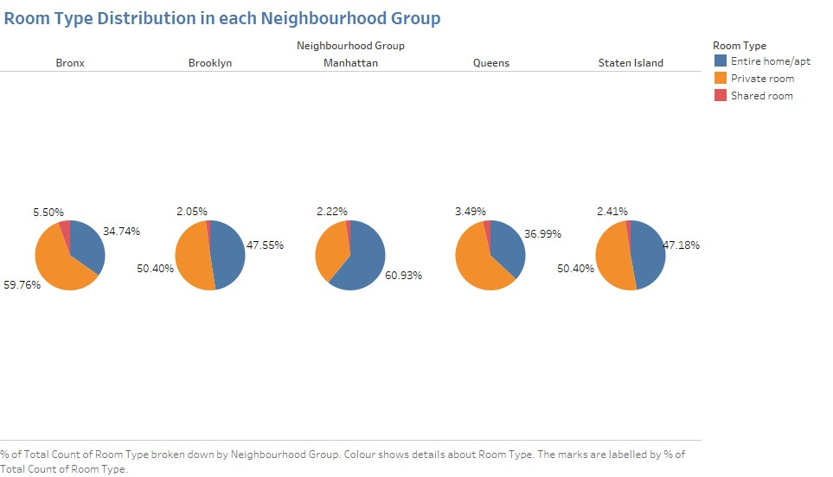
▶ Queens & Bronx contribute 60% each to private rooms, more than the combined ratio of 45%. Whereas, Manhattan has a higher contribution in entire home (61%), compared to the combined ratio of 52%.

Slide 10


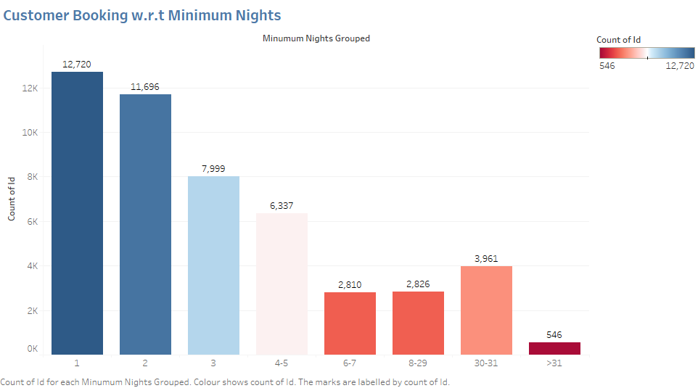
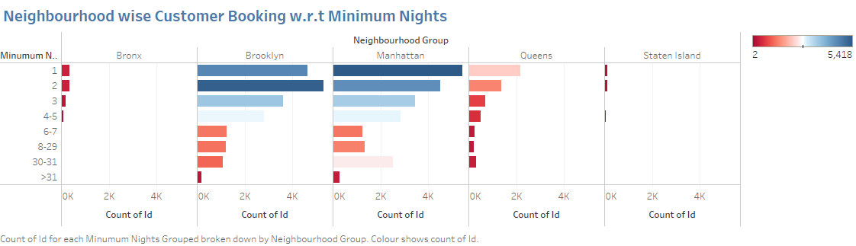
▶ The listings with Minimum nights 1-6 have the most number of bookings. The listings with Minimum nights 1-6 have the most number of bookings.
▶ We can see a prominent spike in 30 days, this would be because customers would rent out on a monthly basis. After 30 days, we can also see small spikes at 60 & 90 days, this can also be explained by the monthly rent taking trend.
▶ Manhattan & Brooklyn have higher number of 30 day bookings compared to the others. The reason could be either tourists booking long stays or mid-level employees who opt for budget bookings due company visits.

Slide 11
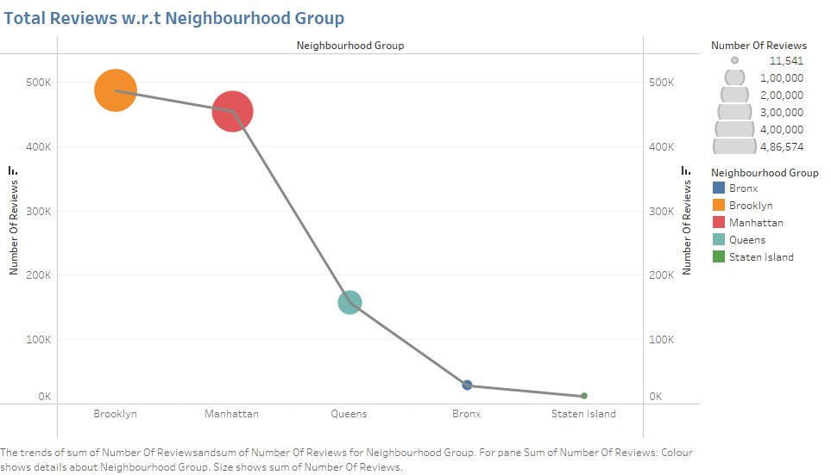
▶ In line with our earlier observation, we see the maximum reviews in listings for Manhattan & Brooklyn, implying that more bookings happen in these neighbourhoods.
▶ The higher number of customer reviews also imply higher satisfaction in these localities.

Slide 12
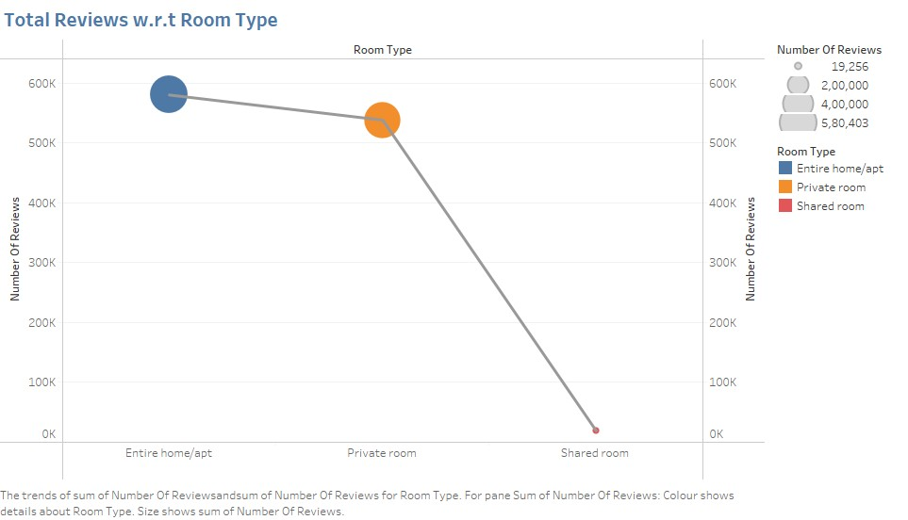
▶ Also, we see the maximum reviews in room types ‘Entire home/apt’ & ‘Private rooms’. We can safely infer that, customers do not prefer ‘Shared rooms’.

Slide 13
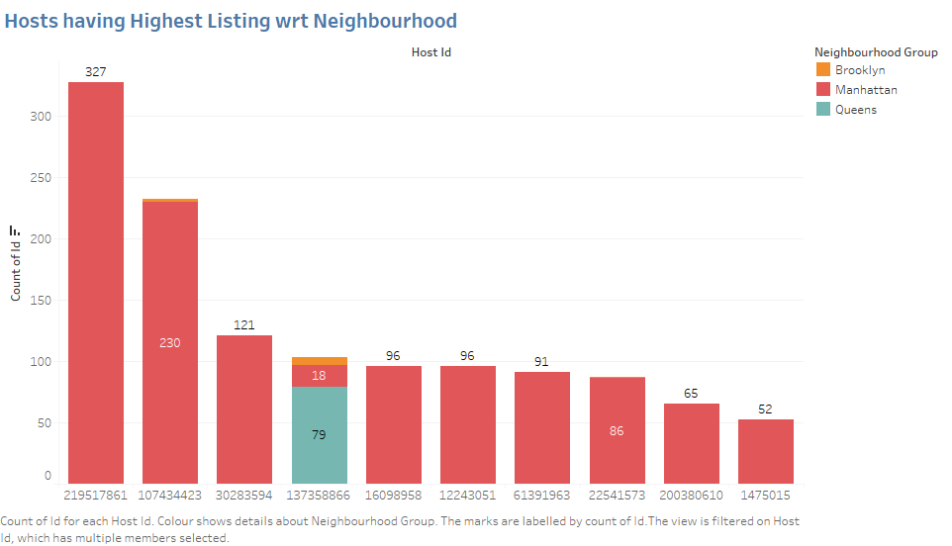
▶ More experienced hosts know the market better.
▶ We observe a single host having multiple listings mainly in the Manhattan area.
This is because Manhattan has the highest influx of tourists and financial
enthusiasts visiting the city all year round.
▶ This makes it more profitable for the host to acquire properties in the same area.

Slide 14
Appendix
About the data
▶ Provided with Airbnb New York City Listings Dataset till 2019 (48895 Rows * 16 Columns)
Column | Description
Id | Listing ID
Name | Name of Listing
Host_id | host ID
Host_name | Name of Host
Neighbourhood | Neighbourhood_group - Location
Neighborhood | Neighborhood - Area
Latitude & Longitude | Map co-ordinates
Room_type | Listing space type
Price | Price of listing
Minimum_nights | Amount of nights minimum
Number_of_reviews | number of reviews
Last_review | Lastest review
Reviews_per_month | number of reviews per month
Calculated_host_listings_count | no. of listings per host
Availability_365 | no. of days when listing is available for booking

Slide 15
Appendix
Methodology
▶ The data was analysed through univariate and bivariate analysis.
▶ The analysis and visualizations were done using Tableau considering various parameters.
▶ The main parameters that have been taken into account for analysis are –
Geography based bookings
Bookings based on room type
Number of reviews
Minimum number of nights
▶ Inferences have been made keeping in mind the above parameters
Assumptions
As we are not aware about the nature of reviews, we have assumed that the properties which
received higher number of reviews have a better customer liking.

Slide 16
Thank You

