Slide 1
AIRBNB NYC
Case Study
By – Vijaykumar Rangvani
Sonam Gupta

Slide 2
Contents
Introduction
Problem Statement
Objectives
Insights & Recommendation
Appendix
About the data
Methodology
Assumptions

Slide 3
Introduction
Airbnb, Inc. is an American company that operates an online marketplace for lodging, primarily homestays for vacation rentals, and tourism activities. Airbnb provides a platform for hosts to accommodate guests with short-term lodging and tourism-related activities.
New York City is the most diverse and populated city in the United States. The city is made up of 5 burrows: Manhattan, Brooklyn, Queens, the Bronx and Staten Island, all of which were “grouped” together into a single city. It is widely recognized as the global centre for the financial services industry. It’s also the heartbeat of the American media, entertainment (along with California), telecommunications, law and advertising industries.

Slide 4
Problem statement
For the past few months, Airbnb has seen a major decline in revenue. Now that the restrictions have started lifting and people have started to travel more, Airbnb wants to make sure that it is fully prepared for this change.
So, analysis has been done on a dataset consisting of various Airbnb listings in
New York.

Slide 5
Objective
The presentation will focus mainly on the following points:
▶ Understand customer preferences and customer experience in airbnb listings
▶ Understand the pricing relation to various parameters
▶ Recommendations to improve quality of new acquisitions and customer
experience.

Slide 6
Key Insights
To understand some important insights we have explored the following
questions:
▶ Customer preference for neighbourhood & room type
▶ Property demand based on minimum nights offered
▶ Price range preferred by customers
▶ Understanding Price variation w.r.t Room Type & Neighbourhood
▶ Understanding Price variation w.r.t Geography
▶ Top reviewed properties

Slide 7


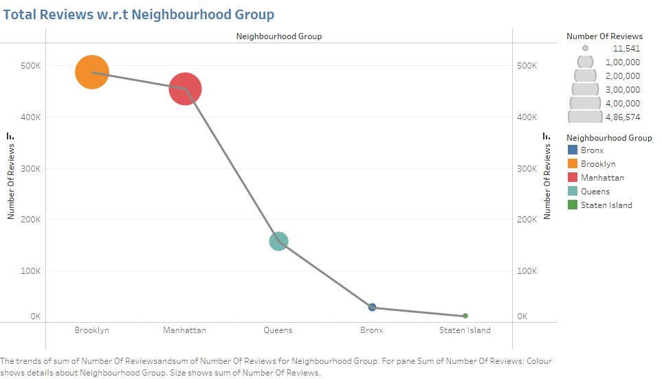
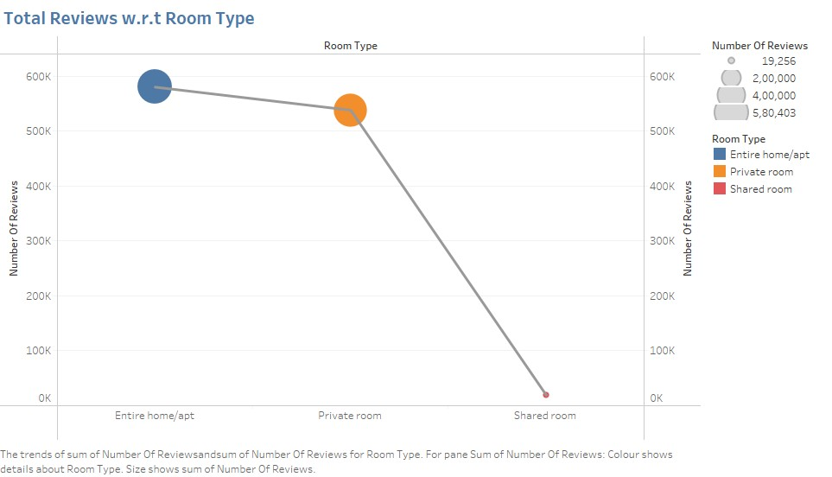
Customer preference for neighbourhood
▶ There are three types of rooms - Entire home/Apartment, Private room & shared room.Customers prefer private rooms or entire homes in comparison to shared rooms.
▶ Also, we can see maximum reviews in listings for Manhattan & Brooklyn, implying that more bookings happen in these neighbourhoods.(The higher number of customer reviews imply higher satisfaction)

Slide 8

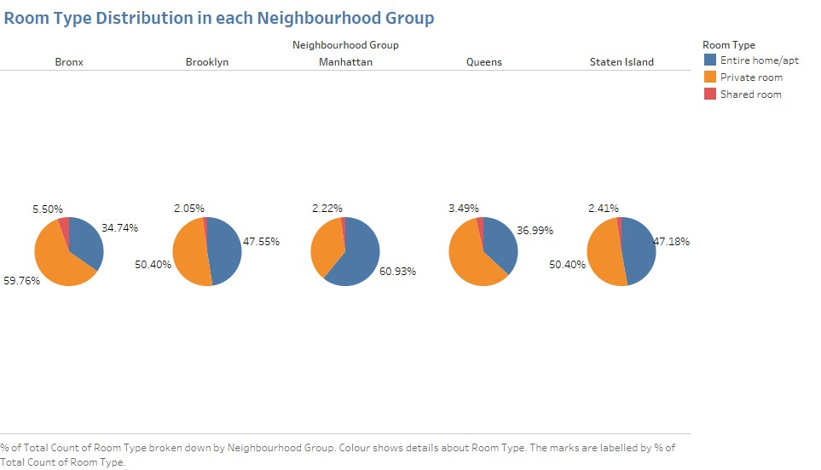
Customer preference for neighbourhood w.r.t Room type
Recommendation:
▶ Airbnb can concentrate on promoting shared rooms with targeted discounts to increase bookings.
▶ New acquisitions can be explored to acquire ‘private rooms’ in Manhattan and Brooklyn and
‘entire homes’ in Bronx and Queens.

Slide 9


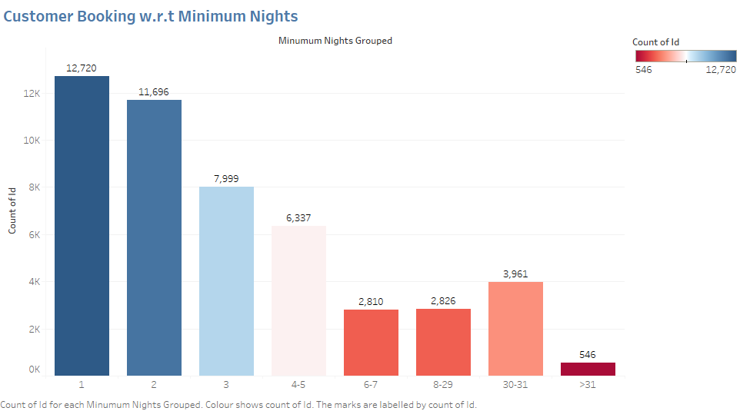
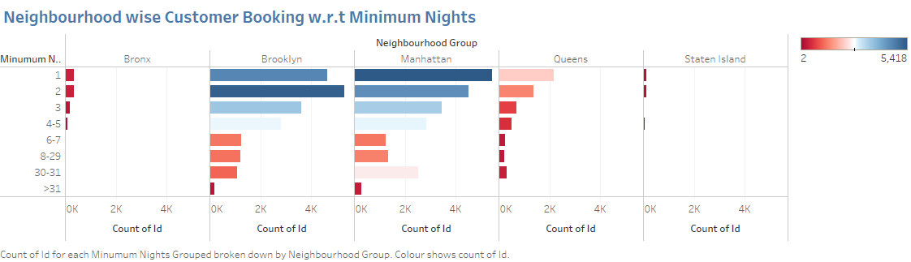
Property demand based on minimum nights offered
▶ The listings with Minimum nights 1-6 have the most number of bookings. We can see a prominent spike in 30 days. This would be because customers would prefer renting out on a monthly basis. After 30 days, we can also see small spikes at 60 & 90 days, this can also be explained by the monthly rent taking trend.
Recommendation:
▶ More number of hosts & listings with monthly rental duration (30-60-90) can be acquired. We see a good potential in the 30-day rental window. Manhattan & Brooklyn have higher number of 30 day bookings compared to the others, these areas can be further targeted.
▶ Also, weekly or bi-weekly rentals can also be acquired as these can be used customers stranded in NYC for quarantine purposes.

Slide 10

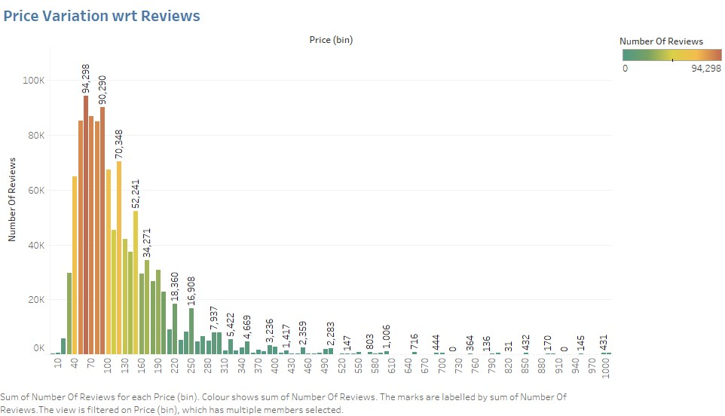
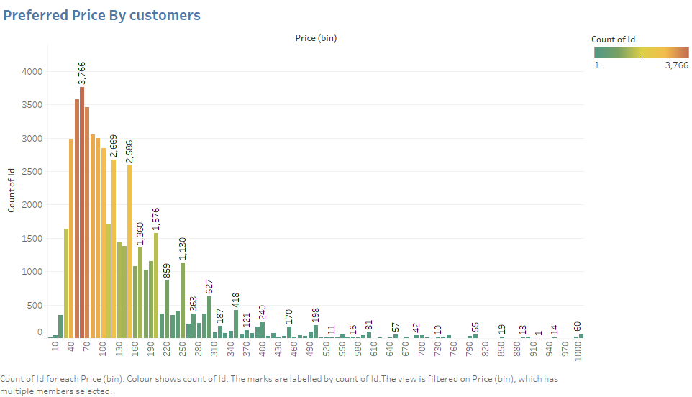
Price range preferred by customers
▶ We have taken pricing preference based on two parameters – volume of bookings done in a price range and number of reviews in a price range.
▶ The favourable price range is $40 - $190. This is the price range most preferred by most customers.
Recommendation:
▶ New acquisitions and expansion can be done in the price range of $40 - $190 as it satisfies both parameters of volume of customer traffic and customer satisfaction.

Slide 11

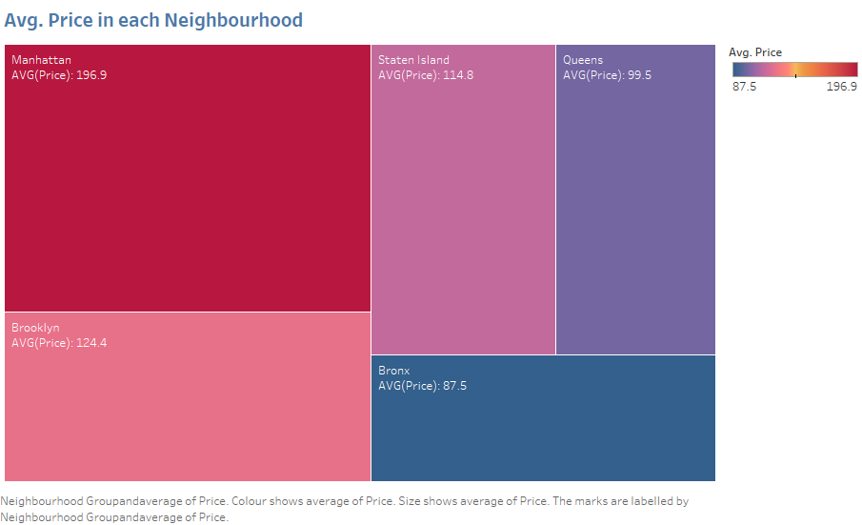
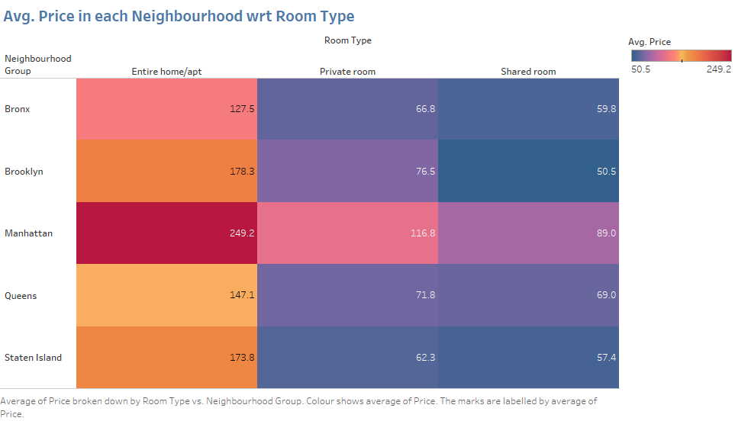
Understanding Price variation w.r.t Room Type & Neighbourhood
▶ Manhattan appears to have the highest average price of $196.9. The 'Entire home/apt' room type in Manhattan is the most expensive at $250, much higher than the overall average.
▶ 'Shared Room' type is the cheapest in Brooklyn.
Recommendation:
▶ ‘private rooms’ of Manhattan & Brooklyn and ‘entire homes’ in Bronx and Queens Fall in the favourable price range ($40-$190).
▶ Brooklyn has an average price of $124. As there are already many listings available in Manhattan, Brooklyn can be considered for expansion.

Slide 12
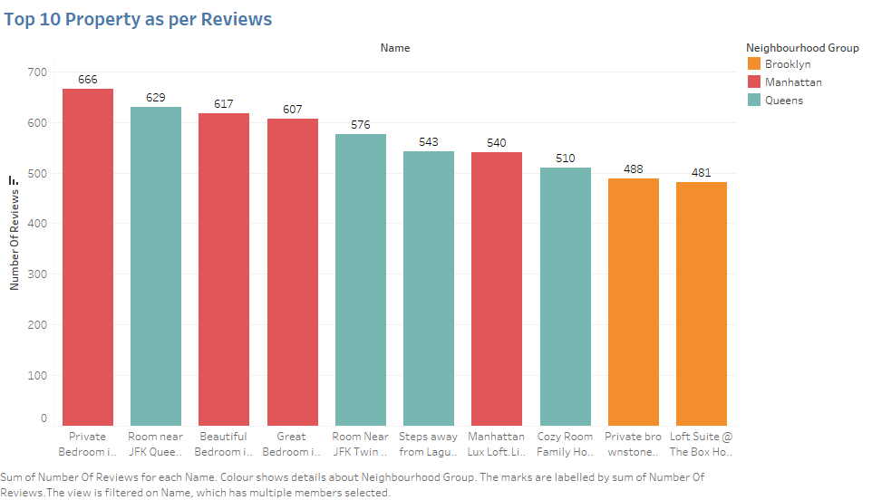
Top reviewed properties
▶ Manhattan, Brooklyn and Queens have the most liked properties (most reviewed)..
▶ The most reviewed property “Private Bedroom in Manhattan”, though it appears to be steeply priced still has managed to get the maximum number of reviews making it the most favourable property in NYC.

Slide 13
Recommendations
▶ Promotion of shared rooms with targeted discounts to increase bookings.
▶ More number of hosts & listings with monthly rental duration (30-60-90) can be acquired. We see a good potential in the 30-day rental window. Manhattan & Brooklyn have higher number of 30-day bookings compared to the others; these areas can be further targeted.
▶ Weekly or bi-weekly rentals can also be acquired, as these can be used customers stranded in NYC for quarantine purposes.
▶ New acquisitions and expansion can be done in the price range of $40 - $190 as it satisfies both parameters of volume of customer traffic and customer satisfaction.
▶ New acquisitions can be explored to acquire ‘private rooms’ in Manhattan and Brooklyn and ‘entire homes’ in Bronx and Queens.
▶ Brooklyn has an average price of $124. As there are already many listings available in Manhattan, Brooklyn can be considered for expansion.
▶ Increasing acquisitions and new properties in coastal regions can increase customer bookings.

Slide 14
Appendix
About the data
▶ Provided with Airbnb New York City Listings Dataset till 2019 (48895 Rows * 16 Columns)
Column | Description
Id | Listing ID
Name | Name of Listing
Host_id | host ID
Host_name | Name of Host
Neighbourhood | Neighbourhood_group - Location
Neighborhood | Neighborhood - Area
Latitude & Longitude | Map co-ordinates
Room_type | Listing space type
Price | Price of listing
Minimum_nights | Amount of nights minimum
Number_of_reviews | number of reviews
Last_review | Lastest review
Reviews_per_month | number of reviews per month
Calculated_host_listings_count | no. of listings per host
Availability_365 | no. of days when listing is available for booking

Slide 15
Appendix
Methodology
▶ The analysis and visualizations were done using Tableau considering various parameters.
▶ The analysis was done keeping in mind the business side of the project. The important factors taken into consideration were customer booking volume and customer preference.
▶ The first half of the presentation focused on customer preference. The second half compared various parameters
of customer preference with respect to price.
▶ The following parameters were considered –
Customer experience : Neighbourhood, Room type & minimum nights offered
Price variation : Volume of customer booking, Room type, Neighbourhood, Number of reviews & Geography.
▶ Recommendations have been made keeping in mind the above parameters.
Assumptions
As we are not aware about the nature of reviews, we have assumed that the properties which received higher number of reviews have a better customer liking.

Slide 16
Thank You

