Slide 1
Optimizing Operational Efficiency in the QSR Industry Through Data-Driven Insights
-by Arko Bhattacharjya

Slide 2
QSR Industry Overview
Fast-food model: speed, efficiency, affordability
Standardized menu & high customer turnover
Highly scalable & profitable

Slide 3
QSR Business Models
Franchise model
Company-owned model
Hybrid model
Cloud kitchen
Aggregator-driven
Combo pricing & loyalty models

Slide 4
Role of Technology
Mobile apps & digital ordering
Delivery platforms (Zomato, Swiggy)
Data analytics for demand & pricing
Improved customer engagement

Slide 5
Key Challenges
Maintaining food quality
Inventory management
Delivery delays
Demand fluctuations

Slide 6
Franchise Operations
Brand owner: menu, pricing, branding, tech
Franchise partner: operations, staff, delivery

Slide 7
Key Operational Activities
Order management
Food preparation
Inventory management
Delivery operations
Customer experience
Staffing

Slide 8
Database Design
8 tables: Customers, Store, Menu, Orders
Order_Items, Delivery, Payments, Inventory

Slide 9
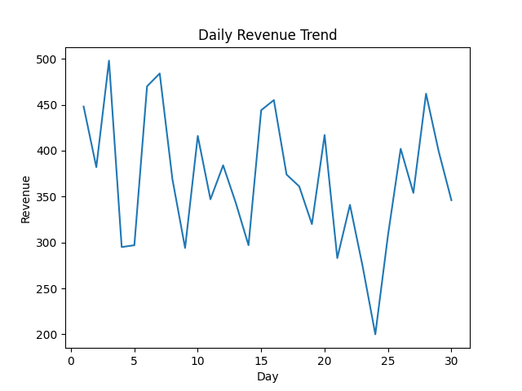
Sales Analysis
Revenue trends over time
Peak hours & demand patterns
Helps forecasting & planning

Slide 10
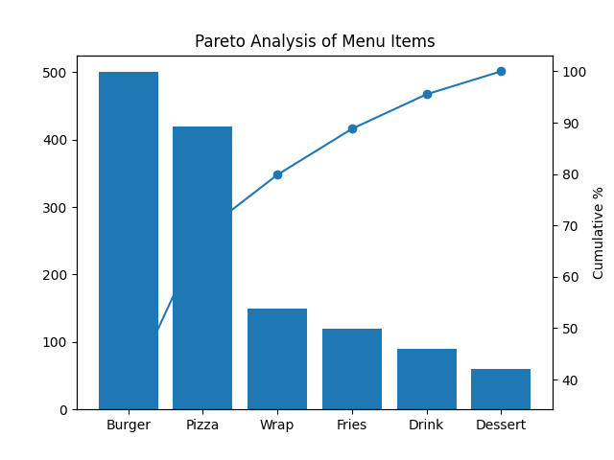
Menu Analysis
Top vs low performing items
80-20 Pareto principle
Optimize menu & combos

Slide 11
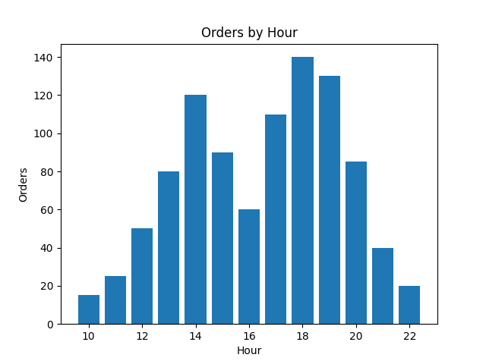
Delivery & Peak Hours
Delays during peak time
Lunch & dinner highest demand
Need better staffing

Slide 12
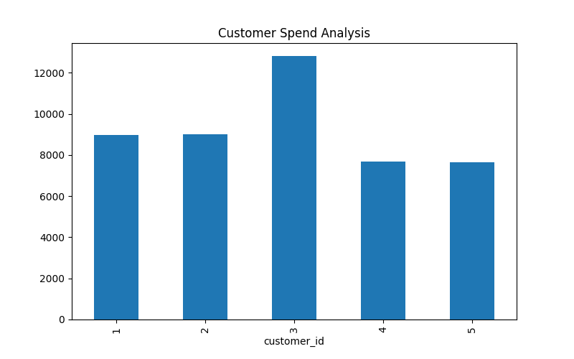
Customer Insights
High-value customers drive revenue
Retention is low
Need loyalty programs

Slide 13
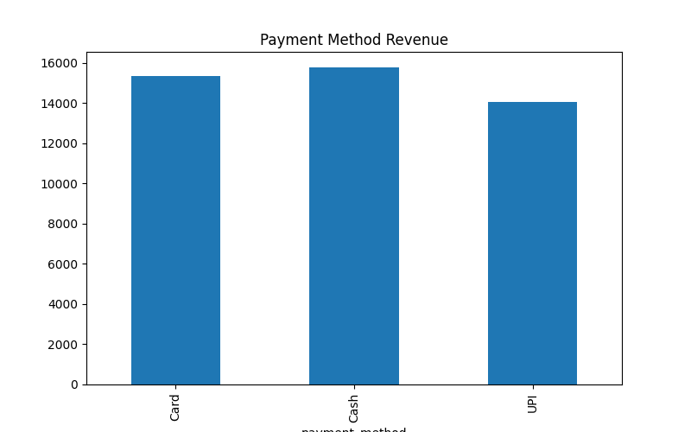
Payment & Store Performance
UPI/cards dominate
Store-wise performance varies
Optimize operations

Slide 14
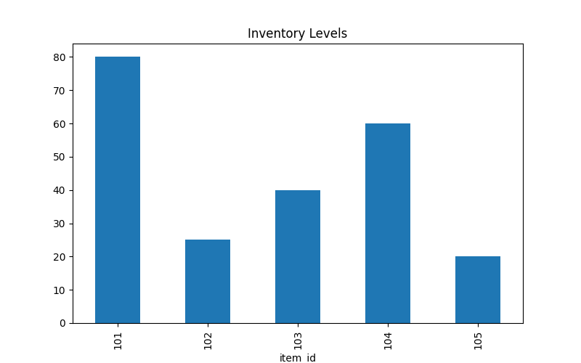
Inventory & Order Value
Stock imbalance issues
Opportunity to increase AOV
Use combos & upselling

Slide 15
Final Insights
Demand is Time-Clustered, Not Uniform
Menu not equally efficient
Operational bottlenecks exist due to delivery
Revenue is Driven by Few Menu Items (Pareto Effect)
Inventory Planning is Inefficient
Digital Payments Dominate Customer Preference

Slide 16
Conclusion
Data-driven decisions improve efficiency
Enhances customer experience
Ensures long-term growth

