Slide 1
BEE Project
Movie Ticket Website
Team Details:
Aman Vashisht(2310990275)
Aryan Singla (2310990304)
Deepanshu Jindal (2310990321)
Gopesh Goyal (2310990337)
Trainer’s Name : Mr. Rahul Singh
:
Chitkara University Institute of Engineering and Technology,
Chitkara University, Punjab

Slide 2
Table of Contents
Introduction
Problem Statement
Technical Details
Challenges Faced
Key Features
Future Scope
Project Highlights
Conclusion
References

Slide 3
Introduction
In today’s fast-paced digital era, standing in long queues for movie tickets has become outdated. This project presents a Movie Booking Website that simplifies the process of exploring movies, checking availability, and booking tickets online. The platform provides a user-friendly interface where users can easily browse “Now Showing” movies, view details, and reserve seats securely. By saving time and effort, the website ensures a convenient and seamless movie-going experience for users.

Slide 4
Problem Statement
Traditional methods of purchasing movie tickets often involve long queues, limited availability, and lack of real-time updates, leading to inconvenience for users. Existing systems may not provide a seamless experience for browsing movies, selecting seats, and securing bookings. There is a need for an efficient, user-friendly online platform that allows users to conveniently check movie details, seat availability, and book tickets anytime, anywhere.

Slide 5
Technical Details
Frontend:
React.js – For building a dynamic and responsive user interface.
CSS / Bootstrap – For styling and creating a modern UI design.
Backend:
Node.js – For server-side scripting and handling requests.
Express.js – For building APIs and managing routing efficiently.
Database:
MongoDB – For storing movie details, user information, and booking records.
Additional Tools:
RESTful APIs for communication between frontend and backend.
Git/GitHub for version control.

Slide 6
Challenges Faced
Integrating seat selection and real-time availability to avoid double bookings.
Designing a responsive and user-friendly interface for various devices.
Ensuring secure user authentication and data handling.
Connecting frontend React components smoothly with backend APIs.
Managing database operations efficiently for bookings and movie listings.
Handling errors and edge cases during ticket booking, such as full shows or invalid inputs.

Slide 7
Key Features
For Users:
Book movie tickets by selecting timing and show.
Choose preferred seats using a seat selector.
View booking history for past and upcoming shows.
For Admin:
Add, edit, or delete movies in the system.
Upload movie posters and provide descriptions.
Manage movie listings and ensure data is up-to-date.

Slide 8
Future Scope
Online Payment Integration: Allow users to pay securely via credit/debit cards, UPI, or digital wallets.
User Reviews and Ratings: Enable users to rate movies and write reviews.
Personalized Recommendations: Suggest movies based on user preferences and booking history.
Mobile App Development: Launch a mobile version for Android and iOS for wider accessibility.
Promotions and Discounts: Implement offers, coupons, and loyalty points for users.
Multi-City Support: Expand the platform to support multiple cities and theaters.

Slide 9
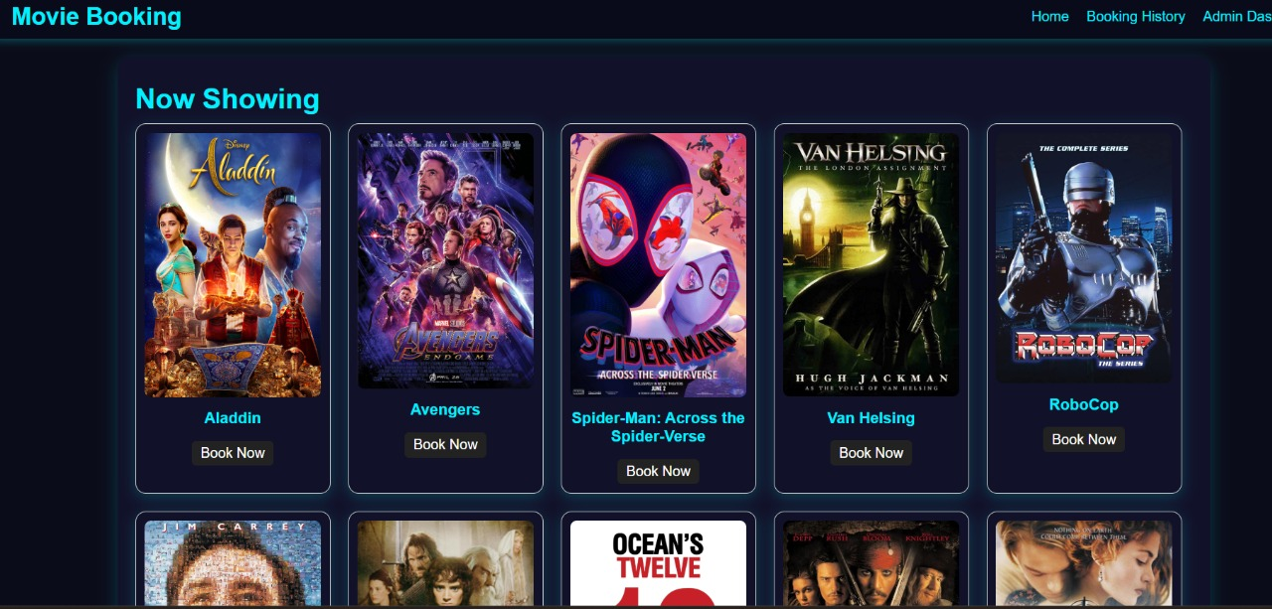
Fig 1. Main Page

Slide 10
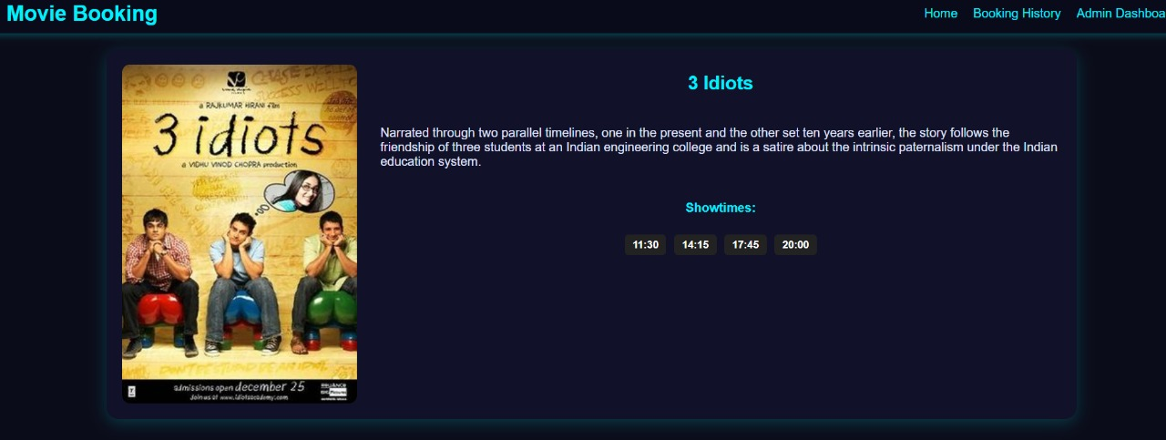
Fig 2. Movie Details & Booking

Slide 11
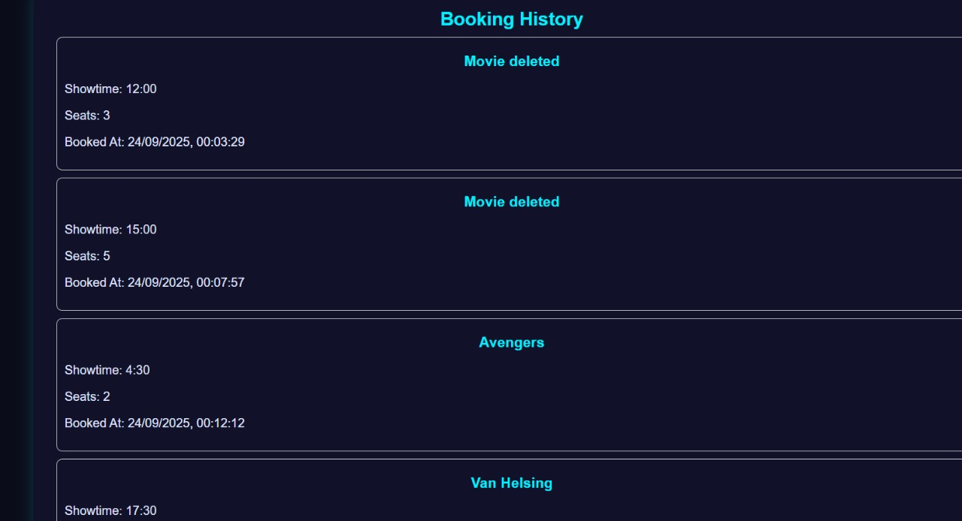
Fig 3. Booking History

Slide 12
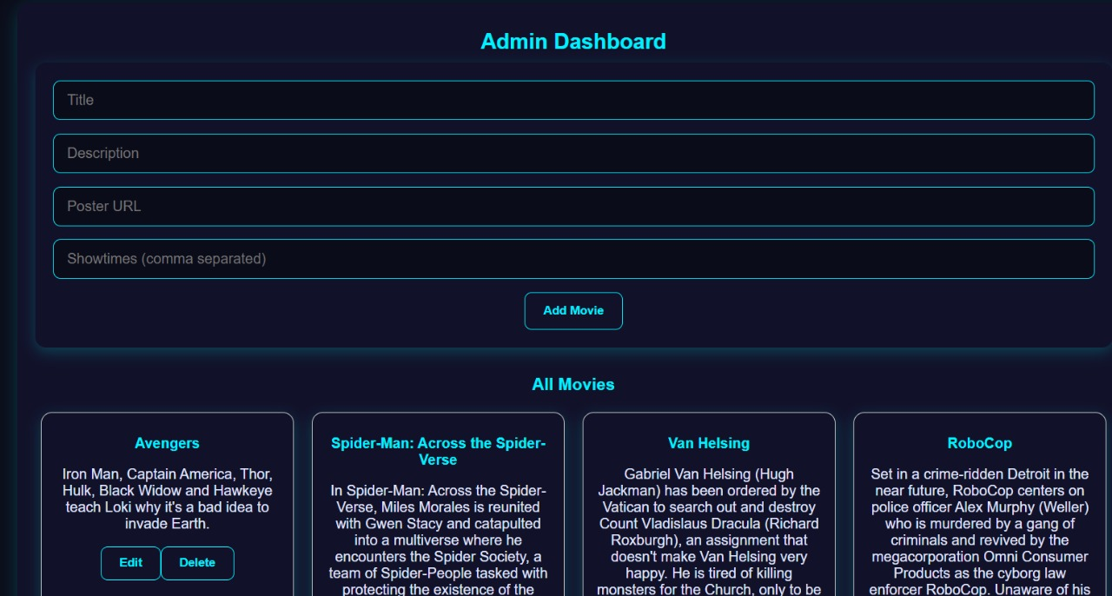
Fig 4. Admin Dashboard

Slide 13
Conclusion
The Movie Booking Website provides a convenient and efficient way to book movie tickets online.
It simplifies the process of selecting movies, choosing show timings, and booking seats.
The platform ensures secure data handling and maintains a user-friendly interface.
Admins can manage movie listings, including posters and descriptions, keeping the system updated.
Overall, the project enhances the movie-going experience for both users and administrators.

Slide 14
References
Official React.js Documentation – https://reactjs.org/docs/getting-started.html
Node.js and Express.js Documentation – https://nodejs.org/en/docs/ & https://expressjs.com/
MongoDB Documentation – https://www.mongodb.com/docs/
Bootstrap Official Documentation – https://getbootstrap.com/docs/
Online tutorials and guides from W3Schools – https://www.w3schools.com/
YouTube tutorials for MERN Stack Projects

Slide 15


