Slide 1

The story of Rodney Alcala
Presented by Schneider Armin

Slide 2
Overwiev
Details about himself
“The Dating Game Killer”
Confirmed murders
His convictions

Slide 3
Details about himself

Slide 4
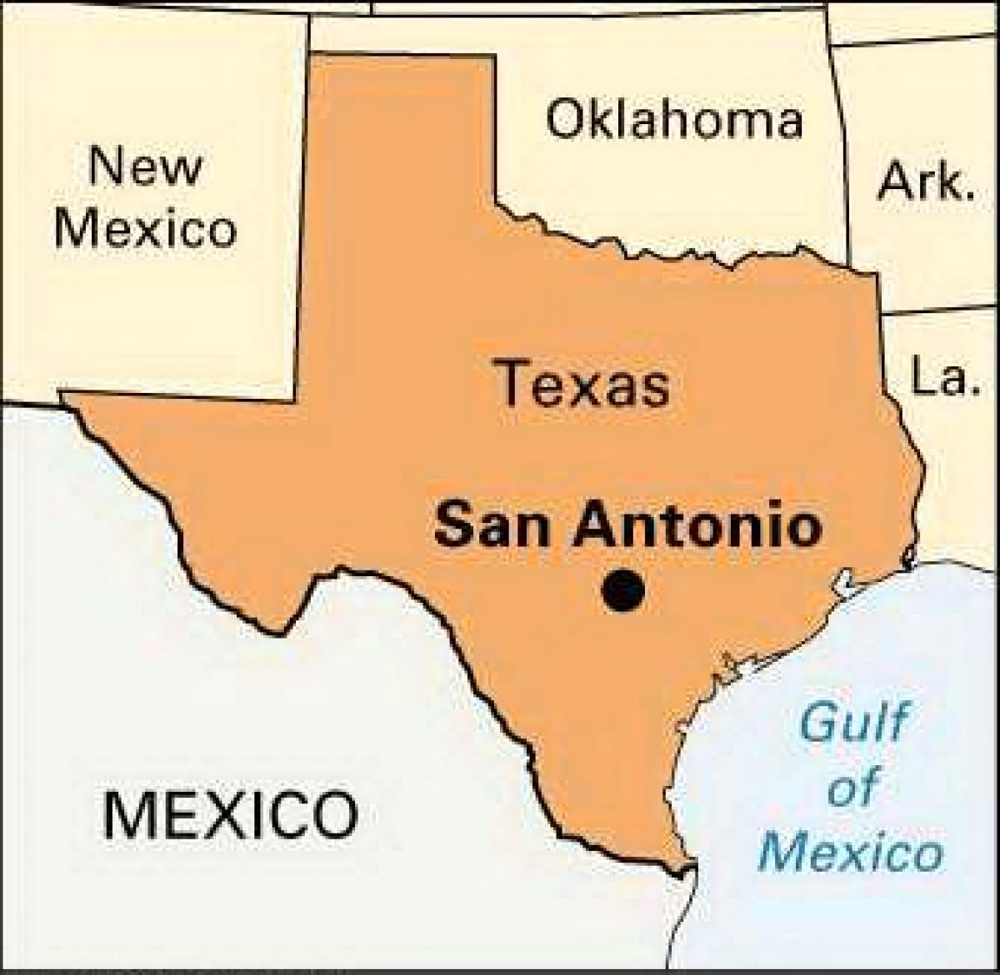
Rodrigo Jacques Alcala-Buquor
He was born on the 23rd August 1943 in San Antonio, Texas.
He had two sisters and one brother
His family moved to the USA in 1951
Three years later his father left the family
After that the rest of the family moved into the area of Los Angeles in 1954
He had eight proven murders, but the police is expecting him to have killed more than 100 persons
He was also known as “The Dating Game killer”

Slide 5
Alcala’s medical condition
In the age of seventeen he started to work at the US-Army
In 1964 the US-Army released Rodney after he had a panic attack and doctors diagnosed him with:
Dissocial personality disorder (“Disregard for social norms, no feel of being guilty”)
Narcissistic personality disorder (“Overestimation of one’s own abilities, increased desire for recognition”)
Borderline personality disorder (“Instable but intensive relations between other people”)
Signs of sexual sadism and psychopathy

Slide 6
Graduations
Despite his medical condition, Alcala was able to graduate at the UCLA (University of California, Los Angeles) of fine Arts and received the title bachelor of Fine Arts in 1968
After that he graduated directing under the name of John Berger at the NYU (New York University), his teacher was Roman Polanski, which is a well known director in the film industry.

Slide 7
“The Dating game Killer”

Slide 8

The charming and funny Rodney Alcala
Rodney was part of a TV show that was called “The Dating game”
He won a date with the female participant
He had already killed five women when this happened.

Slide 9
Confirmed murders

Slide 10
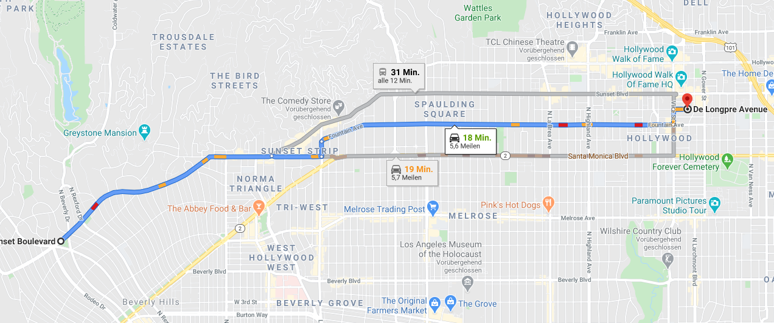
Tali Shapiro
His first heavy crime was in 1968, shortly before he attended NYU.
He lured an eight years old girl from Sunset Boulevard into his apartment on Longpre Avenue, Hollywood where he had beaten her and raped her.
The police found the victim alive, but Alcara already fled from the crime scene.

Slide 11
Cornelia Michel Crilley
She was 23 years old when she met Rodney in 1971.
She was a Trans-World-Airlines flight attendant.
Alcala choked her to death after sexually abusing her in her own apartment at Upper East Side, Manhattan
After that he became part of the Ten Most Wanted Fugitives list of the FBI

Slide 12
Monique Hoyt
At the end of the 1970s he photographed hundreds of naked young (many of them underaged) male and female. He told them, that they would become professional models.
One of these was the 15 years old Monique Hoyt. Alcala had beaten her unconscious before he raped her
He kept the photos until he went to jail in 1979

Slide 13
Robin Samsoe
In summer of 1979 the twelve years old was found dead at the Huntington Beach near Los Angeles, twelve days after gone missing
A bystander told the police that a foreign man wanted to make photos and told the police how he looked like.
Rodney's probation officer identified him, after that they looked in a locker rented on Rodney Alcala and they found the earrings of Robin Samsoe

Slide 14
His convictions

Slide 15
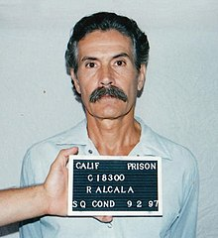
His convictions
1979 he got arrested and sentenced to death due to the murder of Robin Samsoe. Problems occurred and the sentence was cancelled.
In 1986 Rodney got sentenced to death again, but one of the witnesses got hypnotized by the police so this one was not valid either
2003 four unsolved murders of the 1970s were connected to him because of a DNA analyse
2010 he was sentenced to death due to five more murders
2013 he got sentenced to jail for 25 years due to 2 more murders

Slide 16
Thank you for your attention

