Slide 1
Visual Modeling Concepts

Slide 2
What is Visual Modeling?
Visual Modeling is…
Graphical representation using a modeling language that takes something complex and makes it easier to understand.

Slide 3
What is Visual Modeling?
Visual Modeling is…
Graphical representation using a modeling language that takes something complex and makes it easier to understand.

Slide 4
What is Visual Modeling?
Visual Modeling is…
Graphical representation using a modeling language that takes something complex and makes it easier to understand.

Slide 5
What is Visual Modeling?
Visual Modeling is…
Graphical representation using a modeling language that takes something complex and makes it easier to understand.

Slide 6
Benefits of Visual Modeling
Easily understand complex information
Gets all stakeholders involved
Receive requirements efficiently
Identify the underlying problem
Analyze ‘what if’ scenarios
Allows remove of irrelevant information

Slide 7
What Gets Modeled?
Current state, “as-is”
Future state, “to-be”
Requirements fill the gap

Slide 8
Business Models

Slide 9
Organizational Chart

Slide 10
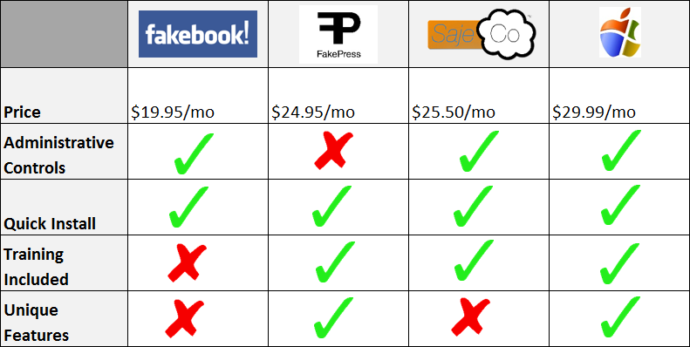
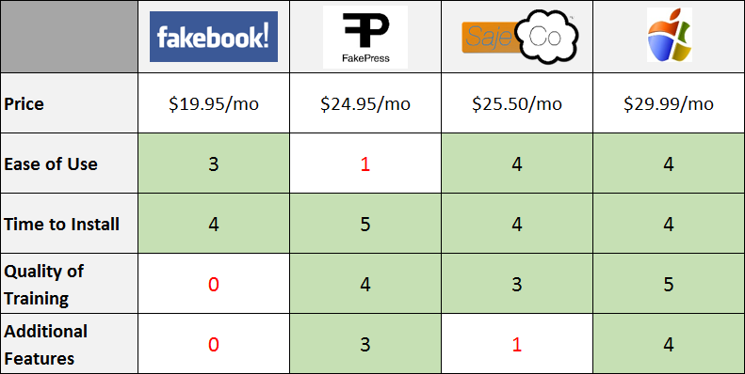
Competitive Comparison Matrix

Slide 11
Stakeholder Map

Slide 12
Use Case Diagram

Slide 13
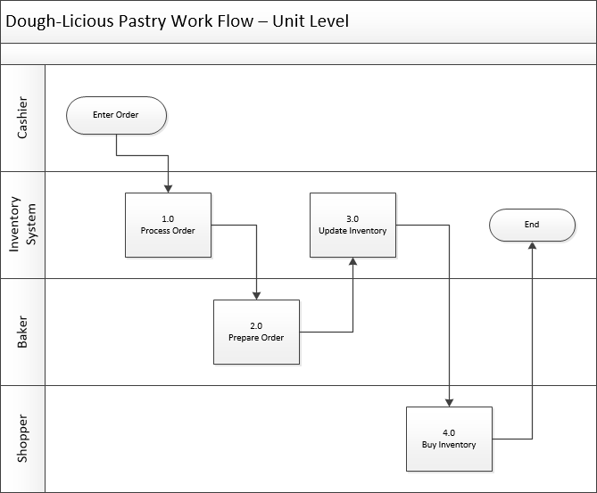
Process Flow Diagram

Slide 14
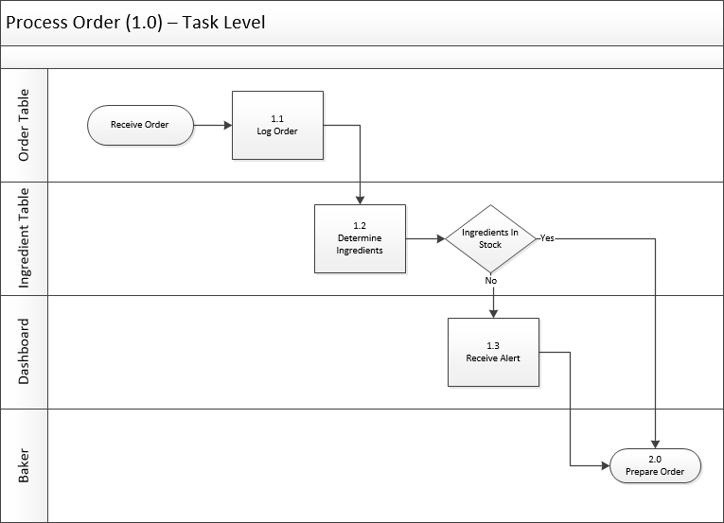
Process Flow Diagram

Slide 15
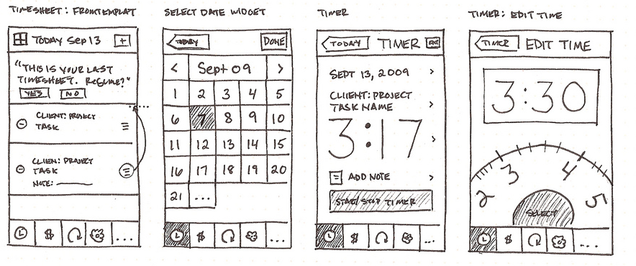
User Interface Wireframe
Credit to Anthony Armendariz for the Interface Wireframe example
https://www.flickr.com/photos/anthonyarmendariz

Slide 16
Technical Models

Slide 17
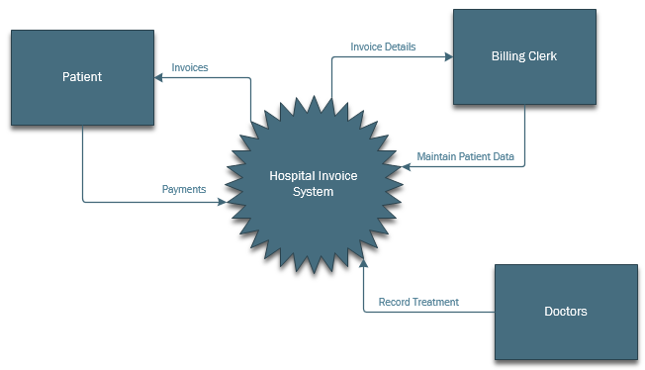
System Context Diagram

Slide 18
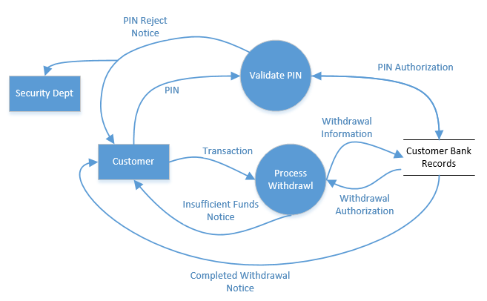
Data Flow Diagram

Slide 19
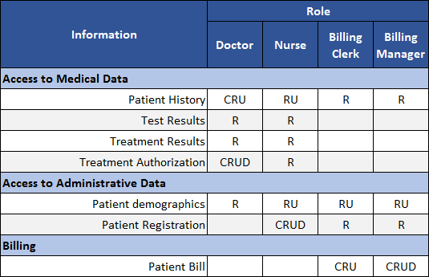
CRUD Matrix
Create
Read
Update
Delete

Slide 20
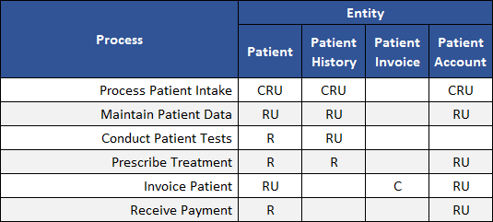
CRUD Matrix
Create
Read
Update
Delete

Slide 21
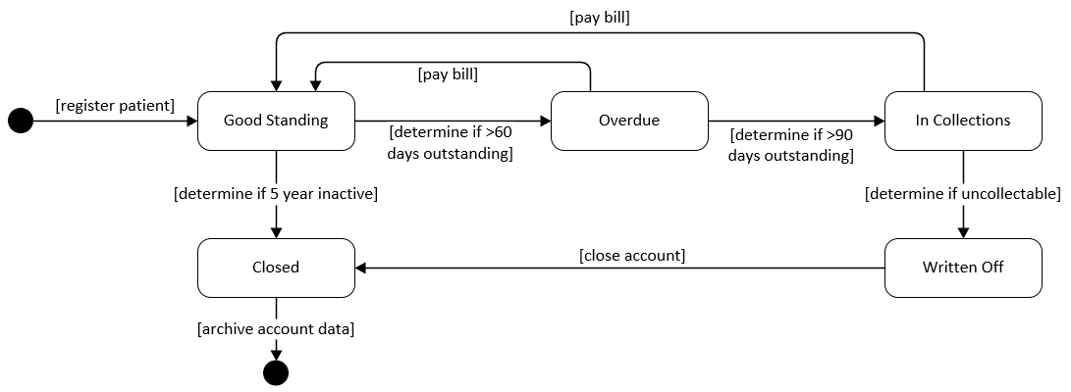
State Diagram

Slide 22
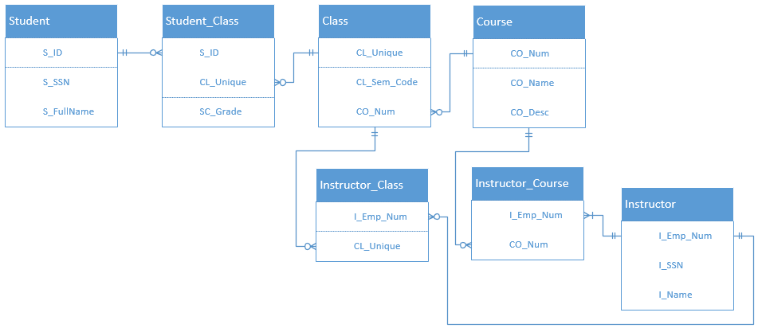
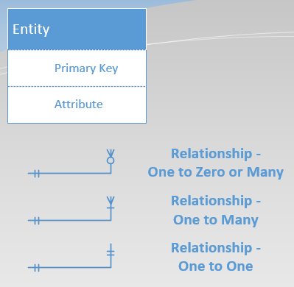
Entity Relationship Diagram (ERD)

Slide 23
BPMN vs UML
Business Process Modeling Notation
vs
Unified Modeling Language

Slide 24
BPMN vs UML: Common Parts
Activity – Activity within a process, triggered by an event
Event – Manual or automated action, or delay in time that triggers an action
Gateway – Split of pathways, where multiple paths can be taken or decision on a path must be made per a condition
Flow – Direction of the sequence or order of events and actions
Swimlanes – Visual distinction of who is doing what within a process

Slide 25
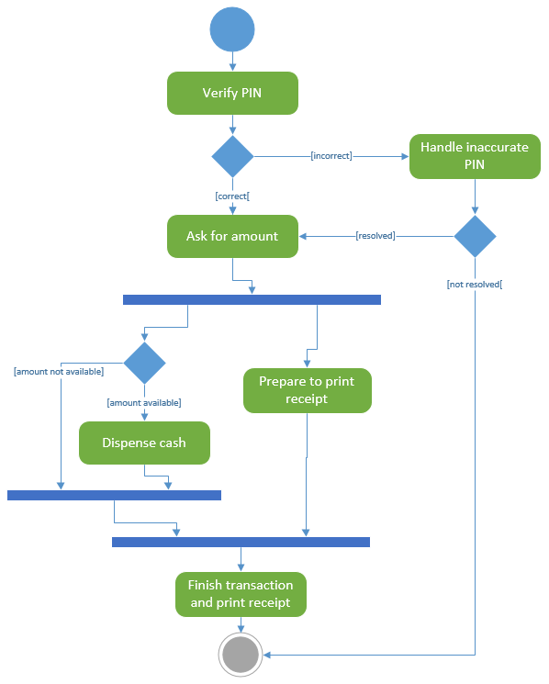
UML Activity Diagram

Slide 26
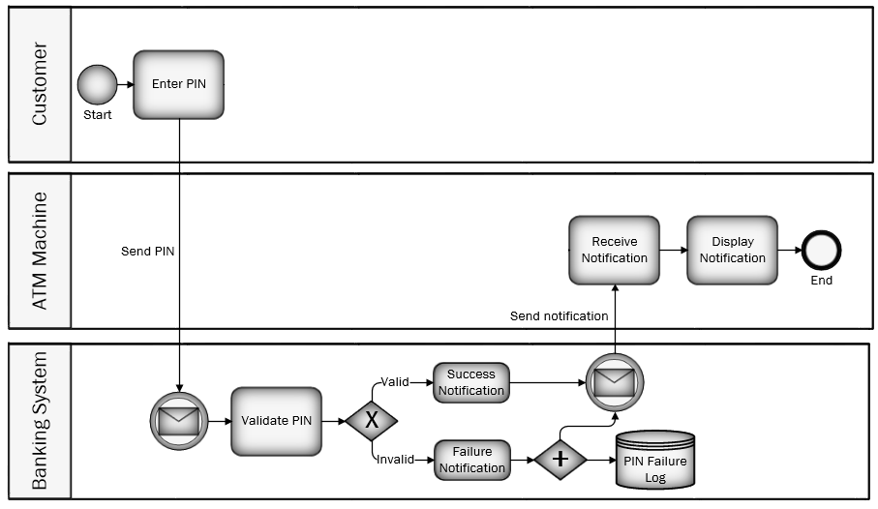
Business Process Modeling (BPMN)

Slide 27


