Slide 1
Phases of the Requirements Process
Requirement Elicitation
Requirement Analysis
Requirement Specification
Requirements Approval

Slide 2
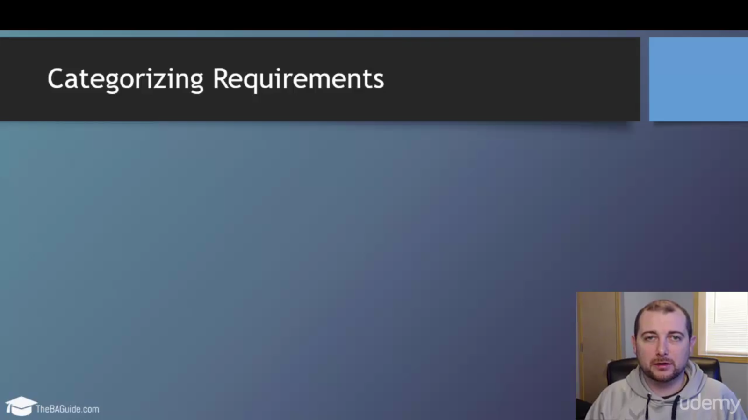

Slide 3
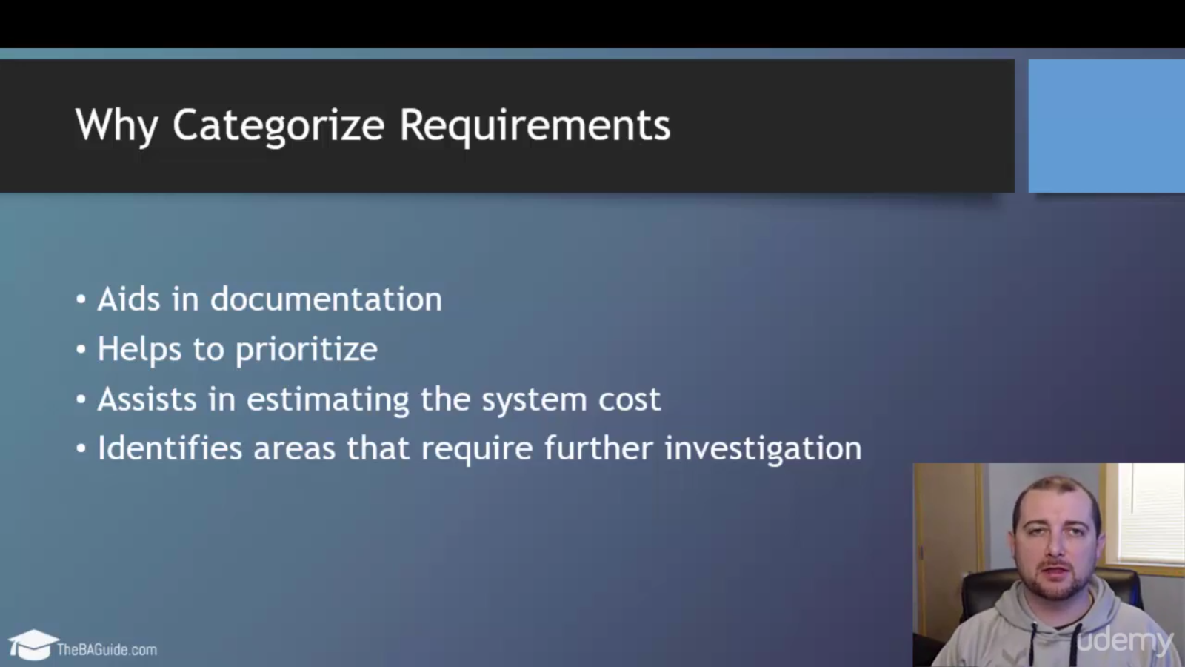

Slide 4
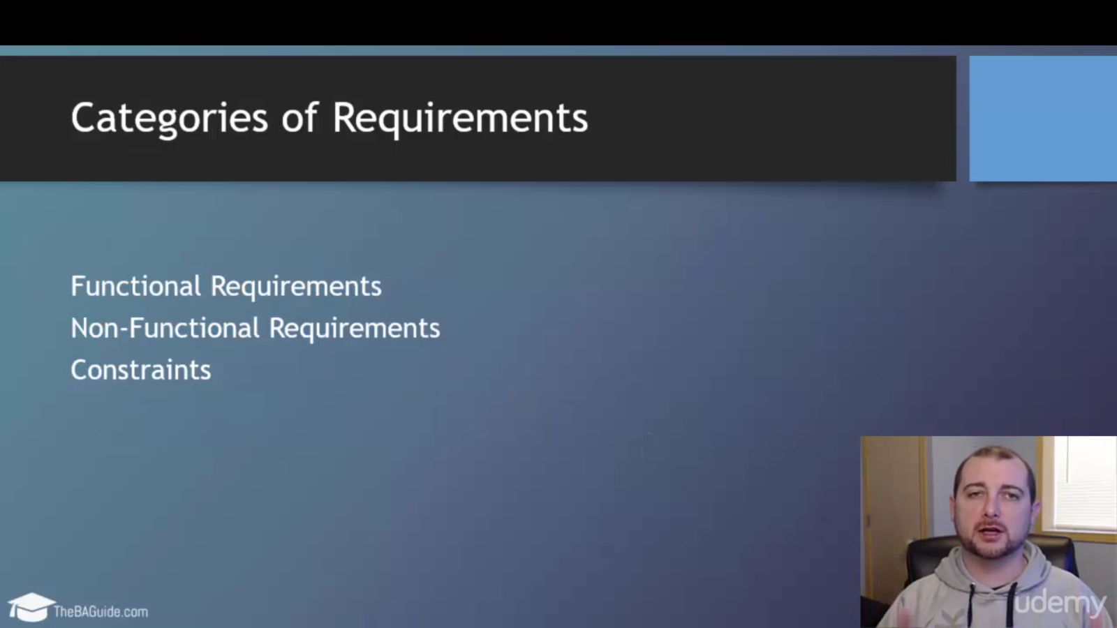

Slide 5
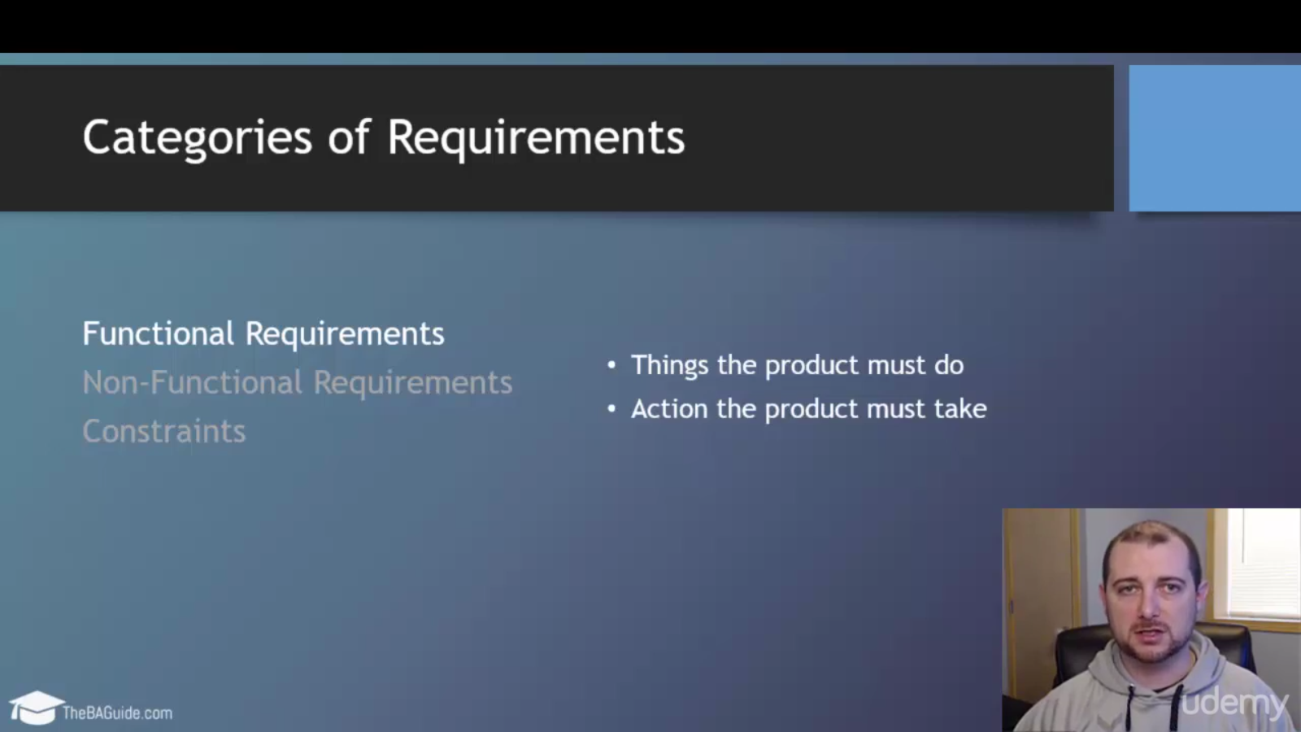

Slide 6
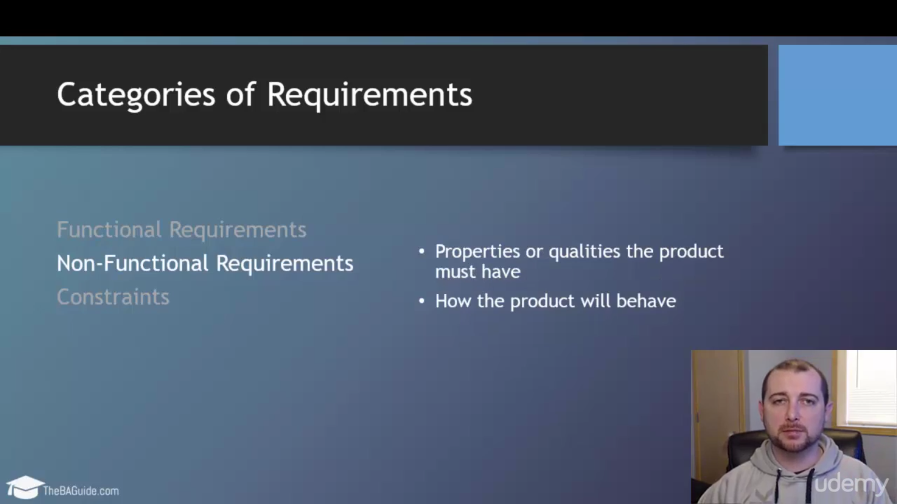

Slide 7
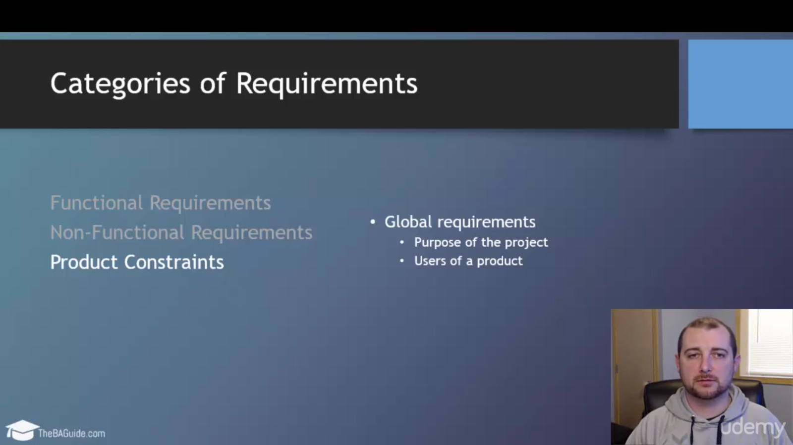

Slide 8
Deriving Requirements

Slide 9
Deriving Requirements
Parsing Requirements
Interpreting Requirements
Focusing Requirements
Qualifying Requirements

Slide 10
Parsing Requirements
Breaking down requirements that are too broad

Slide 11
Parsing Requirements
Original Requirement:
“User-completed fields on tax forms shall be converted to electronic text documents.”
Parsed Requirements:
“The system shall be able to convert handwriting to text.”
“The system shall be able to convert machine print to text.”
“The system shall be able to electronically correct user-completed fields.”

Slide 12
Parsing Requirements
Removing “and” from requirements
Risk is high that only one of the conditions will be tested
Hard to trace the requirement bug/failure

Slide 13
Interpreting Requirements

Slide 14
Interpreting Requirements
Reduce generalness and ambiguity of stated requirements

Slide 15
Interpreting Requirements
Original Requirement:
“Each PC shall have state-of-the-art software installed.”
Interpreted Requirement:
“Each PC shall have Microsoft Office 2013 and Windows 10 installed.”
Parsed Requirements:
“Each PC shall have Microsoft Office 2013 installed.”
“Each PC shall have Windows 10 installed.”

Slide 16
Focusing Requirements
Combine overlapping requirements into one focused requirement

Slide 17
Focusing Requirements
Original Requirements:
“Each PC must have a standard spreadsheet tool installed that runs in Windows.”
Focused Requirement:
“Each PC on the LAN shall have Microsoft Office Excel 2013.”

Slide 18
Qualifying Requirements
Add a requirement to provide a method of verficiation or compliance

Slide 19
Qualifying Requirements
Original Requirement:
“The xxx command must peform the following actions…”
Focused Requirement:
“Each command shall be executed during system testing to demonstrate its functionality.”

Slide 20
Assigning Requirement Attributes

Slide 21
Why Assign Requirement Attributes
Clarification
Filtering
Validation

Slide 22
Typical Attributes
Unique Identifier
Acceptance Criteria
Author
Complexity
Ownership
Performance
Urgency
Business Value
Status
Type
Priority
Source

Slide 23
Typical Attributes
Unique Identifier
Acceptance Criteria
Author
Complexity
Ownership
Performance
Urgency
Business Value
Status
Type
Priority
Source

Slide 24
Prioritizing Requirements

Slide 25
Why Prioritize Requirements
Generally there are too many functions and features to implement within the project schedule and budget.

Slide 26
Prioritization Factors
Value to the business
Value to the customer
Minimize cost to develop
Time to implement
Ease of technical implementation
Ease of business implementation
Obligation to some external authority

Slide 27
3 Step Prioritization Process
Step 1
Define usefulness to business (critical, important, nice to have)
Step 2
Estimate cost (1-5 scale)
Step 3
Determine timeframe (1-5 scale)

Slide 28
Requirement Prioritization Best Practices
Keep it simple
Business value reigns supreme
Remove prioritization away from politics
Prioritize (and re-prioritize) after each project iteration

Slide 29
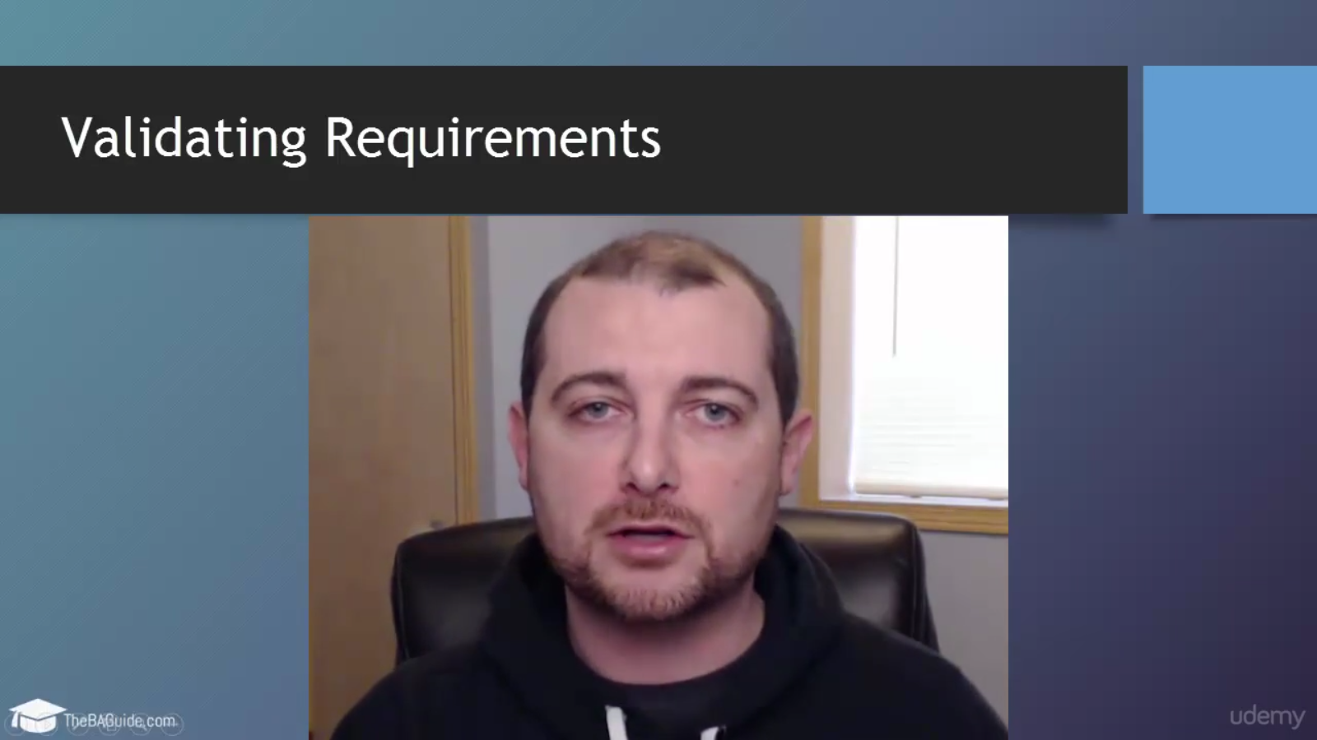

Slide 30
The Business Requirements Document (BRD)

Slide 31

Business Requirement Document (BRD) Basics
What is a Business Requirements Document?
Who prepares it?
What is it used for?
What is the standard format?

Slide 32

BRD Template

