Slide 1
$ ./data_vault --sdg 14
SDG 14 Hudson River Water Quality Database
A relational database for a Hudson River water-monitoring drone
CIT 4350 // Justin Reichelt · Prerit Acharya · Hendrik Vanwingerden · Josiah Maddicks

Slide 2
// 02 context
SDG 14: Life Below Water
› UN Sustainable Development Goal 14 — conserve and sustainably use the oceans, seas, and marine resources
› Focus targets: reduce marine pollution (land-based sources are the primary cause) and reduce ocean acidification
› One of 17 global UN goals — adopted 2015, targeted for 2030
› Our scope: a measurable slice — pollution and acidity in one river
SDG14_hudson.db
02 / 18
Notes:
We picked SDG 14 and scoped it to a measurable slice — pollution and acidity in one river — so a database can actually answer questions about it. Land-based runoff is the UN's named primary source of marine pollution, which is why our site choice matters.

Slide 3
// 03 context
The Problem: Microplastics and Water Quality in the Hudson River
› Microplastics — plastic particles under 5 mm, broken down from larger litter
› Open ocean carries ~13,000 pieces of plastic litter per km²; rivers carry land-based pollution downstream
› Ocean acidification up ~30% since the industrial revolution
› Our site: the tidal Hudson River near Newburgh, NY
SDG14_hudson.db
03 / 18
Notes:
These are big, abstract global numbers. Our project asks what the local picture looks like near Newburgh and whether it mirrors the global trend. Each figure here maps to a question we answer later with SQL.

Slide 4
// 04 context
Our Project: A Water Drone and the Database Behind It
› An autonomous water drone runs a fixed route, stopping every quarter mile to log sensors and collect a water sample
› Two data sources: onboard sensor array (live) and a lab spectrometer (microplastics, polymer type)
› Our deliverable is the relational database that stores and connects all of it
› (Future expansion: stationary buoy sensors for 24/7 monitoring)
DRONE
›
SENSORS + LAB
›
DATABASE
›
QUERIES
SDG14_hudson.db
04 / 18
Notes:
The drone is the story that makes the data concrete, but the database is the actual project — we are designing the schema, not building the drone. Field telemetry and lab results are the two feeds everything else is built around.

Slide 5
// 05 context
Meet the Team and Our Roles
Member | Focus area
Justin Reichelt | Normalization & relationships
Prerit Acharya | Optional relationships & joins
Hendrik Vanwingerden | Data types & constraints
Josiah Maddicks | Requirements & schema design
SDG14_hudson.db
05 / 18
Notes:
Quick hand-off cue — each person presents the part they owned. Keep this to ~15 seconds.

Slide 6
// 06 context
Requirements: What the Drone Needs to Record
REQUIRED BY RUBRIC
› Relational model + DBMS justification
› ≥ 1 one-to-many relationship
› ≥ 1 many-to-many relationship
› Mock-data scripts
› Questions the data answers
CAPTURED BY DESIGN
› Status, GPS, timestamp per reading
› Water chemistry: temp, pH, oxygen,
› turbidity, salinity, flow
› Lab: polymer type + particle count
› Spectrometer absorbance / wavelength
SDG14_hudson.db
06 / 18
Notes:
Frame this as the checklist the rest of the deck answers — every requirement maps to a table or column shown in the design act.

Slide 7
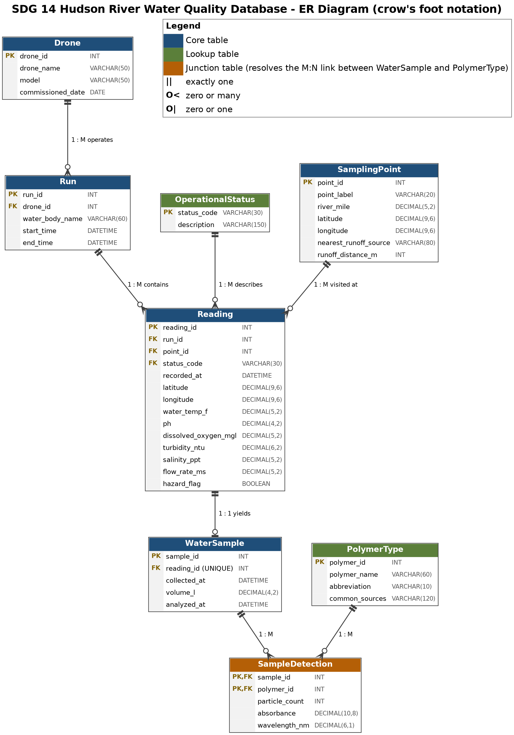
// 07 design
Entity-Relationship Diagram
Eight tables
4 reference / lookup: Drone, OperationalStatus,
SamplingPoint, PolymerType
3 core: Run, Reading, WaterSample
1 junction: SampleDetection
Spine: Drone → Run → Reading (1:M)
M:N: WaterSample ↔ PolymerType
SDG14_hudson.db
07 / 18
Notes:
This one diagram is the whole design. The next two slides zoom into the field half and the lab half. Crow's-foot notation; color-coded core / lookup / junction (see legend).

Slide 8
// 08 design
Field Data: Drone, Run, Sampling Point, and Reading
› Drone → Run one drone, many runs; a run is one trip along the route
› SamplingPoint fixed stops every quarter mile, with runoff source + distance
› Reading one sensor snapshot at one stop on one run — the center of the model
› Reading links to Run, SamplingPoint, and OperationalStatus
› UNIQUE (run_id, point_id) → one reading per stop per run
SDG14_hudson.db
08 / 18
Notes:
Reading is where every field measurement lands; everything else in this half exists to give a Reading its context — which drone, which trip, which stop, what status.

Slide 9
// 09 design
Lab Data: Water Sample, Polymer Type, and Sample Detection
› WaterSample one bottle per Reading (1:1, optional — a reading may have no sample)
› PolymerType lookup of plastics the lab can identify: PE, PP, PET, PS, PVC
› SampleDetection junction: particle_count, absorbance, wavelength_nm
› Composite PK (sample_id, polymer_id) → each plastic logged at most once per sample
SDG14_hudson.db
09 / 18
Notes:
Field and lab are split because a reading is instant but the bottle may sit unanalyzed for days — keeping them separate avoids a wide table full of empty lab columns.

Slide 10
// 10 design
Data Types and Constraints
Column | Type | Rule
ph | DECIMAL(4,2) | CHECK 0–14
dissolved_oxygen_mgl | DECIMAL(5,2) | CHECK ≥ 0
water_temp_f | DECIMAL(5,2) | CHECK 32–100
status_code | VARCHAR(30) | FK → OperationalStatus
hazard_flag | BOOLEAN | default FALSE
DECIMAL not FLOAT → measurements stored exactly. NULL = sensor failed, never a made-up number.
SDG14_hudson.db
10 / 18
Notes:
The constraints are the design doing the data-quality work for us — bad values are rejected at insert, not cleaned up later. Lookup tables also stop typos from creating false categories.

Slide 11
// 11 design
Relationships: One-to-One, One-to-Many, and Many-to-Many
1 : 1
Reading ↔ WaterSample
one bottle per reading (UNIQUE reading_id); optional
1 : M
Run → Reading
one run, many readings — also Drone→Run, SamplingPoint→Reading
M : N
WaterSample ↔ PolymerType
resolved by the SampleDetection junction table
SDG14_hudson.db
11 / 18
Notes:
Relational databases can't store M:N directly — the junction table is how we model 'one sample has many plastics, each plastic appears in many samples' without duplicating data. The rubric requires at least one 1:M and one M:N.

Slide 12
// 12 design
Normalization: 1NF, 2NF, and 3NF
›
›
1NF
Every column holds one value — a Reading stores one pH, one turbidity
2NF
Non-key attributes depend on the whole key — matters for SampleDetection's composite key
3NF
Descriptive facts pulled into lookup tables, stored once and referenced by ID
Result: no redundancy, no update anomalies — we started with one flat table and split it into eight.
SDG14_hudson.db
12 / 18
Notes:
We started with all data in one giant flat table; normalization is the story of splitting it into eight so facts don't drift out of sync.

Slide 13
// 13 design
Data Dictionary
Table | Type | One row represents
Drone, Run, SamplingPoint, Reading | Core | field capture
WaterSample | Core | one collected bottle
OperationalStatus, PolymerType | Lookup | one allowed value
SampleDetection | Junction | one plastic found in one sample
Full dictionary lives in documents/Data_Dictionary.md — on the slide, show the shape + one table (Reading) in depth.
SDG14_hudson.db
13 / 18
Notes:
Don't dump the whole dictionary. Show the 'tables at a glance' summary, then the Reading table's columns as the worked example (PK, three FKs, the sensor columns with types and CHECK rules).

Slide 14
// 14 design
Mock Data and Sample Queries
1
drone
2
runs
8
points
16
readings
15
samples
75
detections
-- Q5: pollution near runoff vs away
SELECT CASE WHEN sp.runoff_distance_m <= 500
THEN 'Near runoff' ELSE 'Away' END AS location_group,
ROUND(AVG(x.particles_per_l),1) AS avg_particles_per_l,
ROUND(AVG(r.turbidity_ntu),1) AS avg_turbidity,
ROUND(AVG(r.dissolved_oxygen_mgl),2) AS avg_do
FROM ( ... ) x JOIN Reading r JOIN SamplingPoint sp
GROUP BY location_group;
Run the scripts for live numbers — near-runoff points show more plastic, higher turbidity, lower oxygen.
SDG14_hudson.db
14 / 18
Notes:
This is where the design pays off — the questions from slide 3 become SQL. The near-vs-away result is the headline finding (association, not proof of cause). Also worth showing Q2, dominant polymers, as the many-to-many payoff. Don't hand-type results; run the scripts.

Slide 15
// 15 design
Progress: What We've Completed
DONE
✓ ER diagram
✓ Schema (DDL)
✓ Mock data
✓ Queries
✓ Data dictionary
REMAINING
○ Indexes
○ Normalization write-up
○ Project definition
○ DBMS justification
SDG14_hudson.db
15 / 18
Notes:
The design and data are done and runnable end-to-end; what's left is documentation and tuning, not redesign.

Slide 16
// 16 progress
What Remains: Indexes, Project Definition, and DBMS Justification
Indexes
Add supporting indexes (e.g. idx_reading_do) for the filter/join queries
Project definition
Finalize the one-paragraph project statement for submission
DBMS justification
Why MySQL 8: enforces CHECK, strong FK integrity, free & widely taught
Normalization write-up is drafted (normalization.md) — fold it into the final docs.
SDG14_hudson.db
16 / 18
Notes:
These are concrete, scoped to-dos — name who takes each and the target date. SQLite and PostgreSQL are the alternatives considered for the DBMS justification.

Slide 17
// 17 progress
Challenges and How We Addressed Them
Challenge | How we addressed it
One giant flat table was ambiguous | Split into eight tables with clear keys + a junction
Choosing realistic data types | DECIMAL for exact values; CHECK ranges to bound them
Location is omnidirectional on water | Store exact GPS coordinates per reading
Field vs lab data arrive at different times | Split Reading / WaterSample 1:1
SDG14_hudson.db
17 / 18
Notes:
These came from real team discussion and peer feedback — each one changed the schema shown in the design act. GitHub and team-coordination learning curves are optional extras if time allows.

Slide 18
// 18 wrap_up
> Questions?_
github.com/Arktikstorm/CIT-4350-Data-Vault
SDG14_hudson.db
18 / 18

