Slide 1
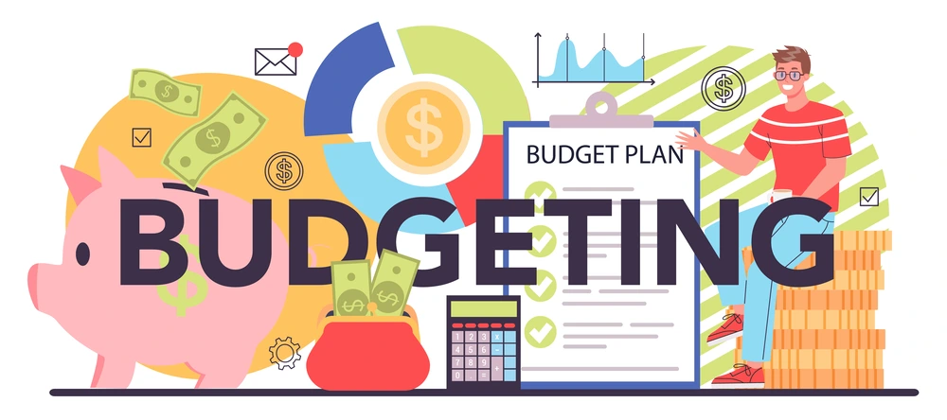

Slide 2
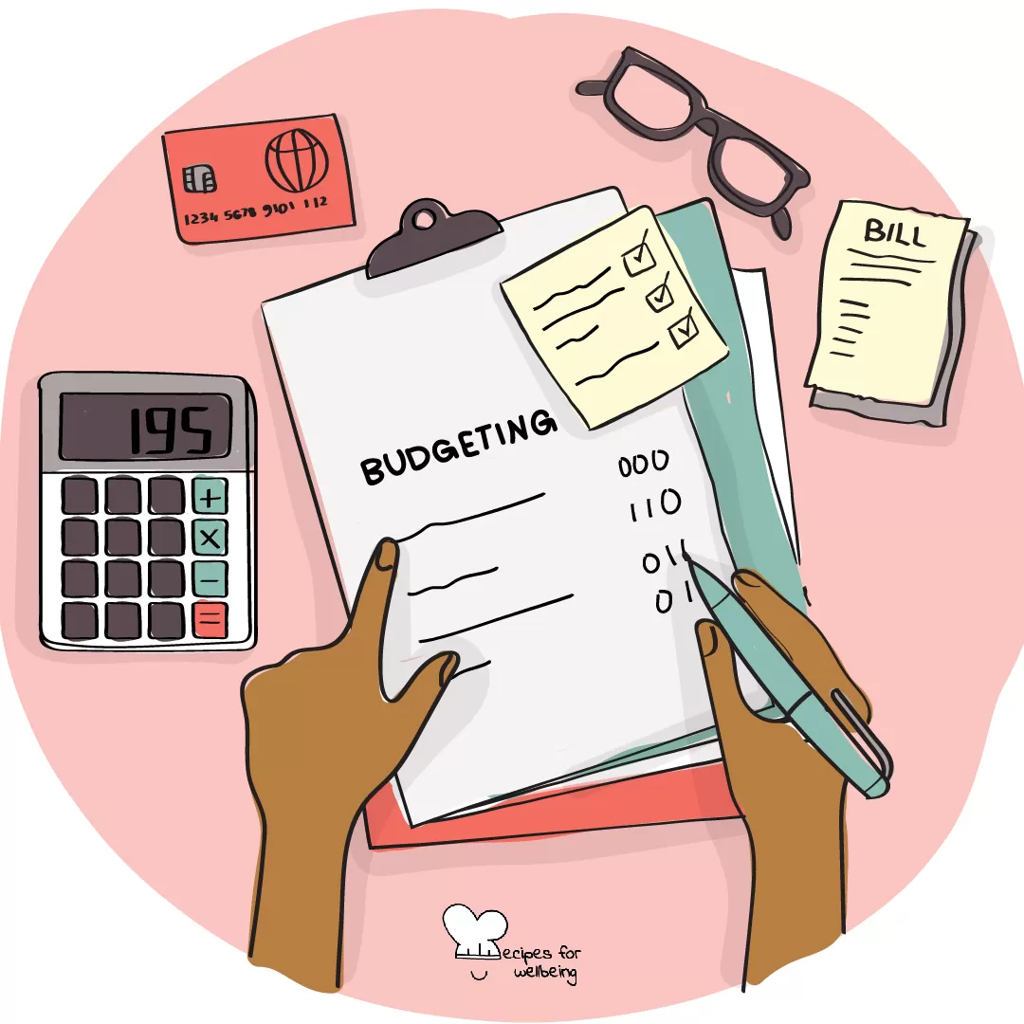
Budgeting is the process of planning how to spend your money. It helps you manage your income, expenses, savings, and investments to achieve your financial goals. Think of it as creating a roadmap for your money to ensure you don’t spend more than you earn.

Slide 3
WHY IS IT IMPORTANT?
Helps Control Spending: You’ll know exactly how much you can spend without running out of money.
Saves Money: Helps you put money aside for big goals like buying a car, traveling, or an emergency fund.
Reduces Stress: You won’t worry about unexpected bills because you’ll be prepared.
Builds Good Habits: Encourages smart money habits like saving regularly.

Slide 4

HOW TO CREATE A BUDGET
Step 1: Track Your Income
Write down all the money you receive each month.
Example: ₹30,000 from your job + ₹5,000 from a side hustle = ₹35,000 total income.

Slide 5
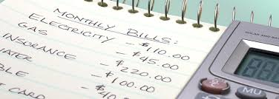
Step 2: List Your Expenses
Write down everything you spend money on in a month.
Don’t forget irregular expenses like insurance, birthday gifts, or yearly subscriptions.

Slide 6
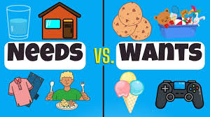
Step 3: Categorize Your Expenses
Needs (Essentials): Rent, groceries, utilities, transportation.
Wants (Non-Essentials): Movies, shopping, dining out.
Savings/Debt: Emergency fund, retirement savings, loan payments.

Slide 7

Step 4: Set Spending Limits
Decide how much you’ll spend in each category.
Example: If your rent is ₹10,000, you might budget ₹4,000 for groceries, ₹2,000 for transport, and ₹3,000 for savings.

Slide 8

Step 5: Adjust as Needed
If you’re spending too much on shopping, reduce that to save more.
Budgeting isn’t a one-time thing—you’ll adjust it as your income or expenses change.

Slide 9
SIMPLE BUDGETING METHODS
1. 50/30/20 Rule (Easy & Effective)
50% of your income for Needs: Rent, food, bills.
30% for Wants: Entertainment, hobbies, shopping.
20% for Savings & Debt Repayment: Emergency fund, investments, paying off loans.

Slide 10

Example:
Income = ₹30,000
Needs = ₹15,000 (rent, food)
Wants = ₹9,000 (movies, shopping)
Savings = ₹6,000 (investment, emergency fund)

Slide 11
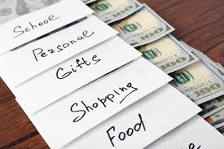
Envelope System (For Cash Users)
Use envelopes for different spending categories: groceries, entertainment, transport, etc.
Once the money in an envelope is gone, you can’t spend more in that category.

Slide 12

BENEFITS
Saves money for emergencies.
Helps pay off debt faster.
Makes financial goals achievable (like buying a car, house, or going on vacation).
Improves financial awareness.

Slide 13
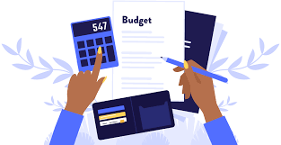
COMMON MISTAKES TO AVOID
Not tracking small expenses (like coffee or snacks).
Being too strict—don’t cut out fun completely; budget for enjoyment too!
Ignoring irregular expenses (like annual insurance payments).
Not reviewing the budget regularly.

