Slide 1
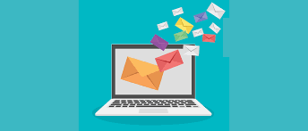
EMAILS

Slide 2

An email (short for electronic mail) is a way of sending and receiving messages over the internet. Instead of using paper and a mailbox, you use your computer, phone, or tablet to send a message through an email account (like Gmail, Yahoo, or Outlook).
Think of it like sending a letter, but much faster and using the internet!

Slide 3
BASIC PARTS OF AN EMAIL
To (Recipient):
This is where you write the email address of the person you want to send your message to.
Example: john@example.com.
Subject:
The subject is the title or heading of your email. It tells the person what your email is about.
Example: Homework Update or Meeting at 3 PM

Slide 4
3. Body:
The body is the main message of your email. This is where you write what you want to say.
Example: Hi John, I hope you're doing well. I wanted to remind you about the homework assignment due tomorrow.
4.Attachments:
These are files you can attach to your email, like photos, documents, or videos.
Example: If you want to send a picture, you can click on an attachment button (usually looks like a paperclip) and choose the file from your computer.

Slide 5
5. Sender:
This is your email address, and it shows up at the top or bottom of the email so the person knows who sent it.
Example: youremail@example.com

Slide 6
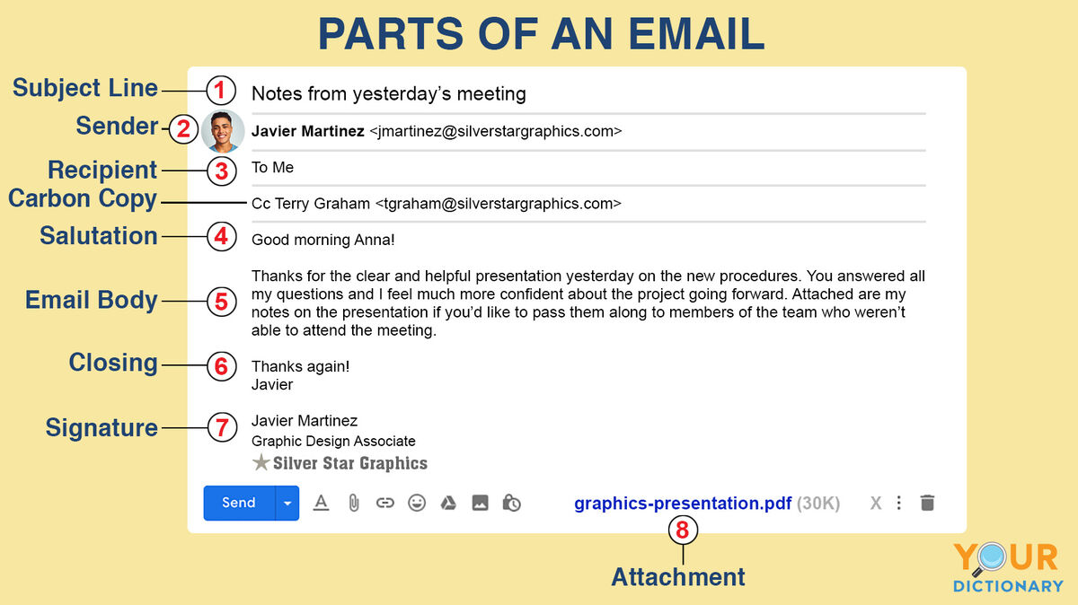

Slide 7
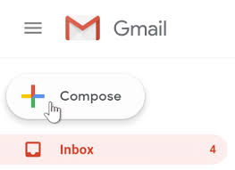
HOW TO SEND AN EMAIL?
Open Your Email App or Website:
If you use Gmail, Outlook, Yahoo, or another email service, open the app or website.
Click "Compose" or "New Email":
Look for a button that says “Compose,” “New Email,” or something similar. This is where you can start writing your email.

Slide 8
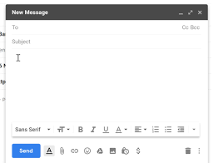
Enter the Recipient’s Email Address:
In the To field, type the email address of the person you’re sending the email to. Make sure you type it correctly!
Write the Subject:
In the Subject field, write a short description of what the email is about.

Slide 9
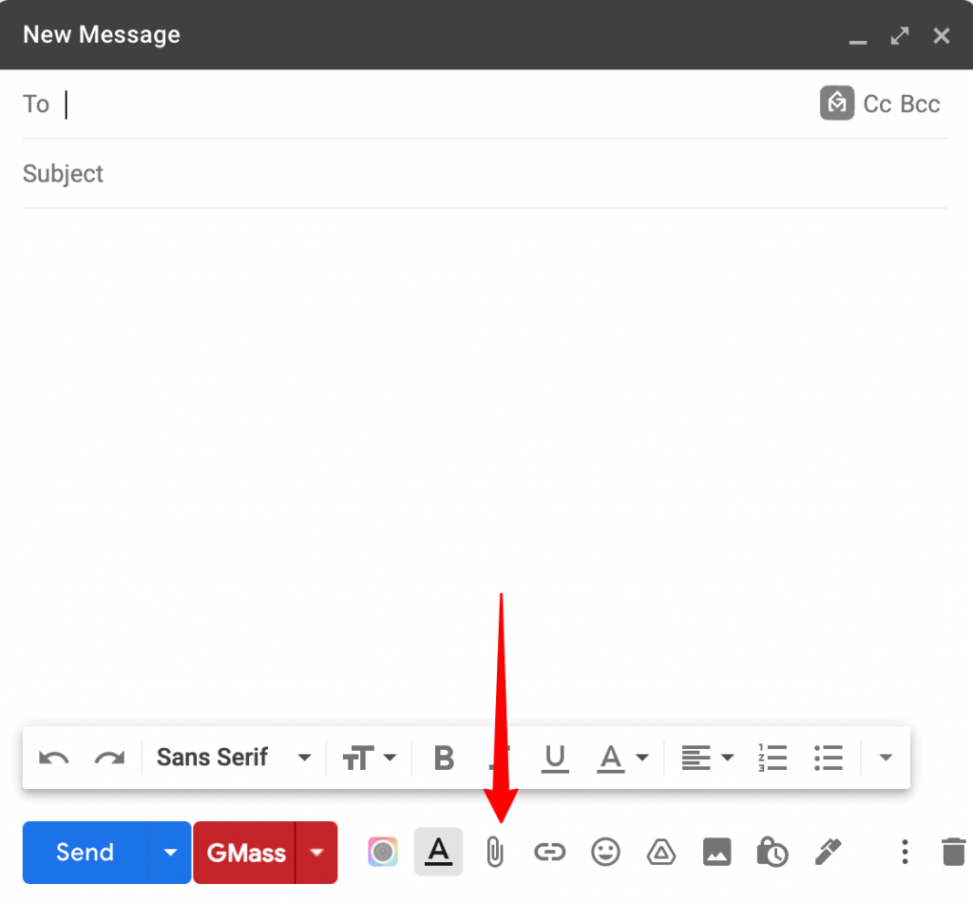
Write the Message:
In the body of the email, type your message. Be clear and friendly!
Add Attachments (Optional):
If you need to attach files (like a photo or a document), click the paperclip icon or an Attach File button, choose the file from your computer, and attach it.

Slide 10
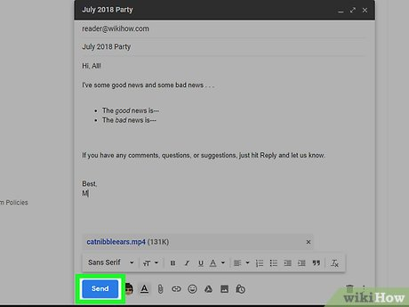
Click "Send":
Once you’ve written everything and double-checked it, hit “Send.” Your email will go straight to the recipient’s inbox!

Slide 11
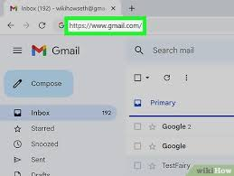
HOW TO RECEIVE AND READ EMAIL:
Open Your Email App:
Just like you opened it to send an email, open your email app or website to check your new emails.
Look in the Inbox:
Your new emails will be in the Inbox. The newest ones are usually at the top.

Slide 12
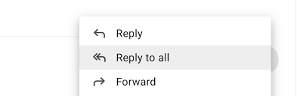
Click on the Email:
Click on the email to open it and read the message.
Replying to an Email:
If you want to respond to an email, there’s usually a Reply button. This lets you write a response and send it back to the person.

Slide 13
IMPORTANT EMAIL TERMS
Inbox:
The place where you receive emails. Think of it as your mailbox on the internet.
Outbox:
This is where your email goes before it is actually sent. It’s like a waiting area.

Slide 14
Spam/Junk:
Sometimes you might get emails you don’t want, like advertisements. These go into your Spam or Junk folder.
BCC (Blind Carbon Copy):
This is used when you want to send the same email to many people without them knowing who else you sent it to. The people in BCC won’t see the other people’s email addresses.
CC (Carbon Copy):
If you put someone’s email in CC, that person will receive a copy of your email, and everyone else can see that they received it too.

Slide 15
