Slide 1
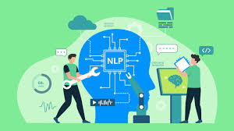
NATURAL LANGUAGE PROCESSING

Slide 2

NLP (Natural Language Processing) is a field of artificial intelligence that helps computers understand, interpret, and respond to human language, like how we speak or write.
Basically, The software can figure out what people are saying (like if they’re happy, frustrated, or asking for help) and give a response quickly, without needing a person to read each message.

Slide 3

IMPORTANCE
Natural Language Processing (NLP) is important because it helps computers understand and work with human language, which can be tricky because we use slang, different dialects, and sometimes don't follow strict grammar rules. NLP helps computers make sense of all this and respond in a meaningful way.

Slide 4
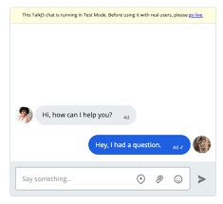

USES
1.Processing and analyzing large documents: Instead of reading long reports or contracts manually, NLP can automatically go through them and find important information.
2.Analyzing customer feedback: NLP can look at reviews, surveys, or customer calls to figure out if customers are happy or upset.
3.Running chatbots: Chatbots use NLP to automatically answer common customer questions without needing a human to respond.

Slide 5

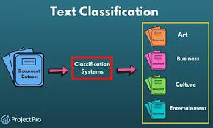
Answering questions: NLP can help systems quickly answer questions like "Who is in charge?" or "When is the meeting?"
Classifying and extracting text: It helps organize and pull useful information from large amounts of text.

Slide 6

USES OF NLP IN BUSINESS
Sensitive data redaction: In industries like insurance, healthcare, or law, there are many private documents with sensitive information. NLP helps automatically hide or remove this sensitive data (like names or addresses) to keep it safe. For example, insurance companies can use NLP to extract important details from documents without revealing personal information.

Slide 7

Customer engagement:
NLP helps businesses use chatbots and voice bots to talk to customers more naturally. For instance, T-Mobile uses NLP to understand what customers are saying in text messages and give them tailored recommendations. This helps businesses handle more customer inquiries without needing more human agents.

Slide 8

Business analytics:
Companies use NLP to understand how customers feel about their products or services by analyzing reviews or feedback. For example, marketers can use NLP to find out if people are saying positive or negative things about a company, helping them improve their products. Some businesses use NLP to analyze phone calls and learn what customers are talking about so they can improve their services.

Slide 9
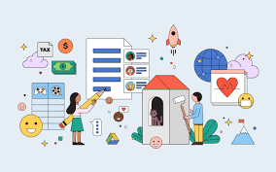
COMMON APPROACHES TO NLP
Supervised NLP
In supervised NLP, the software is trained with a set of data where we already know the right answers. It learns from this data so it can give the correct answer when faced with new, unknown information.
Example: Imagine you have a bunch of documents, and you want to categorize them into different groups (like "reports" or "emails"). The software is trained with documents that are already labeled. It learns how to categorize them correctly and can then label new documents by itself.

Slide 10
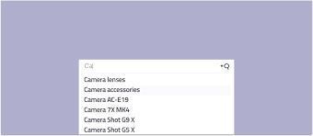
Unsupervised NLP
In unsupervised NLP, the software is given data without labels and has to figure out the patterns on its own. It doesn't know what the correct output is, but it looks for trends in the data.
Example: Think of the autocomplete feature on your phone. It suggests the next word while you type based on the patterns it has learned from your past messages, without needing labels to tell it what comes next.

Slide 11

Natural Language Understanding (NLU)
Natural Language Understanding (NLU) is about teaching the software to understand the meaning behind what people say. It focuses on figuring out things like what words really mean, even if the sentence structure is different.
Example: If someone says "I’m feeling blue," the software should understand that this means the person is feeling sad, even though "blue" usually refers to a color. NLU helps the software understand these meanings and handle sentences with different wording but the same meaning.

Slide 12

Natural Language Generation (NLG)
Natural Language Generation (NLG) is about making the software create text that sounds like it was written or spoken by a person. The software takes certain information, like keywords or topics, and generates sentences or replies.
Example: An intelligent chatbot that can talk to customers like a real person uses NLG. It creates responses based on the conversation, so it feels natural, just like talking to a customer support agent.

