Slide 1

UNIQUE DISABILITY ID

Slide 2
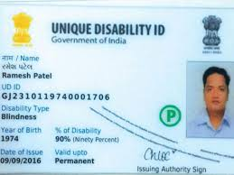
​The Unique Disability ID (UDID) is a government initiative in India aimed at providing a unique identification number to every person with disabilities (PwD). This initiative seeks to create a national database of PwDs, ensuring they can easily access various government schemes and benefits.​

Slide 3
OBJECTIVES
National Database Creation: Establish a comprehensive database of PwDs, capturing their socio-economic and disability details. ​
Simplified Access: Enable PwDs to obtain disability certificates and UDID cards through a streamlined online process.​
Benefit Accessibility: Ensure PwDs can effortlessly access government schemes and benefits using their UDID cards.​

Slide 4
BENEFITS
Single Identification Document: The UDID card serves as the sole document for identification and verification of disability status, eliminating the need for multiple documents.​
Ease of Access to Services: Simplifies the process of availing various government services and benefits tailored for PwDs.​
Transparency and Efficiency: Enhances transparency and efficiency in delivering government benefits to PwDs

Slide 5
Application Process for UDID:
Online Registration:
Visit the official UDID portal:​
Click on "Register" and fill in personal details, including disability information.​
Upload necessary documents such as a recent photograph, identity proof, address proof, and disability certificate (if available).​BankBazaar
Submit the application online.​

Slide 6
Application Processing:
The application is forwarded to the designated medical authority for verification.
The medical authority assesses the disability and determines the disability percentage.​india.gov.in
Upon successful verification, a UDID card is generated.​

Slide 7
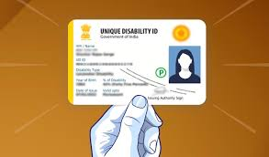
Card Issuance:
The UDID card is dispatched to the applicant's registered address.​
Applicants can also download an electronic version (e-UDID) from the portal

