Slide 1
MINI PROJET
NSI 2023
ENON Loïs
DIDRY Jules
TG5

Slide 2
TRIAD
Here’s what you’ll find in this Slidesgo template:
A slide structure based on a consulting sales pitch, which you can easily adapt to your needs. For more info on how to edit the template, please visit Slidesgo School or read our FAQs.
An assortment of illustrations that are suitable for use in the presentation can be found in the alternative resources slide.
A thanks slide, which you must keep so that proper credits for our design are given.
A resources slide, where you’ll find links to all the elements used in the template.
Instructions for use.
Final slides with:
The fonts and colors used in the template.
More infographic resources, whose size and color can be edited.
Sets of customizable icons of the following themes: general, business, avatar, creative process, education, help & support, medical, nature, performing arts, SEO & marketing, and teamwork.
You can delete this slide when you’re done editing the presentation.

Slide 3
TABLE OF CONTENTS
01
02
03
PROBLEM & SOLUTION
OUR PROCESS
TARGET
Here you could describe the topic of the section
Here you could describe the topic of the section
Here you could describe the topic of the section

Slide 4
OUR COMPANY
Mercury is the closest planet to the Sun and the smallest one in the Solar System—it’s only a bit larger than the Moon. The planet’s name has nothing to do with the liquid metal

Slide 5
UNDERSTANDING THE PROBLEM
MARS
VENUS
Despite being red, Mars is a cold place. It’s full of iron oxide dust, which gives the planet its reddish cast
Venus has a beautiful name and is the second planet from the Sun. It’s terribly hot, even hotter than Mercury

Slide 6
OUR SOLUTIONS
MARS
NEPTUNE
JUPITER
SATURN
Despite being red, Mars is a cold place
It’s the farthest planet from the Sun
It’s the biggest planet in the Solar System
Saturn is the ringed one and a gas giant

Slide 7
MAIN COMPETITORS
NEPTUNE
MARS
VENUS
SATURN
It’s the farthest planet from the Sun
Despite being red, Mars is a cold place
Venus is the second planet from the Sun
It’s composed mostly of hydrogen and helium

Slide 8
COMPANY
01
You could enter a subtitle here if you need it

Slide 9
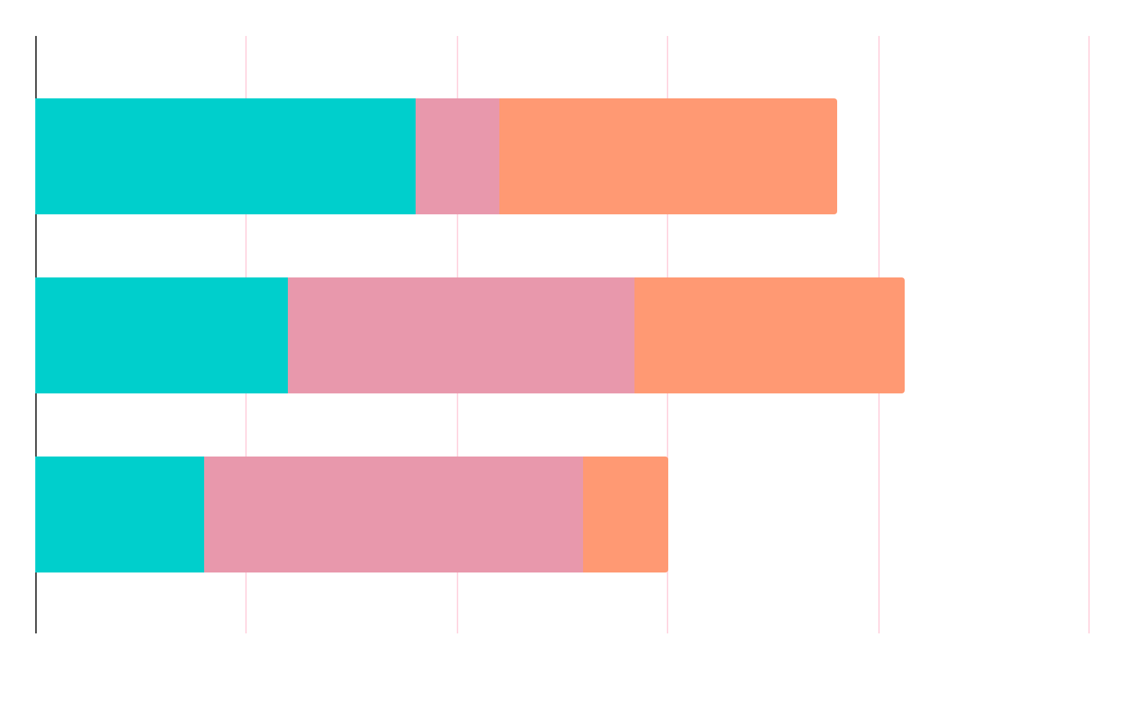
MARKET RESEARCH
NEPTUNE
MERCURY
SATURN
It’s the farthest planet from the Sun
Mercury is the closest planet to the Sun
Saturn is composed of hydrogen and helium

Slide 10
ANALYSIS
OUTREACH
TOP RATED VALUES
30%
80%
50%
Mars
Mercury
Saturn
Neptune
Venus

Slide 11
TARGET
GENDER
AGE
20-39
80%
40-60
50%
75%
Female
500,000+
Employees
60%
Male

Slide 12

A Picture Is Worth a Thousand Words

Slide 13
AWESOME WORDS

Slide 14
OUR PROCESS
MARS
SATURN
DAY 02
DAY 04
DAY 01
DAY 03
JUPITER
NEPTUNE
Despite being red, Mars is a cold place
Saturn is composed of hydrogen and helium
It’s the biggest planet in the Solar System
It’s the farthest planet from the Sun

Slide 15


OUR CONSULTANTS
HELENA PATTERSON
JANE DOE
You can replace the image on the screen with your own
You can replace the image on the screen with your own

Slide 16
—SOMEONE FAMOUS
“This is a quote. Words full of wisdom that someone important said and can make the reader get inspired.”

Slide 17
OUR PARTNERS
VENUS
MARS
SATURN
MERCURY
Venus has an extremely poisonous atmosphere
Despite being red, Mars is actually a cold place
Saturn is composed mostly of hydrogen and helium
Mercury is the closest planet to the Sun

Slide 18
TESTIMONIALS
—RYAN DIXON
—ALIYA FARLEY
—HENRY McKANE
—BILLY BROOKS
—LUCY JADE
—ROSE CLARK
“Mercury is the closest planet to the Sun and the smallest of them all”
“Venus has a beautiful name and is the second planet from the Sun”
“Jupiter is a gas giant and the biggest planet in the Solar System”
“Saturn is composed mostly of hydrogen and helium”
“The Sun is the star at the center of the Solar System”
“Neptune is the fourth-largest planet in the Solar System”

Slide 19
4,498,300,000
Big numbers catch your audience’s attention

Slide 20
AWARDS
 | DATE | REASON | DESCRIPTION
MERCURY | 2010 | Jupiter | It’s the closest planet to the Sun and the smallest one
MARS | 2012 | Neptune | Despite being red, Mars is actually a cold place
VENUS | 2016 | Saturn | It has a nice name and is the second planet from the Sun

Slide 21
UPCOMING GOALS
JUPITER
SATURN
NEPTUNE
JUNE 2
OCTOBER 14
JANUARY 23
It’s the biggest planet in the Solar System
Saturn is composed mostly of hydrogen and helium
Neptune is the farthest planet from the Sun

Slide 22
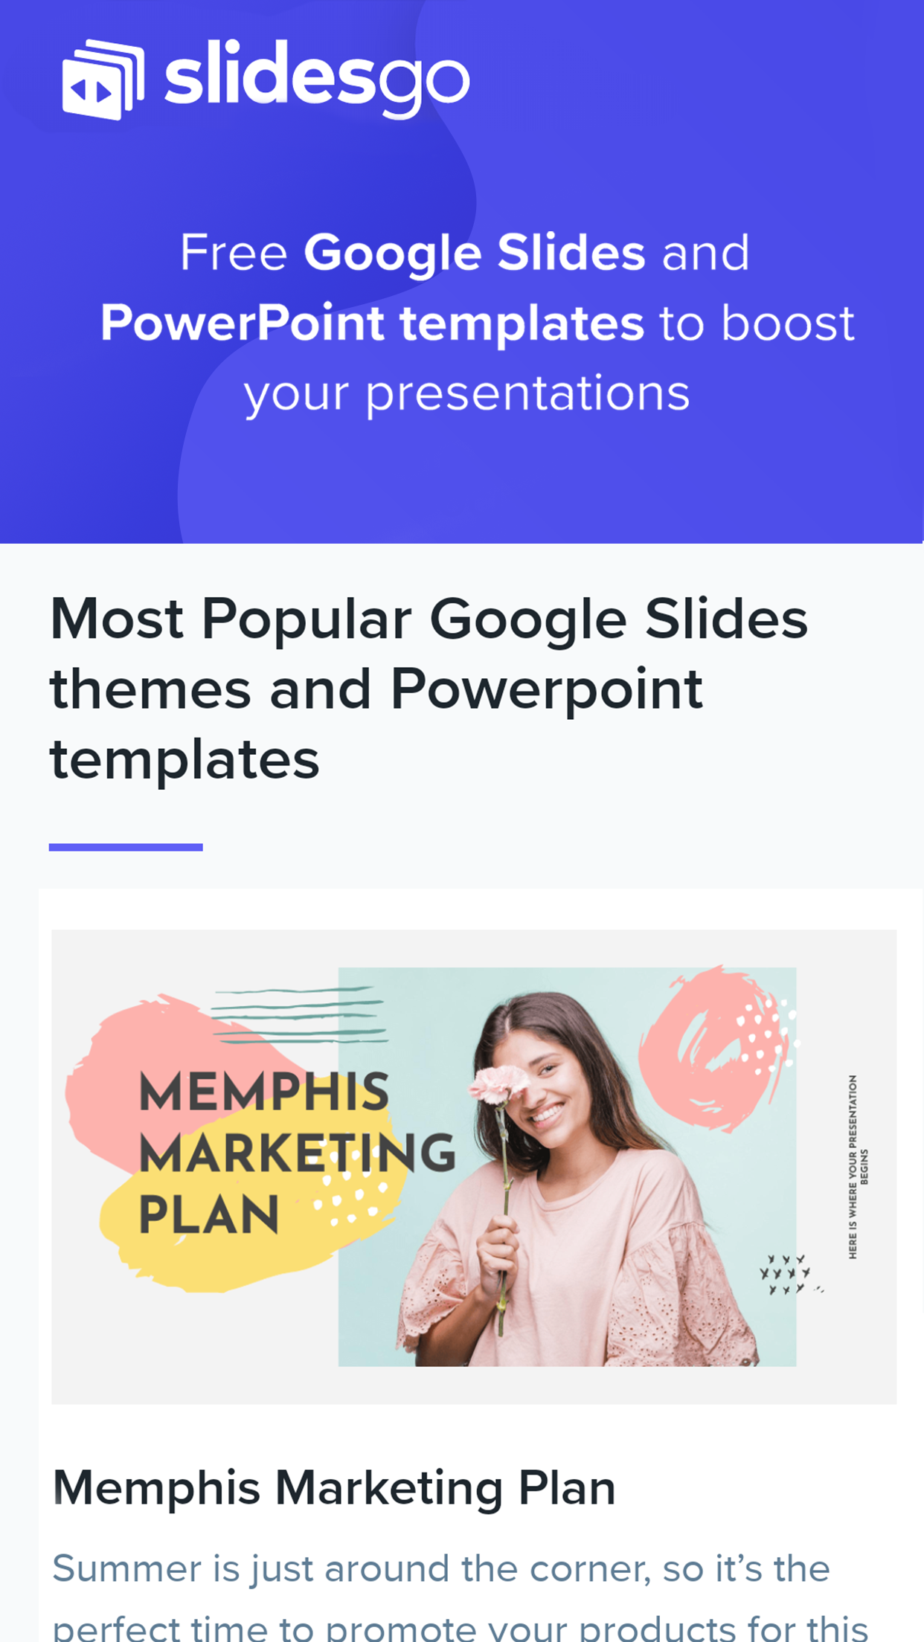
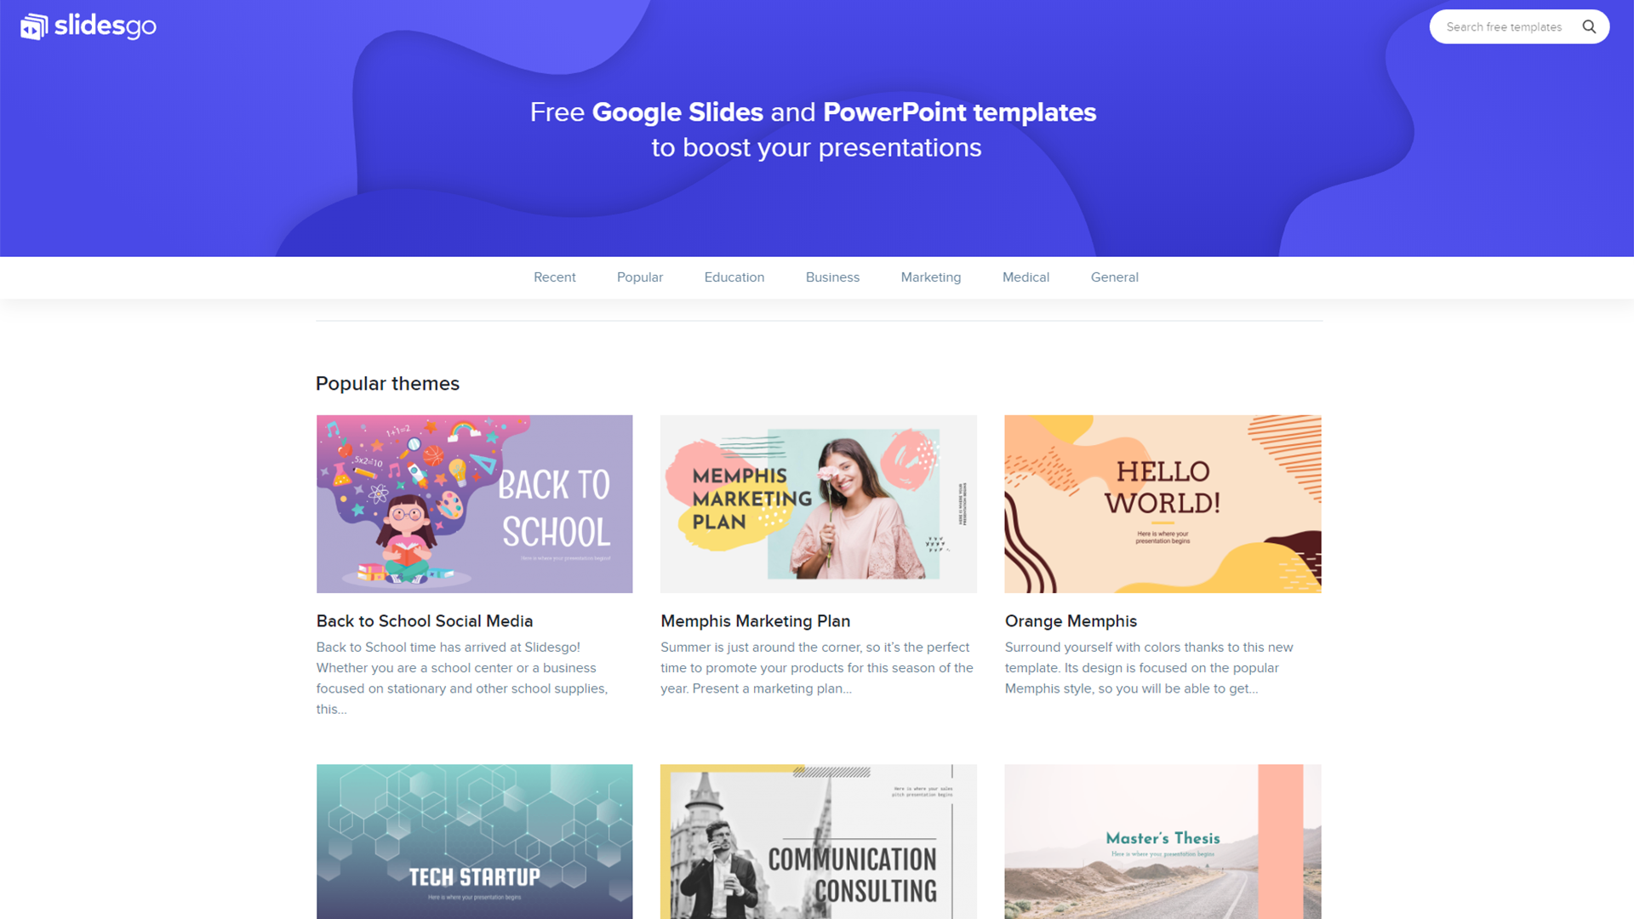
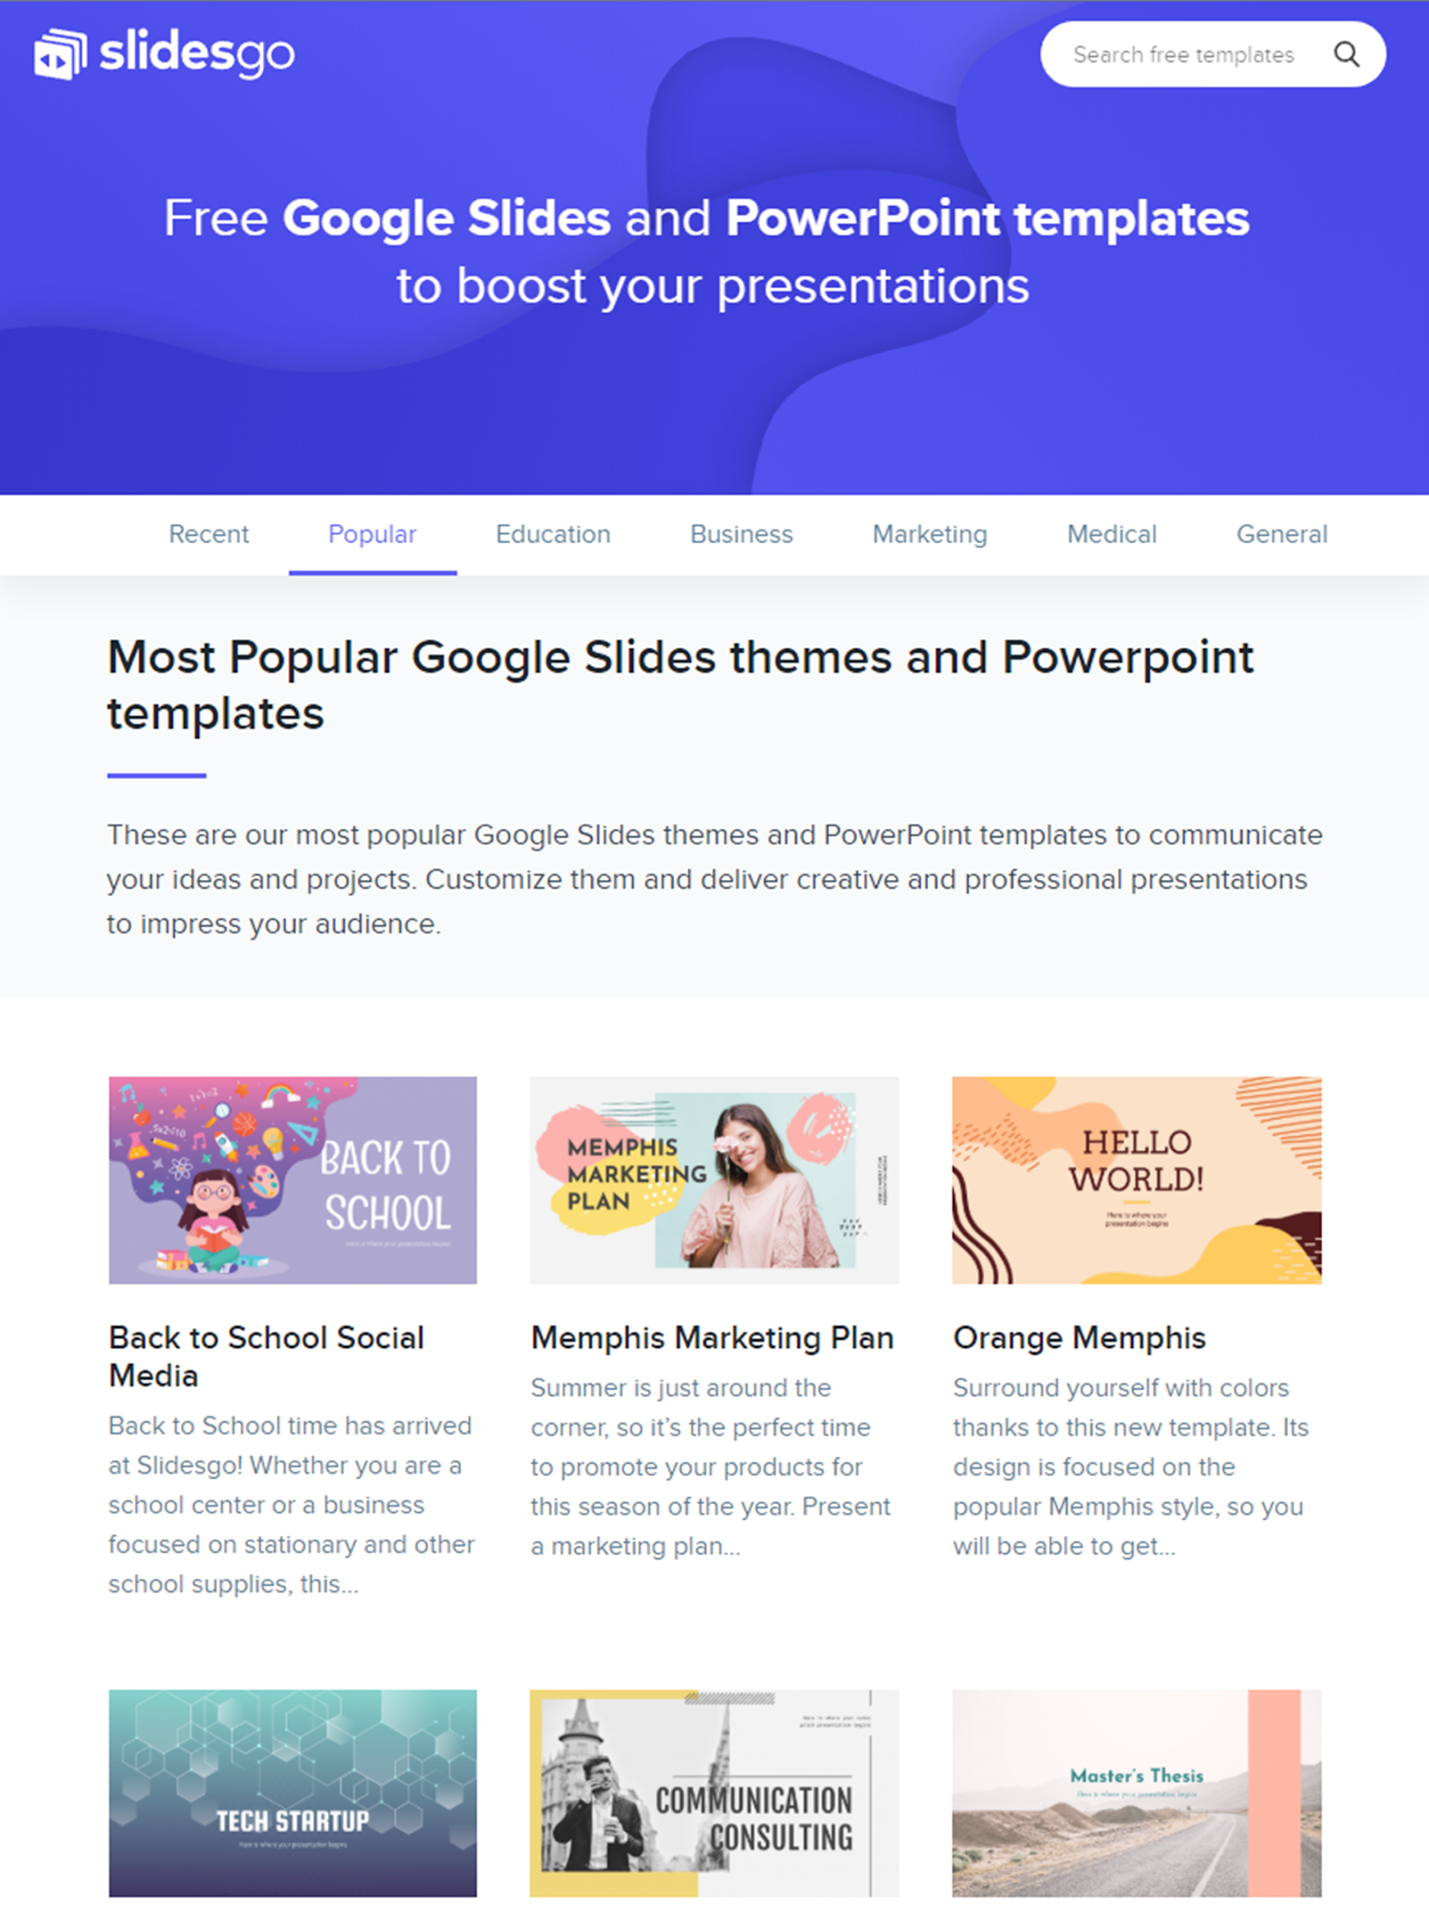
SNEAK PEEK
You can replace the images on these screens with your own work

Slide 23
THANKS
Do you have any questions?
youremail@freepik.com
+91 620 421 83
yourcompany.com
Please keep this slide for attribution

Slide 24
ALTERNATIVE RESOURCES

Slide 25
RESOURCES
Did you like the resources on this template? Get them for free at our other websites.
VECTORS
Abstract pixel rain blue background
Dashboard element collection
Red and blue neon fingerprint background
Dashboard element collection template
PHOTOS
Female colleagues discussing work at office
Close-up confident adult woman posing
Portrait of beautiful adult woman smiling

Slide 26
Fonts & colors used
This presentation has been made using the following fonts:
Share Tech
(https://fonts.google.com/specimen/Share+Tech)
Maven Pro
(https://fonts.google.com/specimen/Maven+Pro)
#1a5e8f
#ffffff
#002845
#ffd6e1
#e898ac
#00cfcc
#ff9973
#f64975
#5efffd
#fc723f

