Slide 1
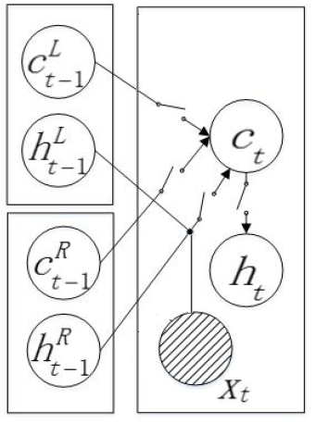





c_{t}
h_{t}
$${\vec{x}}_{t}$$
$$c_{t−1}^{L}$$
$$h_{t−1}^{L}$$
$$c_{t−1}^{R}$$
$$h_{t−1}^{R}$$
c_{t}
c_{t}

Slide 2
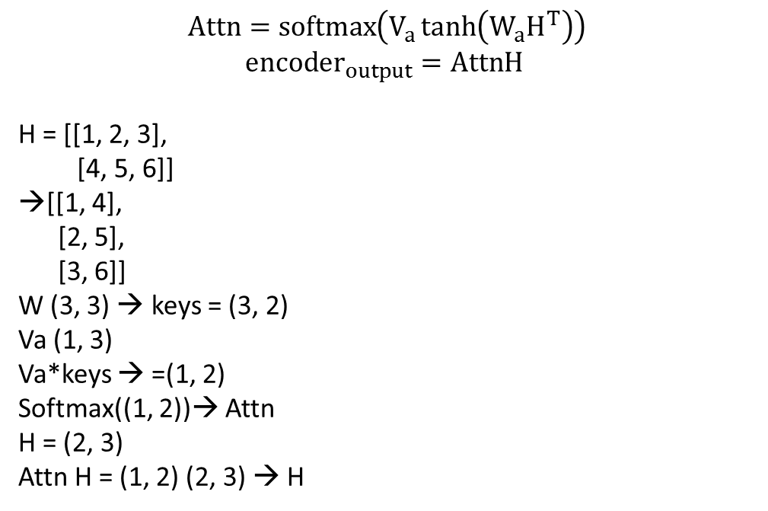
$$Attn=softmax\left(V_{a}\tanh\left(W_{a}H^{T}\right)\right)$$
$$encoder_{output}=AttnH$$
H = [[1, 2, 3],
[4, 5, 6]]
→[[1, 4],
[2, 5],
[3, 6]]
W (3, 3) → keys = (3, 2)
Va (1, 3)
Va*keys → =(1, 2)
Softmax((1, 2))→ Attn
H = (2, 3)
Attn H = (1, 2) (2, 3) → H

Slide 3
Wsj_0637
attribution
Mr. Vaux said
Same-Unit
that
condition
if no agreement is reached,
other buyers will be
sought by bid or auction.

Slide 4









$${ h}_{composed}$$
$$\vec{h}$$
$$……$$
$$……$$
$${ c}_{1}$$
$${ c}_{2}$$
$${ c}_{3}$$
$${ state}_{m}=\left[{\vec{h}}_{b}^{1},{\vec{h}}_{s}^{1},{\vec{h}}_{s}^{2}\right]$$
$$connectives in the next EDU{ e}_{k}$$

Slide 5


























encoder_output
Attention layer
$$c_{t}$$
$$a_{1}$$
$$a_{2}$$
…
$$a_{t}$$
$$h_{1}$$
$$h_{2}$$
$$h_{t}$$
Bi LSTM layer
$$\vec{h_{f1}}$$
$$\vec{h_{f2}}$$
……
$$\vec{h_{ft}}$$
$$\overset{⃖}{h_{b1}}$$
$$\overset{⃖}{h_{b2}}$$
……
$$\overset{⃖}{h_{bt}}$$
embedding
$${pos}_{1}$$
$${pos}_{2}$$
$${pos}_{t}$$
$$w_{1}$$
$$w_{2}$$
……
$$w_{t}$$
$$\vec{h}$$
$$……$$
$${{{{ w}_{1} w}_{2} w}_{3} w}_{n}$$
$${ h}_{composed}$$
$${ c}_{1}$$
$${ c}_{2}$$
$${ c}_{3}$$
$$connectives in next EDUs{ e}_{k}$$
$$……$$

Slide 6











encoder_output
$${\vec{x}}_{{EDU}_{encoded}}$$
max_pooling
max_pooling
$$……$$
$$……$$
convolution
$${filter}_{1}$$
$${filter}_{k}$$
convolution
$${filter}_{1}$$
$${filter}_{k}$$
POS
embedding
$${pos}_{1}$$
$${pos}_{1}$$
$${pos}_{1}$$
$${pos}_{1}$$
$${pos}_{1}$$
$$w_{1}$$
$$w_{1}$$
$$w_{1}$$
$$w_{1}$$
$$w_{1}$$
embedding
You will win at last
Words
You will win at last

Slide 7




















Attention layer
$$c_{t}$$
$$a_{1}$$
$$a_{2}$$
…
$$a_{t}$$
$$h_{1}$$
$$h_{2}$$
$$h_{t}$$
Bi LSTM layer
$$\vec{h_{f1}}$$
$$\vec{h_{f2}}$$
……
$$\vec{h_{ft}}$$
$$\overset{⃖}{h_{b1}}$$
$$\overset{⃖}{h_{b2}}$$
……
$$\overset{⃖}{h_{bt}}$$
embedding
$${pos}_{1}$$
$${pos}_{2}$$
……
$${pos}_{t}$$
$$w_{1}$$
$$w_{2}$$
$$w_{t}$$

