Slide 1
Neural Machine Translation zt

Slide 2














RNNSearch——Encoder & Decoder
$$y$$
$$<s0>$$
We choose to be brave and face difficulties
$$c_{t}$$
$$a_{1}$$
$$a_{2}$$
$$a_{3}$$
$$a_{4}$$
$$a_{5}$$
$$h_{1}$$
$$h_{2}$$
$$h_{3}$$
$$h_{4}$$
$$h_{5}$$
$$x$$
我们 选择 勇敢 面对 困难

Slide 3






RNNSearch——Encoder
Bi-LSTM
$$a=[a_{1}, a_{2}, …, a_{t}]=softmax\left(V_{a}\tanh\left(W_{a}h^{T}\right)\right)$$
$$h=\left[h_{1}, h_{2}, …, h_{t}\right]$$
$$h_{1}$$
$$h_{2}$$
$$h_{3}$$
$$h_{4}$$
$$h_{5}$$
我们 选择 勇敢 面对 困难

Slide 4









RNNSearch——Decoder
$$y$$
$$<s0>$$
We choose to be brave and face difficulties
$$s0$$
$$c_{t}$$
$$s_{0}=\tanh\left(W_{s}{\overset{⃖}{h}}_{1}\right)+b_{s}$$
$$a_{1}$$
$$a_{5}$$
$$s_{t}=U_{o}{s_{t−1}}+{V_{o}y}_{t−1}+C_{o}c_{t}+b_{o}$$
$$a_{2}$$
$$a_{3}$$
$$a_{4}$$
$${compute c}_{t} one by one for each y.$$
$$h_{1}$$
$$h_{2}$$
$$h_{3}$$
$$h_{4}$$
$$h_{5}$$
$$e_{tj}=v_{a}^{T}tanh⁡(W_{a}s_{t−1}+U_{a}h_{j})$$
$$a_{t}=softmax({[e}_{t1},e_{t2}, …,e_{t5}])$$
$$c_{t}=a_{t}h$$
$$get those decoded vectors.$$
$$x$$
我们 选择 勇敢 面对 困难
$${[s}_{0},s_{1}, …,s_{8}]$$

Slide 5
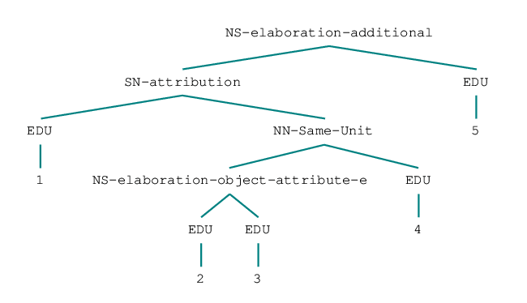
RNNSearch——Encoder
Bi-LSTM
Brush Wellman Inc. said its board increased the number of shares of common stock to be purchased under a previously authorized program to 3.9 million from 2.9 million. The maker of engineered materials has acquired more than 2.7 million shares under the program.
Will it be better when translate those EDUs first, then use tree LSTM to compute the output of a sentence?

Slide 6
RNNSearch——Encoder
Bi-LSTM
Translate process
1. Tran EDU1 with padding hidden-state
2. Tran EDU2 with padding hidden-state
3. Tran EDU3 with hidden-state from EDU2
compose EDU2 and EDU3 to form a new hidden-state of them
4. Tran EDU4 with hidden-state from EDU2-3
compose EDU2-3 and EDU 4 to form a new hidden-state of them
compose EDU1 and EDU2-3-4 to form a new hidden-state of them
5. Tran EDU5 with hidden-state from EDU1-2-3-4
compose EDU1-2-3-4 and EDU5 to form a new hidden-state of them

Slide 7
RNNSearch——Tasks
Seaching corpora: Financial and Political
Best segmentor
Best parser or myselves
Transforming Tree obj (transform an rst_tree into specific object)
RNNSearch + Tree LSTM → NMT

Slide 8
Problem 1

