Slide 1
Women’s Clothing E-Commerce Reviews Analysis
Arlene Huang, Cathy C. Hou, Michael Haoxiang Guo, Lanzhen Zhang, Zekun Li

Slide 2
Topics
Topic
Dataset
Problem statement
E-commerce is gradually becoming main channel for distributors to sell products.
Comments largely influence people's shopping decisions.
Text is one of the most popular data type for the sell-side.
Women’s Clothing E-Commerce Reviews dataset revolving around the reviews written by customers. The ultimate purpose of our research is to approach customers precisely.
•23486 rows
•10 feature variables
·
What are the words being treated as useful information as customers rating the review?
What are the relationships of review text/title and rating, rating and recommend IND, and review text/title and recommend IND?
Whether other listed variables have potential relations to title/text?
Can we predict with words alone whether or not a customer would recommend a purchased item of clothing?
·
·
·

Slide 3
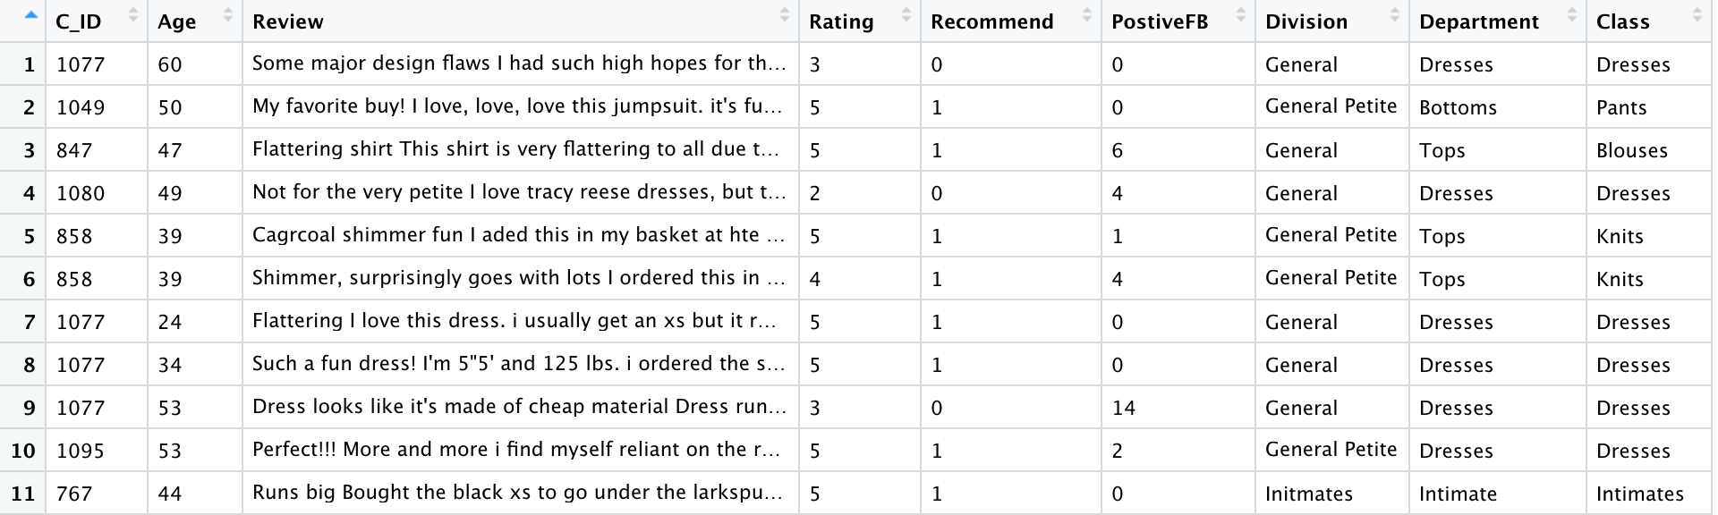
A Quick Overlook of the Dataset
The number of customers who found this review helpful
Age of the reviewer
My favorite buy! I love, love, love this jumpsuit. it's fun, flirty, and fabulous! every time i wear it, i get nothing but great compliments!
Cloth unique ID
Content of the review
(Avg: 63 words)
Rating of 1~5
If they will recommend it
Belong to which
division
Belong to which
department
Belong to which
class

Slide 4
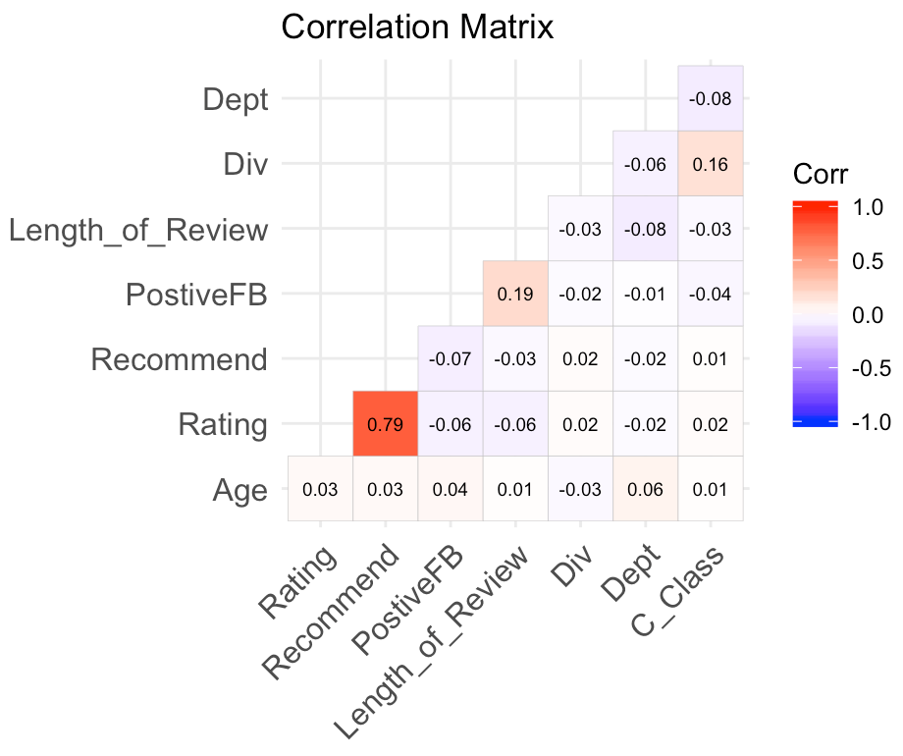
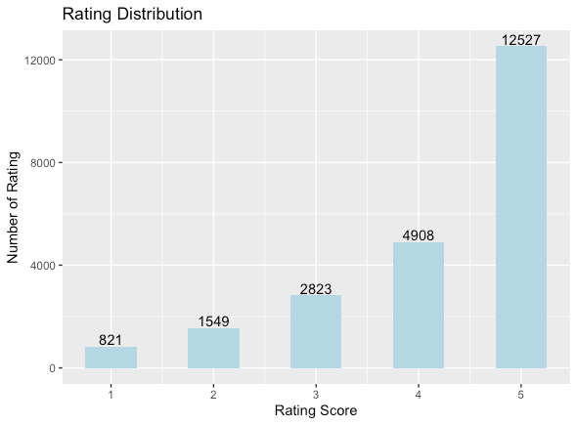
Exploring the data
53.34%

Slide 5
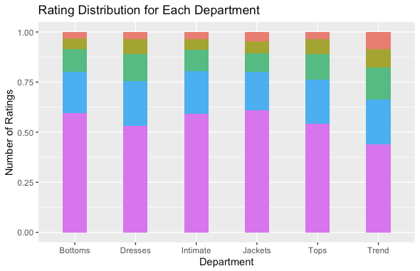
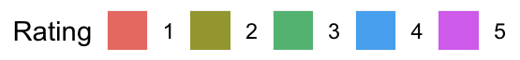
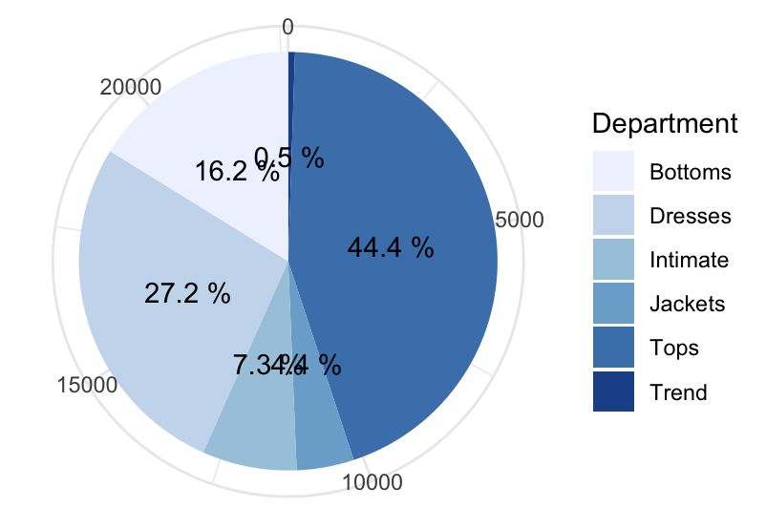
Descriptive analysis - Department
Percentage of Reviews from Each Department
87.8% reviews are for Tops, Bottoms, Dresses

Slide 6
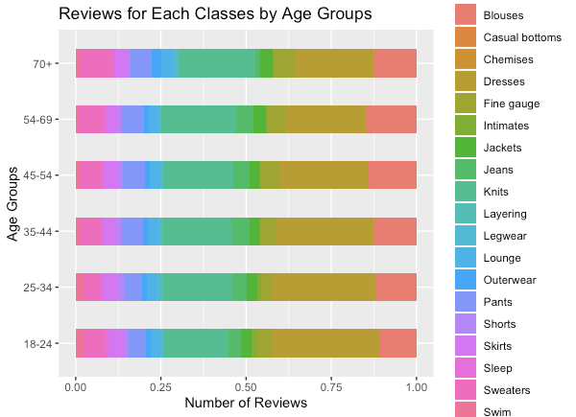
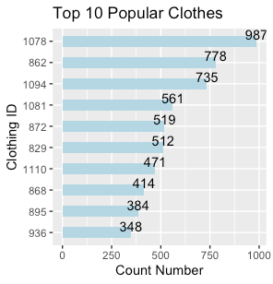

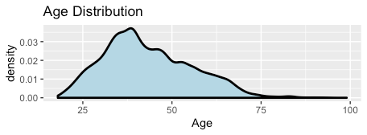
Descriptive analysis - popularity analysis
more
blouses
40%
more
sweater
more dresses
39 years old

Slide 7
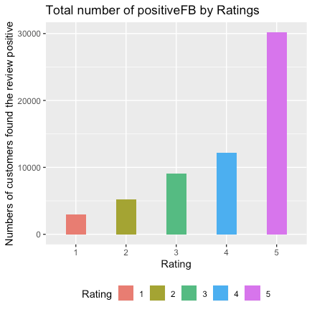
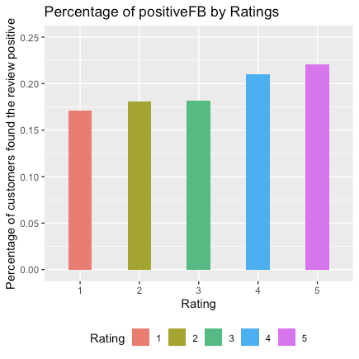
Descriptive analysis - Positive Feedback
Less likely to have positive feedback
More likely to have positive feedback

Slide 8
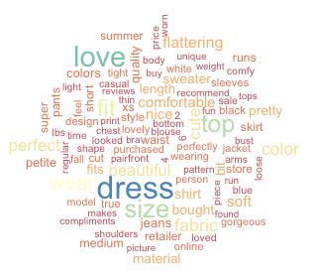
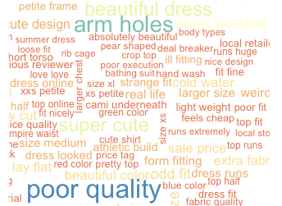
NLP - High rating words VS Low rating words

Slide 9
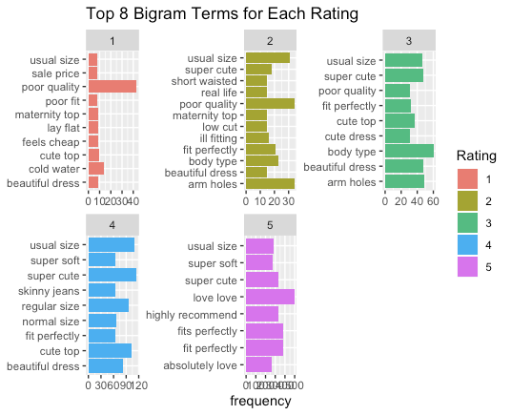
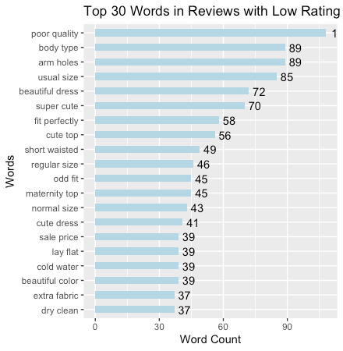
NLP - What factors led to low ratings?
Targeting low-end mkt:
Improve fabric quality;
be careful of arm holes;
use loose waist design
Targeting high-end mkt:
cute design, perfectly fit size.

Slide 10
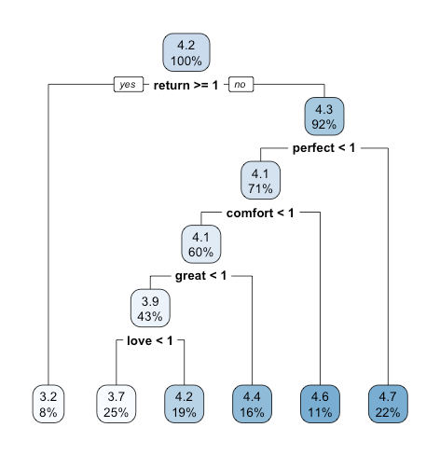
Predictive model - tree
Typical score of review: 4.2/5.0
reviews that contain “perfect”, “comfort”, ”great”, “love” are rating higher than if not; reviews that contain “return” are rating very low as around 3.2;
If the review only says “perfect” without much other comments, the rating would be very high as around 4.7;
RMSE: 1.00645.

Slide 11
Insights & suggestions
Insights
The majority of the cloth sales are in Tops, Bottoms and Dress department.
Clothes designed for Trend department are getting far more negative reviews than others, meanwhile it seems that customers are less picky in Bottoms and Jackets departments.
Children under 18 and seniors above 70 love sweaters, middle-age people are focusing more on blouses; young people favor dresses more.
Nearly half of the top selling clothes are dress.
People found 4 or 5 star reviews much more helpful than others.
Typical score of review: 4.2
Complaints are mainly regarding poor quality (especially in arm holes), or the cloth has odd fit.
Positive reviews typically mentioned not only design are cute, but also the cloth fit perfectly.
Suggestions
Bottoms department can become the next cash cow, as there the volume indicates constant high demand of Bottoms and analysis shows that customers are less picky for Bottoms.
Products in Trend department are risky in getting lower ratings. Only develop product in Trend department when there’s higher return.
Sweaters: Focusing on under 18 and 70+ people
Blouse: middle-age people, need a bit fashion.
Dresses: young people, more fashion and design, dresses can become very popular suddenly, so factories must be prepared.
A good fit can be extremely important for getting high ratings.

Slide 12
Thank you

