Slide 1
Make Your Body the Controller
Adina Shanholtz
@FeyTechnologist
Kat Harris
@KatVHarris
Tobiah Zarlez
@TobiahZarlez

Slide 2

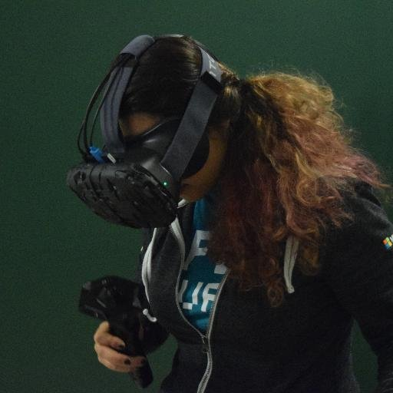


Who are we?
Tobiah Zarlez
Twitter: @TobiahZarlez
Blog: www.TobiahZ.com
Podcast: www.BeIndieNow.com
Katherine Harris
Twitter: @KatVHarris
Blog: www.Kaharri.com
Adina Shanholtz
Twitter: @FeyTechnologist
Blog: www.AdinaShanholtz.com
Notes:
Technical Evangelist, call myself a “Game Evangelist” at Microsoft.

Slide 3
Kinect Prerequisites
USB 3 port
Kinect SDK - https://www.microsoft.com/en-us/kinectforwindows/develop/downloads-docs.aspx
Unity Plugins (which I provide in the git repo) – https://github.com/KatVHarris/Unity5-KinectGestures
Kinect Setup Instructions - http://bit.ly/UnityKinect

Slide 4
Questions?

Slide 5
Contact us =)
Tobiah Zarlez
Twitter: @TobiahZarlez
Blog: www.TobiahZ.com
Podcast: www.BeIndieNow.com
Katherine Harris
Twitter: @KatVHarris
Blog: www.Kaharri.com
Adina Shanholtz
Twitter: @FeyTechnologist
Blog: www.AdinaShanholtz.com
Notes:
Technical Evangelist, call myself a “Game Evangelist” at Microsoft.

