Slide 1
Digital Health Interventions for Cardiovascular Risk
♥
500 veterans aged 50-75 with hypertension — Mobile app with daily BP monitoring and coaching

Slide 2
Population
500 veterans aged 50-75 with hypertension
Study Highlights
• Mean 8
• 5 mmHg reduction (95% CI: 6
Intervention
Mobile app with daily BP monitoring and coaching
• 2-10
• 8, p=0
• 003)
Setting
VA community health centers nationwide
Primary Outcome
Systolic blood pressure reduction at 12 weeks

Slide 3
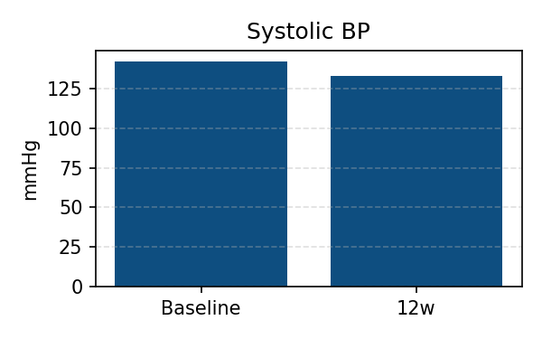
Key Findings
• Mean 8
• 5 mmHg reduction (95% CI: 6
• 2-10
• 8, p=0
• 003)
• Clinically significant improvement in cardiovascular risk profile
Effect
−8.5 mmHg
Quality
87%
N
500
Generated by JAMA VA Abstractor • October 12, 2025

