Slide 1
Scale-Dependent Regularization from Quantization in Low-Data LLM Fine-Tuning
Does quantization noise help LLMs generalize better with limited data?
Armaan Rehman Shah & Burhanuddin Dalal
STAD68H3 • Department of Statistical Sciences • University of Toronto Scarborough
Winter 2026
Notes:
Welcome everyone. Today we present our investigation into whether quantization noise can act as an implicit regularizer when fine-tuning LLMs with limited data. This is a controlled empirical study spanning two model scales with 156 total experiments.

Slide 2
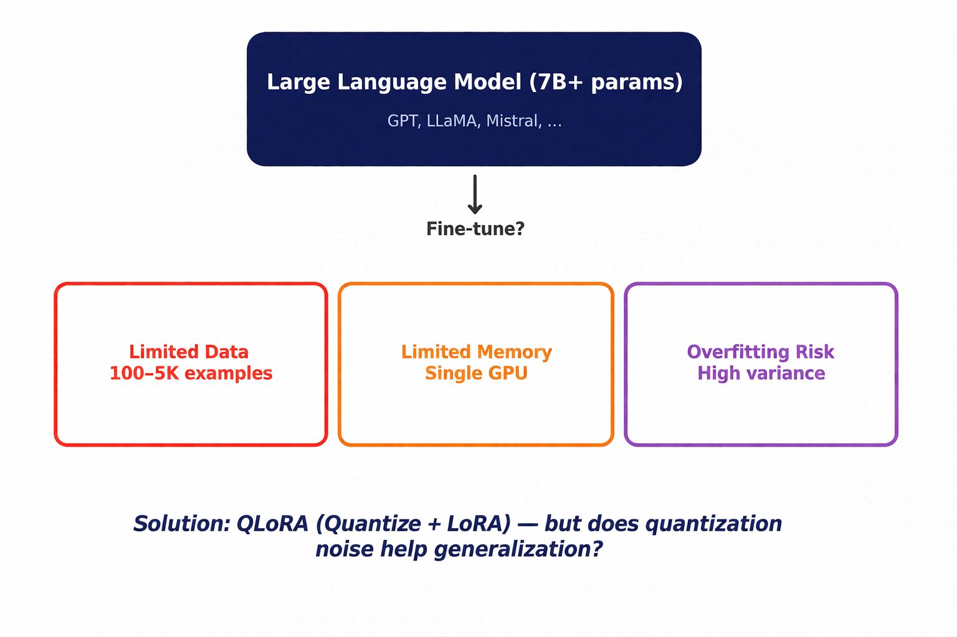


The Challenge: Fine-Tuning LLMs with Limited Data
Notes:
TAKEAWAY: Fine-tuning large language models is the standard way to adapt them to specific tasks, but practitioners face three interrelated challenges: limited training data (often just hundreds of examples), limited GPU memory (models need 14+ GB), and high overfitting risk. QLoRA solves the memory problem, but we ask: does it also accidentally help with overfitting? That's the core question of our study.

Slide 3
Background: Fine-Tuning a Large Language Model
What is fine-tuning?
Fine-tuning = training a general LLM (Ex: GPT or LLaMA) further on a small, task-specific dataset so it learns to follow instructions, answer questions, etc.
The Problem with Full Fine-Tuning:
1. Memory: A 7B model needs ~14GB just for weights + optimizer states
2. Overfitting: With only 100-5000 examples, the model memorizes rather than learns
3. Cost: Updating billions of parameters is computationally expensive
Pre-trained LLM
Knows general language
+
Small Task Dataset
100 - 5,000 examples
=
Specialized Model
Follows your instructions
Notes:
TAKEAWAY: Fine-tuning means taking a general-purpose language model and teaching it a specific skill with a small dataset. Think of it like teaching an expert a new specialty — they already know the fundamentals. The challenge is that with very few examples (low-data), the model tends to memorize rather than truly learn, which is called overfitting.

Slide 4
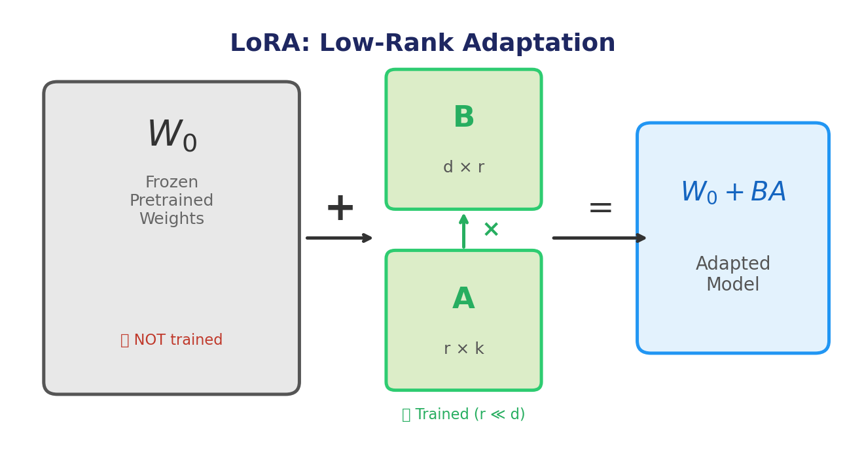
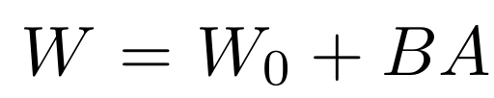
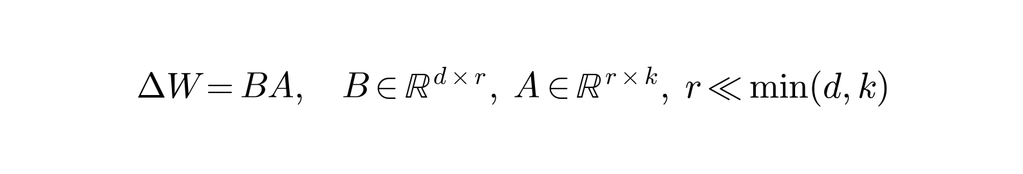
Background: LoRA — Low-Rank Adaptation
Hu et al., 2021
(LoRA)
Key Insight
Instead of updating ALL 7 billion parameters, LoRA only trains ~0.1% of them!
Rank (r) controls capacity:
r=4: 6.7M params
r=16: 13.4M params
r=64: 22.0M params
LoRA itself acts as a regularizer: by restricting updates to a low-dimensional subspace
Notes:
TAKEAWAY: LoRA freezes all pretrained weights and adds small trainable matrices (B and A). The rank r determines how expressive these adapters are. Crucially, LoRA is already a form of regularization because it restricts the model to a low-dimensional update subspace. This becomes important later when we explain why quantization doesn't help at small model scales.

Slide 5
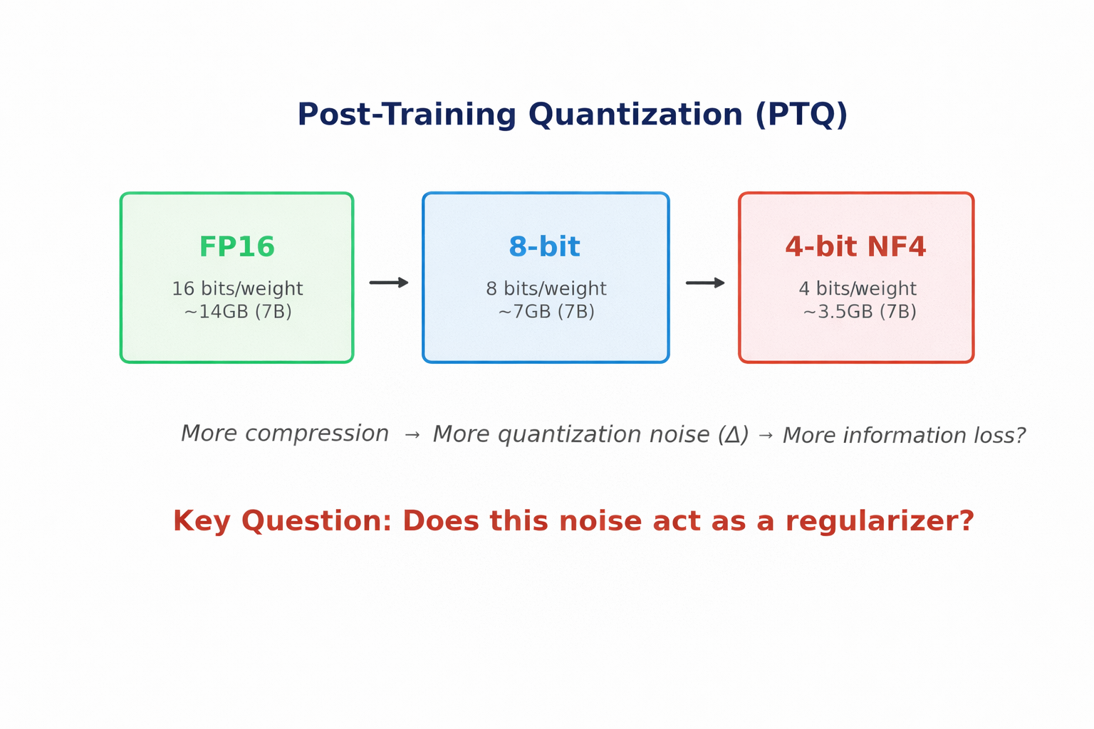
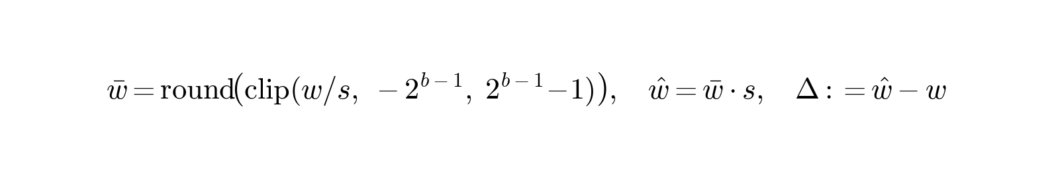
Background: Quantization — Compressing Model Weights
A scalar weight $w$ is quantized with step size $s>0$ and bit-width $b$ as:
Think of it like this: Quantization rounds each weight to the nearest allowed value, introducing small errors (noise). Lower bit-width = more rounding = more noise.
Notes:
TAKEAWAY: Quantization reduces the precision of model weights — from 16-bit to 8-bit or 4-bit. This introduces 'quantization noise' (Delta). The key formula shows how each weight is rounded to the nearest discrete level. 4-bit NF4 is the format used in QLoRA — it's specifically designed for normally-distributed weights. The question is: does this rounding noise help or hurt the model?

Slide 6
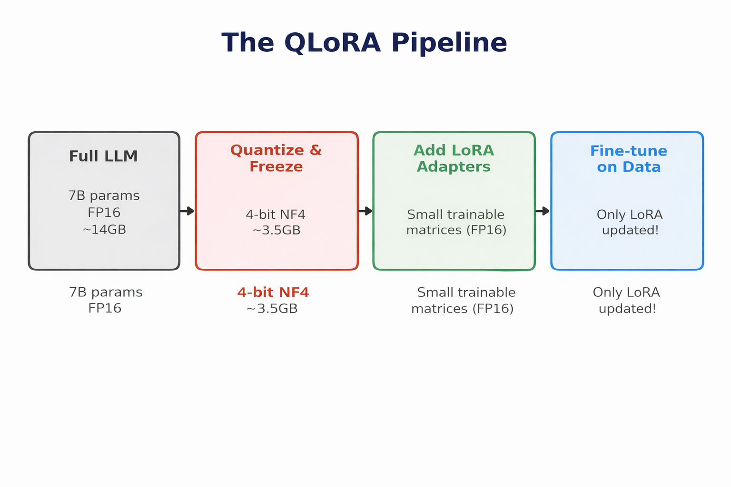
Background: QLoRA = Quantization + LoRA
Dettmers et al., 2023
(QLoRA)
Standard Use:
QLoRA is used for memory savings.
7B model: 14GB -> 3.5GB (4-bit)
Enables single-GPU training!
Our Question:
Beyond memory savings...
Does the quantization noise act as
an implicit regularizer?
Notes:
TAKEAWAY: QLoRA combines quantization and LoRA. The standard view is that it's purely about memory savings — fitting a big model on a small GPU. Our research asks a different question: does the noise introduced by quantization accidentally help the model generalize better? This is the 'implicit regularization' hypothesis. Dettmers et al. (2023) introduced QLoRA; we investigate its statistical side-effects.

Slide 7
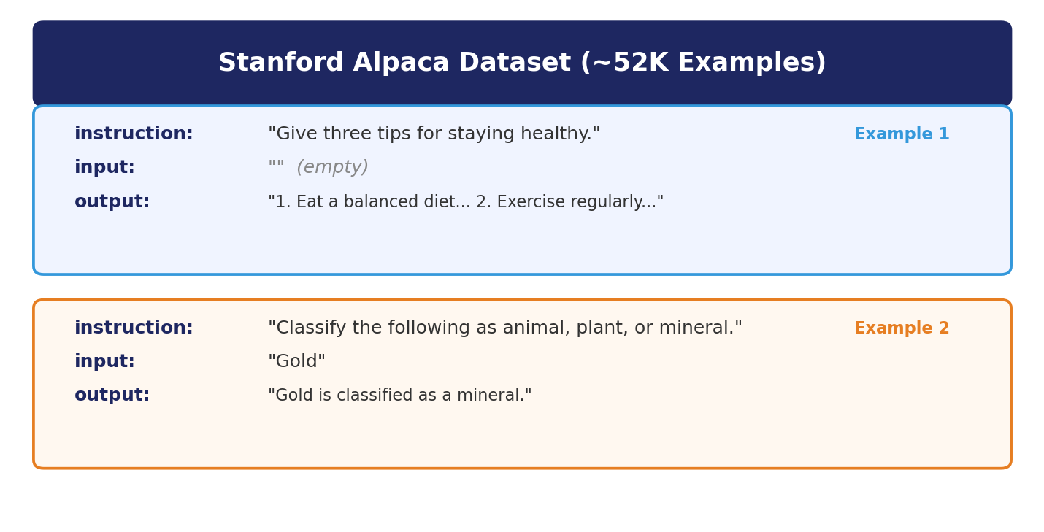
Dataset: Stanford Alpaca (~52K Instruction Examples)
Dataset Details
Source: Stanford (tatsu-lab)
Size: ~52K examples
Format: instruction/input/output
Our Splits:
Test: 500 fixed examples
Train: 100, 500, 1K, 5K
Val: 10% of each train set
Taori et al., 2023
(Alpaca)
Why Alpaca? It is a standard instruction-tuning benchmark, generated by a teacher model (text-davinci-003). We deliberately use small subsets (100-5K) to create low-data regimes where regularization matters most.
Notes:
TAKEAWAY: Alpaca is a ~52K instruction-following dataset from Stanford. Each example has an instruction (what to do), an optional input, and the expected output. We use subsets of 100, 500, 1000, and 5000 examples — these small sizes simulate the real-world scenario where you have very limited training data. The test set of 500 examples is kept fixed across ALL experiments for fair comparison.

Slide 8



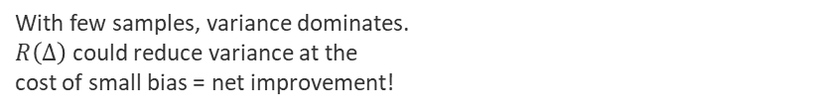
Theoretical Motivation: Quantization as Regularizer
1: Model output with quantization noise (first-order Taylor expansion)
2: The effective training loss gains an extra penalty term
Key Insight (AskariHemmat et al., 2024 — QGen paper):
$R\left(Δ\right)≥0$: Quantization adds a non-negative penalty that grows with bin width (lower bits = larger R).
This looks just like a regularizer (similar to weight decay or dropout)!
3: Why this could help in low-data regimes (bias-variance trade-off)
With few samples, variance dominates. $R\left(Δ\right)$ could reduce variance at the cost of small bias = net improvement!
Notes:
TAKEAWAY: The theory from AskariHemmat et al. (QGen, 2024) shows that quantization adds a non-negative penalty R(Delta) to the training loss. This penalty grows with more aggressive quantization. In the bias-variance framework, when you have few training examples, variance dominates test error. A regularizer (like R(Delta)) can reduce variance at the cost of small bias — potentially improving generalization. This is the theoretical basis for our hypothesis that quantization could help.

Slide 9
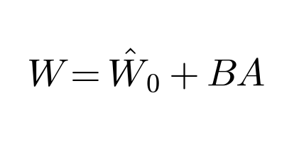
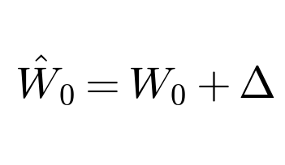

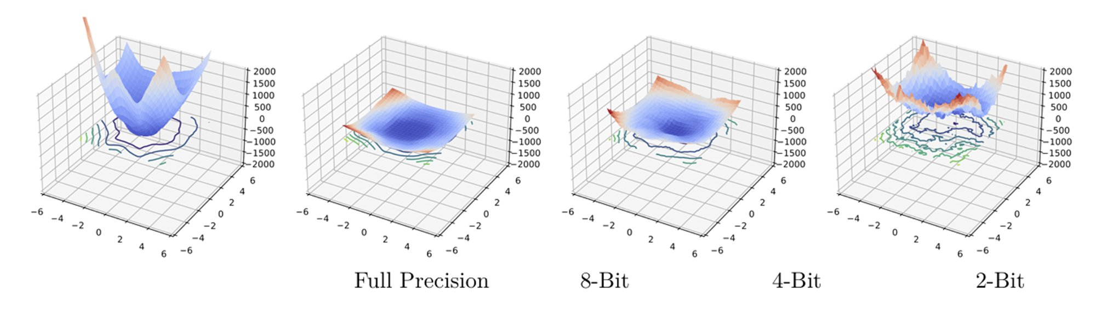


Theoretical Motivation II: Sharpness & LoRA Interaction
Interaction with LoRA Adapters
Loss Landscape Visualization
Variance-like penalty on adapter gradient:
Sharpness-Based Generalization Bound (PAC-Bayes)
8-bit smooths the landscape (flatter minima).
4-bit introduces jagged peaks (too much noise).
Source: AskariHemmat et al. (QGen, 2024)
sharpness
complexity
If quantization reduces sharpness → lower population loss $L_{D}(w)$→ better generalization!
Notes:
TAKEAWAY: This slide deepens the theory. Two key ideas: (1) The LoRA interaction — quantization error creates a variance-like penalty tr(Cov(Delta) G^T G) that biases adapters toward stable, small-norm solutions. (2) The sharpness bound — the PAC-Bayes bound has two terms: a sharpness term (max loss in a neighborhood) and a complexity term (weight norm). Quantization reduces sharpness by smoothing the landscape, which can lower the population loss bound. The loss landscape visualization from QGen shows this concretely: 8-bit is smoother than full precision, while 2-bit/4-bit becomes jagged. This is why 8-bit hits the sweet spot at 7B scale.

Slide 10
Our Research in One Sentence
We study: whether quantization noise in frozen LLM weights acts as implicit regularization during low-data fine-tuning.
Existing methods: QLoRA was designed purely for memory savings/efficiency.
We propose: Does it have free statistical side-effects? We run a systematic 156-experiment ablation across two model scales (1.1B and 7B), varying precision, data size, and LoRA rank.
Notes:
This is the one-sentence summary of the entire project. The key discovery is that quantization's statistical effect depends on model scale — it's not just about saving memory. At 7B parameters, 8-bit quantization actually makes the model generalize BETTER. This was unexpected because we initially hypothesized the effect would appear even at small scale.

Slide 11
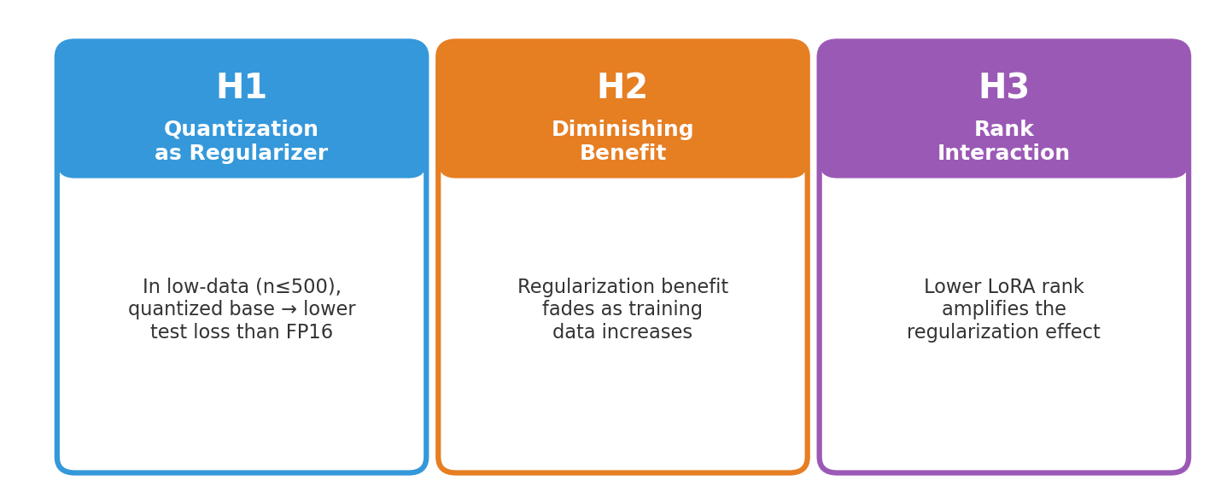
Hypotheses Under Test
In plain language:
H1: Does 4-bit or 8-bit beat full precision when data is scarce?
H2: Does this advantage disappear as you add more training examples?
H3: Does using fewer trainable parameters (low LoRA rank) amplify the effect?
Notes:
TAKEAWAY: We test three hypotheses. H1 is the core claim — that quantization acts as a regularizer and helps at low data. H2 checks whether the benefit fades with more data (which classical regularization theory predicts). H3 tests an interaction: since LoRA rank controls model capacity, lower rank + quantization should provide compounding regularization. We originally had an H4 about numeracy failure modes, but we've excluded it from this presentation.

Slide 12
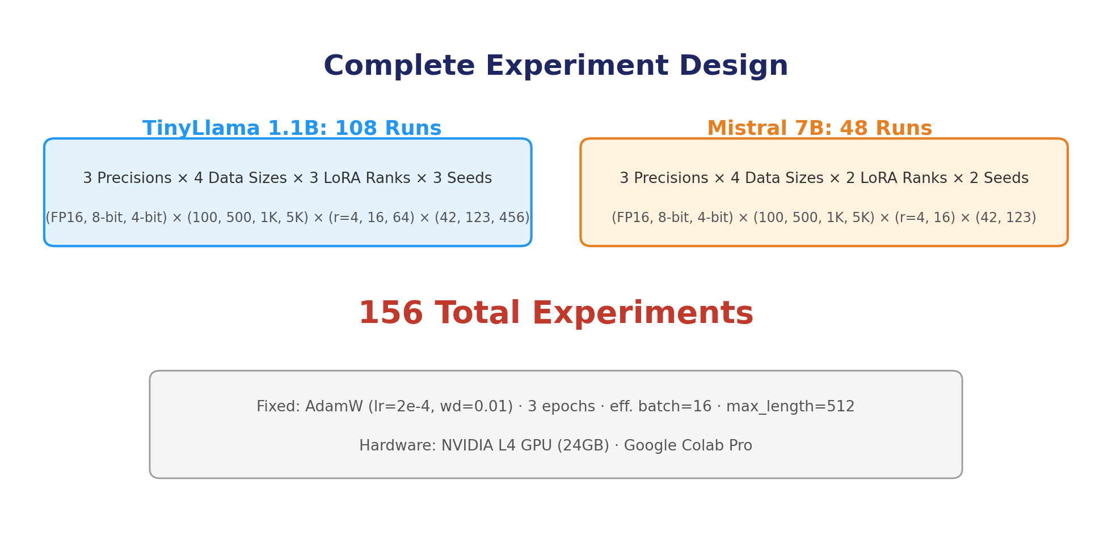
Experimental Design: 156 Controlled Experiments
Evaluation Metrics:
Test Loss: NLL on 500 held-out examples
Gen. Gap: Train loss - Val loss
Perplexity: exp(test loss)
All means +/- std across seeds
~126
Hours!
Notes:
TAKEAWAY: We ran 156 total experiments in a controlled factorial design. For TinyLlama (1.1B params), we test 3 precisions x 4 data sizes x 3 LoRA ranks x 3 seeds = 108 runs. For Mistral-7B, we use a reduced design with 48 runs. Everything is fixed except the variables we're testing — same learning rate, same optimizer, same epochs, same test set across ALL conditions. This is crucial for clean causal attribution.

Slide 13
TinyLlama 1.1B Results
108 experiments • 3 precisions • 4 data sizes • 3 ranks • 3 seeds
Spoiler: No regularization benefit at this scale
Notes:
Section transition. We now present the TinyLlama-1.1B results. The headline: we found NO evidence of quantization acting as a regularizer at this model scale. FP16 wins everywhere.

Slide 14
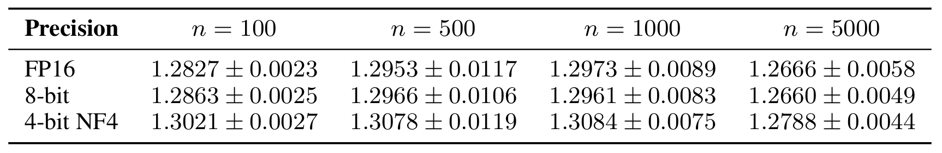
TinyLlama 1.1B: Main Results — FP16 Wins Everywhere
Mean Test NLL (+/- std) across 3 LoRA ranks and 3 seeds (9 runs per cell)
H1: NOT SUPPORTED
FP16 achieves the lowest test loss at every data size. The ordering FP16 < 8-bit < 4-bit holds universally.
At n=100 (most favorable for regularization): 4-bit NF4 = 1.302 vs FP16 = 1.283
This is a degradation of 0.019 NLL — quantization HURTS, it does not help.
H2: NOT SUPPORTED — The 4-bit penalty persists at all data sizes (0.012-0.019 NLL).
Notes:
TAKEAWAY: This is the core negative result at 1.1B. FP16 is best everywhere. Even at n=100, where the theory most strongly predicts a regularization benefit, 4-bit is WORSE by 0.019 NLL. 8-bit is very close to FP16 (within 0.003), making it practically viable for memory savings. But there's zero evidence of regularization. H2 also fails — the gap doesn't shrink with more data.

Slide 15
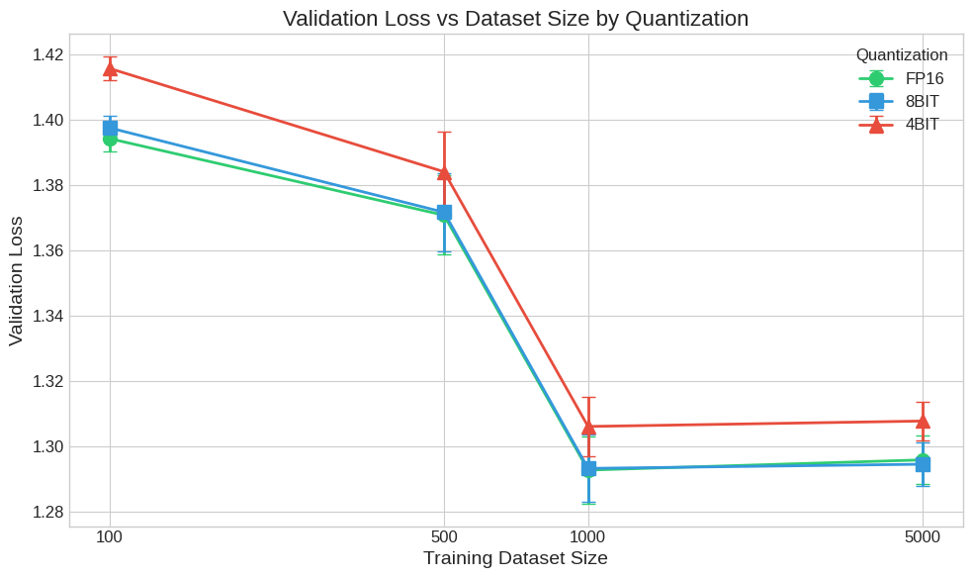
TinyLlama: Validation Loss vs. Dataset Size
What to notice:
FP16 (green) and 8-bit (blue) overlap almost perfectly
4-bit (red) sits persistently ABOVE both
If H1 were true, 4-bit would be BELOW FP16 at small n
Conclusion: No crossover at any data size
Notes:
TAKEAWAY: This plot is the visual smoking gun for the null result at 1.1B. FP16 and 8-bit validation loss curves are nearly indistinguishable at all data sizes. 4-bit sits consistently above — meaning higher loss = worse performance. If quantization were regularizing, we'd expect 4-bit to cross below FP16 at small n (left side). This never happens.

Slide 16
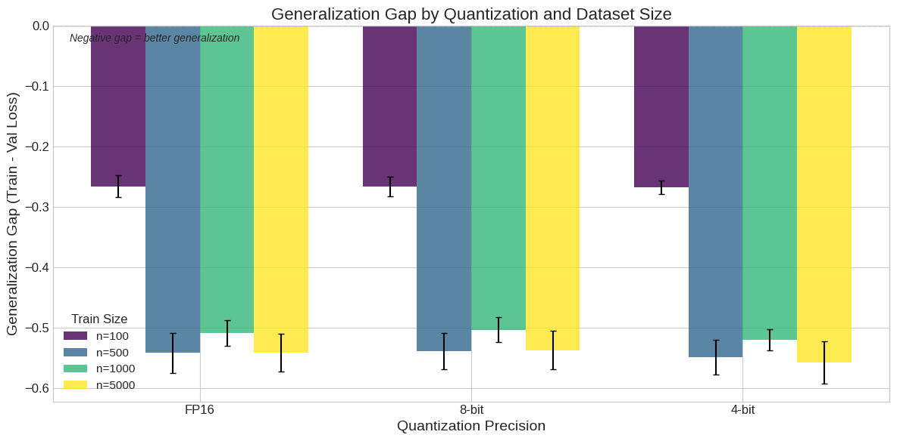

TinyLlama: Generalization Gap — Nearly Identical Across Precisions
Gen. Gap = Train Loss - Val Loss
(negative = overfitting)
At n=100:
FP16: -0.266
8-bit: -0.266
4-bit: -0.268
Almost identical!
If $R\left(Δ\right)$) were reducing variance, 4-bit should show a smaller-magnitude gap. Instead, it is slightly LARGER.
Notes:
TAKEAWAY: The generalization gap (train loss minus val loss) tells us about overfitting. If quantization were reducing variance (acting as a regularizer), we'd expect 4-bit to show a noticeably smaller gap at low n. Instead, all three precisions have nearly identical gaps at every data size. This rules out a variance-reduction mechanism at 1.1B. The fact that 4-bit has a marginally larger gap is consistent with capacity degradation, not regularization.

Slide 17
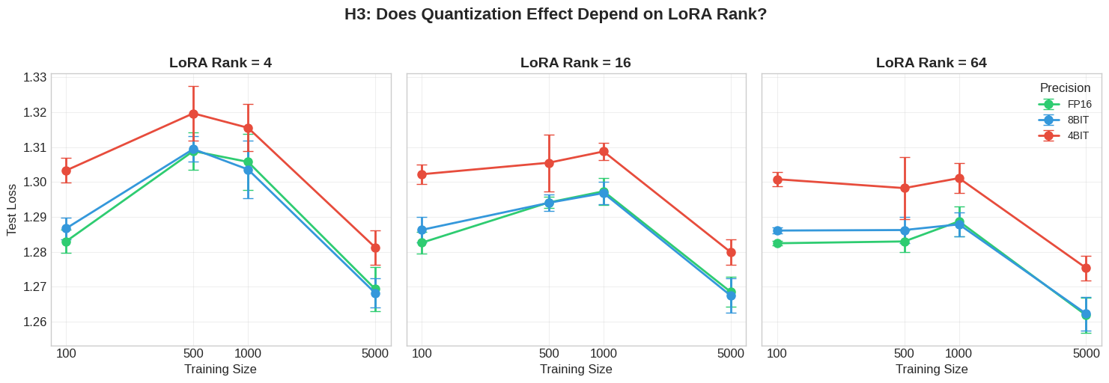
TinyLlama H3: LoRA Rank x Quantization — Weak Trend Only
H3 at 1.1B: Weak, inconclusive trend
Mean 4-bit penalty: r=4: 0.013 | r=16: 0.013 | r=64: 0.015 — differences within noise.
The direction is consistent with H3 (penalty grows with rank), but the magnitude is too small relative to run-to-run variance to claim support.
Notes:
TAKEAWAY: H3 predicts that lower LoRA rank should amplify quantization's benefit (or reduce its harm). At TinyLlama, we see a slight trend in the right direction — the 4-bit penalty is marginally larger at r=64 (0.015) than at r=4 (0.013). But this is within the noise band. We can't claim H3 is supported at this scale. However — and this is key — the same analysis at 7B scale tells a very different story.

Slide 18
Mistral-7B Results
48 experiments • 3 precisions • 4 data sizes • 2 ranks • 2 seeds
Spoiler: A qualitatively different picture emerges at scale
8-bit quantization outperforms FP16 at every data size
Notes:
Section transition. Now we scale up to Mistral-7B — 6x the parameters. The story completely changes. 8-bit quantization doesn't just match FP16 — it BEATS it at every data size tested. This is the scale-dependent regularization we discover.

Slide 19
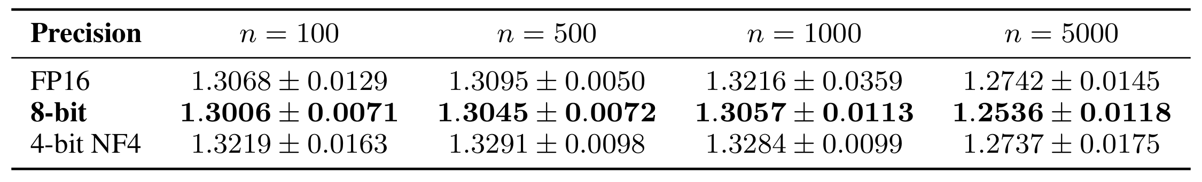
Mistral-7B: 8-bit Beats FP16 at EVERY Data Size
Mean Test NLL (+/- std) across 2 LoRA ranks and 2 seeds (4 runs per cell)
H1: SUPPORTED (for 8-bit!)
8-bit improvement over FP16:
n=100: Delta = -0.006 NLL
n=500: Delta = -0.005 NLL
n=1000: Delta = -0.016 NLL
n=5000: Delta = -0.021 NLL
H2: INVERTED!
8-bit benefit GROWS with data, opposite of H2 prediction!
Explanation: With more data,
FP16 reaches sharper minima;
8-bit is forced to stay in flatter
regions that generalize better.
Notes:
TAKEAWAY: This is the key positive finding. At Mistral-7B, 8-bit quantization achieves the LOWEST test loss at every data size — beating FP16 by margins from 0.005 to 0.021 NLL. H2 is inverted: the benefit grows with more data, not shrinks. This is explained by loss landscape smoothing: more data means longer training, FP16 reaches sharper minima, but 8-bit stays in flatter regions. NOTE: The growth is not perfectly monotonic — it dips slightly at n=500 before jumping at n=1000 — but the overall trend is clear.

Slide 20
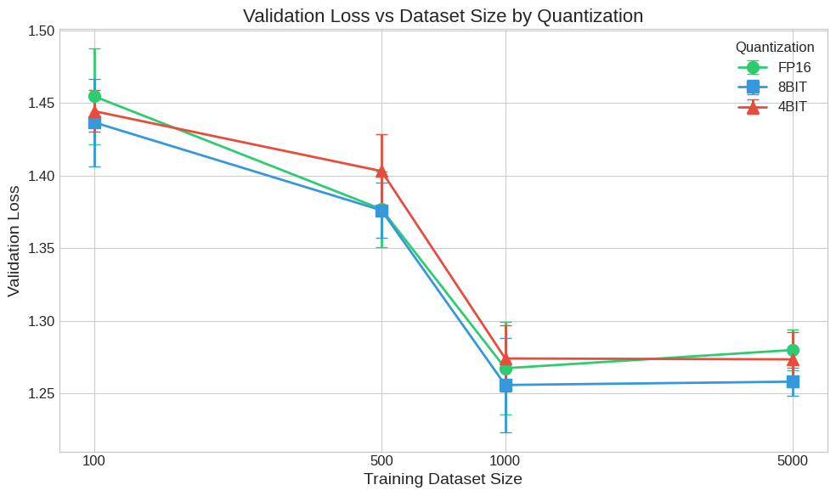
Mistral-7B: 8-bit Consistently Below FP16
Compare with TinyLlama:
TinyLlama: FP16 = 8-bit >> 4-bit
(Curves overlap, 4-bit above)
Mistral-7B: 8-bit < FP16 < 4-bit
(8-bit is BELOW FP16!)
The ordering reverses at 7B scale.
This is the scale-dependent effect.
Notes:
TAKEAWAY: Compare this plot directly with the TinyLlama validation loss plot. The relative positions of the curves are REVERSED. At TinyLlama, FP16 was always on the bottom (best). At Mistral-7B, the blue 8-bit curve sits below FP16 — meaning it generalizes better. The gap widens as n increases, which is the opposite of what H2 predicted.

Slide 21
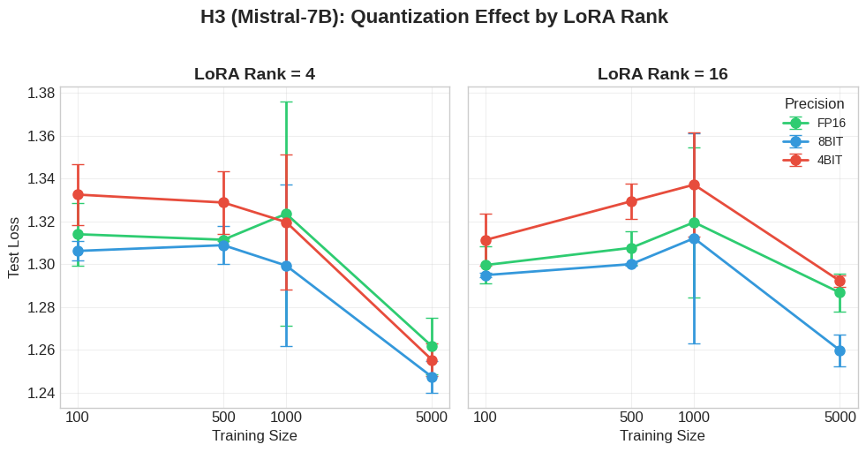
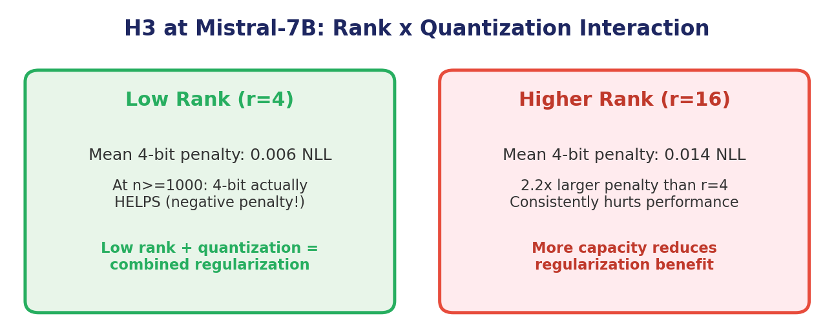
Mistral-7B H3: Rank x Quantization — Strongly Supported
Notes:
TAKEAWAY: H3 is STRONGLY supported at 7B. The 4-bit penalty at r=16 is 2.2x larger than at r=4. Even more striking: at r=4 with n>=1000, 4-bit actually has a NEGATIVE penalty — meaning it HELPS. Low rank + quantization = compounding regularization. This confirms the theoretical prediction that the regularization effect interacts with adapter capacity.

Slide 22
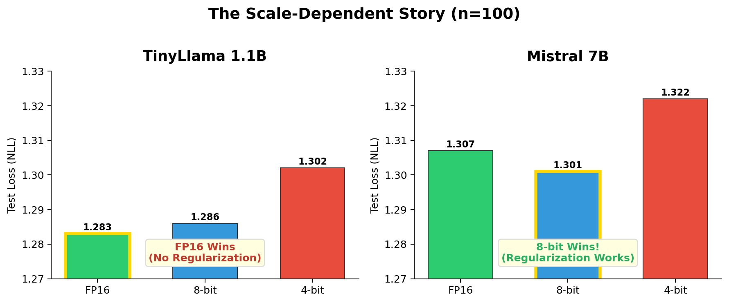
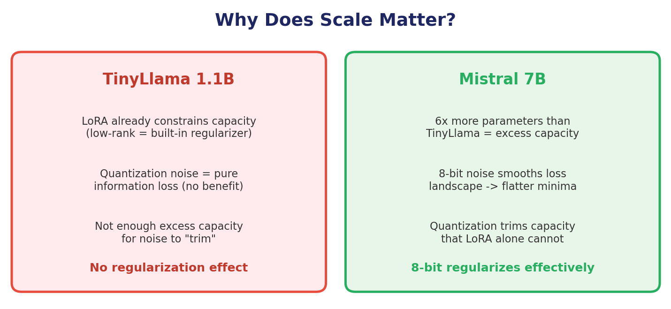
The Key Finding: Scale-Dependent Regularization
Notes:
TAKEAWAY: This is the central insight of the paper. At 1.1B, LoRA already provides sufficient regularization — the model doesn't have enough excess capacity for quantization noise to help. At 7B, there's massive excess capacity that LoRA alone can't constrain. 8-bit quantization provides just enough capacity reduction to smooth the loss landscape without destroying representation quality. 4-bit is too aggressive — it damages representations at low data, but at high data + low rank it becomes beneficial too.

Slide 23
Discussion: Three Mechanisms Explaining the Results
1. Capacity Loss vs. Gain
At 1.1B: quantization destroys representations the model needs
At 7B: 8-bit trims excess capacity the model does NOT need
4-bit is too aggressive at both scales (mostly)
2. Loss Landscape
Larger models have sharper loss landscapes
QGen theory: quantization noise smooths toward flatter minima
More data = longer training = sharper minima = more benefit from smoothing
3. Deterministic Noise
Unlike dropout (random), quantization noise is FIXED
At 1.1B: constant bias, no variance reduction
At 7B: the landscape smoothing mechanism overcomes this limitation
Bottom line: The regularization effect requires sufficient model capacity for noise to "trim." LoRA already regularizes small models; only large models have enough excess capacity for quantization to provide additional benefit.
Notes:
TAKEAWAY: Three mechanisms explain our results. (1) Capacity: 1.1B is small enough that quantization destroys useful representations, while 7B has so much excess capacity that mild quantization is beneficial. (2) Loss landscape: QGen theory predicts that quantization pushes toward flatter minima — this matters more for larger models with sharper landscapes. (3) Deterministic noise: unlike dropout, quantization noise is fixed per weight. At small scale this just adds bias; at large scale the landscape-smoothing effect dominates.

Slide 24
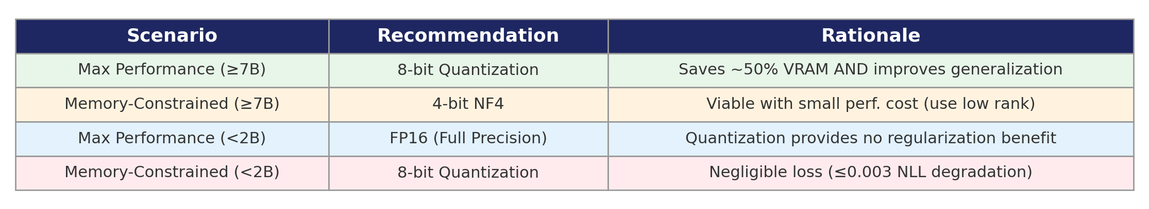
Practical Recommendations for Practitioners
Limitations:
Only 2 seeds at 7B (limited stat. power)
Single task type (Alpaca instruction tuning)
bitsandbytes-specific (GPTQ/AWQ may differ)
PTQ only (QAT may have different effects)
Fixed hyperparams (LR may differ by precision)
Future Work:
Test on 13B+ models (does the effect grow?)
Test stochastic quantization (random noise)
Try QAT vs PTQ comparison
More datasets (SST-2, BoolQ, etc.)
Theoretical bounds for the scale threshold
Notes:
TAKEAWAY: The practical recommendation is clear: at 7B+ scale, use 8-bit quantization — you save memory AND improve generalization. At sub-2B scale, use quantization only for memory, not performance. Key limitations: we tested only 2 seeds at 7B (limited statistical power), a single task type, and one quantization library. Future work should test at larger scales and with different quantization methods.

Slide 25
Key Takeaways
1. Quantization as regularization is SCALE-DEPENDENT: absent at 1.1B, genuine at 7B
2. At 7B, 8-bit quantization improves generalization by up to 0.021 NLL — use it!
3. Negative results are valuable: we prevented a false hypothesis at small scale
Thank You — Questions?
Armaan Rehman Shah • Burhanuddin Dalal • STAD68H3 • Winter 2026
Notes:
CONCLUSION: Three things to remember. (1) Whether quantization helps or hurts depends on model scale — this was unknown before our study. (2) At 7B and above, 8-bit quantization is not just a memory-saving trick — it genuinely improves how well the model generalizes. (3) The null result at 1.1B is itself a contribution — it prevents others from pursuing a false hypothesis at small scale.

Slide 26
References
[1] Hu, E.J., Shen, Y., Wallis, P., Allen-Zhu, Z., Li, Y., Wang, S., Wang, L., and Chen, W. LoRA: Low-rank adaptation of large language models. arXiv preprint arXiv:2106.09685, 2021.
[2] Dettmers, T., Pagnoni, A., Holtzman, A., and Zettlemoyer, L. QLoRA: Efficient finetuning of quantized LLMs. arXiv preprint arXiv:2305.14314, 2023.
[3] AskariHemmat, M.H., Jeddi, A., Askari Hemmat, R., Lazarevich, I., Hoffman, A., Sah, S., Saboori, E., Savaria, Y., and David, J.-P. Quantization and generalization behavior in large models. arXiv preprint arXiv:2404.11769, 2024.
[4] Taori, R., Gulrajani, I., Zhang, T., Dubois, Y., Li, X., Guestrin, C., Liang, P., and Hashimoto, T.B. Stanford Alpaca: An instruction-following LLaMA model. https://github.com/tatsu-lab/stanford_alpaca, 2023.
Notes:
These are the four key papers our work builds on. Hu et al. introduced LoRA. Dettmers et al. introduced QLoRA. AskariHemmat et al. (QGen) provided the theoretical basis for quantization as regularization. Taori et al. created the Alpaca dataset we used for all experiments.

