Slide 1




EXCELSSIOR EDUCATION SOCIETY’S K. C. COLLEGE OF ENGINEERING AND MANAGEMENT STUDIES AND RESEARCH (Affiliated to the University of Mumbai) Mith Bunder Road, Near Hume Pipe, Kopari, Thane(E)-400603
Department of Computer Engineering
Academic Year 2023-24(Odd Semester)

Slide 2
Index
Group Members
Hardware and software requirements
About the project
Screenshots of GUI(With explanations)
Future Scope
Conclusions
References

Slide 3
Group members
Armaan Nakhunda :- 02
Sushant Navle :-05
Nishal Poojary:-17

Slide 4
Hardware requirements:
Processor: A modern multi-core processor, such as Intel Core i3 having 2 cores or equivalent.
RAM: At least 4 GB
Storage: Sufficient disk space to run JDK or any other resource intensive IDE like VScode.
Software requirements:
OS: Windows:
Windows 10 or later
Linux:
Ubuntu 20.04 or later
Or equivalent Linux Distro
MacOS:
MacOS Big Sur or later
JDK: Version 19 or later
IDE: either run it in cmd or equivalent or using an IDE like VS code, Netbrains, etc

Slide 5
About the project
The Java Quiz Game application stands out as an interactive educational platform solely dedicated to Java-related questions. Offering a wide array of challenges within the realm of Java programming, the game ensures a deep dive into the language's intricacies. With features like a competitive scoring system and a user-friendly interface, the application encourages learning through play, making the process of mastering Java both enjoyable and engaging. Strategic gameplay is enhanced with specific lifelines, providing players with advantages such as removing 2 wrong options or having a 80% of getting the right answer by the computer. The educational focus is paramount, covering various aspects of Java programming and offering detailed progress tracking with statistics for continuous improvement.

Slide 6
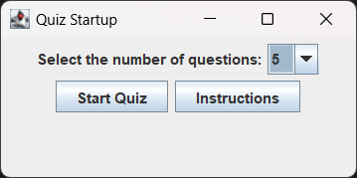
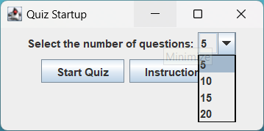
Screenshots and basic explanation of the project
Startup Screen to give the user the option to choose how many questions they would like while
also giving the instructions options they can see the full functionality of the app

Slide 7
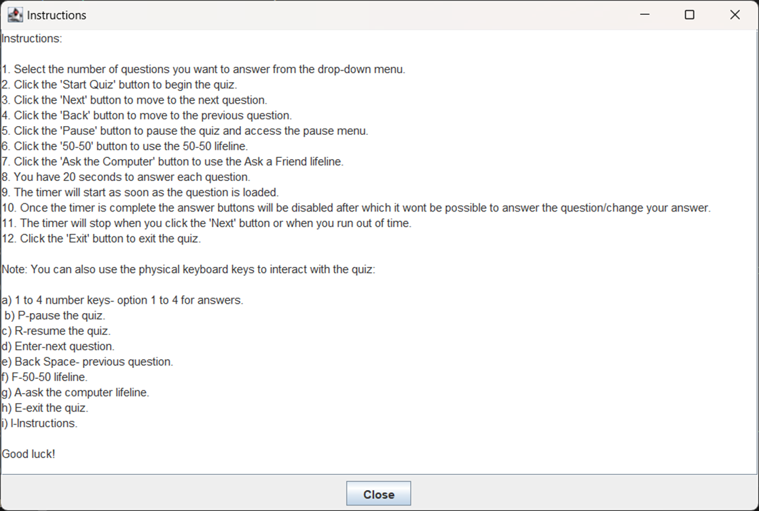
Instructions panel for the user to understand the functionality and a close button to return back to the quiz startup screen

Slide 8
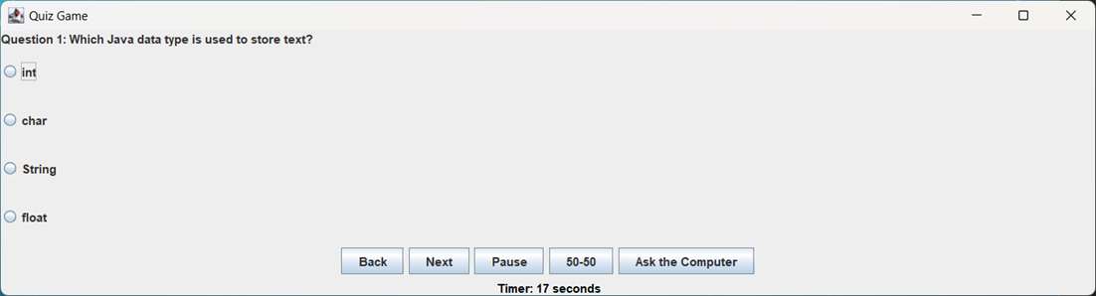
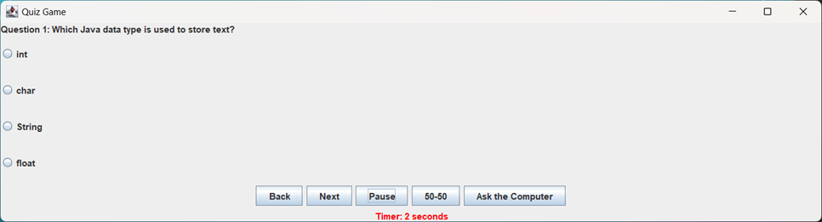
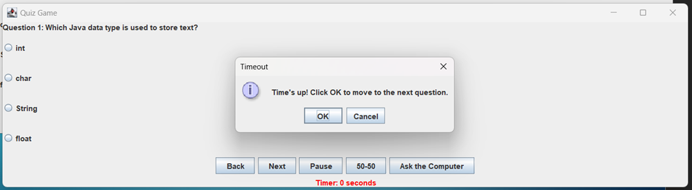
The 1st question along with the game options after the user starts the quiz
As the timer is heading towards 0 the timer flashes red so warn the user after which a time’s up pop up
comes up and disables the radio buttons so the user cannot change or add their answer

Slide 9
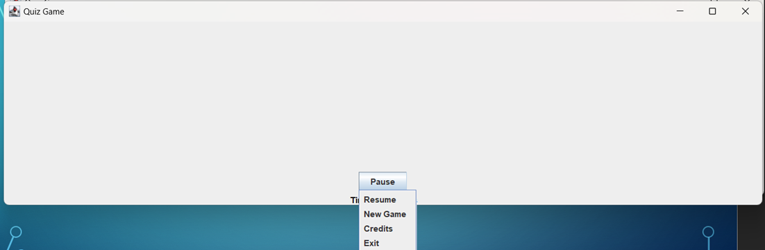
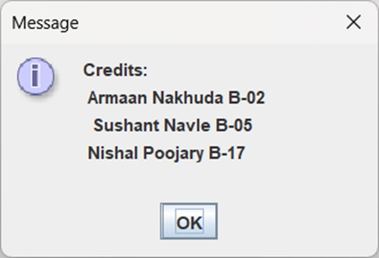
The popup menu the user gets after clicking the pause button which also hides the questions and options to reduce cheating and also pause the timer
The resume option resumes the quiz from the point it was paused
The new game option takes the user back to the quiz startup screen and resets everything
The Credits button brings a separate popup to show the names of the team members
The exit button quits the whole quiz

Slide 10
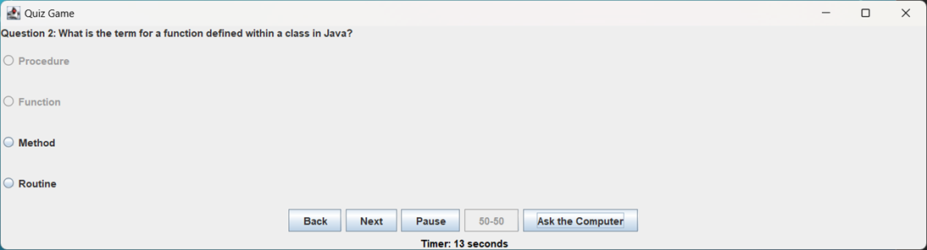
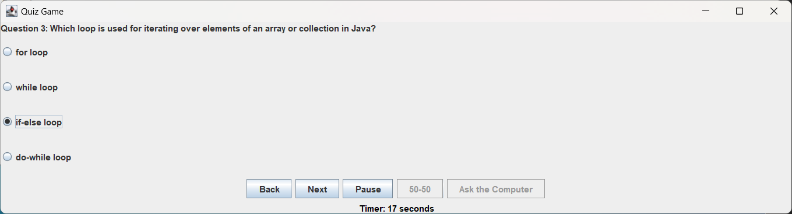
The 50-50 lifeline button disables 2 random wrong options giving the user only 2 options to choose from, this is an one
Time use button after which it will be disabled for rest of the quiz
The Ask the computer Lifeline has a 80% chance of giving the user the right answer and a 20% chance of the wrong answer,
This is also an one time use button after which it will be disabled for rest of the quiz

Slide 11
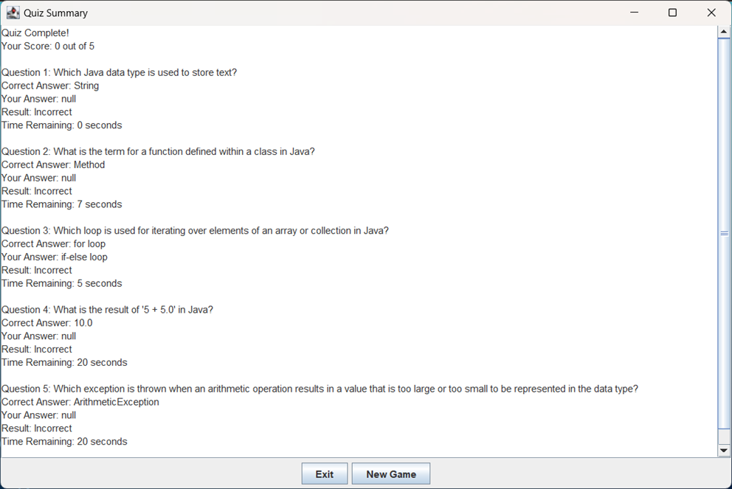
The Summary/Results screen which shows the overall right answers, time taken by the user for each question,
the option chosen by the user, the current answer and if the user choose the right answer or not.

Slide 12
Future scope of the project
The future scope of the project involves implementing several enhancements to enrich the user experience:
Database Integration: Integrate a database feature to empower users with the option to add their own questions, fostering a dynamic and user-driven content environment.
Expanded Lifelines: Enhance the game's interactivity by incorporating additional lifelines, providing players with more strategic options and increasing the overall engagement of the gaming experience.
Diverse Game Modes: Introduce various game modes catering to different levels of difficulty, offering players a broader range of challenges to choose from and ensuring the game's adaptability to diverse skill sets.
Improved GUI: Elevate the graphical user interface (GUI) to make it more visually appealing and user-friendly, enhancing the overall aesthetics and usability of the application.

Slide 13
Conclusions
This is a Quiz game based on the java coding language using the inbuilt GUI functions like swing and Jframe to get a interactive app to the end user while having future scope of making the project bigger as mentioned in the previous slides.
References
Used Chatgpt to give a better Grammatical format for the wording
Used Chatgpt for Bug fixing
Used youtube videos for ideas in project

Slide 14
Thank You!!!
The Github project repository with all the commits history and progress of the project can be found here:-
Or alternatively you can type: https://github.com/Armaan4477/Quiz-Game/ to head straight to the repository for this project.

