Slide 1

Lucky Unicorn Slides
Armaan Singh

Slide 2
Lucky Unicorn
Link to GitHub repository:
https://github.com/Armaan516/01-Lucky_Unicorn
Links to trello board / project management tools:
You must provide evidence showing how the problem has been decomposed, how the components have been developed and trialled, and of how they have been assembled and tested to create a final, working outcome.

Slide 3
Relevant Implication - Functionality
Functionality means that your program works properly. In this case my program asks the user how many rounds they want to play. The program should be able to handle expected answers like 3, boundary answers like 1 and should not break on a value too low like 0, and handle invalid answers without crashing e.g. text or decimals.

Slide 4
Relevant Implication - Usability
Usability means how easily the end user can succeed in doing tasks. The implication may involve making clear instructions and clear error messages that can be easily understood by the users.

Slide 5
Relevant Implication - Aesthetics
Aesthetics mean what the program looks like. For example, a program with spaced instructions, prompts and decoration around key messages is more likely to be aesthetically pleasing than a program with plain, unformatted and unaligned text.

Slide 6
Relevant Implication - Social
The social implication involved how the program affects users and the society. For example, a gambling game can have a negative affect on users if there are no safeguards in place to limit users from excessive losses.

Slide 7
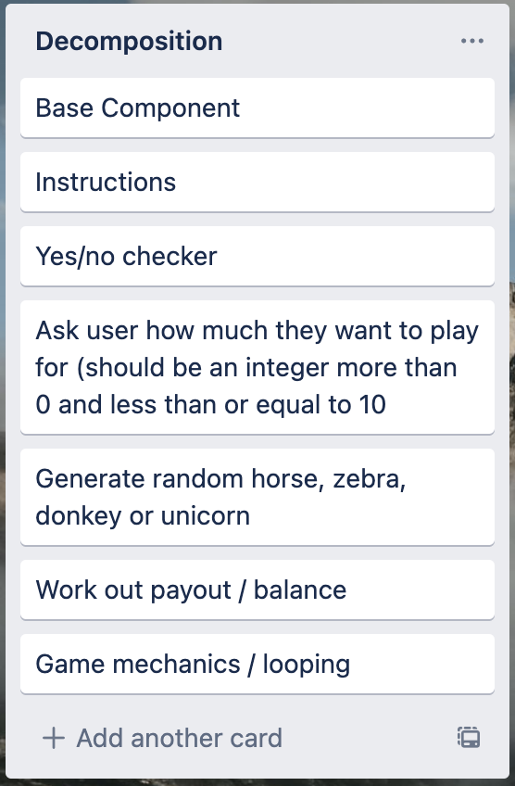
Decomposition

Slide 8
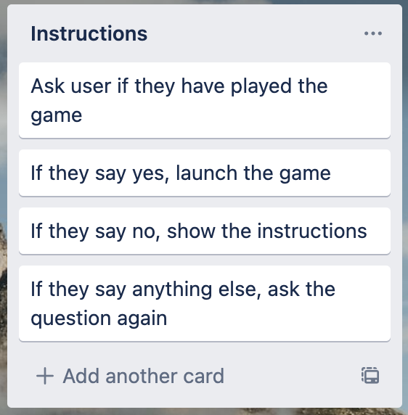
Instructions (and yes / no checker)

Slide 9
Instructions (and yes / no checker) Test Plan
Test Case | Expected Values
Have you played before? Maybe | <error> Please choose y/n
Have you played before? Yes | Game starts
Have you played before? No | Show instructions, then start game

Slide 10
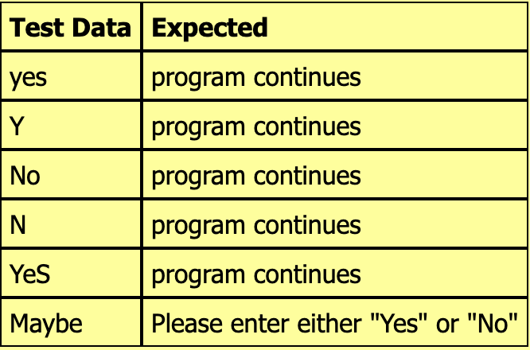
Yes / no checker test plan

Slide 11
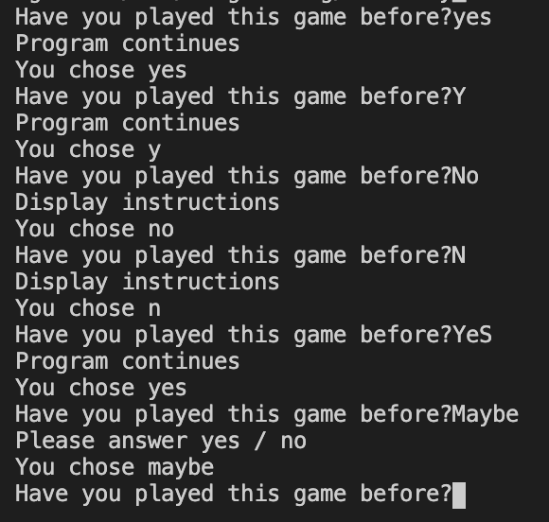
Yes / no checker testing
All cases worked as expected (code has been looped to make testing easier)

Slide 12
Yes / No trialling
Initial Trial: The code worked for yes / no but failed if UPPERCASE characters were used.
Trial 1 (01_yes_no_v1.py): This piece of code worked for both UPPER and lower case characters but was inefficient. It has five if / elif / else statements and quite a bit of repeated code.
Trial 2 (01_yes_no_v2.py): I used the ‘or’ command to combine my ‘yes’ / ‘y’ statements and this code is more efficient compared with trial #1.
Trial 3 (02_yes_no_function_v1.py): I made the code from trial 3 into a function which makes it easier to ask more than one yes / no question in a program. I will use this function in my Lucky Unicorn outcome.

Slide 13
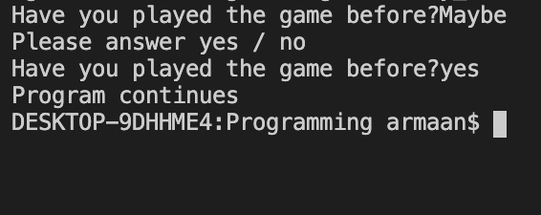
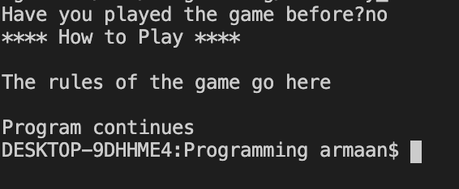
Instructions (and yes / no checker) Testing
Test Case 1 (maybe then ‘yes’) – output is as expected
Test Case 1 (maybe then ‘yes’) – output is as expected

