Slide 1
Mobile Price Prediction
Armaan C Rao, 185001023

Slide 2
Problem Statement
To predict if the mobile with given features will be economical or expensive by finding some relation between its features and selling price.

Slide 3
Literature Survey
Predicting the Price of Used Cars using Machine Learning Techniques
Sameerchand-Pudaruth predicts the prices of second hand cars in Mauritius [1]. He implemented many techniques like Multiple linear regression, k-nearest neighbors(KNN), Decision Tree, and Naïve Bayes to predict the prices. Sameerchand-Pudaruth got Comparable results from all these techniques. During research it was found that most popular algorithms i.e Decision Tree and Naïve Bayes are unable to handle, classify and predict Numerical values. Number of instances for his research was only 97(47 Toyota+38 Nissan+12 Honda). Due to less number of instances used, very poor prediction accuracies were recorded.

Slide 4
2) Introduction to Multiple Regression: How Much Is Your Car Worth?
Shonda Kuiper has also worked in the same field. Kuiper used multivariate regression model to predict price of 2005 General Motor cars. He collected the data from available online source www.pakwheels.com [2]. The main part of this research work is “Introduction of suitable variable selection techniques, which helped to find that which variables are more suitable and relevant for inclusion in model. This (His research) helps students and future researchers in many fields to understand the conditions under which studies should be conducted and gives them the knowledge to discern when appropriate techniques should be used.

Slide 5
3) Support Vector Regression Analysis for Price Prediction in a Car Leasing Application
Support Vector Machine(SVM) concept is used by one another researcher Mariana Listiani for the same work [3]. Listiani predicted prices of leased cars using above mentioned technique. It was found in this research that SVM technique is far more better and accurate for price prediction as compared to other like multiple linear regression when a very large data set is available. The researcher also showed that SVM also handles high dimensional data better and avoids both the underfitting and overfitting issues. To find important features for SVM Listiani used Genetic Algorithm . However, the technique failed to show in terms of variance and mean standard deviation why SVM is better than simple multiple regression.

Slide 6
4) House Price Prediction: Hedonic Price Model vs. Artificial Neural Network
Neural Networks (NN) are more better in estimating price of house, this was concluded in the research of Limsombunchai [4]. By comparing with hedonic method his method was more accurate.Operation of both the methods are same, but in NN the model is trained first and then tested for prediction. Using both the methods NN produced higher R-sq and smaller root mean square error (RMSE), while hedonic produced lower values. This research was limited because the actual house price were missing and only estimated prices were used for the research work.

Slide 7
5) Vehicle Price Prediction System using Machine Learning Techniques
K Noor and Saddaqat J also worked to predict the price of Vehicles using different techniques [5]. The researchers achieved highest accuracy using multiple linear regression. This paper proposes a system where price is dependent variable which is predicted, and this price is derived from factors like vehicle’s model, make, city, version, color, mileage, alloy rims and power steering.

Slide 8
Scope
Every day new mobiles with new versions and more features are launched. Hundreds and thousands of mobile are sold and purchased on a daily basis. This work can be used in any type of marketing and business to find an optimal product with minimum cost and maximum features.

Slide 9
Dataset Description
The dataset was taken from Kaggle datasets and contains information about 3000 records of mobiles and its features [6].
https://www.kaggle.com/iabhishekofficial/mobile-price-classification

Slide 10
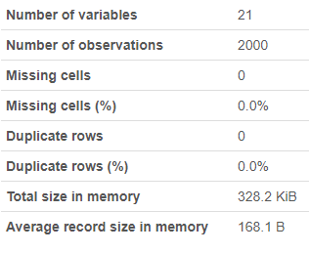
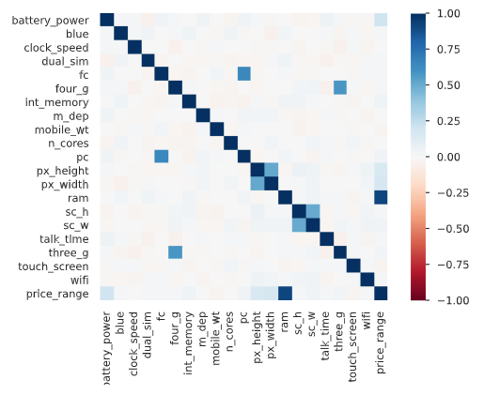
Dataset Statistics
Pearson’s Correlation

Slide 11
Visualisation
best price

Slide 12
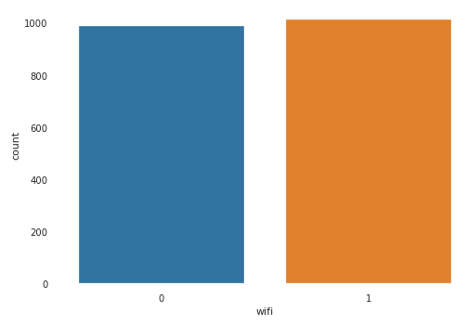
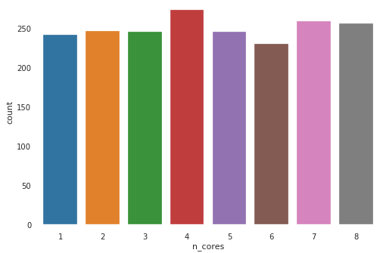
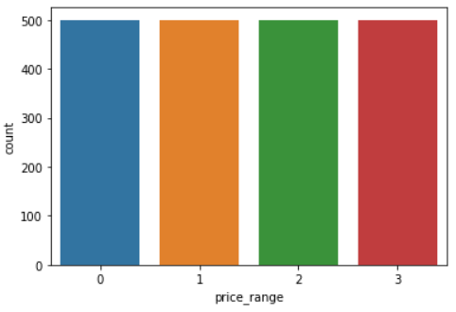
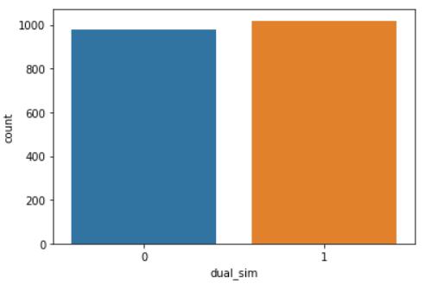
Dataset is evenly distributed.

Slide 13
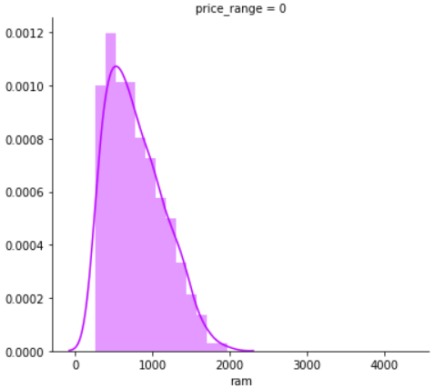
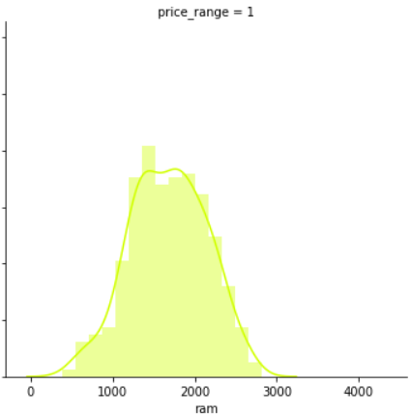
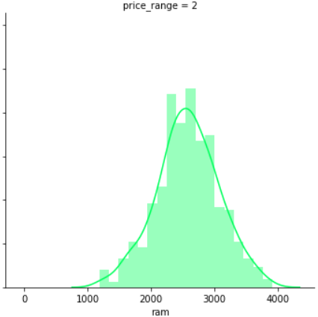
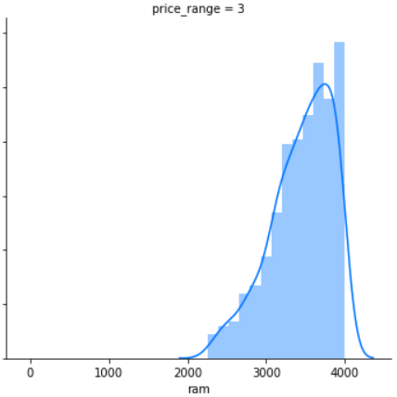
Correlation between price_range and RAM
Price-range mapping
Cheap
Standard
Expensive
Very Expensive
*RAM has highest Pearson’s correlation with price_range (slide 10)

Slide 14
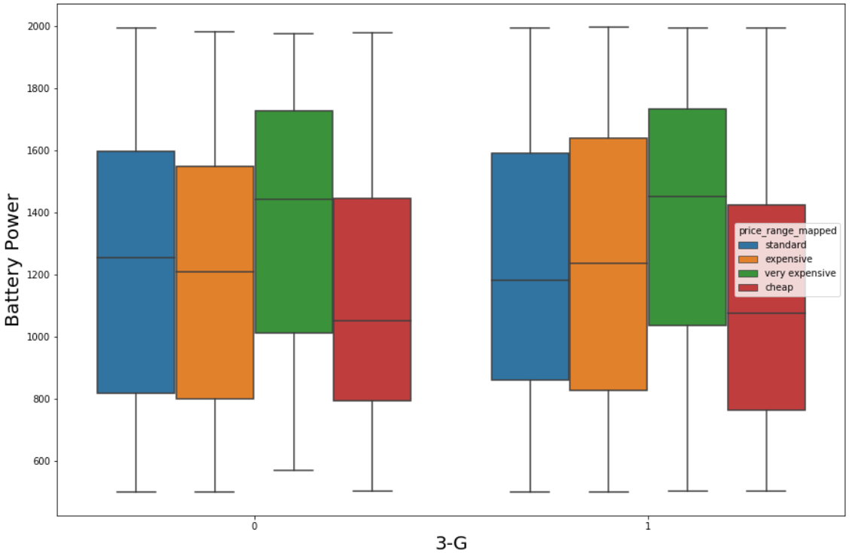
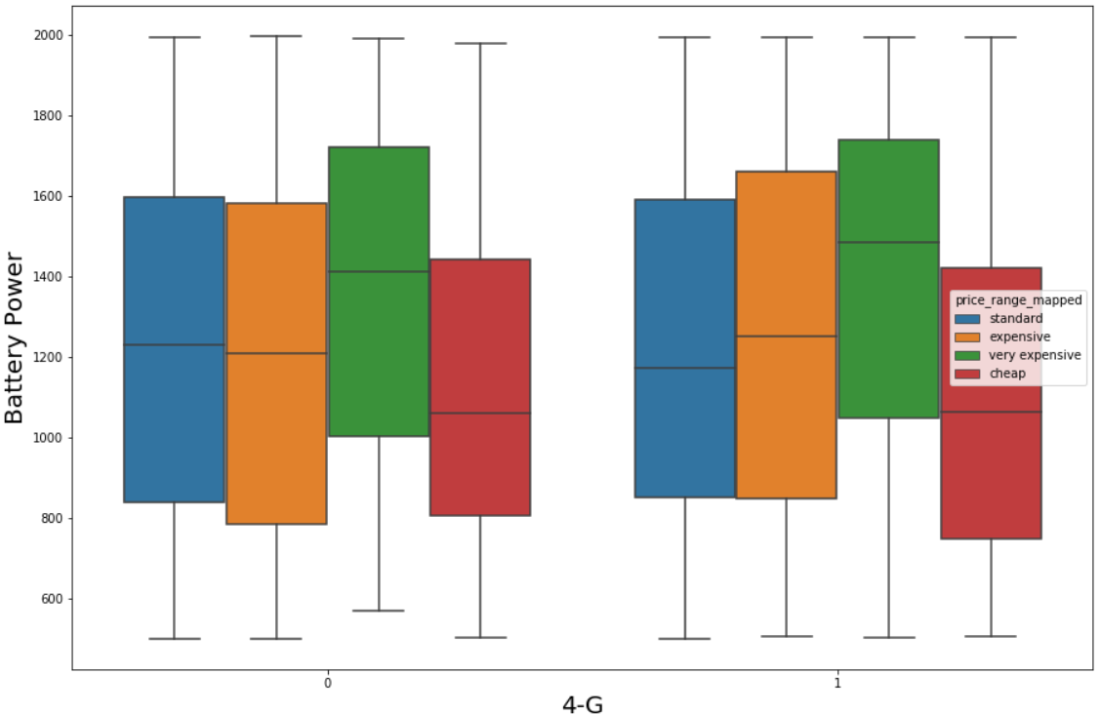

Slide 15
Data Preprocessing

Slide 16
'battery_power', 'blue', 'clock_speed', 'dual_sim', 'fc', 'four_g', 'int_memory', 'm_dep', 'mobile_wt', 'n_cores', 'pc', 'px_height', 'px_width', 'ram', 'sc_h', 'sc_w', 'talk_time', 'three_g', 'touch_screen', and 'wifi' are selected as features.
Training and test data is split as 75% and 25%.
Feature Selection
Target Selection
Train-test Split
Scaling
price_range is selected as the target variable.
Train and test data is scaled.

Slide 17
Solution

Slide 18
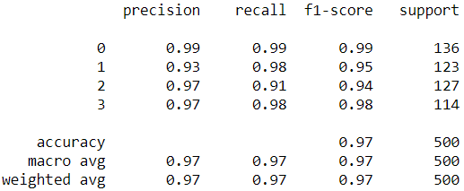
Logistic Regression
Justification
Logistic regression tries to find the probabilities of class membership as a multilinear function of the features. Then depending on the probabilities, the classification is done. Since the problem of identifying the price range of a mobile as cheap, standard, expensive or very expensive is a classification problem, logistic regression has been chosen.
Confusion Matrix
Classification Report
135 | 1 | 0 | 0
1 | 120 | 2 | 0
0 | 8 | 116 | 3
0 | 0 | 2 | 112

Slide 19
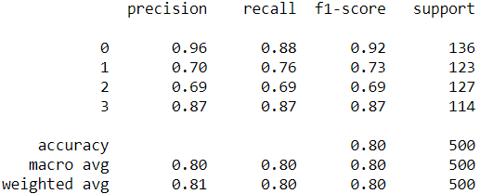
Naive Bayes Classifier
Justification
Naive Bayes classifiers are a collection of classification algorithms based on Bayes’ Theorem. Naive Bayes classifiers have worked quite well in many real-world classification problems. They require a small amount of training data to estimate the necessary parameters. It predicts the class with the highest probability.
Confusion Matrix
Classification Report
119 | 16 | 1 | 0
5 | 94 | 24 | 0
0 | 24 | 88 | 15
0 | 0 | 15 | 99

Slide 20
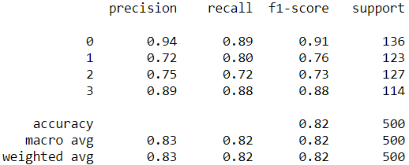
Decision Tree Classifier
Justification
The goal of this algorithm is to create a model that predicts the value of a target variable, for which the decision tree uses the tree representation to solve the problem in which the leaf node corresponds to a class label and attributes are represented on the internal node of the tree. Since the problem is to determine the price range of mobile phones based on features, the decision tree classifier can be used.
Confusion Matrix
Classification Report
121 | 15 | 1 | 0
8 | 99 | 16 | 0
0 | 24 | 91 | 12
0 | 0 | 14 | 100

Slide 21
Tools Used
numpy
pandas
matplotlib.pyplot
seaborn
StandardScaler from sklearn.preprocessing
Train_test_split from sklearn.model_selection
DecisionTreeClassifier from sklearn.tree
confusion_matrix, accuracy_score, classification_report from sklearn.metrics
LogisticRegression from sklearn.linear_model
GaussianNB from sklearn.naive_bayes
DecisionTreeClassifier from sklearn.tree

Slide 22
Performance Metrics
Accuracy
Precision
F1-score
Recall

Slide 23
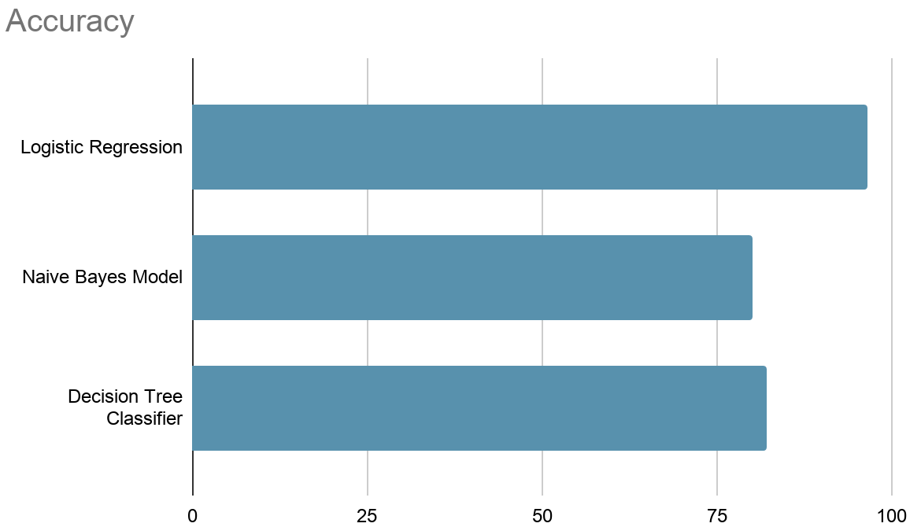
Results
Logistic Regression : 96.6%
Naive Bayes Model : 80.0%
Decision Tree Classifier : 82.2%

Slide 24
Conclusion
For the problem statement, experiments were carried out for three different models - Logistic regression, Naive Bayes model, and Decision tree classifier. For the collected dataset, logistic regression showed 96.6%, naive Bayes showed 80.0%, and decision tree showed 82.2% accuracy. From the experiment results, it can be inferred that logistic regression works best for the selected problem statement and dataset.

Slide 25
References
[1] Pudaruth, Sameerchand. (2014). Predicting the Price of Used Cars using Machine Learning Techniques. International Journal of Information & Computation Technology. 4. 753-764.
[2] Shonda Kuiper (2008) Introduction to Multiple Regression: How Much Is Your Car Worth?, Journal of Statistics Education, 16:3, DOI: 10.1080/10691898.2008.11889579
[3] Listiani, M., Möller, R., Morlock, M., Lessmann, S., & Hamburg, G. (2009). Support Vector Regression Analysis for Price Prediction in a Car Leasing Application.
[4] Limsombunchai, Visit & Gan, Christopher & Lee, Minsoo. (2004). House Price Prediction: Hedonic Price Model vs. Artificial Neural Network. American Journal of Applied Sciences. 1. 10.3844/ajassp.2004.193.201.
[5] Noor, Kanwal & Jan, Sadaqat. (2017). Vehicle Price Prediction System using Machine Learning Techniques. International Journal of Computer Applications. 167. 27-31. 10.5120/ijca2017914373.

