Slide 1
Student Employability: Strategic Development
Dr Dino Willox
BA(hons) MA PhD PFHEA
Pronouns: they / them / their

Slide 2


Acknowledgment of Country
The University of Queensland (UQ) acknowledges the Traditional Owners and their custodianship of the lands on which we meet.
We pay our respects to their Ancestors and their descendants, who continue cultural and spiritual connections to Country.
We recognise their valuable contributions to Australian and global society.
Notes:
Guidelines for use:
Use this slide when presenting at UQ or at any site in Australia, when appropriate.
Remember to pause briefly after acknowledging Country as a sign of respect.
If you are more familiar with acknowledging Country you may add a statement about the event, meeting or forum’s connection with Country. For example; at a higher education event you might acknowledge that the campus has always been a space for teaching, learning, research and collaboration tens of thousands of years before it was established as a university campus, and continues today.
When to use longer version:
If you are the main speaker at the event/gathering
If you are the first person to present.
When to use a shorter version:
If you are not the first person to acknowledge Country
In a more informal setting
Thanking a Traditional Owner for welcoming people to Country.
Longer version
I acknowledge the Traditional Owners and their custodianship of the lands on which we meet today. On behalf of * I pay our respects to their Ancestors and their descendants, who continue cultural and spiritual connections to Country. We recognise their valuable contributions to Australian and global society.
* If you are hosting an event, meeting or seminar, you might say something like “On behalf of the event organisers or your section….”
Shorter version
I (too,) acknowledge the Traditional Owners and their custodianship of the lands on which we meet today and pay my respect to their Ancestors and their descendants.
Slide last updated August 2019. Source: PVC(IE); contact Nell Angus.

Slide 3
Overview
understand the holistic and complex nature of employability a self-reflective learning process;
conceptualize and articulate an embedded collaborative strategic model for enhancing employability in a complex institution;
lead a whole-of-institution change and identify strategies to influence institutional investment;
Consider impacts, outcomes, and critical success factors
Basically, I’m going to tell you a story …
Notes:
conceptualisation and articulation of an embedded strategic model for enhancing employability
primacy of experiential learning and development of the SEAL self reflective methodology through students as partners
Leading a whole-of-institution change and accessing strategic funding to enhance employability
Impacts, outcomes, and critical success factors

Slide 4






Who we are
53,600+
18,000+
18,600+
students
international students
postgraduate students
14,500+
6,600+
268,000+
PhD graduates
staff
graduates
#UQ
Notes:
Slide last updated June 2019, includes July 2019 grad figures.
Source: Students and staff (pbi.uq.edu.au/ClientServices/UQStatistics/index.aspx), graduates and PhD graduates (Student Progression – contact Tess Robinson – updated each July and December for graduations)

Slide 5
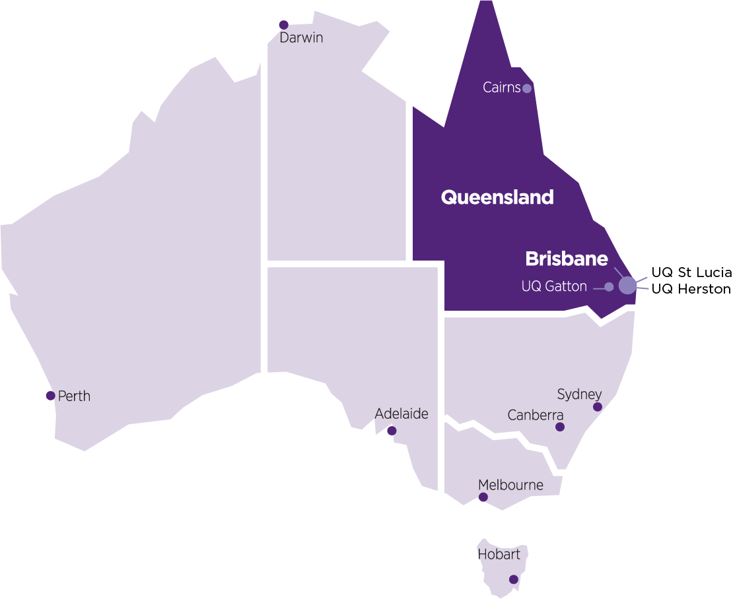




Where we are
3
campuses
6
faculties
30+ teaching and research sites
8 research
institutes
#UQ
Notes:
UQ is famous for its beautiful locations and world-class research and teaching facilities.
The bulk of UQ’s research and teaching activities are organised into large divisions known as faculties – which group schools and centres that focus on similar disciplines – and institutes – which specialise in particular fields of research and development.
UQ’s six faculties are:
Business, Economics and Law (BEL)
Engineering, Architecture and Information Technology (EAIT)
Health and Behavioural Sciences (HABS)
Humanities and Social Sciences (HASS)
Medicine
Science.
UQ’s eight institutes are:
Australian Institute for Bioengineering and Nanotechnology (AIBN)
Global Change Institute (GCI)
Institute for Molecular Bioscience (IMB)
Institute for Social Science Research (ISSR)
Mater Research Institute – UQ (MRI–UQ)
Queensland Alliance for Agriculture and Food Innovation (QAAFI)
Queensland Brain Institute (QBI)
Sustainable Minerals Institute (SMI).
Slide last updated June 2019.

Slide 6
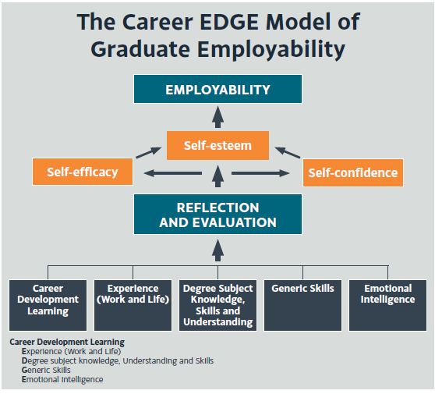

2014 Scoping Employability
Research to define vision
Benchmarking
Employer feedback
Student engagement
UQ Context
Dacre Pool, L. & Sewell, P. (2007).
#UQ
Notes:
Employability has become a critical issue in higher education, with students expecting a return on their investment, and employers increasingly looking for agile, critical, creative, innovative and entrepreneurial mindsets. With an increased focus on deliverables, the Government is also considering performance funding linked to employment outcomes.
Using the CareerEDGE model of graduate employability (Dacre Pool & Sewell 2007), the UQ framework is focussed on learning from experiences, curricular and extracurricular, in order to develop employability. The model provides a means of understanding the components of employability, and that reflection and evaluation are necessary to transform those components into employability (Dacre Pool & Sewell 2007).
Dacre Pool, L. & Sewell, P. (2007). The key to employability: developing a practical model of graduate employability. Education + Training, 49(4), 277-289.

Slide 7



2015 Defining and Framing Employability
Employability strategy and framework endorsed by DVCA
Pilot of post-experience reflective workshops with students
Development of MOOC: EMPLOY101x
Definition: employability is a set of capabilities and personal attributes that empower graduates to perform effectively in the workplace, generate opportunities, and create positive social and economic impact
Awareness
employability as both degree knowledge and attributes that guide workplace performance
Experiences
Engaging with a range of experiences to develop capabilities and attributes for employability
Learning
Using self-reflection to translate experiences into employability development
Transfer
Communicating employability effectively and transferring learning into workplace performance
#UQ
Notes:
Employability has become a critical issue in higher education, with students expecting a return on their investment, and employers increasingly looking for agile, critical, creative, innovative and entrepreneurial mindsets. With an increased focus on deliverables, the Government is also considering performance funding linked to employment outcomes.
Using the CareerEDGE model of graduate employability (Dacre Pool & Sewell 2007), the UQ framework is focussed on learning from experiences, curricular and extracurricular, in order to develop employability. The model provides a means of understanding the components of employability, and that reflection and evaluation are necessary to transform those components into employability (Dacre Pool & Sewell 2007).
Dacre Pool, L. & Sewell, P. (2007). The key to employability: developing a practical model of graduate employability. Education + Training, 49(4), 277-289.

Slide 8





Spotlight: SEAL
SITUATION
What was the new experience or challenge you faced and what happened to you?
EFFECT
What impact did it have on you and what were the consequences of this impact?
ACTION
What action did you take to deal with the new situation and any challenges, and why did you do this?
LEARNING
What did you learn from this experience and how will you apply this in the future?
#UQ

Slide 9


2016 Establishing Employability
1st run of EMPLOY101x (24,200 learners)
Definition and typology of Work Integrated Learning (WIL)
WIL embedded in LMS and student record systems
Expansion of post-experience workshops
Creation of Student Employability Centre
Student Strategy: Goal 1: Game Changing Graduates
#UQ
Notes:
Employability has become a critical issue in higher education, with students expecting a return on their investment, and employers increasingly looking for agile, critical, creative, innovative and entrepreneurial mindsets. With an increased focus on deliverables, the Government is also considering performance funding linked to employment outcomes.
Using the CareerEDGE model of graduate employability (Dacre Pool & Sewell 2007), the UQ framework is focussed on learning from experiences, curricular and extracurricular, in order to develop employability. The model provides a means of understanding the components of employability, and that reflection and evaluation are necessary to transform those components into employability (Dacre Pool & Sewell 2007).
Dacre Pool, L. & Sewell, P. (2007). The key to employability: developing a practical model of graduate employability. Education + Training, 49(4), 277-289.

Slide 10
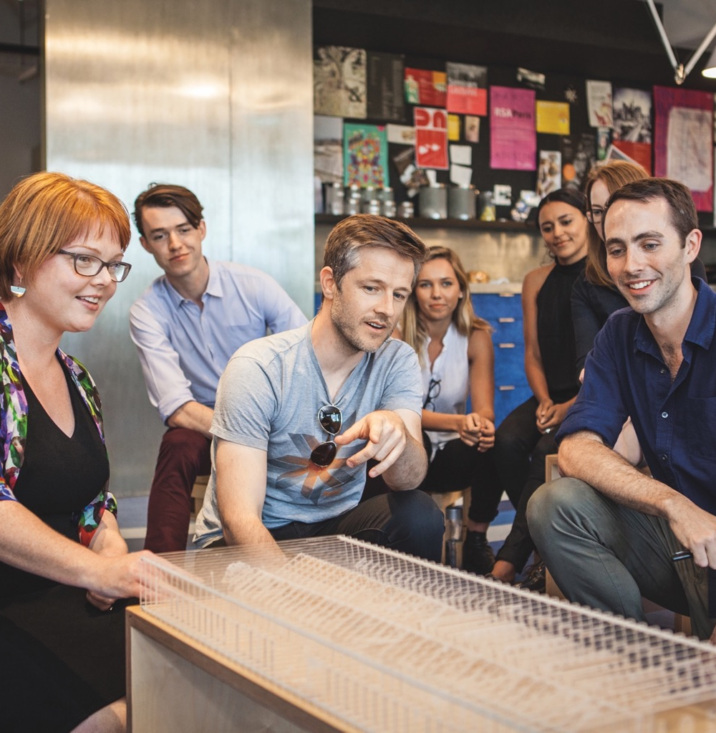



Spotlight: Student Strategy
Game-changing graduates
Student centred flexibility
An integrated learning environment
Dynamic people and partnerships
#UQ
Notes:
At UQ, we see the world differently, which is why we’re changing the way higher education is imagined and experienced.
Our student strategy (2018–2020) is part of UQ’s commitment to provide our students with the best opportunities and practical experiences during their time at university, empowering them to create change with a skill set that will prepare them to exceed expectations throughout their careers.
Through the strategy, which is based on extensive consultation with staff, students, alumni and industry, we aim to:
Expand our employability programs to provide greater mentorship, careers advice, industry experience and start-up opportunities.
Embed our research excellence within the core of our teaching for students to gain cutting-edge knowledge with a highly valued and distinctive skill set.
Meet the learning expectations of a hyperconnected and entrepreneurial generation of digitally-minded learners.
Provide flexible learning options that support the professional ambitions and personal aspirations of an increasingly diverse student cohort.
Support a student experience that recognises students as both consumers and co-creators of knowledge.
Create vibrant campus settings that generate the right conditions for higher learning and support student life.
Engender a culture whereby staff commitment to an enriched student experience is supported and rewarded so that our students remain at the heart of all that we do.
Goal 1: Game-changing graduates
To graduate students who use their intellectual assets to build meaningful careers, become effective leaders, and turn their ideas into impact.
Goal 2: Student-centred flexibility
To provide our students with flexible options that support and service their priorities, meet their expectations and personalise their learning experience.
Goal 3: Dynamic people and partnerships
To strengthen a dynamic and enterprising culture that supports continued innovation, adapts to change, and is shared, valued and enriched by students and staff.
Goal 4: An integrated learning environment
To build a vibrant, practical and digitally-integrated environment that supports and enhances on- campus learning, community engagement and student life.
Slide last updated June 2019. Source: student-strategy.uq.edu.au/strategy

Slide 11


2017 Embedding Employability
Employability Award launched
2nd run of EMPLOY101x (34,650 learners)
Integration of Framework into the curriculum
Staff development course ‘Embedding Employability’
Baseline WIL numbers captured
Investment in employability system infrastructure (Placements and ePortfolio)
Employability Award
$1.3 million to Faculties to enhance employability
#UQ

Slide 12
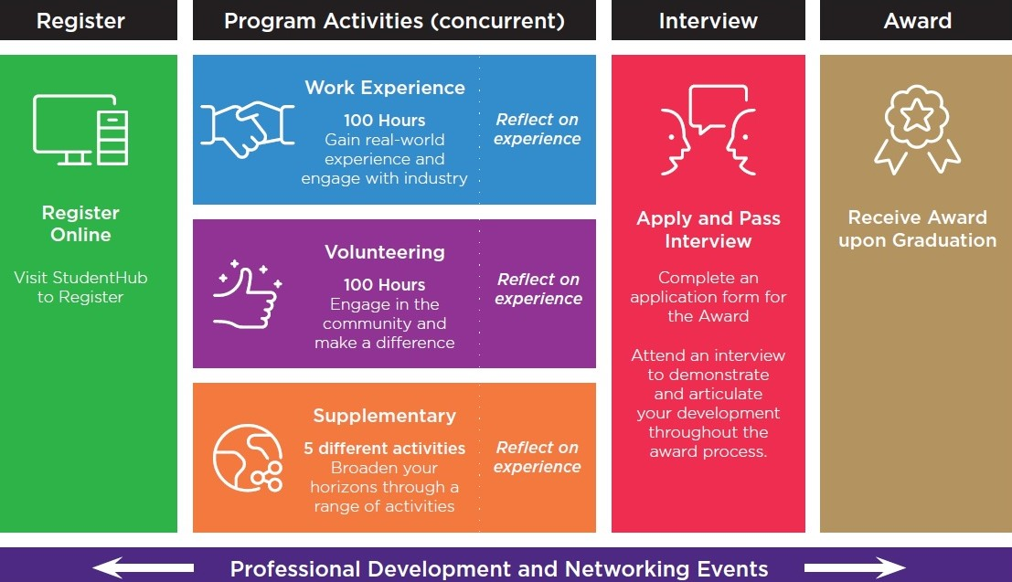
Spotlight: Employability Award
#UQ

Slide 13
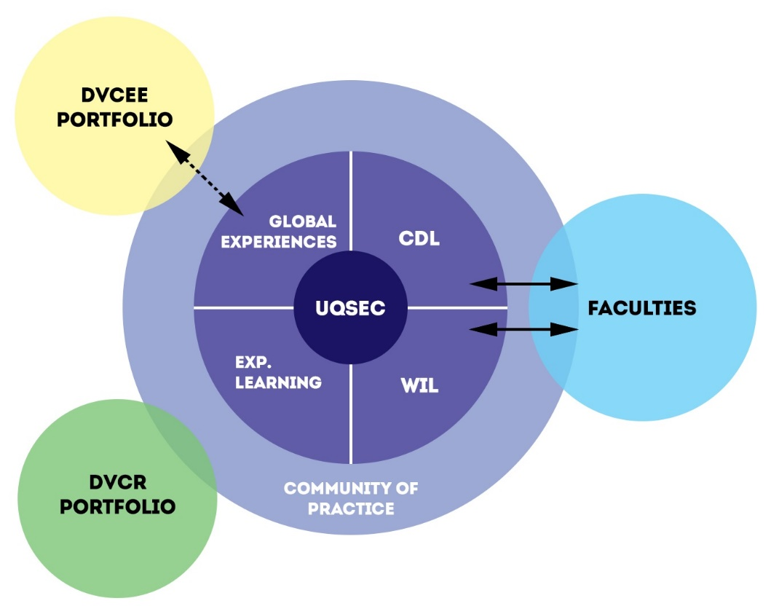
2018-2019 Investing in Employability
#UQ

Slide 14

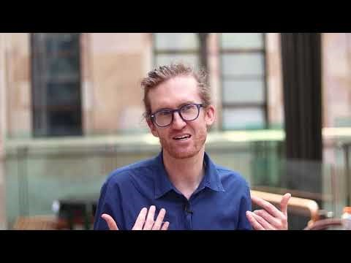



Spotlight: Student-Staff Partnerships
2,411
Students engaged
in partnership with UQ
$2.9m
Funding over three years
987
Student Partner Engagements
539
Student Representatives
31% International Students
885
Student Voice Participants
1 in every 31 Students
#UQ
Notes:
https://youtu.be/At2dbhDKvPs
UQ Student-Staff Partnerships provide a valuable opportunity for staff and students to work collaboratively on projects, committees, or via focus groups and feedback sessions.
Student-Staff Partnership consists of three streams: Partnership Projects; Student Representation; and Student Voice.
Partnership projects: Students and staff connect as co-collaborators on projects that seek to effect positive change within the teaching and learning, student experience and governance/strategy environments.
Student Representation: students and staff members work in a mutually beneficial way on a range of UQ committees, boards and working groups.
Student Voice: to connect students with UQ staff members that are seeking student feedback and opinion (e.g. focus groups)

Slide 15


Spotlight: Entrepreneurial Education
69%
100+
130+ students participated in Startup Adventures
UQ students value
entrepreneurial learning
entrepreneurial courses in the curriculum
30+
185+
startups benefited from accelerator and incubator programs
900+ annual participants in extra-curricular entrepreneurship
entrepreneurial
research academics
#UQ
Notes:
“Every student at UQ will have the opportunity to experience entrepreneurial learning, embedded across all programs and faculties” – UQ Entrepreneurship Strategy 2018-2022
An ecosystem of entrepreneurial education within the curriculum is designed for students to build a complexity of learning during their program

Slide 16
Employability
Entrepreneurial Education
critical thinking
initiative
creativity
Career Development Learning
adaptability
innovating
inquiry
business model canvas
entrepreneurial mindset
empathy
iLab accelerator
Professionalism in the workplace
reflecting
articulating
communicating
networking
investment readiness
Technical competencies
for accreditation
complex problem-solving
IdeaHub
Startup Adventures
design thinking
Startup Academy
Examples of: competencies, attributes & behaviours, UQ programs/activities, technical competencies
#UQ
Notes:
Employability and Entrepreneurial Education are interrelated
In demand competencies across all industry sectors
It’s the lens / frame that is applied to the subject content
There are differences between the two, see diagram. These competencies and activities are not in exactly rigid lines, but placed in the area identified as the main purpose / intent of the learning

Slide 17



Impact: Research Programs
5,726
Student participation since 2009
$770,000
Annual
Co-funded Amount
44
Research
Units Participate
527
Research Projects
Offered
84%
students reported increased employability confidence
#UQ
Notes:
History:
- The Summer Research Program has been administered by the Student Employability Centre since 2009 and the Winter program since 2012.
Since it’s inception, the program has provided 5726 students with access to an early research experience to enhance their employability.
Model:
The programs are offered over the Summer and Winter vacation period
Based on a cost-share model, Student Employability allocates 50% of the total scholarship amount to university research units to facilitate provision of the research experience.
The program is available to undergraduate, honours and postgraduate coursework students enrolled at UQ.
Outcomes/Improvements:
Very competitive program with an application success rate in 2018 of 43% of the total applications received.
Access and quality engagement with supervisors impacts greatly on the research experience with 92% of students reporting that their supervisor had a positive impact.
In the 2019 Winter program, 84% of students reported an increase in their confidence in employability (measured as the skills and mindset to successfully gain, create and maintain work)
Gaining hands-on work experience, exploring interests and clarifying whether to pursue a research career remain the highest ranking motivators for student participation.

Slide 18






Impact: Work Integrated Learning (WIL)
15,800+
Students enrolled in WIL courses in 2019
31.5%
11 Entrepreneurship / Enterprise courses
226 Industry placement courses
57 Industry Project courses
students enrolled in WIL courses
139 Work Simulation courses
21 Reflection on employment courses
169 Field Experience courses
541 WIL courses across UQ in 2019
Based on 2019 Preliminary figures

Slide 19
Impact: WIL Course Enrolments
Proportion of coursework students
enrolled in a WIL course
8%
 | 2017 | 2018 | 2019
Undergraduate | 29% | 30% | 30%
Postgraduate | 36% | 36% | 34%
Total | 31% | 32% | 32%
3%
21%

Slide 20
Impact: Metrics
OPERATIONAL METRICS (INPUTS)
KPIs (OUTPUTS)
Service Performance / | 2016 | 2017 | 2018 | 2018 v 2016
Client Volume
Experiences | 1,670 | 2,016 | 3,274 | 96%
Events | 8,300 | 10,145 | 9,586 | 15%
Careers Advice | 5,828 | 9,596 | 10,367 | 78%
Online Student Hub activity | 396,838 | 633,468 | 748,898 | 89%
 | 2016 Rank | 2017 Rank | 2018 Rank
QS Employability Rankings* | 51-60 | 49 | 48
Employer Satisfaction Survey |  | 6th | 5th
Graduate Outcomes Survey #:
GOS: FT Employment | 11th | 13th | 2nd
GOS: Overall Employment | 6th | 10th | 7th
GOS: Foundation Skills | 6th | 3rd | 3rd
GOS: Adaptive Skills | 8th | 5th | 5th
GOS: Collaborative Skills | 14th | 11th | 8th
* Data reported as the following year e.g.: 2018 data presented by QS in 2019 report
# Reported as Effective Ranks, calculated by PBI, taking into account statistical significance
*includes 329% increase in short term global experiences
#UQ
Notes:
“experiences” includes:
Semester exchange
*Short Term Global (including study, internships, volunteering)*
Research (summer and winter research programs)
Volunteering (students who have gone through the central recruitment and training process and have been approved to volunteer)
Student Staff Partnerships
Does not currently include (but will in future):
IdeaHub / iLab
Student representation and voice

Slide 21
Impact: Qualitative feedback
Student Staff Partnerships
‘I feel like I have learned a lot of valuable skills…So it’s been a really good opportunity to do the sort of work that I’m likely to end up doing as some point, getting a lot of practice at that work with some really good people, and make decisions for myself’ – Student Partner
‘And one [student], after she finished one of our projects, she felt confident enough to apply for a job in the same field in which we had done a project together....She told me after she got the job, and she was so excited. She wouldn't have even gone for it if she hadn't been involved in the partnership project’ – Staff Partner
Summer and Winter Research
‘One of the most important/significant things I discovered was that I had the ability to move out of my comfort zone and pursue an experience I had not previously experienced before. It allowed me to develop my interpersonal skills, improve my communication, presentation skills and ability to problem solve. I had learnt so much more than what I was expecting, and has also further developed my passion and appreciation for research.’
‘My experience gave me more confidence in my ability to manage my Honours year better, as I believe I now have skills that will benefit me during that time. I am also seriously considering choosing an Honours project based around the topic covered in my summer research project. My plans for a PhD and research career have not changed, only been confirmed.’
81% reported an increase in confidence communicating their potential to an employer
#UQ

Slide 22
Impact: Qualitative feedback
Employability Award
“The employability award journey is more than just employability - it's a self-discovery process. Along the way, you learn about what you can do, how far your limits are, and it provides an avenue for you to reach out to other people and make them involved as well”
“The employability Award provides an enormous amount of opportunity to be social and step outside of your comfort zone with support from UQ. It also helps reflect on what you have done and find communicable strengths”
90% reported that participation in the Employability Award improved their ability to communicate their employability
#UQ

Slide 23

Future Focus
Development of High School MOOC
Co-creation of Career Development Learning digital VLE
Establishment of KPIs and creation of Employability Dashboard
Research into measures of success: longitudinal studies
Branding, messaging, and consolidating

Slide 24
Reflections
Critical Success Factors
Context – power dynamics, structures, and institutional maturity
Method – viral approach
Language – stakeholder communication
Serendipity – seize moments
Agility – be willing to change tack where necessary
Evidence
External KPIs
Performance measures (inputs)
Advance HE Audit – best practice
Qualitative feedback
“No enterprise is more likely to succeed than one concealed … until it is ripe for execution”
Niccolo Machiavelli
“In battle, victories do not repeat themselves; formations must be adjusted ceaselessly”
Sun Tsu
#UQ

Slide 25



Thank you
Dr Dino Willox | Director, Student Employability
d.willox@uq.edu.au
07 3346 7012
facebook.com/uniofqld
Instagram.com/uniofqld
https://www.linkedin.com/in/dinowillox/
Empowering students to create change by learning from experiences and unlocking their value

