Slide 1


Competition problem solving

Slide 2
Outline of session
Questions involving digits
Geometrical tricks - self-similar shapes and folding problems
Completing the rectangle

Slide 3
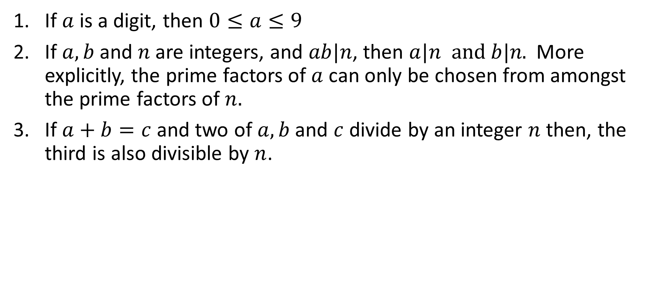
Divisibility and digit properties
If $a$ is a digit, then $0≤a≤9$
If $a, b$ and $n$are integers, and $ab|n$, then $a|n and b|n\text{.}$ More explicitly, the prime factors of $a$ can only be chosen from amongst the prime factors of $n.$
If $a+b=c$ and two of $a,b$ and $c$ divide by an integer $n$ then, the third is also divisible by $n$.

Slide 4
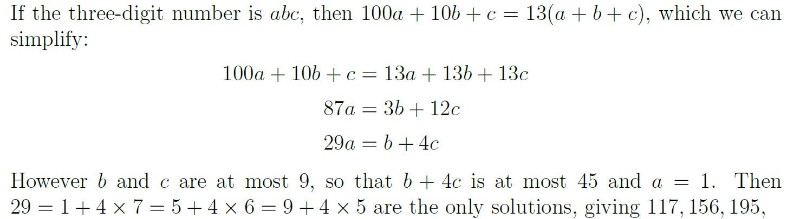
AMC 2017 I23
How many 3-digit numbers are 13 times the sum of their digits?
A 1 B 2 C 3 D 4 E 5

Slide 5
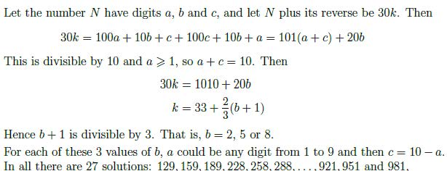
AMC 2017 J28
The reverse of the number 129 is 921 and their sum is 1050, which is divisible by 30. How many 3 digit numbers have the property that, when added to their reverse, the sum is divisible by 30?

Slide 6
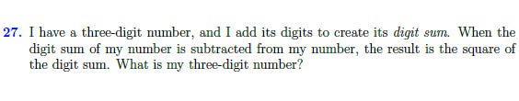
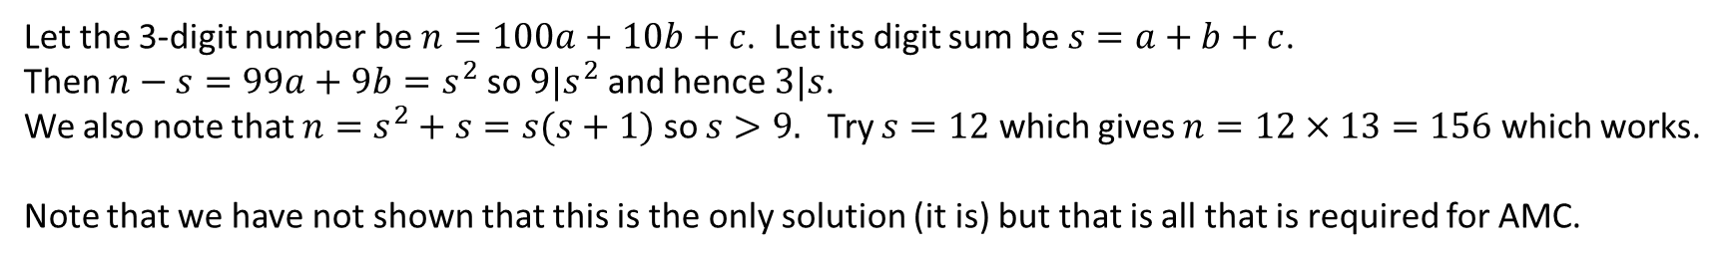
AMC 2018 J27
Let the 3-digit number be $n=100a+10b+c$. Let its digit sum be $s=a+b+c$.
Then $n−s=99a+9b=s^{2}$ so ${9|s}^{2}$ and hence $3|s$.
We also note that $n=s^{2}+s=s(s+1)$ so $s>9.$ Try $s=12$ which gives $n=12×13=156$ which works.
Note that we have not shown that this is the only solution (it is) but that is all that is required for AMC.

Slide 7
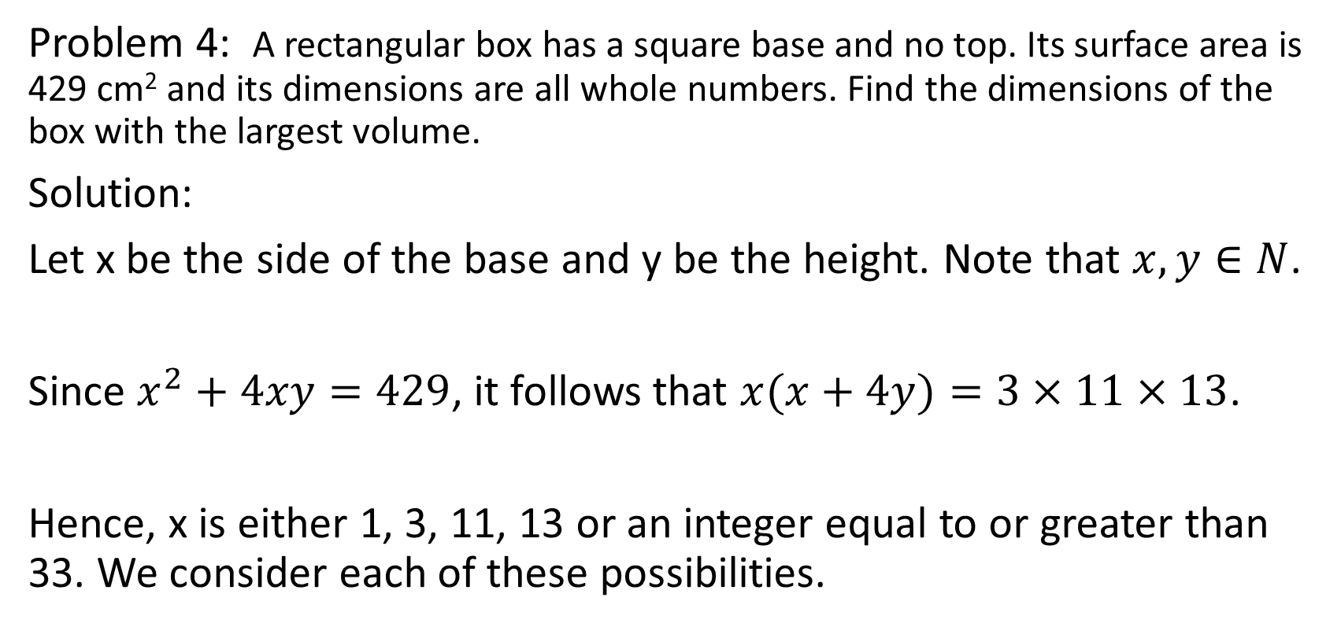
UNSW Schools Competition2016 - Senior Division
Problem 4: A rectangular box has a square base and no top. Its surface area is 429 cm² and its dimensions are all whole numbers. Find the dimensions of the box with the largest volume.
Solution:
Let x be the side of the base and y be the height. Note that $x,y∈N$.
Since $x^{2}+4xy=429$, it follows that $x(x+4y)=3×11×13$.
Hence, x is either 1, 3, 11, 13 or an integer equal to or greater than 33. We consider each of these possibilities.

Slide 8
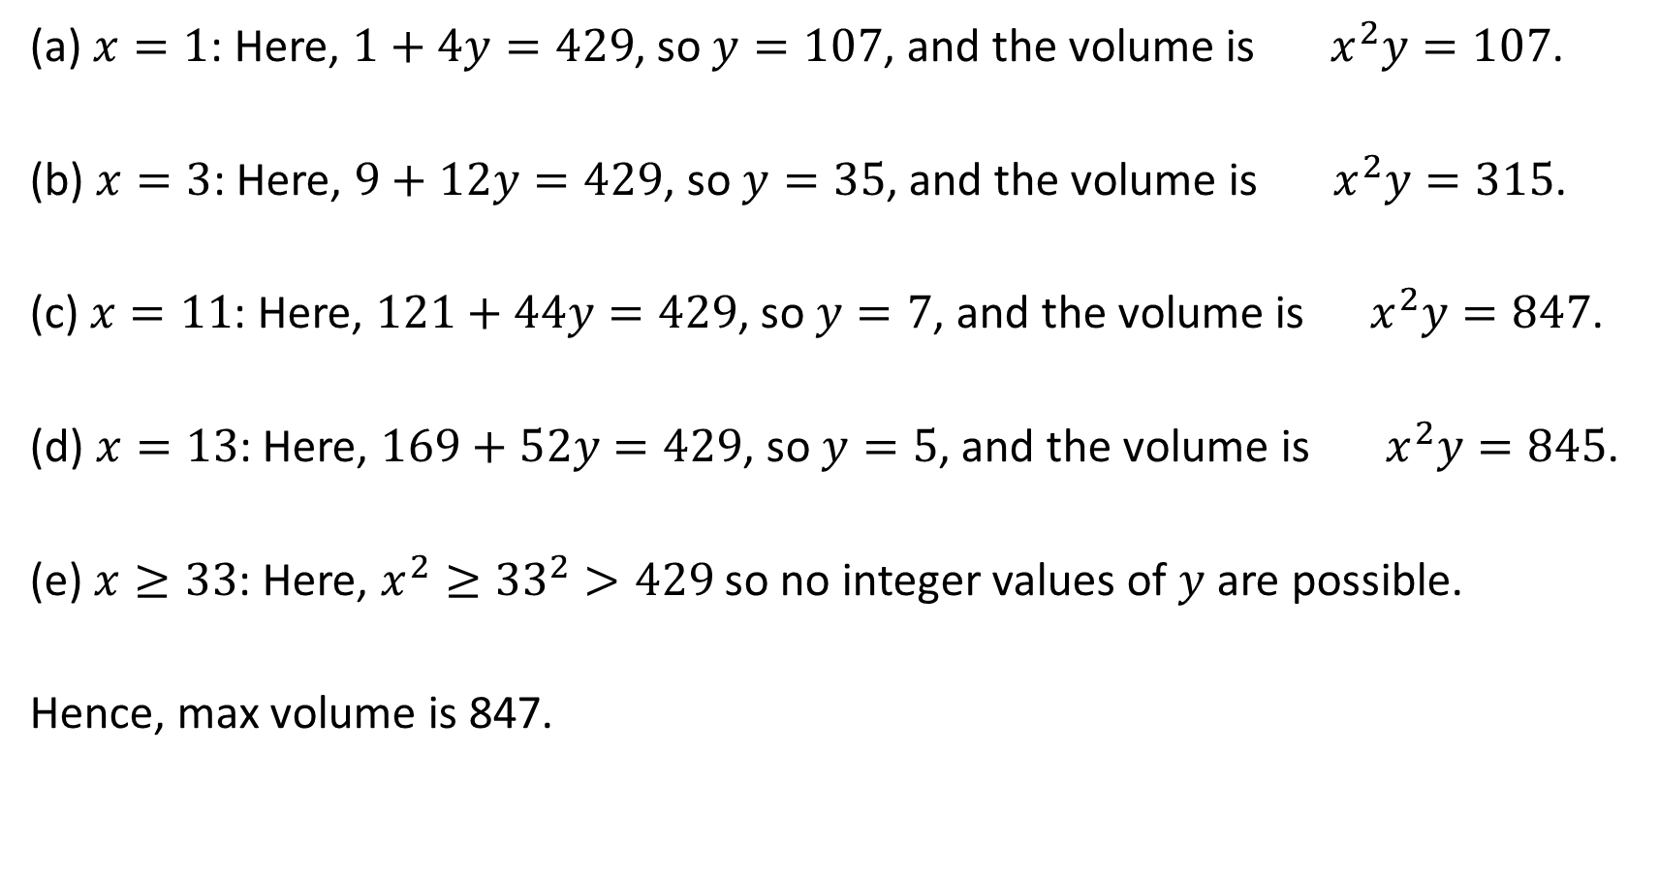
(a) $x=1$: Here, $1+4y=429$, so $y=107$, and the volume is $x^{2}y=107$.
(b) $x=3$: Here, $9+12y=429$, so $y=35$, and the volume is ${ x}^{2}y=315$.
(c) $x=11$: Here, $121+44y=429$, so $y=7$, and the volume is $x^{2}y=847$.
(d) $x=13$: Here, $169+52y=429$, so $y=5$, and the volume is $x^{2}y=845$.
(e) $x≥33$: Here, $x^{2}≥{33}^{2}>429$ so no integer values of $y$ are possible.
Hence, max volume is 847.

Slide 9
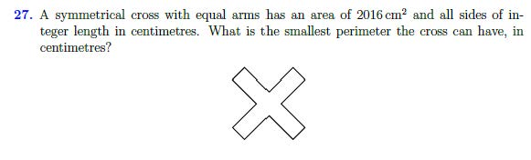
AMC 2016 I27

Slide 10
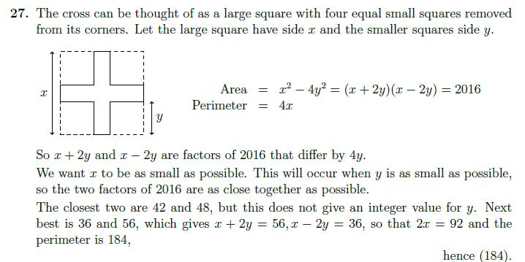
AMC 2016 I27 - solution

Slide 11
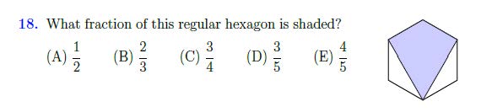
AMC 2018 – UP18

Slide 12
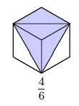
AMC 2018 UP18 - solution

Slide 13
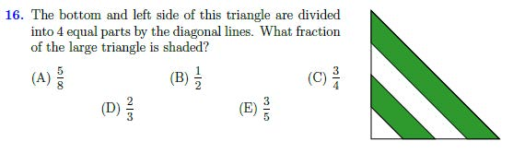
AMC 2017 J16

Slide 14
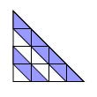
AMC 2017 J16 - solution

Slide 15
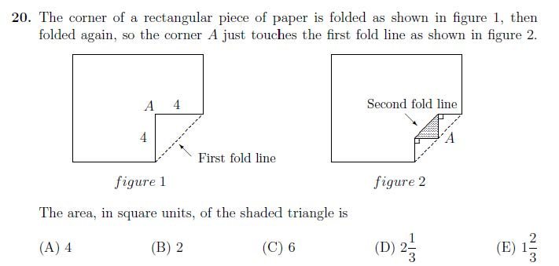
AMC 2006 J20

Slide 16
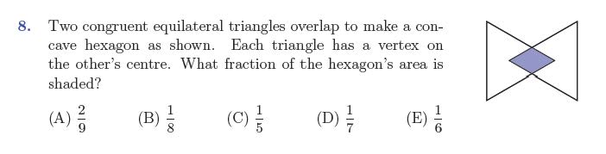
AMC 2016 S8

Slide 17
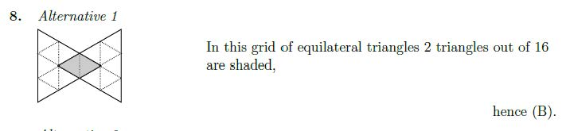
AMC 2016 S8 - solution

Slide 18
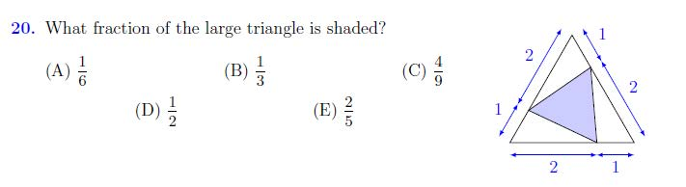
AMC 2015 – I20

Slide 19
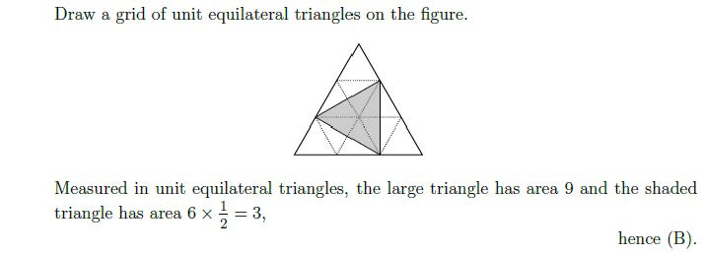
AMC 2015 I20 - solution

Slide 20
AIMO 2014 - Question 2
Triangles ABC and XYZ are congruent right-angled isosceles triangles. Squares KLMB and PQRS are as shown. If the area of KLMB is 189, find the area of PQRS.
A X
P
K L
S Q
B M C Y R Z
Notes:
By focusing on technical skills, we run the risk of neglecting problem formulation.

Slide 21
AIMO 2014 Q2 - Solution
Notes:
Look at how text-book chapters are organised

Slide 22
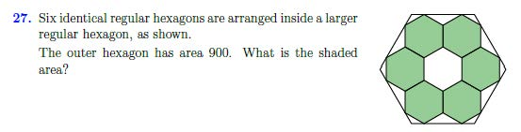
AMC 2016 S27

Slide 23
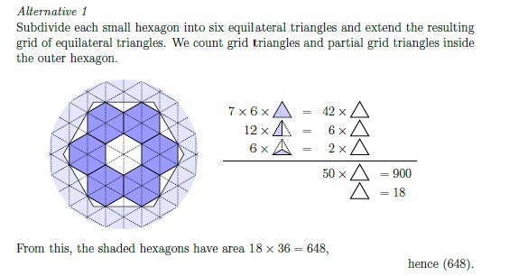
AMC 2017 I27 - solution

Slide 24
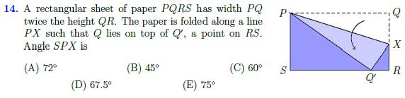
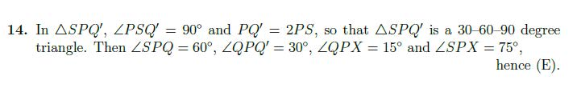
AMC 2016 S14

Slide 25
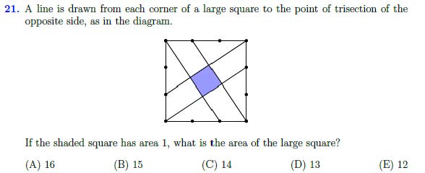
AMC 2016 S21

Slide 26
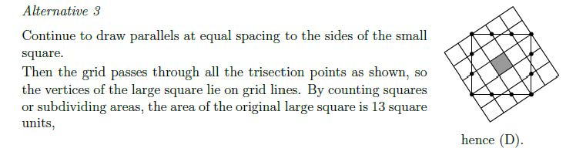
AMC 2016 S21 - solution

Slide 27
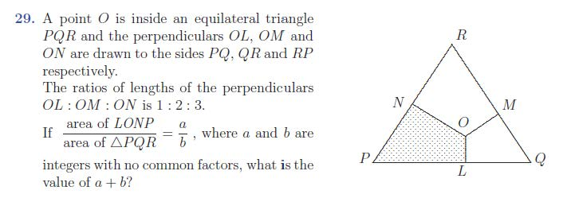
AMC 2008 S29

Slide 28
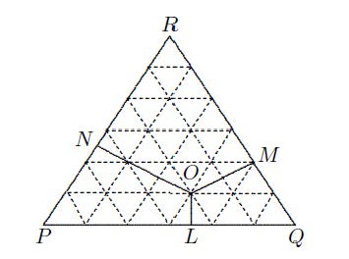
AMC 2008 S29 Solution

Slide 29
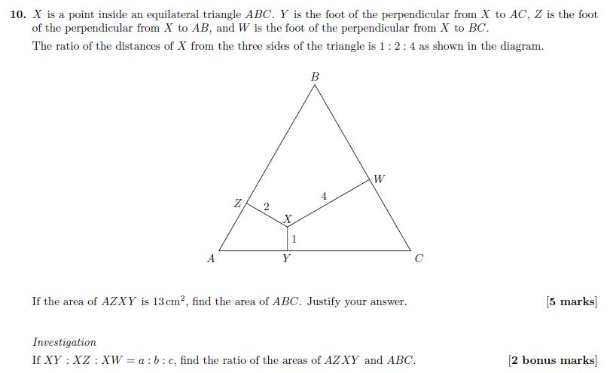
AIMO 2015 Q10

Slide 30
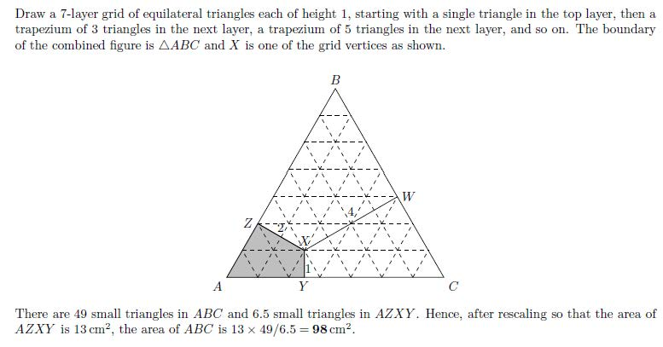
AIMO 2015 Q10 - solution

Slide 31
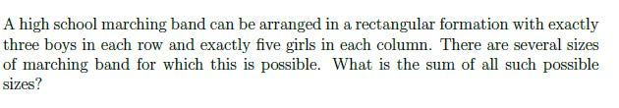

Completing the rectangle
Which scores in AFL have the property that:
Goals times behinds equals score.
2. (AIMO 2014 Q5)
Let $\frac{1}{a}+\frac{1}{b}=\frac{1}{20}$, where a and b are positive integers.
Find the largest value of a + b. [4 marks]
3. (AMC 2016 I29)

Slide 32
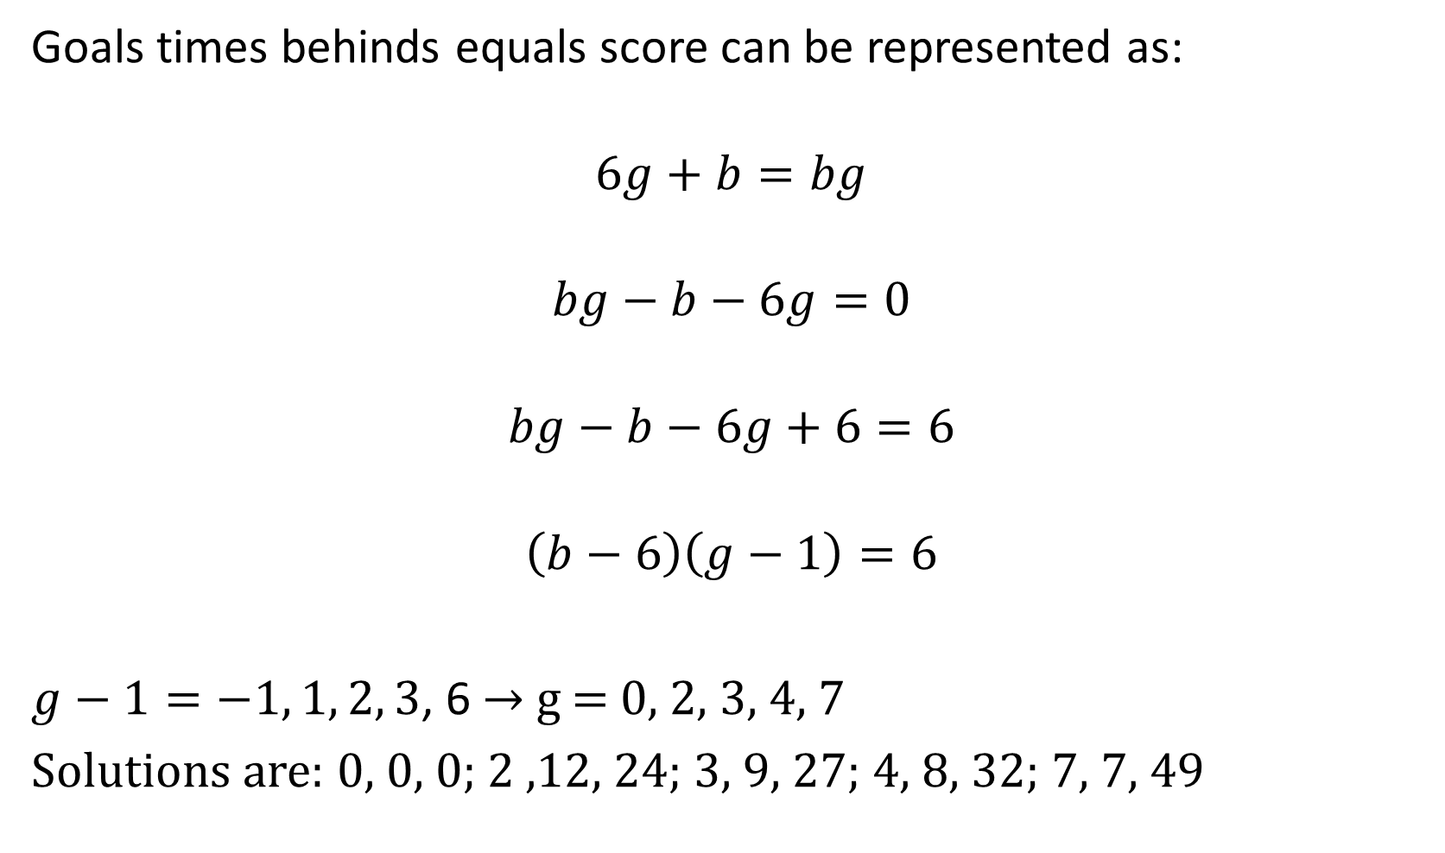
Goals times behinds equals score can be represented as:
$$6g+b=bg$$
$$bg−b−6g=0$$
$$bg−b−6g+6=6$$
$$\left(b−6\right)\left(g−1\right)=6$$
$g−1=−1, 1, 2, 3$, 6 → g = 0, 2, 3, 4, 7
Solutions are: 0, 0, 0; 2 ,12, 24; 3, 9, 27; 4, 8, 32; 7, 7, 49

Slide 33
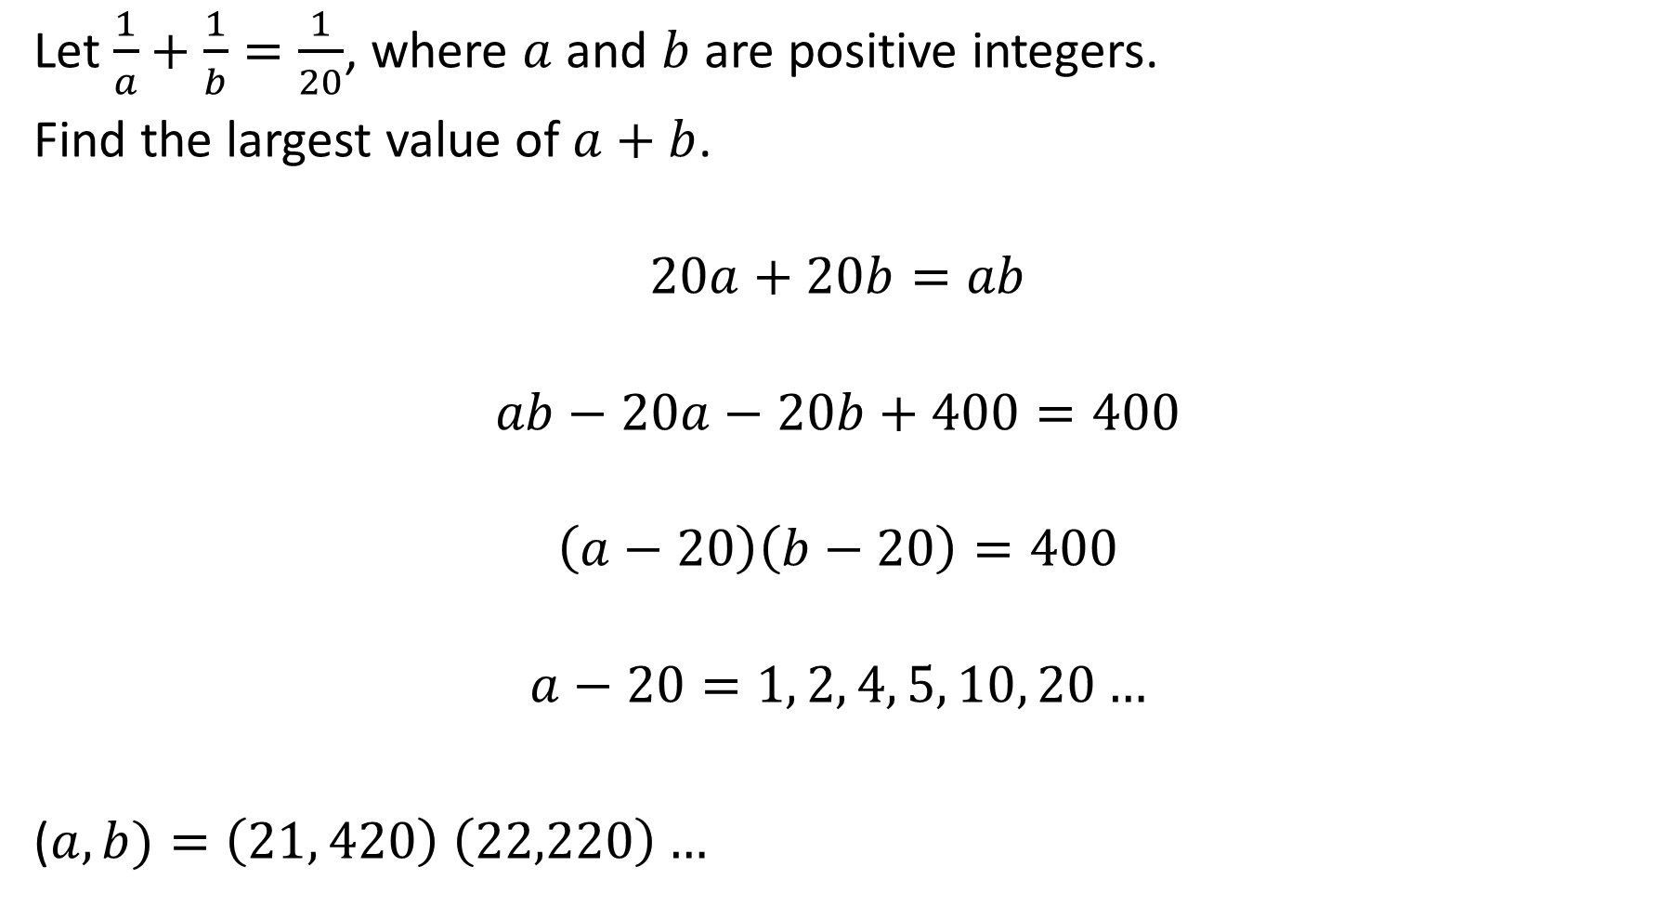
Let $\frac{1}{a}+\frac{1}{b}=\frac{1}{20}$, where $a$ and $b$ are positive integers.
Find the largest value of $a+b$.
$$20a+20b=ab$$
$$ab−20a−20b+400=400$$
$$\left(a−20\right)\left(b−20\right)=400$$
$$a−20=1, 2, 4, 5, 10, 20…$$
($a, b)=\left(21, 420\right) \left(22,220\right)…$

Slide 34
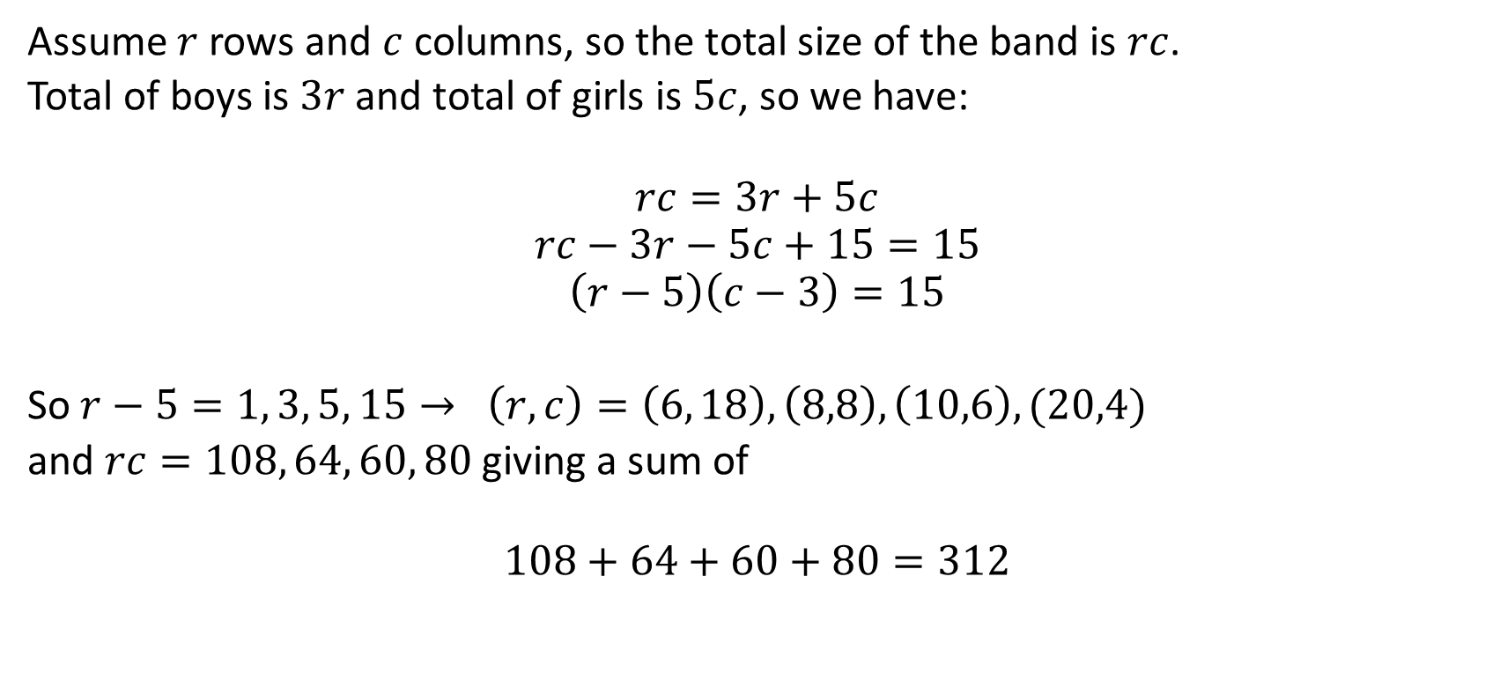
Assume $r$rows and $c$ columns, so the total size of the band is $rc$.
Total of boys is $3r$ and total of girls is $5c$, so we have:
$$rc=3r+5c$$
$$rc−3r−5c+15=15$$
$$\left(r−5\right)\left(c−3\right)=15$$
So $r−5=1, 3, 5, 15→ \left(r,c\right)=\left(6, 18\right), \left(8,8\right), \left(10,6\right), (20,4)$
and $rc=108, 64, 60, 80$giving a sum of
$$108+64+60+80=312$$

Slide 35
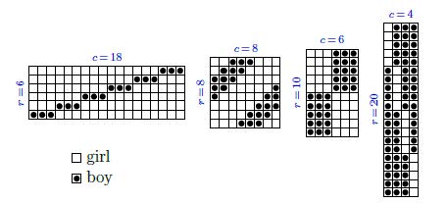
Visual reinforcement

Slide 36
This presentation is available at:

